Slide 1
Maximize Lecture Capture: Classroom Technology
Notes:
The Texas Tech Whitacre College of Engineering conducts online learning courses in conjunction with face-to-face sections using available lecture capture capabilities. The concept of teaching two different sets of students may initially seem challenging. Yet, with careful planning and forethought for the necessary requirements and needs associated with both types of students, instructing two different course sections simultaneously is manageable. This presentation is intended to provide a few tips, advice, and best practices for maximizing lecture capture capabilities for both you and your students.

Slide 2

Classroom Technology
Notes:
You may already be familiar with the College of Engineering classroom equipment but let me highlight the primary connections and how they can best be used. To activate the equipment including screens and projectors, you simply touch the Double-T on the touch panel in the Whitacre Online Learning capable classrooms.

Slide 3
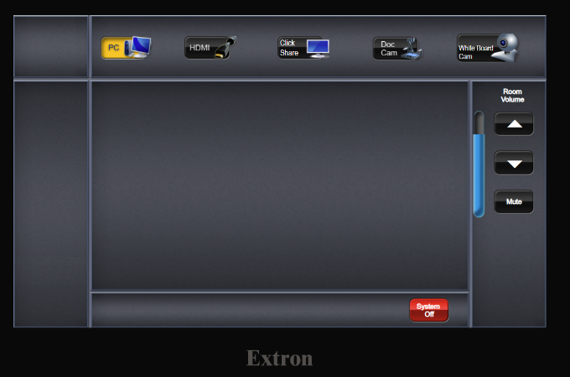
Podium Computer Input
Notes:
The highlighted button activates your input to both the screen within the classroom as well as to the video feed on Mediasite.
Select PC if you are logged into the podium computer, for example, and plan to teach from a PowerPoint presentation or show information from your Learning Management System course site.

Slide 4
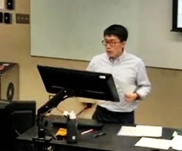
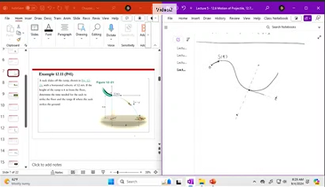
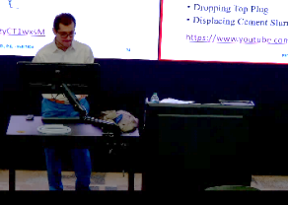
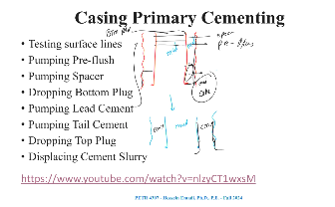
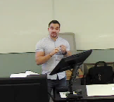
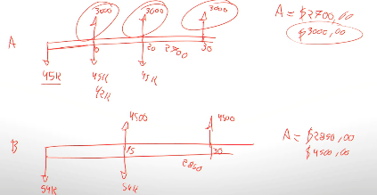
Podium Computer Examples
Notes:
A pen-enabled display is connected to the PC and is beneficial to use as a whiteboard and annotation device during your lecture.
Many professors effectively use PowerPoint or OneNote connected to the classroom technology. They write their equations or information and draw pictures, charts and graphics on their pen-enabled tablets as they progress through their lesson. The information projects within the classroom and on Mediasite. After class, they save and post the very same notes on the Learning Management System for their students.

Slide 5
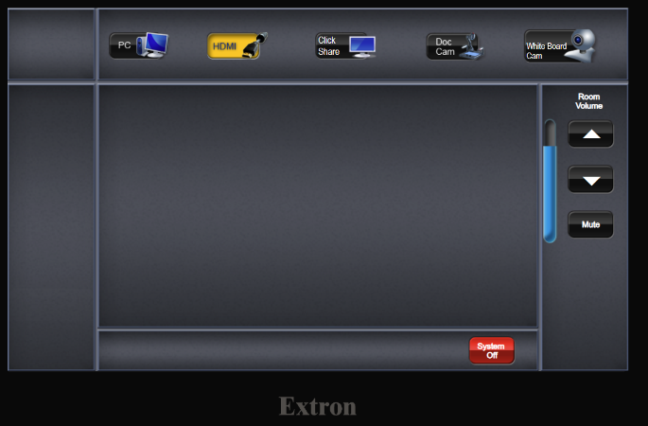
Laptop/Tablet Connection Input
Notes:
If you plan to connect a laptop, you can use the provided HDMI cable at the podium. You may need to bring an adaptor if your device does not have a direct HDMI connection.

Slide 6
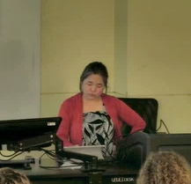
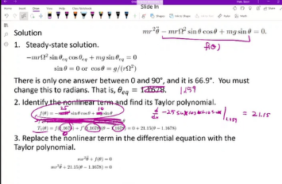
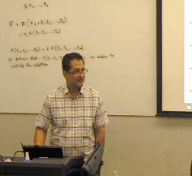
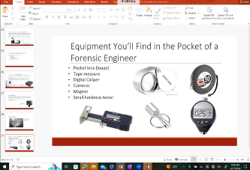
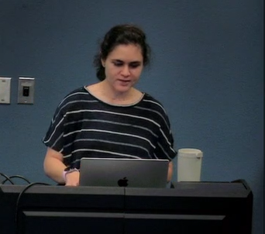
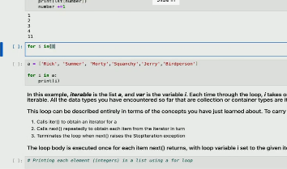
Laptop/Tablet Connection Examples

Slide 7
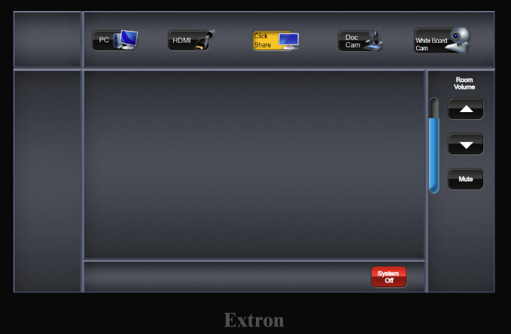
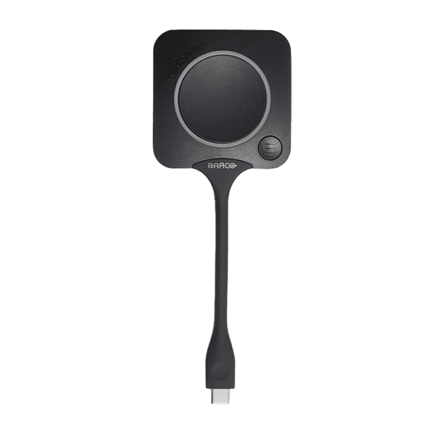
ClickShare Input
Notes:
ClickShare is a presentation sharing device that uses a physical USB-connected ”button” that is located on the podiums and can be plugged into either your laptop or a student laptop if they’re conducting a presentation. These have also been quite helpful if you do not have, or forgot to bring, an HDMI adaptor.
If you use a tablet for your lectures, the ClickShare button will not typically work. You can download the ClickShare application and wirelessly connect to the classroom. Directions are provided on the Whitacre Online Learning webpage under Faculty Resources. If you have questions, you’re always welcome to contact a Whitacre Online Learning staff member for assistance.

Slide 8
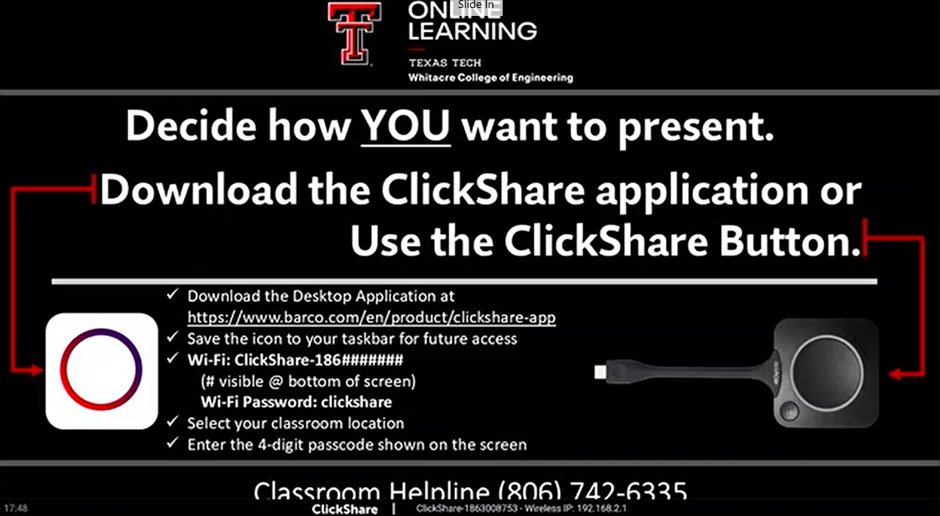
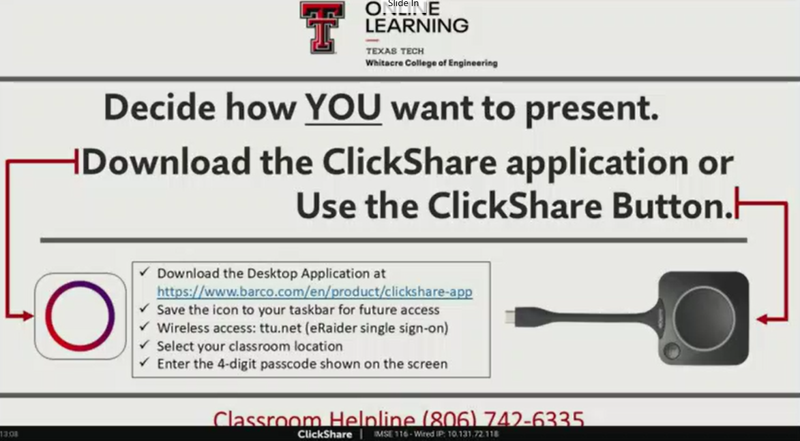
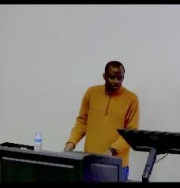
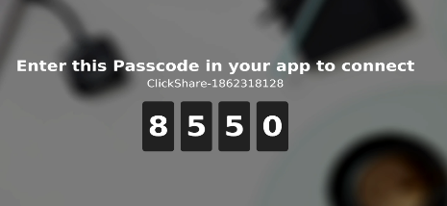
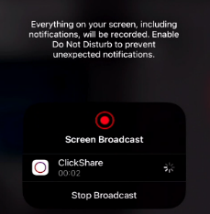
ClickShare Example
Notes:
You may see different ClickShare wallpaper displays in the classrooms with directions concerning how to best connect. When using the app, a passcode displays on the screen at the front of the classroom.

Slide 9
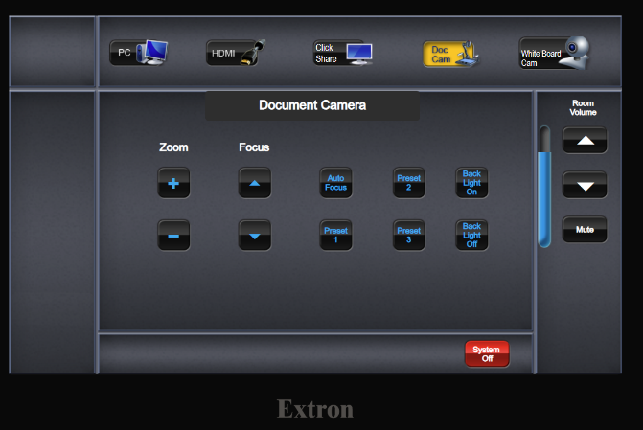
Document Camera Input
Notes:
The ceiling mounted document camera is effective for showing physical objects, writing on documents, or presenting information from a textbook. The video cameras at the back of the classroom are fixed to show you standing at the podium. They’re not designed to follow you or zoom into the front of class. The information that you present while using the doc cam will be clearly visible for your online learning students as this is captured on the video. Your in-class students will also appreciate seeing your smiling face and the information projects to the big screen in the classroom for better visibility. This is especially helpful if you’re teaching in a large lecture hall where face-to-face students sit in the backrow farthest away from you.
Preset locations provide three different sized views from the size of a piece of paper to the larger view of the projection area. You also can zoom in (or out) to best capture your information.

Slide 10
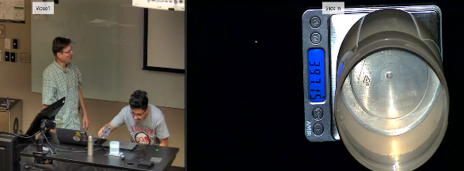
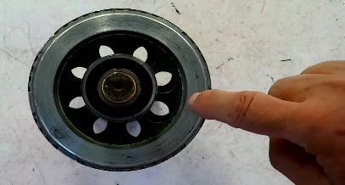
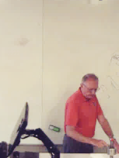
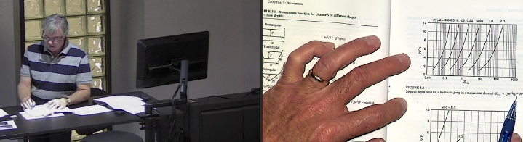
Document Camera Examples

Slide 11
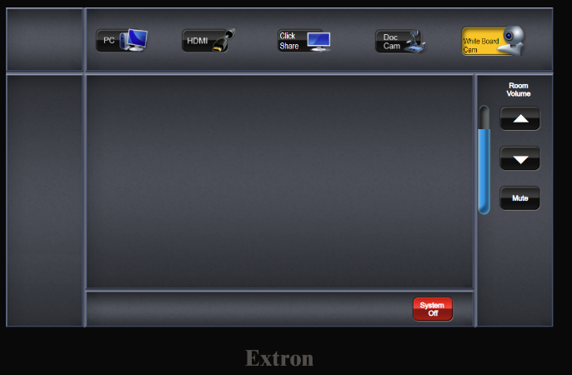
White Board Camera Input
Notes:
Some classrooms do have a whiteboard mounted camera if you would prefer this function. The whiteboard camera will capture approximately a 6-foot area and, similar to the ceiling-mounted camera, the information that you write on the whiteboard will be clearly visible for your face-to-face students and your online learning students as this is captured on the video. I encourage you to use dark pen colors such as black or dark blue for best visibility both in the classroom and in the video.
If you want to use other colors for emphasis of the materials, I encourage you to use the pen-enabled tablet in conjunction with the PC.

Slide 12
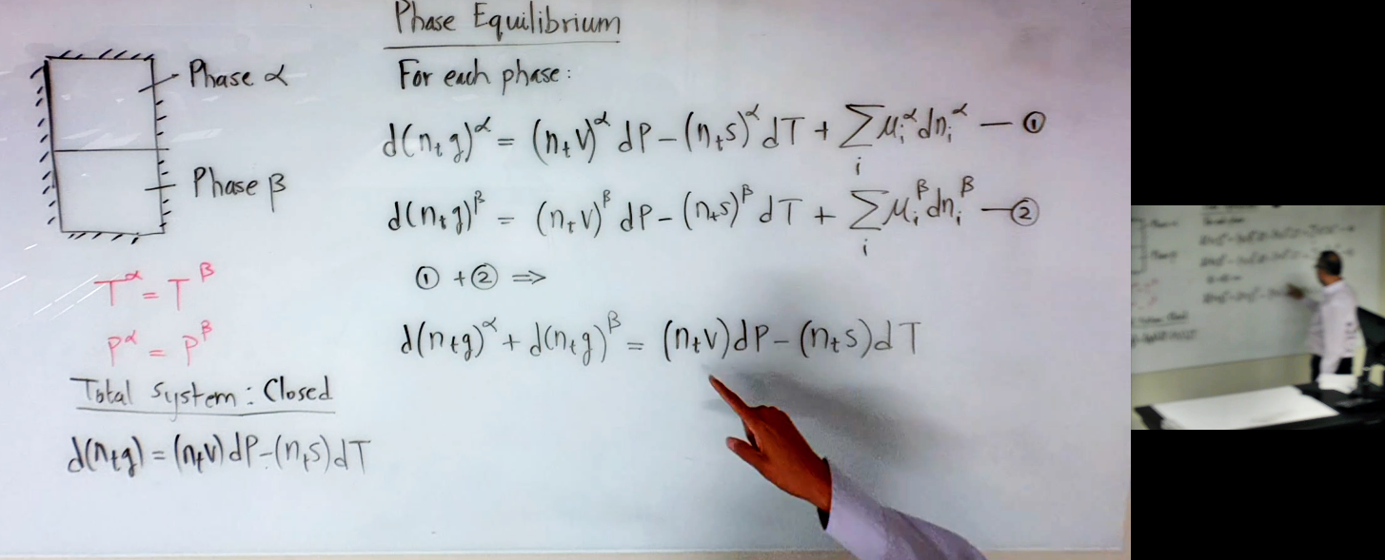
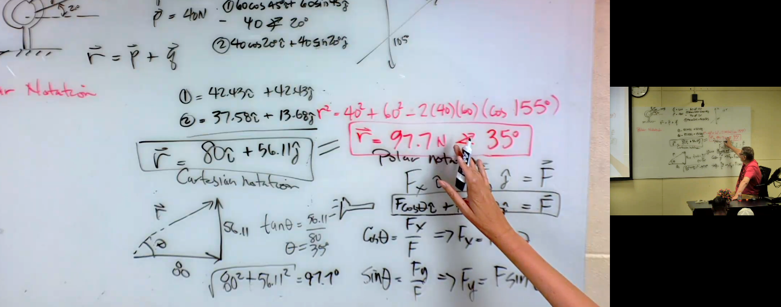
White Board Camera Examples

Slide 13
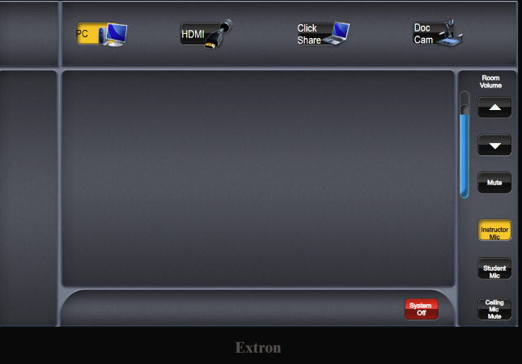
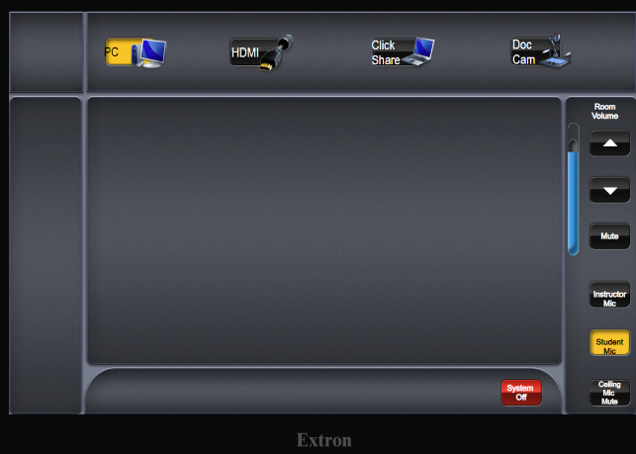
Microphones Input
Notes:
There are ceiling mounted beam-forming microphones that will capture your lecture, conversations, and discussions. The classroom default audio captures instructors' voices near the front of the classroom.
Larger lecture halls have two installed microphones and may have a button on the touch panel labeled “Student Mic”. Highlighting this option, opens the microphone to capture audio from the entire classroom. This function is useful if you are conducting a question-and-answer period and want to ensure online learning students clearly hear all of the student questions. If you’re unsure, a good practice is to repeat any student questions prior to responding with an answer.
If you are soft-spoken, the larger classrooms also provide a voice amplification feature so that your regular voice will carry all of the way to the student in the far back row of the classroom.

Slide 14
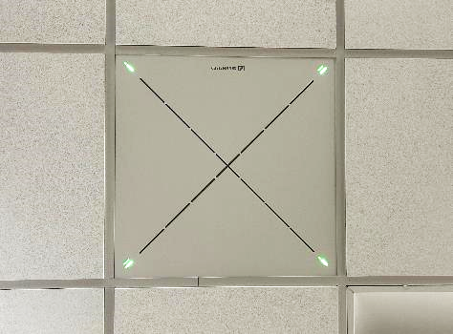
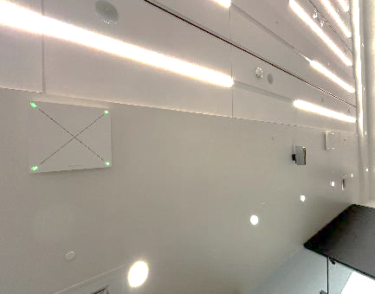
Microphones Examples

Slide 15
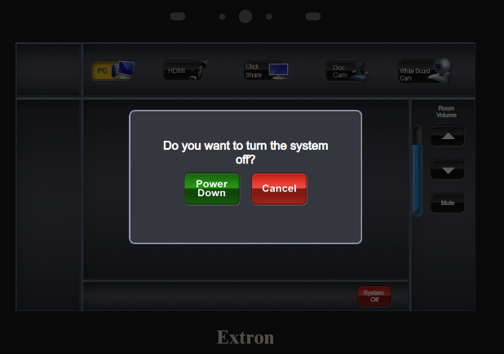
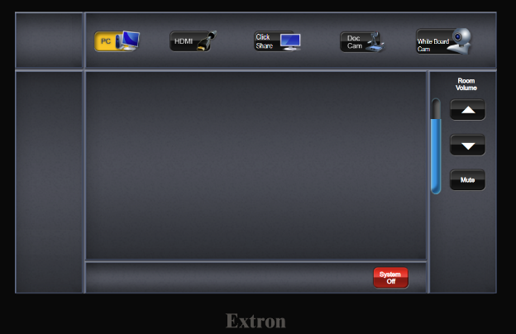
Technology
Notes:
At the end of your class, don’t forget to sign out of the computer and then turn off the audio-visual system at the touch panel.
Many professors leave the equipment on the HDMI input and do not completely power down the AV system. Although it may not be obvious because the screen is black, the lamp in the projector is still lit. We want to be good stewards and preserve the equipment for as long as possible.
Also, there is no need to shut down the computer. Simply sign out.
You’ll receive a prompt on the touch panel asking if you’re sure you want to turn the system off. You are. Please select the green power down button.

Slide 16
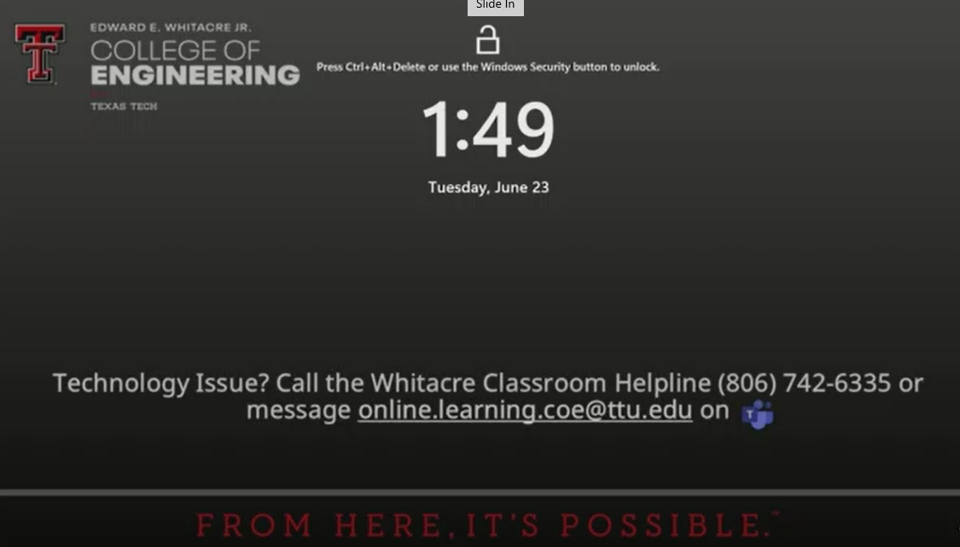
Classroom Helpline
Notes:
If you experience any problems with the equipment, you’re always welcome to call the Classroom Helpline. The phone number is provided on the podium and on the desktop wallpaper. That number rings to the Director, Program Manager, and student assistants. One of us will come assist you as soon as possible. If we don’t answer, please leave a message. We’ll see that and respond when we’re available.
You’re also welcome to message us in Teams.

Slide 17

Questions?
Whitacre Online Learning Program Office
Engineering Center
Room 100C
online.learning.coe@ttu.edu
Notes:
If you have additional questions or would like recommendations, please reach out to the Whitacre Online Learning Program Office. We’ll be happy to discuss your classes with you.

Slide 18
References
Ackerman, B. (2012). Guide to differentiated instruction for Christian educators. Liberty University Press.
Bruggeman, B., Tondeur, J., Struyven, K., Pynoo, B., Garone, A., & Vanslambrouck, S. (2021, January). Experts speaking: Crucial teacher attributes for implementing blended learning in higher education. The Internet and Higher Education, 48, 1-11.
Cifuentes, L., Janney, A., Guerra, L., & Weir, J. (2016, November). A working model for complying with accessibility guidelines for online learning. TechTrends, 60(6), 557-564.
Djoub, Z. (2020, September 27). 4 highly effective online teaching practices. Retrieved August 28, 2021, from EduLearn2Change: https://edulearn2change.com/article-4-highly-effective-online-teaching-practices/
Hendricks, H. (1987). Teaching to change lives. Multnomah Books.
Kitchen, M. (2020, July 5). 9 ways online teaching should be different from face-to-face. (J. Gonzalez, Interviewer) Retrieved August 23, 2021, from Cult of Pedagogy: https://www.cultofpedagogy.com/9-ways-online-teaching/
Ladd, T. (2020, June 19). Optimizing concurrent classrooms: Teaching students in the room and online simultaneously. Retrieved August 28, 2021, from Forbes: https://www.forbes.com/sites/tedladd/2020/06/19/optimizing-concurrent-classrooms-teaching-students-in-the-room-and-online-simultaneously/?sh=475da8393451
Martin, F., Ritzhaupt, A., Kumar, S., & Budhrani, K. (2019, April 15). Award-winning faculty online teaching practices: Course design, assessment and evaluation, and facilitation. The Internet and Higher Education, 42, 34-43.
Van Brummelen, H. (2009). Walking with God in the classroom (3rd Edition ed.). Purposeful Design Publications.

