Slide 1
Comprehensive Portfolio Evaluation
for Language & Literacy Master’s Students
Mellinee Lesley
Professor and Program Coordinator

Slide 2
Overview of the Comprehensive Portfolio Evaluation
During the last semester of coursework, non-thesis seeking students will engage in a comprehensive evaluation of their learning. This evaluation will be a professional portfolio in which students demonstrate mastery of the TEA Standards for Professional Reading Specialists put forth by the Texas Education Agency and the International Literacy Association Standards for the Preparation of Literacy Professionals (2017).

Slide 3
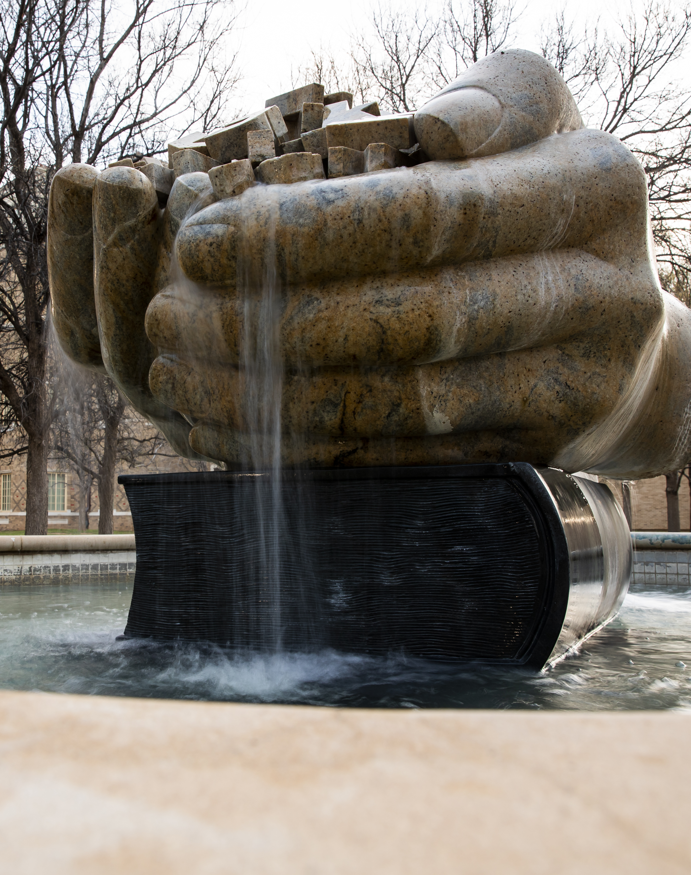
Introduction
We recommend you introduce your portfolio with a statement of how you exemplify being a literacy leader as a master’s student.

Slide 4
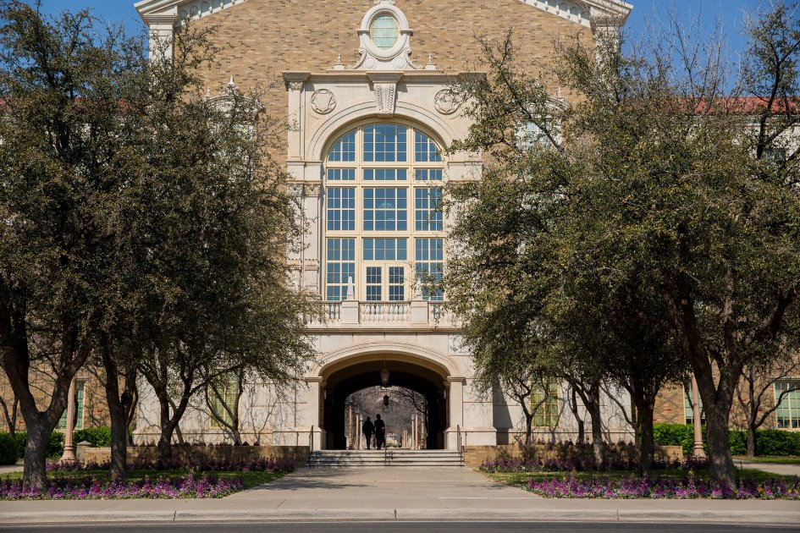
Artifacts
In the portfolio, students must provide and explain artifacts of learning that exemplify their understanding of each of the four domains listed below that are aligned with the TEA and ILA standards.

Slide 5
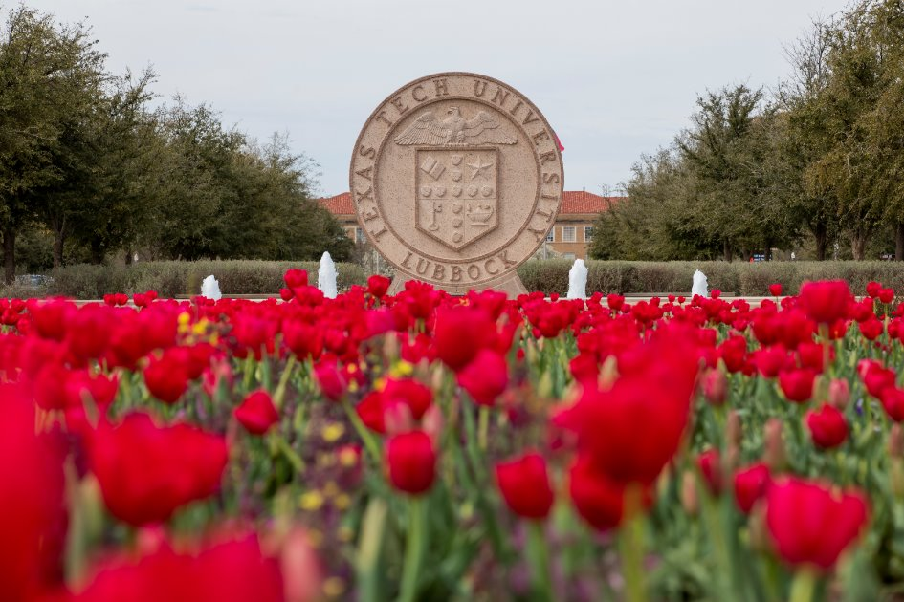
Examples of Artifacts
Such artifacts may include but are not limited to case studies from practicum, review of literature, reader response essays, videos of instruction, and intervention plans.
Please note that artifacts need to be derived from classes completed at TTU as part of your master’s degree.
Please include three artifacts for each domain of literacy research.

Slide 6
Reflections
In addition to each of the artifacts of learning, students must write a 5-7 (10 max) page reflection per domain that explains how the artifacts selected address the standards of that domain and their personal growth in becoming a literacy leader throughout the program.

Slide 7
To Recap, Your Portfolio Should Contain the Following Content:
Introductory statement about how you exemplify being a literacy leader
Three artifacts from class projects for each of the four domains of literacy research addressed in the TEA and ILA standards
A 5-7 page reflection about the four domains and how your experiences in the program helped you develop knowledge about these domains

Slide 8
Domains of Literacy Research to be Addressed
(1) Fundamentals of Literacy Pedagogy in Digital and Non-digital Contexts
(2) Culture, Diversity, Equity, and Classroom Environments
(3) Assessment and Evaluation of Student Learning
(4) Professional Development and Leadership

Slide 9
How to Organize the Portfolio
We recommend building your portfolio in MS Word and including a reference list in APA format at the end.
You can create your portfolio as a Word document, PDF, PowerPoint, and include multimodal elements etc.
You can include a table of contents, images, graphic organizers, tables etc.

Slide 10
How Your Portfolio will be Evaluated
Evidence of Domain 1 Fundamentals of Literacy Pedagogy in Digital and Non-digital Contexts (TEA Std 1 and ILA Std 1&2).
Evidence of Domain 2 Culture, Diversity, Equity, and Classroom Environments (TEA Std. 3 and ILA Std. 4&5).
Evidence of Domain 3 Assessment and Evaluation of Student Learning (TEA Std. 2 ILA Std. 3)
Evidence of Domain 4 Professional Development and Leadership (TEA Std. 4 and ILS Stds. 6&7)
Knowledge of Extant Literature in the field of Literacy Education
Knowledge of Research-based Writing Instruction
Organization and Writing Style Presented in the Portfolio

Slide 11
Pro Tips
Please think broadly about what it means to be a literacy leader in your introduction. For instance, what audiences are you prepared to share your literacy expertise with?
Please remember to cite sources in your reflective essays and include sufficient discussion of your understanding of relevant theories.
Please introduce the artifacts you include for each domain and explain how they exemplify your learning about the literacy domain.
Please consider what you knew when you began the program compared to what you know now at the completion of the program in your reflections.

Slide 12
Questions?
Contact:
Mellinee Lesley
mellinee.lesley@ttu.edu

