Slide 1
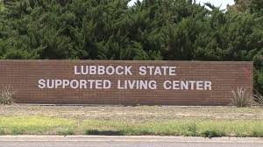
The National Leadership Consortium
- Jim Rodriguez, Assistant Director of Administration
- Kelly Jeanveau, Human Rights Officer
- Megan Copeland, OTR, MOT Habilitation Therapies
- Lamecca Abduljaami, M.Ed, Assistant Director of Behavior Services
Lubbock State Supported Living Center Project

Slide 2
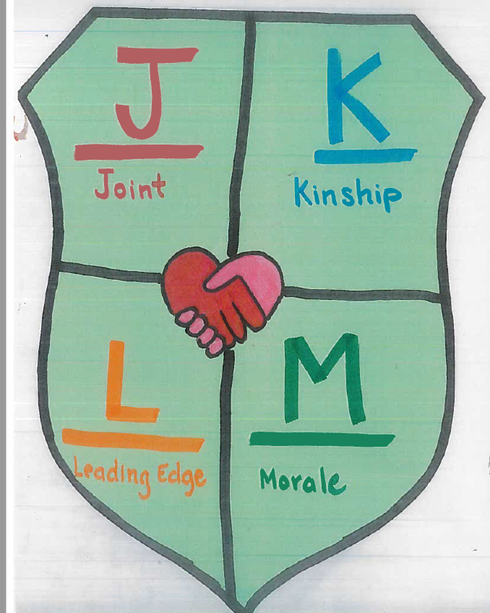
Project Purpose
Overall goal is to improve the client care.
Goal is to boost moral of staff and clients so that we can directly affect the lives of our clients with positive outcomes.
Plan for increase in satisfaction will assist with recruitment and have overall retention of staff.

Slide 3
Upon Return to work
Last day of training, facility acquired a new director. Plan was to meet with director fairly quickly to determine if plan would meet with her goals.
First week back at work we had Department of Justice Court Monitors at our facility! Tried to look at that week through a different set of eyes of what we learned and what we were living in that moment.
Discovered that several Ombudsmen have gone through the training.
LbSSLC director has toured Oregon.
Teams vision and Directors vision are in line.
Director agrees that Texas has a long way to go to have true inclusion in community.

Slide 4
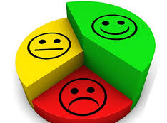
The Plan
Create a satisfaction survey and have every DSP, client, and IDT member answer.
This will address “Do you feel like you belong?”
Leadership team to assess the data for those three groups separately and graph the data to determine how similar the views are.
Meet with facility director monthly for progress and next steps.
Review local policies/procedures to determine which ones are not client centered.

Slide 5
Progress made
Surveys were created: Individually for Client, DSP, and IDT to gage each groups individual satisfaction and analyze the data.
Director and leadership team have the same vision

Slide 6
Surveys: Interdisciplinary Team (IDT) Satisfaction Survey Part 1
This survey is meant to find out how satisfied our IDT’s are with their employment. The following are subgroups that had various questions under each section to be rated with the following scale;
1 – Very Dissatisfied 2 – Dissatisfied 3 - Neither agree nor disagree 4 – Satisfied 5 - Dissatisfied
Collaboration- (supervisor encourages team collaboration, people work w/ cooperate to get the job done)
Communication - (receive info needed to do job effectively, there is open/honest communication)
Company Leadership- (confidence in Senior Leadership to make right decisions for our clients, and are their behaviors consistent with our mission statement “We help people live safe, healthy and meaningful lives)
Individual/Client Focused - (clients problems/concerns dealt w/ quickly, empowered to make decisions to best serve our clients)

Slide 7
Surveys: Interdisciplinary Team (IDT) Satisfaction Survey Part 2
Engagement - (proud to work here, work gives me feeling of personal accomplishment)
Growth & Development - (career goals can be met here, LbSSLC provides learning development opportunity)
Inclusion - (diverse perspectives are values/encouraged in my team, comfortable voicing ideas/opinions)
Job Enablement - (job is challenging/interesting, I have authority I need to do my job)
Performance & Accountability - (people held accountable for performance, receive feedback that helps improve my performance)
Strategic Alignment - (I see link between my work & mission statement, Senior leadership gives employees a clear picture of the direction we are headed)

Slide 8
Surveys: Interdisciplinary Team (IDT) Satisfaction Survey Part 3
Strategic Alignment - (I see link between my work & mission statement, Senior leadership gives employees a clear picture of the direction we are headed)
Work Processes - (encouraged to come up with better ways to do things, work coordinated on my team)
Survey Follow-Up - (confident that action/positive change will be taken because of this survey)
Retention (Yes or No) - (will you be able to reach your full potential here, would you reapply for current job, will you be working here 1 year from now, are there any frustrations cause you to dread coming to work)
Extra Feedback: Narrative

Slide 9
Surveys: Direct Support Professionals (DSP) Satisfaction Survey Part 1
This survey is meant to find out how satisfied DSP’s are with their employment
1 – Very Dissatisfied 2 – Dissatisfied 3 - Neither agree nor disagree 4 – Satisfied 5 - Dissatisfied
Employee Satisfaction - (how happy are you at work, would you refer someone, rate work/life balance, career or promotion path, if you quit what would be the reason)
Manager/Supervisor - (do you feed valued, frequency of receiving recognition, discussion of fair/consistent, is there fear of retaliation, do supervisors have interest in receiving opinion/ideas)

Slide 10
Surveys: Direct Support Professionals (DSP) Satisfaction Survey Part 2
Retention - (can you reach your full potential, would you reapply for current position, do you see yourself working here a year from now, frustration factors that make you dread coming to work. What can be done to further recognize you as an employee?
Culture at LbSSLC - (are you proud, do you have fun at work, does administration contribute to a positive work culture, do coworkers respect each other, what are 3 words to describe our culture)
Extra Feedback (narrative)

Slide 11
Surveys: Client Satisfaction Survey Part 1
This survey is meant to find out how truly satisfied our clients are living at the LbSSLC. Plans to have some professional staff assist with data gathering to ensure accurate data. Each section seen below has a variety of Yes or No questions associated with each category.
Independence - (did client take this survey with/without assistance or unable, therefore staff did their best according to preferences and strengths and answered on client’s behalf.)
Residential - (I like where I live, I am happy how I spend free time and have control of my daily schedule, I choose what I wear, I can change the rules at my house and invite friends/family over)
Work - (I like my job, can choose my job, I work the hours I want, staff at work center respect me, I can choose a job coach)

Slide 12
Surveys: Client Satisfaction Survey Part 2
Community Supports - (I like how much time, the people I spend it with, and the activities I do in the community, narrative to gather info on favorite community activities)
Friends/Social Supports - (I have plenty of friends, I can see my friends when I want, I meet new people, I have friends I like to talk and be with, I feel lonely a lot, I see my family as much as I want)
Activities - (I shop/exercise/play sports, eat out/go out to entertain/Worship as much as I want, I like activities that are provided on campus)
Guardianship (if applicable) - (if applicable) (I am happy with my guardian, I have a say who my guardian is, I see my guardian when I want, guardian lets me make my own decisions)

Slide 13
Surveys: Client Satisfaction Survey Part 3
LbSSLC Services - (I am happy with my services and IDT members, IDT members are supportive to my needs, its easy to contact my IDT and they listen to my concerns during my annual ISP meeting)
Self Determination/Rights - (I attend Self-Advocacy, see/talk to HRO, Ombudsman, I get to learn new things, I have enough control over my life, I make all the choices I want)
Extra Feedback: Narrative

Slide 14
Challenges encountered
Original plan was to collect data twice to be able to have a comparison of data. Survey has not gone out. Here is why.
COVID-19 Changed Everything
Facility with 190 clients and 785 staff had some changes.
GOAL WAS SAFETY / TRANSPARENCY / COMMUNICATION

Slide 15
Solutions to the challenges 1
Screening at the gate upon entry daily with temperature checks.
Eventually full COVID testing to all residents and staff; residents have been retested if there was possible exposure.
COVID plans with administration and state office went into effect.
Facility identified who could work via tele-work. Each department that was able to do this have various work schedules to ensure that the office spaces had social distancing.

Slide 16
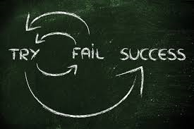
Solutions to the challenges 2
All staff were provided cloth masks made by several of the teleworking staff, orthotics, vocational departments, and a team with program developers and several clients.
As Lubbock numbers increased, all staff now receive a new surgical mask daily and have goggles/face shield for when in contact with clients.
All visitors were prohibited from entering facility and all clients were restricted to stay on campus.
Texting service was set up to get information out to all staff quickly. Updates to COVID on campus are shared via this texting service. At least weekly email from director.
State level gift cards given out for staff who submit their name if they have showed up to all shifts.

Slide 17
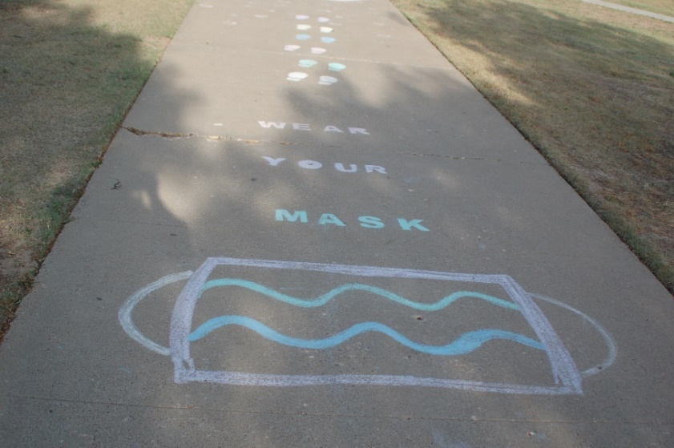
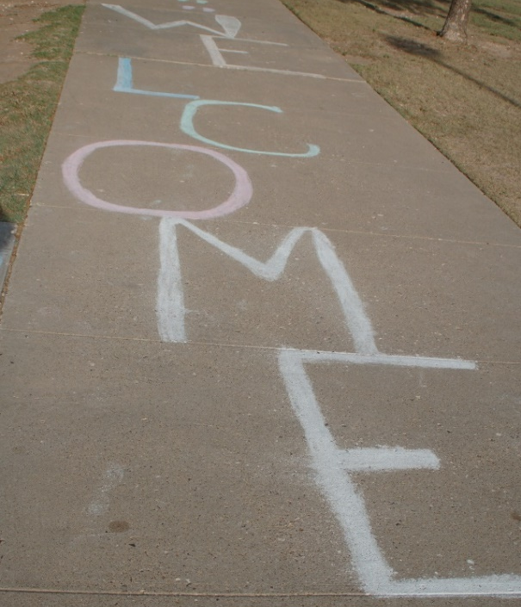
Lessons Learned
Not everything that is a success has to be built into our plan.
Some of the ideas we had are things that people have considered or were in place in the past (DSP council)
It’s important to see and find the value and not allow for good things to go by the wayside.

Slide 18
Next Steps Part 1
Once surveys are completed: Leadership team to seek for volunteer participants to be in a video (1 DSP, 1 client, 1 IDT member) to discuss satisfaction/changes to culture. This can be used during training if deemed appropriate. Once data is analyzed & changes have had a little time to take affect, 6 months later surveys to be re-administered.
DSP Council to be identified.
Designate Clients to sit as active members on the Human Rights Committee and a Self Advocacy Representative. Also to have representative from each home to take turns be the collective voice to administration.

Slide 19
Next Steps Part 2
Set up Face to face meeting with Associate Commissioner
Once COVID-19 precautions have lifted, plan to contact Jennifer Eckels again to see when a tour would be appropriate.
May consider Guardian satisfaction survey
Stay interviews
Revamp Buddy System
Long Term Goal: Self Directed homes on campus

Slide 20
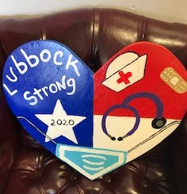
Overall Impact of Leadership Training and project
Changes in administration view of DSP schedule:
Last quarter (report in June 2020) DSP 1 fill rate above 95%
DSP call in rate has improved by more than 50%
Revised DSP scheduling and call-in process – result has been very infrequently working below minimum ratios.
Allowed each professional from the leadership team to look at their own duties and evaluate what they learned from the Institute.

Slide 21
Individual Successes
Each of us from this teamwork in different departments and do not cross paths in day to day tasks.
That allows us to take the information and training and apply it in individual successes.

Slide 22
Individual Successes: Jim – Administration 1
Originally planned for meeting at the home with DSP that consistently call in, to start getting to the heart of why they call in and how it affects others - show administration visibility. This information was presented to Director and this task has been designated to the Rentention Specialist who was recently hired. Retention Specialist is working on relationship with DSPs and this could get the ball rolling on the DSP Council that the leadership team has suggested.
Facility has been able to partake in campus activities during the time of COVID (parades, cookouts, water events, recreation, sidewalk decorating contests). Provides engagement on campus even though they are restricted to campus for their safety.

Slide 23
Individual Successes: Jim – Administration 2
Another exciting thing to see was the way everyone has pulled together during this time. The Executive Team in the planning, the mid-level staff in supporting the plans, and the front-line staff in the execution of the plans.
It hasn’t been perfect, but it has been awesome. The most convincing proof of the buy-in is the fact that our call-in rates have reduced by more than 50%.

Slide 24
Individual Successes: Megan - Habilitation Therapies 1
Member of Staff Choice Awards Committee – review submissions from all 3 units and then staff “at large” outside of the DSP positions to determine who will be acknowledged for that quarter.
Able to impact options for goals for several clients in the next year. 1 is a direct follow up from my discussion with speaker Annette Downey. Client to have work exploration to do well checks for people in the community. Had to provide committee information to change mindset that this is attainable – able to find the allies to work through the naysayers.

Slide 25
Individual Successes: Megan - Habilitation Therapies 2
During beginning of COVID, found out that a local adult enrichment center in town was having difficulties, so used resources from our group to get information for curriculum ideas.
Training all therapists at a distance throughout a pandemic!
Statement in DOJ document stated positive discussion around living options. This came from knowledge we learned at the training.

Slide 26
Individual Successes: Kelly - Human Rights 1
HRO Attending weekly meetings via teleconference to be able to advocate for the individuals and assist staff in difficult situations.
Self-Advocacy continues. It is typically a big group, which cannot be held in the same manner due to social distancing. But the group has been able to adapt and focus topics around current events. One month we had RN Case Managers from each home teach the individuals about proper hand washing in order to prevent the spread of COVID. Another month we had the RC’s & QIDP’s train the individuals on proper social distancing.

Slide 27
Individual Successes: Kelly - Human Rights 2
The Recreation Department worked with HRO to hold a Cinco De Mayo parade, and then in June they had a big parade and separate patio parties with regards to June 19th.
We have continued to hold the Human Rights Committee, as that is the only due process for our individuals when it comes to possible restrictions. We have a number of members join via teleconference in order to make this happen.

Slide 28
Lamecca - Behavioral Services Part 1
Behavioral Services Committee - to ensure that individuals Positive Behavior Support Plans are reviewed by members of the behavioral services department, along with a representative from HT and psychiatry. This committee reviews, approves, and monitors positive behavior support plans and suggests revisions to positive behavior support policies and procedures.
The committee also affords peer review. This meeting continued to be held weekly to ensure that individuals plans would be effective in preventing and reducing challenging behaviors, promoting and reinforcing positive replacement and alternative behaviors and individualized to their needs.

Slide 29
Lamecca - Behavioral Services Part 2
Behavior Coaches - Two new behaviors coaches were hired the month of May; resulting in us being fully staffed. One behavior coach was a staff choice award recipient the month of May. The behavior coaches are Behavior services staff designated to provide staff training and crisis response.
They are an asset to our facility; especially during this pandemic, as some of our individuals may be having a difficult time adjusting to and not fully understanding the changes that have occurred at our facility. The behavior coaches are available 24/7 to assist staff with crises that individuals may be experiencing.

Slide 30
Lamecca - Behavioral Services Part 3
Behavioral Health Specialist Assistant - We hired two new BHSAs in April and May. Both are former behavior coaches and tremendous assets to our department.
Behavioral Services Department - We held a departmental staff appreciation luncheon on 6/11/20. The luncheon was to show appreciation to our staff for doing such a wonderful job and taking care of our individuals during this crisis.

Slide 31
END

