Slide 1
Summerhouse Houston

Slide 2
Vision
Mission
Creating opportunities for adults with IDD to belong and positively impact the Greater Houston community.
Summerhouse supports adults with IDD, their families, and our community through employment, volunteerism, and partnerships to foster a culture of belonging, choice, and respect.

Slide 3
Team Members
Consultant
Joanna Burnett - Assistant Executive Director
Angie Crutchfield - Program Director
Bria Long - Program Associate
Brooke Magers - Program Associate
Jennifer Eckols - Director of IDD Provider Services at Hill Country MHDD Centers

Slide 4
Project Purpose
Inclusion and Belonging
Person-Centered Planning / Self-Determination
Change the Environment, Not the Person
Employment First

Slide 5
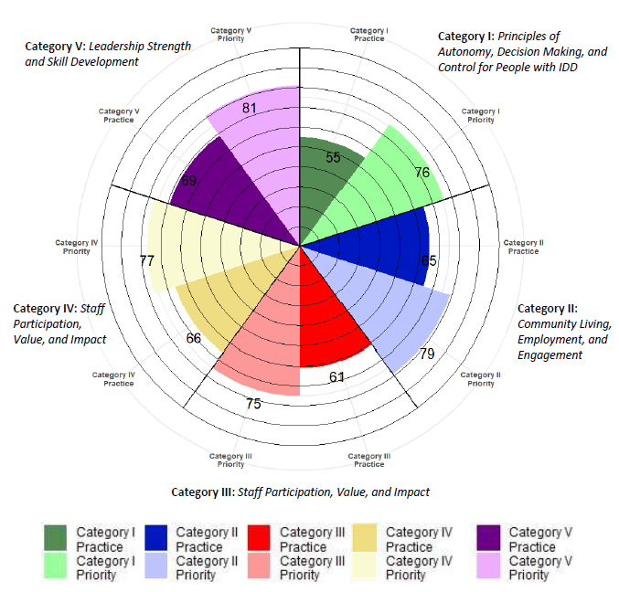
Progress Made With Staff
Created buy-in presentation for staff
Implemented staff survey

Slide 6
Progress Made with Members
Created an interest survey broken into 10 categories
Members completed interest survey and were broken into small groups based on their interests
Increase in choice
Increase in person centered planning

Slide 7
Challenges and Solutions
Understanding our interests
Change has been tough for staff
Identifying when choices should be made
Lack of community opportunities due to COVID-19
Variations of interests in groups

Slide 8
Changes and Solutions
Lack of separate rooms at our Summerhouse location
Transportation
Community Employment opportunities limited
Virtual education is difficult for members
Shred for Independence

Slide 9
Lessons Learned
Change is hard for everyone!
Being adaptable with COVID restrictions
Unpredictability
If the change is something you really value, it can become a possibility if you make it a priority.

Slide 10
Next Steps
Continue to grow our program
Provide ongoing staff support
Increase employment
Develop more community opportunities
Address Shred for Independence
Implement follow up surveys

Slide 11
Overall Impact of Leadership Training
Education on best practices
Team as unified voice to influence positive change in agency
Equipped with knowledge and tools to make change
The start of an ongoing reflection on how we provide services
Network of people to reach out to for support

