Slide 1
Organizational Change
Changing Vision into Action
Cathy Ficker Terrill, MS
2020

Slide 2
Change is difficult, but change is necessary.
It is easier to be the Changer,
than the Change.

Slide 3
SUCCESS FACTORS
Stay focused on the mission,
and the individuals you support

Slide 4
What Usually Happens
Rate of acceptance varies by knowledge of what is happening.
10-20% will be In favor
60-80% will be on the fence
10-20% will be opposed

Slide 5
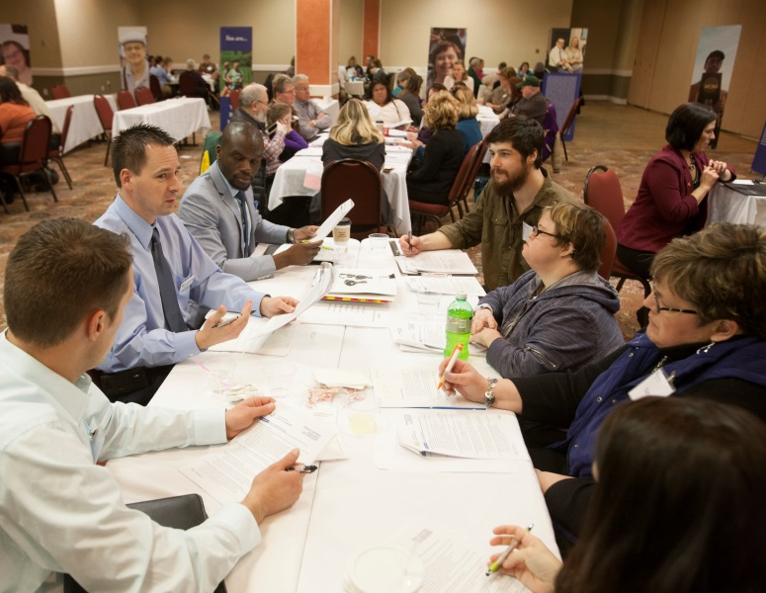
Normal Reactions to Change
Hope It’s Not Real, “I Can Outlast Them”
Impact on Me - Lots of Questions
Fight It - Passive or Blatant
“Prove It to Me”
Support It
Embrace It

Slide 6
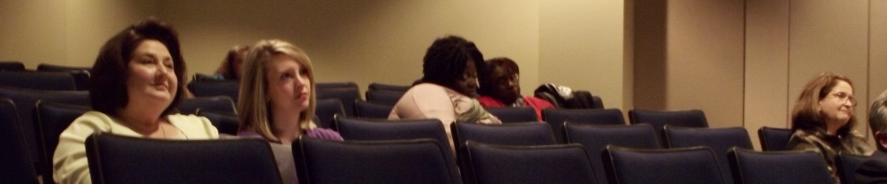
Organizational Change: Resistance
Resistance comes in different forms
Don't take it personally
Some will never accept
Resistance is not necessarily bad

Slide 7
Organizational Change: Fear Of Losing
JOB
FOCUS
REPUTATION
HISTORY
PASSION
FRIENDS
CONTROL
INPUT
RESPECT
PRESTIGE
CULTURE
CONNECTION
COMPETENCE

Slide 8
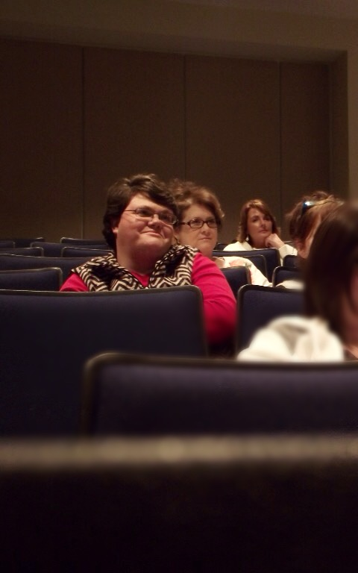
Why Change Fails
Misunderstandings
Power plays
No “say” In process or outcomes
Self interest overrides everything
Fear of the unknown

Slide 9
Communication Guidelines
Need champions
Talk to people in person
Tell the truth
Let people express their feelings
Discuss the real issues

Slide 10
Organizational Change: You need An Action Plan
Describe the change completely
What is the best possible outcome?
Timetable
How will we recognize success?

Slide 11
Quote 1
“If I had an hour to
save the world,
I’d spend 55 minutes
defining the problem.”
- Albert Einstein

Slide 12
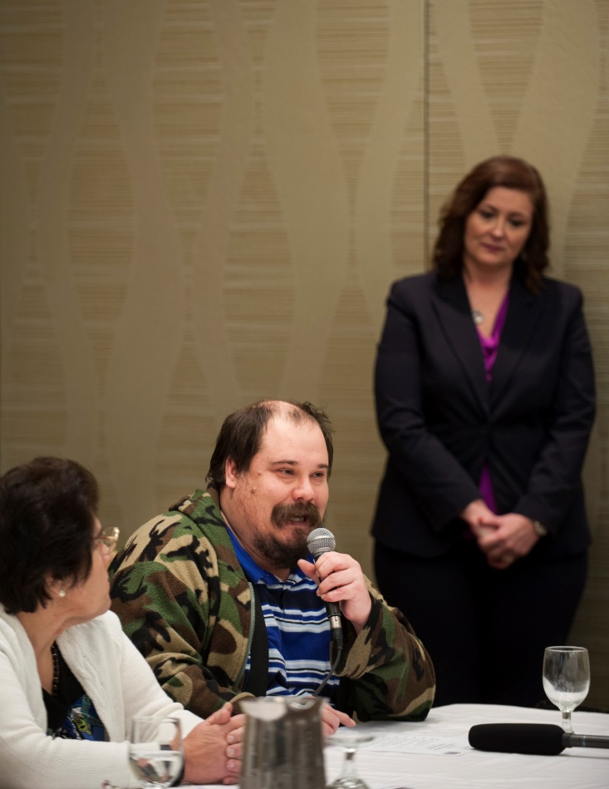
Organizational Change: Focus Groups
Individuals
Families
Board of Directors
Staff at All Levels
Community Members
Funders

Slide 13
Measuring Organizational Change: Outcomes Drive Us
Outcomes defined by individuals
with disabilities and their families:
Home
Friends
Work
Money
Volunteer
Safety
The New Focus Is…

Slide 14
Data driven decision making
2003 2006 + or -
People Choose Services 47% 87% +40%
People Realize Goals 63% 100% +37%
Connected to Natural Sup. 52% 81% +29%
Different Social Roles 21% 50% +29%
People Have Friends 58% 81% +23%
Use their Environment 78% 100% +22%

Slide 15
Why Study The Future?
No one knows what will happen
Opportunities as well as danger
Change needs to be constructive

Slide 16
Becoming A Learning Organization
Learning Organizations take risks
Learning Organizations partner with individuals who will challenge them
For every person considered “too disabled” to work, someone somewhere has figured it out for a person with similar needs

Slide 17
Becoming A Learning Organization - 2
Every improvement in services for people with severe disabilities has been a movement away from institutions and segregation and toward community and inclusion
Learning Organizations need leadership to move toward building social ties.

Slide 18
What Learning Organizations Do
Relentlessly upgrade their team
Use every encounter as an opportunity to evaluate,
coach and build self-confidence.
Make sure people not only see the vision,
They live it.
They breathe it.
They own it.

Slide 19
What Learning Organizations Also Do
Inspire risk taking
Encourage learning by setting the example
Celebrate success
Establish trust with candor

Slide 20
Learning Organizations Also:
Laugh
Positive energy and optimism
Have courage to make unpopular
decisions and gut calls
Probe and push with a curiosity
that borders on skepticism
Make sure questions are answered with action

Slide 21
Where We Used To Be
Lincoln State School
The Rules if you left
Notify us
Don’t drive a car
Do not drink alcohol
Do not get married
Do not buy on lay away

Slide 22
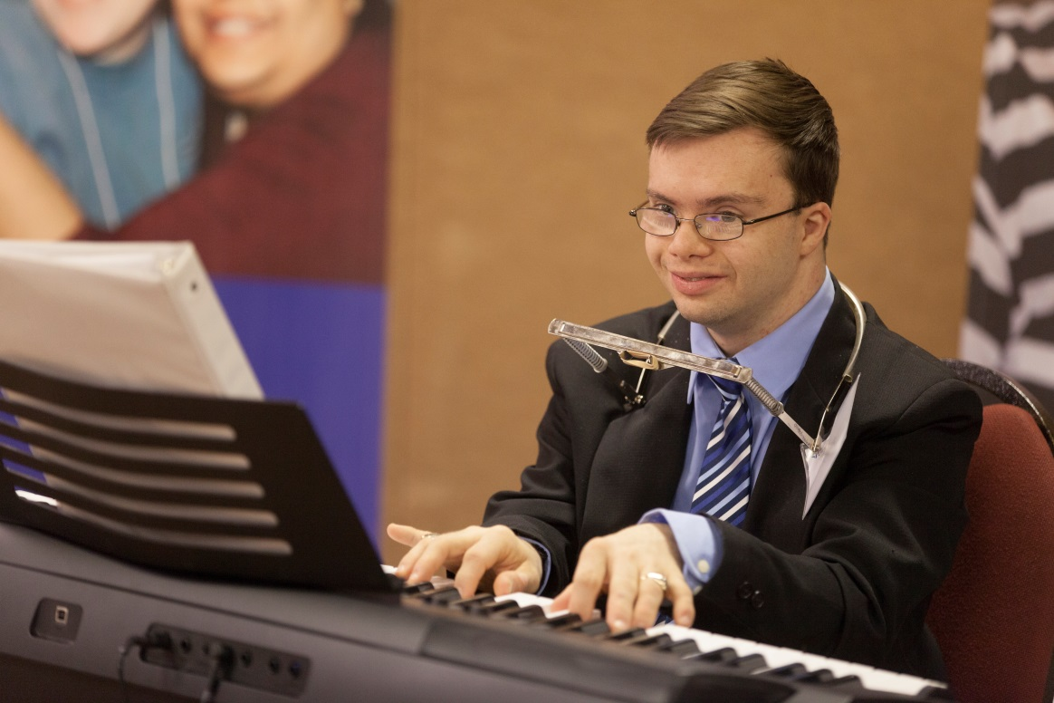
Unprecedented Opportunities
Live more than a century
Conquer Disease
Gold Among Gray
Smart Houses

Slide 23
The Seat Of The Soul
The club that kills can drive a stake into the ground
to build a shelter.
The spear that takes a life can be used as a lever
to ease life’s burdens.
The knife that cuts flesh can be used
to cut cloth.
The hand that builds bombs can be used
to build schools.
The mind that coordinates the activities of violence
can coordinate activities of cooperation.

Slide 24
Quote 2
“We have long recognized that
PEOPLE WITH DISABILITIES
are some of our nation’s greatest untapped resources.
We believe that ALL persons with disabilities
must be fully integrated into mainstream society,
so they live fulfilling and rewarding lives.”
- President Bill Clinton, 1992

Slide 25
Innovation Is As American As Apple Pie
New products every 30 minutes
YET, we still have so much technology untouched
Global World
YET, we can’t convert sheltered workshops to models
for building social capital.
Computers can Drive Cars
Yet, we are afraid to tear down brick & mortar
to get to outcomes.

Slide 26
Cultural Guidelines…
For Changing The Way You Handle Change:
Stop the history
Don’t wait for instruction
Don’t Play it Safe
Try not to break things
Do what works
Take initiative
Take more risks
Welcome destruction

Slide 27
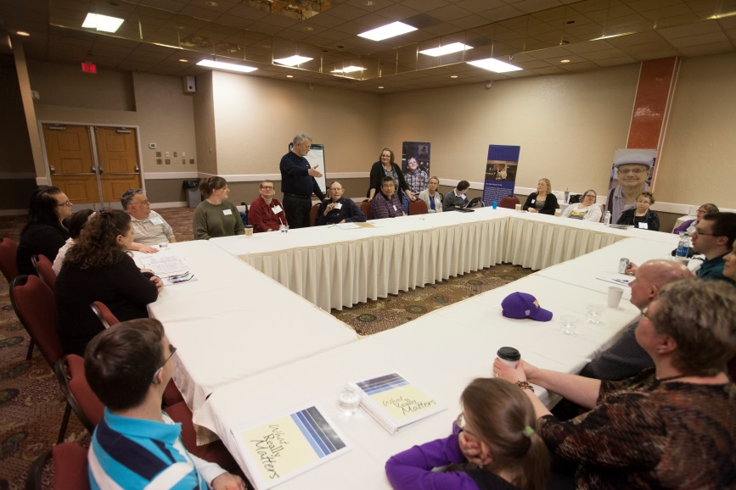
Workforce Issues
Vision
Flexible Leaders
Think Strategically
Retain Best Employees
Information Age
Mentor Staff
Balance Risk with Safety

Slide 28
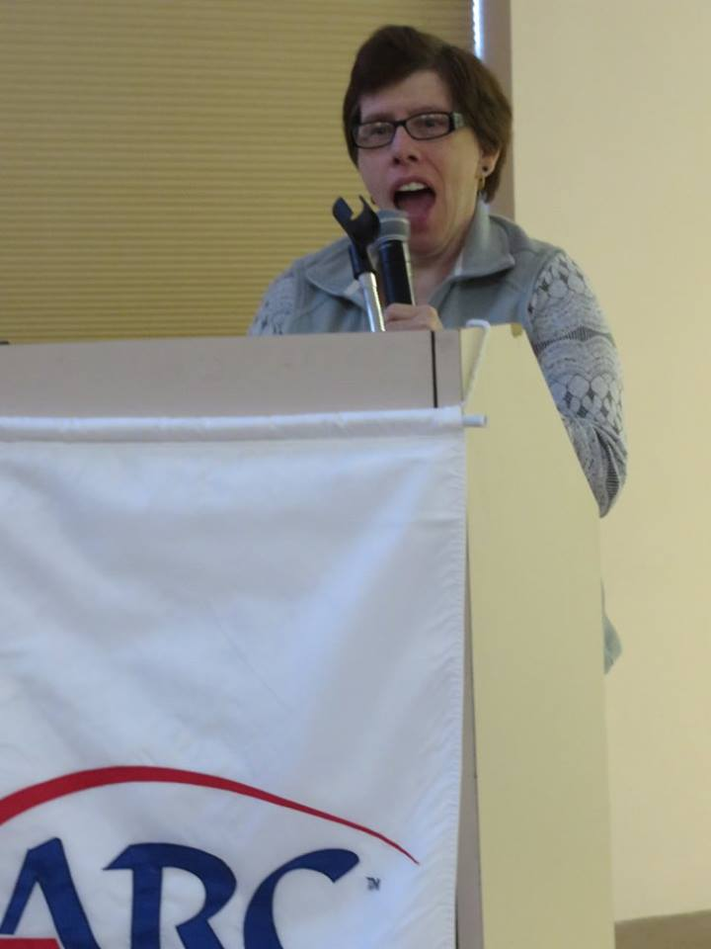
Rethinking Our Internal Policy
Control
Choice
Dignity
Rights
Personal Goals
Self-Advocates as Policy Makers

Slide 29
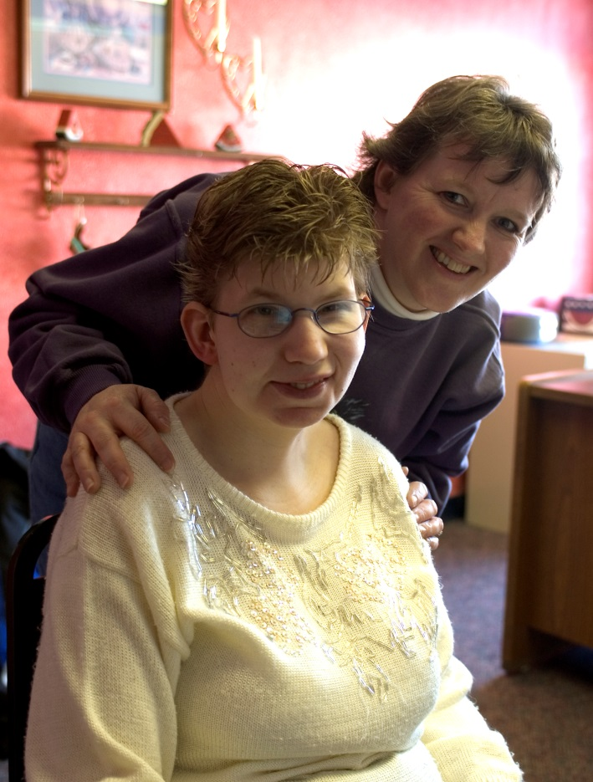
Off To See The Wizard
Friends
Mutual Respect
Interdependence
Courage
Informed Choices
Freedom to go HOME

Slide 30
Quote 3
“Sometimes our light goes out.
But it is blown again into flame
by an encounter with another
human being. Each of us owes
the deepest thanks to those
who have kindled this light.”
- Albert Sweitzer

