Slide 1
How (and Whether) We Know What We Think We Know
Strengthening the Education Research Base
Bryan G. Cook · University of Virginia
Texas Tech University · October 27, 2026
Notes:
Alexander Wiseman
I think we might go ahead and just kick it off, since folks are streaming in. So, I'll just start by saying welcome to everybody who's joining us. Thank you so much for joining us today. If I don't already know you, my name is Alex Wiseman, and I'm delighted to welcome you to the ExpandED Distinguished Research Series, which is hosted by Texas Tech University's College of Education.
For any of you who might be joining us for the first time, ExpandED is our virtual Brown Bag research series where we bring together scholars doing what we think are especially impactful work in education. And the idea is pretty simple. We want to create a space where faculty and students and researchers and practitioners can come together, can hear about important research, exchange ideas, ask questions, and hopefully we spark some new conversations and collaborations along the way. And I think today's talk is a perfect example of what we hope to accomplish with this series and the topics as well. So please ask questions. Engage with our speaker joining us today and everyone else when the time is right.
So, I'm really excited to introduce our speaker, Dr. Bryan Cook, who's going to talk with us about something that is incredibly important for all of us who do research, who read research, or who use research to inform what we do. And that's how do we know we can actually trust the research we're relying on, and how can we make it better? And I really can't think of a better person to help us think through those questions than Dr. Cook.
Dr. Cook is a professor of special education at the University of Virginia, and he's done some very important work around evidence-based practices, research quality, replication, and open science. A large part of his work is focused on how we can make education research more rigorous, more transparent, and, I think, ultimately more useful.
He's also co-director of the Special Education Research Accelerator, or SERA, which brings researchers together to conduct collaborative studies. He served as president of the Council for Exceptional Children's Division for Research, and has held several editorial leadership roles. Including his current role as founding co-editor of Research in Special Education. And I'll just say, Dr. Cook has been incredibly productive along the way, with more than 130 journal articles, 18 special issues or series and 12 books and edited volumes to his name. So he knows what he's talking about when it comes to education research. But I think that's what's especially valuable about, or what's especially valuable about his work, is that he pushes us to ask some really important and frankly, sometimes maybe uncomfortable questions about the research we produce and the conclusions we draw from it. And those are conversations, I think, that we all benefit from having. So, we're really fortunate to have him with us today. I'm looking forward to hearing his perspective, and I know we're going to have a lot to think about. So please join me in welcoming Dr. Bryan Cook.
Bryan Cook
Thank you very much, Alex. It's always slightly uncomfortable to sit through those types of introductions, but I greatly appreciate it. Very grateful to be here and have the opportunity to talk with you all today.
So, when Alex and I talked about me doing this talk. I do a fair number of talks on open science, which is kind of my current primary focus, which I enjoy, I'm passionate about, and I really expected that this talk would be along those lines.
And as we talked, I was pleased to find out that he was interested in other things that I have worked on, or that I am working on, and looking to expand more broadly, including open science, but into some other areas.
and I think this is the first talk that I've done that puts all of these things together in this way, and it was a nice kind of career retrospective for me in some ways.
So, this is new, putting all of this together in one talk. I think there'll be different things to latch onto and connections to make, and so we'll see how it goes.
Oh, and just to mention before we start off, we'll have time at the end to talk. And so, as we go along, feel free to ask questions, clarifying thoughts, share a little bit, but if we do it too much, we'll get bogged down, and there may not be time for everyone to talk. So, maybe smaller, specific things as we go, and maybe we'll have more big picture discussions at the end.

Slide 2
Where this started
“
“Well, you were a philosophy major; you’ve always been interested in how and whether we know what we think we know.”
— Michael Gerber
2
Notes:
Brian Cook
So, one thing this brought to mind for me was…this was probably 10 plus years ago, and I was where I went, in, in Santa Barbara where I got my PhD and, and where, my family actually lives now. And I, I ran into one of my old mentors and professors, Michael Gerber, and my background is in special education, so a lot of this will be about special education, but I think it generalizes broadly across different fields or different areas in special education and I was talking about some things about implementation science, and about open science, and about crowds, some initial crowdsource thoughts about crowdsourcing that we were thinking about. And I think I said something like, I don't know where I kind of get these ideas about things, and they're a little bit different, but I enjoy them and I think they're important to the field. And he said, well, you know, you were a philosophy major, you've always been interested in how and whether we know what we think we know. And it really made me take a step back and think.
Yeah, that is true. Wow! 25 years or however long it had been at the time into my career and I didn't really see that and at different times I've always felt like I need to have a population of learners that I'm particularly interested, or an area of intervention that I'm really interested in, like most educational scholars, and I don't. I've kind of just skirted around the edges of, well, how do we… do we really know that? And how do we… how do we think we know that? And is that legitimate? And it… anyway, that was a moment where… a little bit of an aha moment for me.

Slide 3
The path, in retrospect
Focus | Question
Evidence-based practices | Does rigorous experimental evidence support practices we think are effective?
Replication | Do findings of effectiveness generalize (across studies, researchers, participants, outcomes, settings)?
Crowdsourcing | How can we replicate at scale?
Meta-research | How reliable is our broader research base? Can we identify areas to improve?
Open science | Can we make our research transparent to improve its credibility?
3
Notes:
So, this is the path for today's talk, a preview, but I'm hoping to be able to look at this before we head in and highlight how this is maybe a set of nested eggs, where they grow on each other to some extent, and the different questions, expand on one another.
So, early in my career, in the very early 2000s, at the time when What Works Clearinghouse had just launched which I believe was 2002, and we started to think and talk about how that was going to play out in special education and I got very interested in how we were developing standards. And I think, more broadly, this question of well, so, if we say a practice works, is it actually based on evidence? And how much evidence do we need? What kinds of evidence, how much evidence do we need for a practice to be considered evidence-based?
And that led me to think about the idea of replication, and the importance of replication, and build into these evidence-based practice standards, are that we need multiple studies to support a practice as effective, because no study is perfect, and we need evidence that replicates. We'll get into that in a little bit. But just this question, I think it's a huge question for science in general and may play out in very specific ways in the social sciences and in education in particular.
But how much do our research findings generalize? How much should we expect them to generalize, both across just studies, across researchers, but also, probably more practically in some ways, across different groups of participants, across different outcomes, across different settings.
And that led me to think about crowdsourcing. And as we'll talk about replication, I think there's a big need in our field to really think about replication systematically. We tend to do more haphazard replications. Where, previous research has informed my research, which is important, but if we really want to know, for example, and there's all kinds of research questions we may be asking, but if we're looking, for example, at intervention effectiveness. I think for a long time, we've been focused on, well, does that work? Is this, does this practice work? And that is an awfully simple, blunt question, and if we really want to dig into that, does it work for all these different populations, in all these different settings, for all of these different outcomes? And for many interventions, there's different variations of the intervention. And that's just a that's a huge potential multidimensional grid that we're looking at instead of just one question. And so if we're really going to investigate that systematically, we need lots of replication studies going on. And how can we really do that realistically? And so I think crowdsourcing is a really interesting approach that might be fruitful.
I've really gotten interested recently in meta-research, so kind of taking this perspective of, do we know…do we know what we think we know? What do we actually know? But applying that to the research base more broadly, what does the research base say? What are the holes in our research bases?
And then, finally, open science, which is, as I'll talk about briefly, I think there's different facets of it, but trying to make the whole research process transparent, and I'm particularly interested in trying to use transparency to improve the credibility of our research base. So I'm going to walk through each of these and hopefully illustrate how they all match up, or how they align with one another at some level, and why they're important, and talk about some of the findings of my and my colleagues' work.

Slide 4
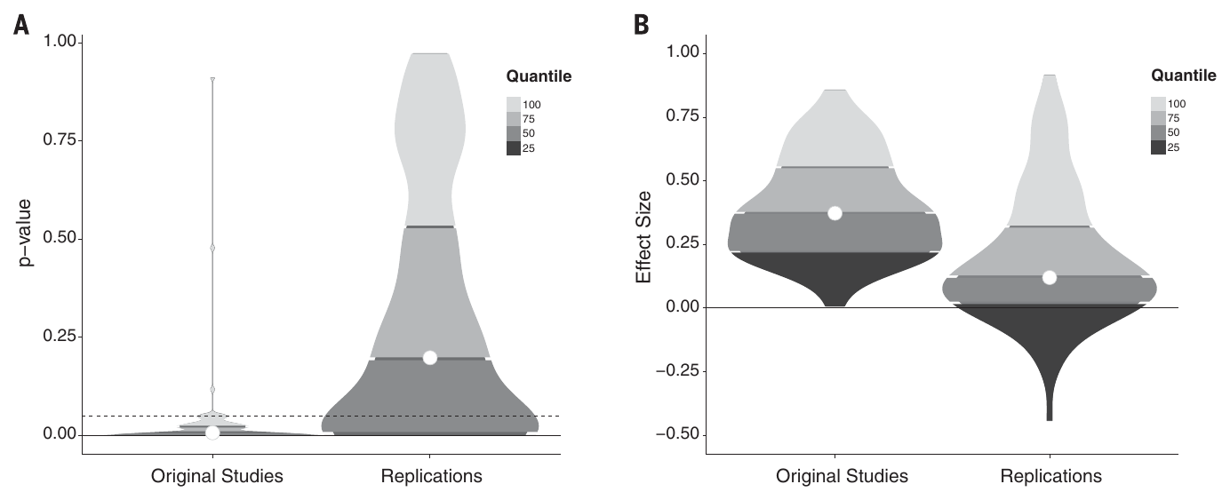
Why this matters in education
• Research directly informs practice and policy
  – IDEA (2004): services “based on peer-reviewed research to the extent practicable”
• Ioannidis (2005): “Why most published research findings are false”
• Wake-up call from psychology: 100 high-powered replications
  – 97% of originals significant → 36% of replications
  – Effect sizes about half as large
• Yet little systematic work on the credibility of (special) education’s research base
Ioannidis (2005), PLoS Medicine; Open Science Collaboration (2015), Science, Fig. 1
4

Slide 5
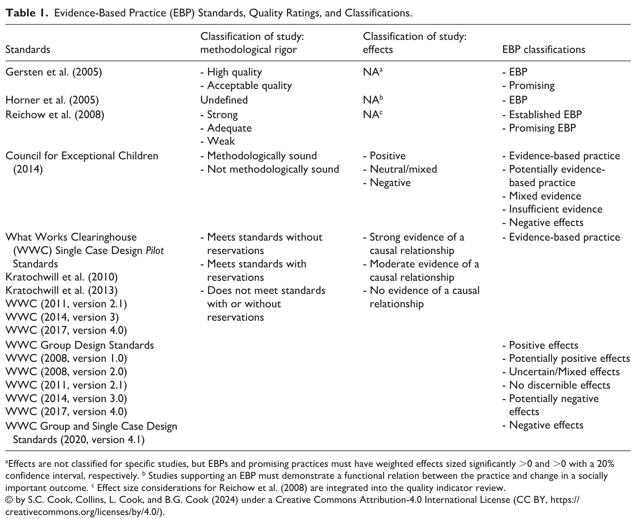
1 · EVIDENCE-BASED PRACTICES
The logic of evidence-based practices
• Experimental studies
  – ↓ meet enough quality indicators (QIs)?
• Apply EBP standards
  – ↓ enough high-quality studies with positive effects — and few/none null or negative?
• Practice = EBP
• Many standards, one logic: design → quality → quantity → effects
S. Cook, Collins, L. Cook, & B. Cook (2025), RASE, Table 1
5
Notes:
I've been thinking about these things for a while, and so we'll go down that path a little bit here. So start at the beginning. Evidence-based practices. Great idea about trying to, I think, in some ways, elevate the discussion about best practices or recommended practices to the idea of.
We need systematic standards about the types and the quantity and the quality of the evidence behind practices before we identify them as evidence-based and recommend them. There have been lots of different standards that have been developed. The What Works Clearinghouse, many of you probably have heard of but there are many others out there. In special education, we have — and this is from a recent paper that we wrote kind of reviewing a lot of these things, we have a number of different people, different groups, who have developed different standards.
I was in charge of the Council for Exceptional Children wanted their own set of standards, and I was in charge of that effort, and that was… that was an experience. And as much as anything, I think I came out of that with these standards were largely developed by group consensus and compromise, that they weren't empirically driven in terms of these standards make a difference in terms of influencing effect sizes of studies. These are just consensus from different groups about what we think is important. I think the logic of it is, is fairly sound that we're looking at, experimental studies that meet certain quality indicators. We need multiple studies and they have to show either all positive, all those studies have to show positive effects. The majority of them have to show positive effects, depending on the specific set of standards that we're looking at.
It's been a big — it's been a thing. Kind of made my career in some ways. Evidence-based practices became a thing. And it was big in policy. It was big in legislation. It was big in practice and I had no shortage of chapter invitations to write about evidence-based practices in education. And I actually got tired of it and moved on. But we do have now a very large body of research. We did a review just of the published, the peer-reviewed published reviews identifying evidence-based practices. And we found just one subset of them, of these reviews that are focused on a particular practice, which we called targeted, EBP reviews. We found 117 of those just in special education, but there are many, many more that have been done by different organizations, like the What Works Clearinghouse, and some other acronyms that I don't remember what exactly they mean, but this is the… it's a national center on Autism, and this is a national center on transition, and there are other groups that have done these types of reviews. And this, I think, helps inform policy and decisions around policy and practice as to what really works. I think one other positive side effect is the broad dissemination around these quality indicators, things like social validity and fidelity and their different checklists of quality indicators with these different EBP standards have really, I think, elevated a lot of the research that we do in the field, kind of knowing that.
As you may be aware of, initially, the What Works Clearinghouse got nicknamed the What Doesn't Work Clearinghouse, because basically, they were doing all these reviews, and they were finding most of the studies that have been conducted don't meet our quality standards. And so there was a reaction, well, these quality standards are too high, they're unrealistic.

