Slide 1

Fellowships and Funding
FY 2024
Tim Dallas, PhD
Associate Dean of the Graduate School
Professor of Electrical and Computer Engineering

Slide 2
Office of Graduate and Postdoctoral Fellowships
Assists students and postdocs with finding external funding opportunities and with developing competitive applications
Coordinates submission of fellowship applications and award administration
Title | Name | Email | Phone
Associate Dean | Tim Dallas, PhD | tim.dallas@ttu.edu | (806) 834-6856
Director Fellowships & Scholarships Alumni & Donor Relations | Donna Rogers | donna.rogers@ttu.edu | (806) 834-4079
Fellowship & Scholarship Coordinator | Matthew Hurtado | matthurt@ttu.edu | (806) 834-0770

Slide 3
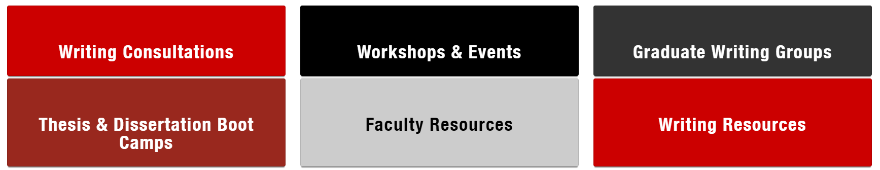
Graduate Writing Center
https://www.depts.ttu.edu/gradschool/gswc.php
806.742.2476, ext. 1
gradwritingcenter@ttu.edu

Slide 4
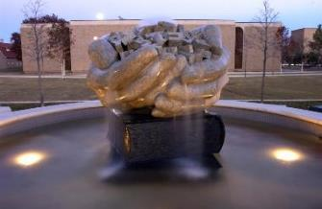
The Why
Why should students apply for externally funded fellowships and other awards?
  Individual benefits
    Financial
    Prestige
    More opportunities
  Enhance scholarly activity
    More publications/performances
    More funded research projects
  Institutional benefits
    Increases graduate student capacity
    Contributes to stature of university

Slide 5
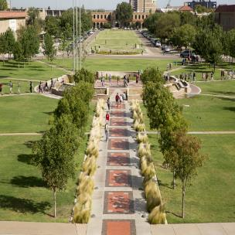
The Opportunities
Comprehensive, multi-year fellowship awards
Travel funding for research conferences
Short-term/special purpose awards
International experiences

Slide 6
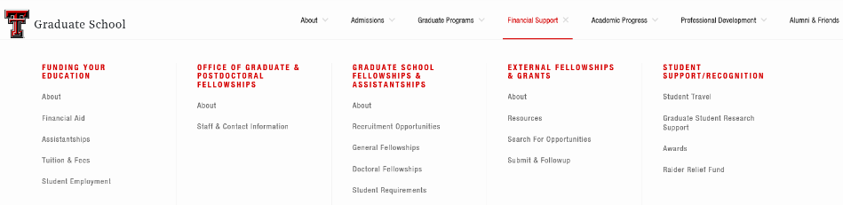
Searching for Fellowships
Go to www.depts.ttu.edu/gradschool
Select “Financial Support” tab

Slide 7
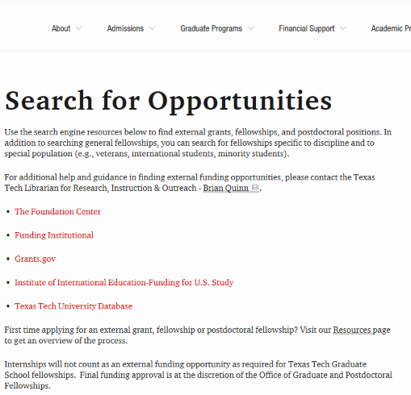
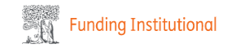
Searching for Fellowships

Slide 8
Significant STEM Fellowships
National Science Foundation-Graduate Research Fellowship Program (GRFP): https://www.nsfgrfp.org/
DOD SMART (Science, Mathematics & Research for Transformation) Fellowships: http://smart.asee.org
DOD National Defense Science & Engineering Fellowship: http://www.asee.org/ndseg
National Physical Science Consortium: http://www.npsc.org
DOE Computational Science Graduate Fellowship, http://www.krellinst.org/csgf
DOE NNSA Stewardship Science Graduate Fellowship: http://www.krellinst.org/ssgf
The Hertz Foundation: http://www.hertzfoundation.org
The National GEM Consortium for underrepresented groups: http://www.gemfellowship.org
Ruth L. Kirschstein National Research Service Award (NRSA) programs: http://grants.nih.gov/training/nrsa.htm

Slide 9



Competitive Federal Fellowships
The US Federal Government supports many fellowship programs for US citizens, US nationals, or permanent residents.
National Science Foundation Graduate Research Fellowship Program: $159,000 in stipend and cost-of-education to support research in many science and engineering fields.
Fulbright: 6-9 months of support to conduct research, teach, or enroll in a special MS program in over 100 countries.
National Institutes of Health Ruth L. Kirschstein Pre-doctoral Individual National Research Service Award: The program enables promising pre-doctoral students with potential to develop into a productive, independent research scientists, to obtain mentored research training while conducting dissertation research.

Slide 10

Texas Tech’s Fulbright Process
Deadline: October, 2024
→ For Fall, 2025 travel
Start early on application (March)
Assigned faculty Fulbright mentor
Present to TTU Fulbright Committee
Rework
Submit
U.S. citizen by application deadline
At least bachelor’s degree or equivalent by start of grant
No doctorate by application deadline
Proficiency in language of host country (varies by country)
^{http://us.fulbrightonline.org}

Slide 11
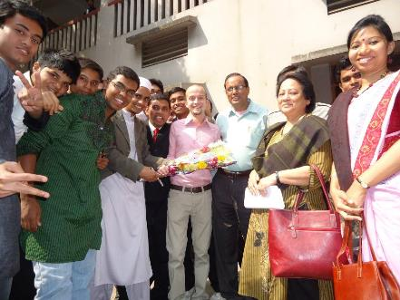
Fulbright US Student Program
All Fulbright Grants Include:
Round-trip Airfare
Monthly Stipend
Accident & Sickness Insurance
Other Possible Benefits *
  Tuition Allowance/Waiver
  Language Training
  Research Allowance
  Enhancement Activities
  Dependent Allowance
  Disability-Related Accommodations
* Varies, depending on grant type and host country
^{For more information, visit:}
^{http://us.fulbrightonline.org}

Slide 12

NSF GRFP
http://www.nsfgrfp.org
Directorates:
  Biological Sciences
  Computer & Information Science & Engineering
  STEM Education
  Engineering
  Geosciences
  Mathematical & Physical Sciences
  Social, Behavioral & Economic Sciences
3 year: $159,000

Slide 13
2024 NSF GRFP
Eligibility Requirements:
  Citizenship – US, nationals or permanent residents of the US
  Degree Requirements (several)
    Expected start date no later than Fall 2025
    Senior year to second year of graduate school
    No prior MS unless 2 year break in studies and not enrolled in a graduate school
  Graduate study leading to research-based master’s and doctoral degrees in science and engineering.
Review them all!

Slide 14
2024 NSF GRFP Program Information
Read and familiarize yourself with the GRFP Program Solicitation:
https://www.nsf.gov/publications/pub_summ.jsp?WT.z_pims_id=6201&ods_key=nsf23605
Read and familiarize yourself with the GRFP application site: https://nsfgrfp.org/applicants/application-resources/

Slide 15
NSF Submission Deadlines
Fellowship Applications: October ?? - ??, 2024
  (varies by discipline)
Letters of Reference: October ??, 2024 [5:00 pm ET]

Slide 16
NSF GRFP
Applicants submit the following information:
Personal Information
Education and Other Experience
Field(s) of Study
Graduate School Information
Personal, Relevant Background and Future Goals Statement (3 pages max)
Graduate Research Plan Statement (2 pages max)
Eligibility Statement (extenuating circumstances)
Transcripts
Reference Letter writers (3) – must be strong

Slide 17
NSF Review Criteria
The following elements should be considered in the review for both criteria:
What is the potential for the proposed activity to:
  Advance knowledge and understanding within its own field or across different fields (Intellectual Merit)
  Benefit society or advance desired societal outcomes (Broader Impacts)
2. To what extent do the proposed activities suggest and explore creative, original, or potentially transformative concepts?

Slide 18
NSF Review Criteria
3. Is the plan for carrying out the proposed activities well-reasoned, well-organized, and based on a sound rationale? Does the plan incorporate a mechanism to assess success?
4. How well qualified is the individual, team, or organization to conduct the proposed activities?
5. Are there adequate resources available to the PI (either at the home organization or through collaborations) to carry out the proposed activities?

Slide 19
Personal, Background, and Future Goals
In this section you are convincing the reviewers that you have exceptional:
  educational accomplishments
  experience
  leadership
  motivation
  other positive personal and professional characteristics to successfully carry out the research proposed

Slide 20
Personal, Background, and Future Goals
Intellectual Merit
Why you?
  What do you bring that will make you successful, a leader in your field?
Describe your previous research experience(s)
  What did you contribute?
  What did you learn (e.g., skills – experimental, software, hardware, inter-personal, etc.)?
Tie in your background (education and experiences) with what you plan to do (future goals).

Slide 21
Personal, Background, and Future Goals
Broader Impacts
How did you, personally and/or through your past research, impact society beneficially?
Reviewers are impressed with what you ‘have done,’ rather than ‘will do.’
How do you plan to actively participate/give back to society?
Don’t exaggerate, be reasonable.
Have you had to overcome a unique challenge?

Slide 22
Research Plan Statement
Background
Topically relevant to the mission of NSF
Convey to reviewers that you know what has been done and the significance of the work proposed
Do your homework (i.e., literature review)
What is considered state-of-the-art or current thinking?
What is your motivation for performing the research?
Are there important benchmarks to be surpassed?
Why is this research important?

Slide 23
Research Plan Statement
Intellectual Merit
What is significant about the proposed research?
What problem will it solve?
How will it advance knowledge?
How will it impact science/engineering?
You are trying to convince a review panel of experts, though not necessarily in the exact area you are working, that your research topic is important enough to award you money and that you have constructed a cogent (clear, logical, rational) plan.

Slide 24
Research Plan Statement
Broader Impacts
You need to convince a panel that the proposed research will impact society and that you will impact society. Be reasonable and realistic.
full participation of women, persons with disabilities, and underrepresented minorities in science, technology, engineering, and mathematics (STEM)
improved STEM education and educator development at any level
increased public scientific literacy and public engagement with science and technology
improved well-being of individuals in society
development of a diverse, globally competitive STEM workforce
applications of research
increased partnerships between academia, industry, and others
improved national security
increased economic competitiveness of the US
enhanced infrastructure for research and education

Slide 25
Research Plan Statement
Other suggestions:
  Make the proposal easy to read with clearly defined sections.
  Include a brief plan for accomplishing the research.
  Divide the work into phases and describe the work to be performed in each phase (timeline).

Slide 26
Reference Letters
Three reference letters required.
Important to ask someone who knows you well enough that they can cite specific examples of your work and/or personal characteristics that support your proposal
Ask for letters well in advance - Professors, Intern and Coop Supervisors, Research Supervisors
Provide a brief synopsis (no more than a couple of pages) of yourself to your references
  Personal and academic achievements
  Activities your references would not be aware of that support your personal characteristics and goals

Slide 27
Take Action
Ask not – Receive not…so go ASK!
Identify opportunities
Develop essays
Compile transcripts
Cultivate letters of recommendation
Get counsel from faculty and staff
Submit compelling applications

Slide 28


