Slide 1

Systematic Proposal Preparation
The Research Proposal Canvas
Tim Dallas, PhD
Professor of Electrical and Computer Engineering
Texas Tech University

Slide 2

Session Timeline
Learn Research Proposal Canvas (RPC) method for outlining funding proposals
Scholars use RPC to outline an NSF GRFP or similar proposal.
Example RPCs presented for discussion and constructive feedback.

Slide 3

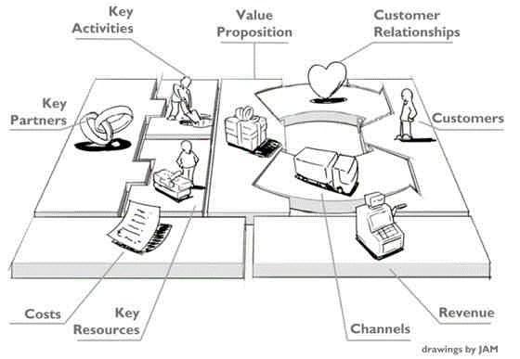
Business Model Canvas
PROPOSAL
FUNDING

Slide 4

Graduate Research Fellowship Program
https://www.nsfgrfp.org/
The purpose of the NSF Graduate Research Fellowship Program (GRFP) is to ensure the quality, vitality, and diversity of the scientific and engineering workforce of the United States. GRFP seeks to broaden participation in science and engineering of underrepresented groups, including women, minorities, persons with disabilities, and veterans.
($37,000 +$12,000)/year x 3 years = $147,000
Stipend
CoE

Slide 5
The Why
Student
+
Research
$$$$
Funding Organization
Trained Graduate
New Knowledge
Value Proposition
Customer

Slide 6
Research/Fellowship Proposal Canvas
Value Proposition
Customers
Trained Graduate
Funding Organization 1
New Knowledge
Funding Organization 2
Funding Organization N
Cost Structure
Revenue Streams
Graduate Stipend
Graduate Fellowship
Research Expenses
Research Grant

Slide 7
Value Proposition
New Knowledge
Summarize your research purpose in one, concise sentence.

Slide 8
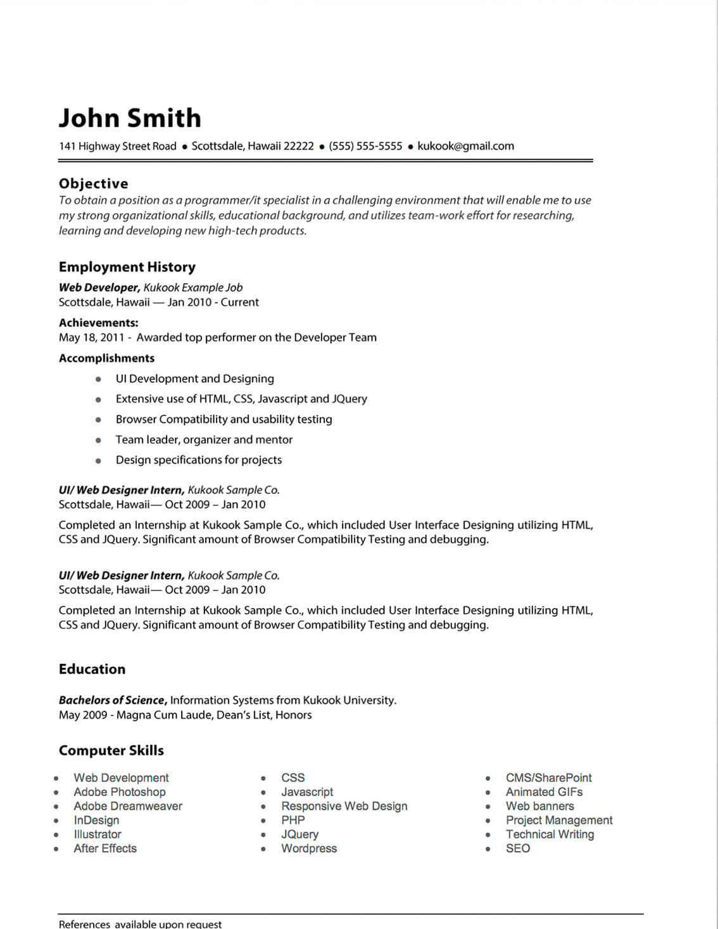
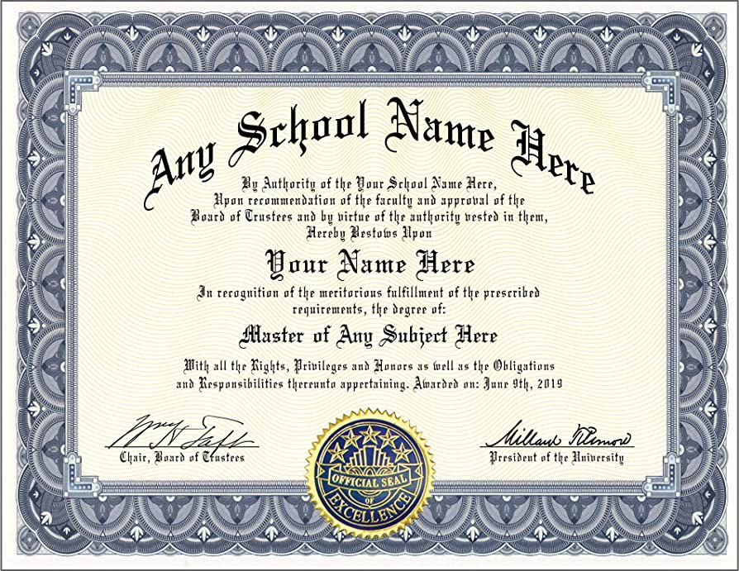

Your History & Future
Personal Statement
Credentials
Experiences
Knowledge
Degrees
Certifications
Aspirations

Slide 9
Research/Fellowship Proposal Canvas
Value Proposition
Customers
Trained Graduate
Funding Organization 1
New Knowledge
Funding Organization 2
History & Future
Funding Organization N
Experiences
Knowledge
Degrees
Credentials
Certifications
Aspirations
Cost Structure
Revenue Streams
Graduate Stipend
Graduate Fellowship
Research Expenses
Research Grant

Slide 10
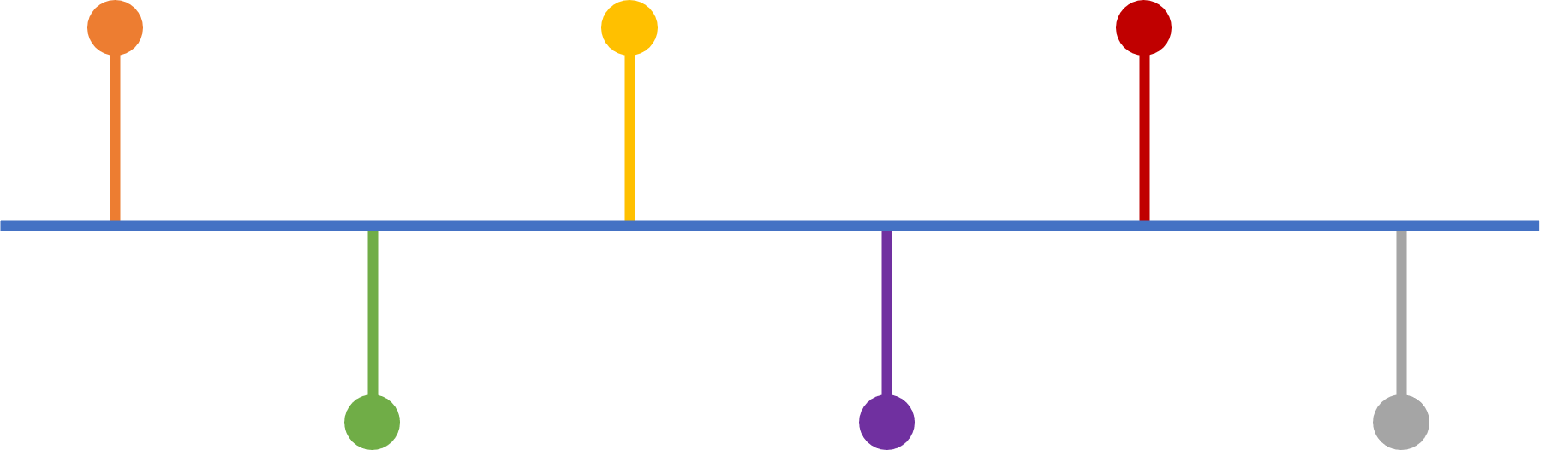
Proposal Channel
Content
Format
Deadline
Reviewers
SUBMIT
BEGIN

Slide 11
Research/Fellowship Proposal Canvas
Value Proposition
Customers
Trained Graduate
Funding Organization 1
New Knowledge
Funding Organization 2
History & Future
Channel
Funding Organization N
Experiences
Knowledge
Degrees
Credentials
Certifications
Aspirations
Content
Format
Deadline
Cost Structure
Revenue Streams
Graduate Stipend
Graduate Fellowship
Research Expenses
Research Grant

Slide 12
Customer Relationship
Program Manager
Panel Review
Feedback
Things to consider:
Who are the reviewers? Not specific names, rather characteristics.
Technical knowledge of reviewers…subject matter experts in your area?

Slide 13
Research/Fellowship Proposal Canvas
Value Proposition
Relationship
Customers
Trained Graduate
Program Manager
Panel Review
Feedback
Funding Organization 1
New Knowledge
Funding Organization 2
History & Future
Channel
Funding Organization N
Experiences
Knowledge
Degrees
Credentials
Certifications
Aspirations
Content
Format
Deadline
Cost Structure
Revenue Streams
Graduate Stipend
Graduate Fellowship
Research Expenses
Research Grant

Slide 14


Activities
Experiments
Design
Calculations
Simulations
Data Analysis

Slide 15
Research/Fellowship Proposal Canvas
Activities
Value Proposition
Relationship
Customers
Experiments
Design
Calculations
Simulations
Data Analysis
Trained Graduate
Program Manager
Panel Review
Feedback
Funding Organization 1
New Knowledge
Funding Organization 2
History & Future
Channel
Funding Organization N
Experiences
Knowledge
Degrees
Credentials
Certifications
Aspirations
Content
Format
Deadline
Cost Structure
Revenue Streams
Graduate Stipend
Graduate Fellowship
Research Expenses
Research Grant

Slide 16


Resources
Equipment
Software
Computer
User Facilities
Human
Funding

Slide 17
Research/Fellowship Proposal Canvas
Activities
Value Proposition
Relationship
Customers
Experiments
Design
Calculations
Simulations
Data Analysis
Trained Graduate
Program Manager
Panel Review
Feedback
Funding Organization 1
New Knowledge
Funding Organization 2
Resources
History & Future
Channel
Funding Organization N
Equipment
Software
Computer
User Facilities
Human
Funding
Experiences
Knowledge
Degrees
Credentials
Certifications
Aspirations
Content
Format
Deadline
Cost Structure
Revenue Streams
Graduate Stipend
Graduate Fellowship
Research Expenses
Research Grant

Slide 18


Partners & Suppliers
User Facilities
Other Researchers
Other Universities
Equipment Supplier
Recommendations

Slide 19
Research/Fellowship Proposal Canvas
Partners/Suppliers
Activities
Value Proposition
Relationship
Customers
User Facilities
Other Researchers
Other Universities
Equipment Supplier
Experiments
Design
Calculations
Simulations
Data Analysis
Trained Graduate
Program Manager
Panel Review
Feedback
Funding Organization 1
New Knowledge
Funding Organization 2
Recommendations
Resources
History & Future
Channel
Funding Organization N
Equipment
Software
Computer
User Facilities
Human
Funding
Experiences
Knowledge
Degrees
Credentials
Certifications
Aspirations
Content
Format
Deadline
Cost Structure
Revenue Streams
Graduate Stipend
Graduate Fellowship
Research Expenses
Research Grant

Slide 20
Research/Fellowship Proposal Canvas
Partners/Suppliers
Activities
Value Proposition
Relationship
Customers
User Facilities
Other Researchers
Other Universities
Equipment Supplier
Experiments
Design
Calculations
Simulations
Data Analysis
Trained Graduate
Program Manager
Panel Review
Feedback
Funding Organization 1
New Knowledge
Funding Organization 2
Recommendations
Resources
History & Future
Channel
Funding Organization N
Equipment
Software
Computer
User Facilities
Human
Funding
Experiences
Knowledge
Degrees
Credentials
Certifications
Aspirations
Content
Format
Deadline
Cost Structure
Revenue Streams
Graduate Stipend
Graduate Fellowship
Research Expenses
Research Grant

Slide 21
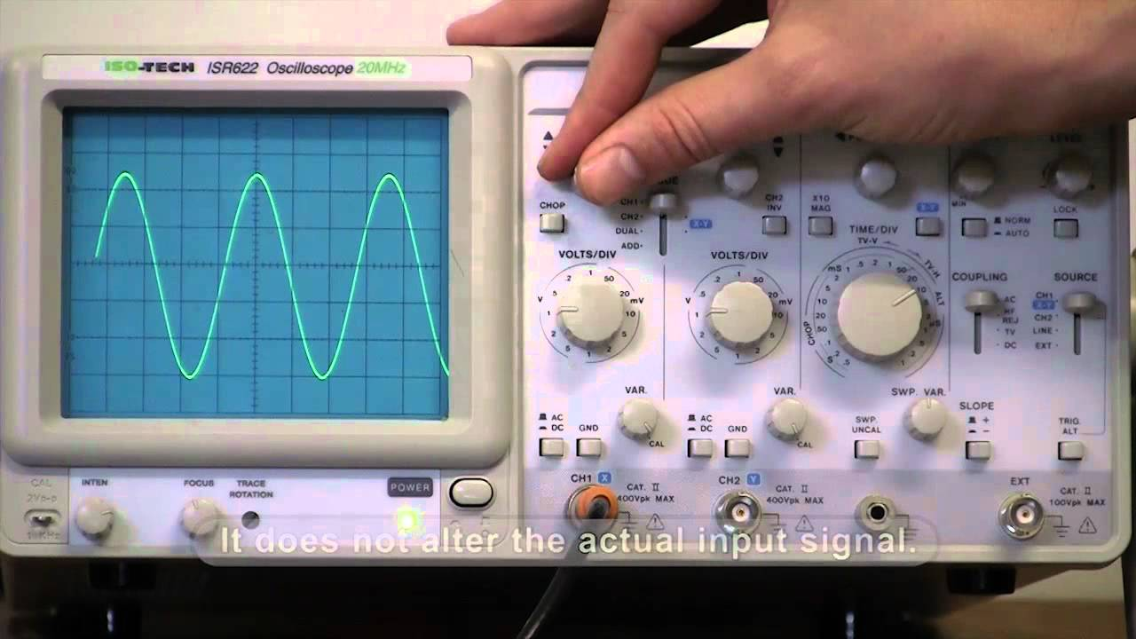
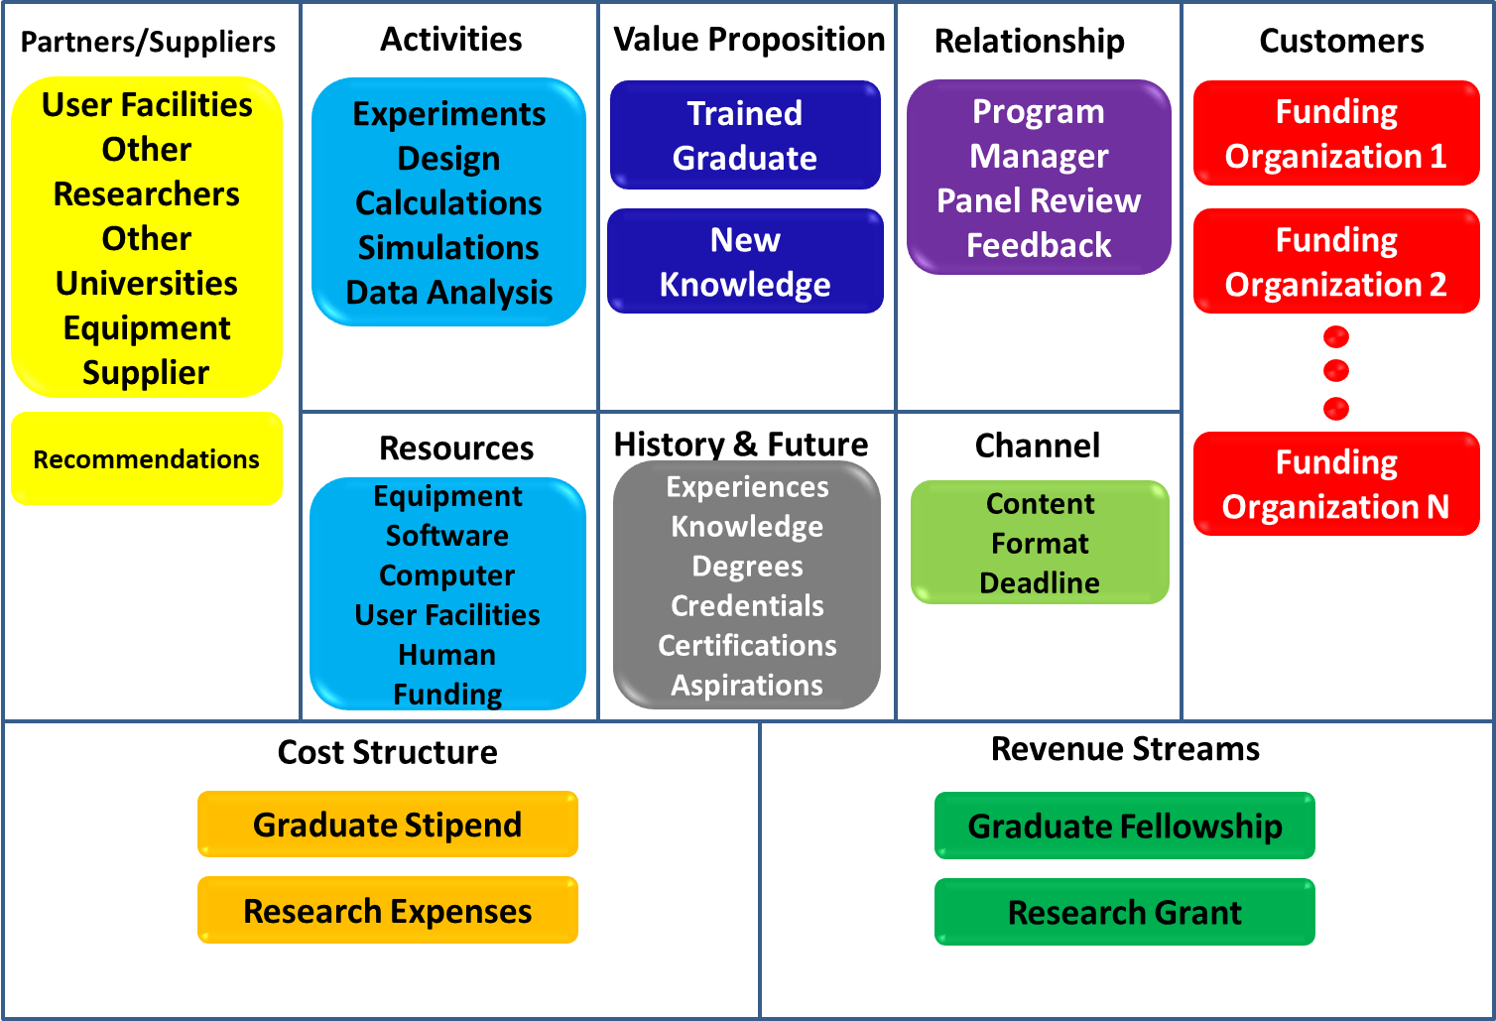
Research/Fellowship Proposal Canvas
Oscilloscope
Turning one dial will almost always require adjustment of others.
.

Slide 22
Proposals needs to be…
Timely
Important
Compelling

Slide 23
Personal Statement
Experience
Cohesive & Compelling Narrative
Info
Info
Story
Experience
Present
How have I bettered myself?
How have I benefited others?
Future
Past

Slide 24
PROCESS
Construct proposals in a systematic fashion
Get rigorous critique before submitting
Improve and Submit

Slide 25
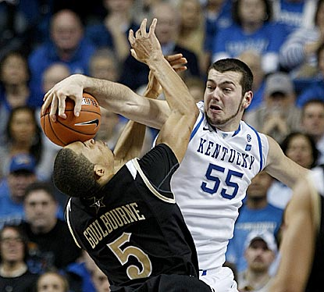
Rejection!!
NSF
Dallas
cbssports.com
It happens…to everybody….learn from it!
TRY AGAIN!

Slide 26
Key Partners
Key Activities
Value Proposition
Customer
Relationships
Customer
Segments
Faculty
Students
Industry
Federal Labs
Non-profits
Medical Facility
K-12 Schools
Universities
State
Research
  Lab
  Education
Student education
Outreach
Commercialization
This research will lead to what benefits for my customers (basic science, industry, etc).
Panel
Program manager
Industry manager
Federal Agency
  NSF
  NIH
  DoD
  ONR
  Other
Federal Labs
  Sandia
  LLNL
  NIST
  Other
Non-profits
State
Industry
Key Resources
History
Channels
Laboratories
Computer
Personnel
General use facilities
Publications
IP
Other
Proposals
White papers
Literature
Where are the key variables & unknowns??
Research Proposal Canvas
Cost Structure
Revenue Streams
Direct Costs
Indirect Cost
Time
Grants
Contracts
Consulting fee
Start-up funds
University matching/overhead return
Endowment

Slide 27
Key Partners
Key Activities
Value Proposition
Customer
Relationships
Customer
Segments
Faculty
Students
Industry
Federal Labs
Non-profits
Medical Facility
K-12 Schools
Universities
State
Sandia Labs
New Deal HS
Lubbock HS
Celeritous
This research will lead to what benefits for my customers (basic science, industry, etc).
Program Manager (don’t know)
Federal Agency
  NSF
  NIH
  DoD
  ONR
  Other
Federal Labs
  Sandia
  LLNL
  NIST
  Other
Non-profits
State
Industry
Research
  Lab
  Education
Student education
Outreach
Commercialization
ONR
D. of Education
Research
  MEMS
Student education
Outreach
This research will produce a really awesome STEM system for everybody.
Panel
Program manager
Industry manager
Key Resources
History
Channels
Laboratories
Computer
Personnel
General use facilities
MEMS Devices
Commercialized System
MEMS Lab
Publications
IP
Other
White papers
Proposals
White Paper
Literature
Research Proposal Canvas
Initial Plan
Cost Structure
Revenue Streams
Direct Costs
Indirect Cost
Time
Grants
Contracts
Consulting fee
Start-up funds
University matching/overhead return
Endowment
Direct Costs
Indirect Cost
Time
Grant: ONR BAA 13-007
University matching/overhead return

Slide 28
Key Partners
Key Activities
Value Proposition
Customer
Relationships
Customer
Segments
Faculty
Students
Industry
Federal Labs
Non-profits
Medical Facility
K-12 Schools
Universities
State
Sandia Labs
New Deal HS
Lubbock HS
Celeritous
This research will lead to what benefits for my customers (basic science, industry, etc).
This research will produce a really awesome STEM system by doing some stuff with MEMS and creatively written lab manuals.
Program Manager (still don’t know)
Federal Agency
  NSF
  NIH
  DoD
  ONR
  Other
Federal Labs
  Sandia
  LLNL
  NIST
  Other
Non-profits
State
Industry
Research
  Lab
  Education
Student education
Outreach
Commercialization
ONR
D. of Education
Research
  MEMS
Student education
Outreach
Panel
Program manager
Industry manager
Prof. Michelle Pantoya
Cooper HS
Frenship HS
Key Resources
History
Channels
Laboratories
Computer
Personnel
General use facilities
MEMS Devices
Commercialized System
MEMS Lab
Publications
IP
Other
White papers
Proposals
White Paper
Graphic Artist
Published kids engineering-themed books
ONR Grant
Research Proposal Canvas
Updated Plan 1
Cost Structure
Revenue Streams
Direct Costs
Indirect Cost
Time
Grants
Contracts
Consulting fee
Start-up funds
University matching/overhead return
Endowment
Direct Costs
Indirect Cost
Time
Grant: ONR BAA 13-007
University matching/overhead return

Slide 29
Key Partners
Key Activities
Value Proposition
Customer
Relationships
Customer
Segments
Faculty
Students
Industry
Federal Labs
Non-profits
Medical Facility
K-12 Schools
Universities
State
Sandia Labs
New Deal HS
Lubbock HS
Celeritous
This research will lead to what benefits for my customers (basic science, industry, etc).
Program Manager (called)
Federal Agency
  NSF
  NIH
  DoD
  ONR
  Other
Federal Labs
  Sandia
  LLNL
  NIST
  Other
Non-profits
State
Industry
Research
  Lab
  Education
Student education
Outreach
Commercialization
ONR
D. of Education
Research
  MEMS
Student education
Outreach
This research will produce a really awesome STEM system by merging MEMS-based educational labs with a compelling naval-centric curriculum.
Panel
Program manager
Industry manager
Engineering narratives & Art
Prof. Michelle Pantoya
Cooper HS
Frenship HS
Key Resources
History
Channels
Laboratories
Computer
Personnel
General use facilities
MEMS Devices
Commercialized System
MEMS Lab
Publications
IP
Other
White papers
Proposals
White Paper
Graphic Artist
Published kids engineering-themed books
ONR Grant
Research Proposal Canvas
Updated Plan 2
Cost Structure
Revenue Streams
Direct Costs
Indirect Cost
Time
Grants
Contracts
Consulting fee
Start-up funds
University matching/overhead return
Endowment
Direct Costs
Indirect Cost
Time
Grant: ONR BAA 13-007
University matching/overhead return

Slide 30
Key Partners
Key Activities
Value Proposition
Customer
Relationships
Customer
Segments
Faculty
Students
Industry
Federal Labs
Non-profits
Medical Facility
K-12 Schools
Universities
State
Sandia Labs
New Deal HS
Lubbock HS
Celeritous
This research will lead to what benefits for my customers (basic science, industry, etc).
This research will produce a really awesome STEM system by merging MEMS-based educational labs with a compelling naval-centric curriculum. Assessment will quantify merits of this intervention at the 4th-6th grade levels.
Program Manager (called)
Federal Agency
  NSF
  NIH
  DoD
  ONR
  Other
Federal Labs
  Sandia
  LLNL
  NIST
  Other
Non-profits
State
Industry
Research
  Lab
  Education
Student education
Outreach
Commercialization
ONR
D. of Education
Research
  MEMS
Student education
Outreach
Panel
Program manager
Industry manager
Engineering narratives & Art
Prof. Michelle Pantoya
Cooper HS
Frenship HS
Education assessment
Key Resources
History
Channels
Laboratories
Computer
Personnel
General use facilities
MEMS Devices
Commercialized System
MEMS Lab
Publications
IP
Other
White papers
Proposals
White Paper
Prof. Zenaida Aguirre-Munoz
Graphic Artist
Published kids engineering-themed books
ONR Grant
Implementation educators
Research Proposal Canvas
Updated Plan 3
Education assessment
Cost Structure
Revenue Streams
Direct Costs
Indirect Cost
Time
Grants
Contracts
Consulting fee
Start-up funds
University matching/overhead return
Endowment
Direct Costs
Indirect Cost
Time
Grant: ONR BAA 13-007
University matching/overhead return

Slide 31
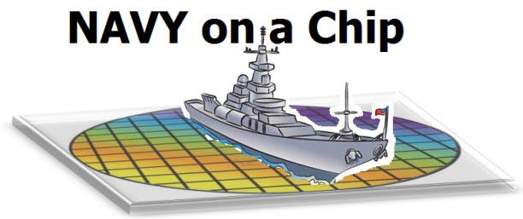

Key Partners
Key Activities
Value Proposition
Customer
Relationships
Customer
Segments
Faculty
Students
Industry
Federal Labs
Non-profits
Medical Facility
K-12 Schools
Universities
State
Sandia Labs
New Deal HS
Lubbock HS
Celeritous
This research will lead to what benefits for my customers (basic science, industry, etc).
Program Manager (called)
Federal Agency
  NSF
  NIH
  DoD
  ONR
  Other
Federal Labs
  Sandia
  LLNL
  NIST
  Other
Non-profits
State
Industry
Research
  Lab
  Education
Student education
Outreach
Commercialization
ONR
D. of Education
Research
  MEMS
Student education
Outreach
This research will produce Navy on a Chip by merging MEMS-based educational tools with a compelling naval-centric curriculum. Assessment will quantify merits of this intervention at the 4th grade level.
Panel
Program manager
Industry manager
Engineering narratives & Art
Prof. Michelle Pantoya
Cooper HS
Frenship HS
Education assessment
Key Resources
History
Channels
Submitted 7/2013
Laboratories
Computer
Personnel
General use facilities
MEMS Devices
Commercialized System
MEMS Lab
Publications
IP
Other
White papers
Proposals
White paper
Prof. Zenaida Aguirre-Munoz
Graphic Artist
Full proposal
Published kids engineering-themed books
ONR Grant
Implementation educators
Research Proposal Canvas
Updated Plan 4
Education assessment
Cost Structure
Revenue Streams
Direct Costs
Indirect Cost
Time
Grants
Contracts
Consulting fee
Start-up funds
University matching/overhead return
Endowment
Direct Costs
Indirect Cost
Time
Grant: ONR BAA 13-007
University matching/overhead return

Slide 32
Research/Fellowship Proposal Canvas
Partners/Suppliers
Activities
Value Proposition
Relationship
Customers
User Facilities
Other Researchers
Other Universities
Equipment Supplier
Experiments
Design
Calculations
Simulations
Data Analysis
Trained Graduate
Program Manager
Panel Review
Feedback
Funding Organization 1
New Knowledge
Funding Organization 2
Recommendations
Resources
History & Future
Channel
Funding Organization N
Equipment
Software
Computer
User Facilities
Human
Funding
Experiences
Knowledge
Degrees
Credentials
Certifications
Aspirations
Content
Format
Deadline
Cost Structure
Revenue Streams
Graduate Stipend
Graduate Fellowship
Research Expenses
Research Grant

Slide 33
Research/Fellowship Proposal Canvas
Partners/Suppliers
Activities
Value Proposition
Relationship
Customers
Resources
History & Future
Channel
Cost Structure
Revenue Streams

