Slide 1

Systematic Proposal Preparation
The Research Proposal Canvas
Tim Dallas, PhD
Associate Dean, Graduate School
Professor of Electrical and Computer Engineering
Texas Tech University

Slide 2

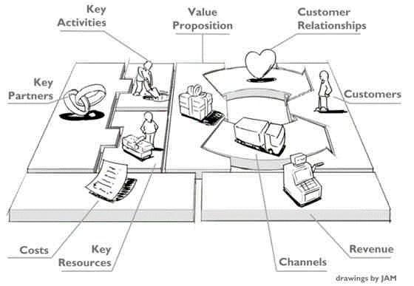
Business Model Canvas
PROPOSAL
FUNDING

Slide 3

Graduate Research Fellowship Program
https://www.nsfgrfp.org/
The purpose of the NSF Graduate Research Fellowship Program (GRFP) is to ensure the quality, vitality, and diversity of the scientific and engineering workforce of the United States. GRFP seeks to broaden participation in science and engineering of underrepresented groups, including women, minorities, persons with disabilities, and veterans.
($37,000 +$16,000)/year x 3 years = $159,000
Stipend
CoE

Slide 4
The Why
Student
+
Research
$$$$
Funding Organization
Trained Graduate
New Knowledge
Value Proposition
Customer

Slide 5
Research/Fellowship Proposal Canvas

Slide 6
Value Proposition
Trained Graduate
New Knowledge
What does the funding entity receive for their support?

Slide 7
Research/Fellowship Proposal Canvas
Value Proposition
Trained Graduate
New Knowledge

Slide 8






Customers
Funding Organization 1
Funding Organization N
Which organizations want to fund you and/or your research and why?

Slide 9
Research/Fellowship Proposal Canvas
Value Proposition
Customers
Trained Graduate
Funding Organization 1
New Knowledge
Funding Organization 2
Funding Organization N

Slide 10
Cost Structure
Travel
Supplies
Materials
Equipment
Lab fees
Overhead
Graduate Stipend
Salary
Insurance
Tuition
Fringe
Overhead
Research Expenses
What are the costs associated with supporting the student and the research?

Slide 11
Research/Fellowship Proposal Canvas
Value Proposition
Customers
Trained Graduate
Funding Organization 1
New Knowledge
Funding Organization 2
Funding Organization N
Cost Structure
Graduate Stipend
Research Expenses

Slide 12
Revenue Streams
$$$
Graduate Fellowship
$$$
Research Grant
What is the type of funding available?
Amount?
Duration?

Slide 13
Research/Fellowship Proposal Canvas
Value Proposition
Customers
Trained Graduate
Funding Organization 1
New Knowledge
Funding Organization 2
Funding Organization N
Cost Structure
Revenue Streams
Graduate Stipend
Graduate Fellowship
Research Expenses
Research Grant

Slide 14
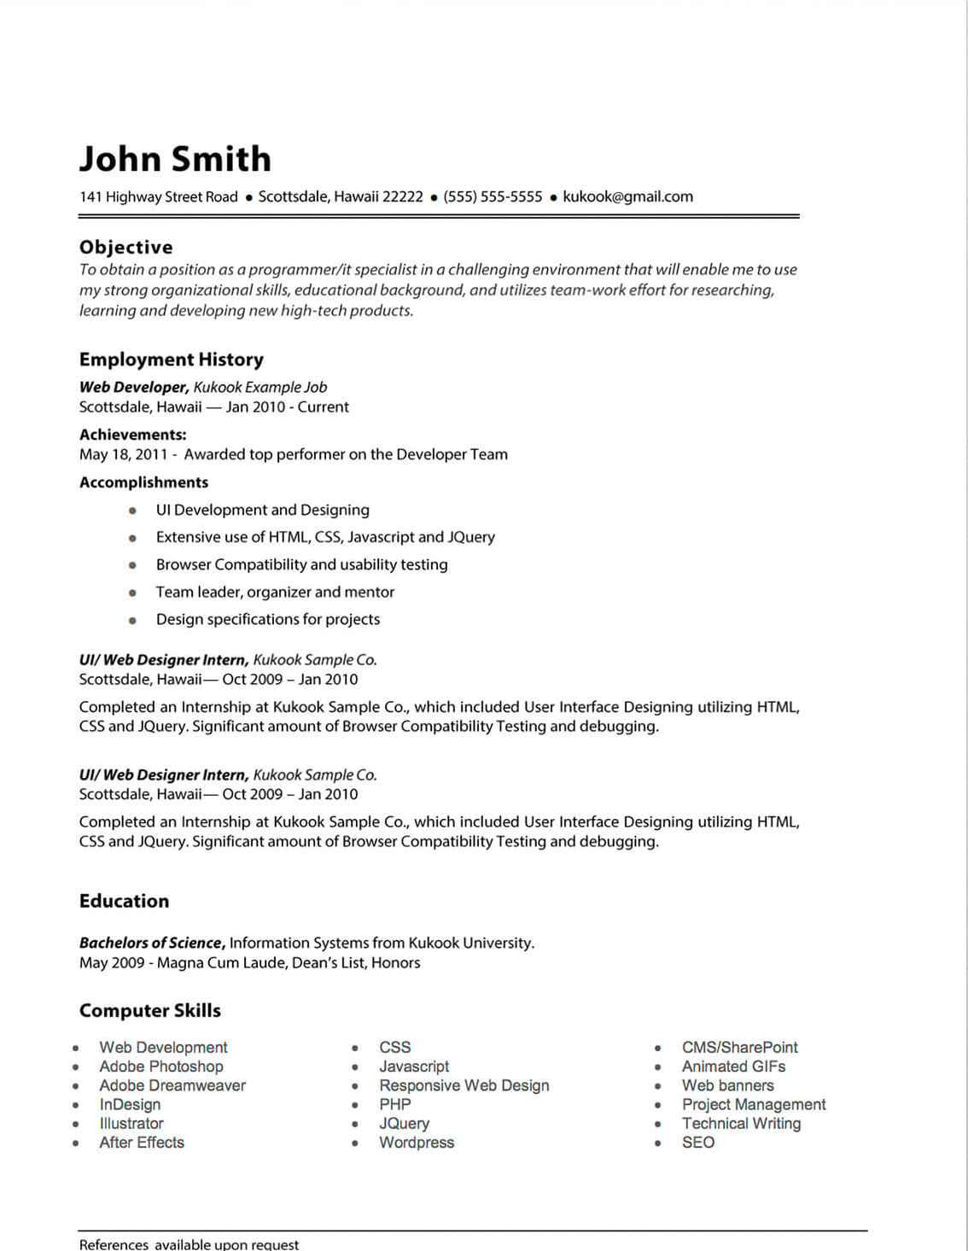
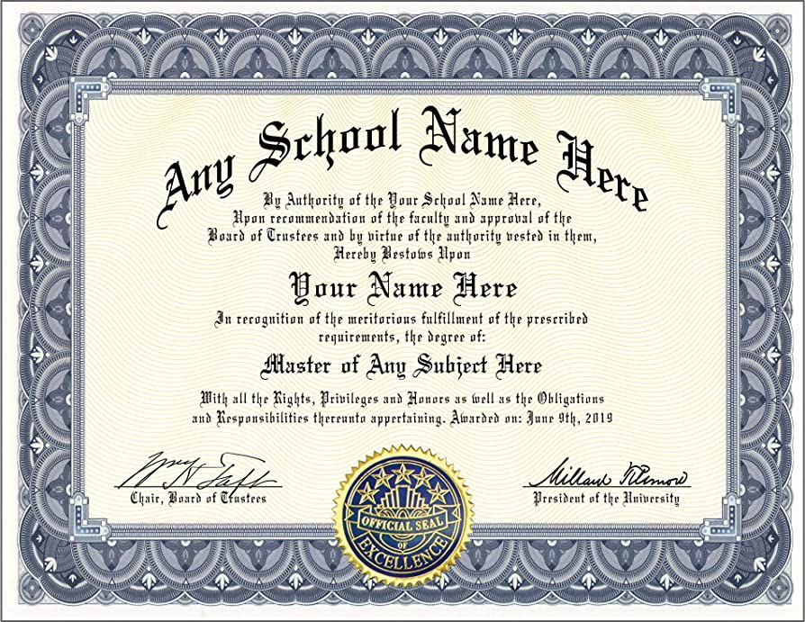

Your History & Future
Personal Statement
Credentials
Experiences
Knowledge
Degrees
Certifications
Aspirations

Slide 15
Research/Fellowship Proposal Canvas
Value Proposition
Customers
Trained Graduate
Funding Organization 1
New Knowledge
Funding Organization 2
History & Future
Funding Organization N
Experiences
Knowledge
Degrees
Credentials
Certifications
Aspirations
Cost Structure
Revenue Streams
Graduate Stipend
Graduate Fellowship
Research Expenses
Research Grant

Slide 16
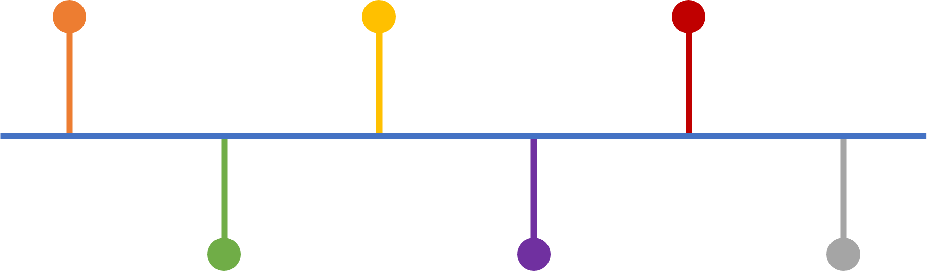
Proposal Channel
Content
Format
Deadline
Reviewers
SUBMIT
BEGIN

Slide 17
Research/Fellowship Proposal Canvas
Value Proposition
Customers
Trained Graduate
Funding Organization 1
New Knowledge
Funding Organization 2
History & Future
Channel
Funding Organization N
Experiences
Knowledge
Degrees
Credentials
Certifications
Aspirations
Content
Format
Deadline
Cost Structure
Revenue Streams
Graduate Stipend
Graduate Fellowship
Research Expenses
Research Grant

Slide 18
Customer Relationship
Program Manager
Panel Review
Feedback
Things to consider:
Who are the reviewers? Not specific names, rather characteristics.
Technical knowledge of reviewers…subject matter experts in your area?

Slide 19
Research/Fellowship Proposal Canvas
Value Proposition
Relationship
Customers
Trained Graduate
Program Manager
Panel Review
Feedback
Funding Organization 1
New Knowledge
Funding Organization 2
History & Future
Channel
Funding Organization N
Experiences
Knowledge
Degrees
Credentials
Certifications
Aspirations
Content
Format
Deadline
Cost Structure
Revenue Streams
Graduate Stipend
Graduate Fellowship
Research Expenses
Research Grant

Slide 20


Activities
Experiments
Design
Calculations
Simulations
Data Analysis

Slide 21
Research/Fellowship Proposal Canvas
Activities
Value Proposition
Relationship
Customers
Experiments
Design
Calculations
Simulations
Data Analysis
Trained Graduate
Program Manager
Panel Review
Feedback
Funding Organization 1
New Knowledge
Funding Organization 2
History & Future
Channel
Funding Organization N
Experiences
Knowledge
Degrees
Credentials
Certifications
Aspirations
Content
Format
Deadline
Cost Structure
Revenue Streams
Graduate Stipend
Graduate Fellowship
Research Expenses
Research Grant

Slide 22


Resources
Equipment
Software
Computer
User Facilities
Human
Funding

Slide 23
Research/Fellowship Proposal Canvas
Activities
Value Proposition
Relationship
Customers
Experiments
Design
Calculations
Simulations
Data Analysis
Trained Graduate
Program Manager
Panel Review
Feedback
Funding Organization 1
New Knowledge
Funding Organization 2
Resources
History & Future
Channel
Funding Organization N
Equipment
Software
Computer
User Facilities
Human
Funding
Experiences
Knowledge
Degrees
Credentials
Certifications
Aspirations
Content
Format
Deadline
Cost Structure
Revenue Streams
Graduate Stipend
Graduate Fellowship
Research Expenses
Research Grant

Slide 24


Partners & Suppliers
User Facilities
Other Researchers
Other Universities
Equipment Supplier
Recommendations

Slide 25
Research/Fellowship Proposal Canvas
Partners/Suppliers
Activities
Value Proposition
Relationship
Customers
User Facilities
Other Researchers
Other Universities
Equipment Supplier
Experiments
Design
Calculations
Simulations
Data Analysis
Trained Graduate
Program Manager
Panel Review
Feedback
Funding Organization 1
New Knowledge
Funding Organization 2
Recommendations
Resources
History & Future
Channel
Funding Organization N
Equipment
Software
Computer
User Facilities
Human
Funding
Experiences
Knowledge
Degrees
Credentials
Certifications
Aspirations
Content
Format
Deadline
Cost Structure
Revenue Streams
Graduate Stipend
Graduate Fellowship
Research Expenses
Research Grant

Slide 26
Research/Fellowship Proposal Canvas
Partners/Suppliers
Activities
Value Proposition
Relationship
Customers
User Facilities
Other Researchers
Other Universities
Equipment Supplier
Experiments
Design
Calculations
Simulations
Data Analysis
Trained Graduate
Program Manager
Panel Review
Feedback
Funding Organization 1
New Knowledge
Funding Organization 2
Recommendations
Resources
History & Future
Channel
Funding Organization N
Equipment
Software
Computer
User Facilities
Human
Funding
Experiences
Knowledge
Degrees
Credentials
Certifications
Aspirations
Content
Format
Deadline
Cost Structure
Revenue Streams
Graduate Stipend
Graduate Fellowship
Research Expenses
Research Grant

Slide 27



Research/Fellowship Proposal Canvas
Partners/Suppliers
Activities
Value Proposition
Relationship
Customers
Sandia Nat. Labs
CINT
Modeling MEMS devices
Simulate MEMS devices
Develop process flow
Produce testing plan
Rapidly develop and produce dynamic microdevices for university education and research using a nanoscale 3D printer.
Program Manager
Resources
History & Future
Channel
Modeling Software
Microscope Probe Stations
Electron Microscope
UG Student
Graduate Student
Developed MEMS Education Chip with dynamic device using Sandia’s SUMMiT V MEMS Foundry Process
Commercialized Class on a Chip system.
NSF EAGER
Cost Structure
Revenue Streams
Student Costs (Stipend, Tuition, Insurance)
Travel
Faculty Summer Salary
Materials and Supplies
SEM usage fees
Grant funds
Internal funds

Slide 28
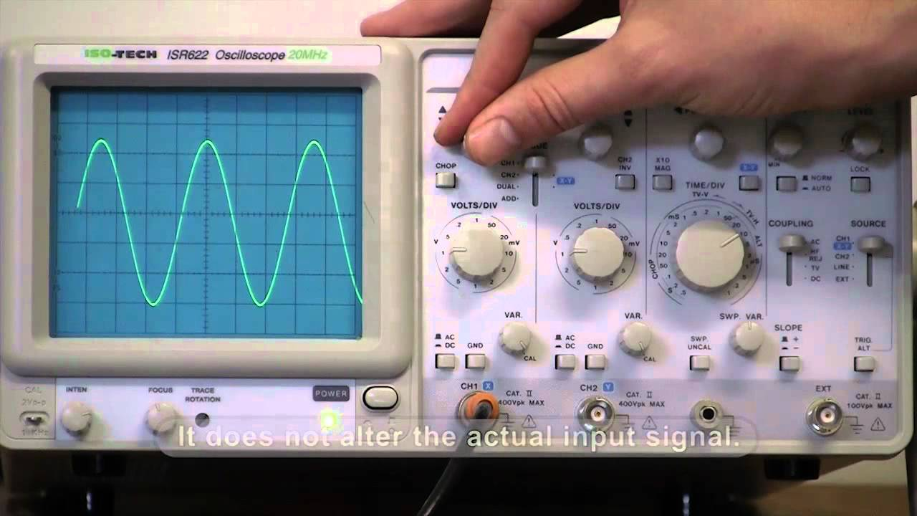
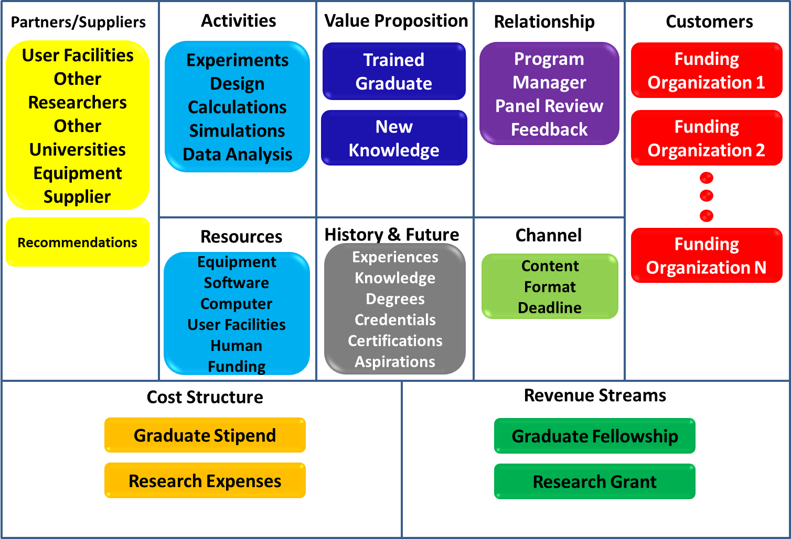
Research/Fellowship Proposal Canvas
Oscilloscope
Turning one dial will almost always require adjustment of others.
.

Slide 29
Proposals needs to be…
Timely
Important
Compelling

Slide 30
Personal Statement
Experience
Cohesive & Compelling Narrative
Info
Info
Story
Experience
Present
How have I bettered myself?
How have I benefited others?
Future
Past

Slide 31
PROCESS
Construct proposals in a systematic fashion
Get rigorous critique before submitting
Improve and Submit

Slide 32
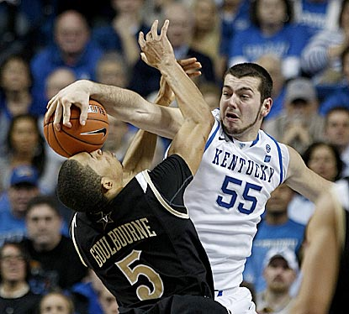
Rejection!!
NSF
Dallas
cbssports.com
It happens…to everybody….learn from it!
TRY AGAIN!

Slide 33
Research/Fellowship Proposal Canvas
Partners/Suppliers
Activities
Value Proposition
Relationship
Customers
User Facilities
Other Researchers
Other Universities
Equipment Supplier
Experiments
Design
Calculations
Simulations
Data Analysis
Trained Graduate
Program Manager
Panel Review
Feedback
Funding Organization 1
New Knowledge
Funding Organization 2
Recommendations
Resources
History & Future
Channel
Funding Organization N
Equipment
Software
Computer
User Facilities
Human
Funding
Experiences
Knowledge
Degrees
Credentials
Certifications
Aspirations
Content
Format
Deadline
Cost Structure
Revenue Streams
Graduate Stipend
Graduate Fellowship
Research Expenses
Research Grant

