Slide 1
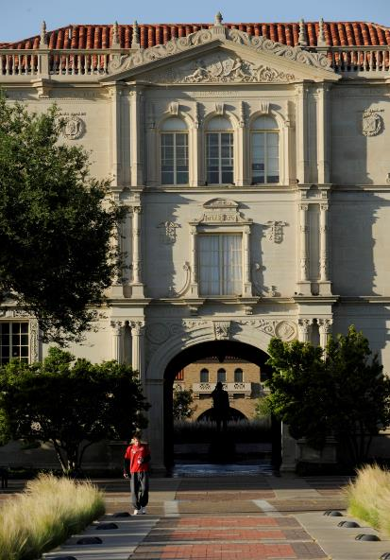
Fellowship Requirement Orientation
Fall 2023
Donna Rogers, M.P.A.
Office of Graduate & Postdoctoral Fellowships
Director of Scholarships, Fellowships,
& Donor Relations

Slide 2
Graduate School
Graduate School
Office of Postdoctoral Affairs
Office of Graduate and Postdoctoral Fellowships
Leadership team:
Mark A. Sheridan, Vice Provost/Dean of the Grad School
Kristi Gaines, Associate Dean (student affairs & pro development)
Tim Dallas, Interim Associate Dean (funding initiatives)
Heather Greenhalgh-Spencer, Associate Dean (programs)
Governing Bodies:
The Graduate Council (14 members)
The Graduate Faculty

Slide 3
Fellowship Requirements
Thank You Note
Professional Development Events
External Funding Application
Community Service
Annual Donor-Recipient Fellowship Reception
Requirement details: https://www.depts.ttu.edu/gradschool/financial/StudentRequirements.php

Slide 4
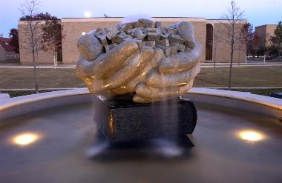
Purpose of Requirements
Thank You Note
Opportunity to share your story with the donors.
Donors are able to see what their investment is supporting.
Professional Development Events
Preparation for life outside of academia.
Stronger candidate in the private sector.
External Funding Application
Prestige for students and TTU.
Possible supplemental funding.
.

Slide 5
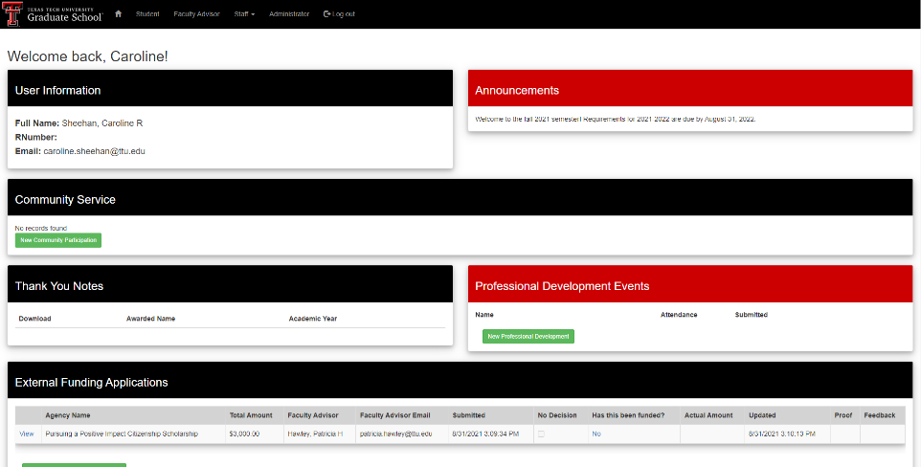
Award Tracker

Slide 6
Searching for Events
Go to www.depts.ttu.edu/gradschool
Select “Professional Development” tab

Slide 7
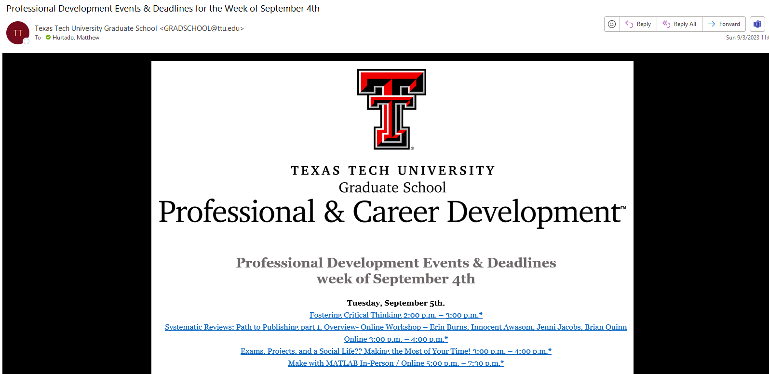
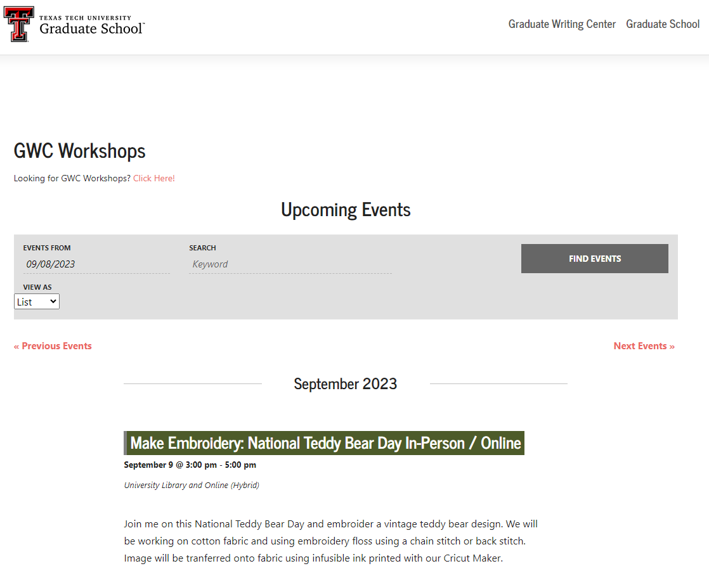
Searching for Events

Slide 8
Searching for External Funding
Go to www.depts.ttu.edu/gradschool
Select “Financial Support” tab

Slide 9
Searching for External Funding
Central coordination support for large grants i.e. Fulbright, NSF GRFP, USDA, NIH

Slide 10
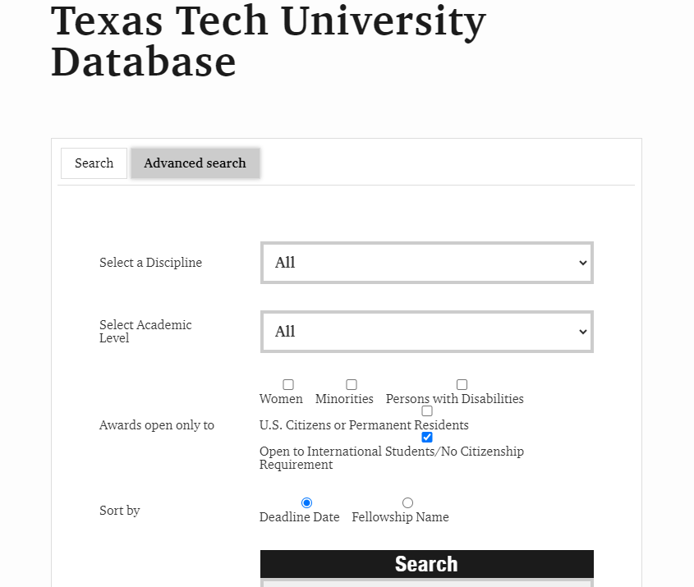
Searching for External Funding

Slide 11
Graduate School Notification
TTU requires the Graduate School to track all external fellowship and scholarship applications
From the “Funding your Education” tab under “External Fellowships & Grants” there is a “Submit & Follow-up” menu
You will be asked to login using your eRaider ID and password
Complete the requested information at least 1 week prior to fellowship/scholarship deadline
You will receive notification from Graduate School that it is ok for you to submit the application

Slide 12
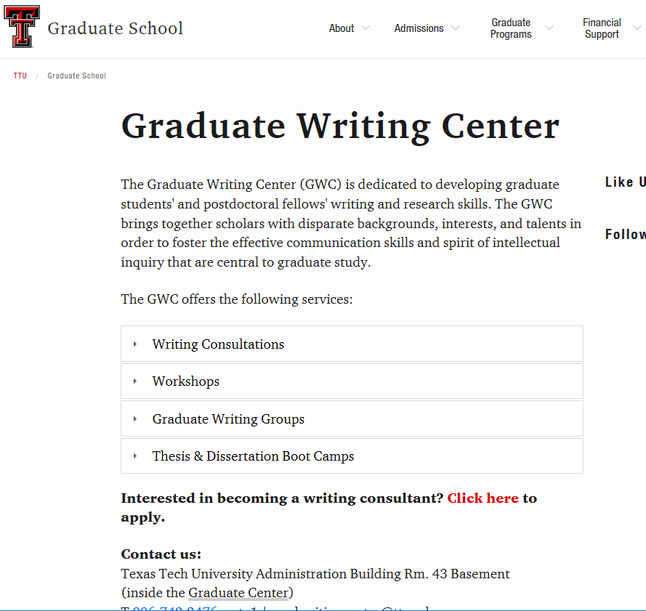
Graduate Writing Center
Director:
Jennifer Marciniak, PhD

Slide 13
Final Notes
Start early! Some academic majors are more difficult to find external funding opportunities so make sure and give yourself enough time to submit prior to our deadlines.
Yearly requirement submission dates are September 1, 2023 – August 31, 2024.
Funding is subject to cancellation if yearly requirements are not met
Questions: gradfellowships@ttu.edu

