Slide 1
Large Eddy Simulation with grid spacing of 12.5 m (upper panel) and 50 m (lower panel)

Slide 2
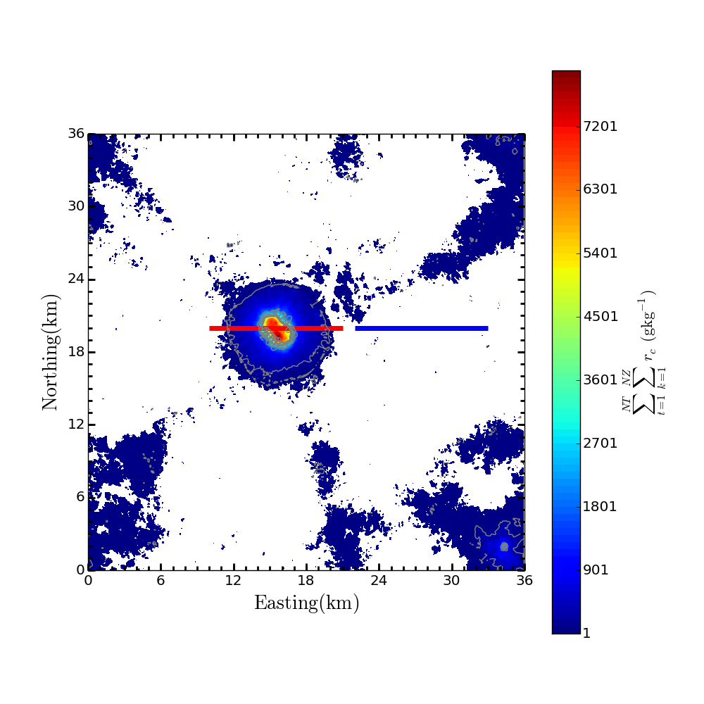
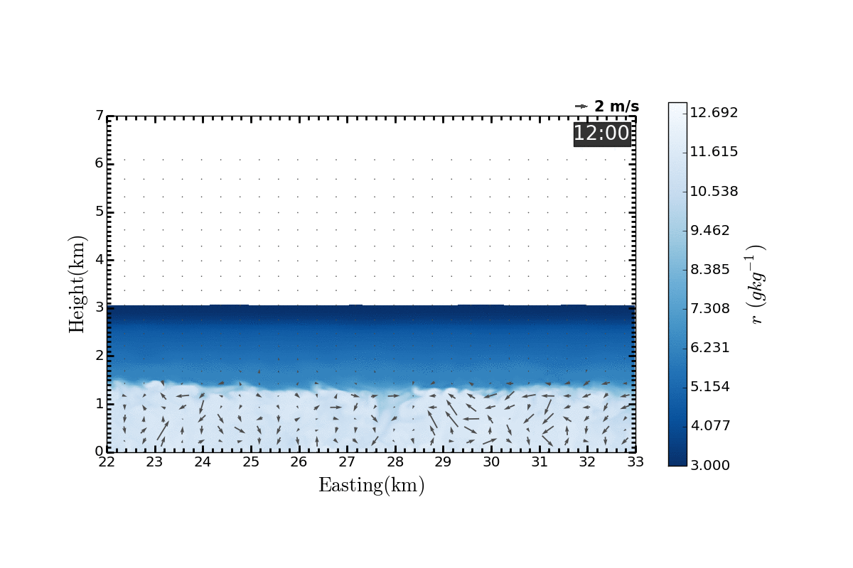
Distribution of cloud water (color shaded) and rain water (contour) integrated over the simulation hours between 12-18 local standard time
U-W wind field (vectors) and water vapor mixing ratio (color shaded), cloud water (white contour), rain water (green contour) across the red and blue lines

