Slide 1
Welcome
Fashion Frenzy
Family and Consumer Sciences Professional Development Conference
August 4, 2011

Slide 2
Fashion Frenzy
10(D)(i) The student is expected to analyze factors that impact consumer purchases of fashion and apparel accessories by describing social, cultural, and life-cycle influences on fashion preferences
Objective: The student assesses the perspectives, practices, and products of a culture that influence fashion preferences.

Slide 3
Impressions?

Slide 4
Impressions?

Slide 5
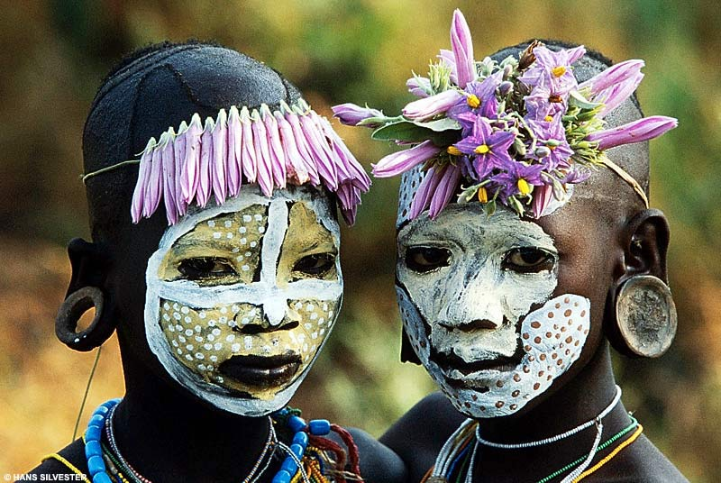
Impressions?

Slide 7
Product
Things of the culture…
What is made and/or used?
May be tangible or intangible
Located and organized in physical places
Perceptible through senses (sight, hearing, touch, smell, taste)

Slide 8
Perspective?
The thinking that guides persons/communities in the practices of the culture…(world view)
Perceptions-what is perceived, what is ignored?
Beliefs-what is held to be true/untrue?
Values-what is right/wrong, good/evil, normal/abnormal?
Attitudes-what is the frame of mind/outlook?

Slide 9
Practices
The doing
How/when is something used?
Who? What? Where? When? Why? How?
Actions and interactions that members of the culture carry out, individually or with others.
Behaviors reflecting customs/traditions.

Slide 10
Impressions?

Slide 12
Impressions?

Slide 14
Impressions?

Slide 15
Fashion Frenzy
10(A)(i) The student is expected to analyze the nature and scope of fashion by explaining the importance of fashion.
Objective: The student will discuss the significance of fashion capitals around the world

Slide 16
Fashion Capitals of the World
1. Milano (+3) – Not only overtakes New York but also Rome and Paris.
2. New York (-1) – Knocked out of Top Spot by Milano after a five-year run.
3. Paris (0) – No 1. in our hearts but No. 3 in the media.
4. Rome (-2) — The Eternal City still reigns strong.
5. London (0) – London remains the laggard of the Fashion Elite.

Slide 17
Fashion Capitals of the World
6. Los Angeles (0) – Holding its own at No. 6.
7. Hong Kong (+4) – Leaps over Sydney and Tokyo to seize the lead in Asia/Pacific.
8. Sao Paulo (+25) – A remarkable rise, now dominating the Latin-American scene.
9. Sydney (-2) – Solidly in the Top 10 while Melbourne sinks.
10. Las Vegas (-2) – Intense media spotlight ensures a top ranking.

Slide 18
Fashion Capitals of the World
11. Dubai (+1) – An unlimited budget continually exceeded.
12. Tokyo (-2) – Loses a bit of luster as it slips out of the Top 10.
13. Miami (+13) – Driven by its dominance in swimwear.
14. Barcelona (+11) – Takes the Iberian spotlight.
15. Shanghai (-2) — Now third in the China/Japan rivalry.

Slide 19
Fashion Capitals of the World
16. Mumbai (+6) – In neck-and-neck race for primacy on the Subcontinent.
17. New Delhi (+7) – Both Delhi and Mumbai break into Top 20.
18. Rio de Janeiro (+12) – Comes on strong but Sao Paulo is stronger.
19. Berlin (-10) – Hurt by weak showing in the ‘haute’ category.
20. Singapore (-6) – Fashion infrastructure strong, but hurt by the economy.

Slide 20
Fashion Capitals of the World
21. Madrid (-6) – Barcelona takes the Iberian crown.
22. Moscow (-6) – Remains strong as it drops out of the Top 20.
23. Santiago (-6) – Now third behind Sao Paulo and Rio in Latin America.
24. Buenos Aires (-4) – Strong in new interpretations of classic fashion.
25. Melbourne (-7) — Slips out of Top 20 as Sydney strives ahead.

Slide 21
Fashion Capitals of the World
26. Stockholm (-7) – Tops in Scandinavia with Copenhagen No. 2.
27. Bangkok (+7) – Breaks into the top tier of Asian Fashion.
28. Krakow (-1) – Hold an increasingly intriguing niche in Middle Europe.
29. Prague (-1) – Strengthening its position as a fashion capitol.
30. Mexico City (Not Listed) – First time on the list.
Others in the ranking in order: Dallas, Toronto, Montreal, Copenhagen, Amsterdam, Frankfurt
Johannesburg, Cape Town, Atlanta

Slide 22
Regional Fashion Capitals
Asia and Oceania: Hong Kong, Sydney, Tokyo, Shanghai, Singapore, Melbourne, Bangkok
Europe: Milano, Paris, Rome, London, Barcelona, Berlin, Madrid, Stockholm, (Copenhagen, Amsterdam, Frankfurt)
India: Mumbai, New Delhi

Slide 23
Regional Fashion Capitals
Latin America: Sao Paulo, Rio de Janeiro, Santiago, Buenos Aries, Mexico City
Middle and Eastern Europe: Moscow, Krakow, Prague
Middle East and Africa: Dubai, (Johannesburg, Cape Town)
North America: New York, LA, Las Vegas, Miami, (Dallas, Toronto, Montreal, Atlanta)

Slide 24
Fashion Frenzy
10(A)(v) The student is expected to analyze the nature and scope of fashion by summarizing the fashion process.
Objective: The student will create a glog using information about a fashion leader.

Slide 25
Types of Fashionistas
Fashion leaders –
Trendsetters; children, men, and women who push the fashion envelope; wear and adopt new styles readily; demand attention and get it; high profile individuals
Fashion followers –
Individuals who wear styles only after the styles have gained mass acceptance and are available in retail stores
Fashion laggers –
Individuals who accept and wear styles as the styles are on the downhill slide; very unsure of their own likes and dislikes
Copyright © Notice: The materials are copyrighted © and trademarked ™ as the property of The Curriculum Center for Family and Consumer Sciences, Texas Tech University.

Slide 26
Fashion Frenzy
10(A)(v) The student is expected to use knowledge of textile and apparel manufacturing systems by determining ethical practices within the textile and apparel industries.
Objective: The student will use available technology to create a presentation on an ethical dilemma in the fashion industry.

Slide 27
Ethical Issues in the Fashion Industry
Models’ Lifestyle
Working Conditions
Designer Fraud
Slaughtering Animals for Fur
Sustainability and Environment Issues
Fashion Industry
Distorted body and gender images
Sweatshops
Counterfeiting of branded products

