Slide 1
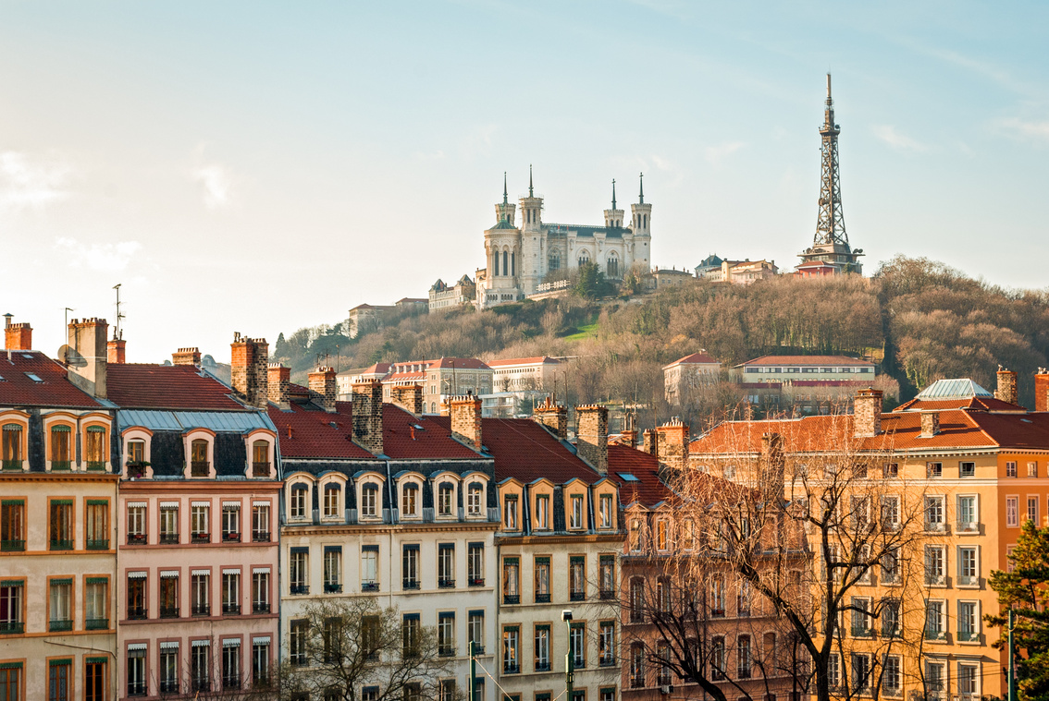

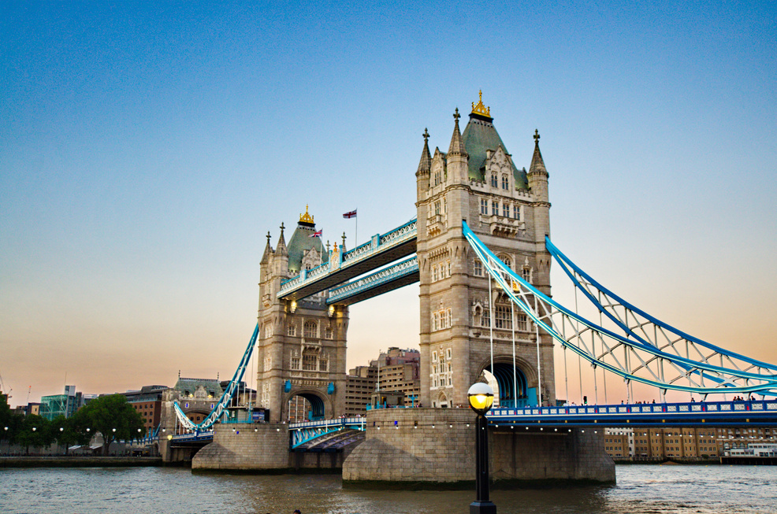
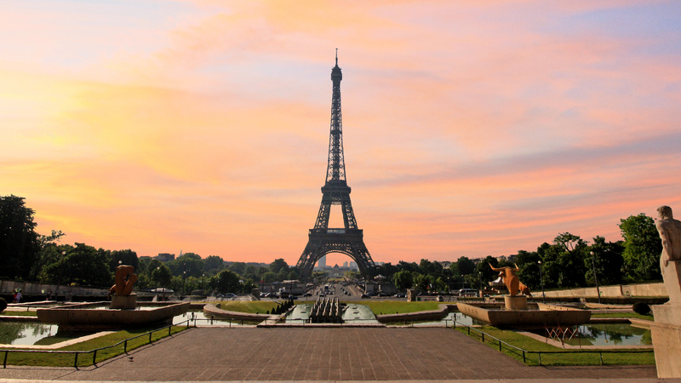

STUDY ABROAD—INTERIOR DESIGN IN FRANCE & LONDON
MAYMESTER
  Open to all ID Majors
  Open to ENVD Graduate Students
  Applications open on Oct. 1st
THURSDAY, MAY 14 – TUESDAY, MAY 19
In London and surrounding areas, with tours that could include:
  Firm visits to large firms such as Gensler, HKS, Zaha Hadid Architects, and more
  Historical architecture tours of sites such as Westminster Abbey, Buckingham Palace, Hampton Court Palace, Tower of London, St. Paul’s Cathedral, Windsor Castle
  Museum tours such as the Victoria & Albert Museum, The Design Museum, the Wallace Collection, the Tate Modern, and the British Museum
  Additional day trips to nearby towns
WEDNESDAY, MAY 21 – TUESDAY, MAY 26
In France, with tours that could include:
  Firm visits to firms such as Philippe Starck, Studio KO, high-end showrooms
  Museum tours such as the Lourve and Musee d’Orsay
  Historical Architecture tours of sites such as the Eiffel Tower, Palace of Versailles, Sainte-Chappelle, Notre-Dame Cathedral, and Champs-Elysees
  Additional day trips to nearby towns
MAY 13 - 27
Michelle Pearson, Ph.D.
Michelle.Pearson@ttu.edu
Interior Design Program Director
LEARN MORE

