Slide 1
Check-In Fall 2025
How to complete Check-In for Fall 2025
Important: Completing Check-In is critical to maintaining your F-1 visa status. Failure to do so may lead to termination & illegal status within the US.

Slide 2
You may only complete the check-in process when you are physically in the US and have secured a physical address in Lubbock! If your program is in Amarillo or El Paso, please report the physical address you have there as part of your check-in process.
NOTICE:

Slide 3
How to complete the Check-In Process:

Slide 4
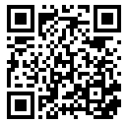
Step 1
Go to the new ISSS Student Portal Website
(Click the link or scan the QR code)

Slide 5
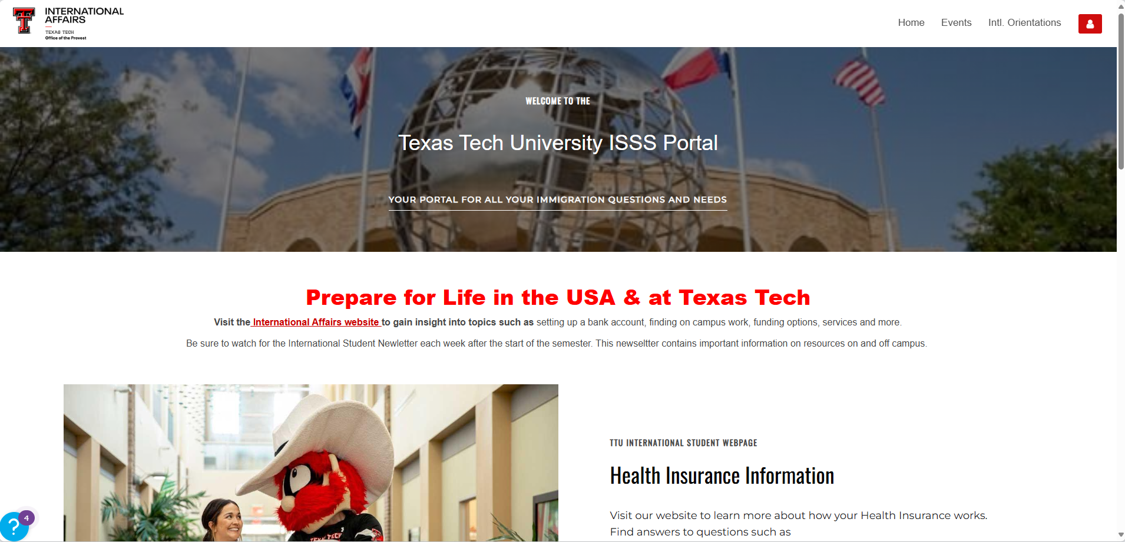
Step 2
Login using your TTU username and password

Slide 6
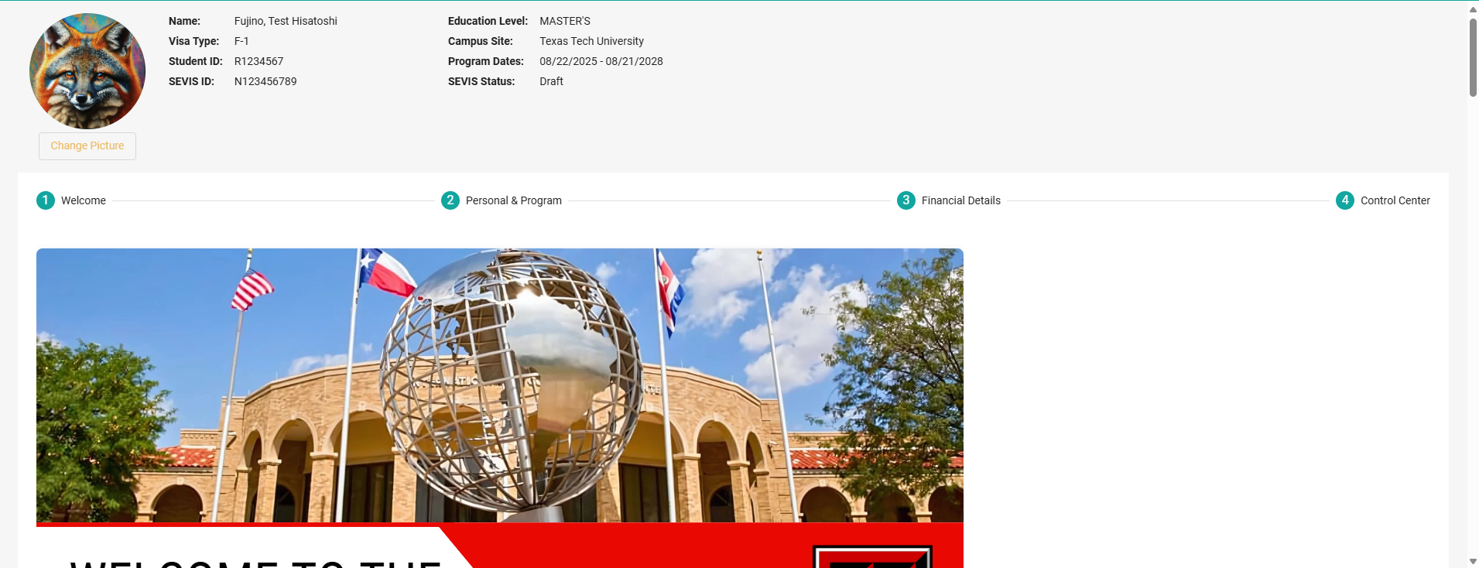
Step 3
Click the “Control Center” Tab

Slide 7
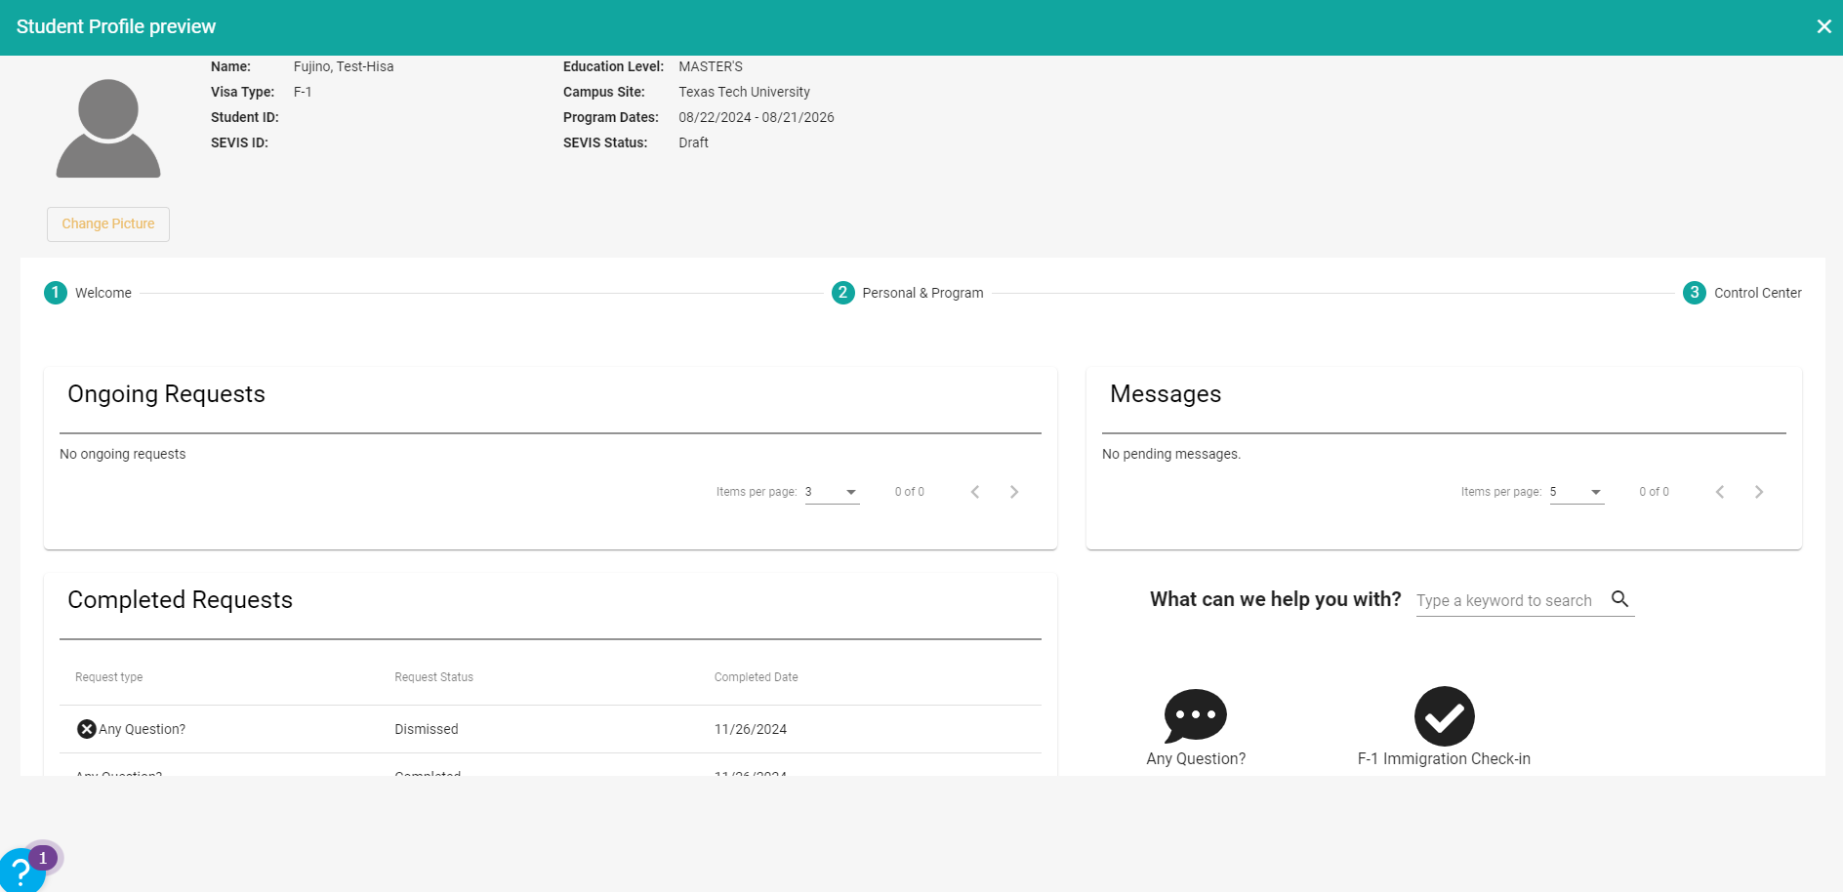
Step 4
Click the “F-1 Immigration Check-in” icon

Slide 8
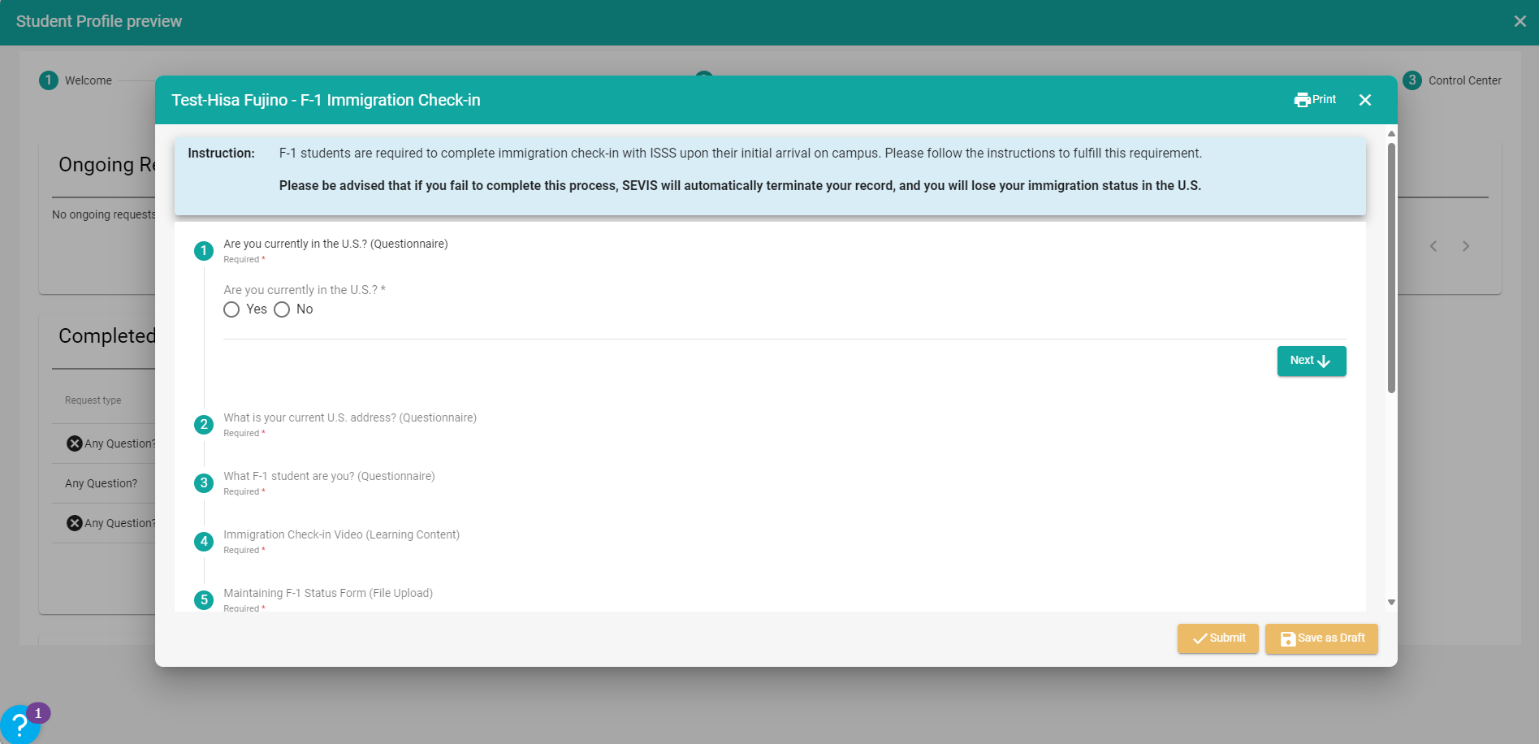
Step 5
Fill out all questions and upload all documents, then click submit.

Slide 9
Step 6
You will receive an email receipt that you have completed Check-In.
Your “Continued Attendance” I-20 will be available in your ISSS Student Portal within 3 business days.

Slide 10
Congrats!
You’ve completed the Check-In instructions!
If you have any questions, please contact your assigned International Student Advisor here.
Welcome to Lubbock, Texas, and welcome to Texas Tech University. We’re so glad to have you here!

Slide 11
FAQs
How do I login to the new ISSS Student Portal?
Login to the new ISSS Student Portal here using your TTU username and password. This is the same information you would use to login to the TTU eRaider account. If you have trouble logging in, please contact our offices oia.isss@ttu.edu

Slide 12
FAQs
What should I use as my address?
Please use the address where you are currently residing for your TTU program. It should include:
Street Name, Apartment Number, City, State, Zip Code
If you are staying in a student dorm, please include the room number and bedspace (A, B, C or D)
If your address is temporary, please remember to provide your new, permanent address to your ISSS advisor when you’ve relocated. This is required by F-1 visa regulations.

Slide 13
FAQs
What should I use as my address?
OFF-CAMPUS EXAMPLE: For a student living off-campus in an apartment, the address may look like: Heritage Apartments 3114 4th St Apartment #102 Lubbock, TX 79415
You may use Google Maps to help determine your correct address.

Slide 14
FAQs
What should I use as my address?
ON-CAMPUS EXAMPLE: For a student living on-campus in the Murdough dorms in room 34, bedspace A, the address will be: 34A Murdough - TTU Lubbock, TX 79406 You can also use this TTU Student Housing generator to learn what your address is.

Slide 15
FAQs
What is an I-94 and how do I get it?
An I-94 is an arrival/departure record issued to those who are admitted to the US. An I-94 record can be retrieved on the Department of Homeland Security’s website:
Get Most Recent I-94 here

Slide 16
FAQs
I can’t upload my documents for check-in.
The ISSS Student Portal system will not allow uploads with file sizes larger than 1.5 MB. If you can't upload your file due to file size, you can compress it using online compression generators, such as this one. Please make sure you upload files in your ISSS Student Portal that are 1.5 MB or smaller.

Slide 17
FAQs
How do I maintain my F-1 status?
Everything you need to know about maintaining your F-1 visa status can be found here:
How to Maintain My F-1 Visa Status
If you have any specific inquiries, you can always reach out to your international advisor for help.

