Slide 1


Excel Data Analysis
https://www.depts.ttu.edu/itts/training/shortcourses/handouts.php OR
Google "TTU Short Course", click the link and then "Handouts"
Benjamin Chamness Accessibility & Data Analyst
ITTS Technology Support, IT Team Web

Slide 2
Material Notes
Information here may apply to other spreadsheet software tools (LibreOffice, OpenOffice, Google Sheets, etc.).
  These other tools are not approved for use with TTU data.
All sample data here is either fully anonymized and random OR publicly available.
  Any connection to real TTU data / events is not intentional.
  I do not intend to make any statements with the sample data presented.
I don’t know your data – so my examples may not be 100% accurate with your processing.
I may touch on concepts in statistics, but this course isn’t meant to teach you statistics.

Slide 3
Outline
Our Test Data
Pivot Tables and Charts
Analysis ToolPak

Slide 4
Our Test Data

Slide 5
Outline
Our Test Data
Pivot Tables and Charts
Analysis ToolPak

Slide 6
Our Test Data – Scoop! There It Is!
Scoop! There It Is! is an ice cream truck serving cool treats to people all over the city.
We have 1 year of sales data, which includes:
  How much we posted on social media
  Where the truck was located
  What the weather was like (high temperature and if it was raining)
  How many people passed the truck
  How many people made a purchase
  The total sales from the day
Not every day is tracked, because even ice cream trucks need a break!

Slide 7
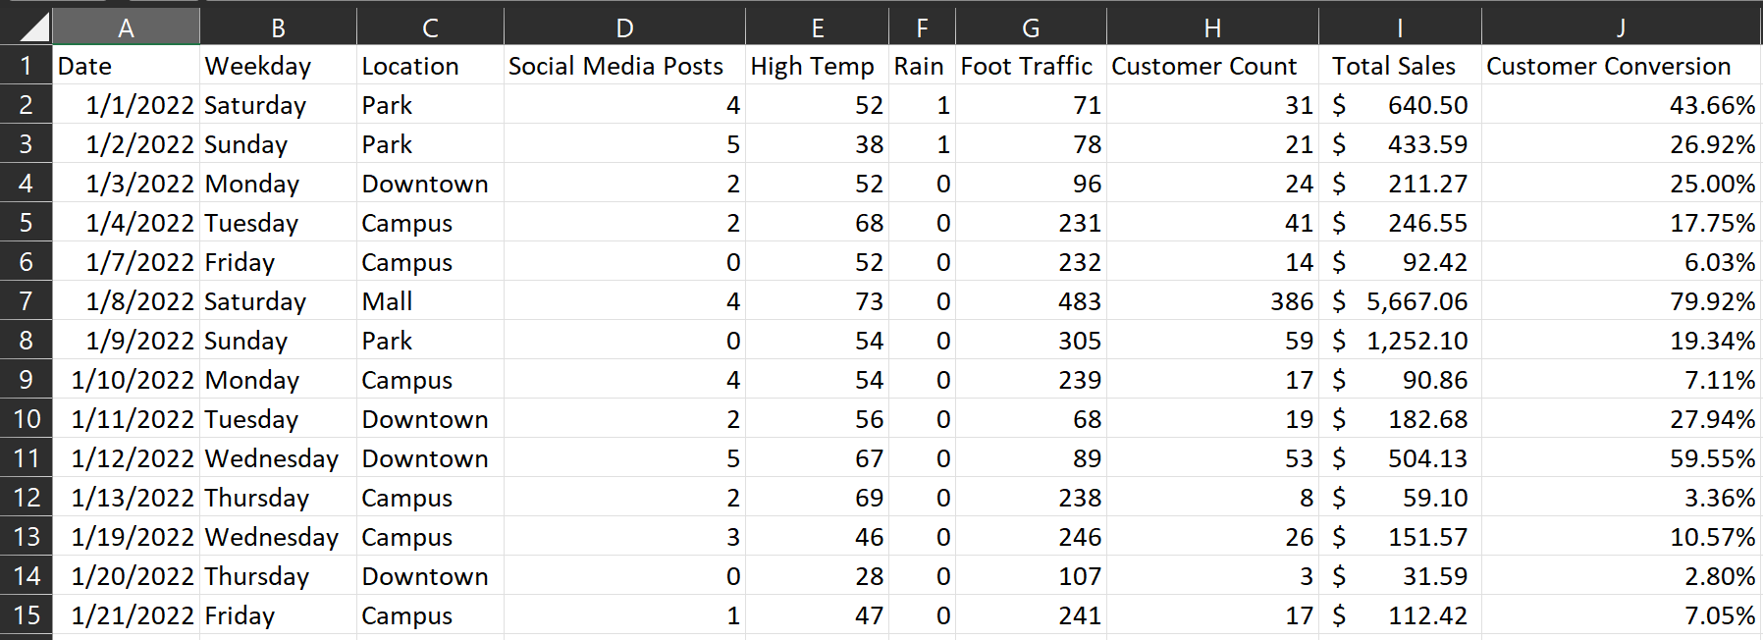
Our Test Data – Scoop! There It Is!

Slide 8
About Our Data
Categories:
Things that describe our data. These can help “Group” our data for insights.
Date
Weekday
Location
Social Media Posts
High Temp
Rain
Foot Traffic
Facts:
The values we care about for our
business needs. These values are often summarized.
Foot Traffic
Customer Count
Total Sales
Customer Conversion (*careful
when summarizing percentages)

Slide 9
Pivot Tables and Charts

Slide 10
Outline
Our Test Data
Pivot Tables and Charts
Analysis ToolPak

Slide 11
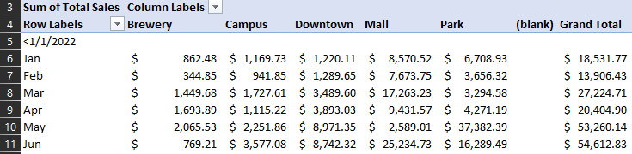
Pivot Tables and Charts
Pivot Tables are an easy way to build reports on your data in Excel
Allow you to group your data by category (date, location, temperature, college, major, residence hall, etc)
Allows you to summarize the data by some calculation (total sales, average traffic, count of students, etc.)

Slide 12
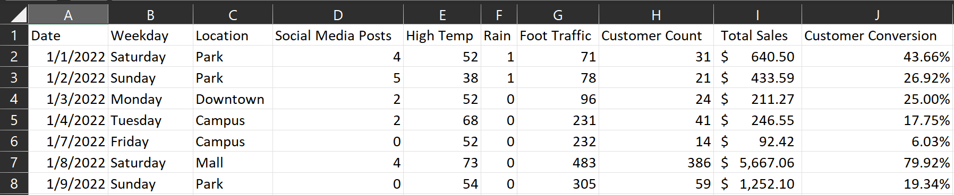
What reports may be relevant with our data?
Total sales and customers by date and location
Average sales and customers by day of week and location
Average sales by temperature

Slide 13
Pivot Table Creation
Select all your data (ideally by selecting the column letters)
Go to the “Insert” menu and select “PivotTable”
Confirm that the “Table/Range” field is the correct value (for our test data, it should be “SampleData!$A:$J”)
State where you want the PivotTable to be created. The default of “New Worksheet” is fine for our purposes, but you could also tell Excel to crate the PivotTable in a specific cell.

Slide 14
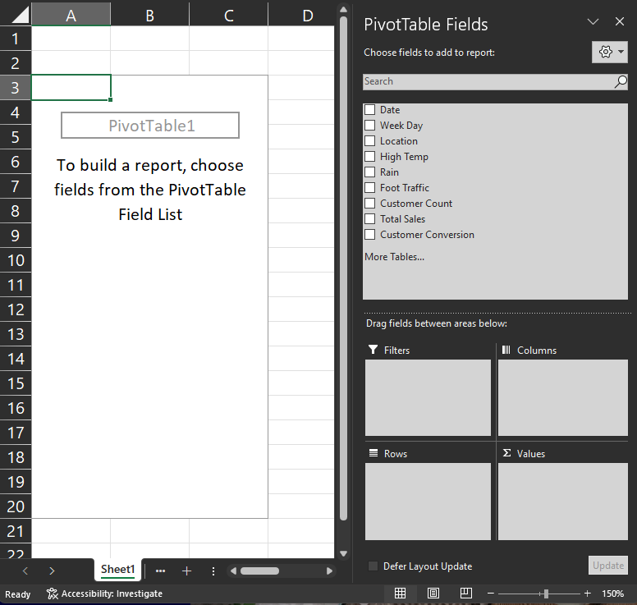
PivotTable Parts
Field List shows all of your available data fields.
Filters will filter your data by a category.
Rows and Columns break data out by categories.
Values will hold your data summaries.

Slide 15
About Our Data
Categories:
  Date
  Weekday
  Location
  Social Media Posts
  High Temp
  Rain
  Foot Traffic
Use these in “Rows”, “Columns”, and “Filters”
Facts:
  Foot Traffic
  Customer Count
  Total Sales
  Customer Conversion (*careful when summarizing percentages)
Use these in “Values”

Slide 16
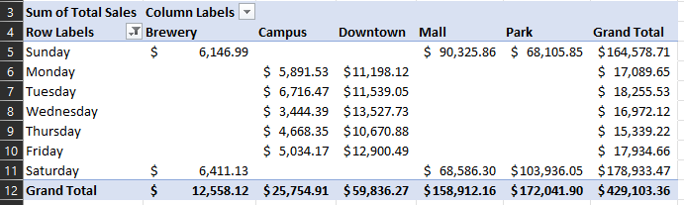
Rows and Columns
Will identify distinct category values in your dataset
Will separate your data points by the categories
Will NOT fill in any gaps (days of the week not represented)

Slide 17
Values
Perform some summary (count, average, sum, etc) on a "fact" in your dataset
Will NOT fill in any gaps (data intersections not represented in your data)
Do not summarize on percentage data

Slide 18
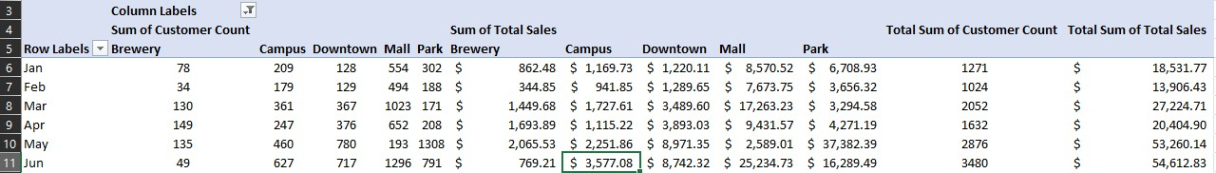
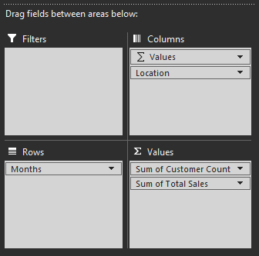
Report 1: Total sales and customers by time and location
Drag “Date” to rows, which automatically summarizes by month
Drag Location to columns
Drag Sales and Customers to values
Change Sales to report in dollar values

Slide 19
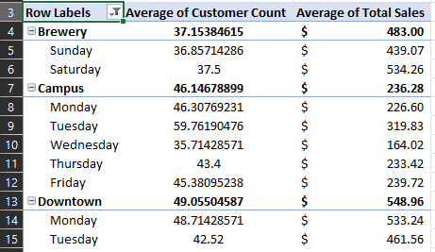
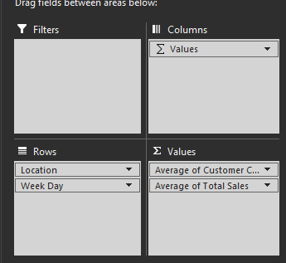
Report 2: Average sales and customers by day of week and location

Slide 20
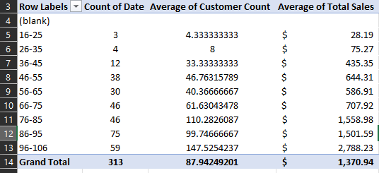
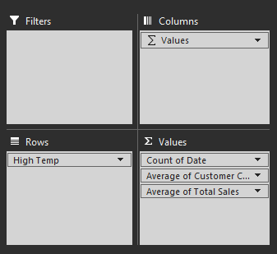
Report 3: Average sales by temperature

Slide 21
Charts
Bar charts show counts or totals grouped by a category
Pie charts show how distinct categories make up parts of a whole
Line charts show changes in value over time
As with other charts in Excel, you have all of the same tools to adjust labels, titles, colors, and other chart elements

Slide 22
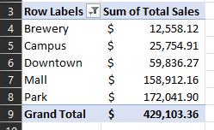
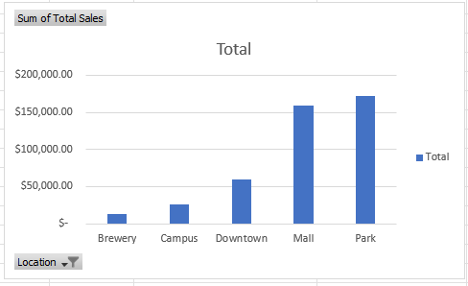
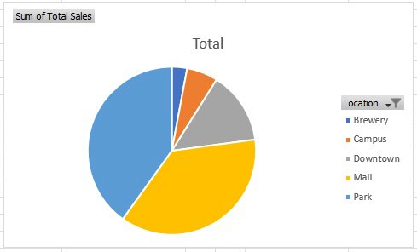
Bar and Pie Chart Examples

Slide 23
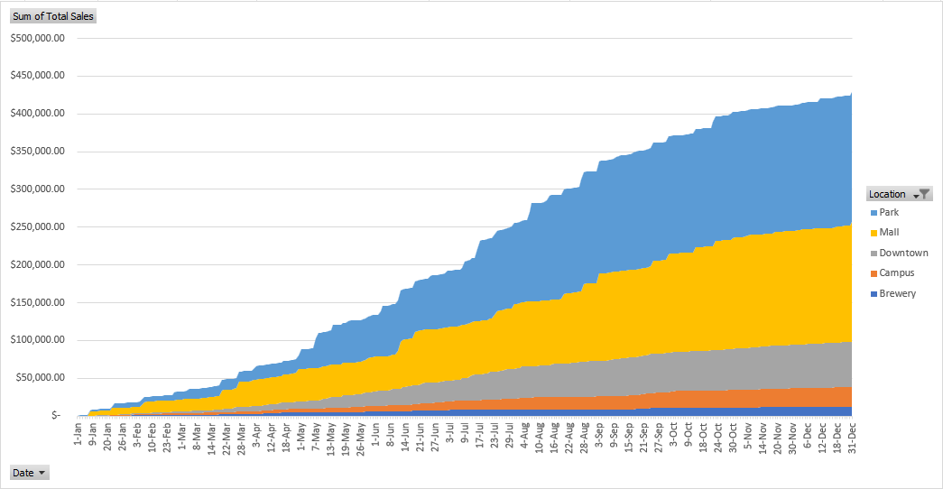
Stacked Area Chart Example
Set "Sum of Total Sales" to be a "Running Total In > Date"
Notice date gap: Jan 9 - 20
  Solution: Build a list of dates and use GetPivotData to fetch values

Slide 24
Analysis ToolPak

Slide 25
Outline
Our Test Data
Pivot Tables and Charts
Analysis ToolPak

Slide 26
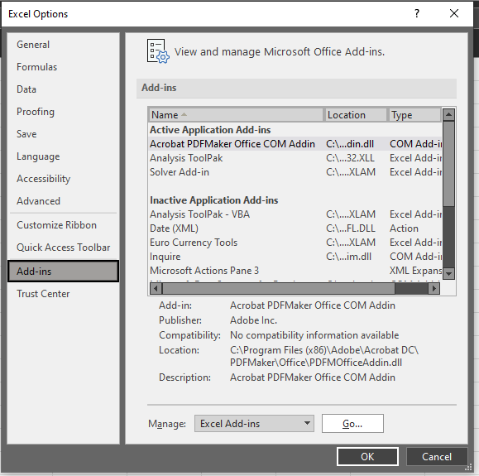
To Enable:
Click on "File" in the top left and then "Options" towards the bottom.
In the "Excel Options" window that opens, click on "Add-ins" on the left, and then click the button that says "Go…"
Check the box next to "Analysis ToolPak" and then click "OK".
When enabled, it should be in the "Data" ribbon menu.

Slide 27
Analysis Limitations: Text
String data is hard to analyze
Binary strings (yes/no, true/false) can be mapped to 0 and 1
Categories with some defined order can sometimes be mapped to integers
  Freshman, Sophomore, Junior, Senior
  Strongly Agree, Agree, Disagree, Strongly Disagree
Our “Rain” column is a binary yes/no, so it is coded as 1s and 0s
Weekday and Location can’t be mapped to numbers as easily

Slide 28
Correlation:
Helps describe a relationship between variables in your dataset.
A positive correlation means two variables will change in the same direction (increase/decrease together).
A negative correlation means two variables will change in opposite directions (increase in one, decrease in the other).
Values close to +/-1 show a strong correlation, values close to 0 show weak / no correlation
Correlation is not causation: the relationship does not mean that one change causes the other.

Slide 29
Correlation
Click the "Data Analysis" tool in the "Data" menu.
Select "Correlation"
Select your data for the "Input Range" (entering in column letters), check the "Labels in First Row" box, and click "OK"
 | Social Media Posts | High Temp | Rain | Foot Traffic | Customer Count | Total Sales
Social Media Posts | 1.00
High Temp | -0.07 | 1.00
Rain | 0.01 | -0.10 | 1.00
Foot Traffic | 0.02 | 0.07 | -0.40 | 1.00
Customer Count | 0.25 | 0.35 | -0.25 | 0.73 | 1.00
Total Sales | 0.24 | 0.29 | -0.17 | 0.60 | 0.91 | 1.00
Green cells are our high(er) correlated values.
Blue cells may be moderately correlated.

Slide 30
Regression
Attempts to create a function that can predict a given value.
In our case, given known values for temperature, rain, traffic, etc – how can we predict our daily sales?
Values:
  R Square: How well the model fits the given data, ideally above 0.95.
  Coefficient: This value will be multiplied by your variable to produce the predicted output.
  P-Value: A p-value less than 0.05 means the variable is a likely predictor of your output.

Slide 31
Regression
Click the "Data Analysis" tool in the "Data" menu.
Select "Regression"
Select the value you want to predict as the "Input Y Range"
Select the values that will influence this output as the "Input X Range"
Check the "Labels" box and the "Confidence Interval" box, then "OK"
Note: In items 3 and 4, you will need to specifically select the cells with data (H1:H314), not just the full column (H:H)

Slide 32
Regression (R Square: 0.83)
 | Coefficients | P-value | Note
Intercept | 335.88 | 0.32 | Ignore: High P-Value
Social Media Posts | -23.07 | 0.55 | Ignore: High P-Value
High Temp | -7.08 | 0.04
Rain | 152.38 | 0.40 | Ignore: High P-Value
Foot Traffic | -2.55 | 0.00
Customer Count | 23.65 | 6.09E-75
Theoretically, we can predict sales with this formula:
dailySales = $-7.08 * highTemp + $152.38 * rain + $-7.08 * footTraffic +
$23.65 * customerCount
This fails to consider the text category of "Location", which was a large contributor of sales.

Slide 33
Descriptive Statistics
Allows you to see some various values that describe a given variable.
Statistics:
  Mean – average
  Median – "middle" number when sorted low to high
  Standard Deviation – how much the value can vary
  Skewness – is the distribution of your data shifted to one side

Slide 34
Skewness
Skewness = 0
Value Frequency
Skewness > 0
Skewness < 0
Daily Sales

Slide 35
Descriptive Statistics
Click the "Data Analysis" tool in the "Data" menu.
Select "Descriptive Statistics"
Select your data for the "Input Range" (entering in the column letters)
Check the "Labels in First Row" box and the "Summary Statistics" box, then "OK"

Slide 36
Descriptive Statistics
Total Sales
Mean | 1370.937
Standard Error | 139.6033
Median | 399.0955
Mode
Standard Deviation | 2469.834
Sample Variance | 6100081
Kurtosis | 7.653245
Skewness | 2.805633
Range | 12895.57
Minimum | 0
Maximum | 12895.57
Sum | 429103.4
Count | 313
Average sales is $1371, but median is $399.
  Lots of small sale days, a few REALLY large sale days
Standard Deviation is $2469, so the daily sale value varies quite a bit.
Skewness is fairly large

Slide 37
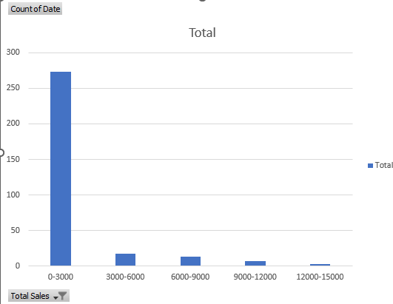
Actual Data Distribution
Heavily skewed towards smaller daily sales
Positive Skewness

Slide 38
Questions? Answers? Favorite PivotTable Uses?

