Slide 1


Excel: Tips & Tricks
Handout

Slide 2
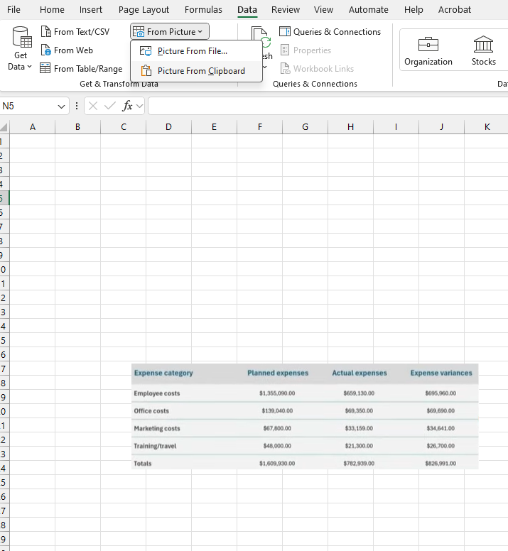
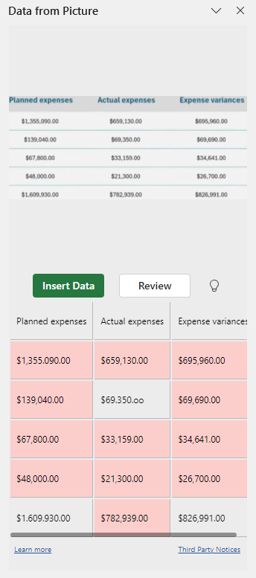
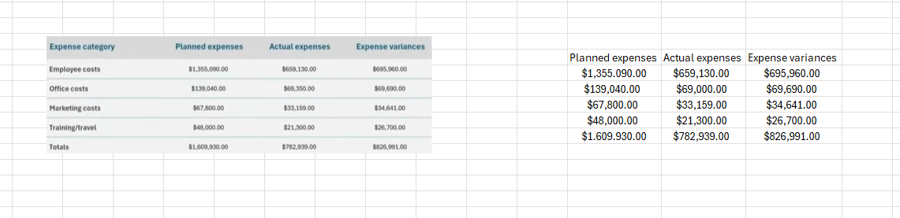
Insert Data from a Screenshot
Screenshot Data:
Windows Button + Shift + S
2) Insert Clipboard picture into Excel Spreadsheet:
Data Tab → From Picture → Picture from Clipboard
3) Insert Data

Slide 3
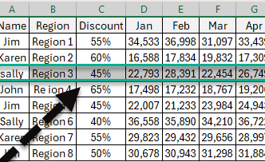
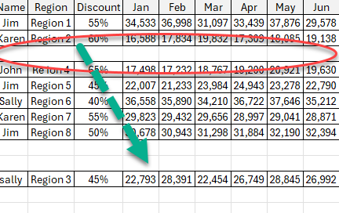
Moving Data/Text from a Row or Column
1) Select the data that you want to move
2) Click on the green border, then drag to new location

Slide 4
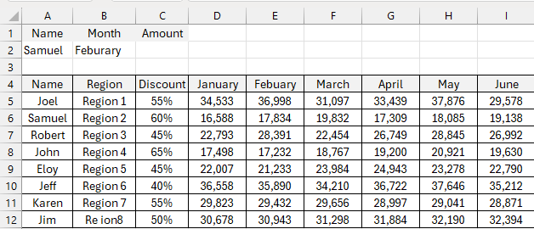
XLOOKUP()
Look up value
XLOOKUP Formula:
=XLOOKUP(look up value, look up array, return array)
Enter formula in cell C2
=xlookup(A2,A5:A12,E5:E12)
Amount Returned: 17,834
Look up array
Return array

Slide 5
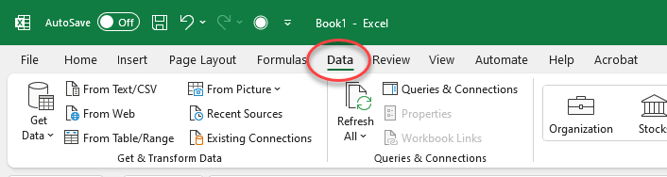
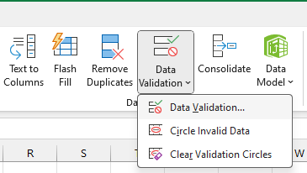
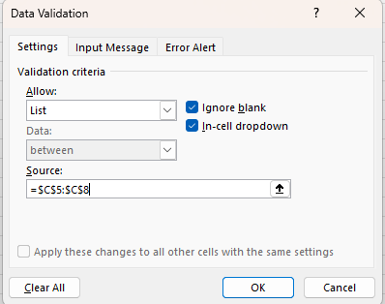
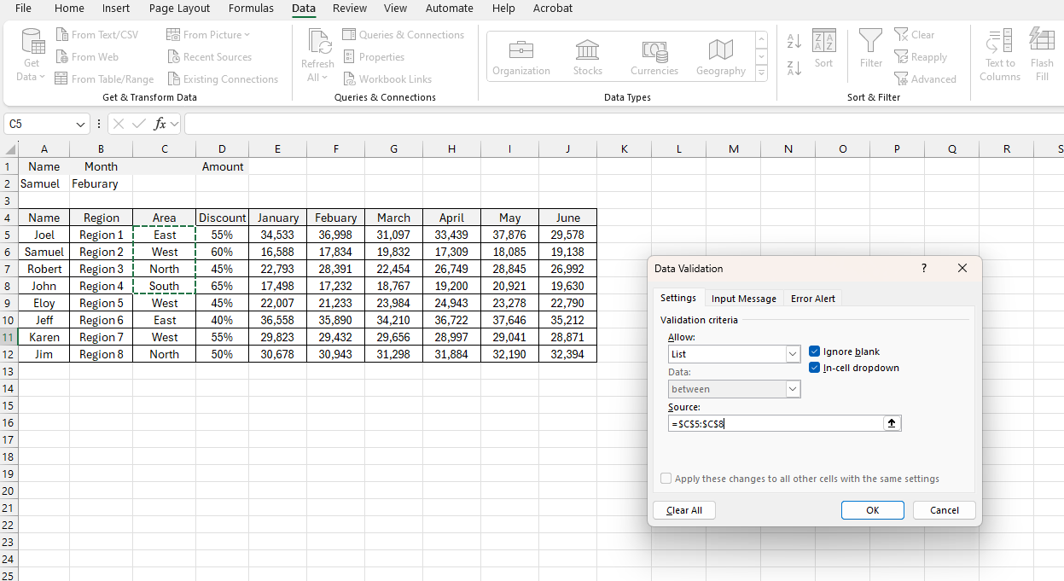
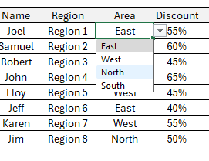
Drop-Down List
1) Click on the Data Tab
2) Click Data Validation → Data Validation
3) Allow: Select Lists
4) Source: Implement your given criteria (select cell range)
5) Select ok
Source: Is the information that you want to be in your drop-down list
Showing drop-down menu

Slide 6
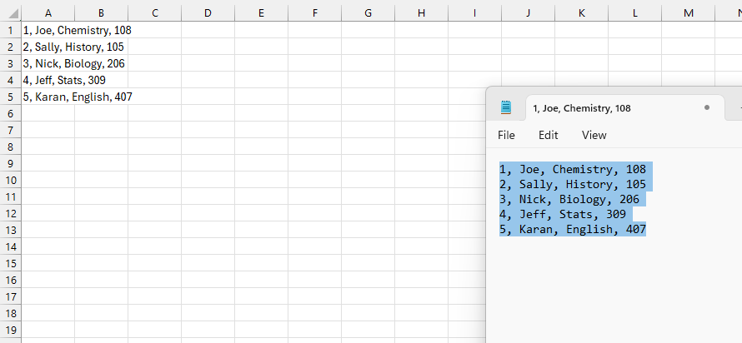
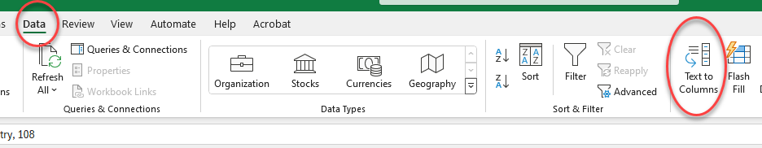
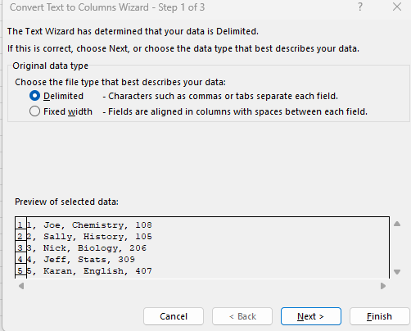
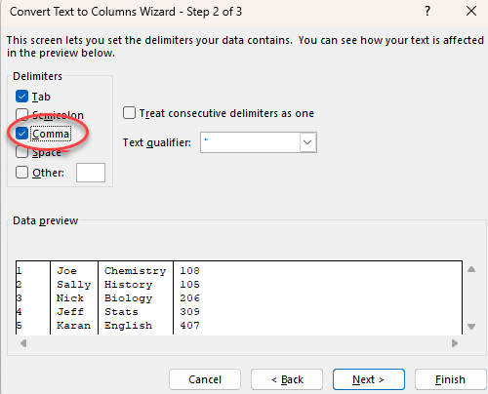
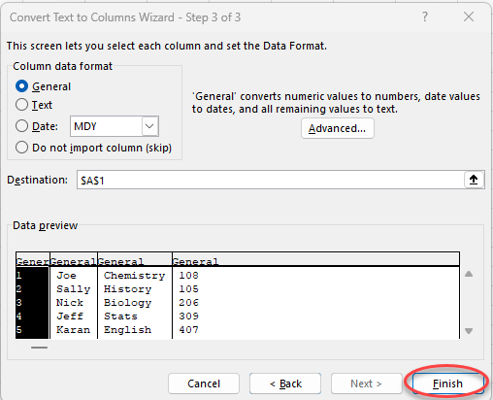
Text to Columns
Highlight text that will be converted into columns
Paste into Excel document → Highlight cell range A1:A5
Click the Data tab → Text to Column
Select the criteria, which best fits the data (ex: the data has commons, therefore “delimited” is the best option → Next
5) Select “Comma” in the delimiters selection → Next → Finish

Slide 7
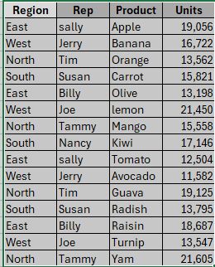
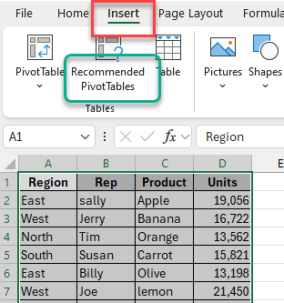
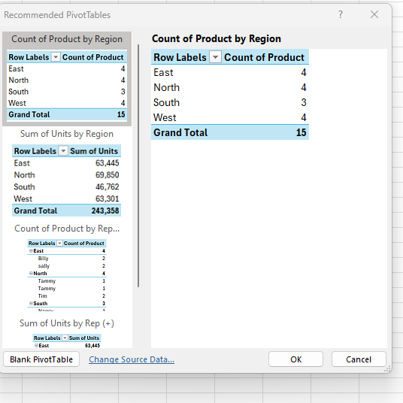
Recommended Pivot Table
Select the Data
Click on Insert → Recommended Pivot Tables
Layout Selection

Slide 8
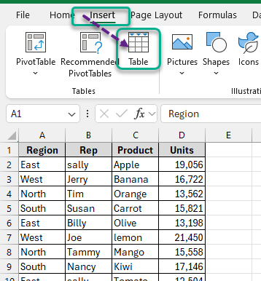
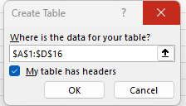
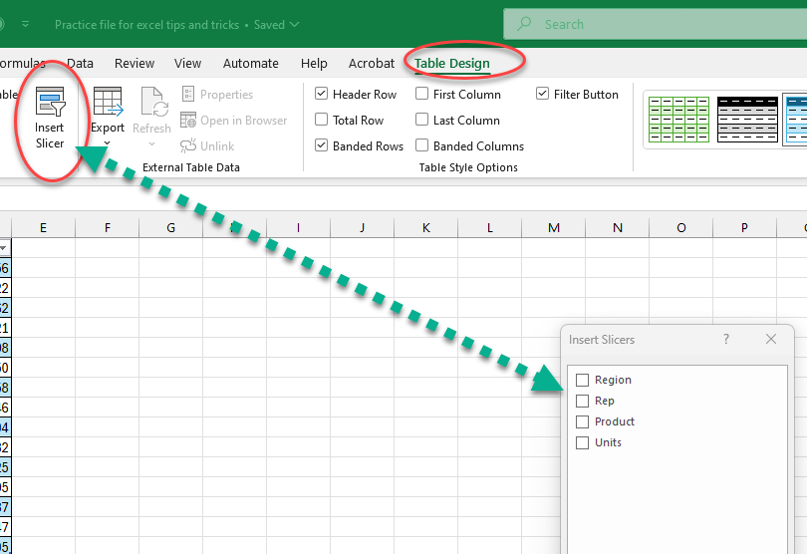
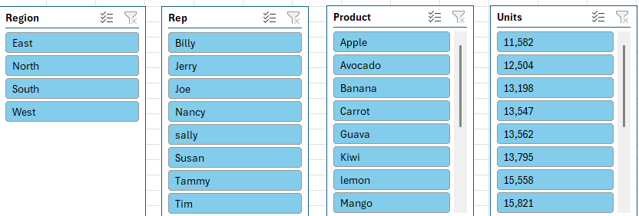
Slicers
1) Select Data
2) Insert → Table → OK
Make sure the table has headers
3) Click Table Design → Insert Slicer
4) Select Categories
Select Slicer Categories

Slide 9
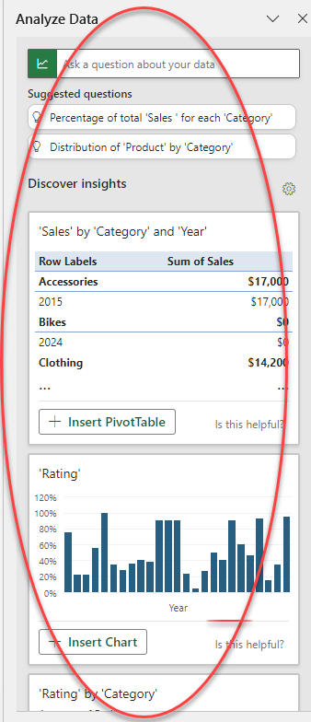
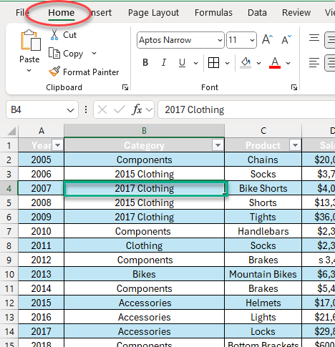
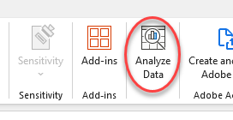
Analyze Data
Home Tab → Click on table
Click on Analyze Data

Slide 10
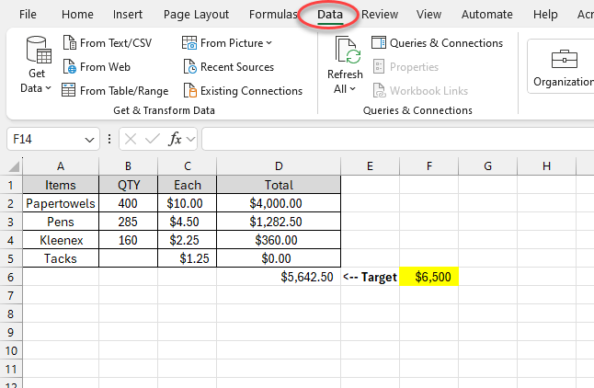
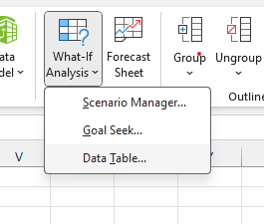
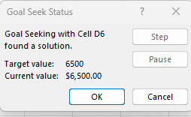
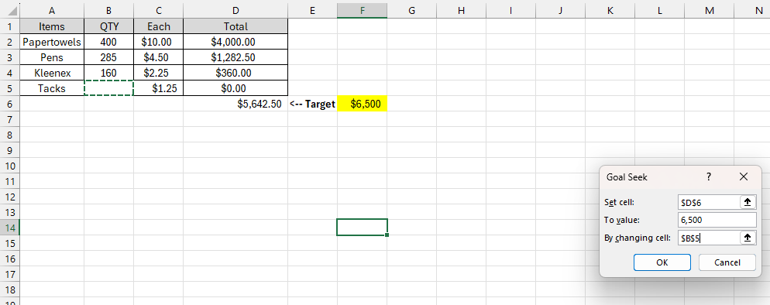
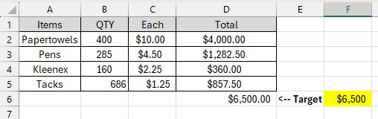
Goal Seek
Click on the Data Tab
Click on the “What-If-Analysis” → Goal Seek
Goal seek info:
Set Cell: The current($5,642.50) total value
To Value: Target ($6,500) Currency
By Changing Cell: B5, the number that is being calculated

Slide 11
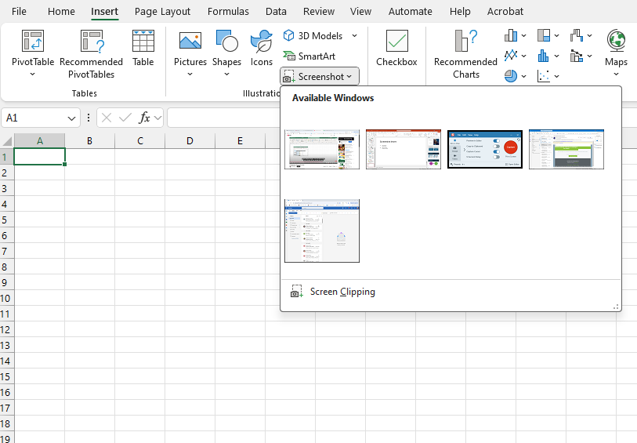
Screenshot Insert
Insert Tab → Screenshot
Select desired windows screen

Slide 12
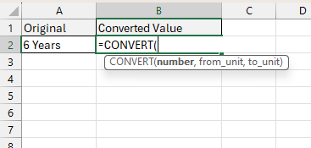
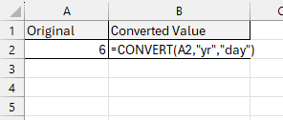
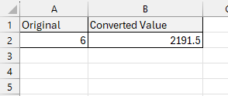
Measurement Conversion “CONVERT()”
Formula: Convert(original value, unit of original value, new unit of measure)
Convert(A2, yr, day)
“A2”

Slide 13
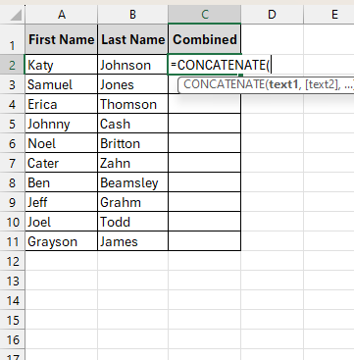
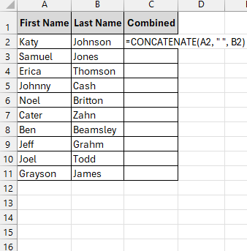
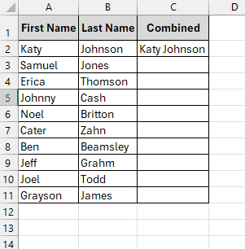
Concatenate Function
Formula:
=Concatenate(text1, text2)
For a SPACE in-between use:
=concatenate(text1, “ “, text2)

Slide 14
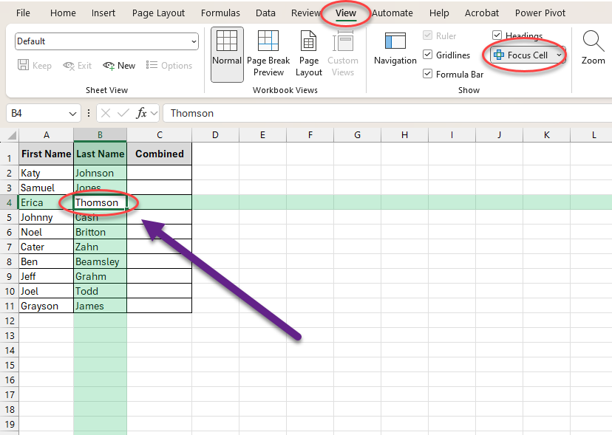
Focus Cell
Click View Tab
Click Focus Cell
Focused on B4

Slide 15
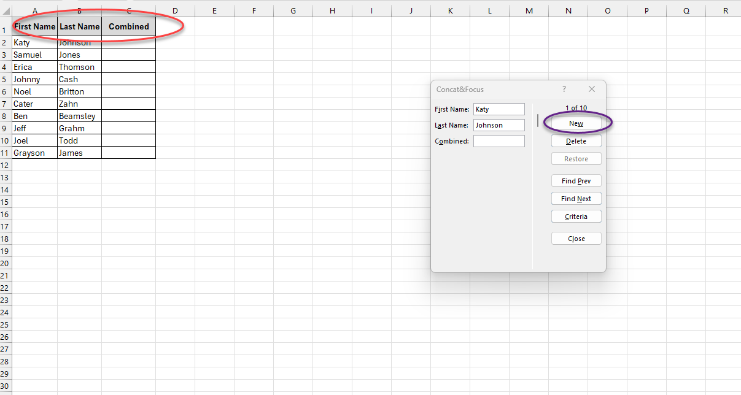
Alt + D + O (Press Keys One at a Time)
Make sure your table has headers
Click anywhere in the given table
Press Alt → D → O, one at a time
Select “New”
Enter in data
Headers
Create New Data

Slide 16
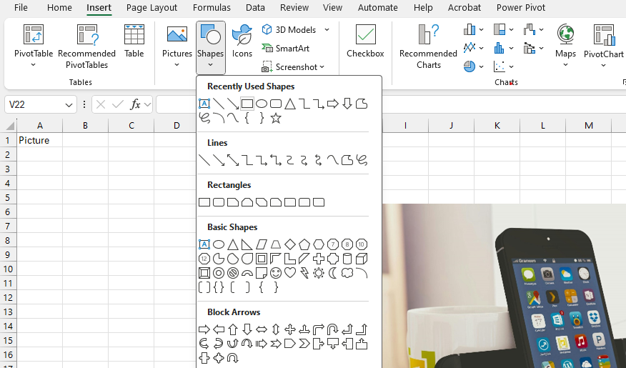
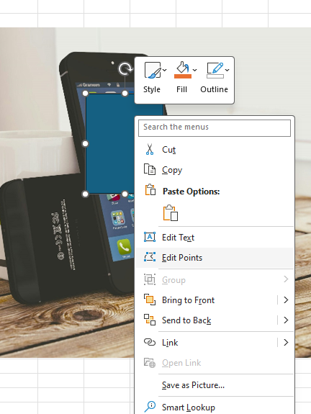

Custom Shape with Picture
Click Insert Tab → Shapes
Select shape of choice
Insert selected shape into the excel document
Right click on the shape → Select edit points
Right click on shape → fill → picture

