Slide 1

Intro to Excel
ShortCourse Handout

Slide 2

Infringement
Copyright 2022, Texas Tech University. ALL RIGHTS RESERVED. Members of Texas Tech University or Texas Tech Health Sciences Center may print and use this material for their personal use only. No part of this material may be reproduced in any form without written permission from the author.

Slide 3
Introduction
Excel is a spreadsheet program in the Microsoft Office system. You can use Excel to create and format workbooks (a collection of spreadsheets) in order to analyze data and make more informed business decisions. You can use Excel to track data, build models for analyzing data, write formulas to perform calculations on that data, pivot the data in numerous ways (using PivotTable or PowerPivot), and present data in a variety of professional looking charts. In this ShortCourse, you will become familiar with the BASIC fundamentals of Excel.

Slide 4
Course Objectives
After completing this ShortCourse, you should be able to:
Recognize the parts of the Excel workspace;
Create and save a workbook;
Work with editing tools;
Resize, insert, and remove columns and rows;
Use Auto Fill features to fill data series;
Insert, delete, move, and rename worksheets;
Preview and print a workbook
Enter Data & work with formulas

Slide 5
Creating a Document

Slide 6
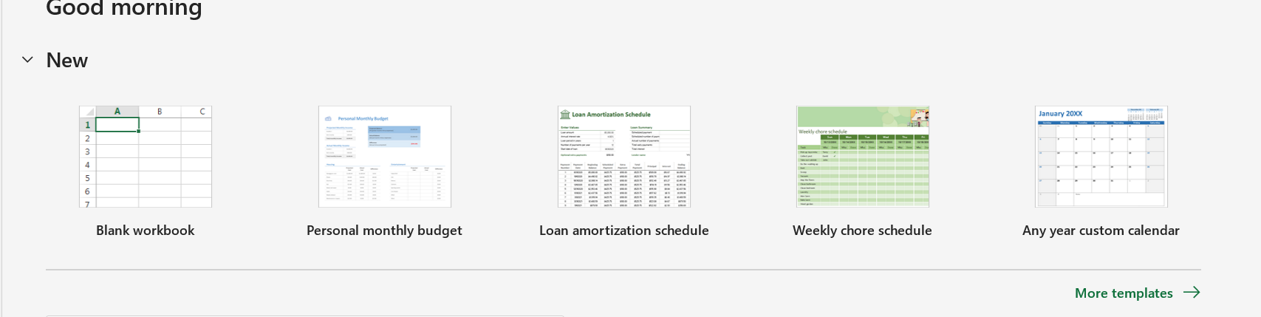
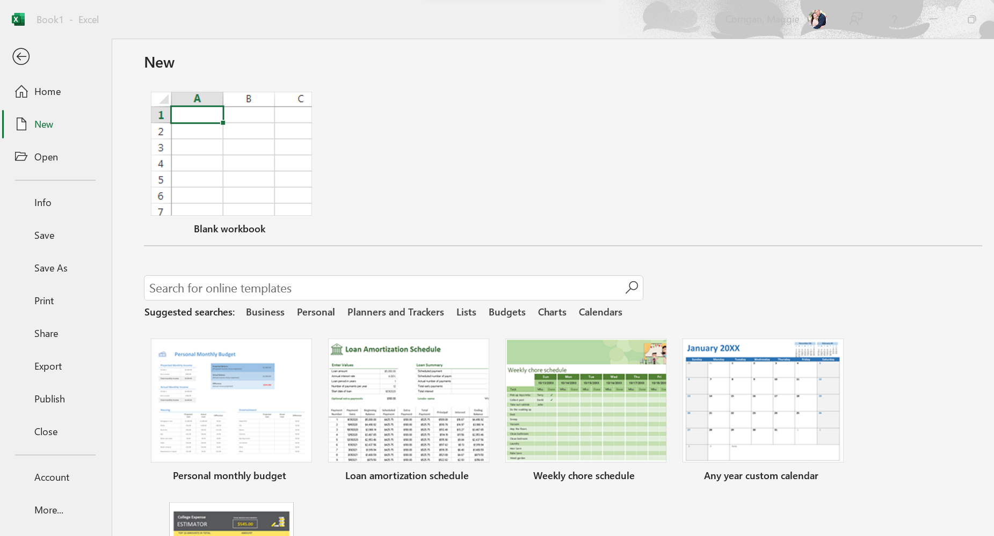
Creating a New Workbook
On the File tab, New, click the Blank Workbook.
Click on more templates, to base a new Workbook on a template.
Search for a template.

Slide 7
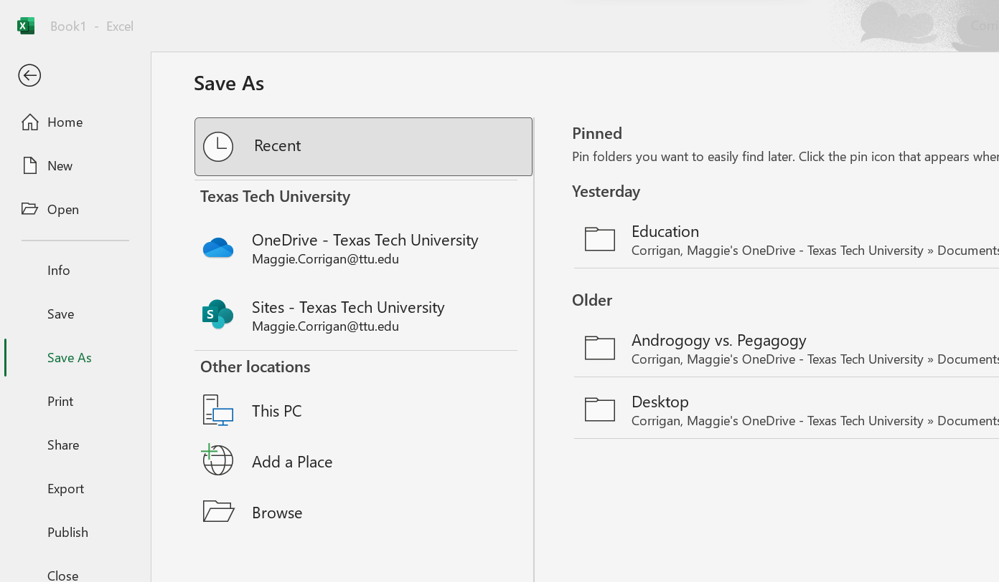
Saving a Workbook
1. From the File tab, click Save As.
2. Select a place to save your file.
3. In the File name box, enter a name for your workbook.
4. Click Save to finish.
5. Click the left arrow to go back to your file.

Slide 8
Definitions
Columns are vertical group of cells denoted with an alphabetical header at the top, running left to right (A, B, etc.).
Rows are horizontal group of cells denoted with numerical headers, running from top to bottom (1, 2, etc.).
Cells are intersections of rows & columns.
Cell address (aka Cell Reference) identifies the location of the cell in the spreadsheet. A cell address is a combination of column letter and row number of a cell, such as C4 or D8. Note: When identifying a cell by its address, the column letter is always listed first followed by the row number.
Cell Range is a group of cells, such as D2:D4
Formula bar is the area of the window where text and formulas can be edited and entered.
Worksheet is a spreadsheet for text, numbers, formulas – it is the basic work area in Excel.
Workbook is the entire Excel file. Think of the workbook as a three-ring binder. Each workbook automatically opens with three worksheets, but more can be added if needed.
Active Cell is a cell with a bold outline around the cell.

Slide 9
Cell Basics

Slide 10
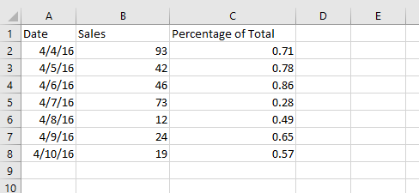
Cell Content
Cells can contain text, such as letters, numbers, and dates.

Slide 11
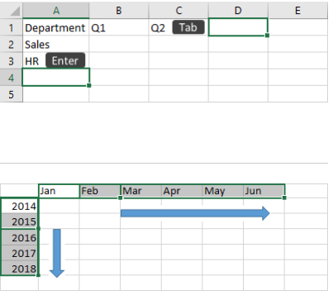
Data Entry
To manually enter data:
Select an empty cell, such as A1, and then type text or a number.
Press Enter or Tab to move to the next cell.

Slide 12
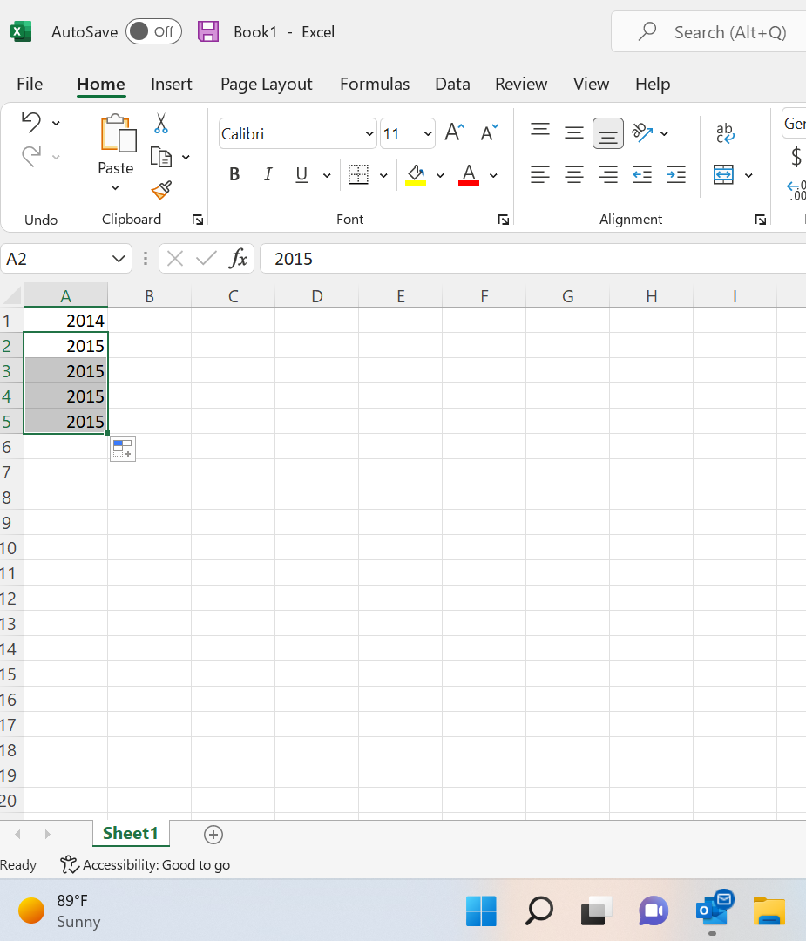
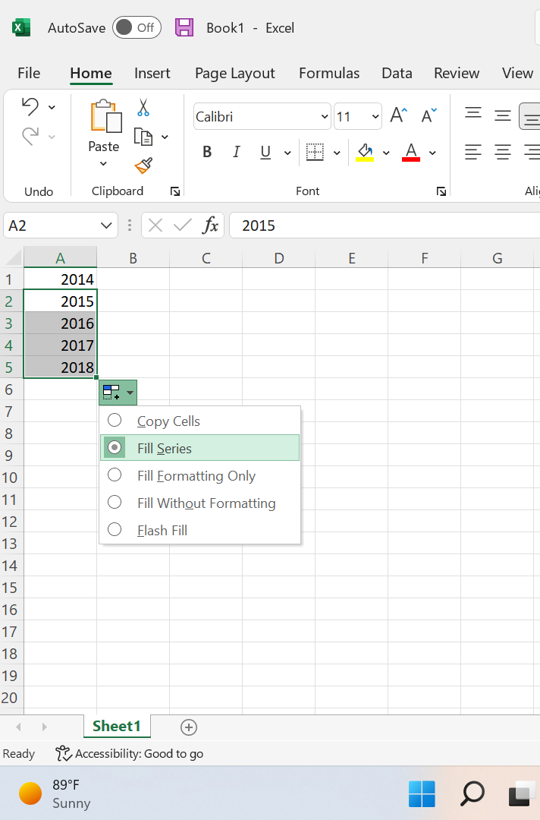
Auto Fill ( Filling in data from a series)
Enter the beginning of the series in two cells: such as Jan and Feb; or 2014 and 2015.
Select the two cells containing the series, and then drag the fill handle across or down the cells.

Slide 13
Formatting Cells

Slide 14
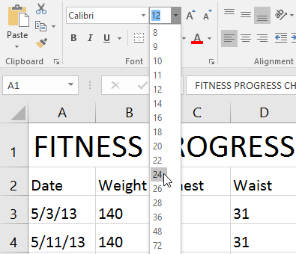
Font Size
1. Select the cell(s) you want to modify.
2. On the Home tab, click the drop-down arrow next to the Font Size command, then select the desired font size. In our example, we will choose 24 to make the text larger.

Slide 15
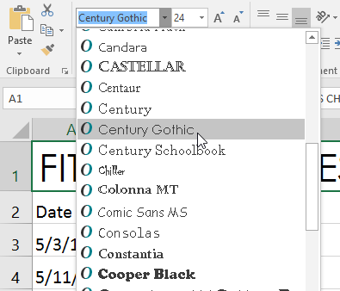
Changing the Font
1. Select the cell(s) you want to modify.
2. On the Home tab, click the drop-down arrow next to the Font command, then select the desired font. In our example, we'll choose Century Gothic.

Slide 16
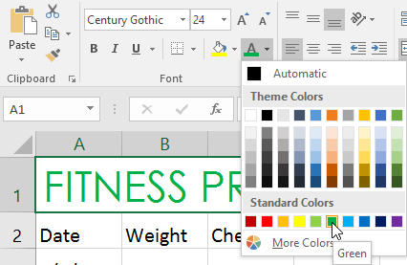
Changing Font Color
Select the cell(s) you want to modify.
2. On the Home tab, click the drop-down arrow next to the Font Color command, then select the desired font color. In our example, we'll choose Green.

Slide 17
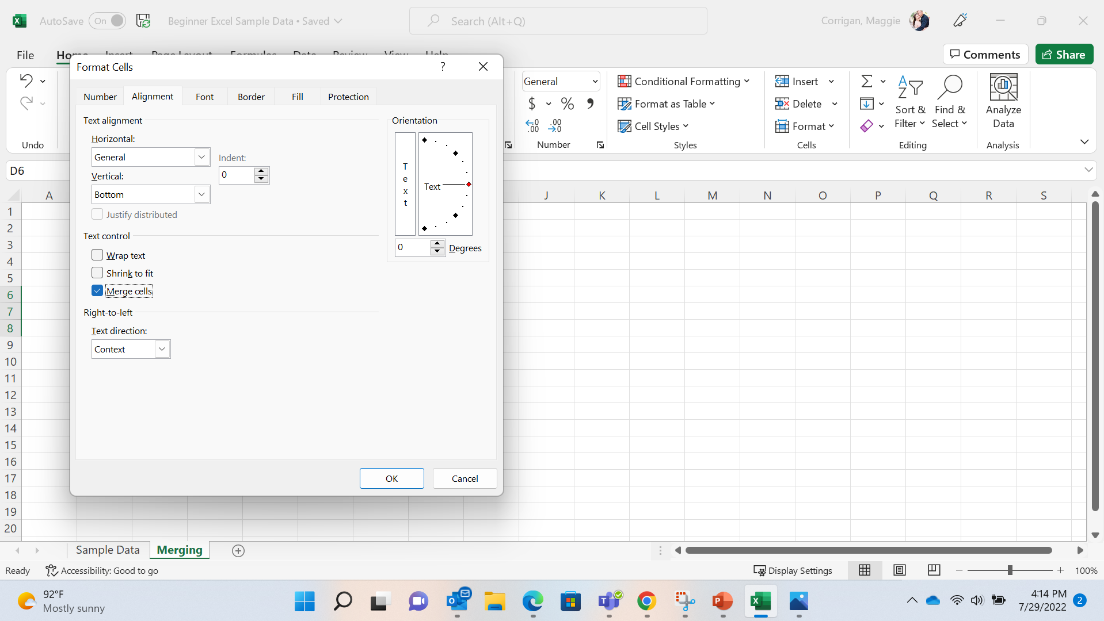
Merging Cells
Select any given amount of cells
Click format > format cells
Click merge cells
c

Slide 18
Text Wrap
Click format > format cells
Click wrap text

Slide 19
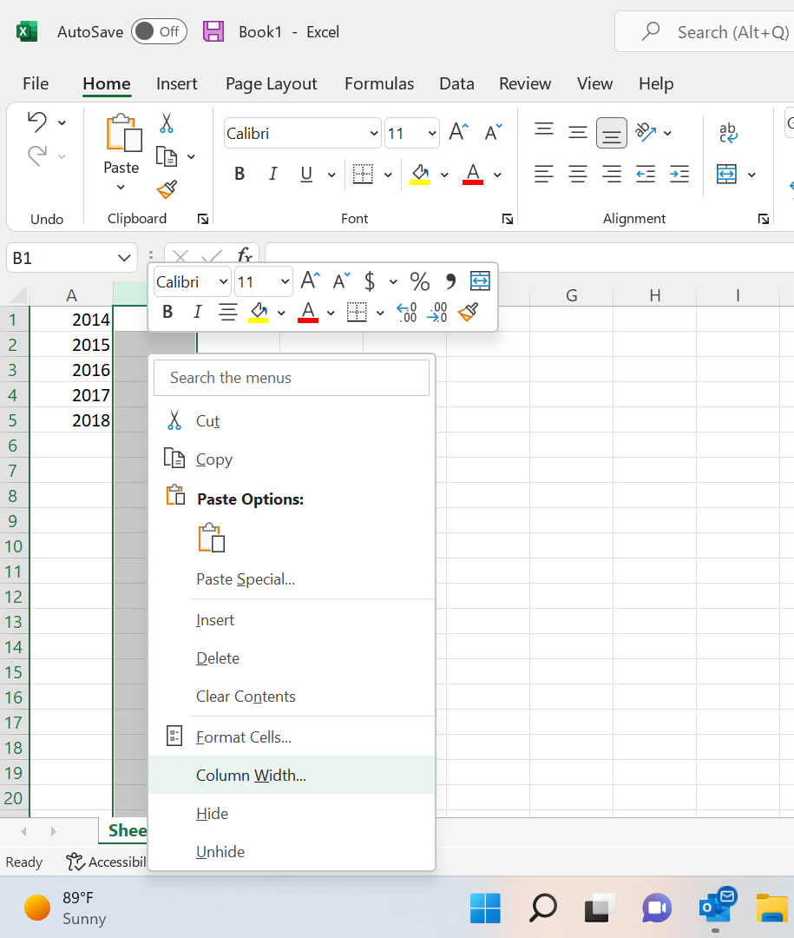
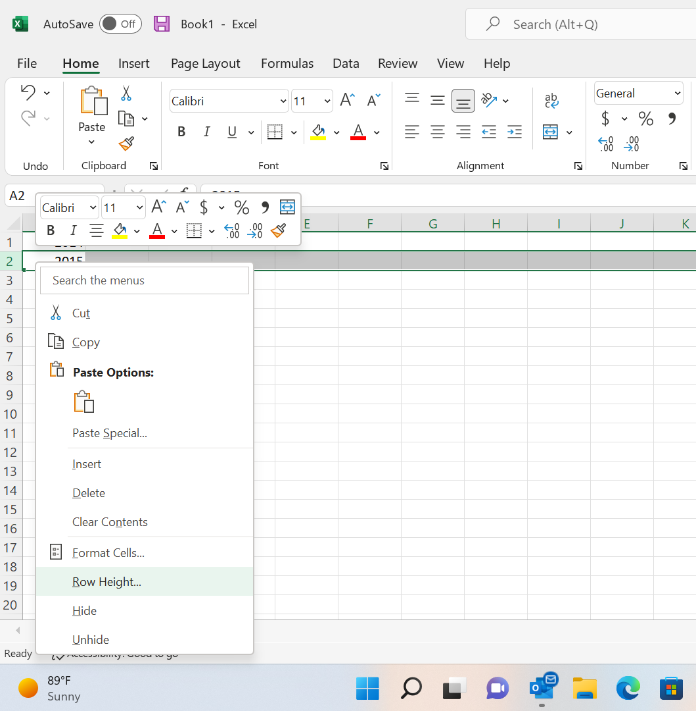
Resizing Columns & Rows
Columns
Rows
Right Click on the A column
Click on Column Width
Right Click on the 1 Row
Click on Row Height

Slide 20
Adding/Deleting Columns & Rows
Columns
Rows
Right Click on the A column
Click on insert
Right Click on the 1 Row
Click on Insert

Slide 21
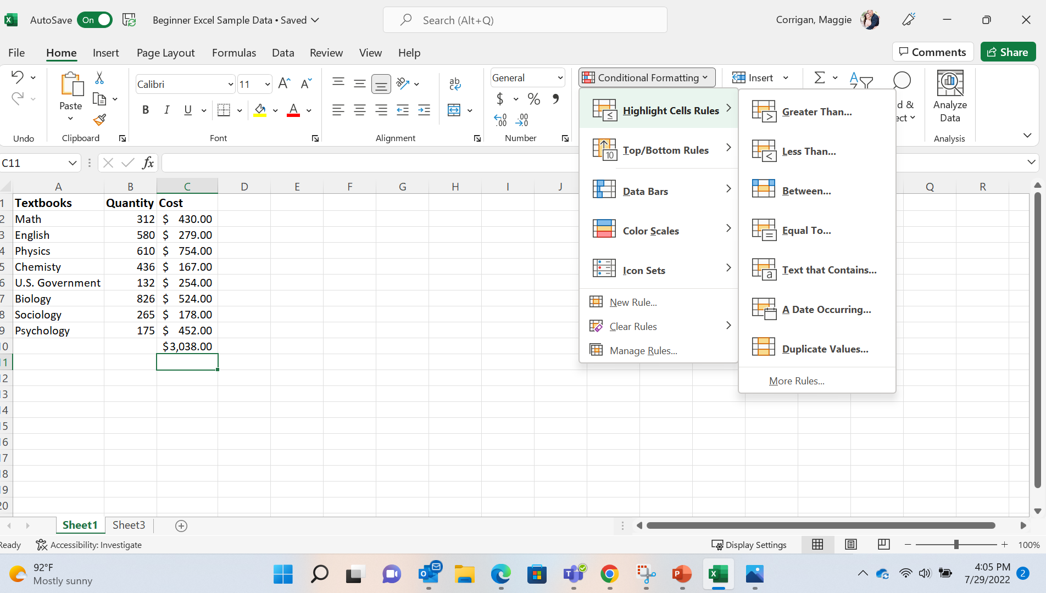
Conditional Styles
Click the home tab on the ribbon
Click Conditional formatting

Slide 22
Number Formats

Slide 23
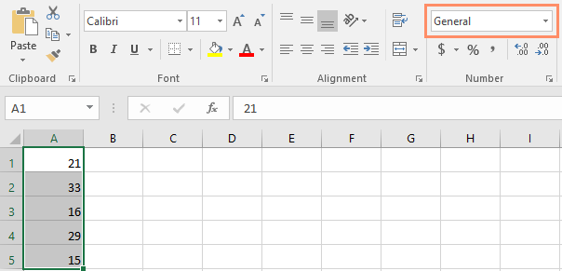
Number Formatting
Click on the home tab
Click number format

Slide 24
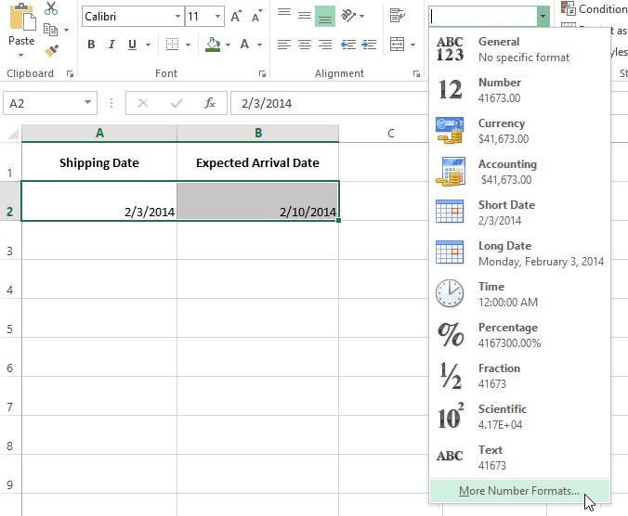
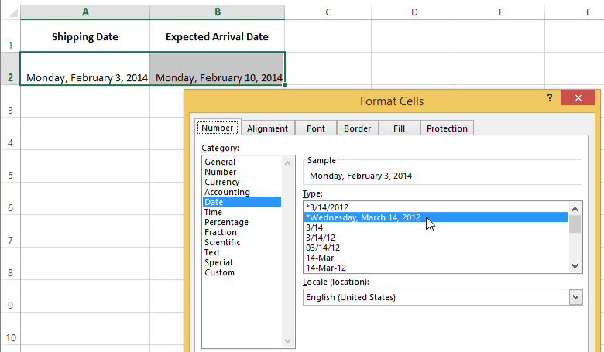
More Number Formats

Slide 25
Formula Introduction

Slide 26
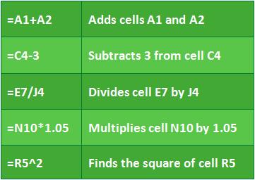
Basic Formula Operations

Slide 27
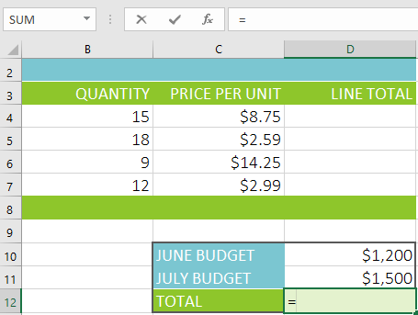
Creating a Formula
Select the cell that will contain the formula
Type the equals sign (=)

Slide 28
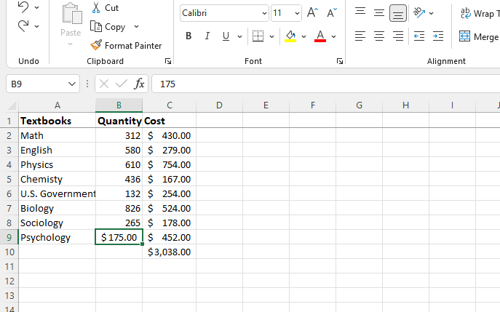
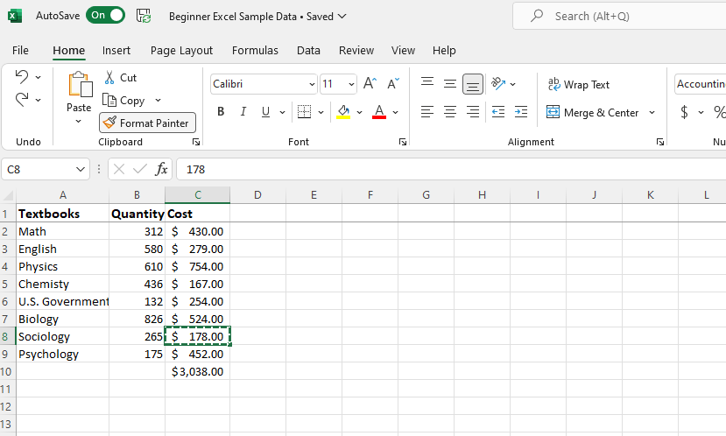
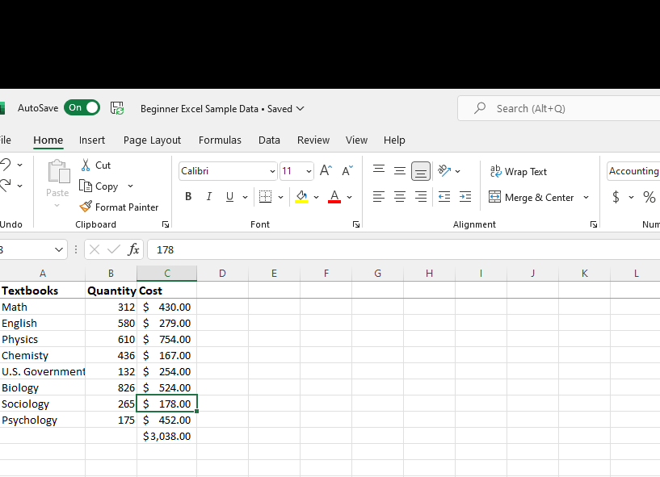
Format Painter
Click Home on the ribbon
Click on a section of the working document with a format that can be replicated.
Click Format Painter
Select the cell(s) that you want the format applied too

Slide 29
Complex Formulas

Slide 30
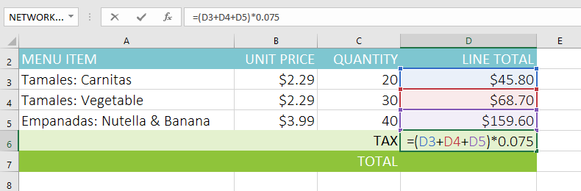
Creating a Complex Formula
In the example below, we are wanting to calculate sales tax

Slide 31
Relative and Absolute Cell References

Slide 32
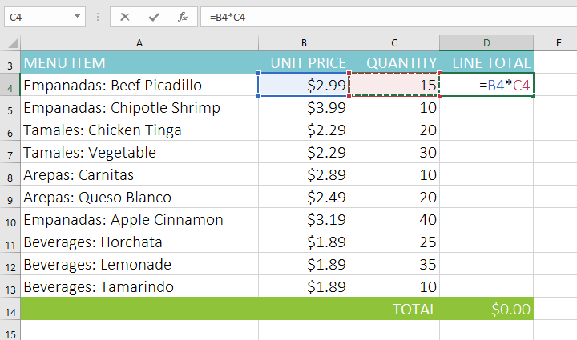
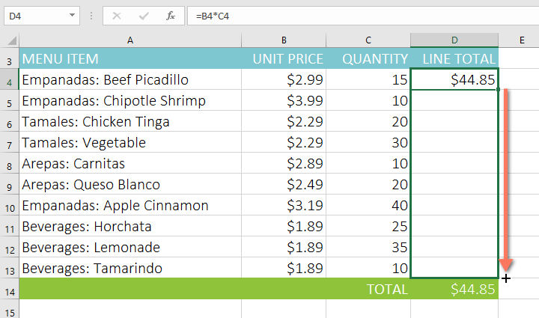
Copying a Formula Across Cells
Enter the formula to calculate the desired value. In our example, we'll type =B4*C4
Locate the fill handle in the bottom-right corner of the desired cell. In our example, we'll locate the fill handle for cell D4.
3. Drag the fill handle down

Slide 33
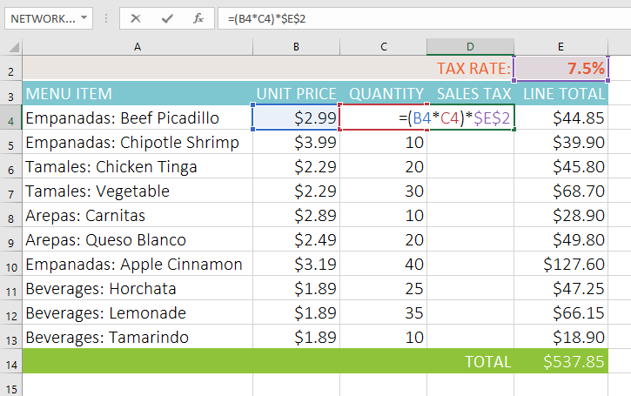
Creating an Absolute Cell Reference
Select the cell that will contain the formula
Enter the formula to calculate the desired value. In our example, we'll type =(B4*C4)*$E$2, making $E$2 an absolute reference.

Slide 34
Functions

Slide 35
Most used Functions within Excel
SUM: This function adds all of the values of the cells in the argument.
AVERAGE: This function determines the average of the values included in the argument. It calculates the sum of the cells and then divides that value by the number of cells in the argument.
COUNT: This function counts the number of cells with numerical data in the argument. This function is useful for quickly counting items in a cell range.
MAX: This function determines the highest cell value included in the argument.
MIN: This function determines the lowest cell value included in the argument.

Slide 36

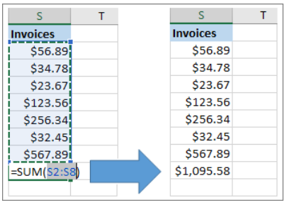
AutoSum
Quickly calculate with AutoSum
Select the cell below the numbers you want to add.
Select Home > AutoSum
Press Enter.

Slide 37
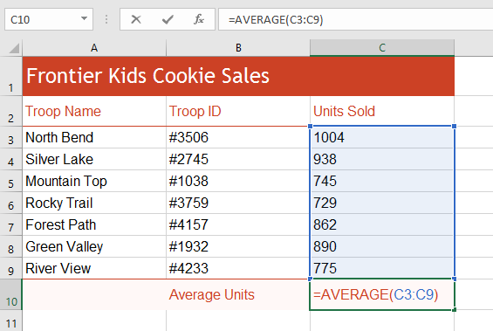
Finding the Average
Type =, then the word AVERAGE
Enter the cell range for the argument inside parentheses

Slide 38
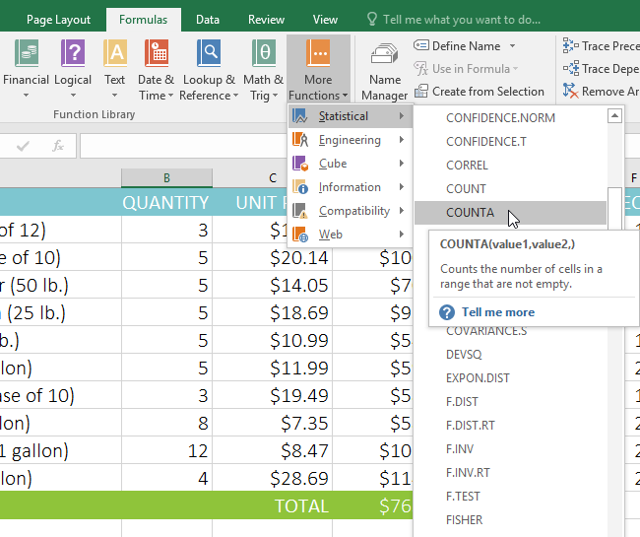
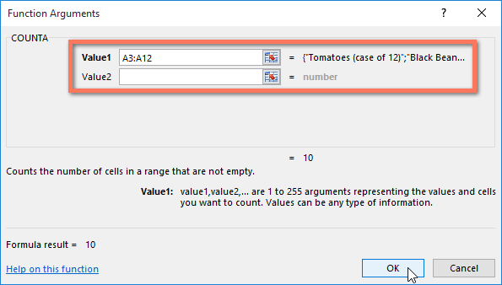
Finding the Count
Click on the formulas tab > More Functions
Click Statistical > CountA
Select the desired cell range

Slide 39
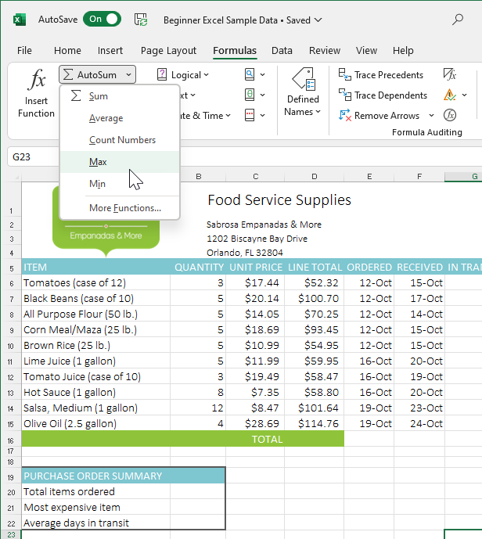
Max
Click formulas > AutoSum
Click Max
Enter in desired range of numbers

Slide 40
Min
Click formulas > AutoSum
Click Min
Enter in desired range of numbers

Slide 41
Basic Worksheet Functions

Slide 42
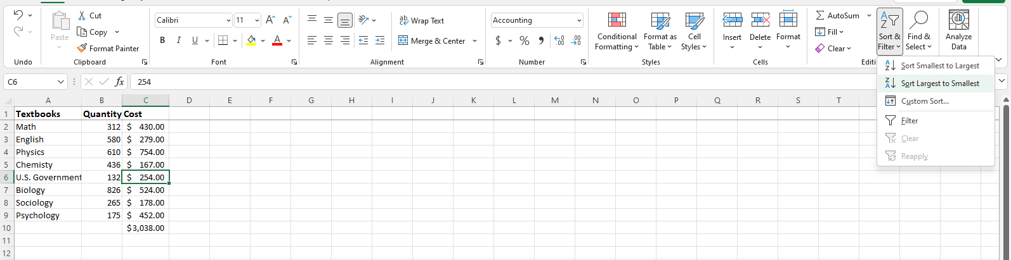
Sort & Filter
Click home on the ribbon
Click on the cell(s) that you want sorted
Click Sort & Filter

Slide 43
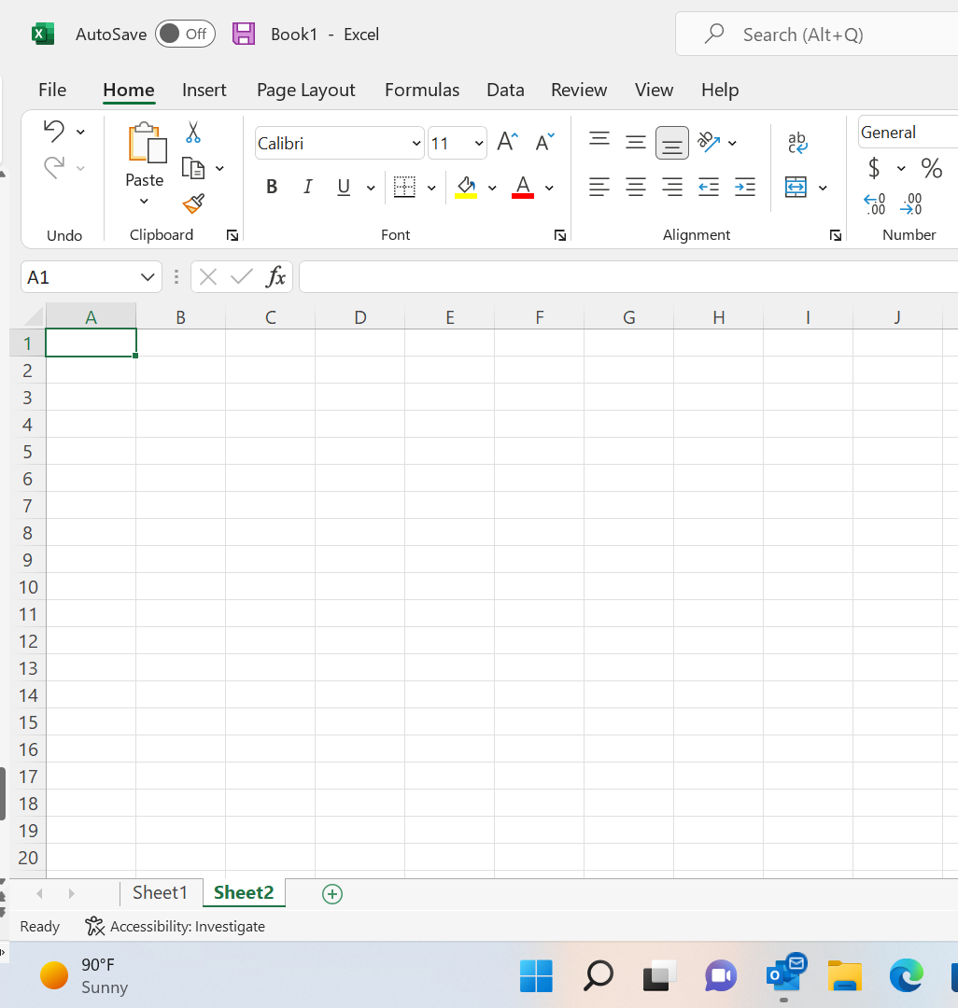
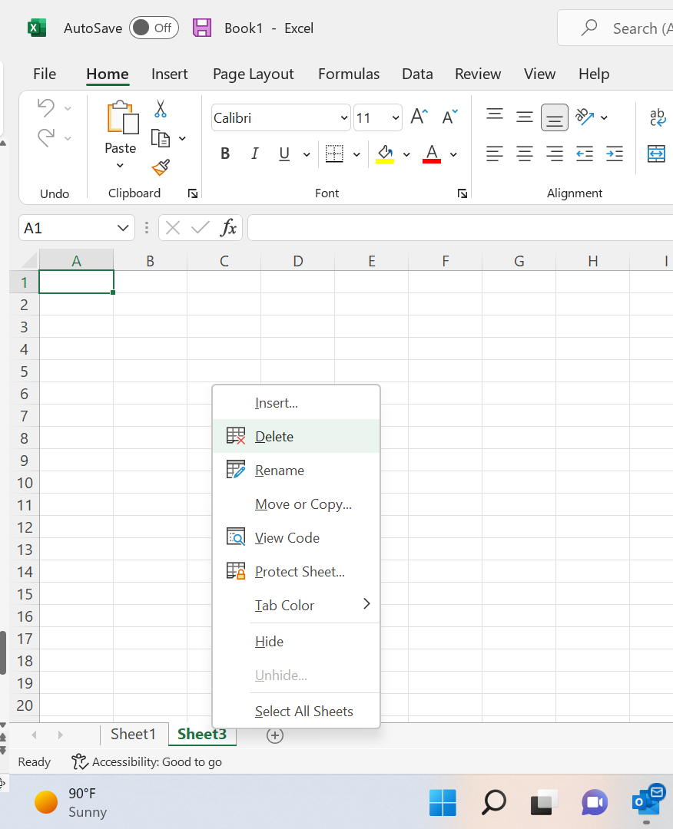
Insert/Delete Worksheets
At the bottom left hand on the screen click the + button to add a worksheet
To delete a worksheet, right click on the sheet name
Click delete

Slide 44
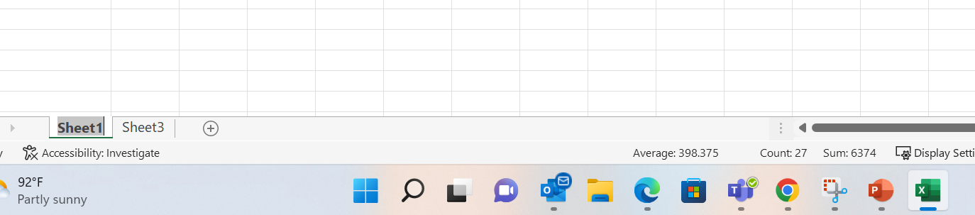
Renaming a Worksheet
Double click the sheet name

Slide 45
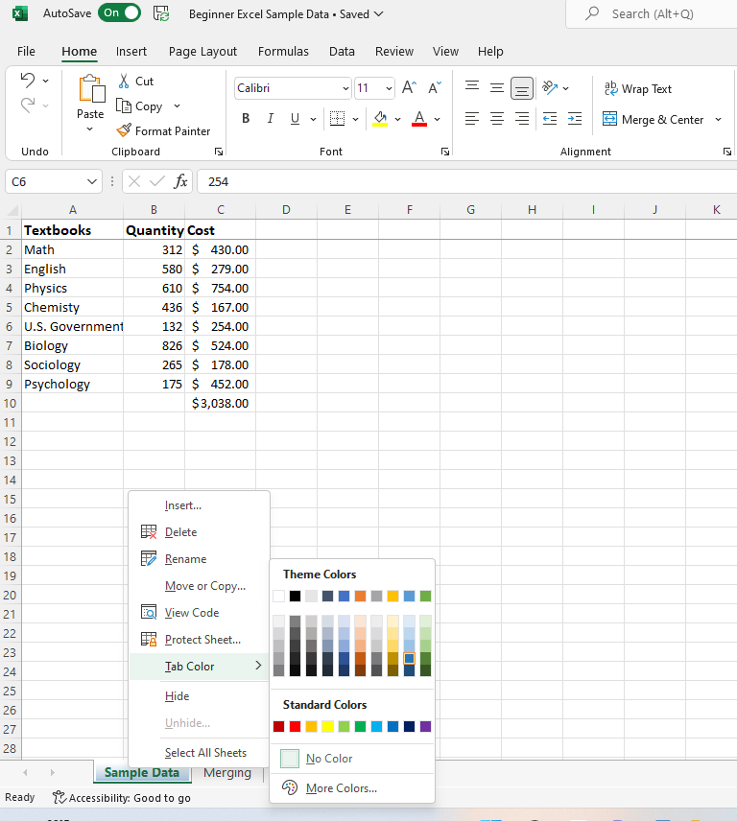
Coloring Worksheet Tabs
Click home
Right click on any worksheet tab
Click on tab color

Slide 46
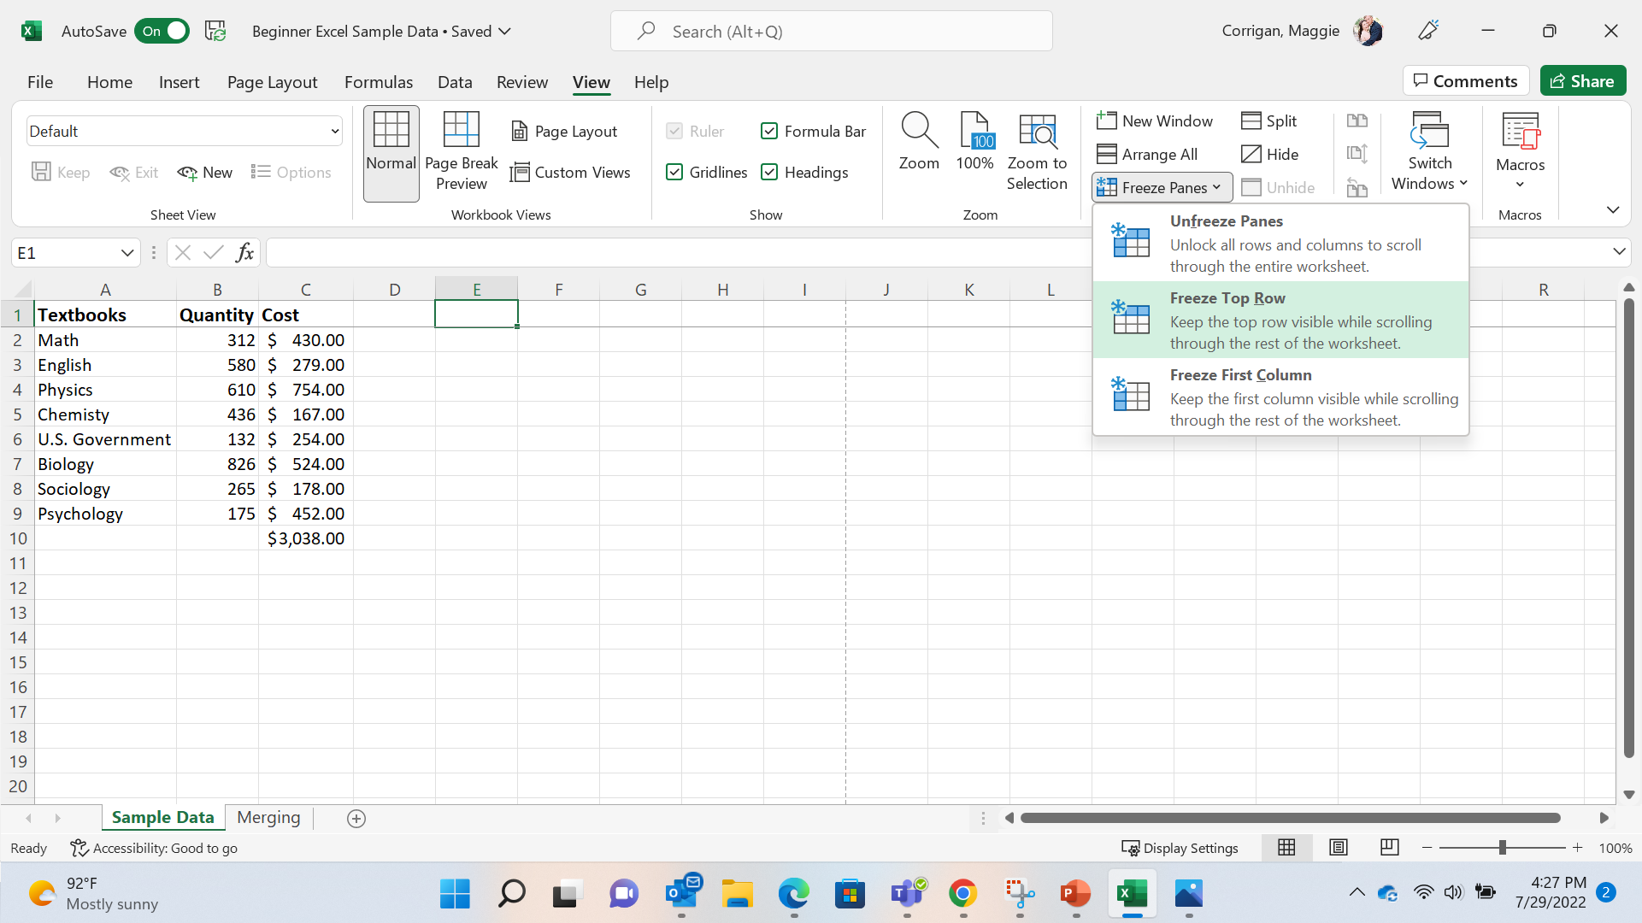
Freeze Panes
Freeze the top row of column headings so that only the data scrolls.
Click view
Click freeze panes
Select freeze top row
*Must select the cell BELOW the column that you would like to freeze

Slide 47
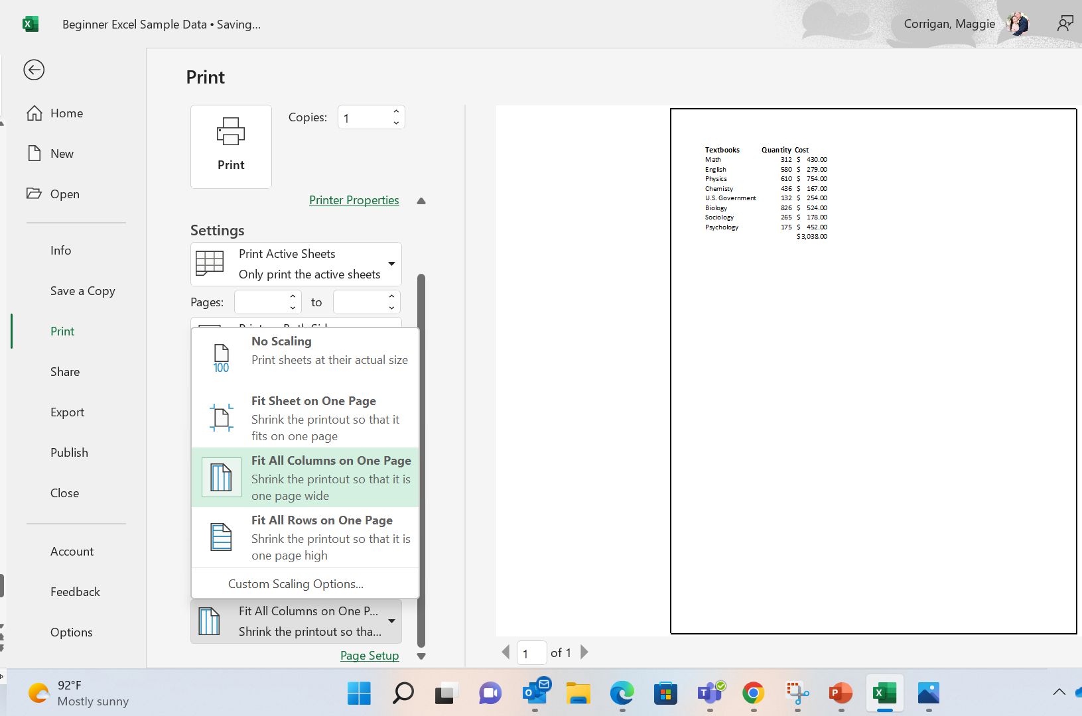
Scaling options (fit all rows/columns to page)
Click file > print
Click fit all columns to one page

Slide 48
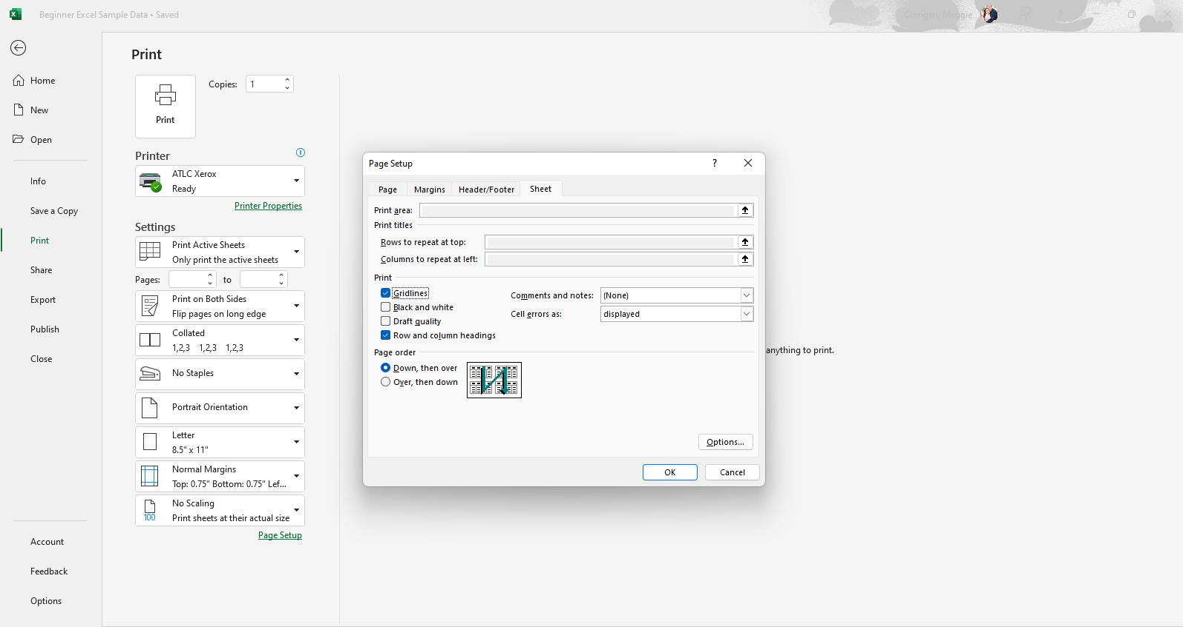
Page Setup (to show gridlines / column headings)
Click file > print
Click Page Setup > sheet
Check gridlines & row and column headings

Slide 49
Resources
This handout was created using information from the following sites:
https://support.microsoft.com/en-us/office/analyze-and-format-in-excel-11a632c1-197e-454f-a515-374a4aa2b3dd
Free Excel 2016 Tutorial at GCFGlobal

Slide 50

Assistance at TTU
For technical assistance, please contact IT Help Central at (806) 742-HELP or ithelpcentral@ttu.edu.
More information and training resources, including training videos, can be found at:
http://unifiedcommunications.ttu.edu. You can also contact IT Education Services at iteducation@ttu.edu or call the ATLC at (806)742-1650.

