Slide 1


Microsoft Teams
Technology Support ShortCourse Handout

Slide 2
Resources and Links
Microsoft Teams help & learning
See what’s new in Office
Microsoft Teams free training, tutorials, and videos Microsoft Support
SharePoint collaboration
Teams and SharePoint integration
Microsoft Teams Frequently Asked Questions

Slide 3
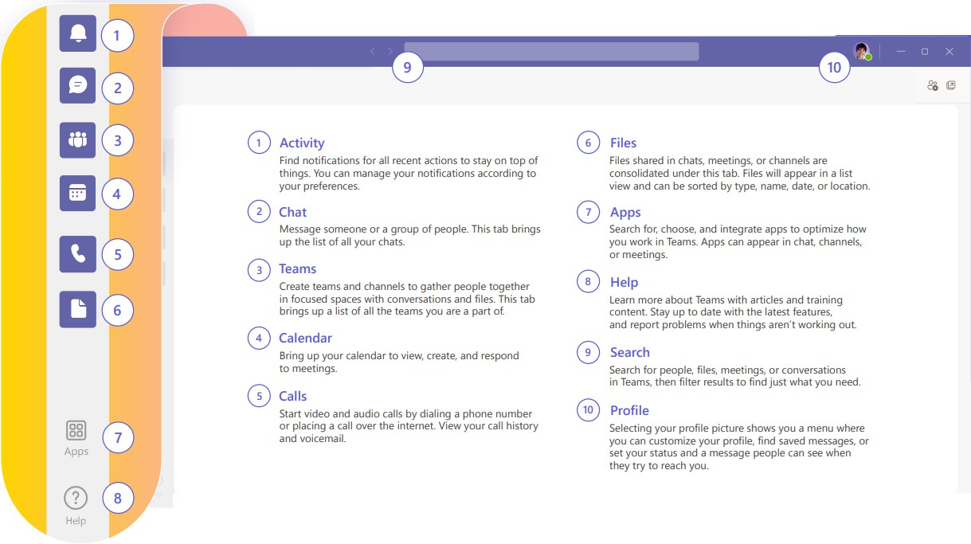
Quick Start Guide – Getting around TEAMS
Microsoft Teams is a collaboration app that helps your team stay organized and have conversations—all in one place. Here's a look at some of the quick-access icons.

Slide 4
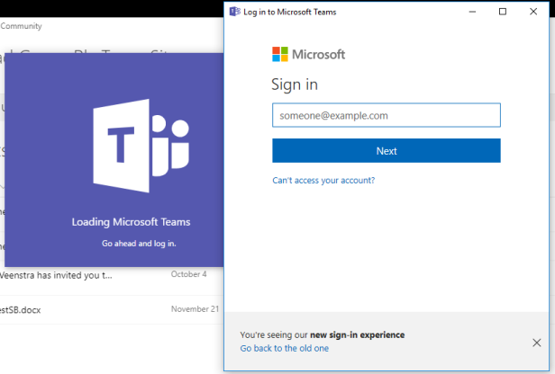

Command Box
Sign In
Start Teams.
  In Windows, click Start > Microsoft Teams.
  On Mac, go to the Applications folder and click Microsoft Teams.
  On mobile, tap the Teams icon.
Sign in with your Microsoft 365 username and password.
Use the Command Box at the top of Microsoft Teams to search for specific items, and people, and perform quick actions that make you feel like a Microsoft Teams wizard. Try it for yourself now:
Head over to Teams and hit CTRL+E to activate the Command Box
Type /chat and hit ENTER
Enter someone’s name and hit ENTER
Type a message and hit ENTER to send
There are a bunch of extra quick actions that you can use too, just type the / symbol in the Command Box to explore and play around with the options.

Slide 5
Use the commands
There are several ways to use commands in Teams.
Command Box
Message Box
Command Box
/available | Set your status to available.
/away | Set your status to away.
/busy | Set your status to busy.
/dnd | Set your status to do not disturb.
/call | Call a phone number or Teams contact.
/goto | Go right to a team or channel.
/chat | Send a quick message
Message Box
/apps | Add an app.
/code | Add a code block.
/participants | See who’s in the chat.
/schedulemessage | Schedule a message.
/createworkflow | Create a work flow.
Full list of commands can be found here: Use commands in Microsoft Teams - Microsoft Support

Slide 6
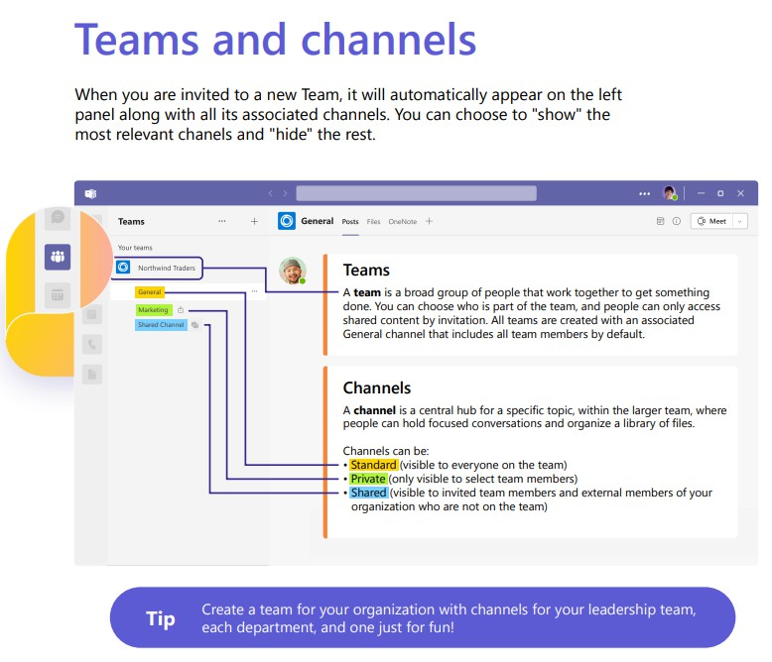

Slide 7
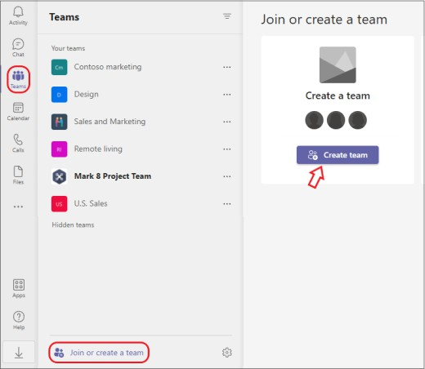
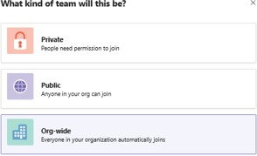
Create a TEAM
Choose Teams
on the left side of the app, then select
Join or create a
team at the bottom of your teams list.
Hover over the Create a team card and select
Choose From scratch.
Create team.
Decide what kind of team that you want this to be:
Private – Public – Org-Wide
To limit content and conversation to a specific set of people, choose Private.
For a community or topic that anyone in the org can join, choose Public.

Slide 8
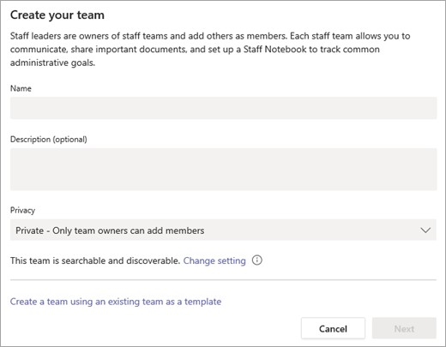
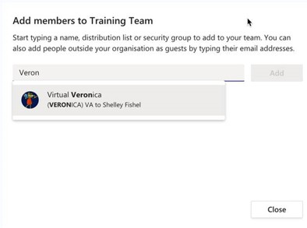
Name your team and add an optional description
1. When you're done, select Create
Add members
You can add people, groups, or even entire contact groups
If you need to add people from outside your organization,
use their email address to invite them as guests. Add a friendly display name for them too
When you're done adding members, select Add and then Close

Slide 9
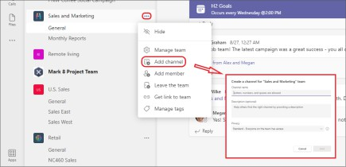
Create a channel
By default, all members of a team can create channels. A General channel is open for all members and anything posted is searchable by others. If you need a smaller audience for a specific project, you can create a private channel for your team.
To add more channels:
Start in the team list. Find the team name and select More
options > Add channel. You can also choose Manage team and then add a channel in the Channels tab.
Select More options... next to the team name.
Select Add channel.
Enter a name and description for your channel.
You can build a channel around a topic, project, department name, or whatever you like.
Select Automatically show this channel
in everyone's channel list if you want this channel to be automatically visible in everyone's channel list.
Select Add.

Slide 10
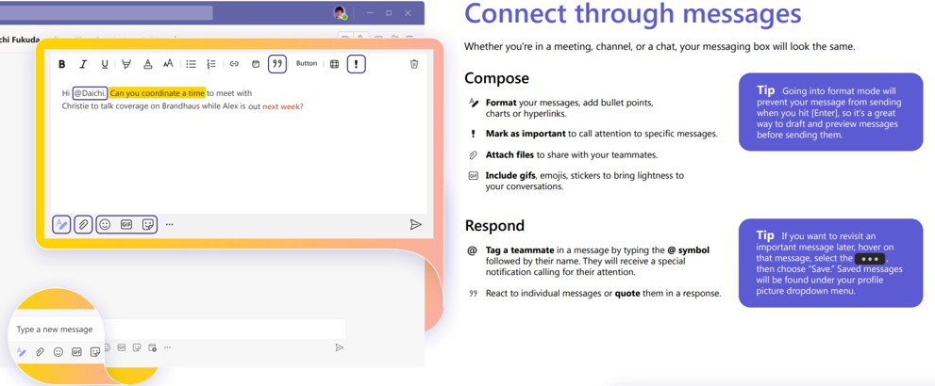

Slide 11
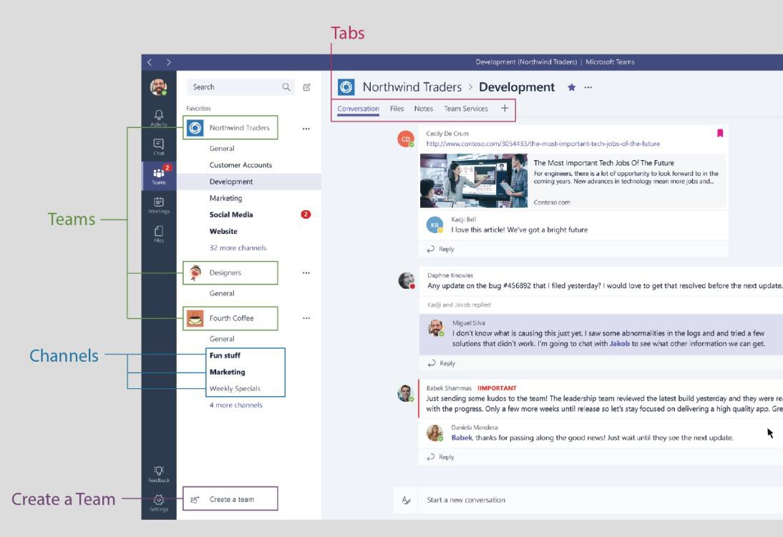
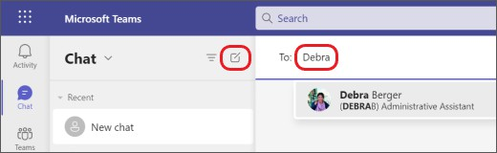
Start a conversation
With the whole team... Click Teams, pick a team and channel, write your message, and lick Send.
With a person or group... Click New chat, type the name of the person or group in the To field, write your message, and click Send.

Slide 12
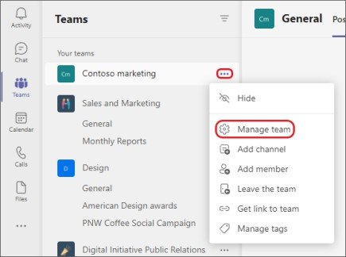


Customize and manage your team
Select more options... next to the team’s name.
Select Manage team to find Members, Channels, Settings, and Apps for your team all in one place.
Select Settings > Team picture to add a team picture and give your team some personality.
Explore the Activity feed in Teams
Select Activity to view your Activity feed, a summary of everything that's
happened in the channels that are in your teams list. Select Filter at the top right corner of the feed to show specific types of messages such as unread messages, @mentions, replies, and likes.
For a more specific feed, go to the Feed menu and select My activity. You'll get a list of everything you've been up to lately in Teams.
When a red circle appears next to Activity , you have a notification—such as an @mention or a reply—in your feed. These notifications remain in your feed for 30 days. After that they expire and no longer show in your feed.

Slide 13
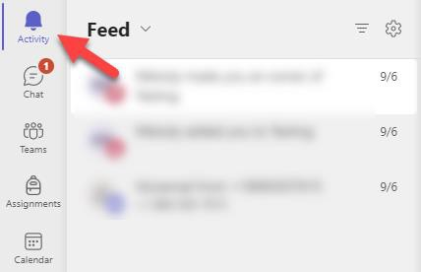
Stay on top of things
Notifications let you know when someone @mentions you, likes something you’ve posted, or replies to a thread you started.
The Activity feed helps you stay on top of all your notifications.
Select Activity .
Feed shows you a summary of everything that's happened in the channels you follow.
  Select Filter to show only certain types of notifications such as @mentions or reactions.
  Select Feed > My Activity to see a list of everything you've been up to lately in Teams.

Slide 14
Activity feed symbols
We attached unique symbols to different types of notifications in your feed. That way, you can look through your feed and prioritize based on the following:
@mentions of you specifically.
@team mentions for teams you're on.
@channel mentions in teams you're on.
Replies to your posts.
Posts you liked.
You were added to a team.
You were made a team owner.
Trending posts.
Suggested posts.
Managing Notifications
You can manage your teams notifications, so you only get notified on the things that matter most.

Slide 15
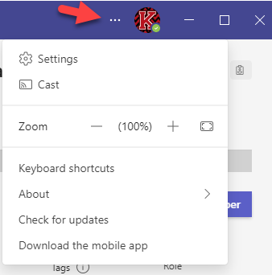
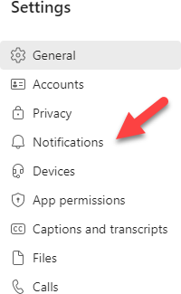
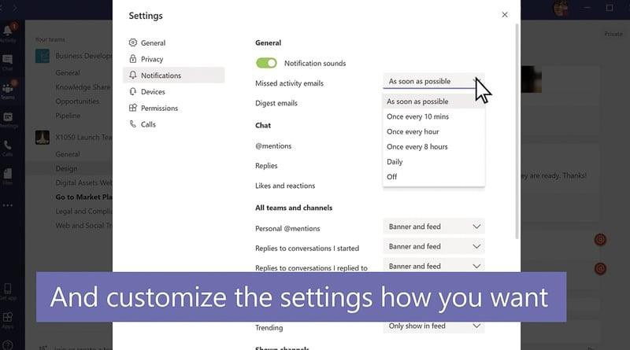
1. Select Settings from the drop-down menu
2.Click Notifications
3. Customize your notifications

Slide 16
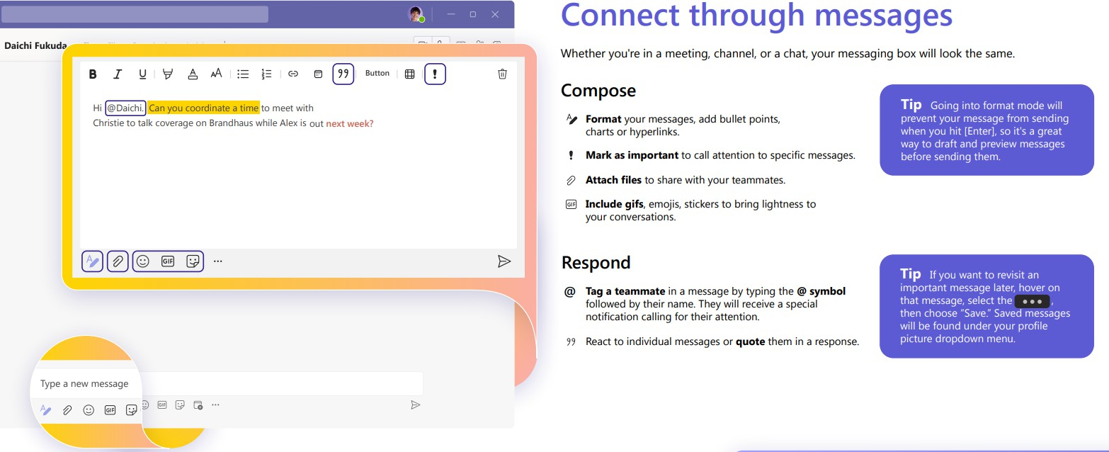
Start a chat in Teams

Slide 17
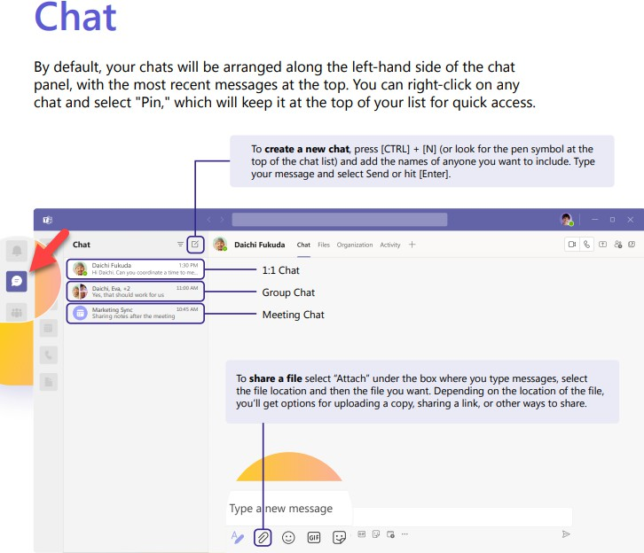
Start a one-on-one chat
You can also start a one-on-one chat from someone's profile card. Open it by clicking their picture in a channel or from a search.
Select New chat .
Type the name of the person or people you want to contact.
Select the down arrow to add a name to your chat group.

Slide 18

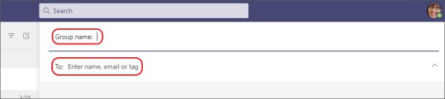
Start and name a group chat
Start and name a group chat
Create a group chat the same way you start a one-on-one chat.
Select New chat at the top of your chat list.
Select the down arrow to the far right of the To field and then type a name for the chat in the Group name field.
Type the names of the people you’d like to add in the To field.
Start a new chat and select the down arrow. Type a name for the group chat and add people
This starts a new conversation. Everyone who has access to the group chat can send messages.
You can include up to 250 people in a group chat.

Slide 19
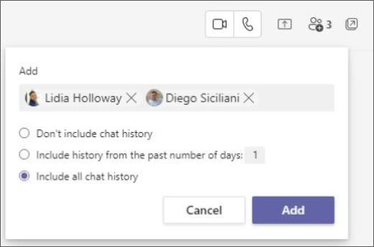
Add people to the conversation
To loop more people into the conversation, just click Add people in the top right corner of Teams. Then, type the names of the people you'd like to chat with, select how much of the chat history to include, and click Add.
Note: When adding someone to a group chat (not a one-on-one), you can
include the chat history.
Teams will save the whole chat history, all the way back to the first message. And if someone leaves the group, their chat responses are still there in your chat history.

Slide 20
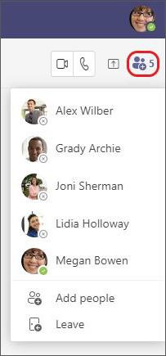
See who's in a group chat
To see who’s in a group chat, select View and add participants in the chat header to show a
list of everyone’s names.
Tip: Don’t forget that you can also use the /participants command in the chat box!

Slide 21
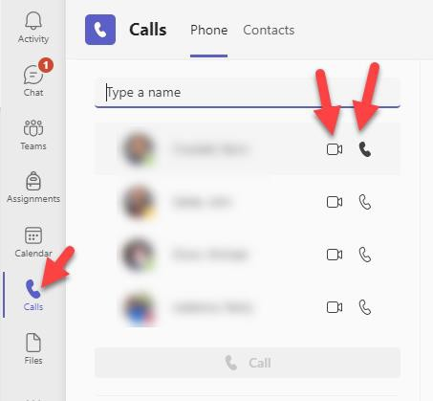
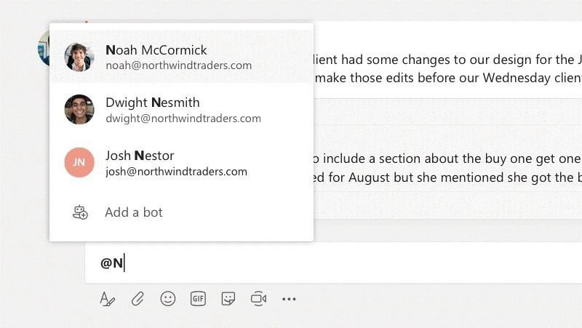
Make video and audio calls
Click Video call or Audio call to call someone from a chat. To dial a number, click Calls on the left and enter a phone number. View your call history and voicemail in the same area.
@mention someone
To get someone’s attention, type @, then their name (or pick them from the list that appears).
Type @team to message everyone in a team or @channel to notify everyone who favorited that channel.

Slide 22
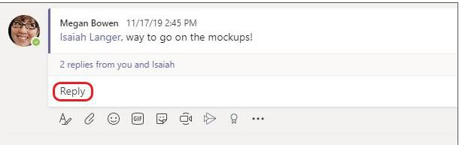
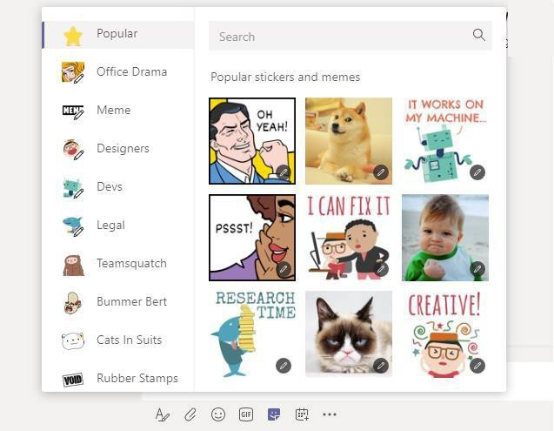
Reply to a conversation
Channel conversations are organized by date and then threaded. Find the thread you want to reply to, then click Reply. Add your thoughts and click Send.
Add an emoji, meme, or GIF
Click Sticker under the box where you type your message, then pick a meme or sticker from one of the categories. There are also buttons for adding an emoji or GIF.

Slide 23

Meetings in Microsoft Teams
In Meetings. Undoubtedly one of Microsoft Teams best features. This is where you can setup 1:1 or group meetings, host meetings channels, share your screens and even create live events. But for now, we'll keep this beginner 101 friendly, so head into your teams Calendar module to get started on managing your meetings.
Note: Your calendar stays in sync with your Outlook calendar and displays everything you've got coming up, even if you have created an appointment outside of teams.

Slide 24
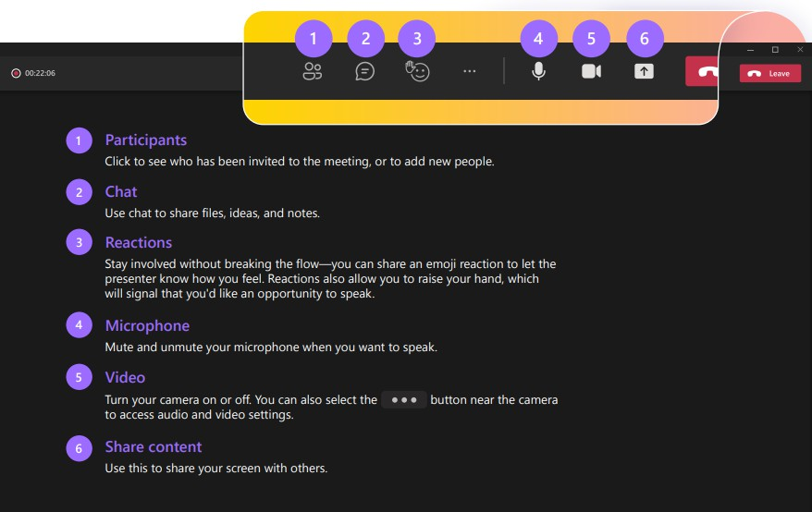
Meeting Controls
Tip - Use [Ctrl]+[Shift]+[M] for a shortcut to mute and unmute during meetings

Slide 25
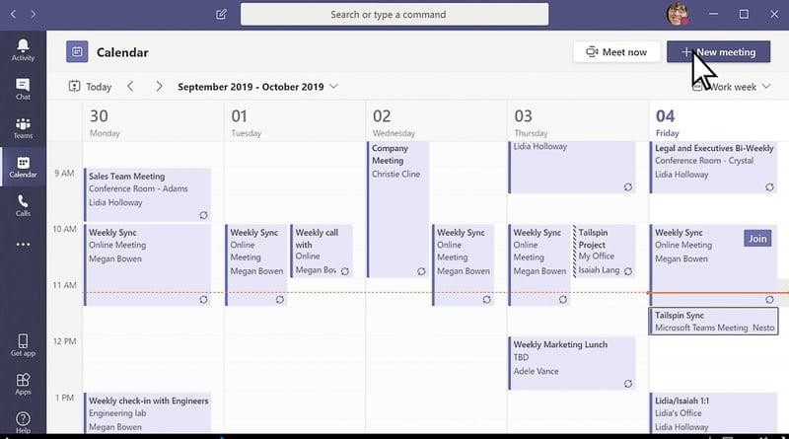
Schedule a meeting
1.
Go to Teams
> Calendar
2. Select + New meeting.

Slide 26
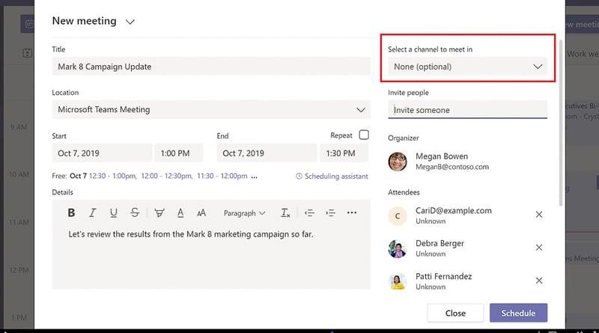
Give your meeting a title. Decide on a date and time. Add any additional details.
Note: To make a recurring meeting, select the Does not repeat dropdown and choose whether you want the meeting to repeat daily, weekly, monthly, or yearly, or customize a cadence.
Type in the names of individual attendees, or select Add channel to select a class team channel to meet in.
Note: When you add a channel, all members of that channel can join the meeting. Also, all resources shared, and any recordings taken during the meeting are saved in the channel.
Take a moment to review your meeting details. Then select Send button. This adds the meeting to your calendar and your
students’ calendars.
Note: (optional) You can also choose a channel to meet in. If you host your meeting in a channel, everyone in the team will see it in the channels post tab, where they can comment, share files and reply.

Slide 27
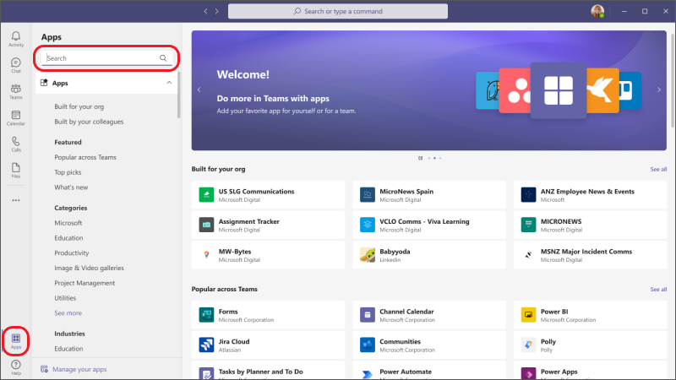
Find your personal apps
Apps let you do more in Teams without having to navigate away or switch applications. Think about the tools, files, and dashboards your org already uses - Do you use Planner to manage your tasks? What about SharePoint files,
forms, PowerBI reports? Well, if so, the apps module means you can seamlessly add your tools right into Teams. Interested? Take a look at how you can use Microsoft Planner with Microsoft Teams to manage your tasks.
Click More apps to see your personal apps. You can open or uninstall them here. Add more apps in the Store.

Slide 28
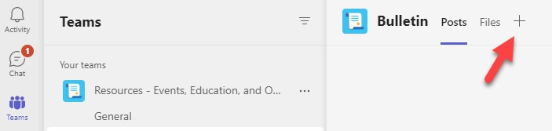
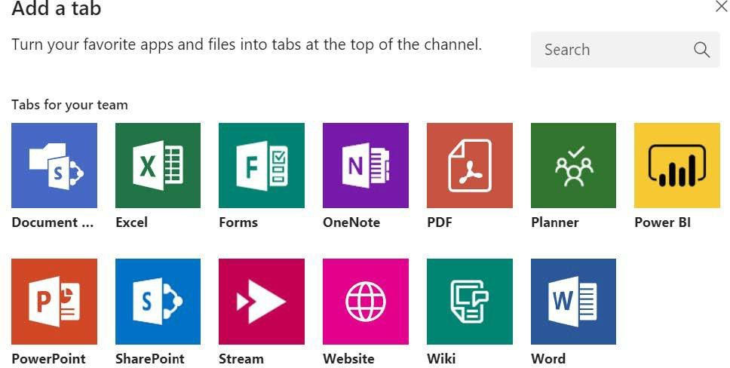
Add a tab in a channel
Click by the tabs at the top of the channel, click the app you want, and then follow the prompts. Use Search if you don’t see the app you want. Tabs allow you to integrate the tools and services you love right into your chat or channel.

Slide 29
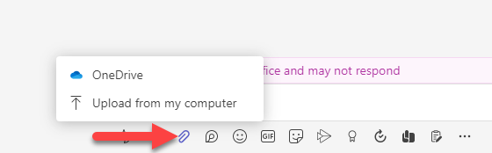
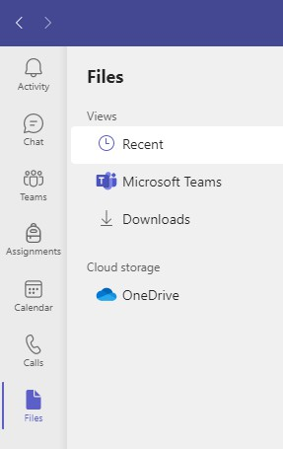
Share a file
In Chat - Click Attach files under the box where you type messages, select the file location and then the file you want. Depending on the location of the file, you’ll get options for uploading a copy, sharing a link, or other ways to share.
Work with files
Click the Files icon on the left sidebar, and you’ll see all attached files. Here, you can also upload files to your team’s OneDrive storage space for access.
You can then work with those files through the file attachment location for OneDrive.

Slide 30

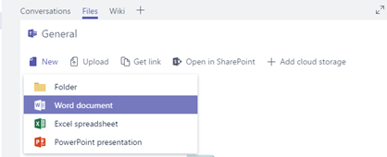
Collaborate on the files
As your team works together, you'll undoubtedly have files that you'll want to share and collaborate on. Teams makes it easy to share files and work on them together. If working in Word, Excel, PowerPoint, or Visio files your colleagues can even view, edit, and collaborate on them, right within Teams (editing in Visio requires a license).
Your files library
Within each team there are channels. Think of these channels as a place for your entire team to discuss a specific topic, like upcoming training, or project updates. Each channel has its own file folder where you can share files for that specific channel. To access that folder, go to the channel and select the Files tab above the conversation window.
Note: Make sure to use the Files tab at the top of the channel conversation window instead of the Files button on the left side of the app. That button gives you access to ALL of your cloud files, rather than just the files for a specific channel.
In the library you can upload existing files or create new ones. When you upload a file, it creates a copy in Teams.
Upload existing files
There are two primary ways to upload existing files into your library. Both methods start by going to the files folder for your channel and both methods, by default, upload copies of your files to the channel file folder.
Drag and drop - Using your mouse, drag the file from where it's currently located and drop it on the Teams window among the files.
Upload - Select Upload, then select the file (or files) you'd like to upload and select Open.
Any files you upload will be accessible by any member of your team. And just like in SharePoint, you can pin specific files to the top of your list for easy access.

Slide 31
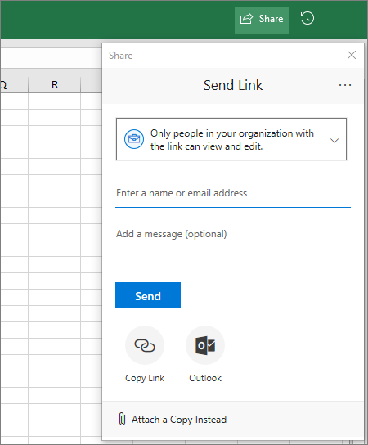
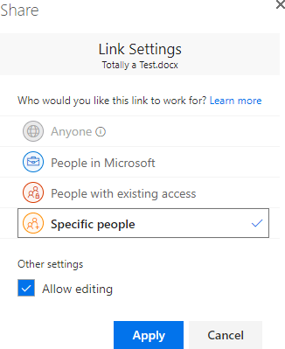
Share with people outside your team
If the file is a Word, Excel, PowerPoint or Visio file, the easiest way to share it is to open the file in its corresponding Office for the web or desktop app. Select Share at the top right corner of the window. From there enter the aliases or email addresses of people you want to email the file link or select Copy Link to choose where you share the link.
If you want to share with people outside your organization, you may have to select the permissions drop-down (right above where you add the people you want to share with) and select that Specific People can access the file.
Once you've shared the file, those users can edit the file in real time (unless you unchecked Allow editing in the Link Settings dialog) just like the other members of your team can.

Slide 32
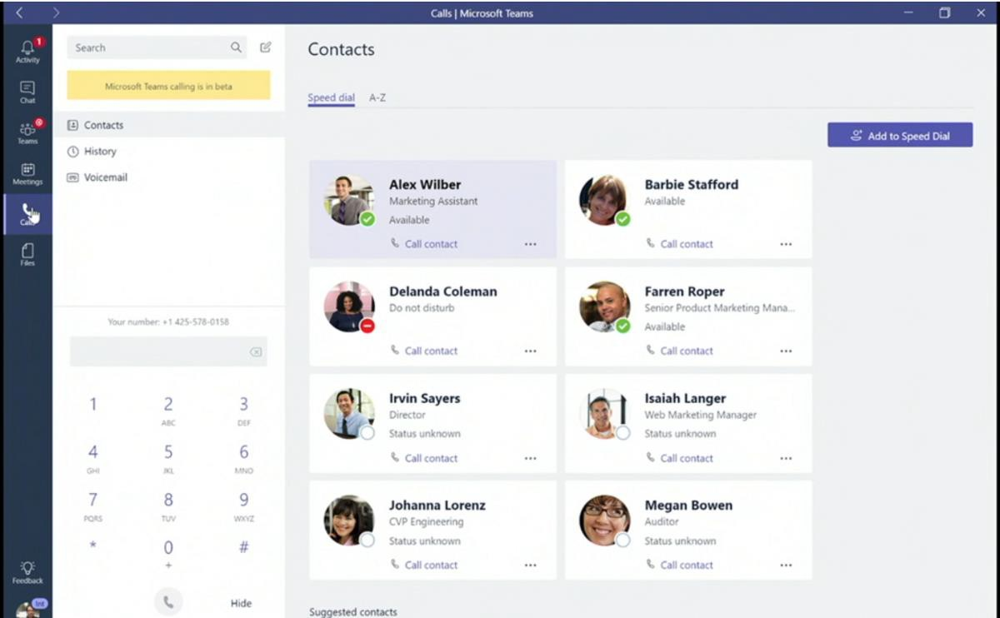
Calls Tab
Starting a call in Teams is extremely simple and can be done in multiple ways, much like on a mobile phone. For example, you can make and receive a call from a chat, the command bar and calls tab – essentially anywhere in Teams.
The calls tab is found on the left-hand side of the Teams platform – unsurprisingly, under ‘Calls’. Once you click that, you can make calls using speed dial and by going through your contacts list. On speed dial, you can add specific contacts to it and quickly type in a name, phone number or email address.

Slide 33
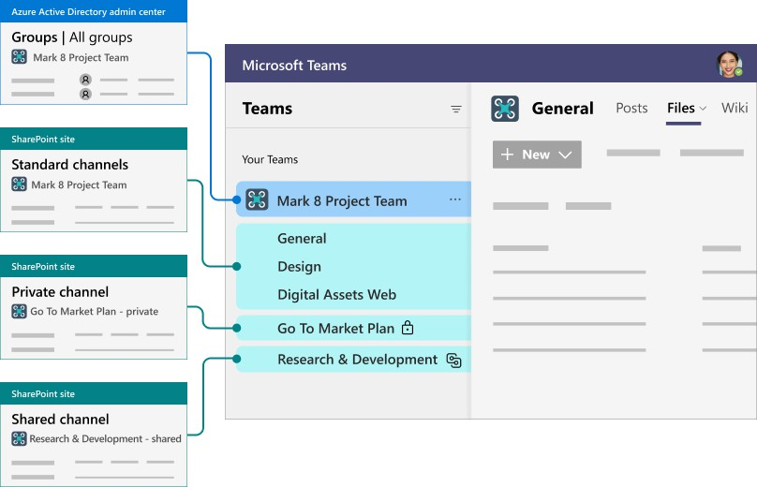
Integration
SharePoint, a part of the Microsoft 365 Office suite, is a web application service for document sharing and team collaboration
offering
enhanced productivity and communication tools. SharePoint provides secure file sharing with real-time collaboration and version management. Using Microsoft Teams as a hub for teamwork, files can be moved easily between Microsoft applications, in one SharePoint location.

Slide 34
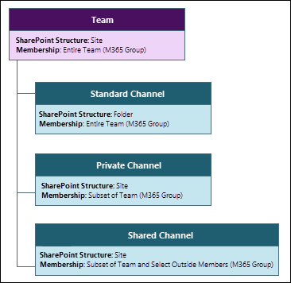
Each team is connected to a Microsoft 365 group in Azure AD where the team membership is stored. The files you see on the Files tab in a team are stored in a SharePoint site. All standard channels in a team share the same SharePoint site, but each private channel has its own site.
Teams and SharePoint are connected in the following scenarios:
When you create a new team from scratch, a new SharePoint site is created and connected to the team.
When you create a new team from an existing Microsoft 365 group, the team is connected to the SharePoint site associated with the group.
When you add Teams to an existing SharePoint site, that site is connected to the new team.
When you create a new private or shared channel, a new SharePoint site is created and connected to that channel.
In Teams, the Files tab on each standard channel is connected to a folder in the parent site's default document library. The Files tab on each private and shared channel is connected to the default document library in the corresponding channel site. Whenever you add or update a file on the Files tab, you are accessing the SharePoint site.
The standard channels display as folders in the parent site. The private channel has its own channel site that is separate from the parent site.

Slide 35
Teams-connected sites are optimized for a Teams connection that include the parent site (created when you create the team), and any channel sites that are created when you create a private or shared channel.
Channel type | SharePoint site | Site sharing | File and folder sharing
Standard | One SharePoint site is shared by all standard channels. There is a separate folder for each channel. | Team owners and members are automatically included in the site owners and members permission groups. Sharing the site separately is possible but managing access through Teams is recommended for easiest user management and the best user experience. | Files and folders can be shared with anyone in the organization by using sharable links. If guest sharing is enabled, Anyone and Specific people links can be used to share with people outside the organization.
Private | Each private channel has its own SharePoint site. | Channel owners and members are automatically included in the site owners and members permission groups. The site can't be shared separately. | Files and folders can be shared with anyone in the organization by using sharable links. If guest sharing is enabled, Anyone and Specific people links can be used to share with people outside the organization.
Shared | Each shared channel has its own SharePoint site. | Team owners and members are automatically included in the site owners and members group. The site can't be shared separately. | Files and folders can be shared with anyone in the organization and external participants in the channel by using sharable links. Sharing with people outside the organization who are not channel members is not supported.
Teams-connected sites can only be managed from Team, with some settings inherited from the parent site that can't be changed.
Setting | Parent site | Channel site
Site permissions | Team permissions are synced with the site. Team and site owners can add additional people directly to the site. (Managing all permissions through Teams is recommended.) | Channel site permissions are inherited from the channel itself. Site permissions can't be managed in SharePoint but will display permissions in read-only mode.
Site sharing settings | Team and site owners can set the sharing settings for files, folders, and the site. This is a SharePoint-specific setting.
Guest access expiration | Guest access expiration can be set in the SharePoint admin center.
Sensitivity | Sensitivity labels can be applied either to the team or the parent site. The same label is used for both and a change made in either location is reflected in the other. | Sensitivity of channel sites is inherited from the parent site.
Site quota | The site quota can be set in the SharePoint admin center. | The site quota can be set in the SharePoint admin center.
Default sharing link type | The default sharing link type can be set in the SharePoint admin center. | The default sharing link type can be set in the SharePoint admin center.

Slide 36

Additional Tips
  Private Channels
  Password Expiration
  Default – Members can create them.
  Chats/Channels Settings
  Grid Vs. List
  Chat Retention – 30 Days
  Clearing Teams Cache
  E911
  On-Campus
  Off-Campus
  Call Settings
  Organizational Charts
  Meeting Settings
  Loop

