Slide 1

PowerPoint
Handout
ShortCourse Handout

Slide 2
Copyright © 2022 Texas Tech University. ALL RIGHTS RESERVED. Members of Texas Tech University or Texas Tech Health Sciences Center may print and use this material for their personal use only. No part of this material may be reproduced in any form without written permission from the author.

Slide 3
Introduction
PowerPoint is a Microsoft Office Suite product used to create slideshows. These can be simple with text and images, or more complex with interactive elements like links, videos, loops and more. This course serves as an introduction on how to perform basic tasks to create your own slideshow and show you what’s new in the release. Topics Covered
What’s new
Create a basic slideshow
Add advanced features to your slideshow
Resources to learn more

Slide 4
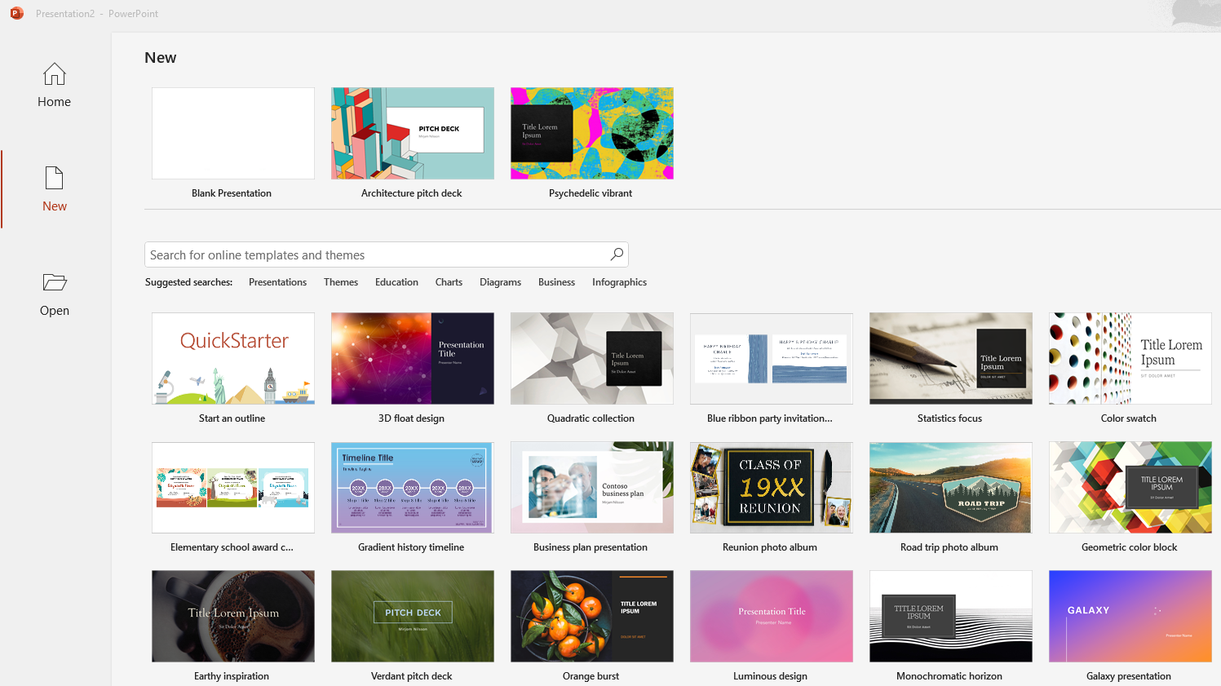
What’s New?
PowerPoint includes more options to create templates, themes, open a blank or recent presentation.

Slide 5
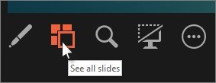
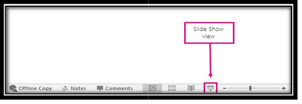


Improved Presenter View
View your speaker notes as you deliver your slide show
To view all the slides in your presentation, select See all slides.
At the bottom of the PowerPoint slide window, select Slide Show.
To manually determine which computer will display your notes in Presenter view and which will face the audience (Slide Show view), on the task bar, at the top of Presenter view, select Display Settings, and then select Swap Presenter View and Slide Show.
To point to or write on your slides as you present, select Pen and laser pointer tools.

Slide 6
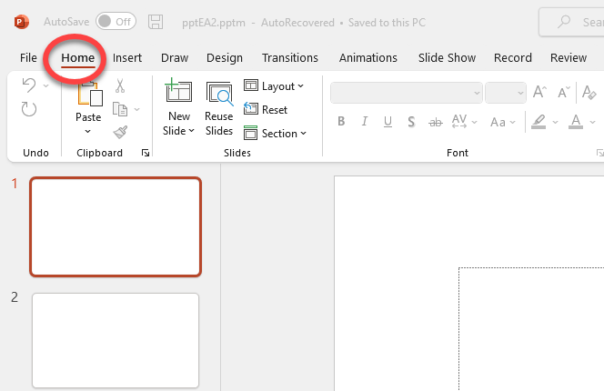
Insert a New Slide
1. On the Home tab, click New Slide, and pick a slide layout.
To rearrange slides, drag and drop a slide into a new position.
To delete a slide, select the slide (ctrl – click to select multiple) right click then select Delete Slide.

Slide 7
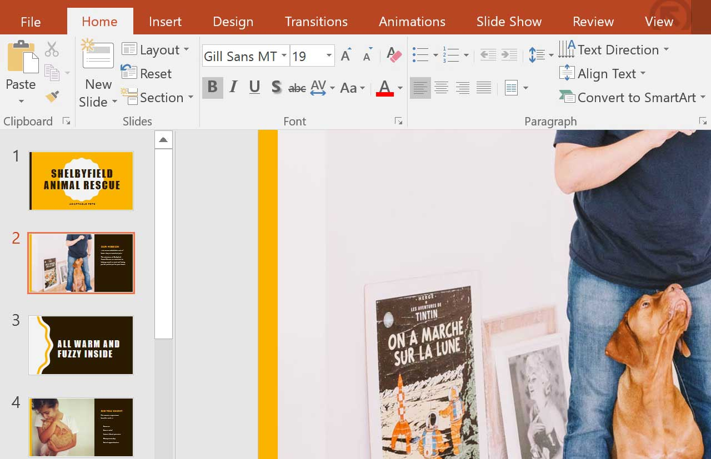
Editing Text
1. Highlight the given text.
2. Click one of these options:
Bold
Italics
Highlight
Color Change

Slide 8
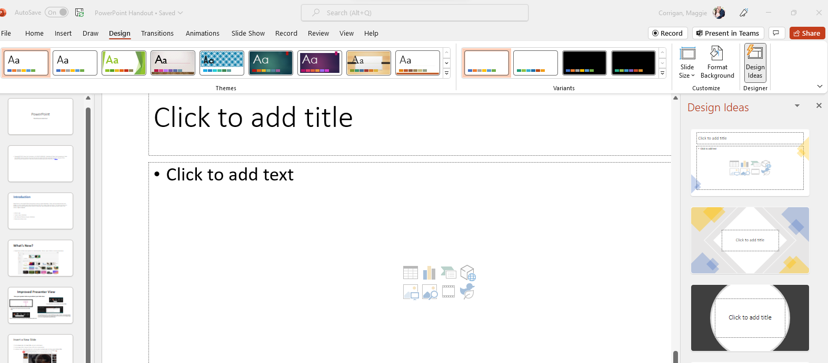
Design-Themes-Variants
click on design, from there you can change the theme, variant, or even improve the overall presentation with design ideas.

Slide 9
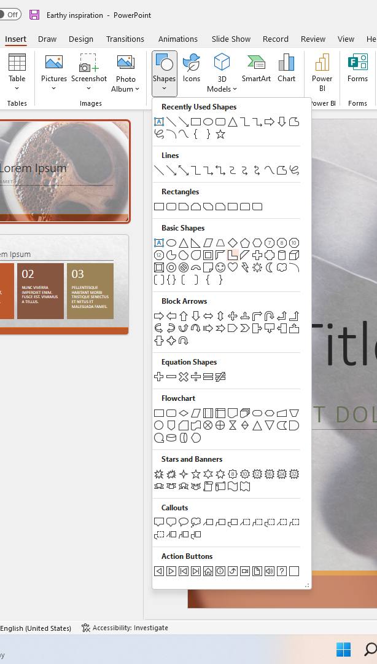
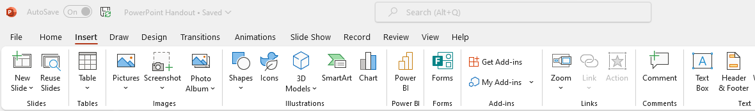
Creating a Custom 2-D or 3-D Shape
On the Insert tab-click Shapes
Pick the shape that you want, click anywhere on the slide, and then drag to draw the shape.

Slide 10
Creating a Custom 2-D or 3-D Shape Cont.
Line-up and space objects equally
No more eyeballing objects on your slides to see if they’re lined up. Smart Guides automatically appear when your objects, such as pictures, shapes, and more, are close to even, and they also tell you when objects are spaced evenly.

Slide 11
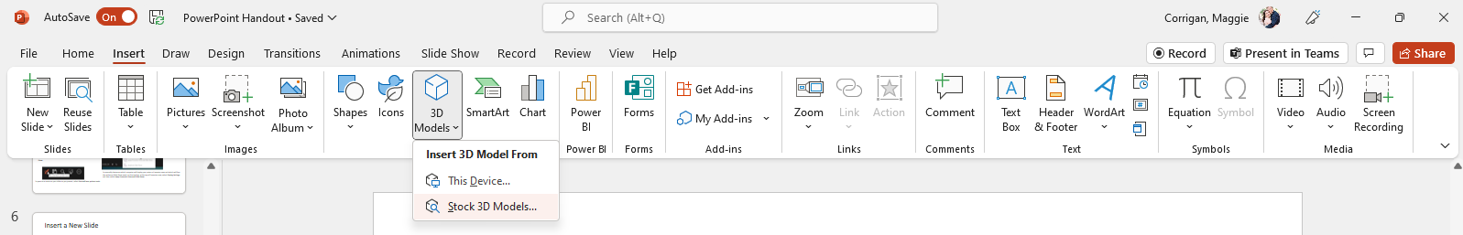
Inserting 3-D Shapes
3-D models help foster conceptual understanding as well as visual and spatial reasoning within different shapes, and objects.
- On the ribbon, click insert
- Click 3D Models > Stock 3D Models

Slide 12
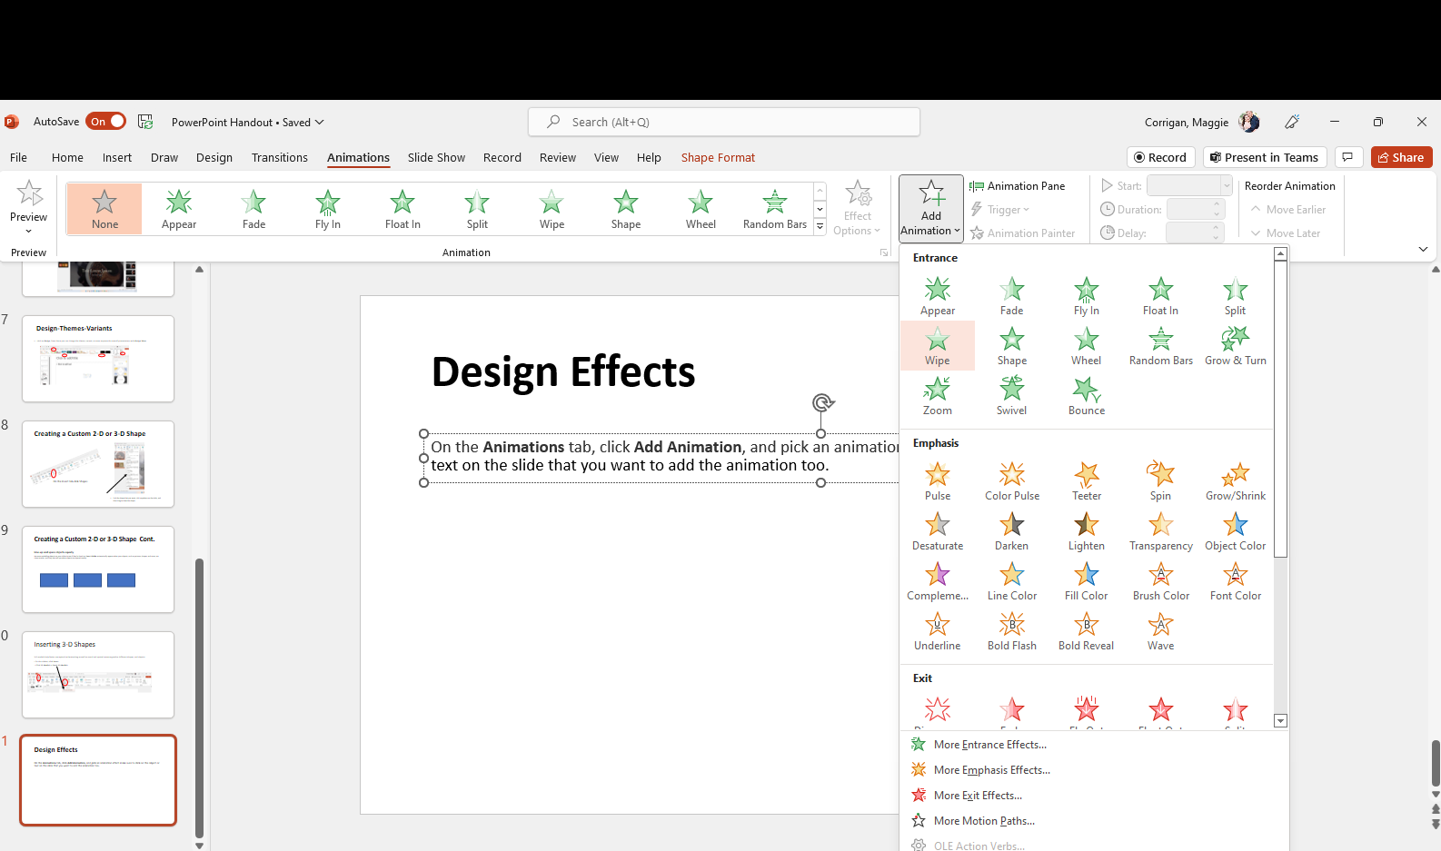
Design Effects
On the Animations tab, click Add Animation, and pick an animation effect make sure to click on the object or text on the slide that you want to add the animation too.

Slide 13
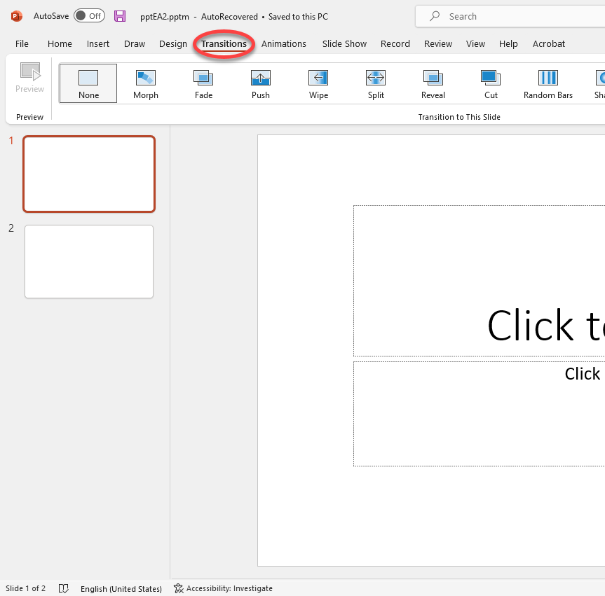
Transitions
Add or remove transitions between slides
Slides that snap from one to the next can be jarring to an audience. If you want the pace of your presentation to feel more controlled and flowing, add transitions between slides. Everything you need is on the Transitions tab.
In the Thumbnail Pane, click the slide that you want to apply a transition to. The transition setting dictates how that slide enters and the preceding slide exits
On the Transitions tab, find the effect that you want in the Transition gallery. Click the More button to see the entire gallery. Click the effect that you want for that slide and to see a preview.
3.Enter a time at Duration to set how fast the transition goes. Set the number higher to make the transition go slower. For more about transition timing, see Set the speed and timing of transitions.
4. Click Preview to see what the transition looks like with all the settings.

Slide 14
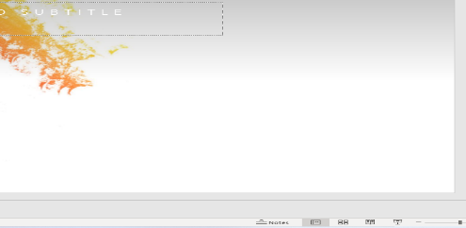
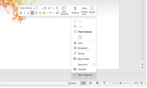
Adding Speaker Notes
Slides are best when you don’t cram in too much information. You can put helpful facts and notes in the speaker notes on each individual slide and refer to them as you present. The audience will not see these notes.
To open the notes pane, at the bottom of the window, click Notes.
Click inside the notes pane below the slide and begin typing your notes.
To add comments, right click within the notes panel.

Slide 15
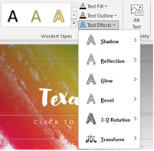
Format your text
To change the color of your text, highlight the text you want to change then click Text Fill, under the Shape Format Tab.
To change the outline color of your text, click Text Outline, and then choose a color.
To apply a shadow, reflection, glow, bevel, 3-D rotation, a transform, click Text Effects, and then choose the effect you want.

Slide 16
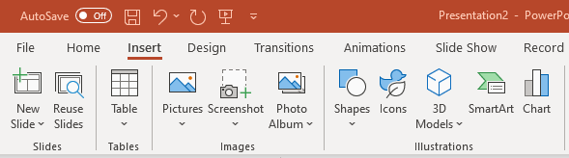

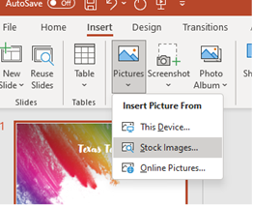
Add pictures from your computer
From the Insert tab, click Pictures.
Browse for the picture, and then click Insert.
Insert Stock/Online Pictures
From the Insert tab, click Pictures.
Use the search box to find a picture.

Slide 17
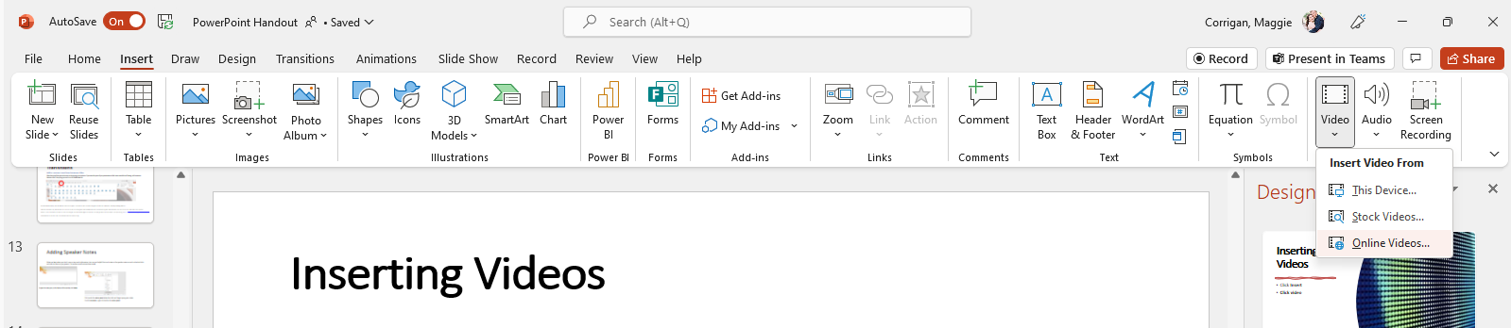
Inserting Videos
Click Insert
Click video

Slide 18
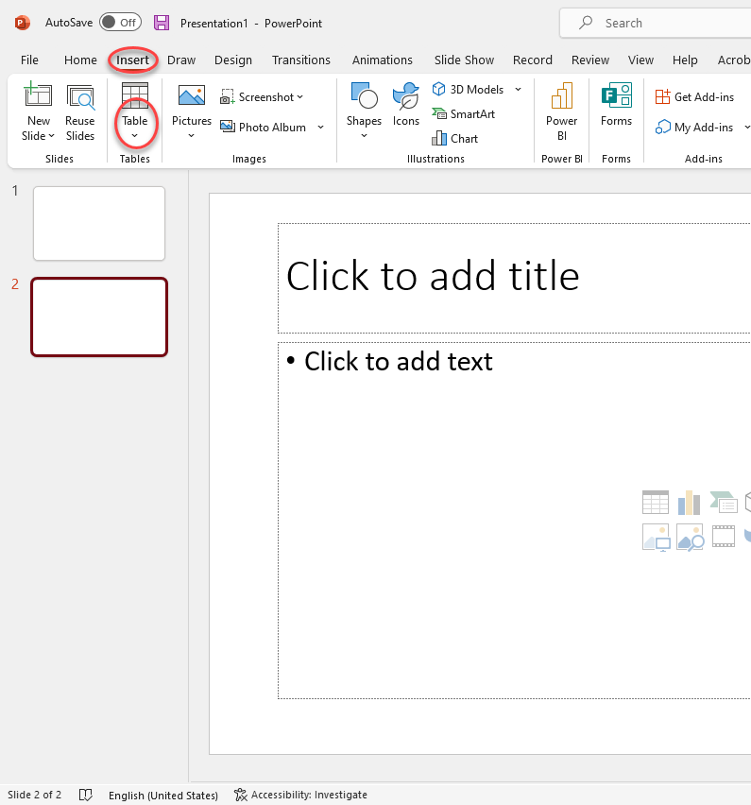
Table
Click Insert
Click Table

Slide 19
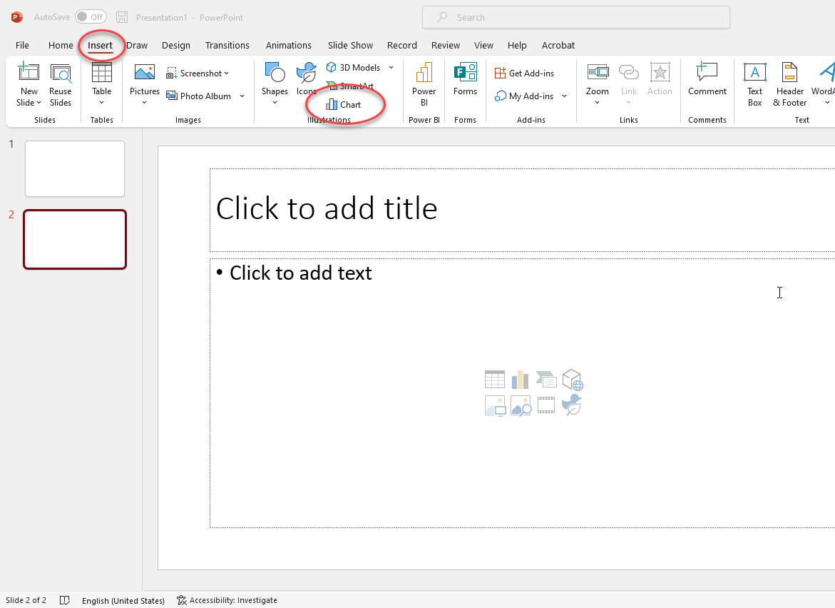
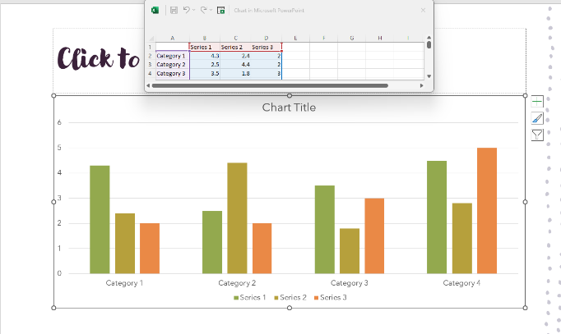
Charts
1. Click on insert, Chart
2. Edit data information with the excel pop-up box.

Slide 20

Share and save
Share and save your Office files to the cloud
The cloud is like file storage in the sky. You can get to it anytime you’re online. Now it’s easy to save your Office files to your own OneDrive or to your organization’s site. From there you can access and share your PowerPoint presentations and other Office files. You can even work together with your colleagues on the same file at the same time. • File-Save as-OneDrive

Slide 21
Export your presentation
Click the File tab and select Export and do one of the following:
1
Click Create Adobe PDF
Click Change File Type to save as a Template or JPEG.
Name the file and choose a location, then click Save.
2

Slide 22
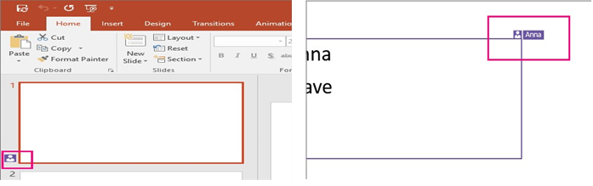
Real Time Presence
Collaboration is getting better and better in PowerPoint for Windows. When you share your presentation with others using OneDrive or Office 365 SharePoint, you can work together in real time. You can now not only see when others are working on the same shared presentation as you, but also see an indicator that shows you exactly what slides they're working on, and where in the slides they're working.

Slide 23
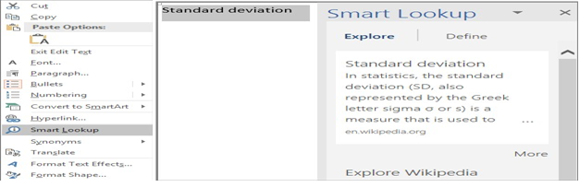
Insights into what you're working on
The Insights pane, powered by Bing, offers more than just definitions. When you select a word or phrase, right-click it, and choose Search, the insights pane will open with definitions, Wiki articles, and top related searches from the web. You can also get to Smart Lookup any time by going to Review > Search and entering a query there.

Slide 24
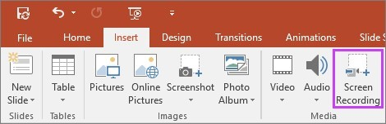
Screen recording
Perfect for demonstrations, you can now include screen recordings in your PowerPoint presentations with just a few clicks. Just set up whatever you'd like to record on your screen, then go to Insert > Screen recording, and you'll be able to select a portion of your screen to record, capture what you need, and insert it directly into your presentation in one seamless process.

Slide 25
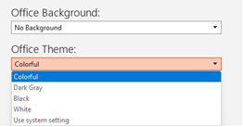
Colorful, Dark Gray, and White Office Themes
There are now three Office themes that you can apply to PowerPoint: Colorful, Dark Gray, Black, and White. To access these themes, go to File > Account, and then click the drop-down menu next to Office Theme.

Slide 26
Resources
This handout was created using information from the following sites:
presentationHA102809627.aspx?CTT=5&origin=HA102809628
https://support.microsoft.com/en-us/office/powerpoint-for-windows-training-40e8c930-cb0b-40d8-82c4-bd53d3398787
https://edu.gcfglobal.org/en/powerpoint/

Slide 27
Recommended FREE Online Resources
http://www.depts.ttu.edu/itts/software/cbt.php
http://cbt.ttu.edu

Slide 28

Assistance at TTU
For technical assistance, please contact IT Help Central at (806) 742-HELP or ithelpcentral@ttu.edu.
More information and training resources, including training videos, can be found at:
http://unifiedcommunications.ttu.edu. You can also contact IT Education Services at iteducation@ttu.edu or call the ATLC at (806)742-1650.

