Slide 1


SharePoint Online
Presented by IT Learning Technologies

Slide 2


WHAT IS SHAREPOINT ONLINE

Slide 3
OVERVIEW
With Microsoft SharePoint on your PC, Mac, or mobile device, you can:
Build intranet sites and create pages, document libraries, and lists. | Add web parts to customize your content. | Show important visuals, news, and updates with a team or communication site. | Discover, follow, and search for sites, files, and people across your company. | Manage your daily routine with workflows, forms, and lists. | Sync and store your files in the cloud so anyone can securely work with you. | Catch up on news on-the-go with the mobile app.

Slide 4

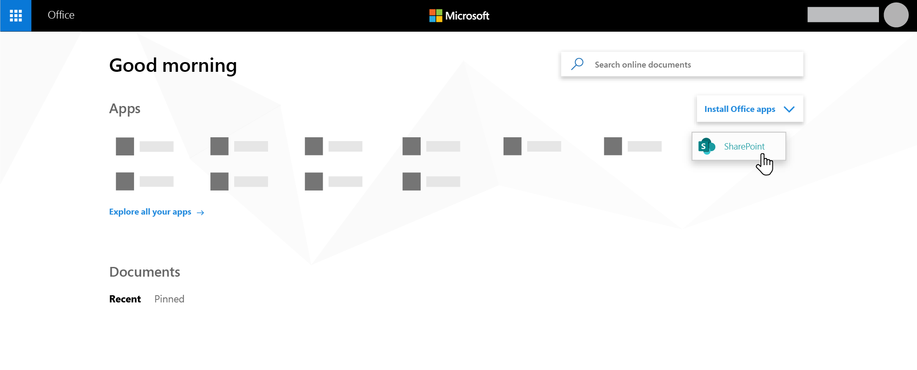
START PAGE
⯈To view the SharePoint in Microsoft 365 start page in Microsoft 365: Go to Office.com
⯈Sign into Microsoft 365 with your TTU email and password
⯈In the top left corner of the page, select the app launcher icon , and then select SharePoint.

Slide 5

⯈ Use a communication site to broadcast information out to a broad audience.
⯈ With a communication site, typically only a small set of members contribute content that is consumed by a much larger audience.
⯈ If you want to collaborate with other members of your team or with others on a specific project, a team site is the better choice.
⯈ With a team site, typically all or most members can contribute content to the site and the information is limited to only the members of the team or project and specific stakeholders.
COMMUNICATION SITE VS. TEAM SITE

Slide 6

⯈ A SharePoint communication site is a great place to broadcast information to others. Share news, reports, status updates, and more in a visually appealing format. Use communication sites to engage and inform broad audiences.
Create portals, department, or project-specific sites
Share company news, announcements, and events
Engage dozens, or thousands, of viewers
⯈ If you need a site for collaborating with your team, use a team site instead.
WHAT IS A COMMUNICATION SITE

Slide 7

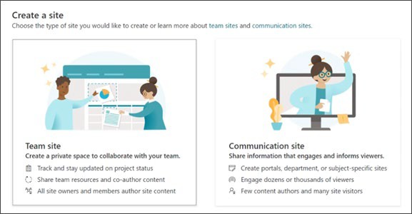
⯈ At the top of the SharePoint home page, click + Create site and then choose the option for Communication site
CREATING A COMMUNICATION SITE

Slide 8

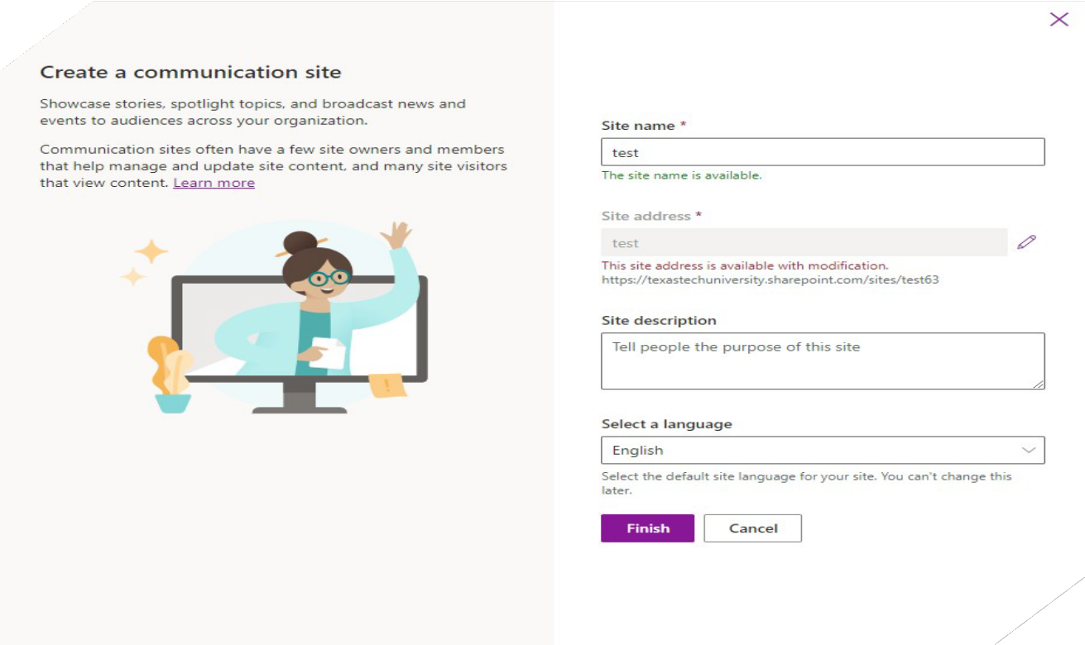



CREATING A COMMUNICATION SITE
You will name your new site and put a general description in the Site Description box.
Name
Choose a language for your site
(Important: once you select a language you cannot change it later – So make sure you select correctly)
Choose
Open up
Select next/finish and your new site will open.

Slide 9

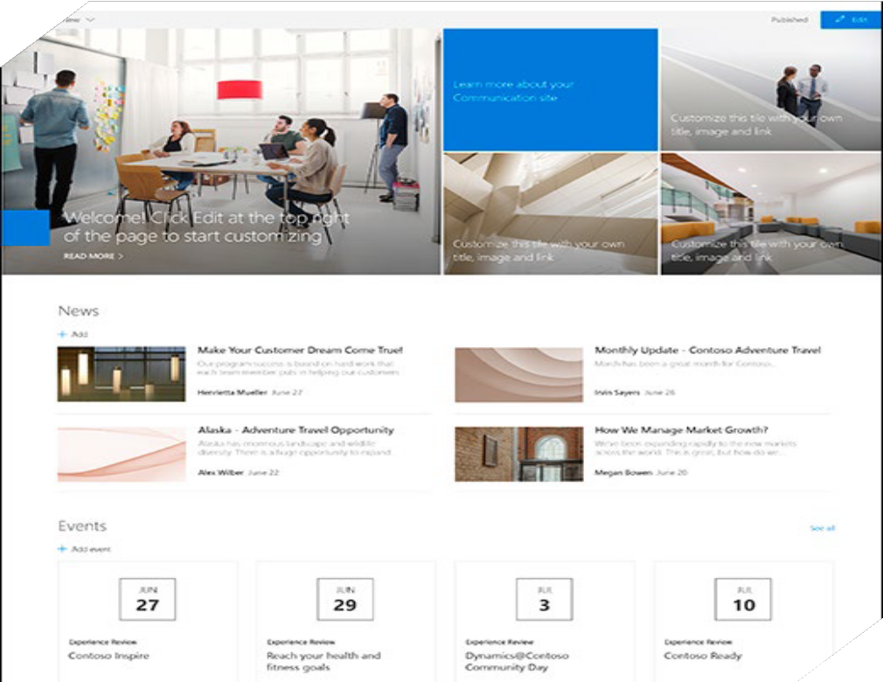
⯈ When you create a communication site in SharePoint, you can start with a blank site or choose one of the other site templates, each of which comes with a default set of web parts. Some of the communication site template options are:
Topic to share information such as news, events, and other content.
Showcase to use photos or images to showcase a product, team, or event.
Blank to create your own design.
⯈ Note: The Topic site is the default SharePoint communication site.
TEMPLATES

Slide 10







How to customize your Microsoft SharePoint Online website
These next tips will help you find out how to:
₁ Customize ₂ Customize ₃ Customize ₄ Customize logo navigation theme page layout
₅ Customize
web parts

Slide 11

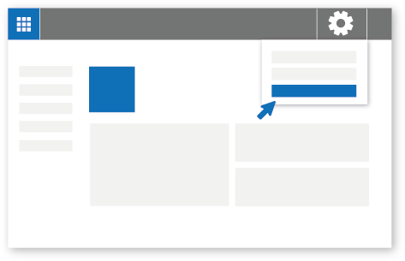
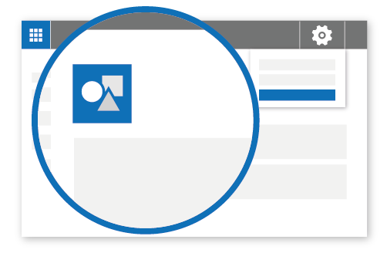
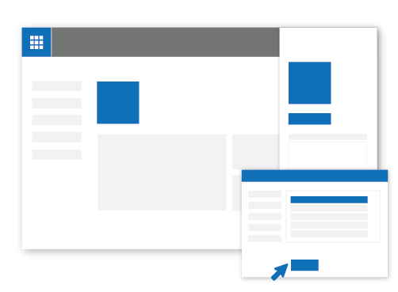


Customize your logo
You can change the logo for your site.
Office 365 | SharePoint
TS
Team Site
Site information
Team Site
Site information
Office 365 | SharePoint
TS
Change
TS
Team Site
A
> Site information.
C
Click on
yourlogo.jpg
Review your updated logo.
B
The Site information panel will open.
Click Change the look and then choose Header,
Scroll down to Site logo, Select Change
select the image you want to use, then click Open > Save. Recommended logo size is 64px x 64px.
save

Slide 12

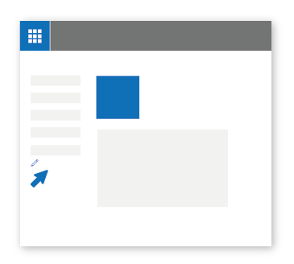
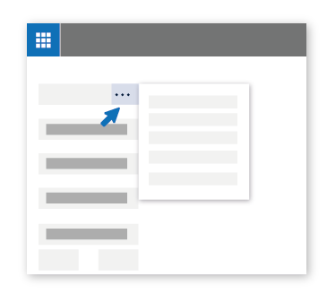
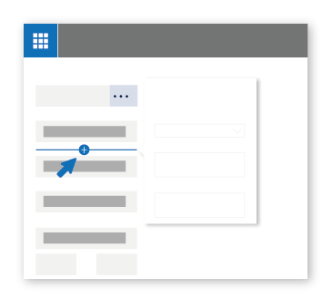
Customize the navigation
You can add, delete, or change the order or position of links on the left-hand (Quick Launch) nav, top nav, or hub nav bar.
Office 365 | SharePoint Office 365 | SharePoint
Office 365 | SharePoint
Home
TS Team Site
Home
Edit
Move up Move down
Make sub link Remove
Home
Add a link
Choose an option
URL
Address
http://
Edit
Display Name
New Menu Item
Save
Cancel
Save
Cancel
A
B
C
To add a new link, click the
+ icon that appears when you place your mouse pointer above or below a link. In the dialog box that appears, choose URL to add a custom link or choose one of the default items associated with your site. Then click OK.
To make changes to the nav, click
To edit existing links, click the ellipses (...)
next to the link.
Edit - Changes the address and/or display name
Move up - Moves the link up
Move down - Moves the link down
Make sub link - Makes the link a sub link of the link above it
Promote sub link - Converts a sub link to a top-level link
Remove - Deletes the menu item
Edit. (NOW AT THE TOP in
Communication site)

Slide 13

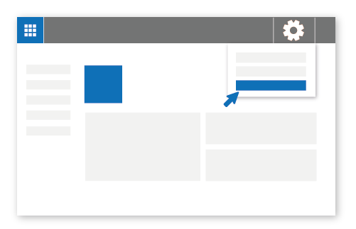
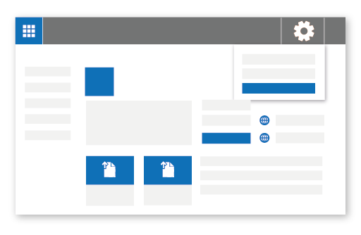
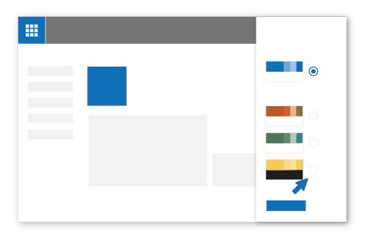
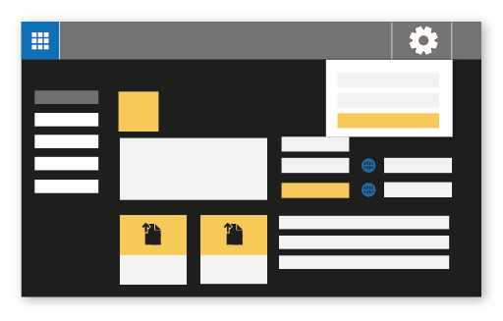

Customize the theme
Here’s how to change the look of your SharePoint Online website.
Office 365 | SharePoint
Office 365 | SharePoint
TS
Team Site
Change the look
TS Team Site
Change the look
Office 365 | SharePoint
TS Team Site
Change the look
Change the look
Office 365 | SharePoint
Abc
Current
SharePoint Themes
TS
Team Site
Change the look
Abc
Orange
A
> Change the look.
Abc
Green
Abc
Dark Yellow
Click on
Apply
C
B
The Change the look panel will open. Select the theme you want to use and then click Apply. If selecting an out-of-the box theme, you can further customize the main and accent colors.
Before and after
Here’s an example of what happens when you choose the Dark Yellow theme for a SharePoint Online team site.
The background turns to black, the text switches to white, and the other elements change from blue to yellow.

Slide 14

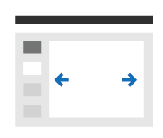
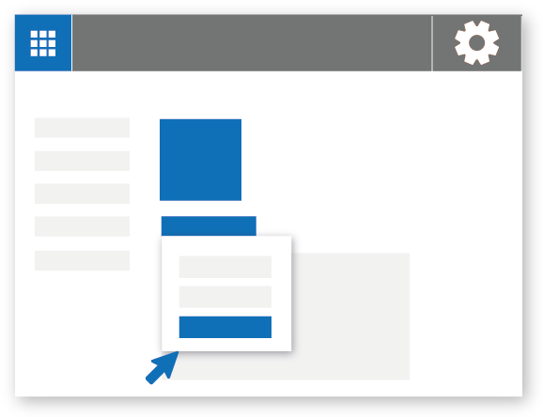
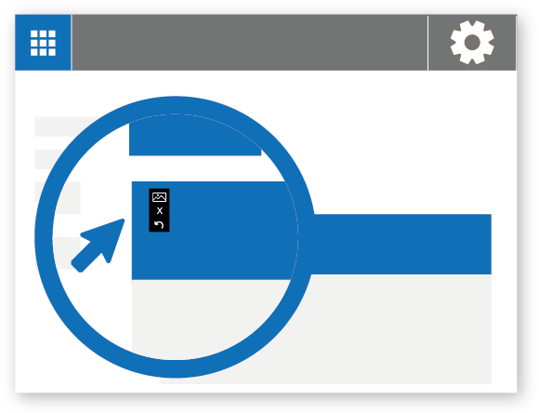

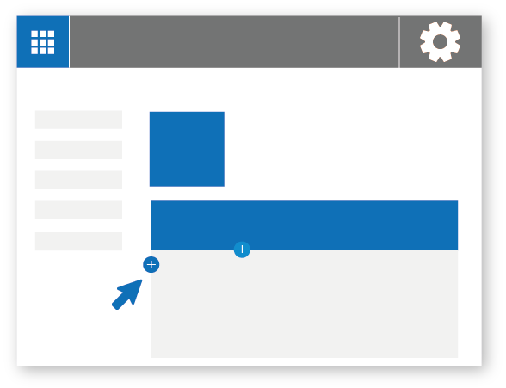
Add pages
You can easily add new pages and content to your site. Here’s how:
Office 365 | SharePoint
Office 365 | SharePoint
Pages
TS
Team Site
Team Site
One column
Two Three
column column
+ New
Page Title
Office 365 | SharePoint
Page
One-third left
One-third right
TS
Team Site
A
Click on New>Page
Page Title
C
Click the + icon on the left to add sections and columns Click the + icon in the center to add web part
Publish
Users on the site won't see the page until you publish it.
Published pages are viewable by users who have the appropriate permissions on the site.
B
You can add a page title and image

Slide 15
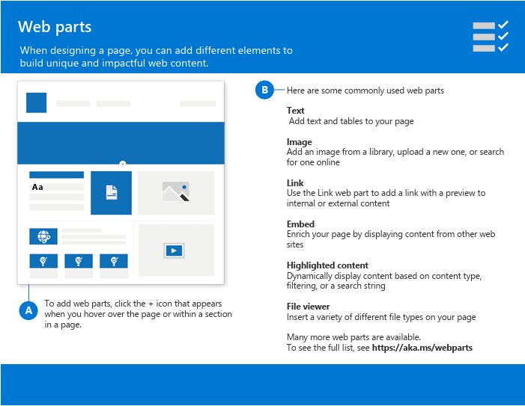
A

Slide 16
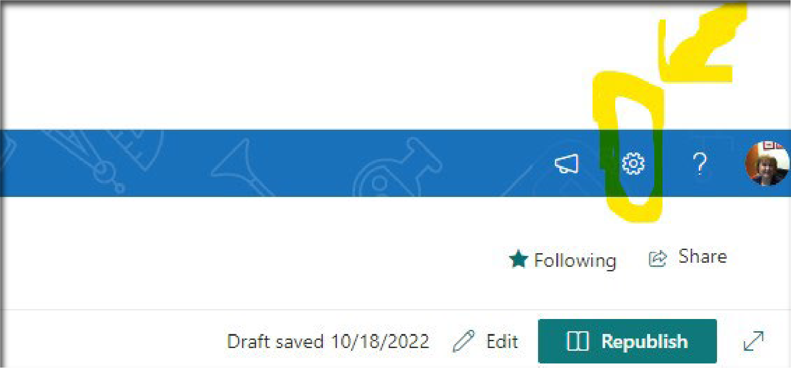
⯈ Click on the settings icon on the top right corner of your site
⯈ Click on change the look
DEEPER LOOK AT CUSTOMIZATION
THERE ARE SEVERAL THINGS YOU CAN DO TO CUSTOMIZE YOUR SHAREPOINT SITE IN MICROSOFT 365

Slide 17
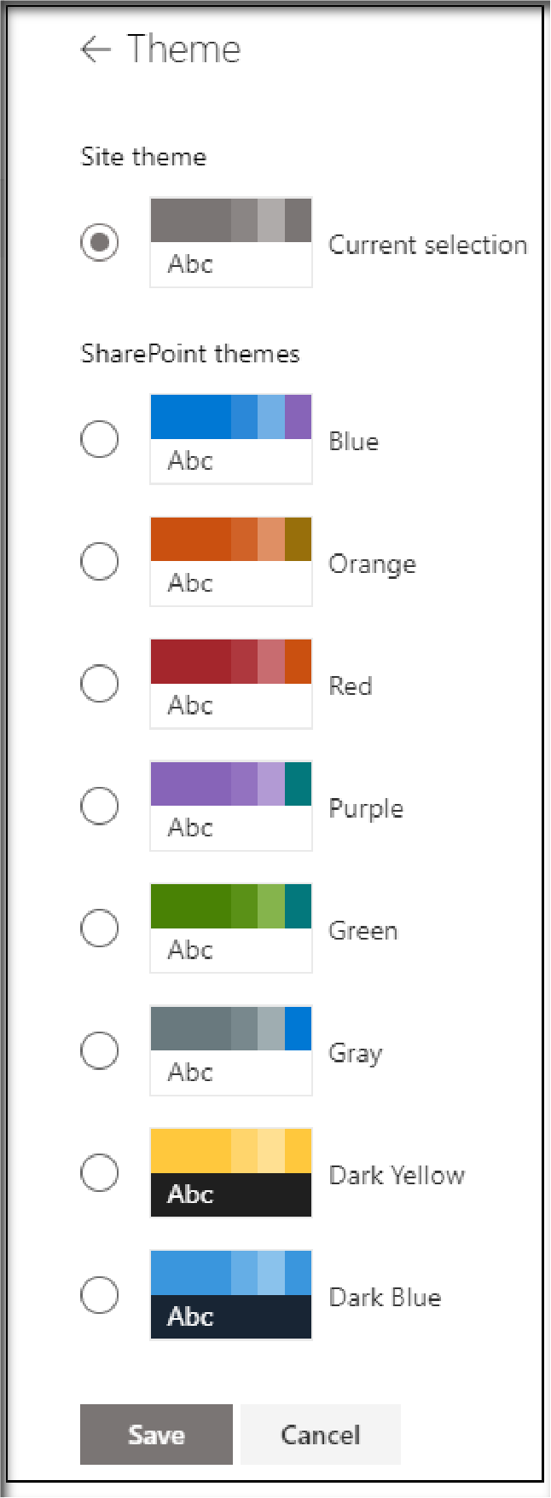
THEME
⯈ You can change the look and color for your site theme

Slide 18


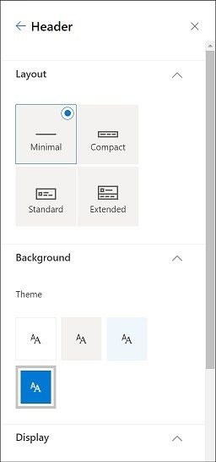
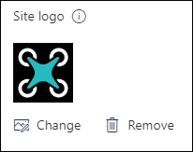

HEADER
From here you can change the header and logo

Slide 19

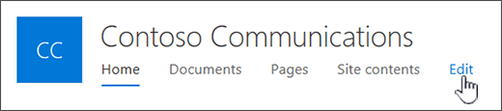
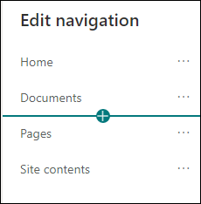
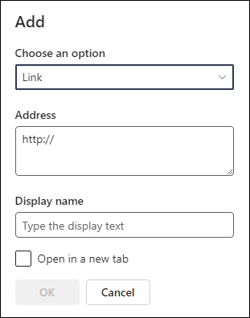
⯈ Select Edit to the right of the navigation menu
⯈ Hover in between the existing links where you want to add and click the + sign
⯈ A link will add a link to a site either internal or external
⯈ A label will add text to your navigation menu that is not clickable
⯈ Type or paste the web address of the link in the address box
⯈ Type the name you want to show in the navigation bar
⯈ Put a check in Open in New Tab
⯈ Click OK
NAVIGATION

Slide 20

⯈ SharePoint offers you the ability to collaborate on documents at the same time. It gives you a central location for storing documents so that they are available to everyone you share with.
COLLABORATE

Slide 21
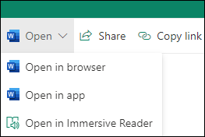
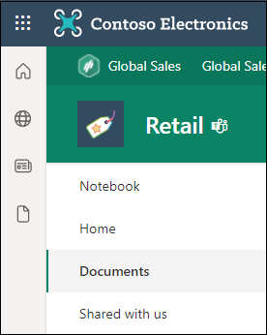
⯈ Go to your SharePoint site
⯈ Click Documents from the Top Menu
⯈ Select a document to view
OPEN A DOCUMENT FROM THE LIBRARY

Slide 22

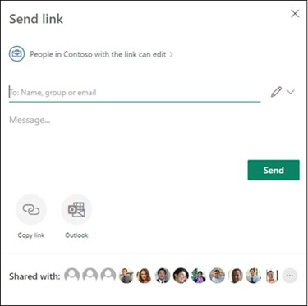
⯈ Select the document you want to share
⯈ Select Share
⯈ You have three options
⯈ Type the names or email address of those you want to share with and add a message then send
⯈ Select COPY LINK to create a direct link to the file that you can then share via email or IM
⯈ Select Outlook to open Outlook on the web and add a link to the file in the new message
SHARE A DOCUMENT

Slide 23

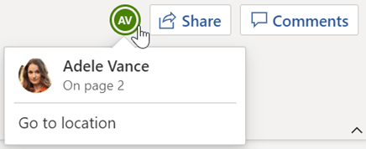
⯈ Open the document for editing in Office for the web.
⯈ The number of people currently editing the document appears at the top of the document in Office Online.
⯈ You will be able to see what is being changed in the document in real time
WHO IS WORKING ON THE SAME DOCUMENT?

Slide 24
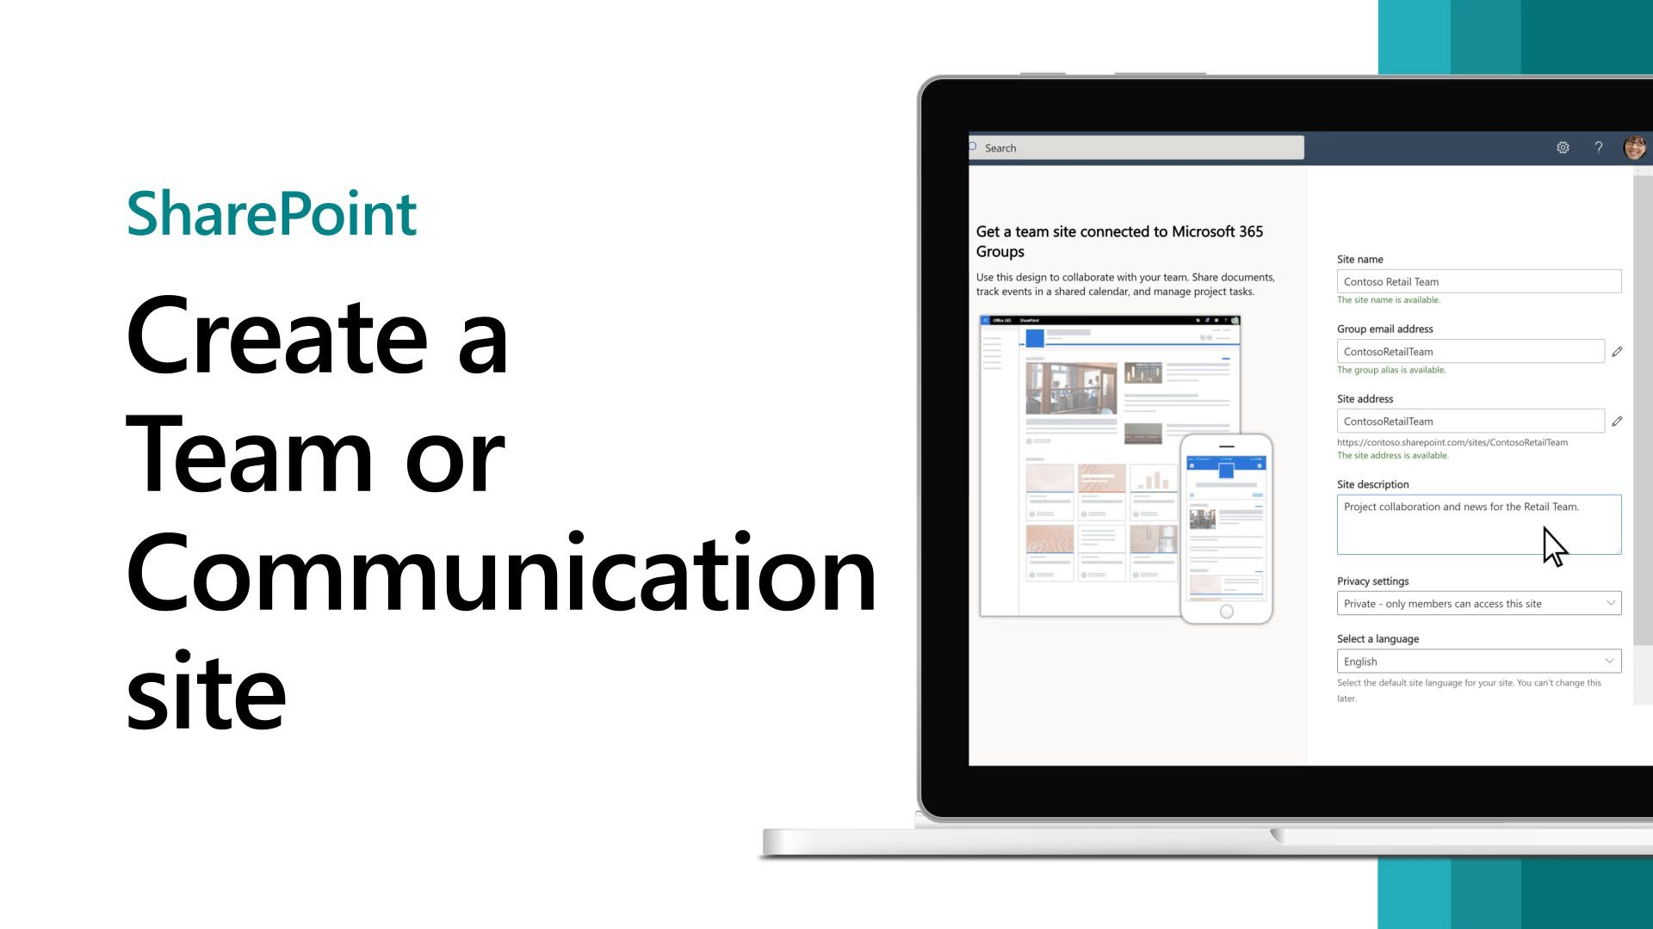
Create a Team or Communication Site
TEAMS SHAREPOINT SITE

Slide 25
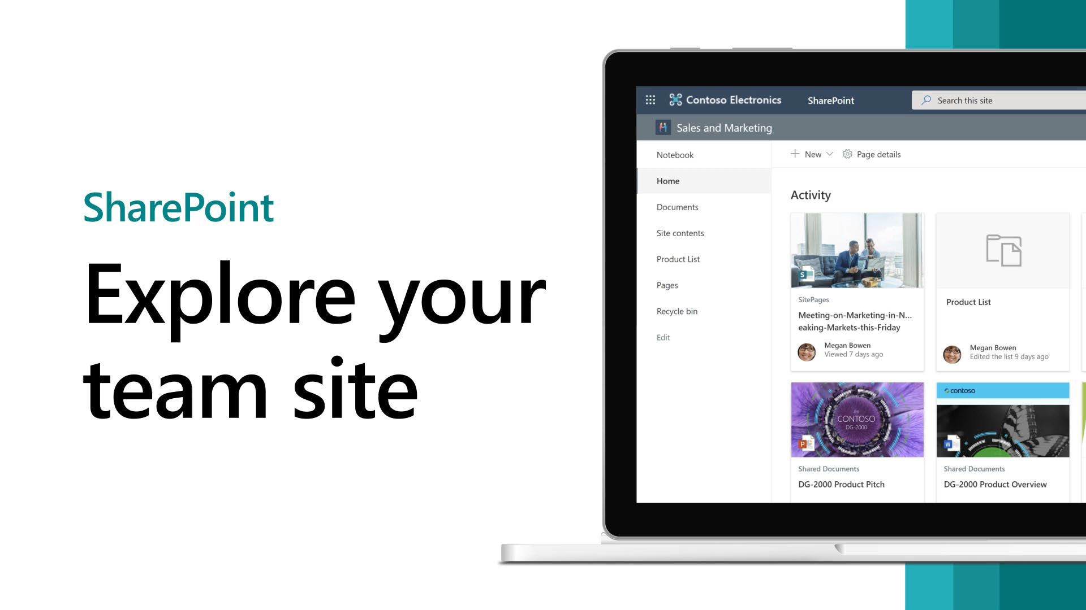

A MICROSOFT SHAREPOINT TEAM SITE CONNECTS YOU AND YOUR TEAM TO THE CONTENT, INFORMATION, AND APPS YOU NEED.

Slide 26

⯈ Use team sites to
⯈ Store and collaborate on files
⯈ To create and manage lists of information
⯈ Track and stay updated on project status
⯈ Organize and co-author shared content
⯈ Connect to a Microsoft 365 group to access team resources
⯈ If you need a site for broadcasting information out to others, use a communication site instead.
WHY USE A TEAMS SITE?

Slide 27
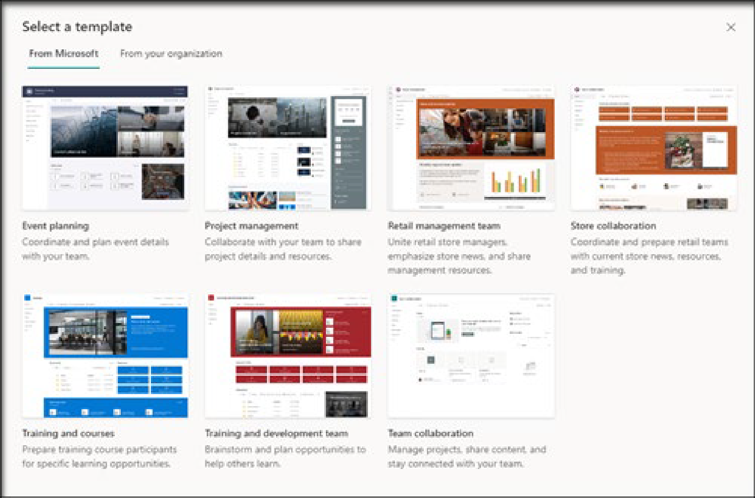
⯈ Start by creating a new team site. By default, you will get a new Team collaboration site template.
⯈ To browse more team site templates, select Settings and then Site templates to view template options.
CREATE A TEAM SHAREPOINT SITE

Slide 28

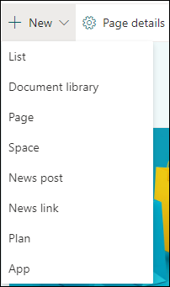
At the top of a team site, you'll see the site logo, the name of the site, and whether the site is private (only approved members can view) or public (anyone in your organization can view).
⯈
⯈
If you have permission to edit the site, there's also a link at the top of the team site to add a new list, document library, page, space, news post or link to a news post, Microsoft Planner board, or SharePoint app to the site.
REVIEW TEAMS SITE CONTENT

Slide 29
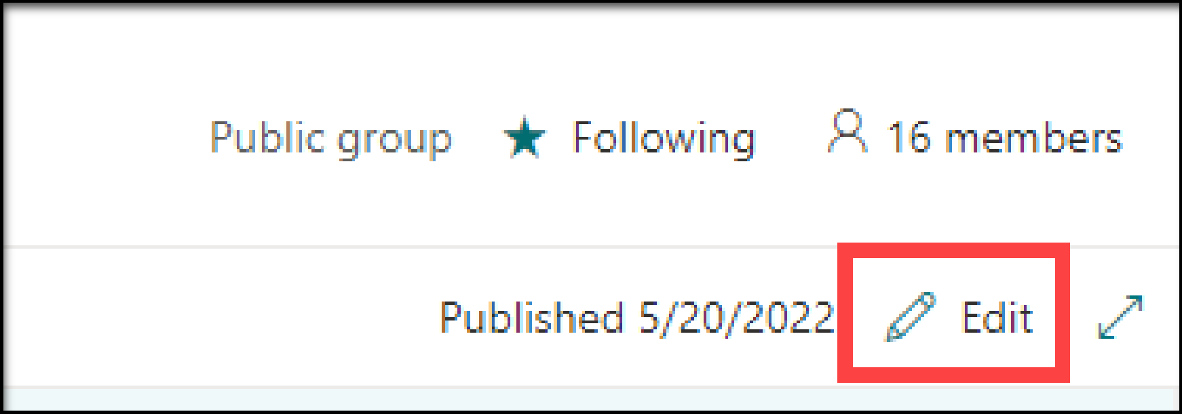
EDIT THE HOEMEPAGE
⯈ If you have edit or owner permissions on the site, you can edit the home page by clicking Edit in the top right corner of the page and then make your changes.
⯈ The editing in a Teams Site is very similar to the previous training you saw here for a Communications site.

Slide 30
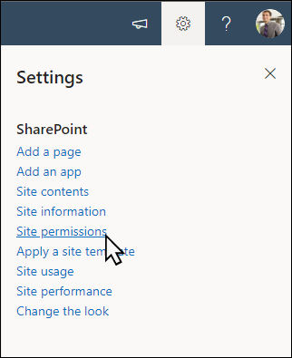
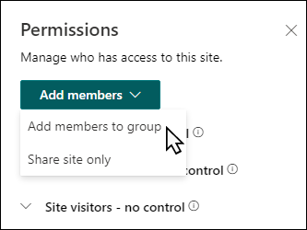
Share your site with others after you've customized your site, reviewed it, and published the final draft.
Select Add members and then select Add members to group.
Select Add members then enter the name(s) of all users you want to grant full access to team site content, shared resources like the team Outlook calendar and editing rights to the site.
Select Save when finished adding members and setting permissions.
SHARING YOUR SITE

Slide 31


RESOURCES
SHAREPOINT LOOKBOOK
SHAREPOINT VIDEO
TEAMS SHAREPOINT SITES

Slide 32
⯈ So that concludes our SharePoint training.
THE END!
Now I would like to open things up for questions and hands on lab time.
⯈ ANY QUESTIONS!

