Slide 1

Zoom Handout

Slide 2
Introduction to Zoom Workplace
Zoom Workplace is an easy, reliable cloud platform that has evolved beyond just video and audio conferencing. It now offers a comprehensive suite for collaboration, chat, webinars, events, and more, seamlessly integrating across mobile devices, desktops, telephones, and room systems. This guide provides instructions on using the key features of Zoom Workplace in 2025.

Slide 3
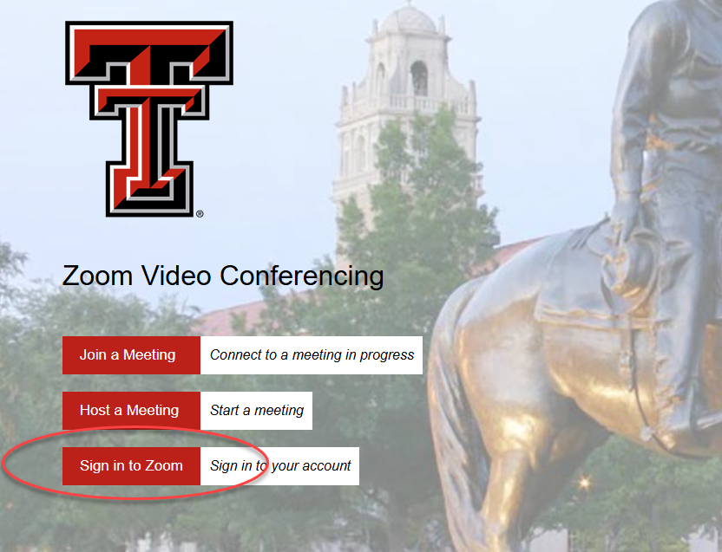
Getting Started & Signing In
To begin using Zoom Workplace, download the desktop client for Windows or Mac from Zoom's Download Center at https://zoom.us/download.
TTU Zoom: https://texastech.zoom.us/
TTU Single Sign-On (SSO) Note: If you have a Zoom license through Texas Tech University, do NOT use the "Sign Up Free" option. Instead, select "Sign In" and then "Sign in with SSO." Enter "texastech" or "ttu" as the company domain. You will then be redirected to the TTU eRaider login page to complete the sign-in process. For assistance with your TTU Zoom license, contact itts.licensing@ttu.edu.

Slide 4
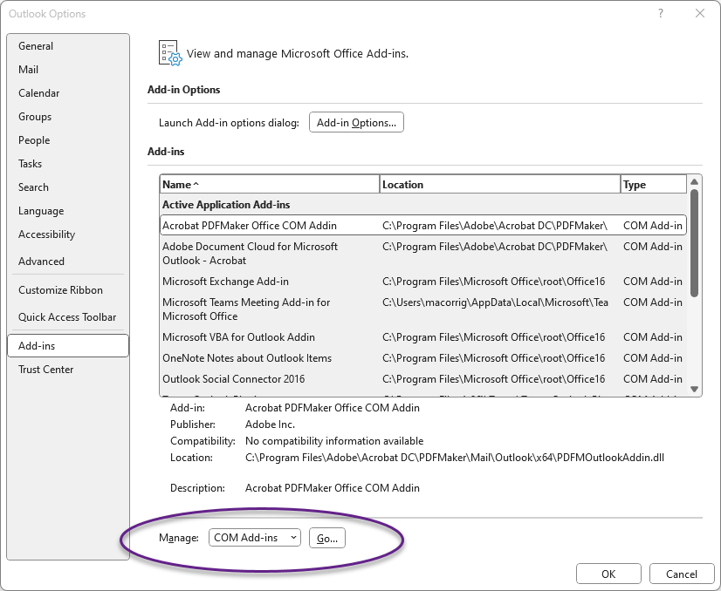
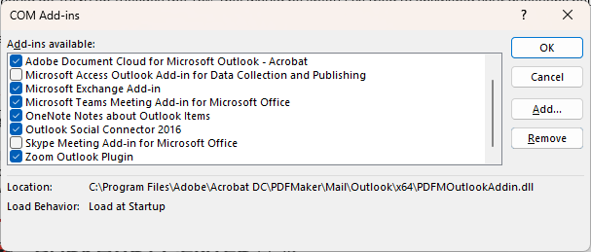
Adding the Zoom for Outlook Add-in
For Outlook Desktop App (Windows/Mac)
Open your Outlook desktop application.
Navigate to the “File" tab in the ribbon and click “Options” → “Add-ins”
Manage: COM Add-ins, click “Go”
Click “Zoom Outlook Plugin" → “OK”
Follow any on-screen prompts to complete the installation. You may need to restart Outlook for the add-in to appear.
When creating a new meeting or event in Outlook, you should now see a "Zoom" button or option to "Add a Zoom Meeting" in the toolbar.
Note: A Microsoft Exchange account is usually required for the desktop add-in. If you encounter permission errors, contact your IT administrator.

Slide 5
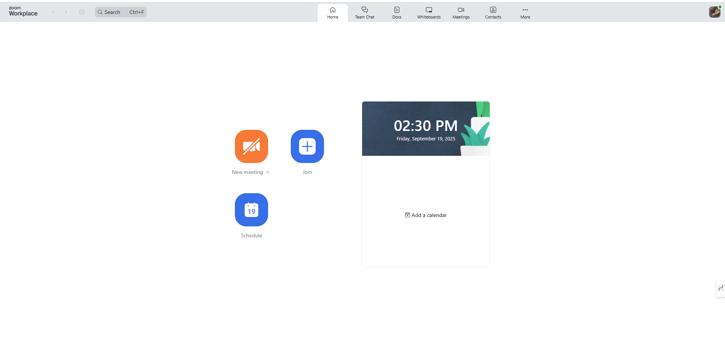
Home Tab
Primary Actions
New Meeting: Start an instant meeting.
Join: Enter a meeting ID to join.
Schedule: Set up a future meeting.
Date & Time: Customizable background
Profile Picture Menu
Personal meeting ID
Edit Name, Department, Job Title, ect.

Slide 6
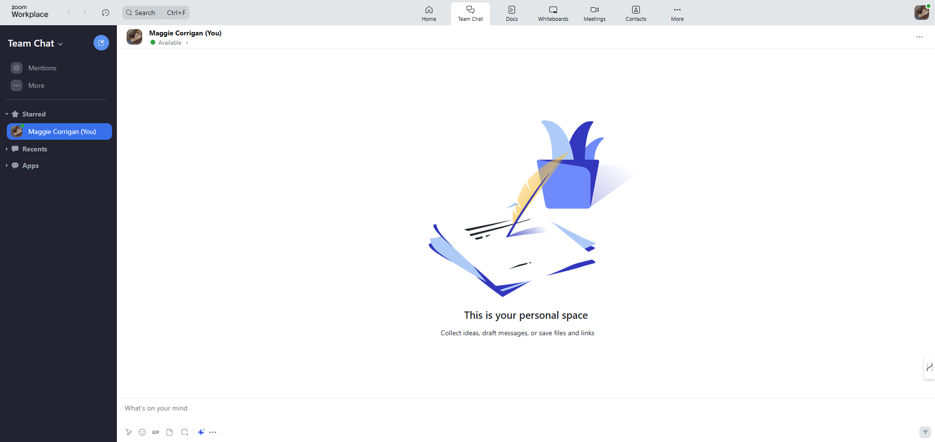
Team Chat Tab
Key Features:
Customizable Sidebar: Organize chats, channels, and apps.
Continuous Meeting Chat: Chats persist after meetings.
External Collaboration: Chat with outside contacts.
AI Companion Integration: Summarize chats, draft messages.

Slide 7
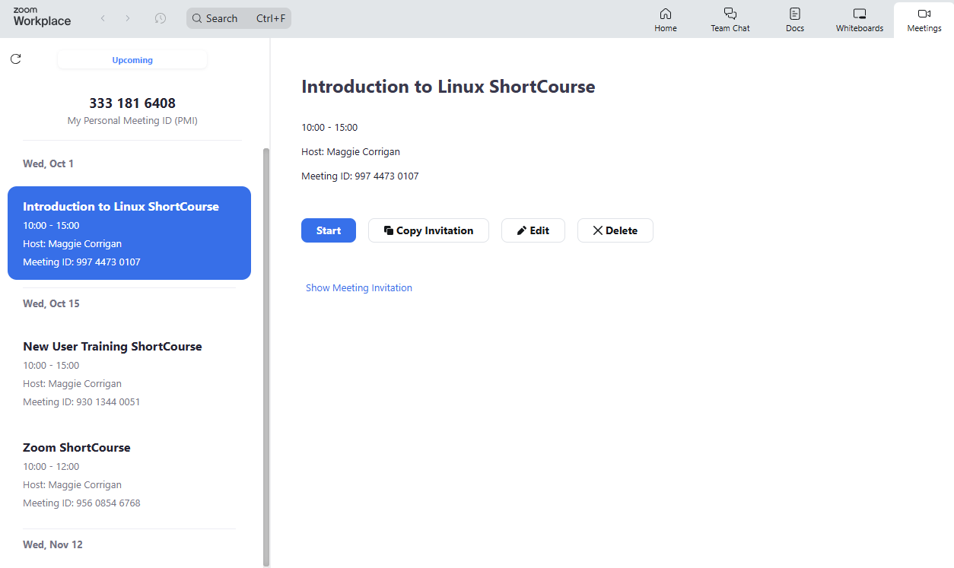
Meetings Tab
Meeting Actions
Start: Begin the scheduled meeting.
Copy Invitation: Copy details to share.
Edit: Modify meeting options.
Delete: Permanently remove the meeting.
Reactions: Use non-verbal feedback (e.g., thumbs up, clap) during meetings.
AI Companion Features
Meeting Summary: Get AI-powered summaries.
Smart Recording: Cloud recordings with chapters.
In-Meeting Questions: Ask the AI for info during a meeting.

Slide 8
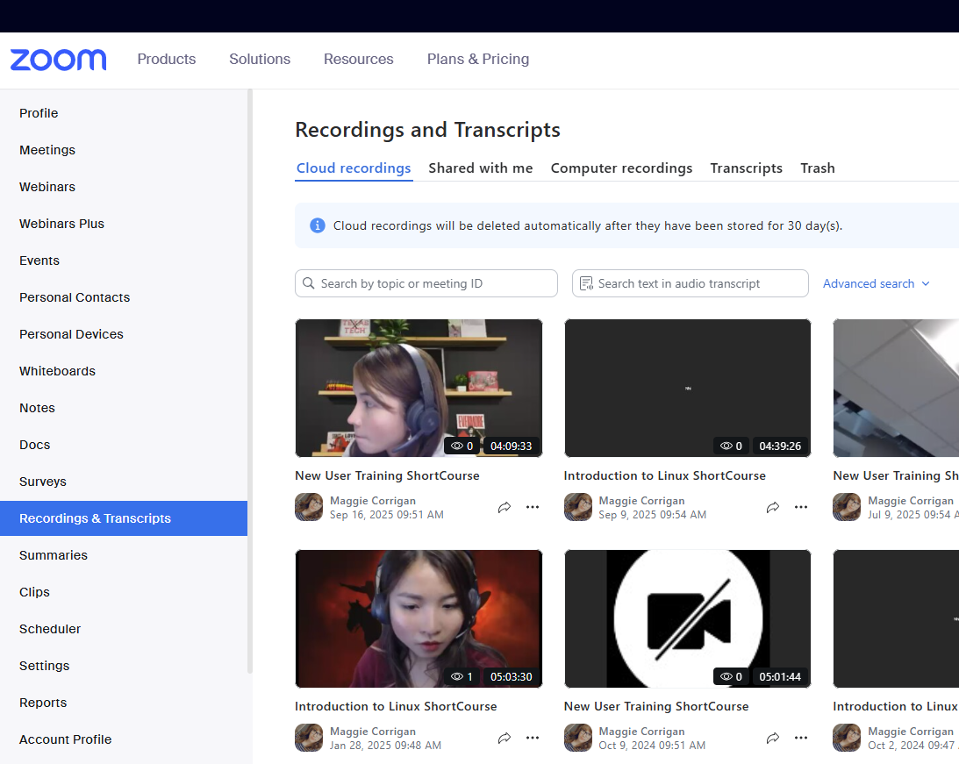
Recording Management
Accessing Recordings:
Cloud Recordings: Sign in to the Zoom web portal, then navigate to the "Recordings" tab. Here you can view, play, download, and share your cloud recordings.
Local Recordings: These are saved to your computer's hard drive. By default, they are usually found in a "Zoom" folder within your "Documents" folder.
Sharing Recordings:
For cloud recordings, you can share a link directly from the Zoom web portal. You can set password protection, expiration dates, and disable download options for enhanced security and control over who can access your content.

Slide 9
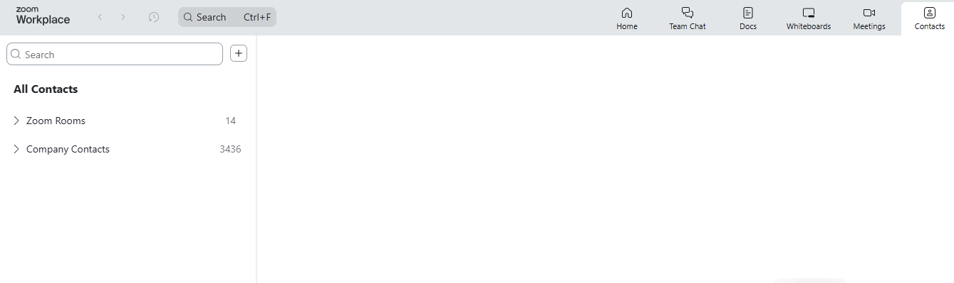
Contacts Tab
Contacts tab: Directory of all contacts (starred, external).
Channels tab: Directory of your group messaging channels.
Add icon (+): Add contacts or create contact groups/channels.

Slide 10
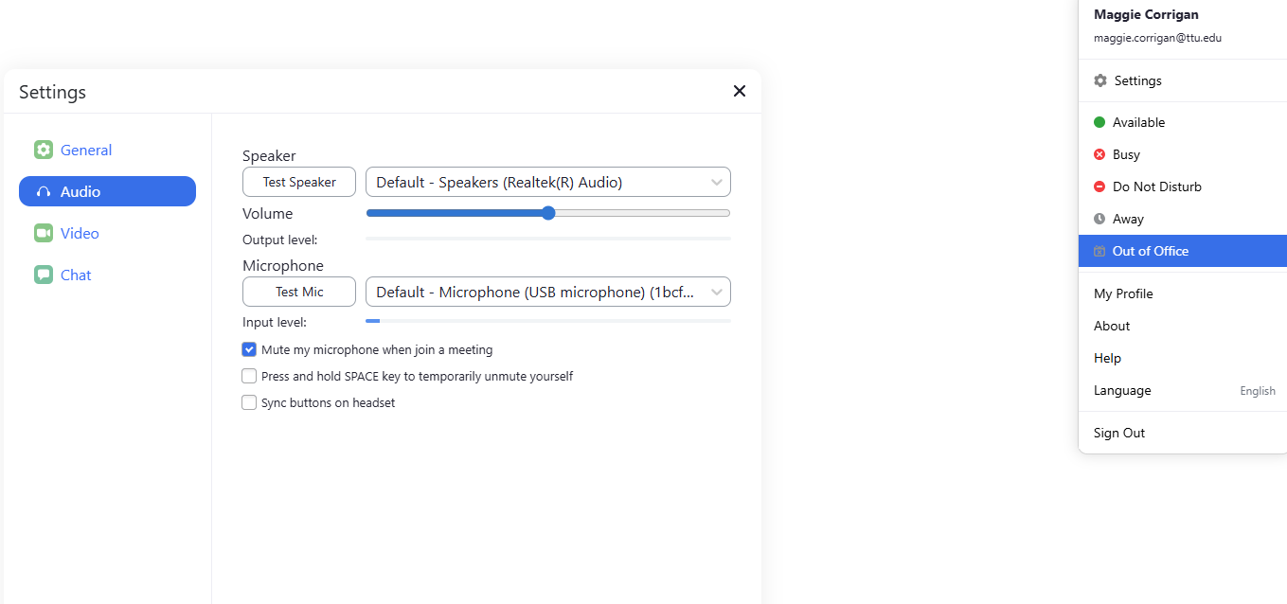
Testing Audio
Via Settings
Click your profile picture, then Settings.
Go to the Audio tab to test your speaker and mic. You can also access advanced features like Noise removal and Personalized audio isolation.
Before a Meeting
After clicking to join, select Test Speaker and Microphone.
Follow prompts to test speakers (ringtone) and microphone (audio replay).
Select Join with Computer Audio.

Slide 11
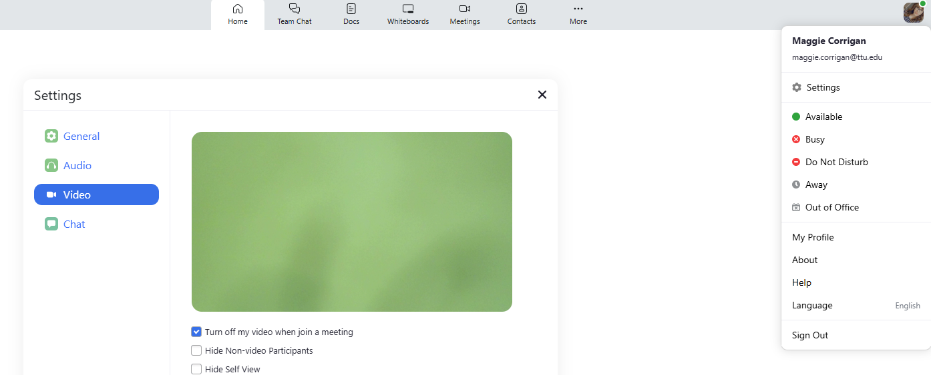
Testing Video
Click your profile picture, then Settings → Video tab.
You will see a preview of your camera. Choose a different camera if needed.
Explore settings like Portrait lighting to enhance your appearance.
You can also set a Virtual Background to replace your real surroundings with a clean, professional backdrop.
During a meeting, click the arrow next to Start/Stop Video and select Video Settings to make adjustments.

Slide 12
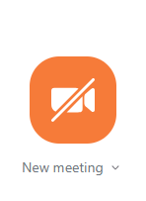
Hosting a Meeting
Open the Zoom Workplace Client and Sign In.
From the Home tab, click the arrow next to New Meeting and ensure Start with Video is checked if desired.
Click New Meeting to begin immediately.

Slide 13
Meeting Roles
Host
The host is the user who scheduled the meeting. They have full control over the meeting, including managing participants, starting/stopping recordings, creating polls, and managing breakout rooms. There can only be one host per meeting.
Co-Host
Co-hosts share many of the controls that hosts have, allowing them to manage the administrative side of a meeting, such as managing participants, starting/stopping recordings, and managing polls. Co-hosts cannot start a meeting, manage alternative hosts, or end the meeting for all participants. A host must assign co-host privileges during the meeting.
Alternative Host
An alternative host is someone who can start the meeting on behalf of the original host. They have most of the host controls once they start the meeting. Alternative hosts must be on the same account as the scheduler. The host can assign alternative hosts when scheduling the meeting.

Slide 14
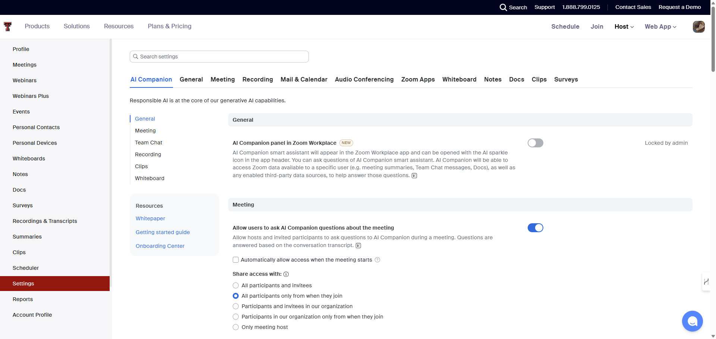
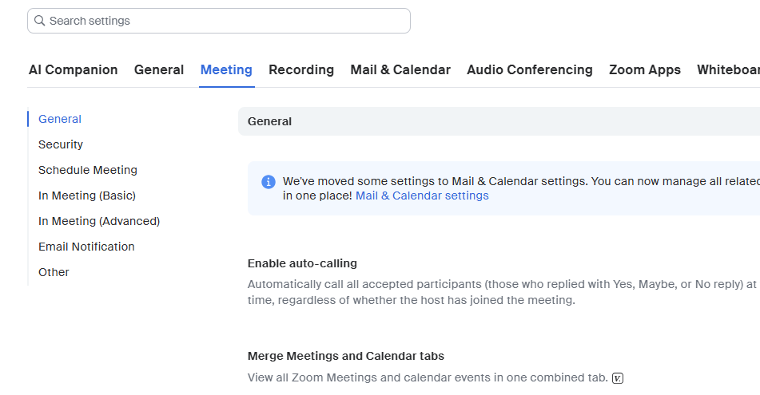
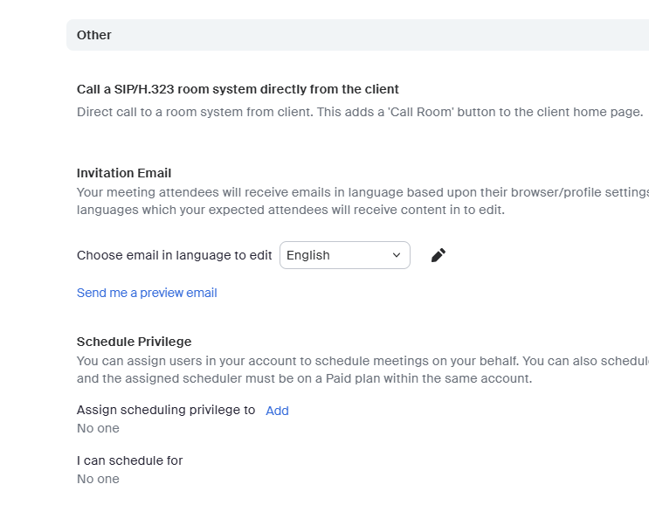
Assigning Delegation
On the Zoom website :
  Select “Settings” → “Meetings” → “Other”
    Schedule Privilege
      “Assign scheduling privilege to”

Slide 15
Inviting Participants
For a Scheduled Meeting
From the Meetings tab on the desktop client or web portal, select the meeting and click Copy Invitation to share the details.
During an In-Progress Meeting
Click Participants in the meeting controls, then Invite. Choose to invite via Email, your Contacts, or by copying the meeting URL/Invitation.

Slide 16
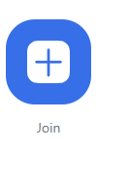
Joining a Meeting
Desktop Client: Click Join a Meeting and enter the Meeting ID.
Email: Click the Join Zoom Meeting link in the invitation.
Telephone: Dial the number from the invitation and enter the Meeting ID.

Slide 17
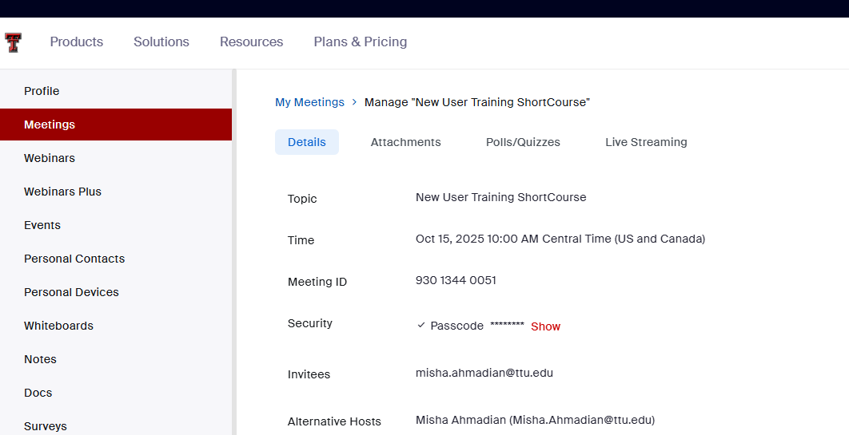
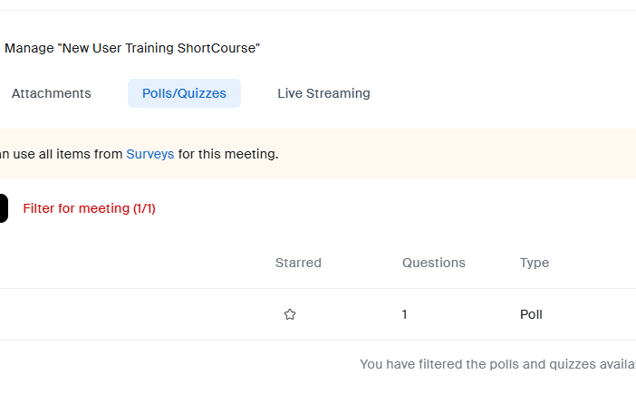
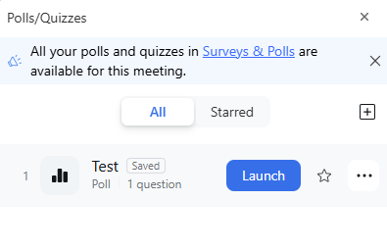
Polls
Creating a Poll (Before Meeting)
Sign in to the Zoom web portal.
Navigate to Meetings and select the scheduled meeting you want to add a poll to.
At the top of the meeting details page and click the Polls/Quizzes tab, then + Create.
Choose Poll and enter your question(s) and answer choices. You can also set it to be anonymous.
Click Save.
Launching a Poll (During Meeting)
During your meeting, click the Polls button in the meeting controls.
Select the poll you wish to launch.
Click Launch Poll. Participants will see the poll pop up on their screen.
Once you are ready to end the poll, click End Poll. You can then Share Results with participants or Relaunch Poll.

Slide 18
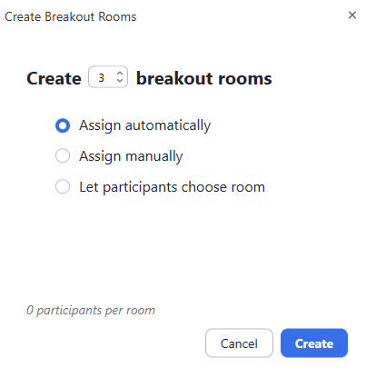
Breakout Rooms
Managing Breakout Rooms (As Host)
During a meeting, click “more” then “Breakout Rooms button” in the meeting controls.
Choose how many rooms you want to create and how to assign participants:
  Assign automatically: Zoom will randomly assign participants to each room.
  Assign manually: You assign participants to each room.
  Let participants choose room: Participants can select which room to join.
Click Create. You can then Open All Rooms to start the sessions.
As the host, you can join any breakout room, broadcast messages to all rooms, and close all rooms.

Slide 19

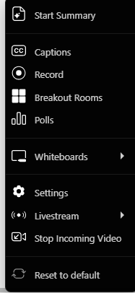
Screen Sharing
Click the Share button in the meeting controls.
Select the screen, application, or Whiteboard to share. The Whiteboard is a collaborative canvas where you and participants can draw, type, and annotate together.
Optionally, check Share computer sound or Optimize for Video Clip.
Click Share to begin.

Slide 20
Meeting Security Best Practices
Require Passcodes for Meetings
Always enable passcodes for your meetings. This adds an extra layer of security, ensuring that only invited participants can join. You can embed the passcode in the invitation link for ease of access for legitimate attendees.
Utilize Waiting Rooms
The Waiting Room feature allows you to control who enters your meeting and when. Participants will be held in a virtual waiting room until you admit them. This is especially useful for preventing uninvited guests or "Zoom-bombing.“
Manage Participant Controls
As a host, you have various controls to manage participants during a meeting:
Lock Meeting: Once all expected participants have joined, you can lock the meeting to prevent anyone else from entering.
Remove Participants: You can remove disruptive participants from the meeting. Once removed, they cannot rejoin.
Mute Participants: Mute individual participants or all participants upon entry to minimize background noise or disruptions.
Disable Screen Sharing for Participants: Restrict screen sharing privileges to only the host or specific presenters to prevent unauthorized content sharing.

Slide 21
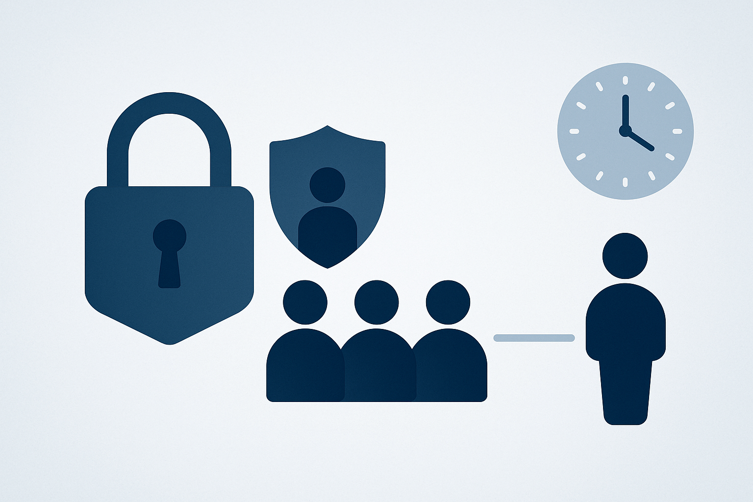
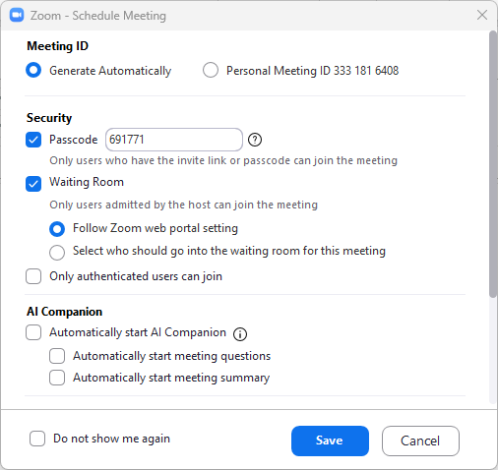
Importance of enabling a waiting room
1. Protects against “Zoombombing”
2. Controls who enters the meeting
3. Adds a layer of security
4. Allows the host to verify participants identity
5. Gives the host more control (No host, no control features)

