Slide 1
Welcome to the Clinical Programs Information Session for the 2025-2026 academic year.
During this presentation you will hear HOW to apply to the Clinical program, as well as the Deadlines for Applications, Interview dates, Selection Dates, and Acceptance dates.
During this presentation, you will hear from Clinic Directors from all the Clinics.
At the end of this presentation, you will be able to ask questions, as well as talk to current clinic students.

Slide 2
CLINIC APPLICATION INSTRUCTIONS AND DEADLINES!
Below is a list of all clinics – Visit https://www.depts.ttu.edu/law/clinics-and-externships/clinics/index.php for descriptions of each:
  Advanced ADR Clinic
  Civil Practice Clinic
  Family Law Clinic
  Tax Clinic
  Criminal Defense Clinic
  Caprock Regional Public Defender Clinic
  Innocence Clinic
  Veterans Clinic

Slide 3
WHAT’S NEXT IF YOU WANT TO APPLY?
Go to: http://www.depts.ttu.edu/law/clinics-and-externships/clinics/index.php
Review the clinics listed at the bottom of the page you are interested in applying to
Under Important Links, Click on Student Selection Policies and Application Link
If prompted, Sign in using your eRaider username/password
Review the Clinic Selection and Enrollment Policies
Click here to access the online application, complete, and submit. You will have to sign in using your TTU email.

Slide 4
COMPLETING THE APPLICATION
If applying to more than one clinic, submit only ONE application and indicate which clinics you are applying to and indicate your preference for each (i.e. 1st choice, 2nd choice, etc.);
Upload resume (references not necessary) and UNOFFICIAL transcript, as well as a short narrative for each clinic you are applying to unless otherwise specified (example: if applying to Civil and Family Law, attach two narratives – one for each); follow instructions provided at the beginning of the online application; and
Complete and submit online application with uploaded documents on or before 4:00 p.m. Wednesday, February 5th.

Slide 5
STUDENT SELECTION TIMELINE:
Deadline to submit application – 4:00 PM, Wednesday – February 5th
Interviews with Clinic Directors (if necessary) during the weeks of February 17th and February 24th
Selection and offers to students will be made on or before March 7th
Acceptance of offers from students to Professors by March 14th

Slide 6
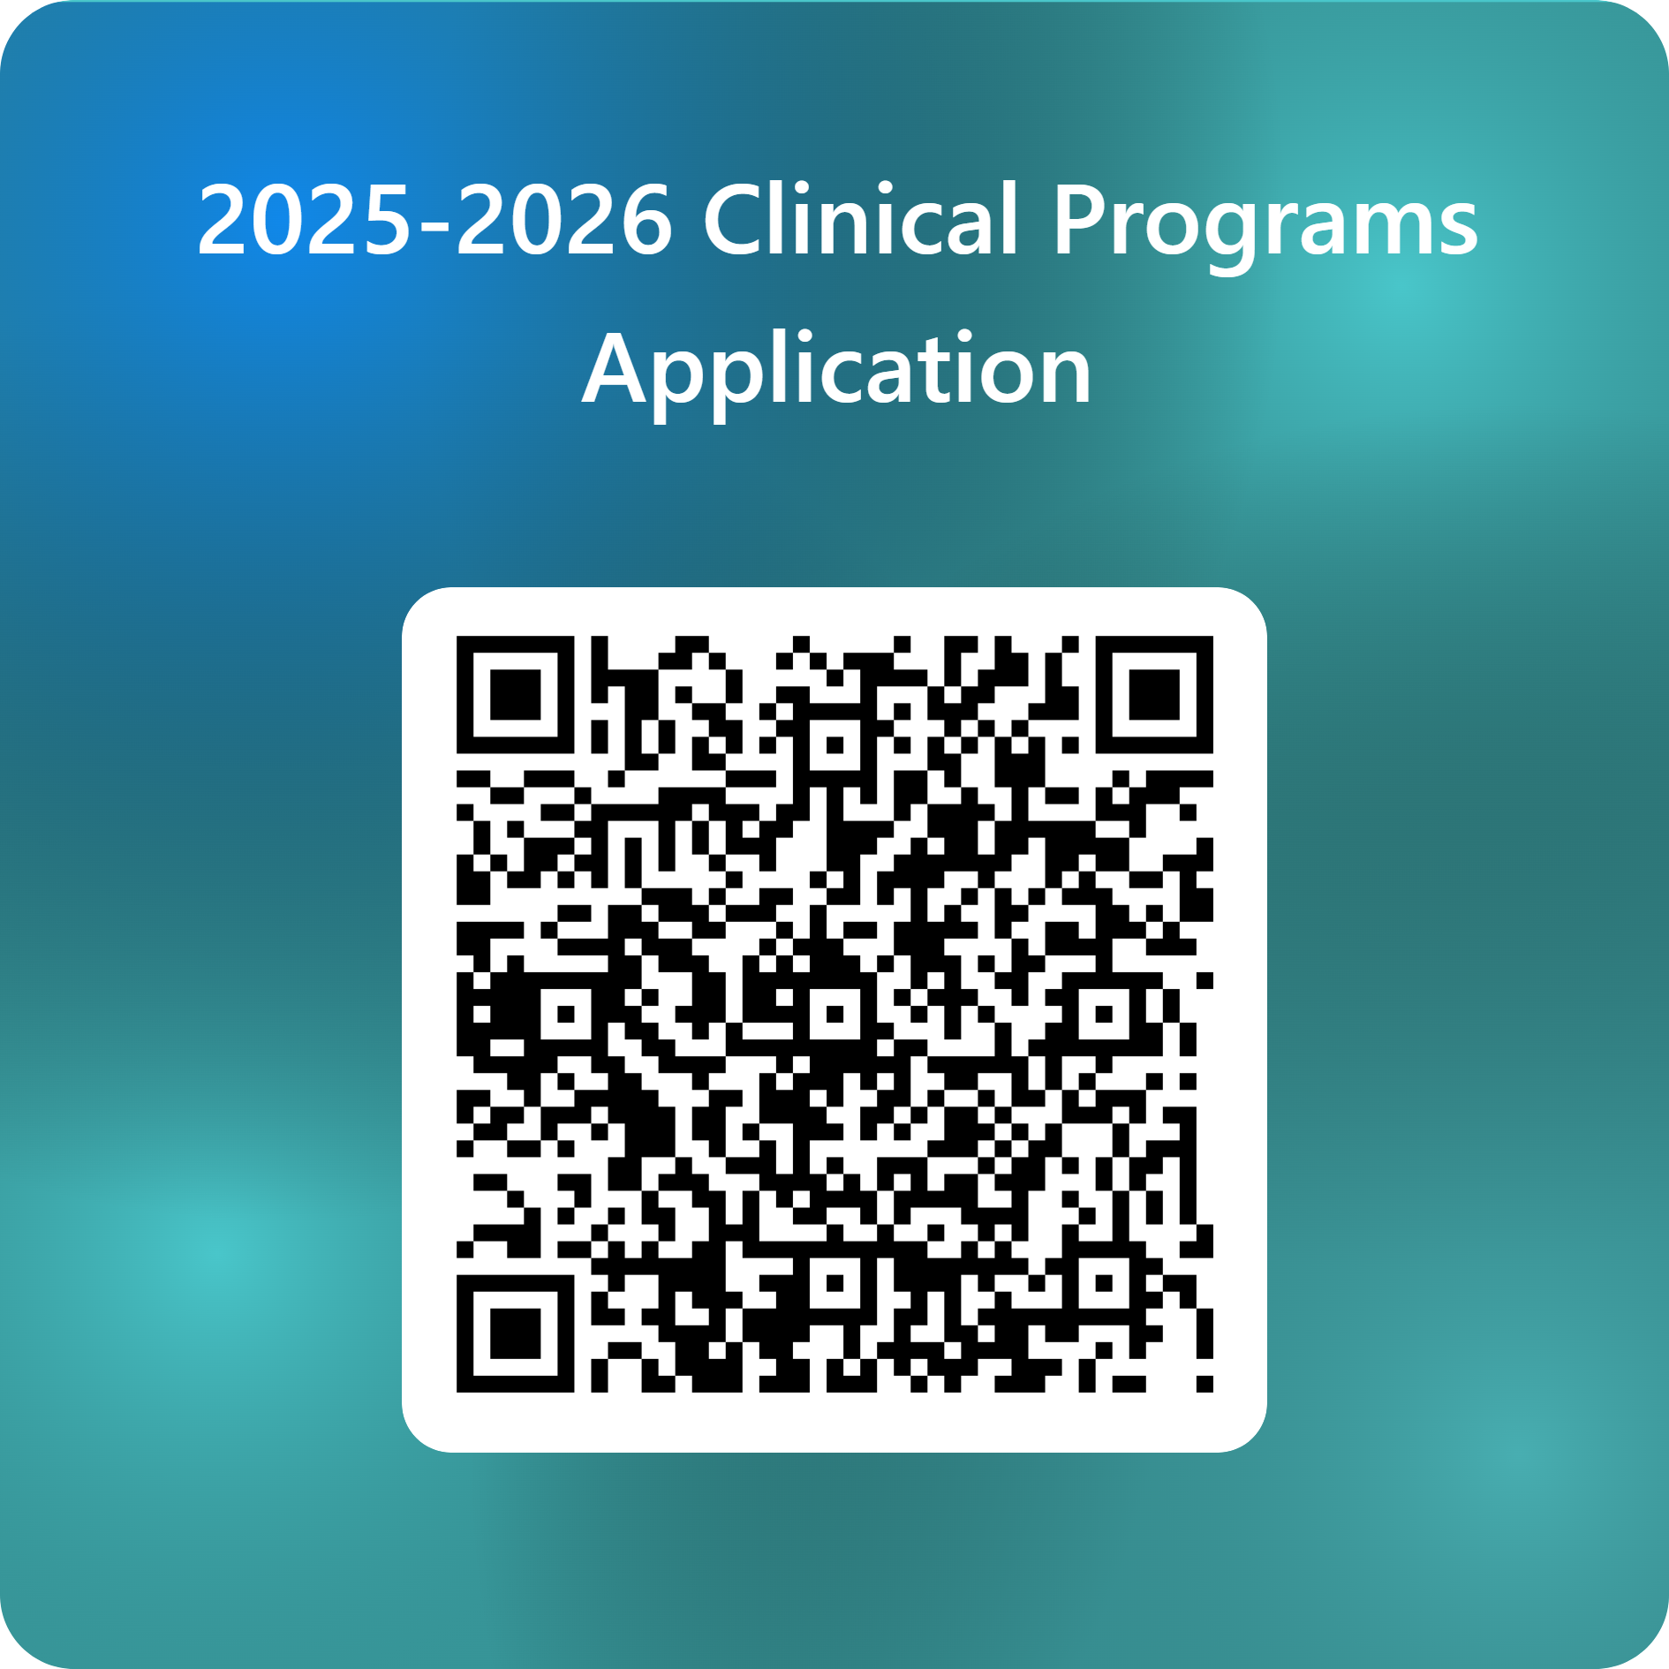
SCAN QR Code to Access online application!

Slide 7

For additional information or clarification, please email melissa.Vasquez@ttu.edu or the designated clinic director!

