Slide 1
Composition of Muscle
ANSC 3404

Slide 2
Composition of Muscle

Slide 3
Water (moisture) in muscle
Varies inversely with fat content;
muscles with more fat contain less water. Practical range = 65 to 80%.
If fat content of a muscle ranges from 0.5 to 30% at the extremes, what would be the water range?
Affects initial juiciness
more water, more initial juiciness.

Slide 4
Water
Water is a carrier of many intra- and inter-cellular constituents.
In low fat meat products, water content is higher than in products with a higher fat content.
binders must be added to hold this extra water in the products.

Slide 5
PROTEIN
Averages 18.5% In Muscle
Is The Least Variable Major Component
Is The Most Important Component Nutritionally
Is The Food Component In Shortest Supply In World Food

Slide 6
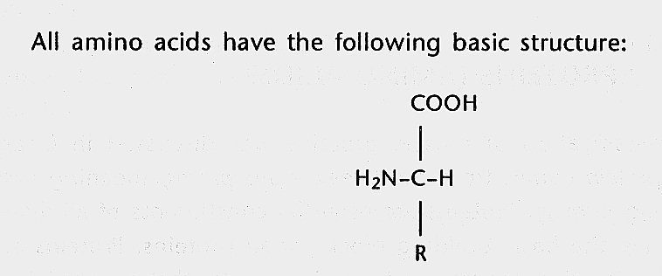
Proteins are Composed of Amino Acids: NH₂ and COOH Groups

Slide 7
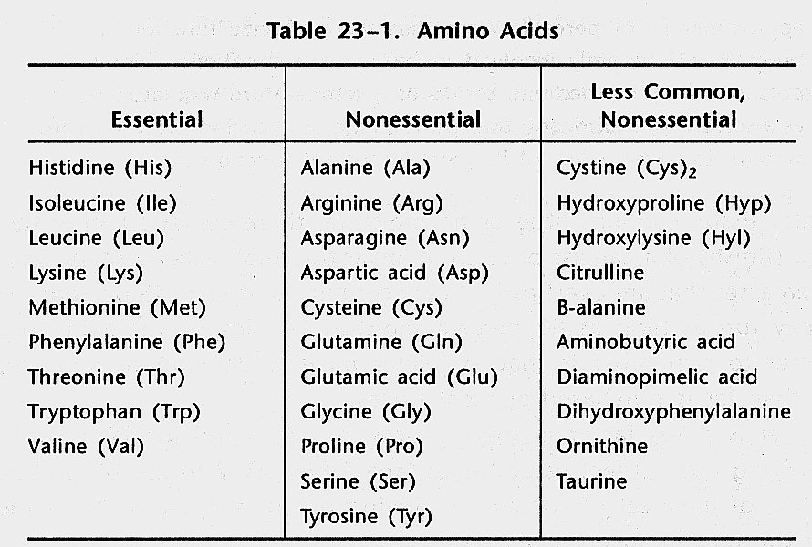
Amino Acids

Slide 9
KINDS OF PROTEIN IN MUSCLES
Myofibrillar - 9.5%
Principal ones are Actin and Myosin
Sarcoplasmic - 6.0%
Enzymes and pigments.
The two principal pigments are Myoglobin and Hemoglobin.
Hemoglobin in red blood cells Carries O₂ from the lungs to cells.
Myoglobin Stores O₂ in the cells.

Slide 10
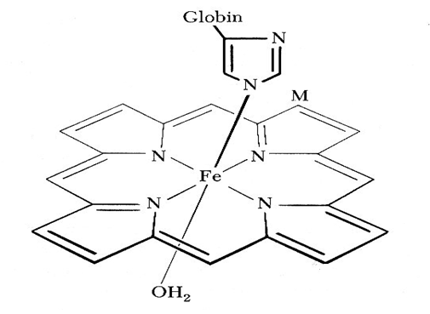
Myoglobin
Important

Slide 11
More About Pigments
Meat color reactions are very important to its appearance and will be studied later in detail. A sample will be shown later.
Which of the two pigments (hemoglobin or myoglobin) is predominant in postmortem muscle? Why?

Slide 12
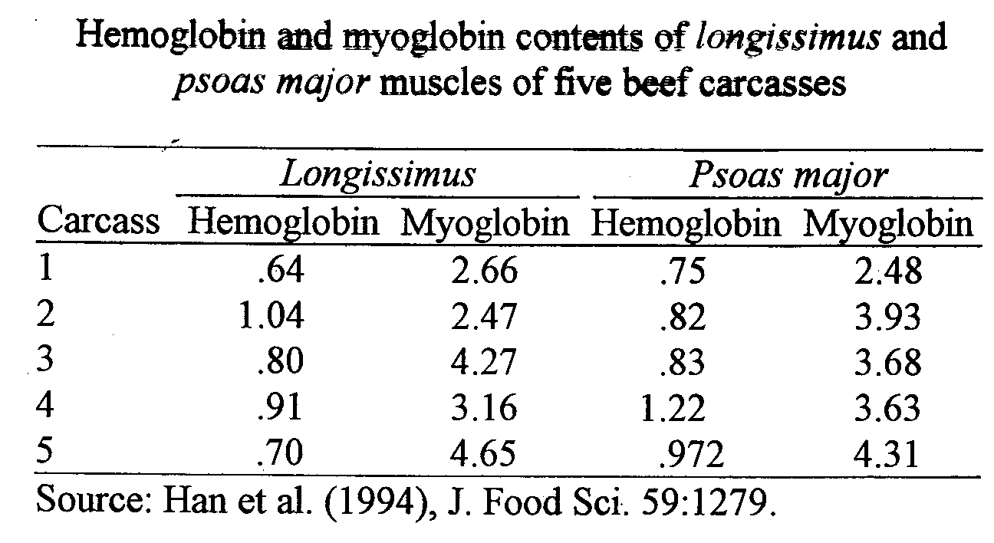

Slide 13
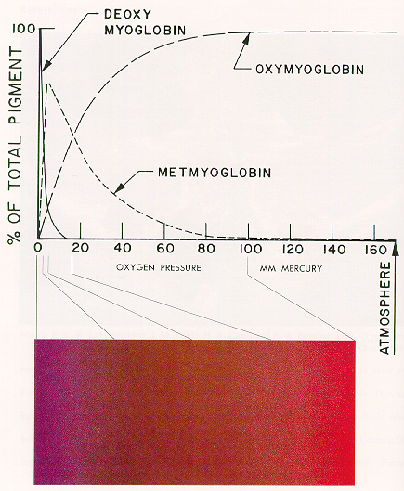
Myoglobin State Affects Color
DEOXYMYOGLOBIN (PURPLE) OXYGENATION OXYMYOGLOBIN (RED) OXIDATION METMYOGLOBIN (BROWN)

Slide 15
More Proteins
Stromal - 3.0%
connective tissues (ct)
collagen, elastin , reticulin
the “skeleton” of a muscle.
Collagen predominates (the most abundant protein in mammals) and can affect tenderness greatly
as an animal ages, collagen forms a network & becomes less tender.
Collagen degrades to gelatin at 65ºC with moist heat cookery.

Slide 16
Elastin
Elastin does not degrade to gelatin with moist heat cookery
An example of elastin is the ligamentum nuchae (backstrap) that courses along the spinous processes of the cervical vertebrae
Elastin imparts elasticity to arterial walls

Slide 17
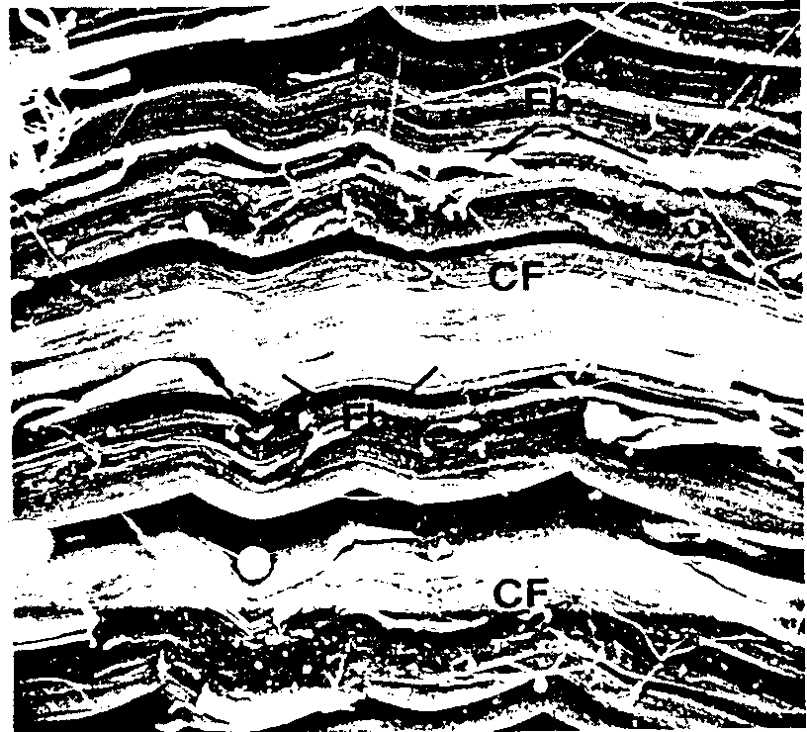
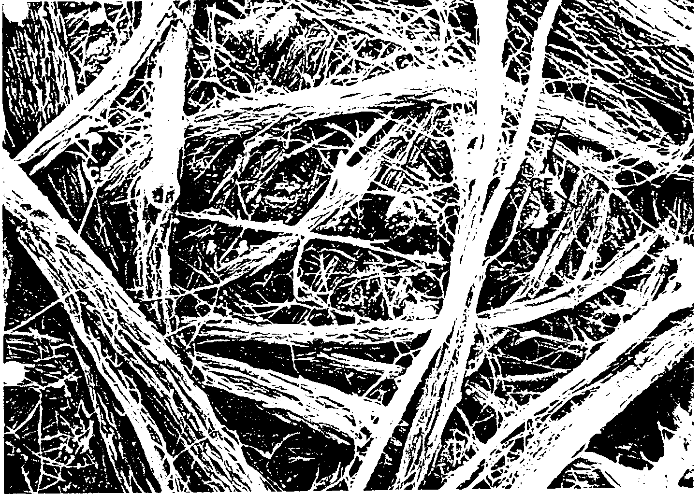
PHOTOMICROGRAPHS OF CONNECTIVE TISSUE
OTHER TISSUES HAVE BEEN LEACHED OUT

Slide 18
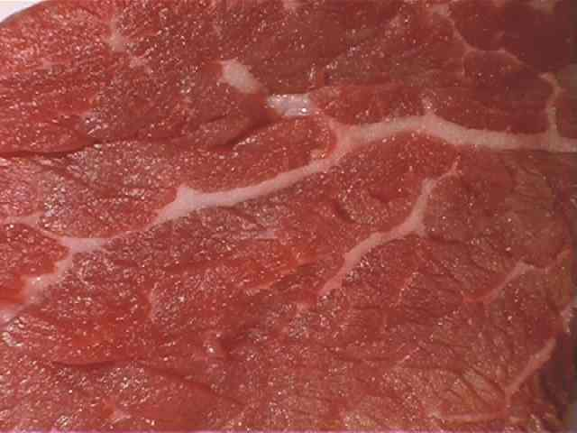
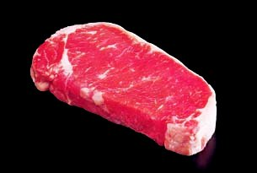
Lipids - Fats and Oils
Influence flavor, juiciness and caloric content of meat
Have a small effect on tenderness
Average 3% in muscle
Muscle with a “Devoid” marbling score will still have about 0.5% fat content

Slide 19
Kinds of Lipids
NEUTRAL LIPIDS - 1%
PHOSPHOLIPIDS - 1%
CHOLESTEROL - 0.5%

Slide 20
NEUTRAL LIPIDS
Triglycerides = 3 mole of fatty acid attached to a glycerol
CH₂OH H₂C-O-C(CH₂)₁₆CH₃ l l CHOH + 3 HOOC(CH₂)₁₆CH₃ HC-O-C-R + 3 H₂O
l l CH₂OH H₂C-O-C-R GLYCEROL + STEARIC ACID TRISTEARIN

Slide 22
KINDS OF TRIGLYCERIDES
If the same kind of fatty acid occupies all three positions on the glycerol molecule, the result is a simple triglyceride.
If more than one kind of fatty acid is attached to glycerol, the result is a mixed triglyceride.
What determines what kinds of triglycerides an animal manufactures?

Slide 23
SATURATED FATTY ACIDS
Stearic Acid :
- No double bonds between carbon atoms
- Third most predominant FA in meat animals

Slide 24
UNSATURATED FATTY ACIDS
Oleic Acid :
- The most prevalent fatty acid in animal fats
- Monounsaturated fatty acids (contains one double bond)

Slide 25
Polyunsaturated Fatty Acids
Linoleic Acid:
- Polyunsaturated fatty acids
- Has two (or more) double bonds

Slide 26
Reactivity of Fatty Acids
Unsaturated fatty acids are more reactive
O₂ attaches at double bonds
Results in rancidity and oxidation

Slide 27
Kinds of Fats in Beef and Poultry
Meat | Saturated Fat | Monounsaturated Fat | Polyunsaturated Fat | Cholesterol
Top Round | 35% | 39% | 5% | 72 mg
T-bone | 40% | 40% | 4% | 68 mg
Ground Beef (80% lean) | 39% | 44% | 4% | 74 mg
Chicken Breast (skinless) | 29% | 35% | 21% | 72 mg
Turkey (skinless) | 32% | 18% | 27% | 59 mg

Slide 28
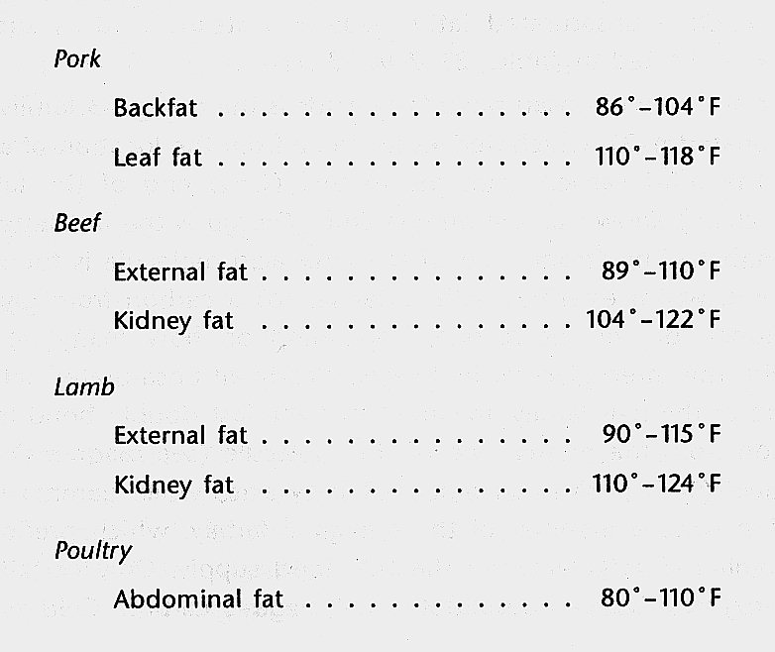
Melting Points of Some Fats
WHY THE RANGES AND SPECIES DIFFERENCES?

Slide 29
In General
Fats with longer carbon chains and more saturation have higher melting points.
Internal fats are more saturated and have higher melting points than external fats
Why?
What practical difference does melting point of fats per se make in animal bodies and in industry?

Slide 30
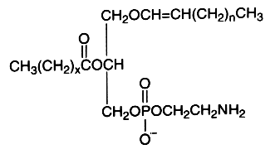
The Third Kind of Lipids
Phospholipids - compounds containing phosphorus and lipids An example is ethanolamine
Function in rancidity development in fats.

Slide 31
The Fourth Kind of Lipids
Cholesterol - that much maligned, essential dietary component.
Required for hormone function and cell wall integrity.
About 20% of body needs is consumed whereas, 80% is manufactured.
If we don’t eat enough, our bodies manufacture more.
Contrary to popular belief, cooked meats of different species vary little in cholesterol content.
Notes:
Why is cholesterol important?
Hormones especially seroid hormones like testosterone, estrogen, and cortisol
Helps the liver produce bile acids that aid in digestion and ridding the body of waste
Acts in cell walls to interconnect fatty tails and hold things together
Important part of the meylin sheath to aid electrical impulses from one point to anouther
Important for immune health.

Slide 32
NPN – Non - Protein Nitrogen
About 1.5% in muscle
Molecules contain nitrogen but are not proteins
Some NPN compounds contribute to meat flavor
NPN example
ATP (Adenosine triphophate)

Slide 33
CHO - Carbohydrates
About 1% (0.8%) found in muscle
ranges from 0.5 - 1.5% in muscle.
Although low in amount, CHO’s play large roles in meat properties and appearance.
Best example is Glycogen
storage form composed of glucose units

Slide 34
Inorganic Compounds - Minerals
About 1% in muscle
Measured as ash after burning samples in a muffle furnace
Meat (particularly beef) is a good source of some minerals, particularly Fe and Zn.
Fe in meat is in a heme form that is more readily available than Fe from plants.
Zn is in many enzymes and hormones, including sex hormones.

Slide 35
How to Calculate Caloric Values
Fats contain 9 Calories/gram
Proteins and CHO’s contain 4 Calories/gram
Fats contain 2.25 (9 / 4) times as many Calories as proteins & CHO’s
Calories usually are calculated on a per-100-gram basis
If so, percentages of composition can be used directly in equations because percentages are parts/100

Slide 36
How Many Calories in 100g of Average Muscle on a Raw Basis?
75% water, 3% fat, 18.5% protein, 1% CHO, and 1% ash
Water and minerals contain no Calories so:
(3 * 9) + (18.5 * 4) + (1 * 4) = 105 kcal
This 3% fat would represent the muscle from Select Grade Beef.
Is 105 Calories per 100 grams a high, medium, or low value for foods?

Slide 37
Assume we Buy Choice Grade Instead of Select Grade
Muscle composition might be 70% water, 8.5% fat, 18% protein, 1% CHO and 1% ash on a raw basis
(8.5 * 9) + (18 * 4) + (1 * 4) = 153 kcal
153 - 105 = 48 more calories by going from Choice to Select beef

Slide 38
Caloric Values for Cooked Meats
Food | Kcal/100g
Beef with ¼ inch trim | 216
Fried Hamburger – 15% fat | 240
Pork Ham | 211
Fried Chicken without skin | 219
Fried chicken leg without skin | 208
Fried catfish | 228

Slide 39
Fat, Protein and Caloric Content of Differing Beef Quality Grades
Quality Grade | Marbling | Fat, % | Calories from Fat | Protein, % | Calories from Protein | Total Calories
Select | Slight | 3.7 | 66 | 26 | 208 | 275
Low Choice | Small | 5.2 | 93 | 25.6 | 204 | 298
Mid Choice | Modest | 6.7 | 120 | 25.2 | 201 | 322
High Choice* | Moderate | 8.2 | 147 | 24.8 | 198 | 346
* Meets marbling specification for Certified Angus Beef products

Slide 40
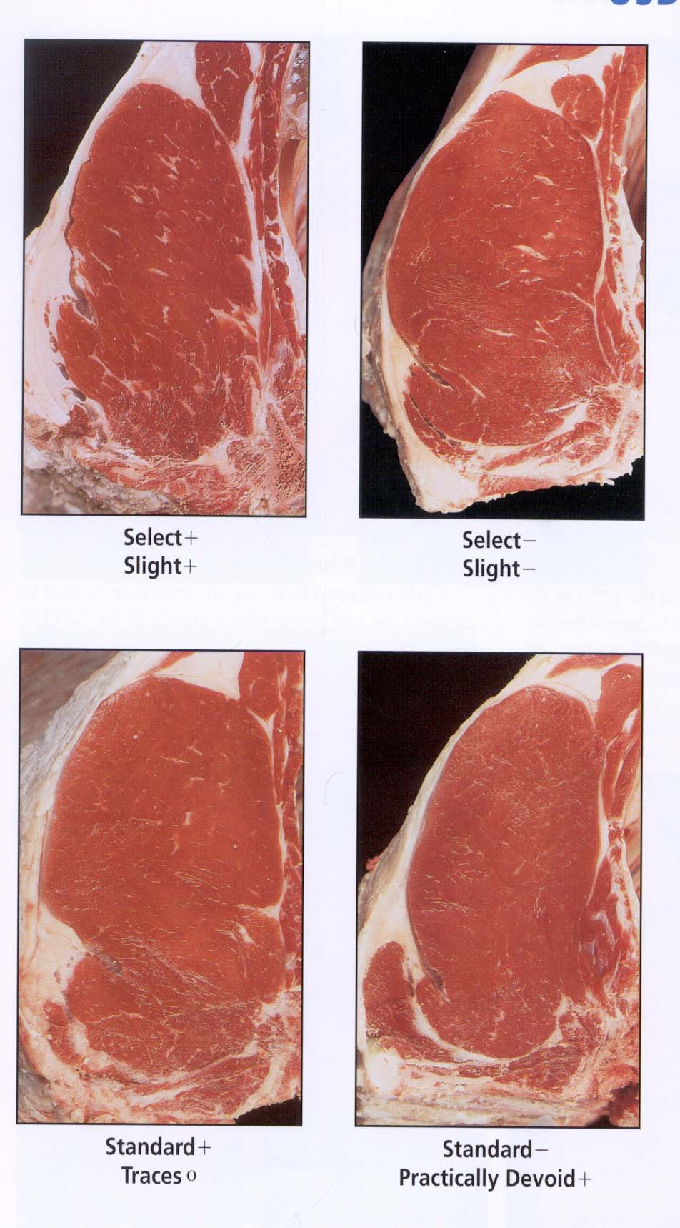

Slide 41
Why be Concerned About Calories?
Assume we eat lower calorie foods and eliminate 47 calories/day
47 * 365 = 17,155 calories / year
About 3,000 calories equate to 1 lb. of body weight gain
17,155 / 3,000 = 5.7 lb. of weight not gained each year

