Slide 1
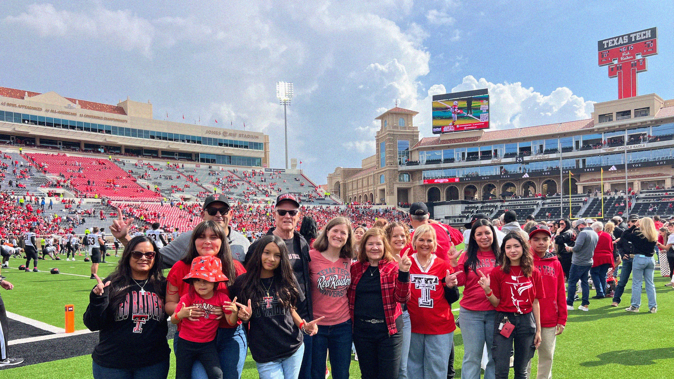
PARTNERING WITH TEXAS TECH
TO SUPPORT YOUR STUDENT
Notes:
Introduce self
Welcome to the Red Raider Family! You will learn about the Red Raider Family Network, conversations to have with your student as their first semester approaches, resources to support your student’s success at Texas Tech, some important reminders, and how to get involved as a family member of a Red Raider!
We’re excited to be here with all of you who support our Red Raiders – parents, grandparents, aunts, uncles, siblings, and friends!
Who is visiting us from the Houston Area? North Texas? Hill Country? Central Texas? West Texas? South Texas? East Texas? Out of State?
Stand up if this is your second child to attend TTU? Third Child? Fourth or more?
Stand up if you are a TTU Alumni/a?

Slide 2

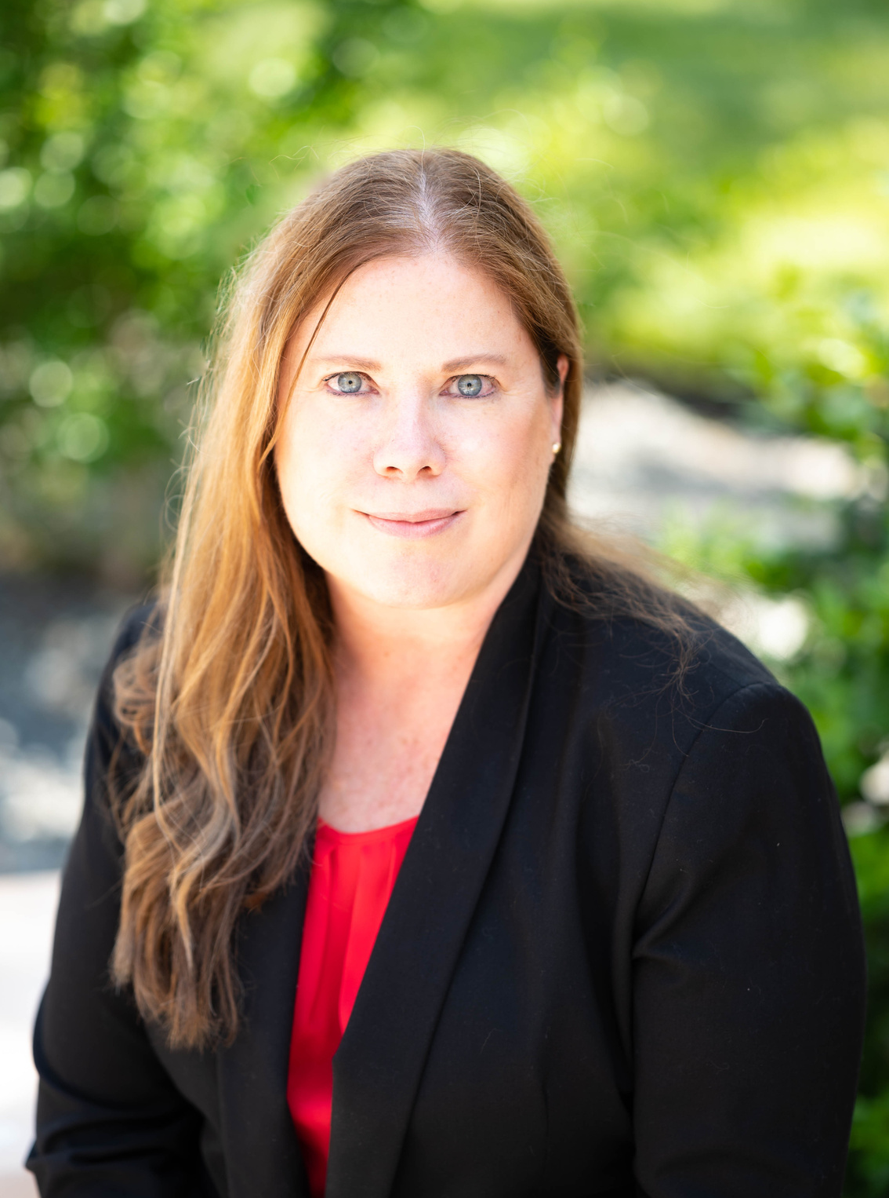
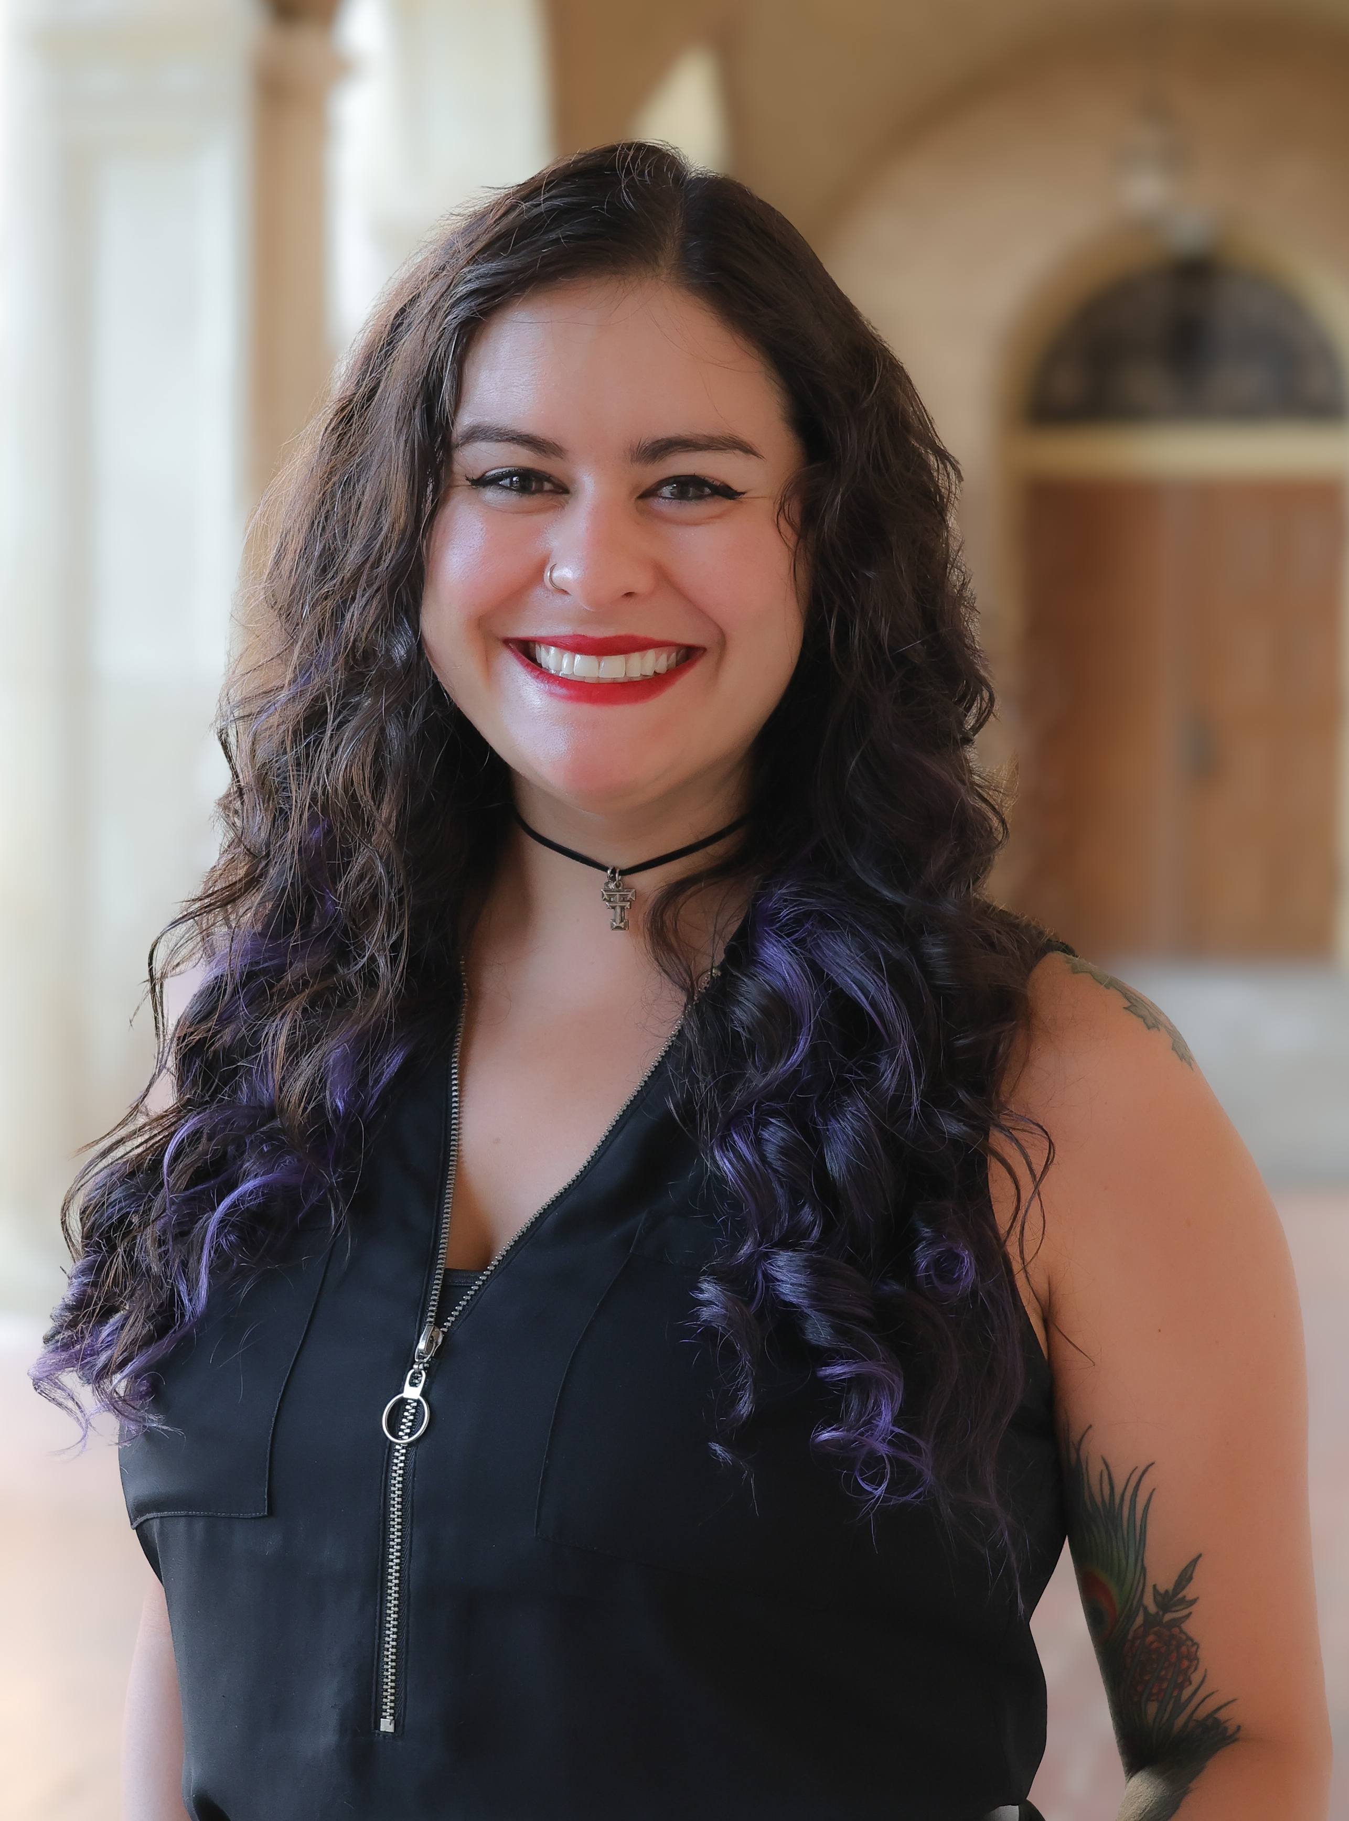
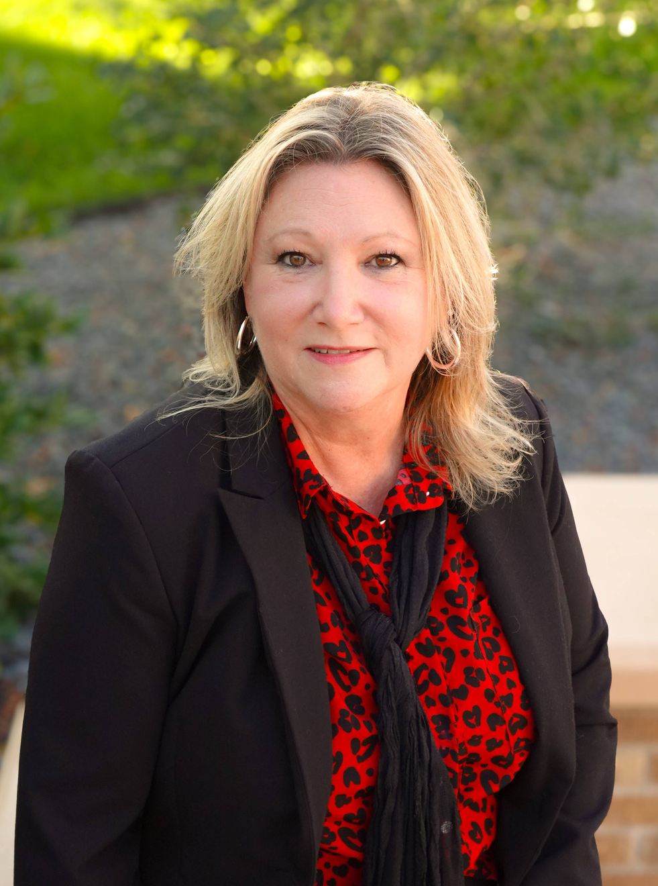
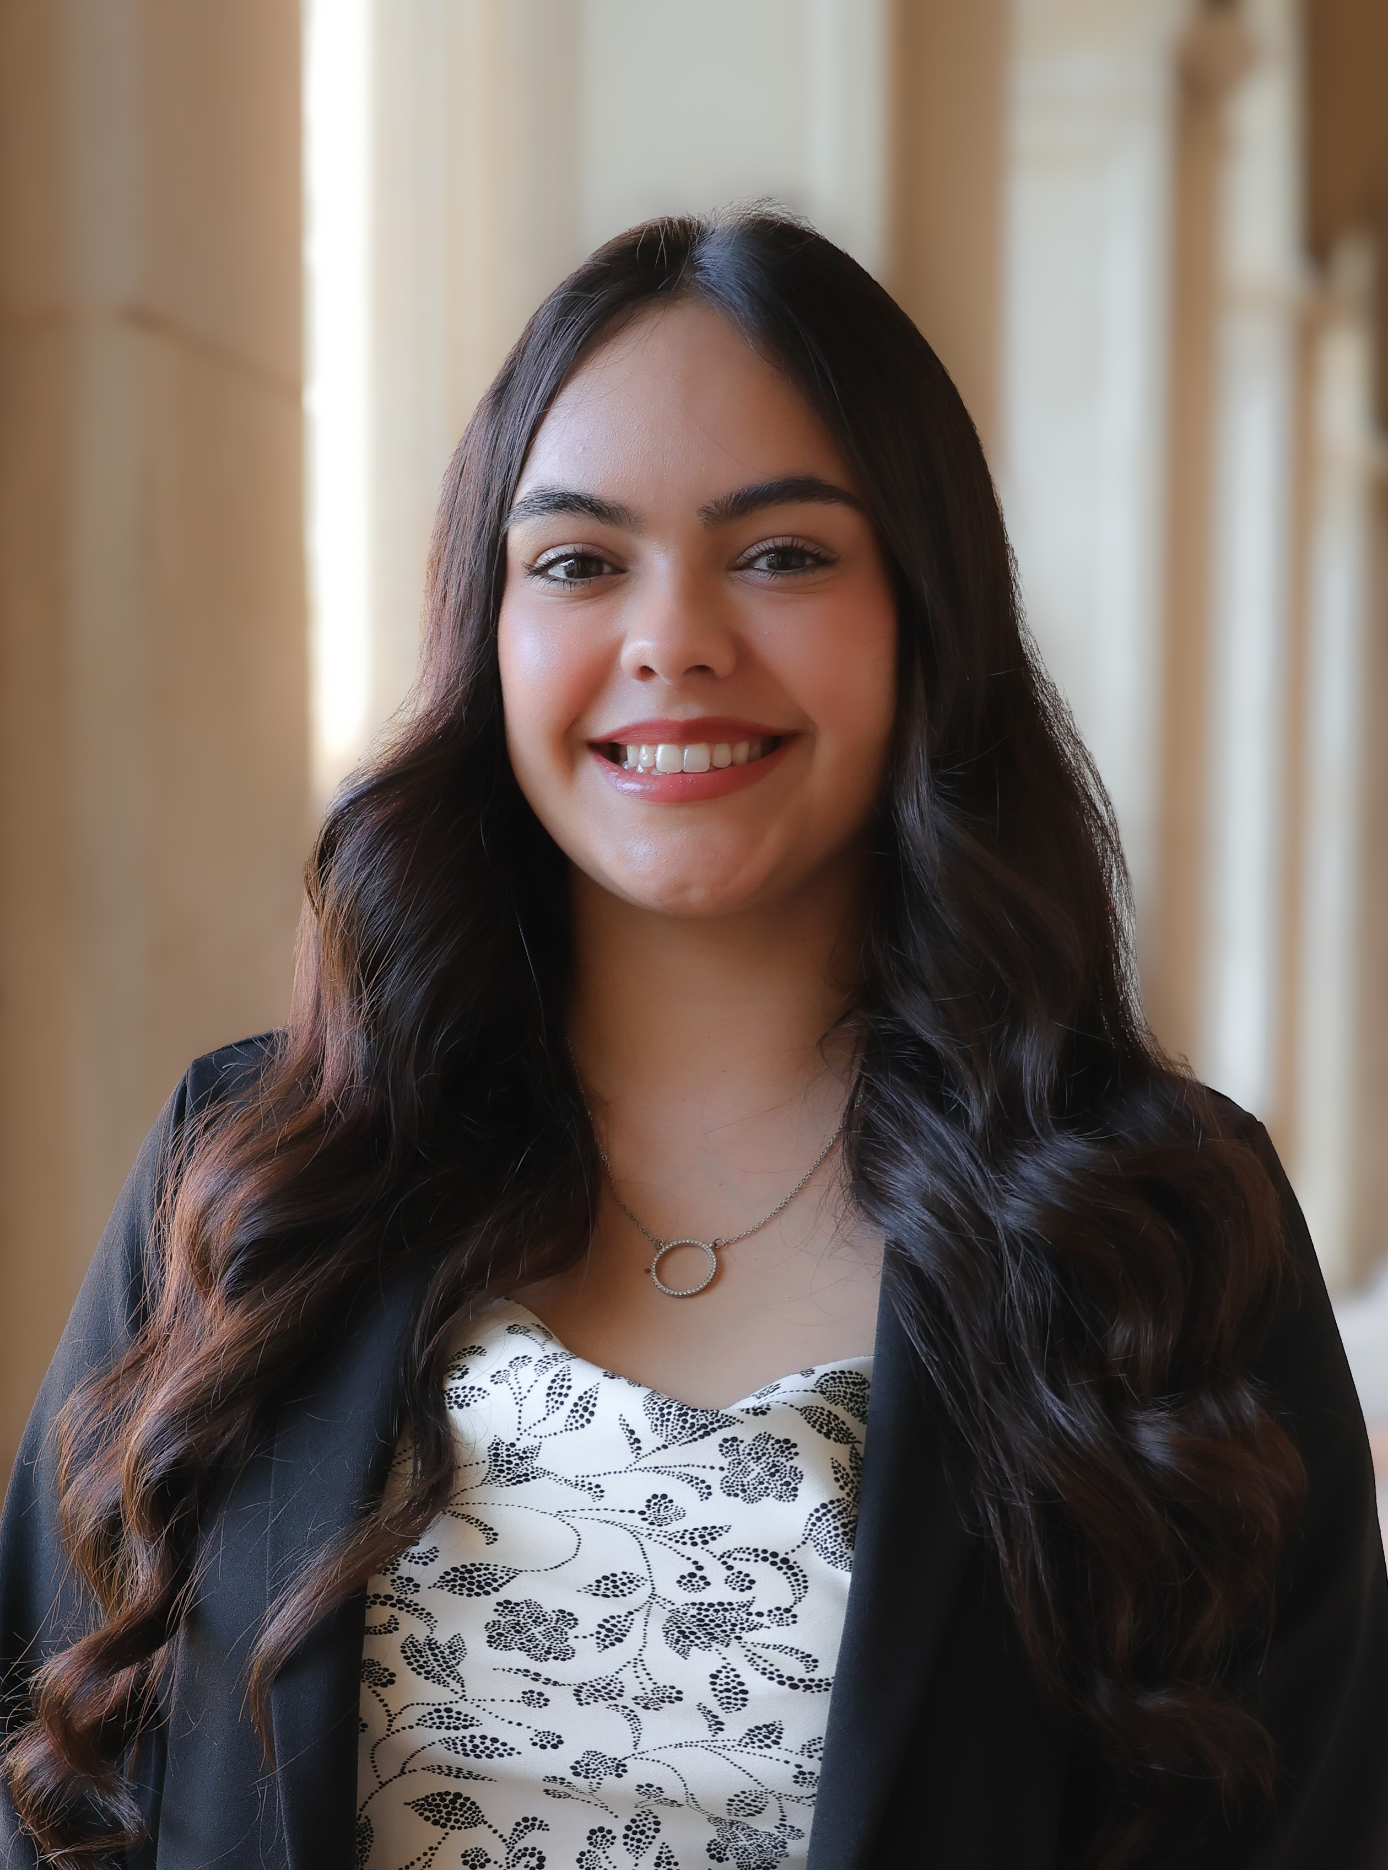
Meet Our Team
Christine Self
Director
Lubbock, TX
Morgan Chavez-Brannon
Program Director
Albuquerque, NM
Connie Watson
Program Director
Henderson, TX
Bryanna Valdivia
Event Coordinator
El Paso, TX

Slide 3
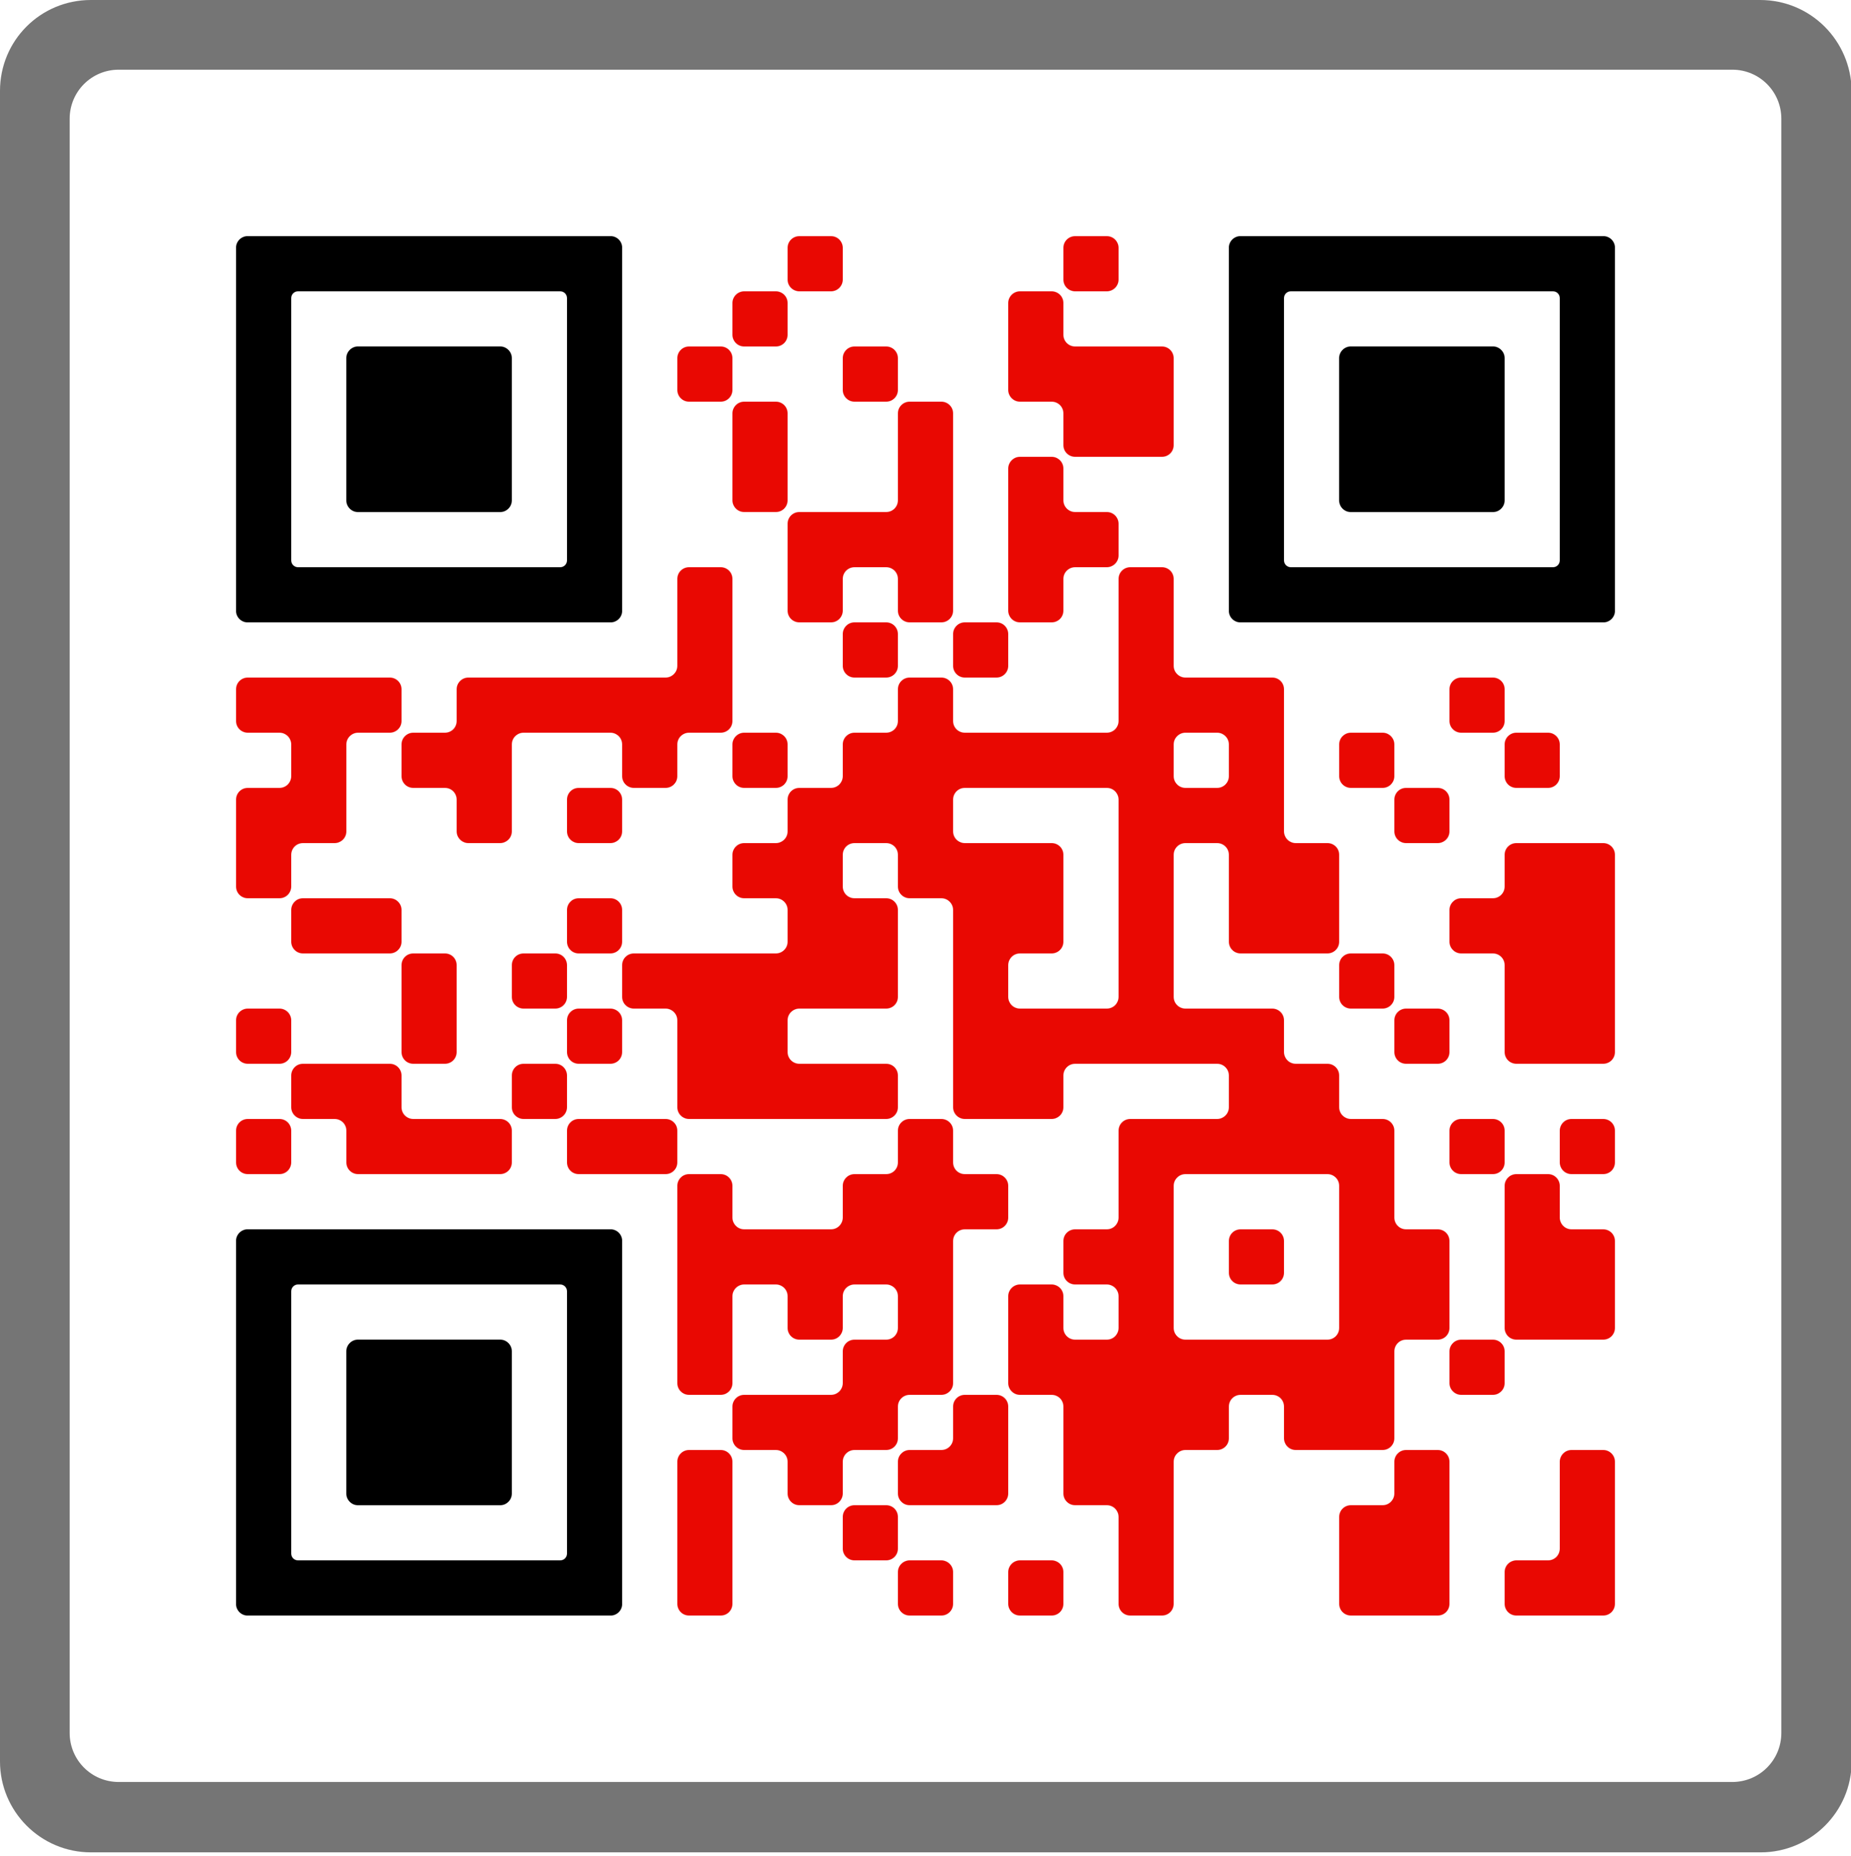


Connect with us
Parent & Family Relations is your support team on campus!
Red Raider Family Network and Newsletter
Webinar Series
Red Raider Family Guide
Social media
PARTNERSHIP SUMMARY

Slide 4


Red Raider Orientation for Parents & Family Members
go.ttu.edu/parentrro
RED RAIDER FAMILY
WEBINAR SERIES
Tuition, Financial Aid, and Scholarships – June 3
Health and Wellbeing at Texas Tech – June 10
Campus Safety at Texas Tech – June 17
Academic Success at Texas Tech – July 8
Finishing Touches with PFR – August 5
Register on our website or through the
Red Raider Family Network
All webinars are recorded and available for rewatch on our website and YouTube

Slide 5
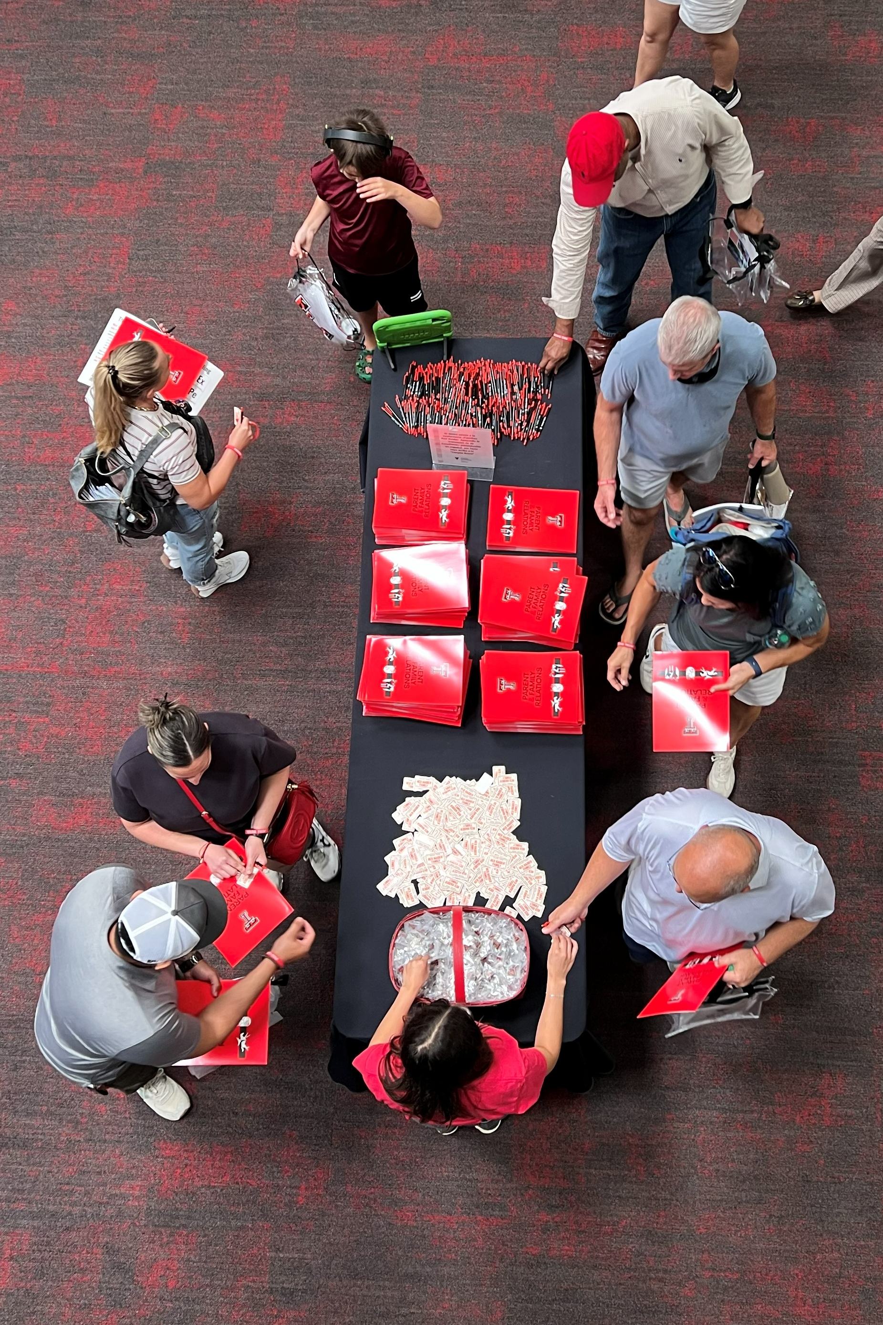
ON YOUR WAY IN
Your Folder Contains
  Red Raider Family Syllabus
  Postcard from Home
  One-page Academic & Event Calendar
Red Raider Family decal
Double T Pin
Pen for taking notes

Slide 6
HOW CAMPUS CONNECTION SUPPORTS STUDENTS DURING TRANSITION
The transition to college is one of the biggest adjustments your student will experience
Students are more successful when families stay informed and connected to campus
Access to accurate information helps families provide support with confidence
Parent & Family Relations serves as a bridge between families and Texas Tech

Slide 7
Empowering Students’ Growing Independence
Encourage ownership of academics and decision-making
Build trust and healthy check-in routines
Family Educational Rights and Privacy Act (FERPA)
  Student privacy laws encourage independence while allowing families to stay informed
  Families receive general information and important updates, not academic details
  Understanding what information is available helps families set realistic expectations
Campus communication helps families support students through conversation and encouragement

Slide 8
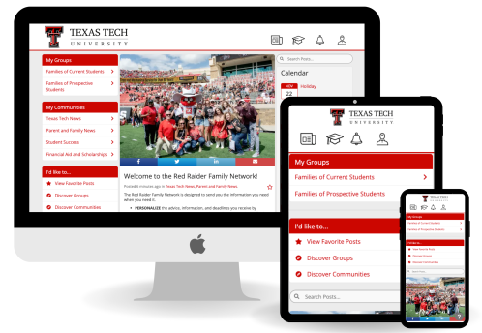
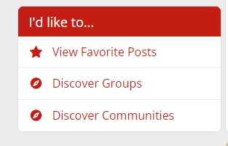


Red Raider Family Network
Make sure you’re signed up – ttu.campusesp.com
  Complete your registration by logging in – there is more than just receiving emails!
  Monthly newsletter and newsfeed with emailed digests
  Browse and join “communities” based on your interests and student’s college

Slide 9
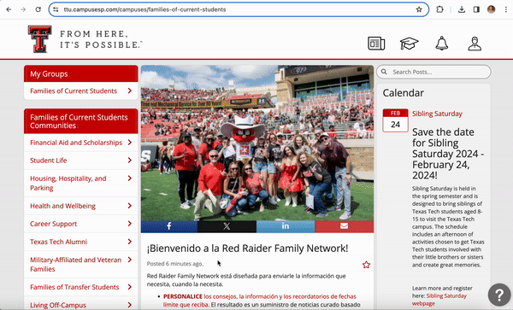
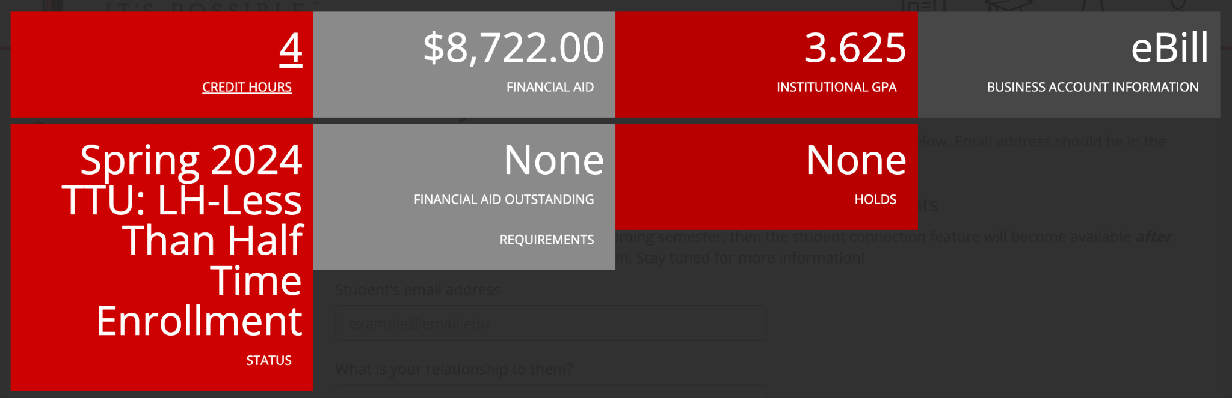
Red Raider Family Network and FERPA
Complete your registration, then request a connection to your student
  You only need their TTU email address
This will give you an overview, not details
  Class schedule, grades, holds, and financial information

Slide 10
Supporting students across their college experience
Academic, personal, and financial challenges often overlap for students
Staying connected helps families know where to guide students when questions arise
Campus resources offer support at key moments—not just during crises
Knowing these resources exist builds confidence for both families and students

Slide 11
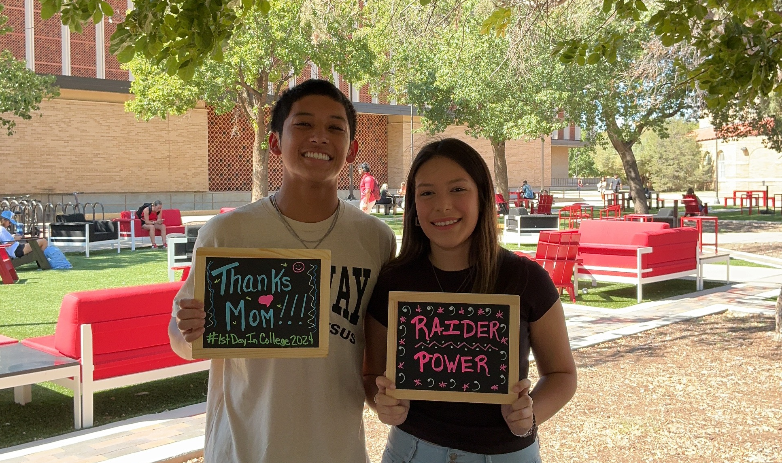
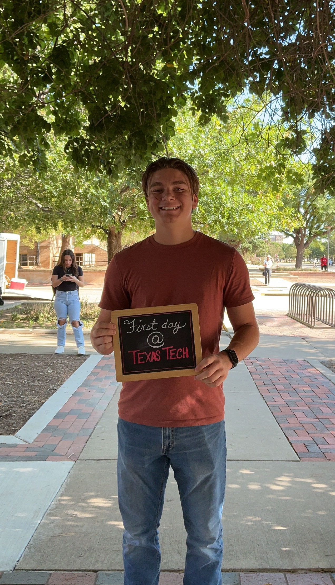
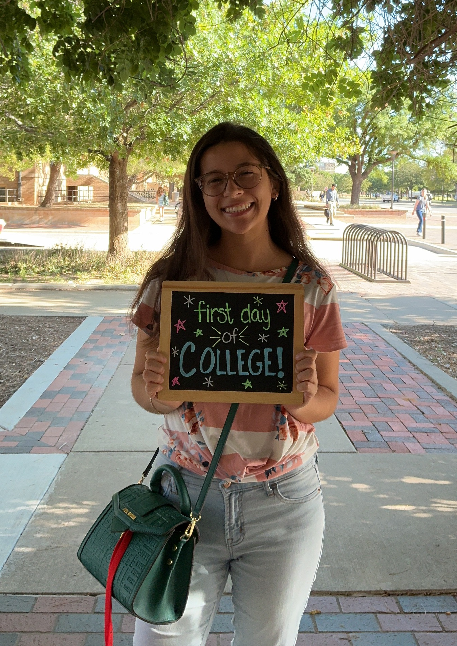
Move-in
  Begins August 20 for those with a timeslot
  Refuel & Refresh with Parent & Family Relations
    International Cultural Center
    August 21 and 22
    11:00am to 2:00pm
    Register on the Red Raider Family Network
Raider Welcome
  August 20th – 30th
  www.raiderwelcome.ttu.edu
First Day of Classes
  Monday, August 24
  Back to School Photos in SUB Gazebo
Family Weekend
  September 25-27
  go.ttu.edu/familyweekend
What’s Next?
Important Dates and Reminders
Notes:
One of the most fun, in our opinion anyway, activities during Raider Welcome is Back to School Photos on the first day of classes! Be sure your student gets one! This is event is free and one of our favorite events to host every years.

Slide 12
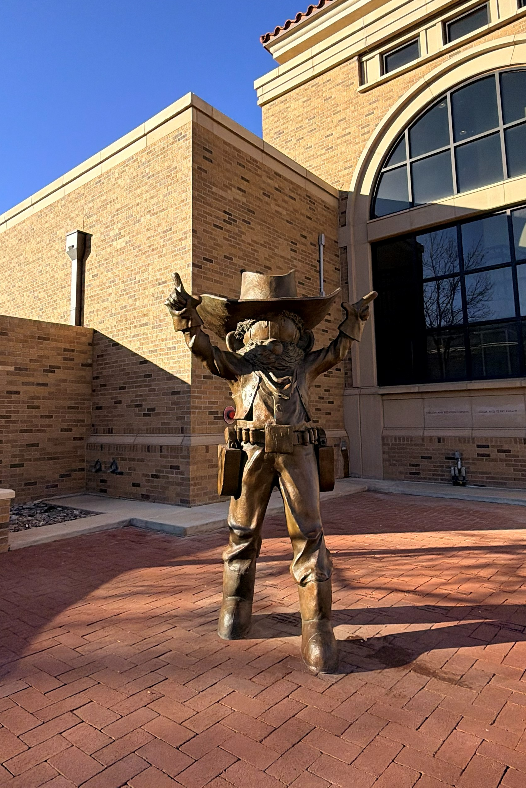
SCHEDULE HIGHLIGHTS
Welcome Session
  Get a detailed schedule overview
Things to look for
  College Welcome
  Campus Resource & Apartment Fair
  Individual Meetings
    Financial Aid & Scholarships
    Student Business Services
2:30pm – 4:00pm – First Pic at the Texas Tech Seal
Need a break? Check out the Quiet Space in the SUB Llano Estacado Room from 11:00am to 2:00pm

