Slide 1
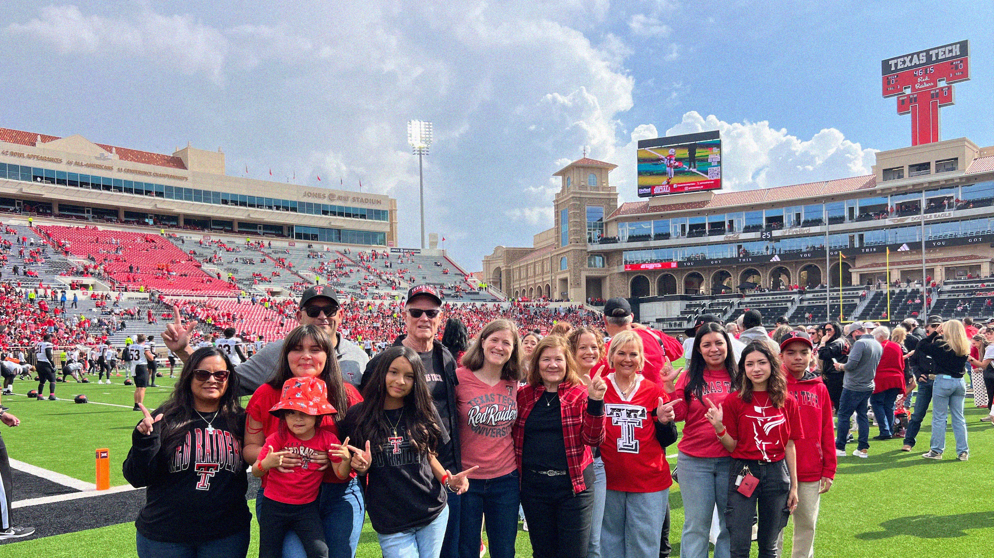
Red Raider Families:
Supporting Your Student’s Transition

Slide 2

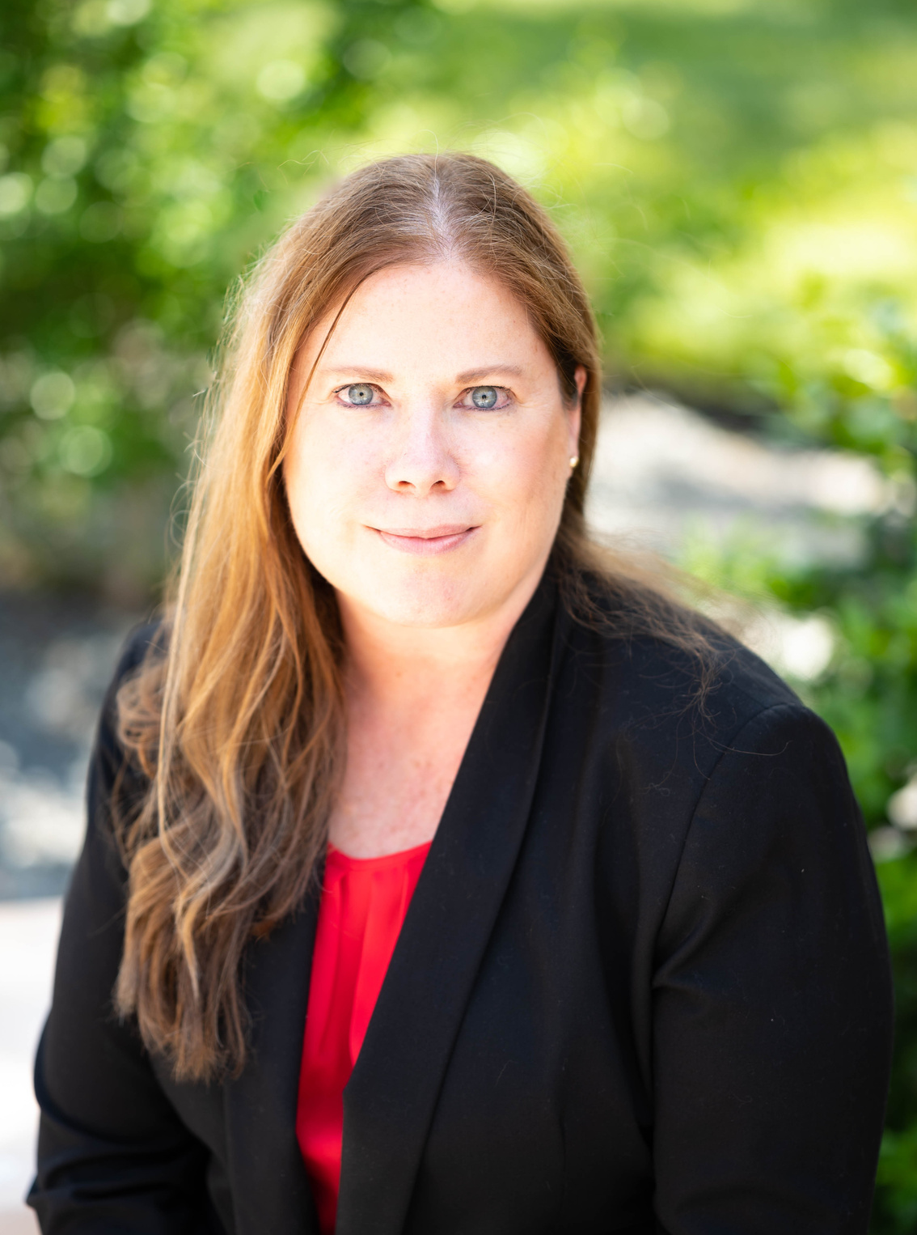
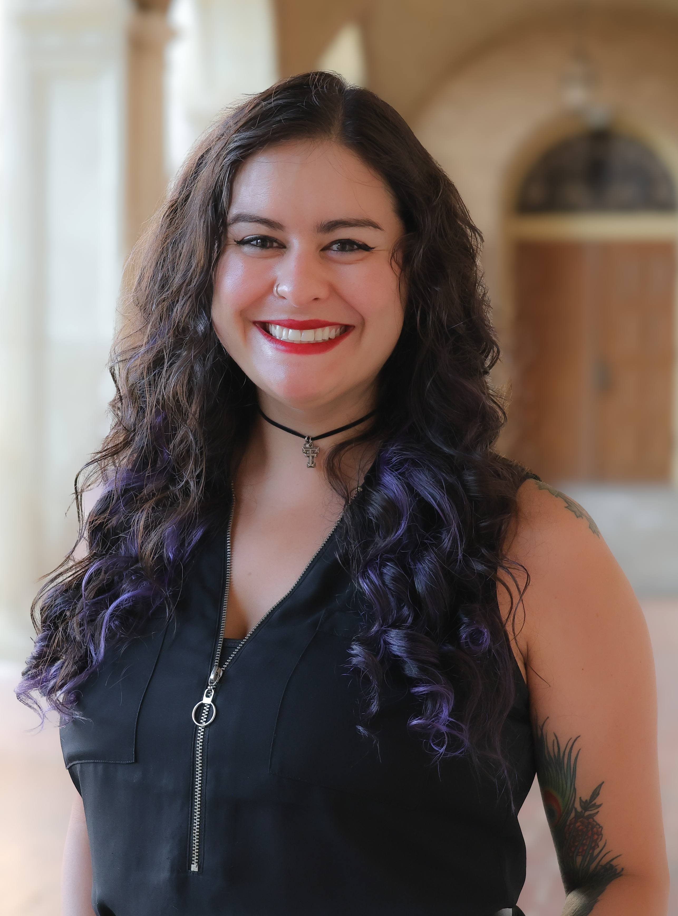
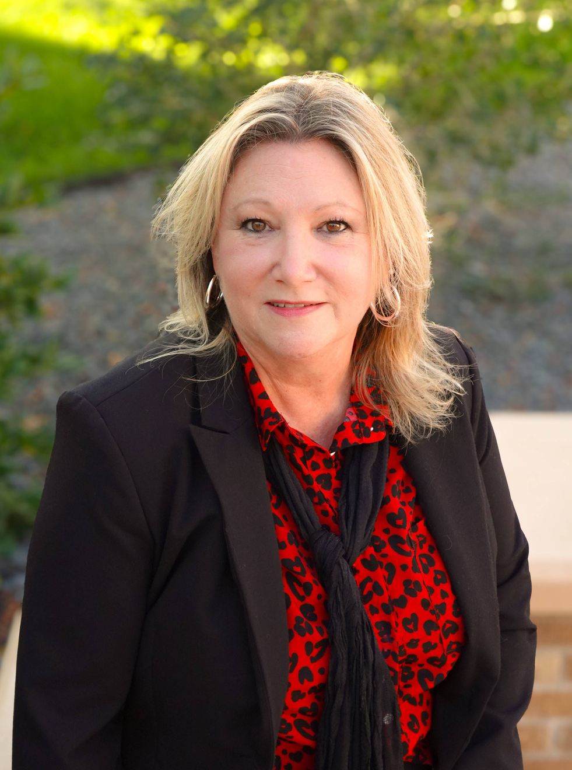
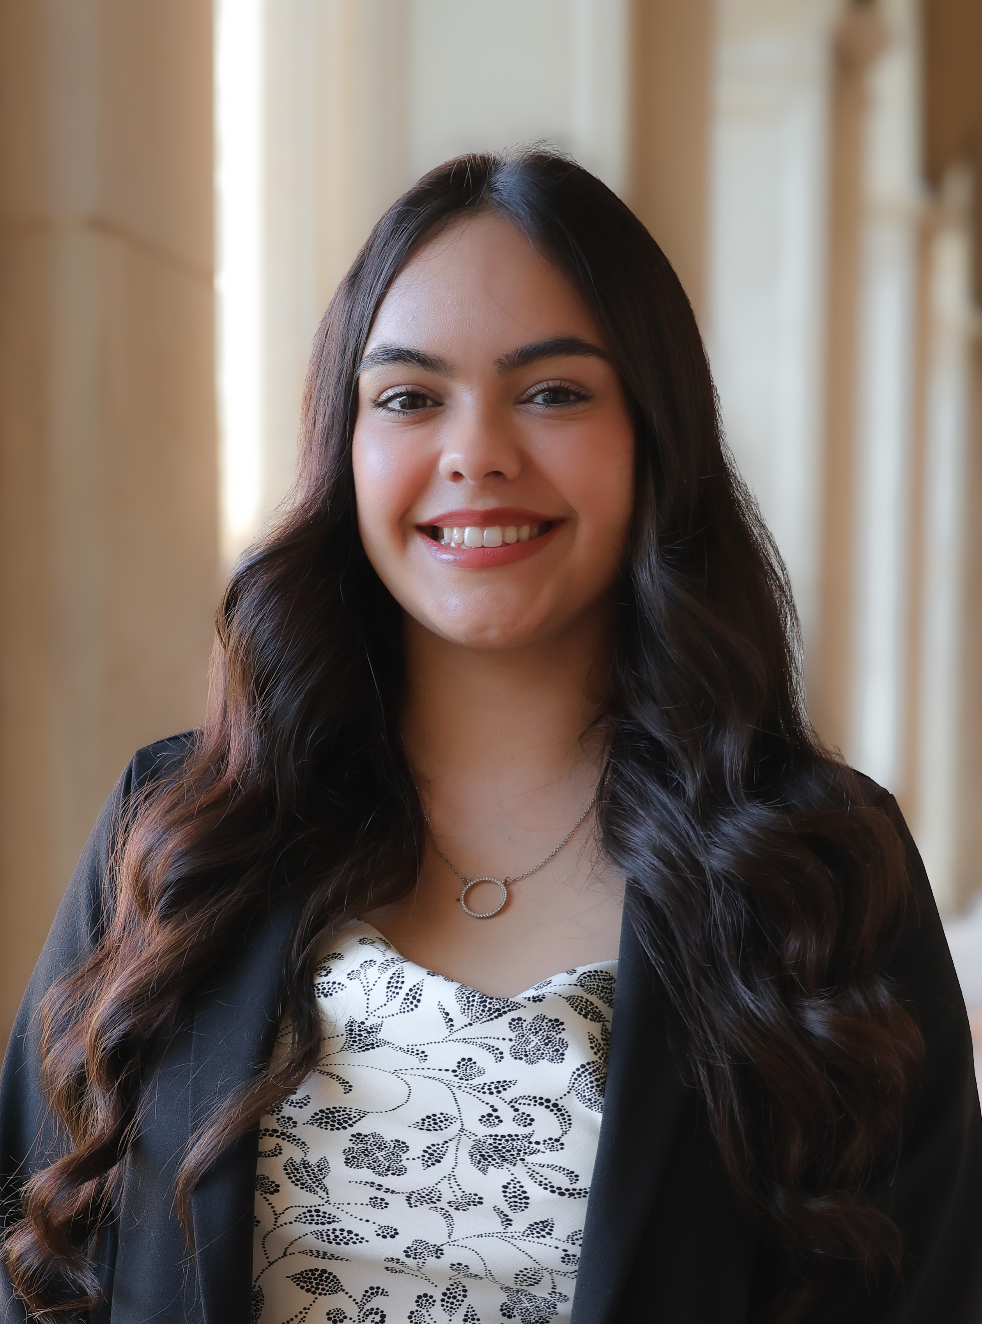
Meet Our Team
Christine Self
Director
Lubbock, TX
Morgan Chavez-Brannon
Program Director
Albuquerque, NM
Connie Watson
Program Director
Henderson, TX
Bryanna Valdivia
Event Coordinator
El Paso, TX

Slide 3

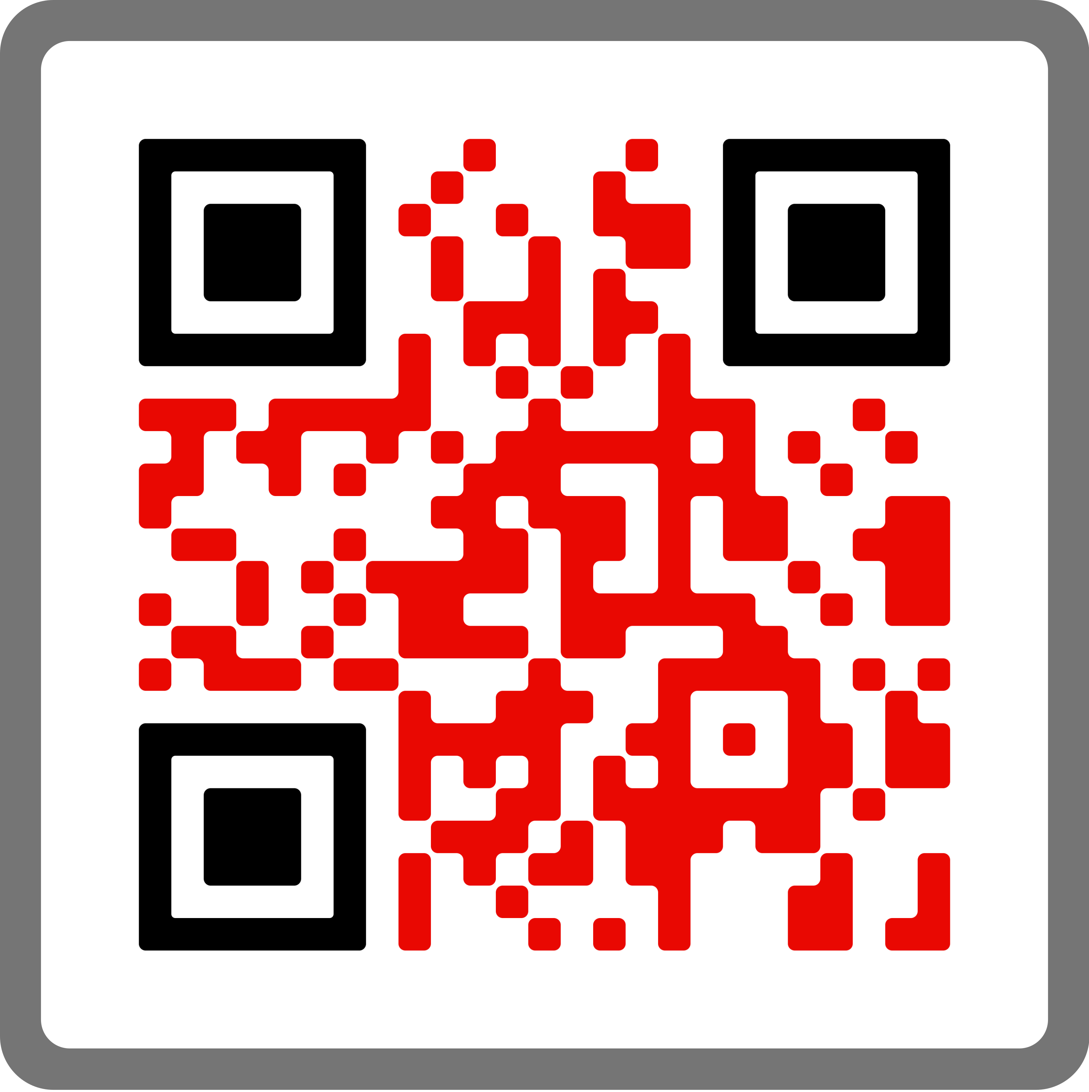


Connect with us
Parent & Family Relations is your support team on campus!
Red Raider Family Network and Newsletter
Webinar Series
Red Raider Family Guide
Social media

Slide 4

Red Raider Orientation for Parents & Family Members
go.ttu.edu/parentrro
RED RAIDER FAMILY
WEBINAR SERIES
Tuition, Financial Aid, and Scholarships – June 3
Health and Wellbeing at Texas Tech – June 10
Campus Safety at Texas Tech – June 17
Academic Success at Texas Tech – July 8
Preparing Your Red Raider for On-Campus Living – July 22
Finishing Touches with PFR – August 5
Register on our website or through the
Red Raider Family Network
All webinars are recorded and available for rewatch on our website and YouTube

Slide 5
Let’s Check In
Sad… scared
Happy/Joyful
ALL THE THINGS
Excited!
Why am I here?
What would you add?
Anxious

Slide 6
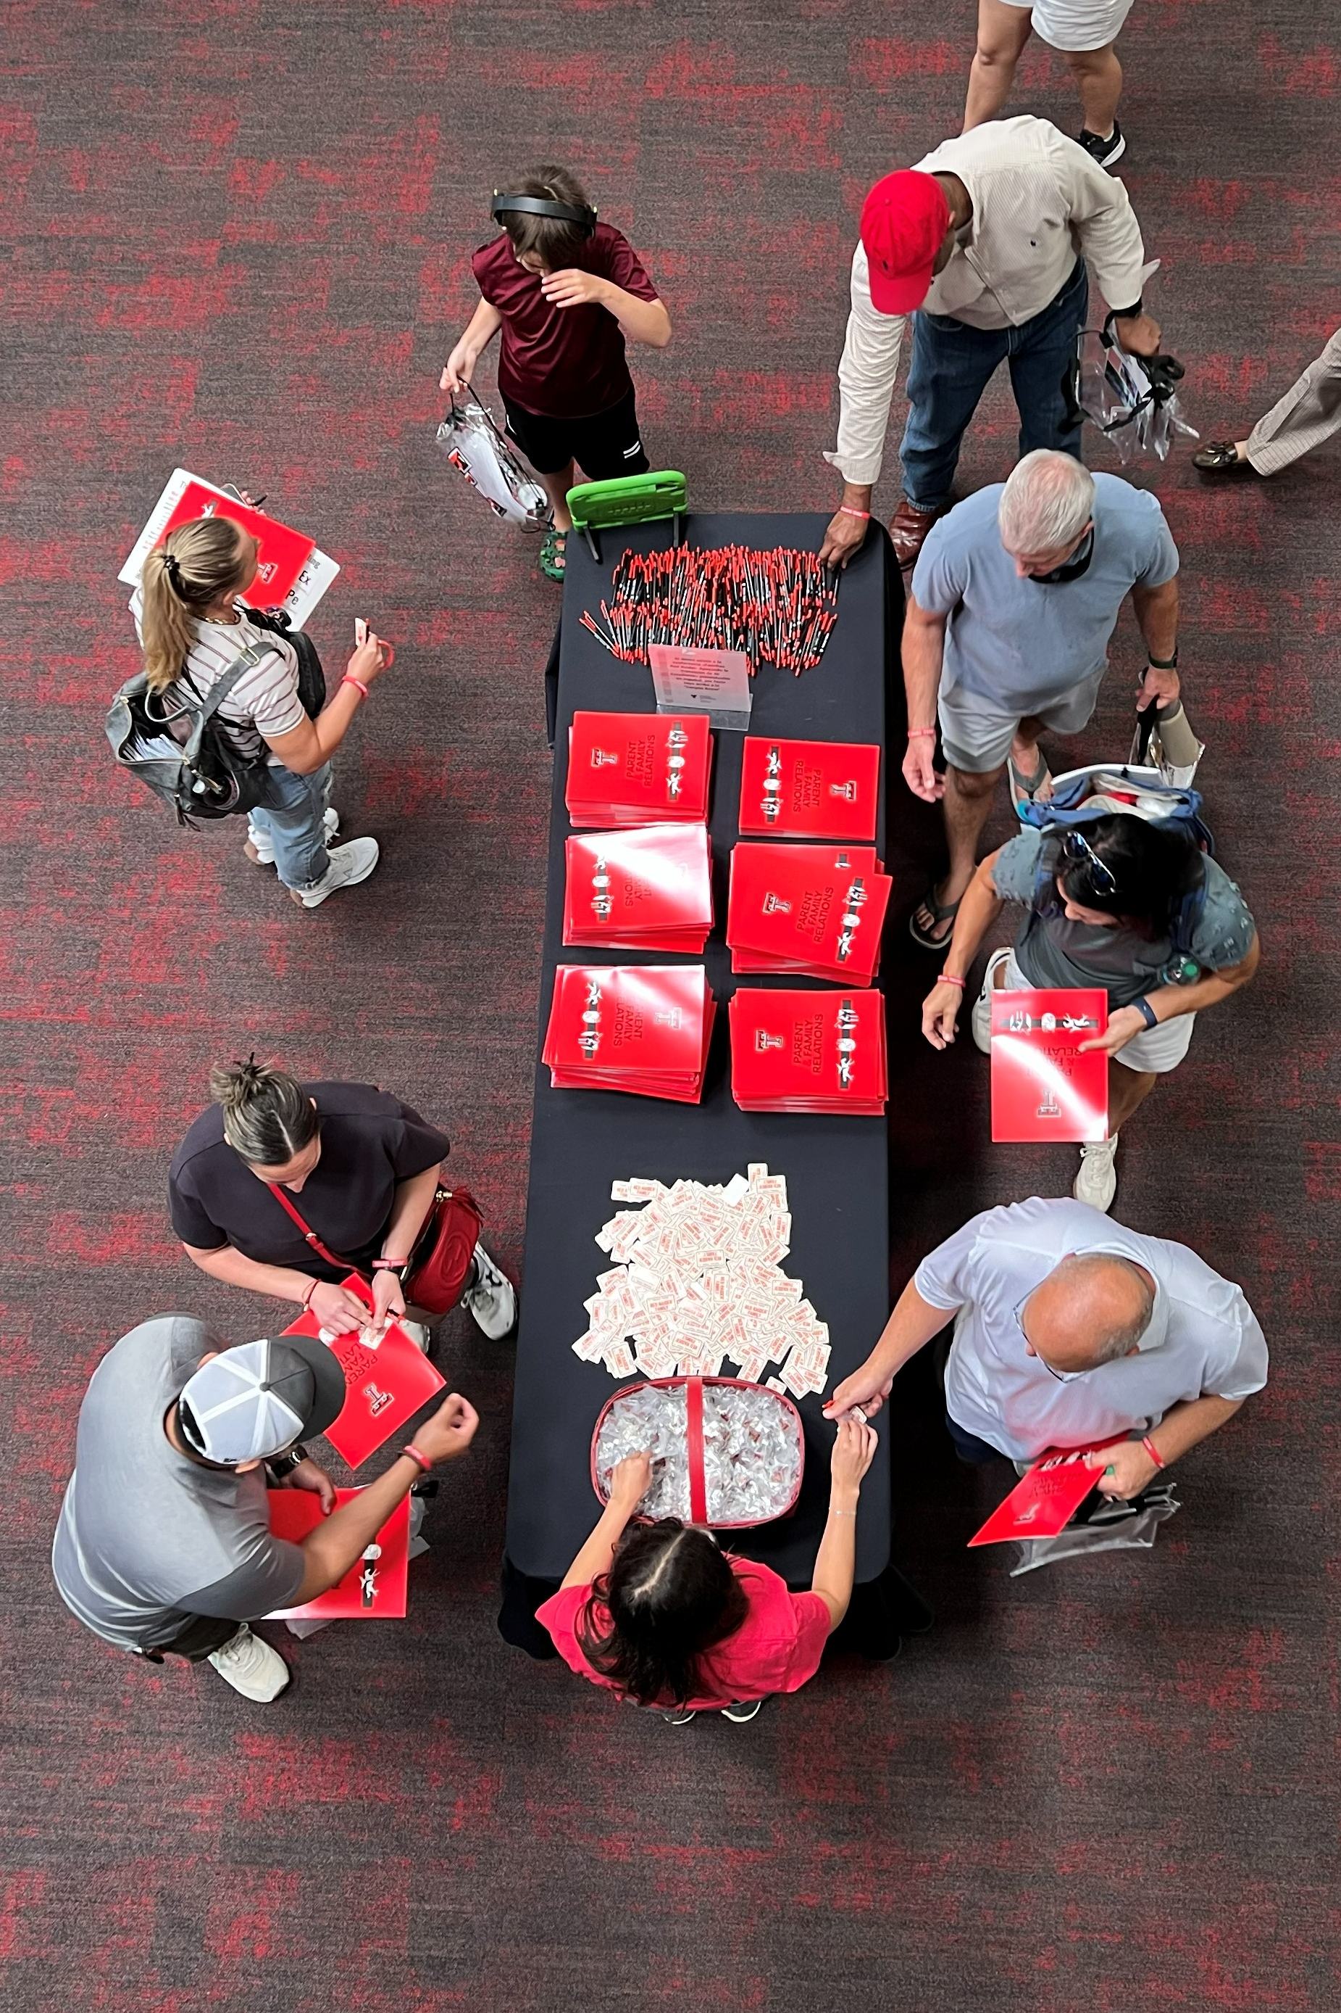
ON YOUR WAY IN
Your Folder Contains
  Red Raider Family Syllabus
  Postcard from Home
  One-page Academic & Event Calendar
Red Raider Family decal
Double T Pin
Pen for taking notes…and writing a postcard

Slide 7
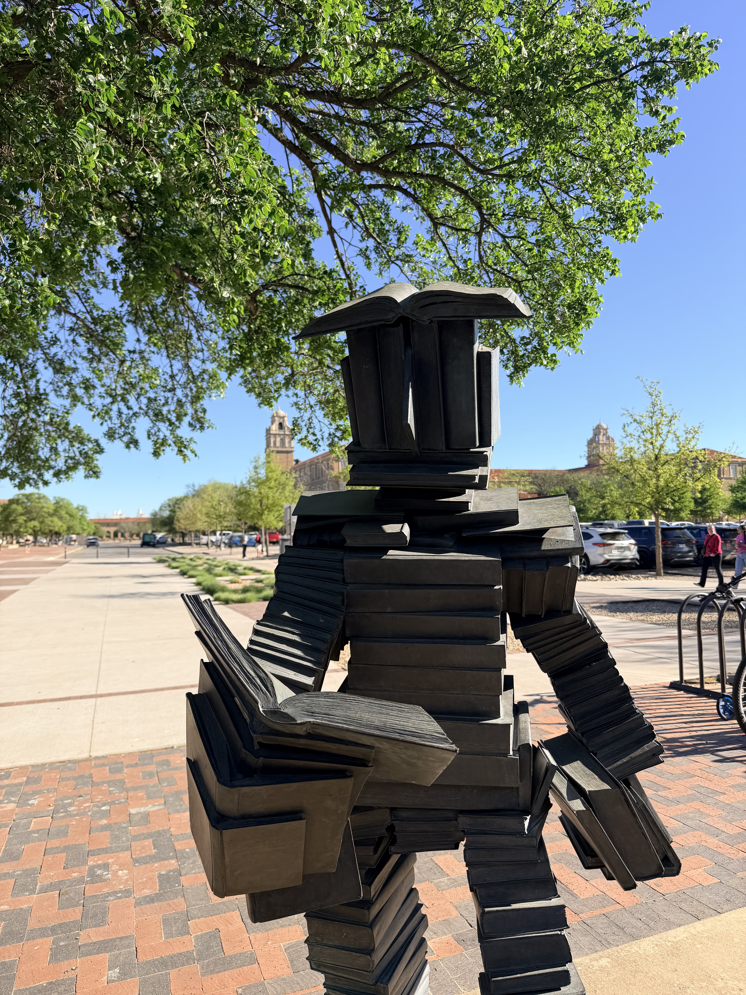
IN YOUR SYLLABUS
Understand the first-year college transition for students and families
Learn how to support your student’s academic, emotional, and social development
Balance support with fostering independence
Texas Tech resources to help your student succeed
Important dates and reminders

Slide 8
College Transition:
What Changes for Families
Think about: How you show up affects how your student handles this transition. Are you jumping in to help or just checking in?
Expect emotional and academic changes for both students and families
Ask your student:
  What’s been most different for you so far?
  What do you wish I understood better right now?

Slide 9
Supporting Independence and Self-Advocacy
Think about: How will you shift from managing your student’s life to empowering them to manage it themselves?
Encourage ownership of academics and decision-making
Build trust and healthy check-in routines
Family Educational Rights and Privacy Act (FERPA)
Ask your student:
  Who have you talked to about _______?
  Have you checked your TTU email for that?
  How will you share your academic progress with me?

Slide 10
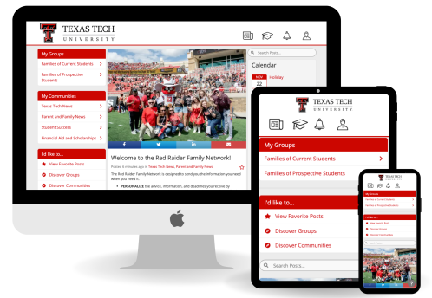
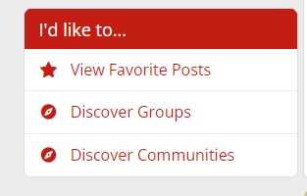
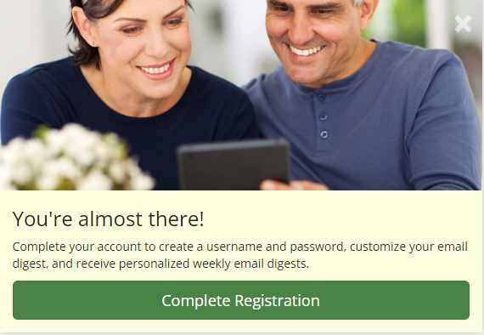

Red Raider Family Network
Make sure you’re signed up – ttu.campusesp.com
  Complete your registration by logging in – there is more than just receiving emails!
  Monthly newsletter and newsfeed with emailed digests
  Browse and join “communities” based on your interests and student’s college

Slide 11
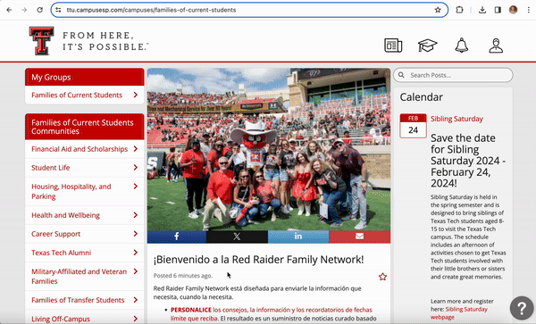
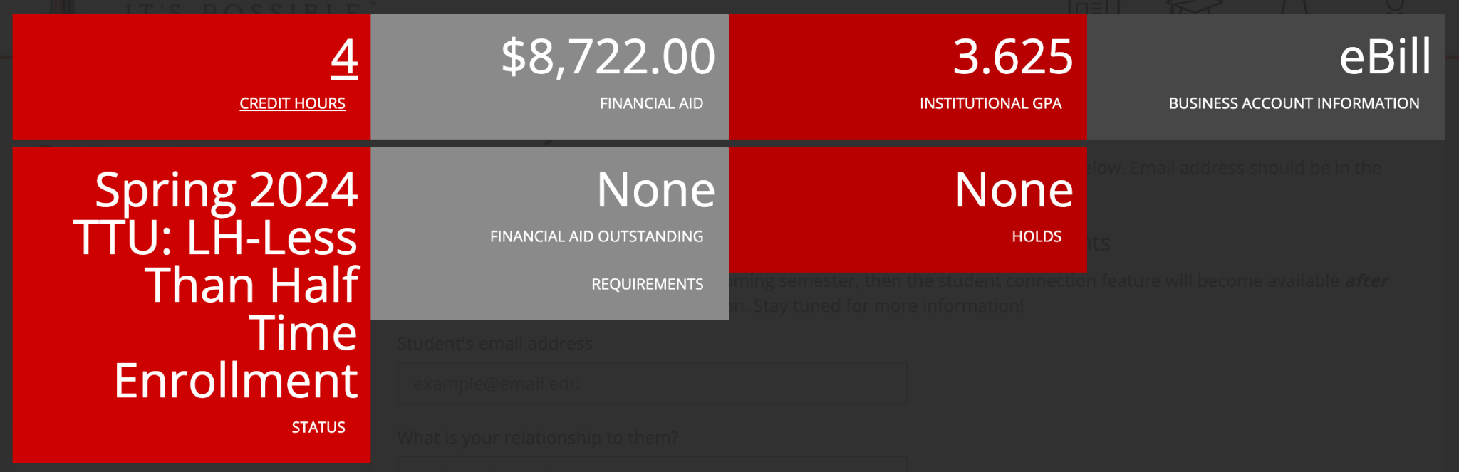
Red Raider Family Network and FERPA
Complete your registration, then request a connection to your student
  You only need their TTU email address
This will give you an overview, not details
  Class schedule, grades, holds, and financial information

Slide 12
Student Involvement
Think about: How you will talk to your student about their overall wellbeing. What coping skills do they already have?
Talk about taking advantage of involvement opportunities
Balancing time between activities and academics
Ask your student:
  What are your thoughts about joining a student organization?
  What events do you plan to attend throughout the semester?
  How are you balancing school, social activities, and downtime?

Slide 13
Health, Well-Being, and Safety
Think about: How you will talk to your student about their overall wellbeing. What coping skills do they already have?
Talk about mental and physical health, social opportunities, and safety resources
Ask your student:
  What’s stressing you out right now?
  Do you know what to do if you get sick or stressed?
  How are you balancing school, social activities, and downtime?
  Do you know how to get a safe ride across campus after hours?

Slide 14
Finances and
Real-Life Skills
Think about: How you are preparing your student for financial and career independence?
Help students navigate the financial aspects of college life
Talk about budgeting, keeping on top of financial aid and scholarship requirements, and career planning
Ask your student:
  How are you managing your finances? How is your meal plan holding up?
  Do you need help completing the FAFSA form?
  Do you know what the career outlook is for your major?

Slide 15
Academics at Texas Tech
Think about: How can you be encouraging, without pressure, as your student adjusts to the academic demands of college?
Learn about academic expectations, tools, and resources
Ask your student:
  Do you know where to go for tutoring? What resources does your college have?
  What are your professors’ office hours? What are the AI usage policies?
  Do you have all the textbooks and access codes you’ll need?
  Do you have the free Microsoft 365 software downloaded?

Slide 16


Postcards from Home
Write an encouraging message and turn it in to us after this session, during the Social tonight, or tomorrow during the OneStop for Questions session
You’ll need your student’s Residence Hall name and Room #
If you don’t have it, no worries! You can take the postcard with you and mail it later

Slide 17

Texas Tech Parents Association

Slide 18
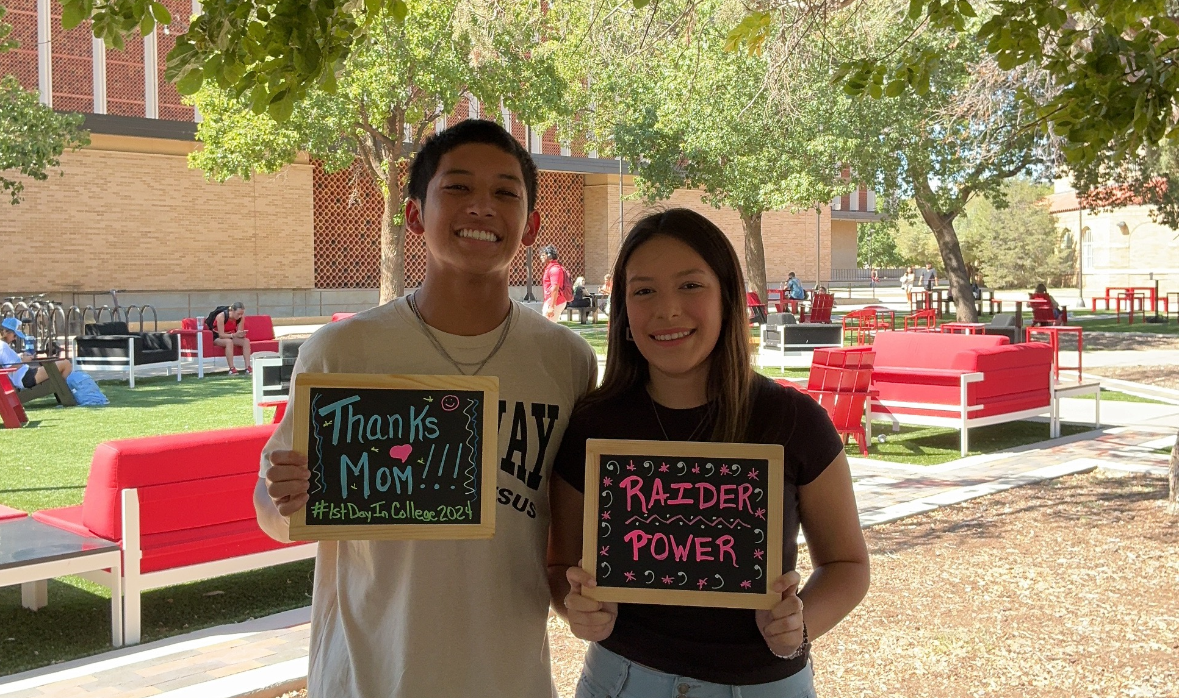
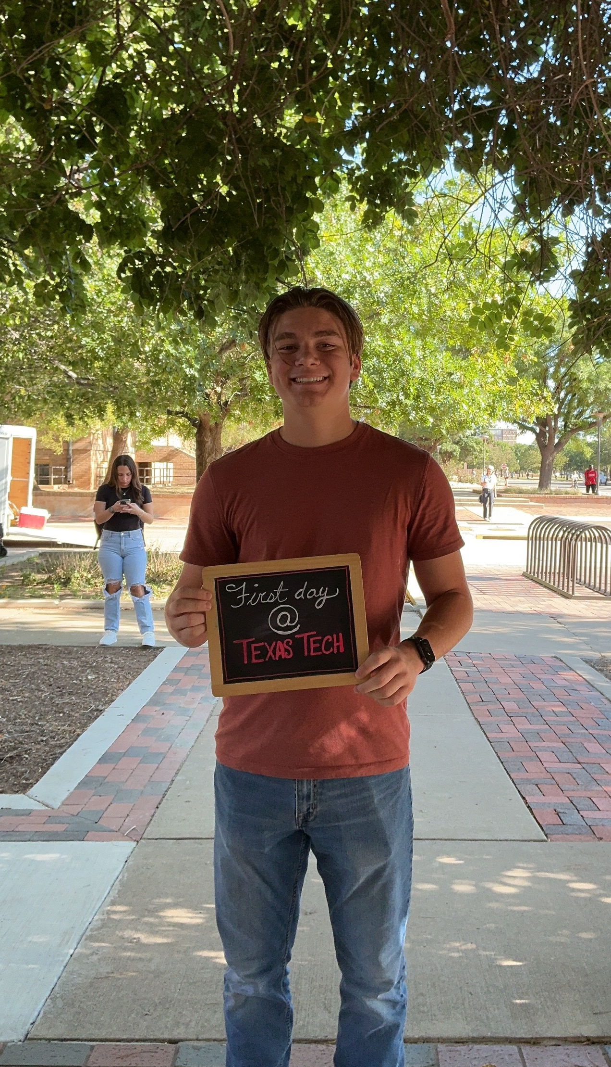
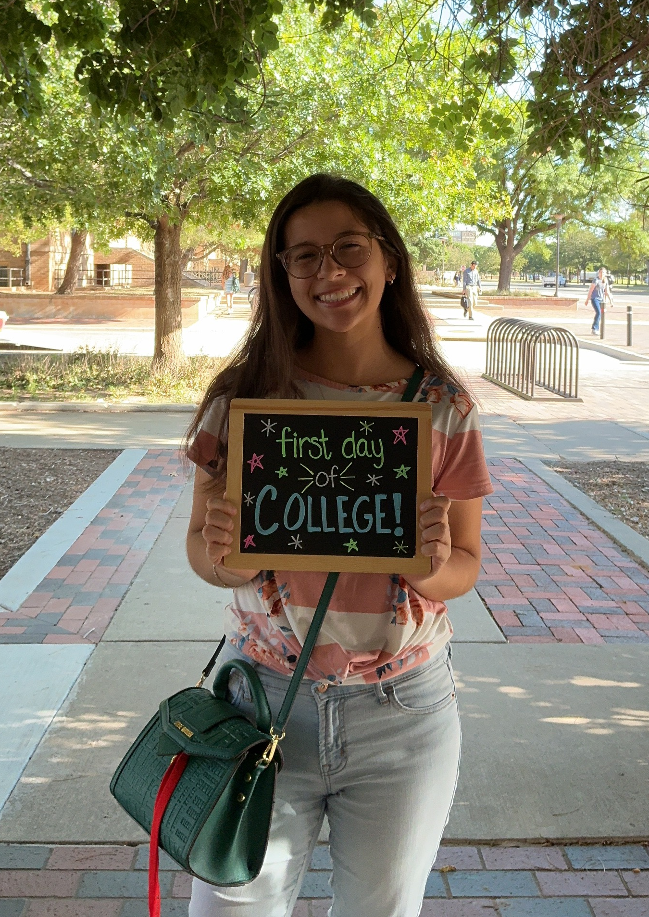
What’s Next?
Important Dates and Reminders
Move-in
  Begins August 20 for those with a timeslot
  Refuel & Refresh with Parent & Family Relations
    International Cultural Center
    August 21 and 22
    11:00am to 2:00pm
    Register on the Red Raider Family Network
Raider Welcome
  August 20th – 30th
  www.raiderwelcome.ttu.edu
First Day of Classes
  Monday, August 24
  Back to School Photos in SUB Gazebo
Family Weekend
  September 25-27
  go.ttu.edu/familyweekend

Slide 19
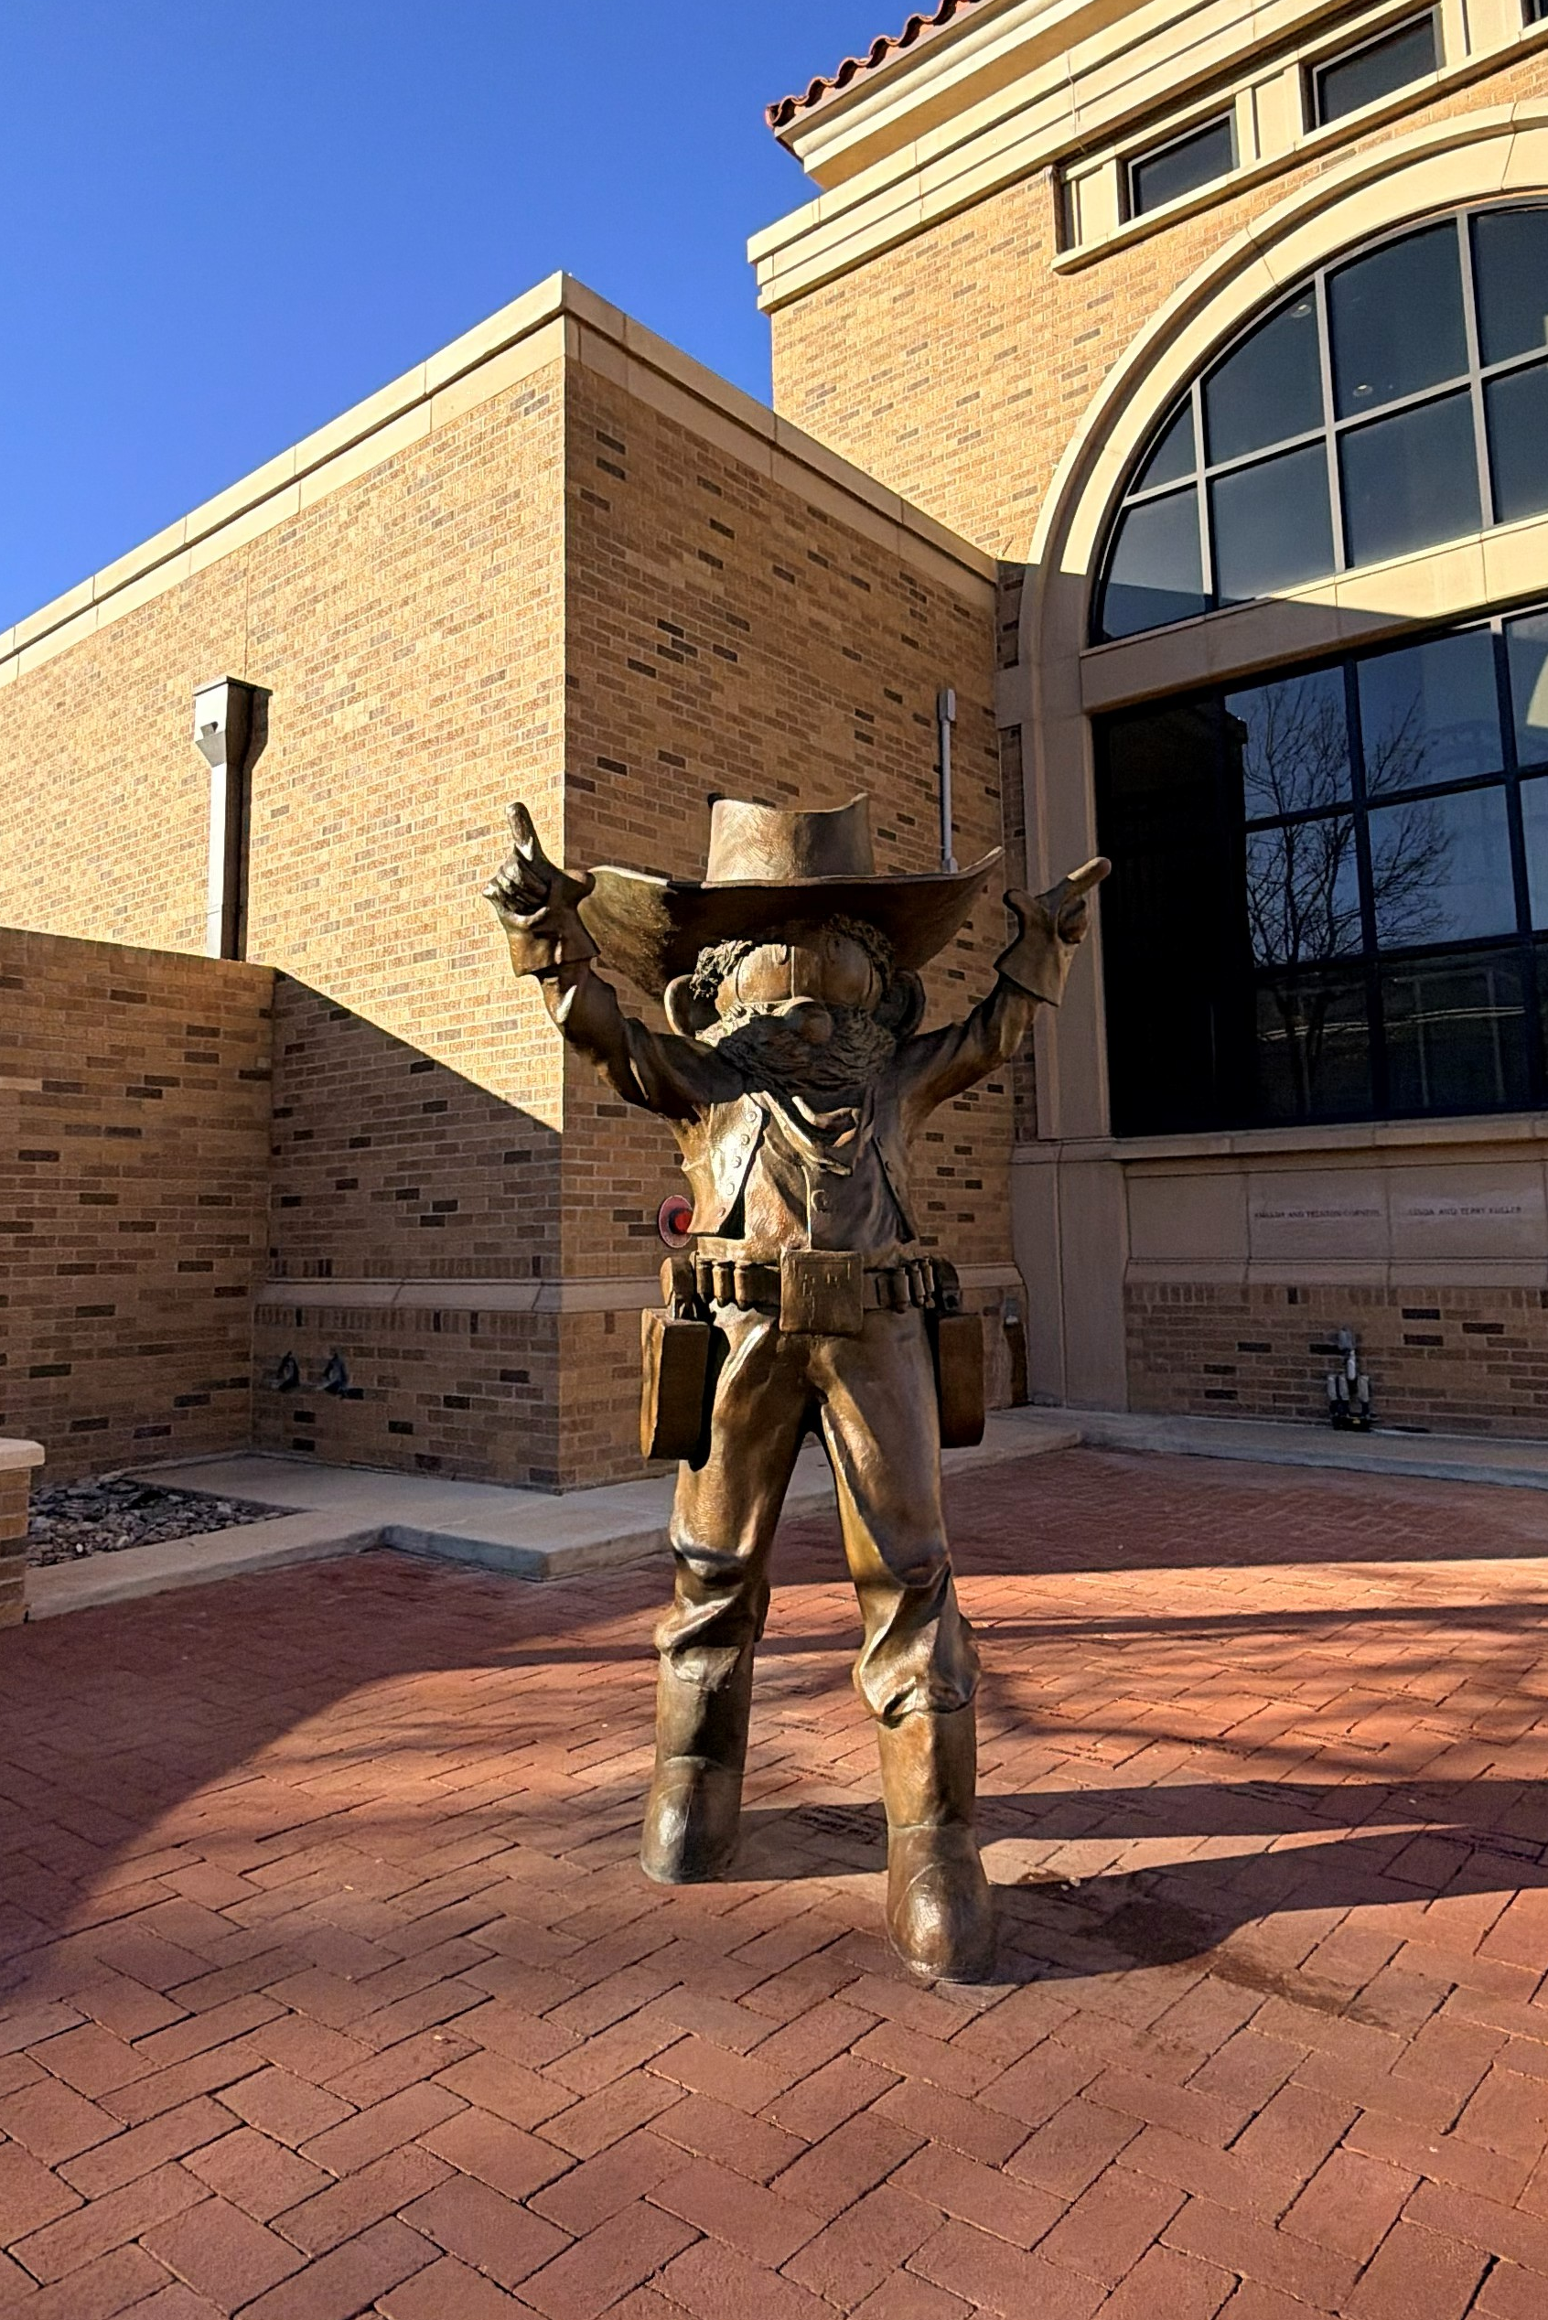
SCHEDULE HIGHLIGHTS
TODAY: DAY 1
3:30pm – 5:00pm – Campus Resource Fair
3:45pm – 5:40pm – Breakout Sessions
  Financial Aid, Scholarships & Student Business Services – Allen Theatre
  Check the schedule for other sessions and locations
5:45pm – 6:30pm – Fajita Dinner with your Student in the Food Court and Ballroom
6:30pm – 8:00pm – Parent & Family Social
  McKenzie-Merket Alumni Center
Students will have programming through 10:00 p.m.

Slide 20
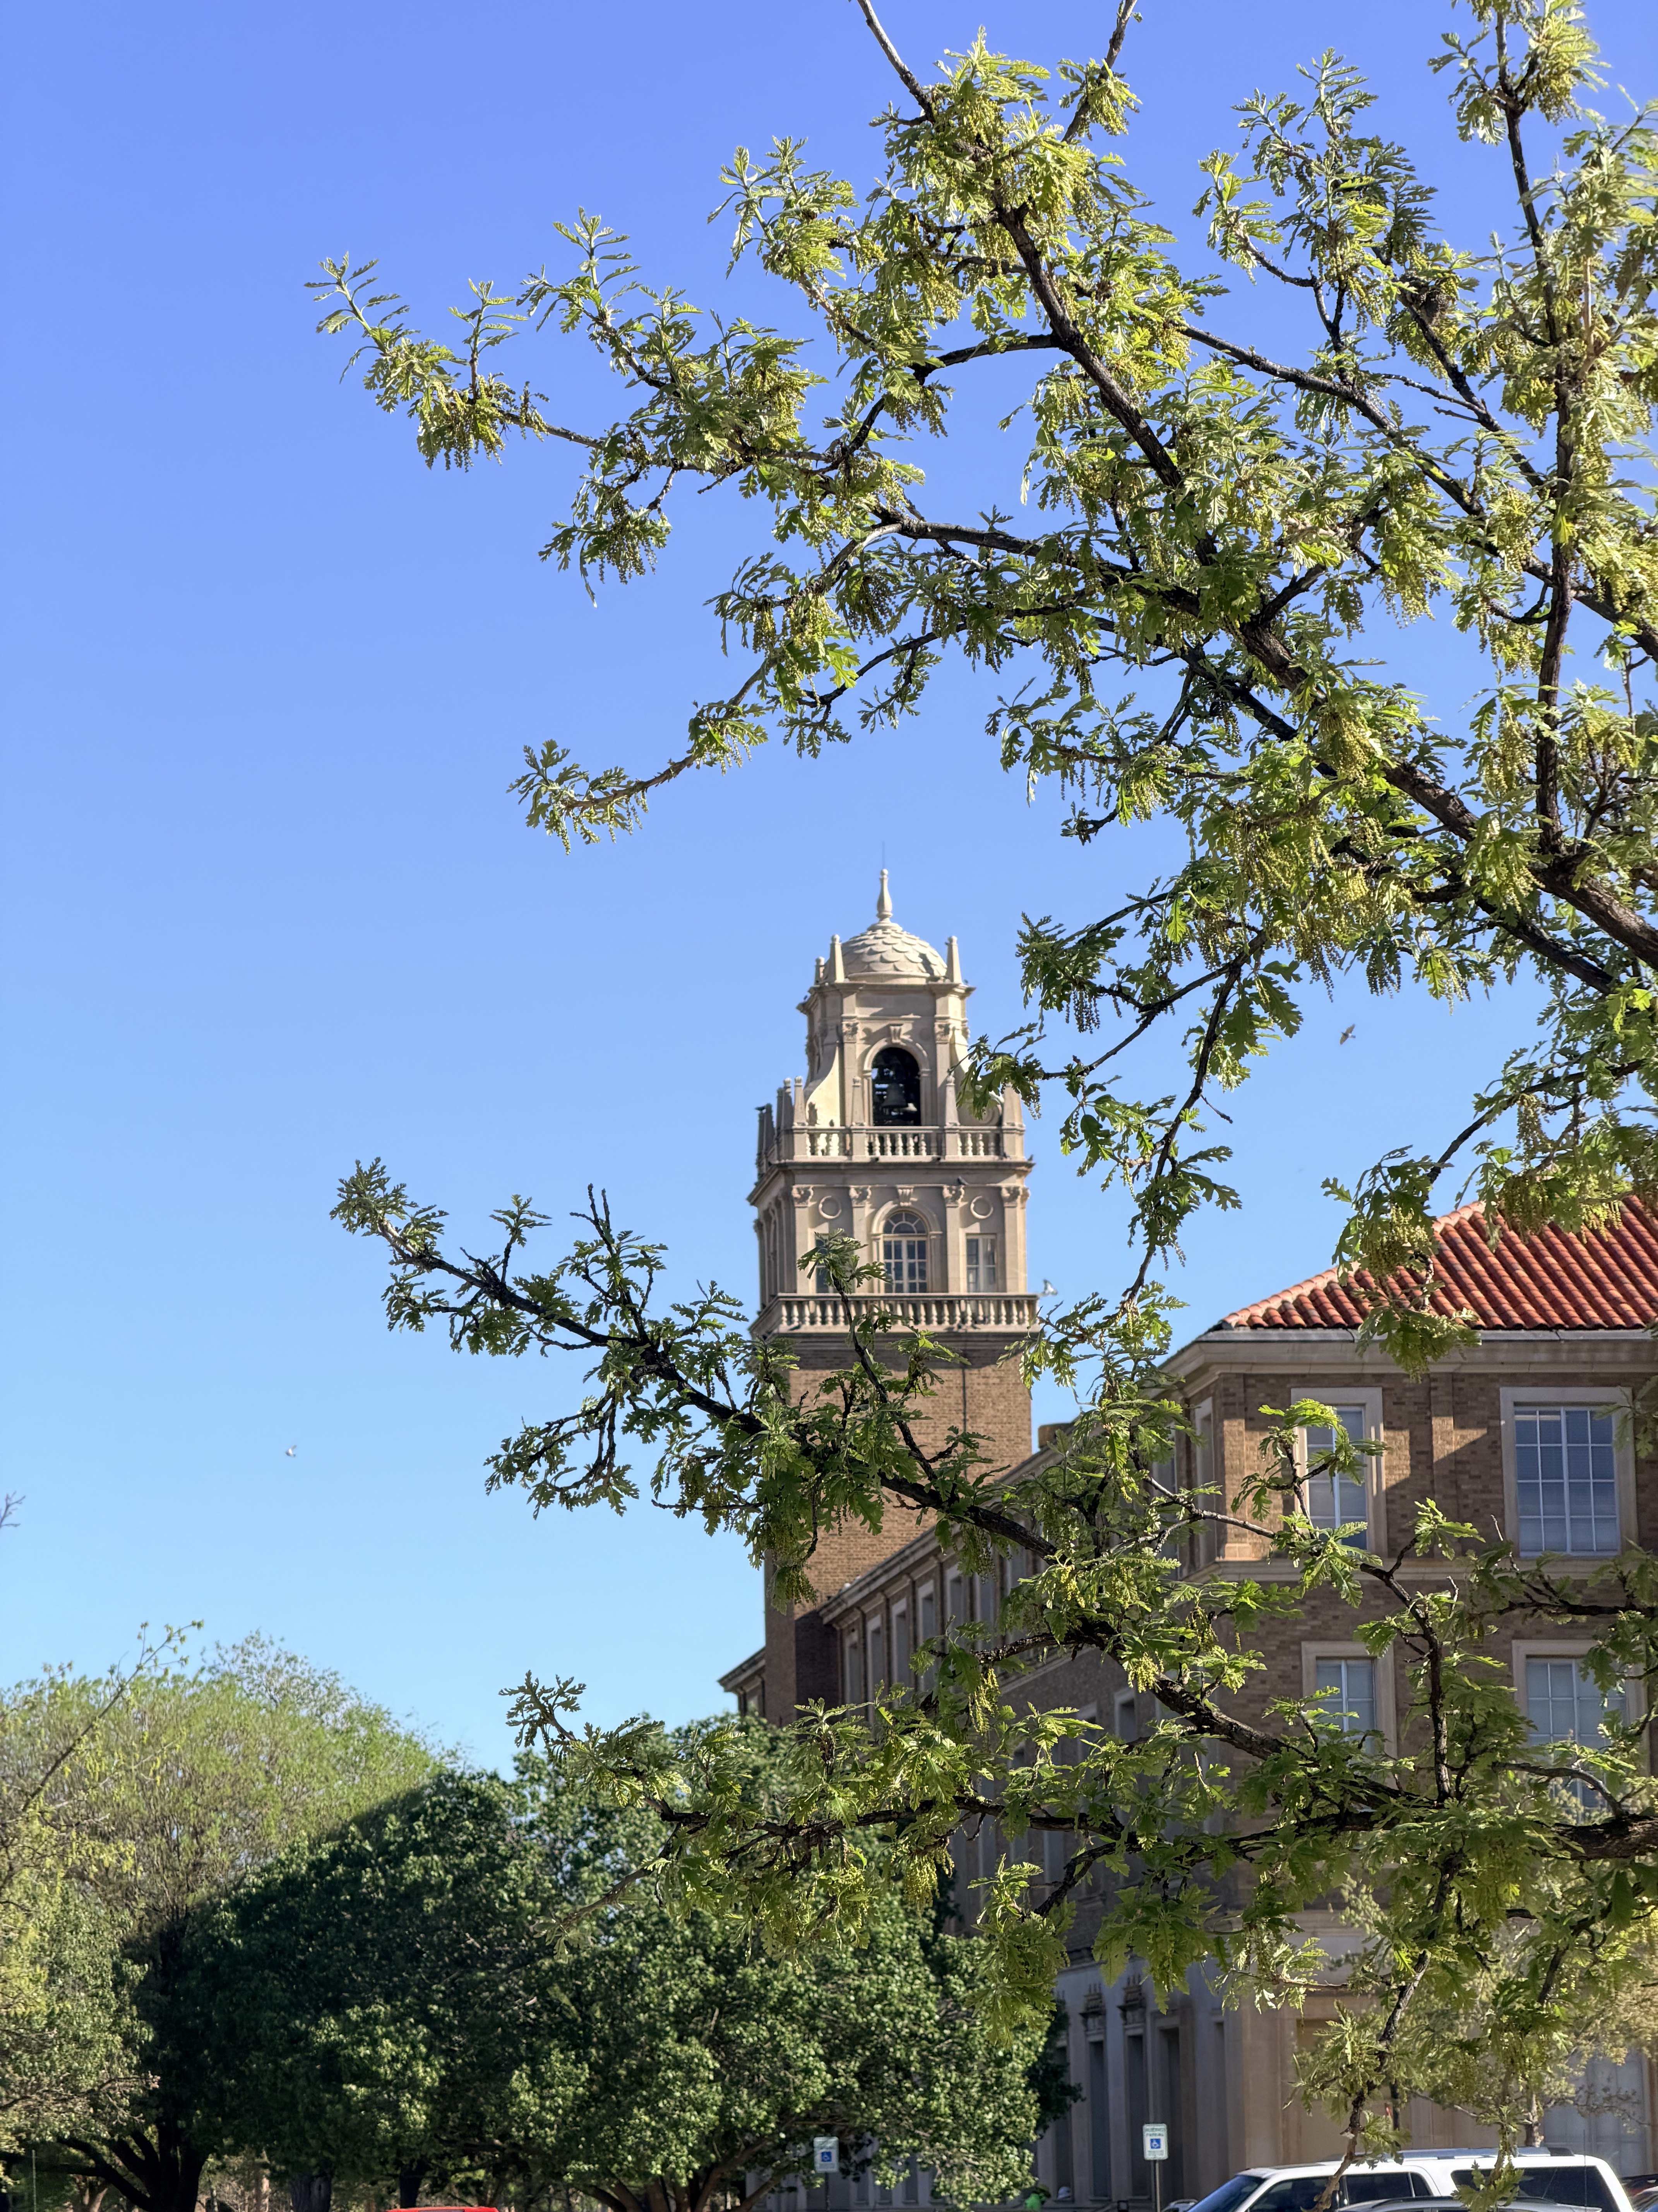
SCHEDULE HIGHLIGHTS: Day 2
TOMORROW: DAY 2
8:30am – Preparing for Student Success at Texas Tech
  SUB Allen Theatre
  Will dismiss to advising and course registration
10:00am – Noon
  OneStop & Residence Hall Tours – SUB Red Raider Ballroom
  Library Tours – University Library Front Desk
10:00am – 1:30pm – Individual Meetings
  SUB Red Raider Ballroom
    Financial Aid & Scholarships
    Student Business Services
    Military Benefits
11:00am – 1:00pm – RRO Closing & First Pic
  Jones Stadium (Southwest Ramp)

Slide 21
Connect with us
Parent & Family Relations is your support team on campus!
Red Raider Family Network and Newsletter
Webinar Series
Red Raider Family Guide
Social media
Notes:
In Parent & Family Relations, we know that college is a transition not only for your student, but for you as family members and supporters as well. We’re here to help!
Like I said earlier, we believe that our students’ supporters are key partners in their success. We are here to make sure you know about the resources that can help your student succeed!
Sign up for the Red Raider Family Network and Newsletter, watch one of our webinars, bookmark our website, and follow us on social media.
You can scan the QR code to save our contact information directly to your phone right now! This includes our phone number, website, email, and social media accounts.

