Slide 1

TSI and Spring Registration
Christine Self | Parent & Family Relations
Jackie Dowell | College Readiness
Important Reminders
Please type all questions in the Q&A Chat.
The presentation will be recorded if you are unable to stay for the entire meeting.
This is a public forum; please do not share any personal information in accordance with HIPAA & FERPA guidelines.

Slide 2

Texas Success Initiative – TSI

Slide 3
Test Optional Does Not Apply to TSI
In accordance with Texas state legislation, TSI scores must be on file with any Texas higher educational institute you attend. These scores may not be used to determine admittance, only to help develop a personalized learning plan if needed.
Entering college students must demonstrate college readiness by meeting minimum standards on TSI Assessments in math, reading, and writing or by demonstrating an exemption for each area.
Those students who do not meet these standards must enroll in appropriate support courses designed to improve their academic skills and prepare them for college-level courses.​ Taking the TSI Class does not replace the need to submit TSIA scores.

Slide 4
College Prep and College Bridge
Texas Tech University does not accept College Bridge or College Prep coursework to exempt a student from TSI classes.
If a student takes either of these programs in high school, it is important that the student understands Texas Tech will still require TSI scores or another acceptable exemption.

Slide 5
Why does my student need to submit scores?
In accordance with Texas state legislation, TSI scores must be on file with any Texas higher educational institute you attend.
If scores are not on file, your student will have a TSI Compliance hold – TSI Needs on their account.
  This hold prevents registration for next semester.
  Emails went out on September 17th if scores need to be submitted.
  Can only be lifted once scores are submitted and processed.
All nonexempt students will have a 'TSI F26 email tsi@ttu.edu' hold
  This will be lifted October 26th, 2026 and placed back on January 4th, 2027 for those who have scores submitted.

Slide 6
TSI Coursework
Emails went out on October 12th to students letting them know if they need a TSI course on their Spring 2027 schedule.
Nonexempt students must take a corequisite course with their entry level math or ENGL 1301 if they are not exempt in each area within the first year of attendance.
Taking in Spring 2027: | Needs if not exempt:
ENGL 1301 | TSI 0304
Taking in Spring 2027: | Needs if not exempt:
MATH 1300 | TSI 0300
MATH 1320 | TSI 0320
MATH 1330 | TSI 0330
MATH 2300 | TSI 0340

Slide 7
How can I talk to my student about College Readiness?
Do you know what TSI is?
Do you know what TSI measures and why it is important?
Have you thought about your goals?
  What is your math skill set?
  What is your Literacy (ELAR) skill set?
Are you participating in any TSI exempt pathways
  Military
  Dual Credit
  Qualifying AP scores
  Qualifying ACT/SAT scores
  Qualifying College Credits

Slide 8
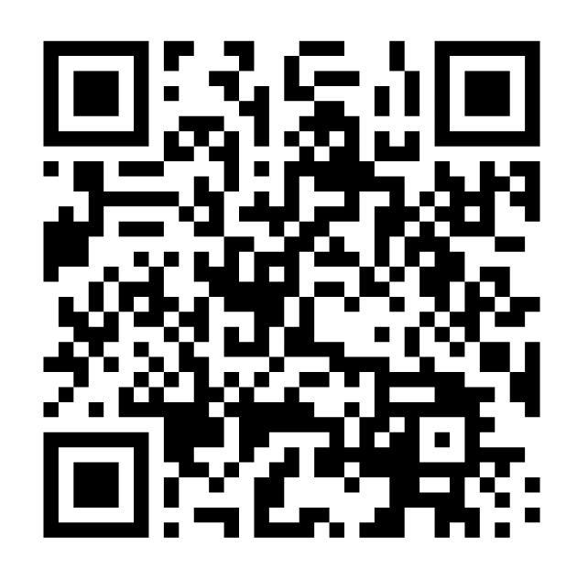

FAQ for TSIA
We have TSIA study materials available on our website.​
You can retake the TSIA as many times as you want. We do not encourage more than 3 times.
The cost of a TSI class at Tech is $250.00. You take the TSI class at the same time as you take the math or English core class. They are co-requisites.
TSI classes have 30 students or fewer, allowing students to receive individual attention and support on coursework throughout the semester.
​
TSI Tips and Tricks
Notes:
Do we need this slide

Slide 9
What students have to say about TSI
“Your teaching has genuinely been the best thing that has happened to me in my math career, and I finally feel like I am able to understand math that meant nothing to me previously.”
“Just want to say thanks for helping me become college ready in Math. I was so overwhelmed when I first walked into your class. I could barely use the blackboard much less understand Logic. But you found a way to connect with me and help me understand the work. You're the reason I have an A in my Contemporary math class. I'll be forever grateful for your teaching. I can do math again! Thank You.”
“"I learn more in these TSI classes than in my regular classes."
"English is going great because of my TSI class and I took TSI math last semester with Pablo. He helped me so much!"
What students have to say About
TSI

Slide 10
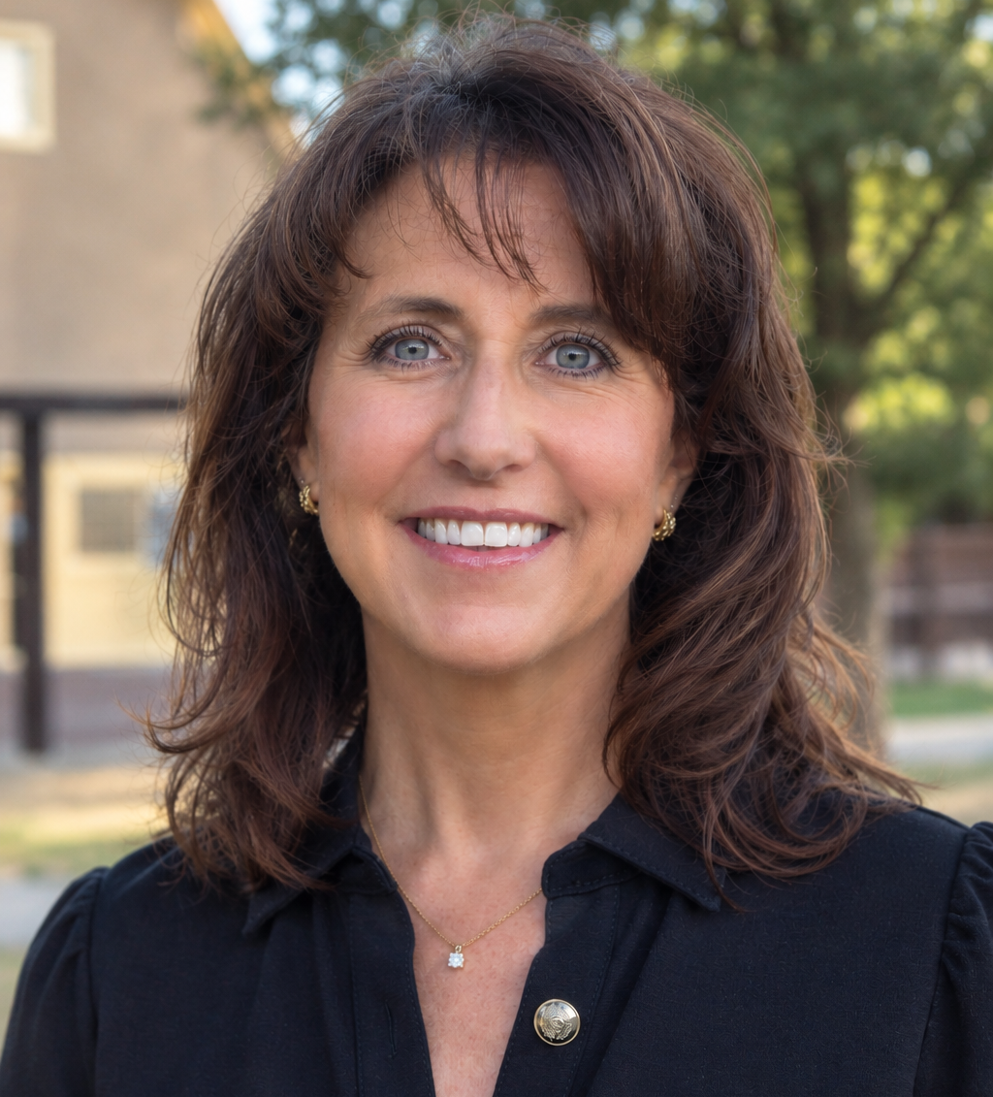
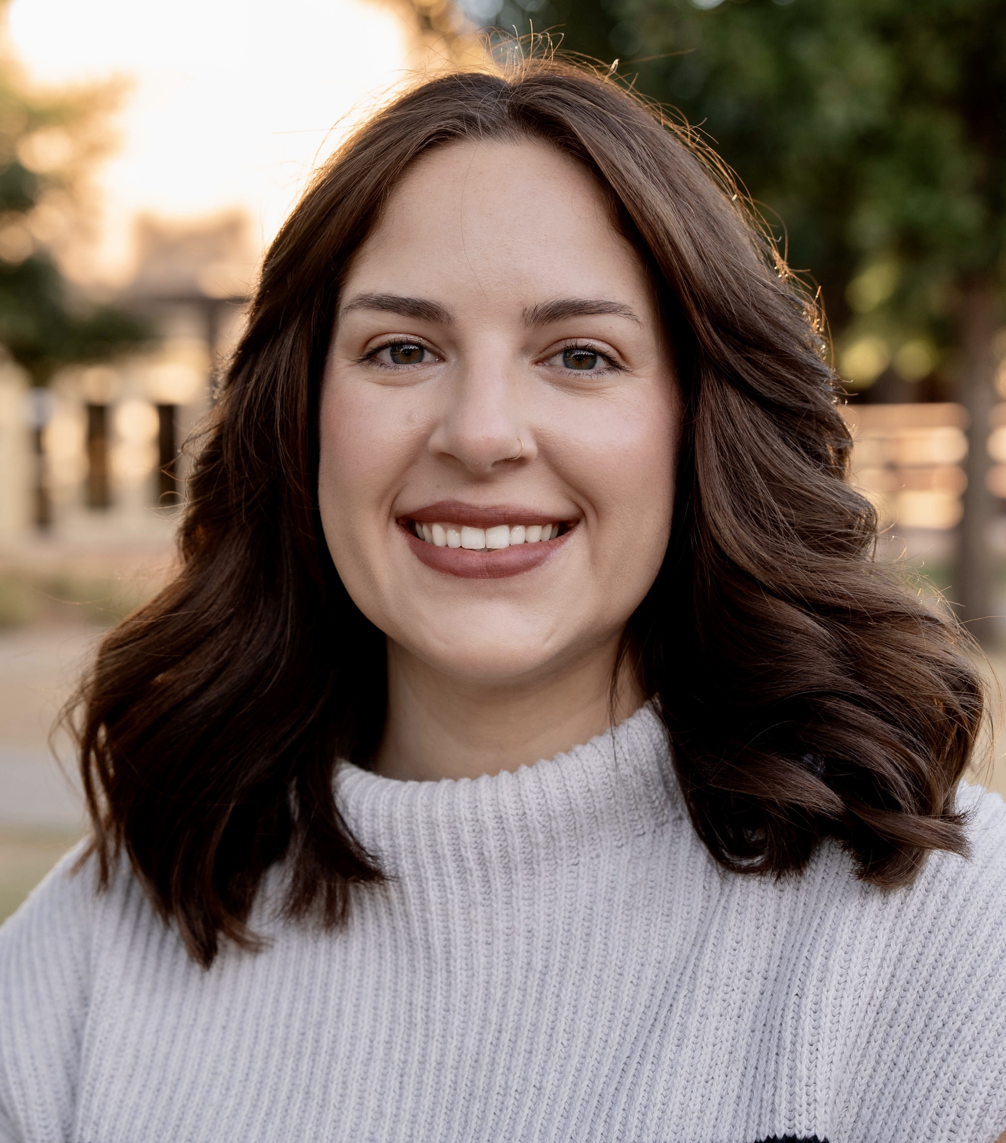
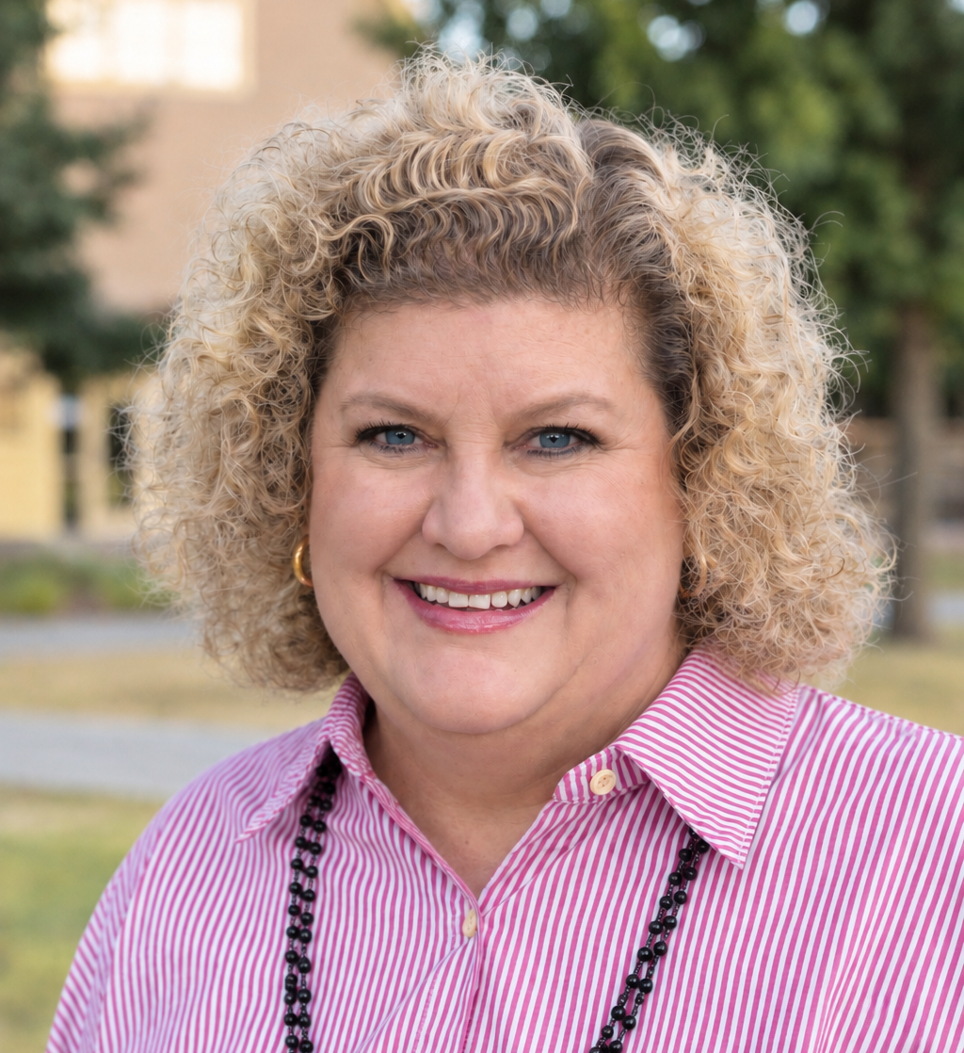
Texas Success initiative
Robin Straley
Senior Director
Robin.straley@ttu.edu
806.742.3242
Jackie Dowell
Program Director
Jackie.dowell@ttu.edu
806.742.3242
Alissa Carter
Program Coordinator
Alissa.Carter@ttu.edu
806.742.3242

Slide 11
Questions?
Use the Zoom Q&A feature

Slide 12
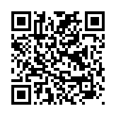

Closing
Up Next:
What is University Coaching? – October 28
Raider Ready Courses: Supporting Student Success from Day One until Graduation – November 13
Spring & Intersession Study Abroad: What Parents Need to Know – November 17
  This webinar is specifically for families with a student already committed to 2027 Spring and Intersession programs
Parent and Family Relations
parent@ttu.edu
Texas Success Initiative
tsi@ttu.edu

