Slide 1

What to Expect at Red Raider Orientation
Connie R. Watson| Parent & Family Relations
Zach Manning| Orientation Services
Notes:
PFR: Welcome to the webinar, Family Members and Guests: What to Expect at Red Raider Orientation! We will begin shortly.
Thank you for joining us! My name is _________.
OS staff intro

Slide 2
What to Expect at Red Raider Orientation
What is RRO?
Why should parents and family members attend?
Notes:
OS

Slide 3
Prior to Red Raider Orientation
Remove Holds
Check TTU Email Daily
Complete RRO Online Modules
Red Raider Family Network
  Receive a monthly newsletter from Parent & Family Relations
  Receive emailed updates based on your interests
  Request access to student records once they’re enrolled
Notes:
OS - removing holds
PFR– Red Raider Family Network

Slide 4
What to Expect at Red Raider Orientation
Guest fees
  Adult Guests (8+ years old): $25 per guest (non-refundable)
  Children (7 and under): Free
What does the guest fee cover?
  Guest fees for One-Day sessions cover program materials, parking, staffing, and administrative and technology costs.
Notes:
OS

Slide 5
What to Expect at Red Raider Orientation
  Schedule Highlights –
  Student and Guest check-in begins at 8:30 AM – Student Union Building (SUB)
      Parking – Z-3 Parking Lot – 18th and Detroit – watch signage
  Hold Removal and Photo IDs
  Red Raider Families: Supporting Your Student's Transition
  Transfer Connection
  Official RRO Welcome and College Welcome
Notes:
PFR
You will receive a complete printed schedule when you arrive at Red Raider Orientation. Here are some highlights for you:
During check-in, your student will receive items they will need during orientation. Families and guests will need to arrange for hotel accommodations. Guests will receive a clear bag (great for bringing to athletic events) you can use to gather items during your orientation experience – you’ll need it for all the goodies you’ll pick up at the Red Raider Families session and the Campus Resource Fair.
Red Raider Families: Supporting Your Student's Transition – During this session, you will learn all about your Red Raider's support network at Texas Tech and important conversations to have with your student before the fall semester begins

Slide 6
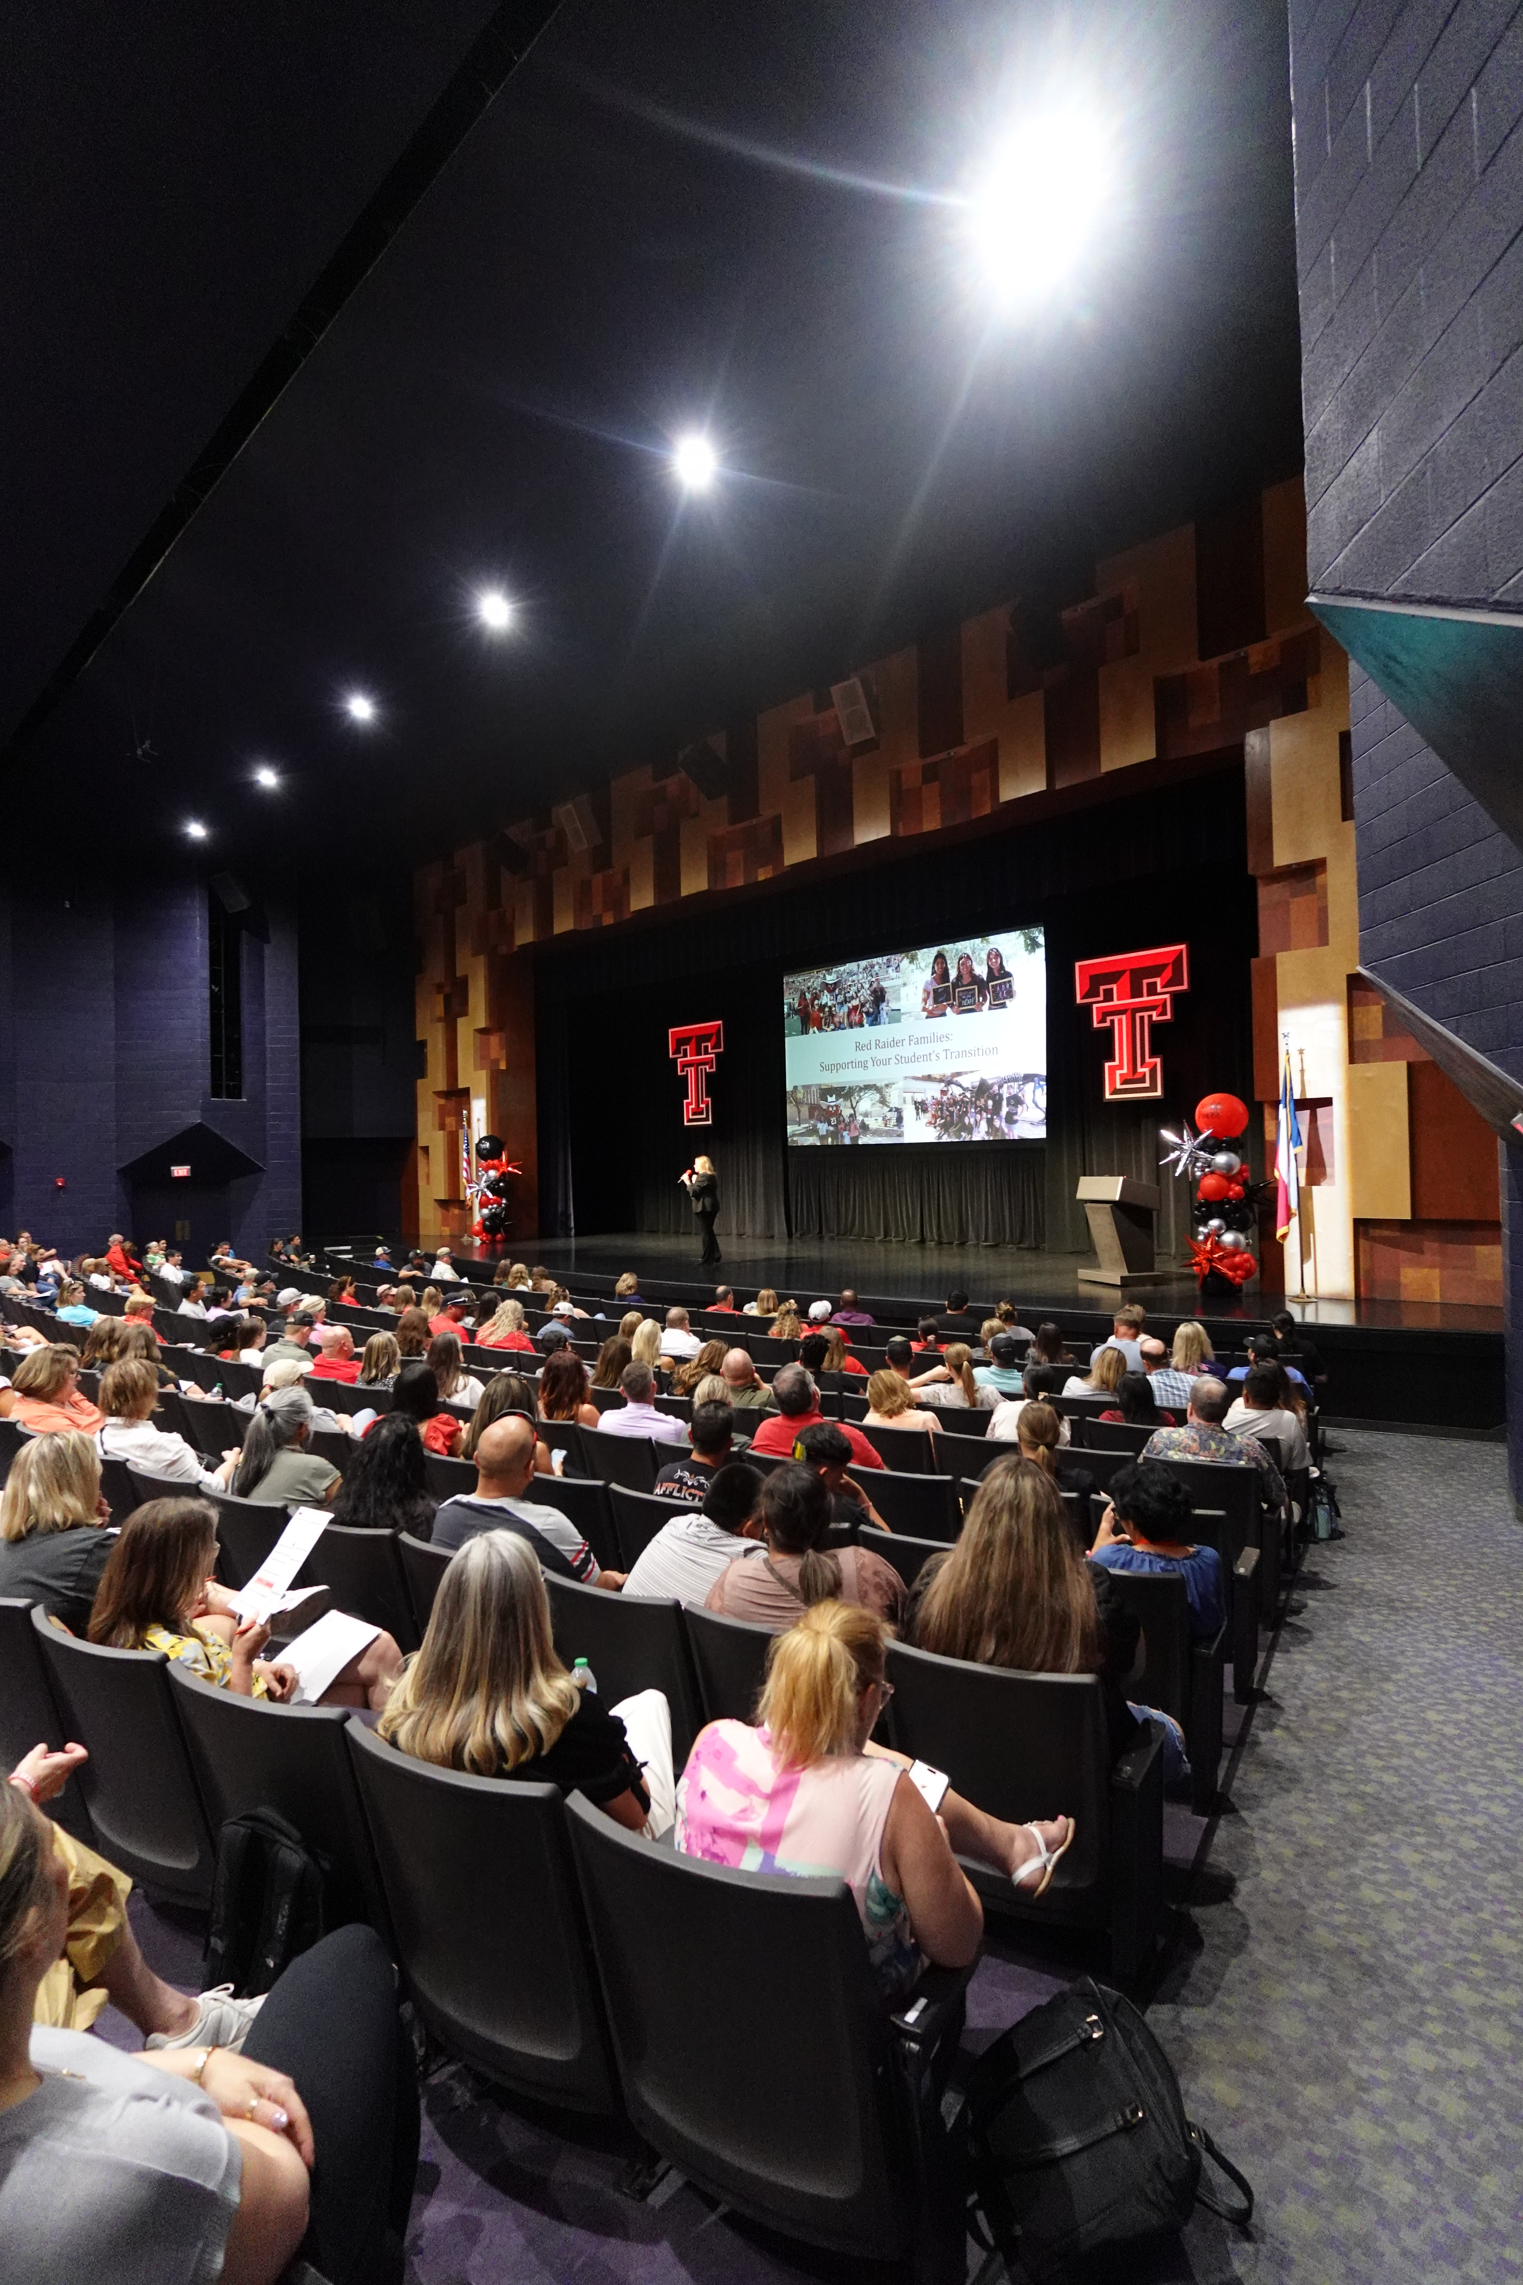
What to Expect at Red Raider Orientation
  Schedule Highlights
  Campus Resource Fair
  Apartment & Housing Fair
  Campus Tours
  Individual Meetings with Financial Aid, Student Business Services, and Military & Veterans Programs
  Academic Advising and Registration
  RRO Check-Out
  Tours – Library and Rec Center
Notes:
OS – Academic Session, Financial Aid/SBS meetings, tours,

Slide 7
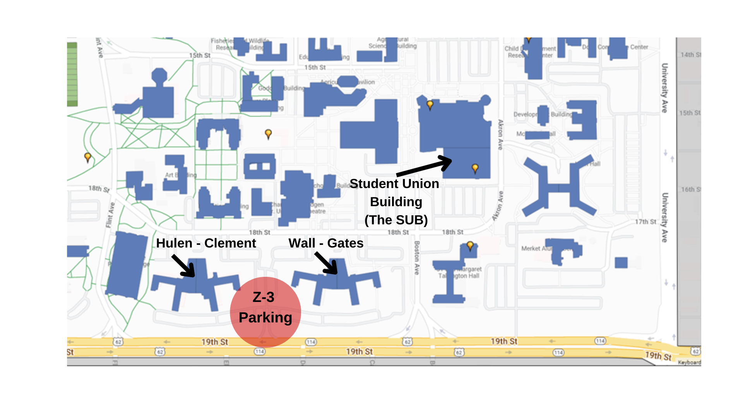
What to Expect at Red Raider Orientation
Notes:
PFR

Slide 8

What to Expect at Red Raider Orientation
Parking
You will park in the Wall/Gates Residence Hall parking lot.
Please do not park in any other lots. Those are reserved for TTU faculty and staff.
One week before your RRO session, you and your student will receive an email with parking registration instructions.
Rental cars can be registered.
ADA parking is permitted across campus with proper license plate or placard.
Notes:
OS: Speaking of Parking--

Slide 9
What to Expect at Red Raider Orientation
  What to Bring – Students
  Government-issued ID – for Student ID pick up
  Laptop or tablet for course registration
Notes:
OS

Slide 10
What to Expect at Red Raider Orientation
What to Bring
  Financial documents if you will be speaking with Financial Aid or Military and Veterans Programs
  Casual, comfortable clothing and shoes. Texas Tech is a very large campus, and you will be walking around.
  A light jacket or cardigan as some meeting rooms can be cool
  Money for meals and snacks throughout the day. Dining locations on campus are cashless.
Notes:
PFR

Slide 11
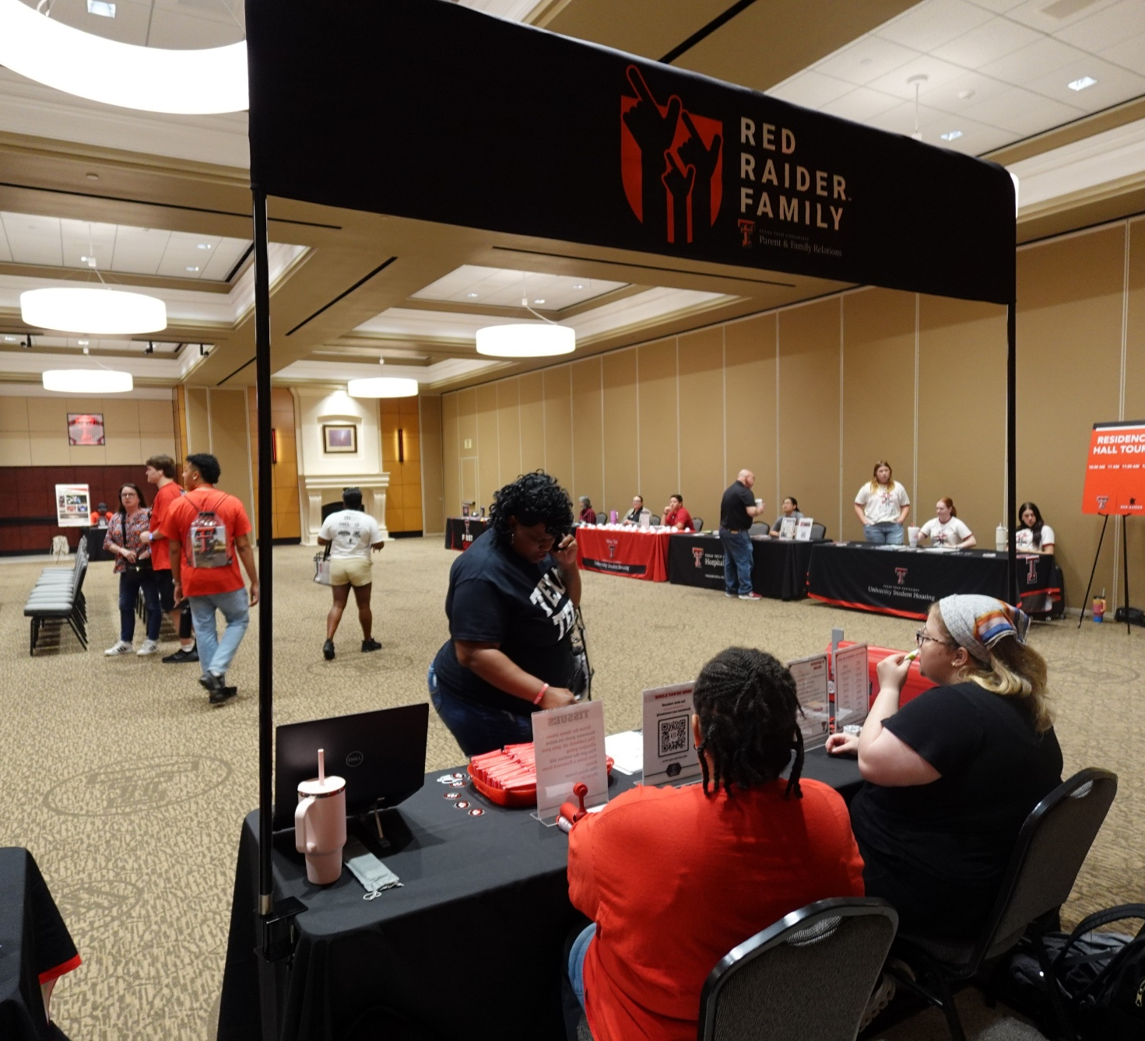
What to Expect at Red Raider Orientation
  What to Expect
    You will attend the Red Raider Families session on your own, while students have the Transfer Connection session
    Students will meet with their advisors
    Parents & Family Members will be involved with Advising (varies by college)
    You will not need to pay tuition at RRO—tuition is due three days before the start of classes
      Bills will be electronically sent to your student’s email address starting in late July
Notes:
OS: Here are some general things to expect at RRO

Slide 12
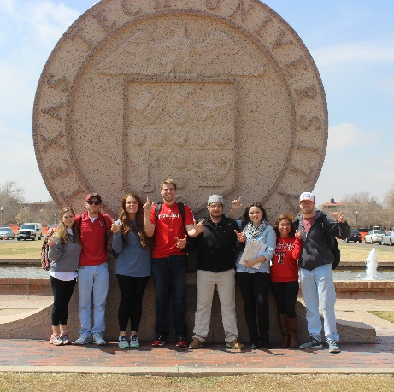
What to Expect at Red Raider Orientation
  Don’t leave without:
    Asking questions – there are plenty of opportunities built in to ask questions
    Connecting with Parent & Family Relations staff
    Meeting other families from your hometown or in your student’s major
Notes:
PFR

Slide 13
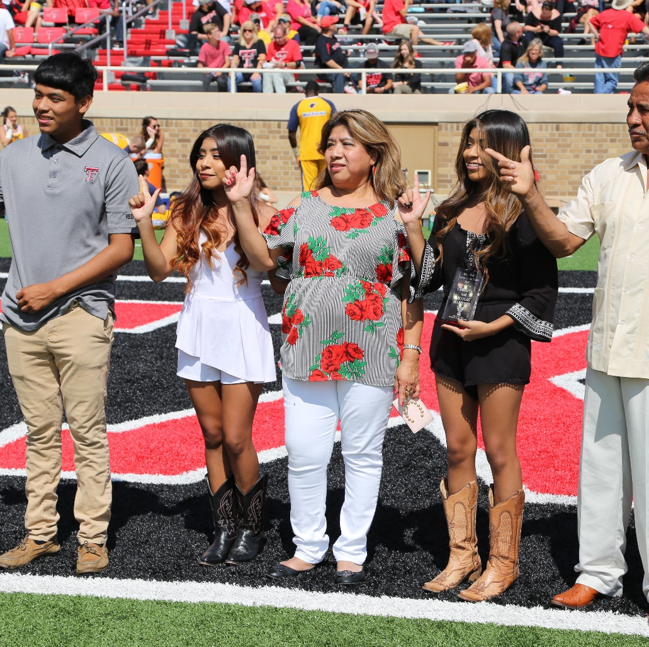
What to Expect at Red Raider Orientation
  Updates
    Be sure your student checks their TTU email address for updates about RRO, housing, academic advising, involvement opportunities, etc.
    Make sure you’re part of the Red Raider Family Network – log in or create an account at ttu.campusesp.com
Notes:
OS

Slide 14
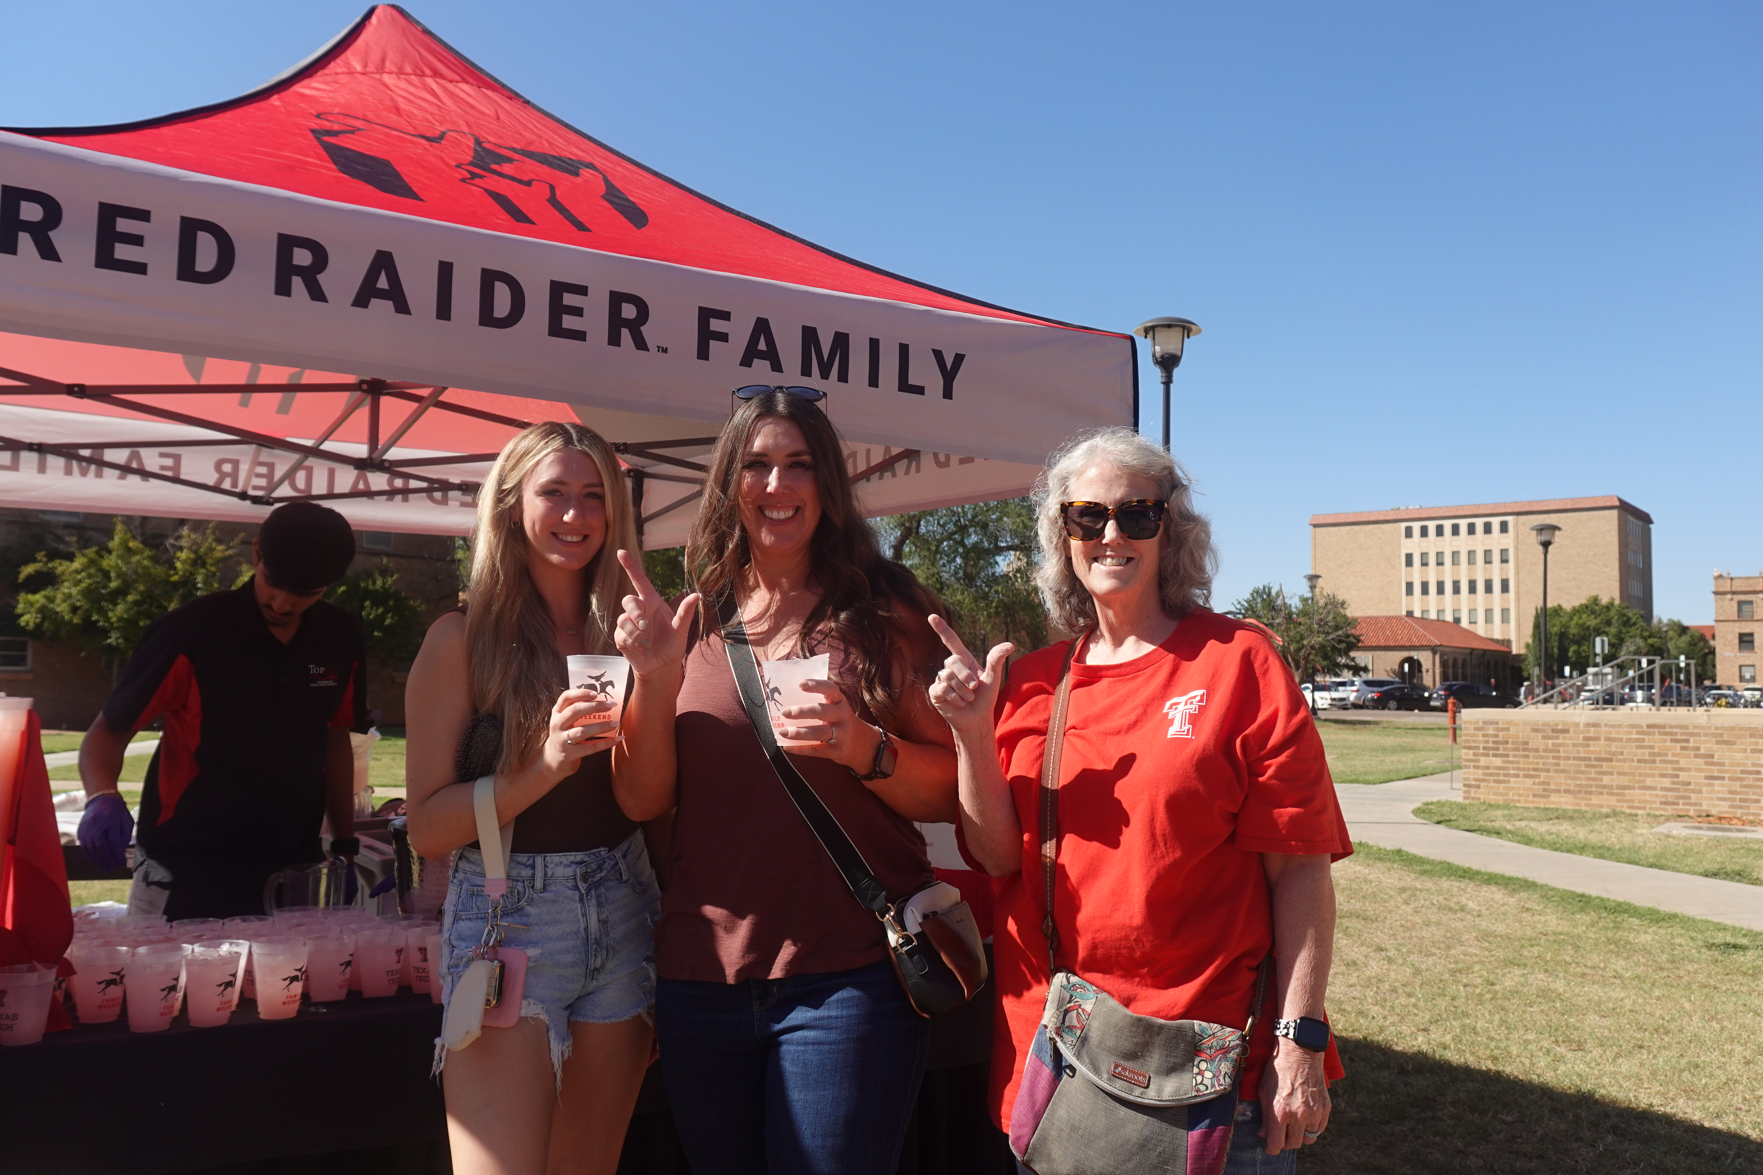
Next steps
Visit www.parent.ttu.edu
Follow us on social media @TTUPFR
Attend additional webinars throughout the summer
Log into your Red Raider Family Network account – ttu.campusesp.com
Family Weekend – September 25-27 – go.ttu.edu/familyweekend
Notes:
PFR – Webinars, Newsletter, FW

Slide 15


Next steps
Move-in Information if living on campus
  Students will receive an email from University Student Housing about signing up for a Tech-In Timeslot for moving in.
  Visit www.housing.ttu.edu for information related to move-in
Raider Welcome
  Activities and events from August 20th – August 30th
Notes:
PFR –Tech-in and RW

Slide 16
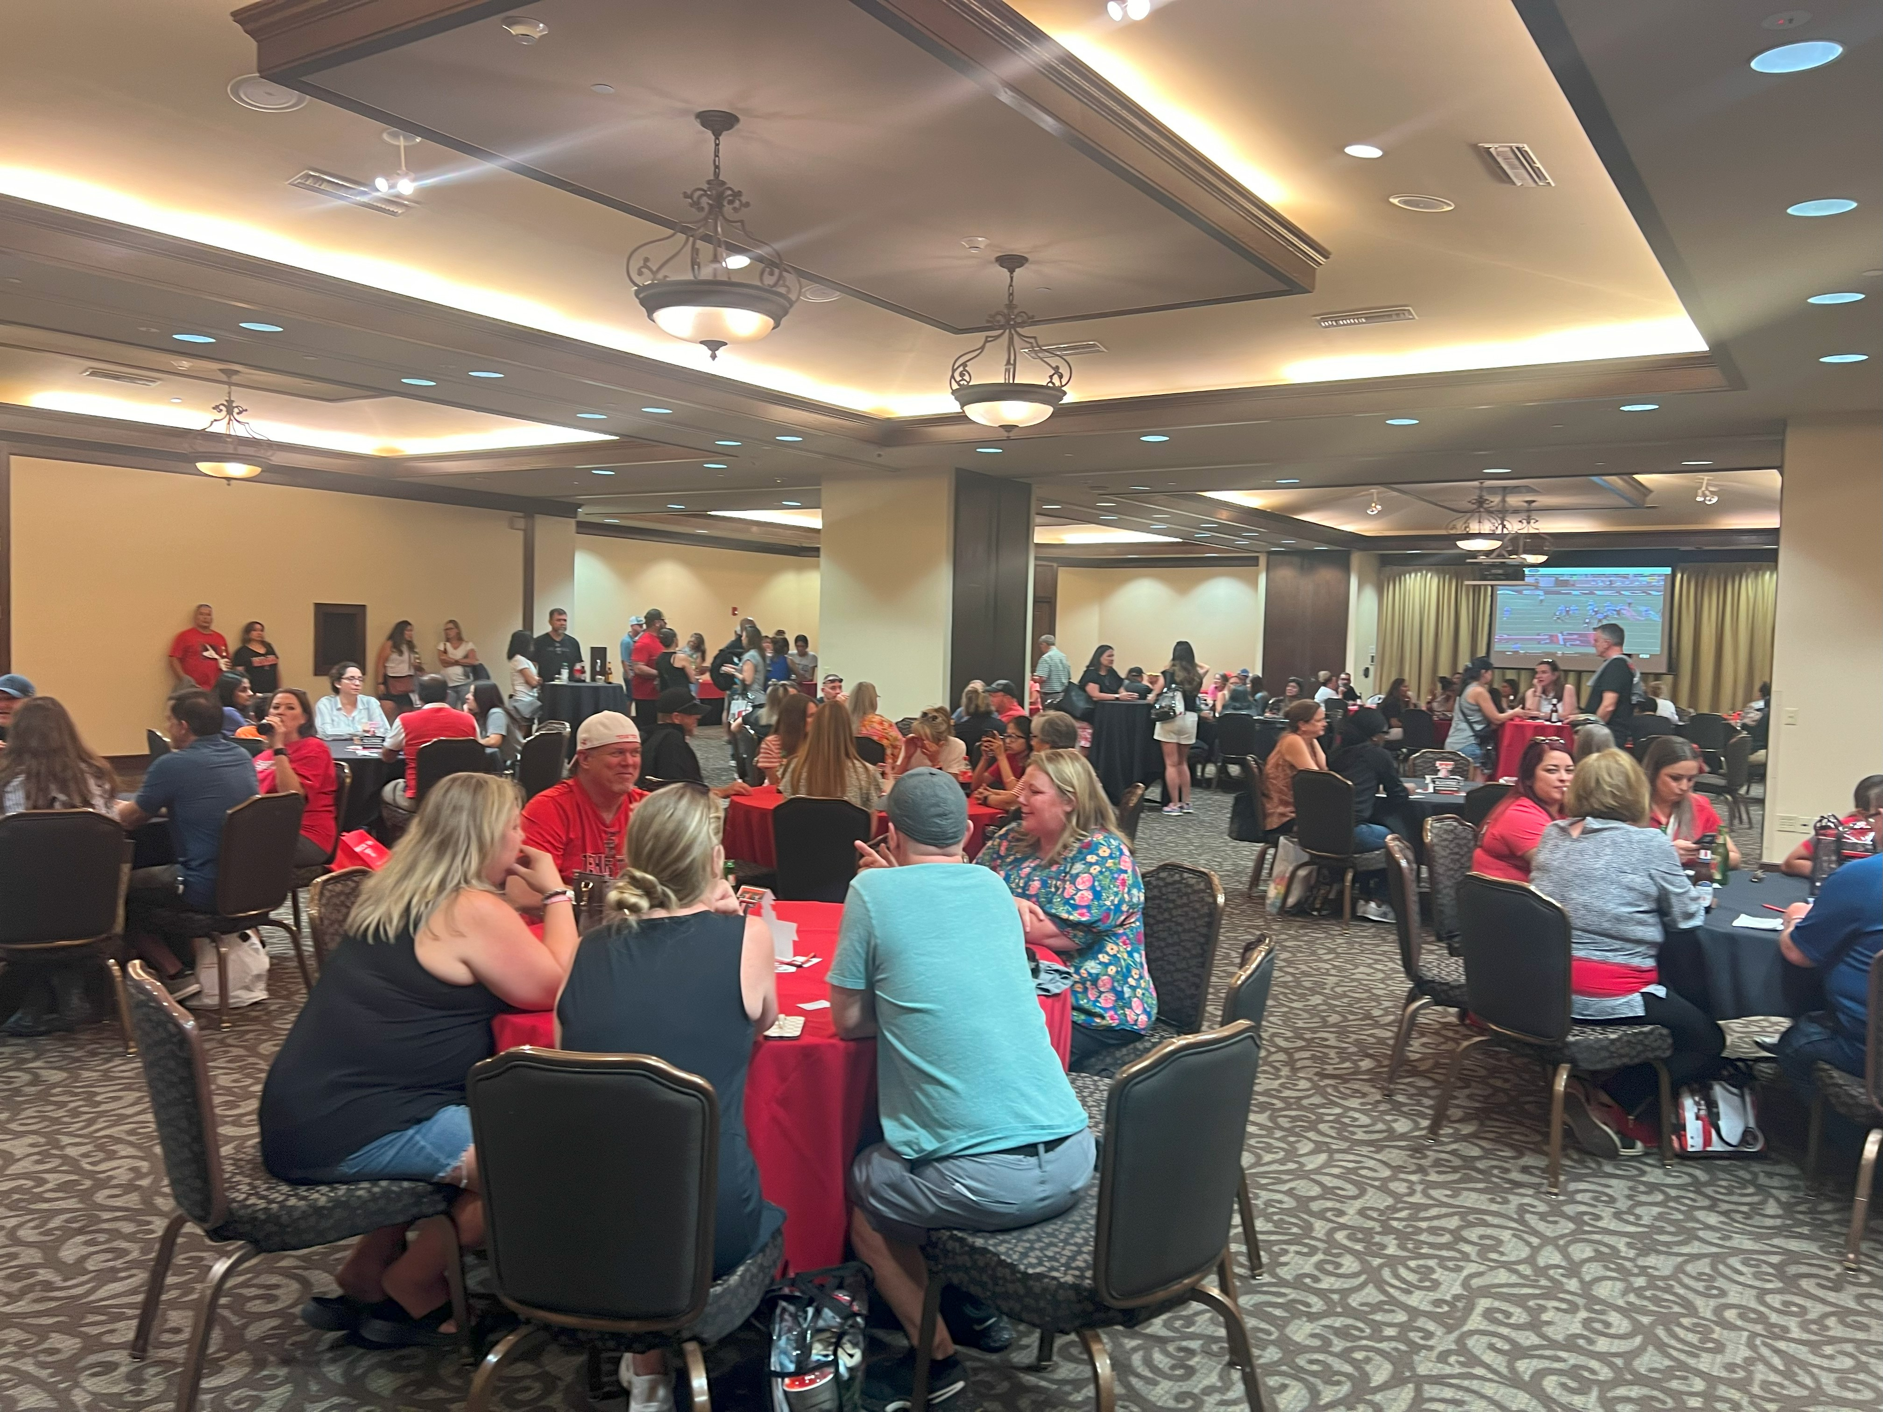
What to Expect at Red Raider Orientation
Need additional information about RRO?
  Visit: www.orientation.ttu.edu
  Email: orientation@ttu.edu
  Call: 806-742-2993
  Instagram: @TTUOrientation
Notes:
OS

Slide 17
Questions?
Use the Zoom Q&A feature
Notes:
PFR

Slide 18
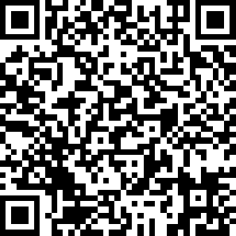

Red Raider Family Webinar Series
Up Next:
CARS 2310: Teaching Student to Thrive at Texas Tech – May 12
Tuition, Financial Aid, and Scholarships – June 3
Health and Wellbeing at Texas Tech – June 10
Parent and Family Relations
parent@ttu.edu
Orientation Services
orientation@ttu.edu

