Slide 1

What to Expect at Red Raider Orientation
Christine Self| Parent & Family Relations
Fabiola Hernandez| Orientation Services

Slide 2
What to Expect at Red Raider Orientation
What is RRO?
Why should parents and family members attend?

Slide 3
Prior to Red Raider Orientation
Remove Holds
Check TTU Email Daily
Complete RRO Online Modules
Red Raider Family Network
  Receive a monthly newsletter from Parent & Family Relations
  Receive emailed updates based on your interests
  Request access to student records once they’re enrolled

Slide 4
What to Expect at Red Raider Orientation
Guest fees
  Adult Guests (8+ years old): $75 per guest (non-refundable)
  Children (7 and under): Free
What does the guest fee cover?
  Guest fees for Two-Day sessions cover…
    Program materials
    Day 1 Dinner
    Day 2 breakfast
    Guest shirt
    Parent & Family Social
    Parking, staffing, and administrative and technology costs

Slide 5
What to Expect at Red Raider Orientation
  Schedule Highlights – Day 1
    Check-In begins at 10:00 AM on Day 1
      Parking – Z-3 Parking Lot – 18th and Detroit – watch signage
      Check-In - Student Union Building (SUB)
    Day 1 Morning/Afternoon
      Hold Removal, Welcome Session, College Welcome, Family Presentation
    Campus Resource Fair
    Breakout Sessions:
      Financial Aid and Student Business Services, First Gen Raider Experience, Study Abroad, Student Organization Fair, and more
    Fajita Dinner with your student
    Parent & Family Social

Slide 6
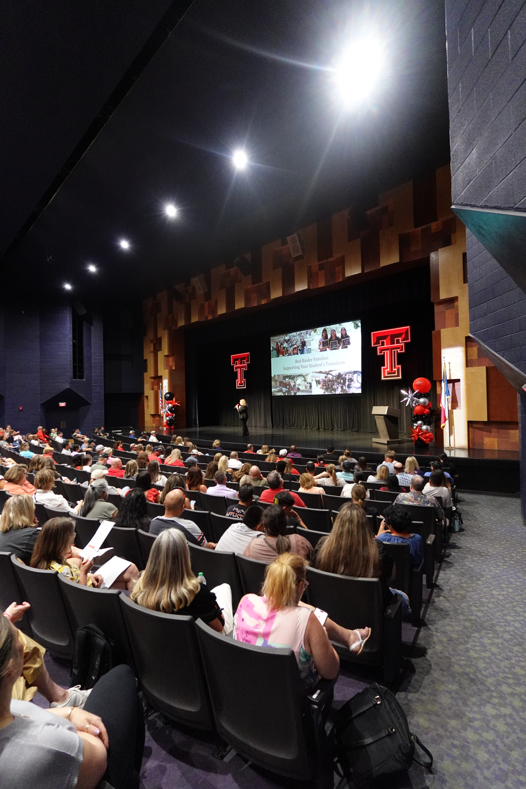
What to Expect at Red Raider Orientation
  Schedule Overview – Day 2
    Breakfast in SUB Ballroom at 7:45 AM
    Preparing for Student Success session at 8:30 AM
    Academic Advising – varies by college
    OneStop & Residence Hall Tours – 10:00 AM - Noon
    Individual Meetings with Financial Aid, Student Business Services, & Military Benefits – 10:00 AM – 1:30 PM
    RRO Closing at Jones Stadium – 11:00 AM – 1:00 PM
    Library Tours Noon – 2:00 PM
    Do not plan to leave RRO before 2:00 PM

Slide 7
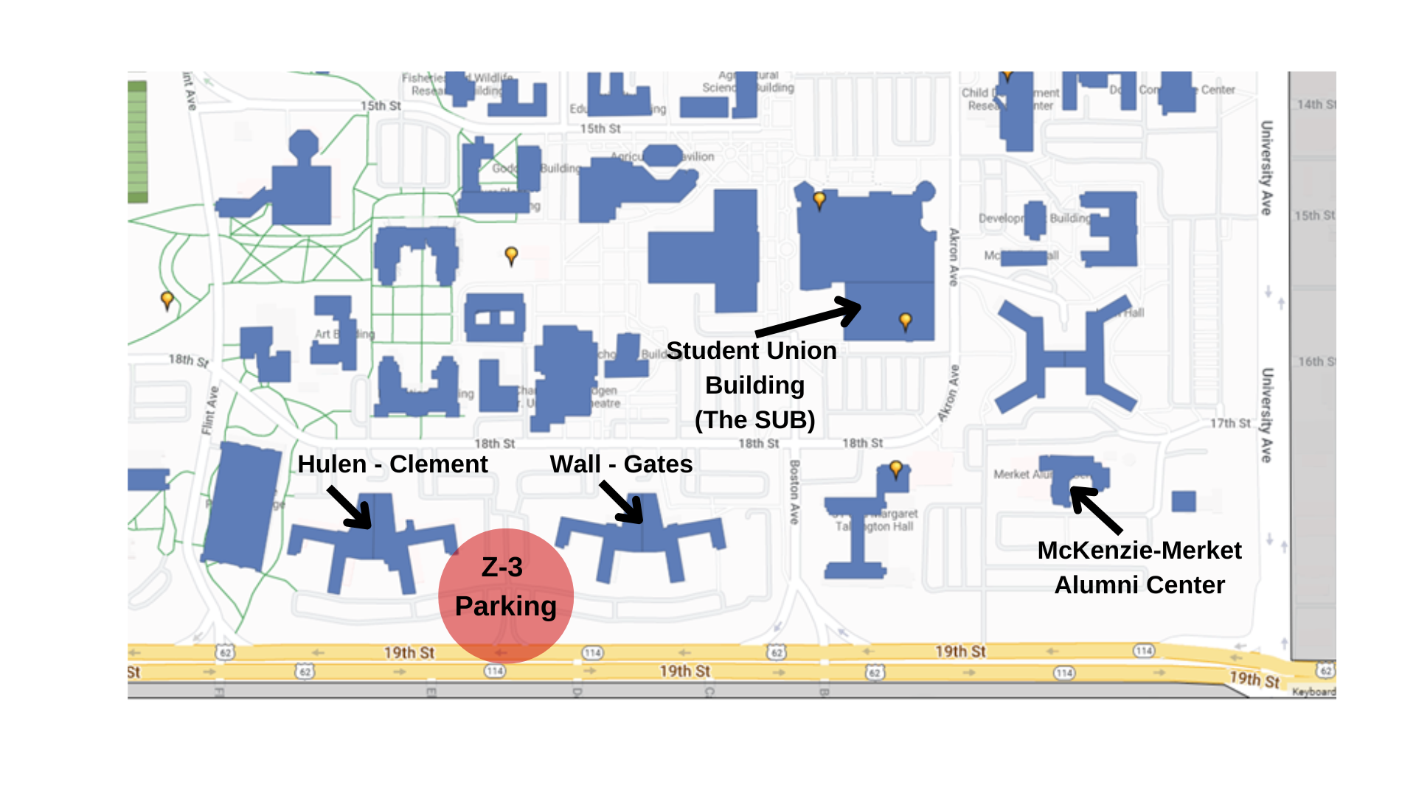
What to Expect at Red Raider Orientation
Notes:
PFR

Slide 8
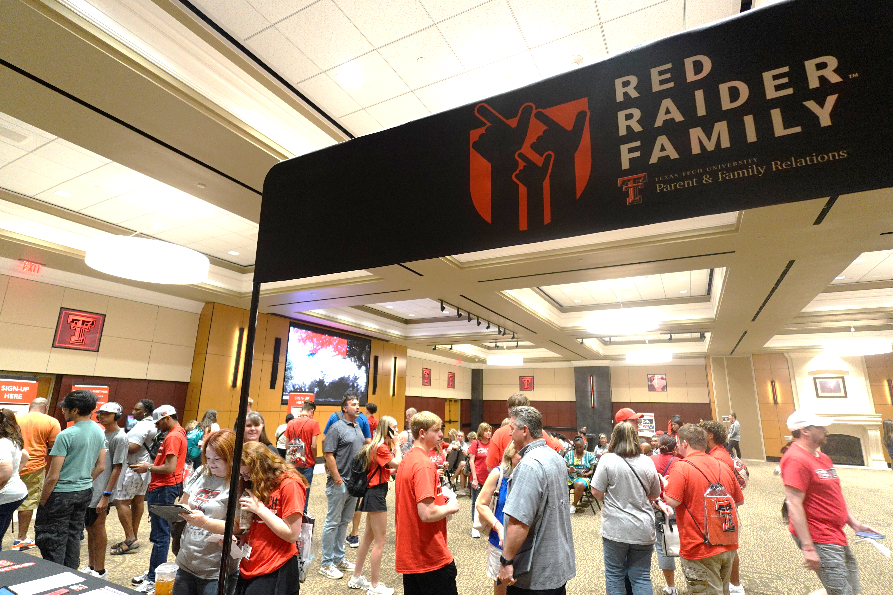
What to Expect at Red Raider Orientation
Parking
  You will park in the Wall/Gates and Hulen/Clement Residence Hall parking lot (where students are staying for RRO).
  Please do not park in any other lots. Those are reserved for TTU faculty and staff.
  One week prior to your RRO session, you and your student will receive an email with parking registration instructions.
  Rental cars can be registered.
  ADA parking is permitted across campus with proper license plate or placard.

Slide 9
What to Expect at Red Raider Orientation
What to Bring - Students
  Government issued ID – for Student ID pick up
  Laptop or tablet for course registration
  Bedding and towels for staying on campus - Twin XL sheets
  Swimsuit and/or athletic attire for Night at the Rec

Slide 10
What to Expect at Red Raider Orientation
What to Bring - Families
  Financial documents if you will be speaking about Financial Aid or military benefits.
  Casual, comfortable clothing and shoes—you will be walking around. Expect summer Texas heat!
  A light jacket/cardigan—meeting rooms can be cool.
  Money for meals not included in RRO.
    Dining locations on campus are cashless.

Slide 11
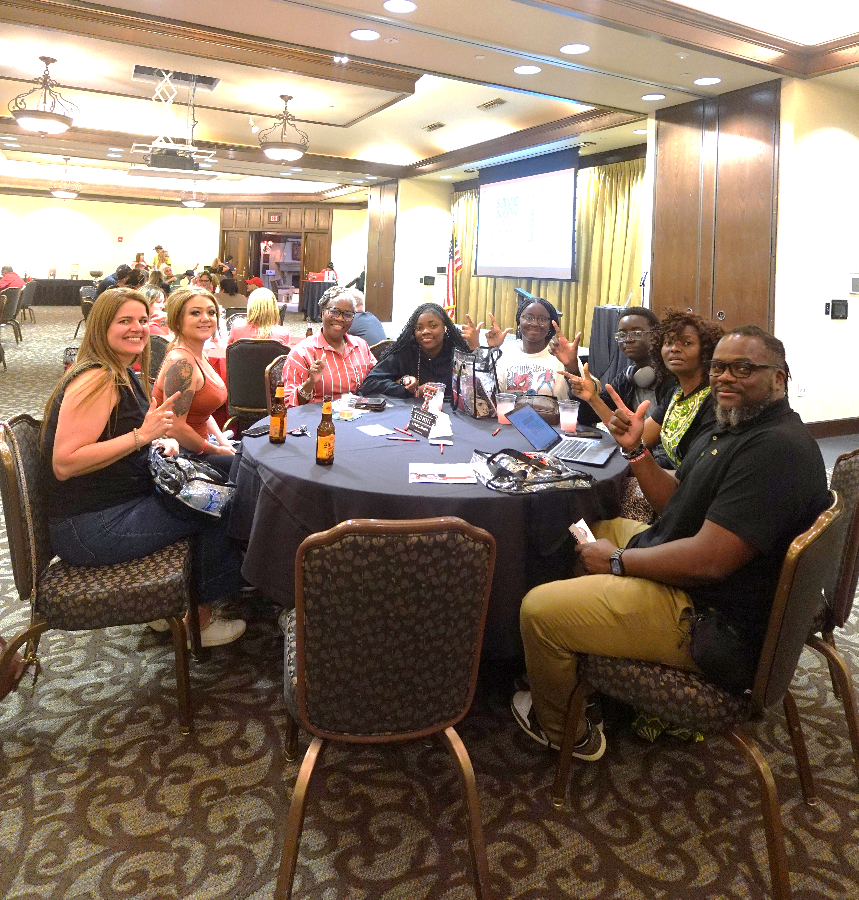
What to Expect at Red Raider Orientation
  What to Expect
    You will attend some sessions with your student and some on your own.
    Your student will be meeting lots of other students and making new friends.
    Students will meet with their advisors.
    Parents & Family Members will be involved with Advising (varies by college)
    You will not need to pay tuition at RRO—tuition is due three days prior to the start of classes
      Bills will be electronically sent to your student’s email starting in late July.

Slide 12

What to Expect at Red Raider Orientation
& Red Raider Camp
  Red Raider Camp
    Students will stay in the same Hulen/Clement room that they did for RRO. They do NOT need to check-out on Friday.
    Your students will:
      Further explore campus
      Experience traditions
      Make new friends
      Have fun
    Parents & Families – explore Lubbock.
    Students can still register for Red Raider Camp. Spots are limited.

Slide 13
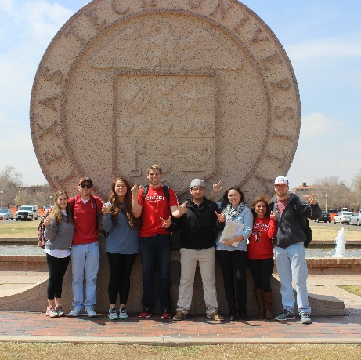
What to Expect at Red Raider Orientation
  Don’t leave without:
    Asking questions – plenty of opportunities built in
    Connecting with Parent & Family Relations staff
    Meeting other families from your hometown or in your student’s major

Slide 14
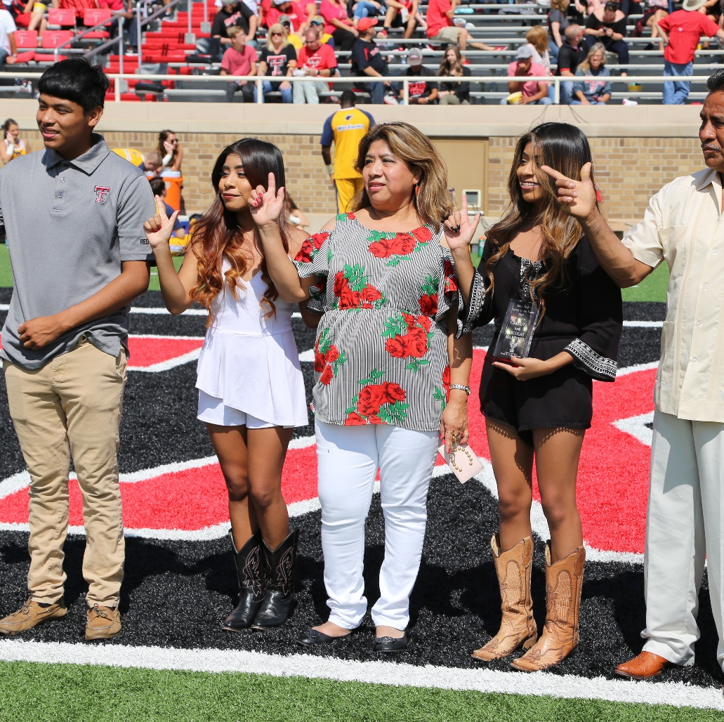
What to Expect at Red Raider Orientation
  Updates
    Be sure your student checks their TTU email address for updates about RRO, housing, academic advising, involvement opportunities, etc.
    Make sure you’re part of the Red Raider Family Network – log in or create an account at ttu.campusesp.com

Slide 15
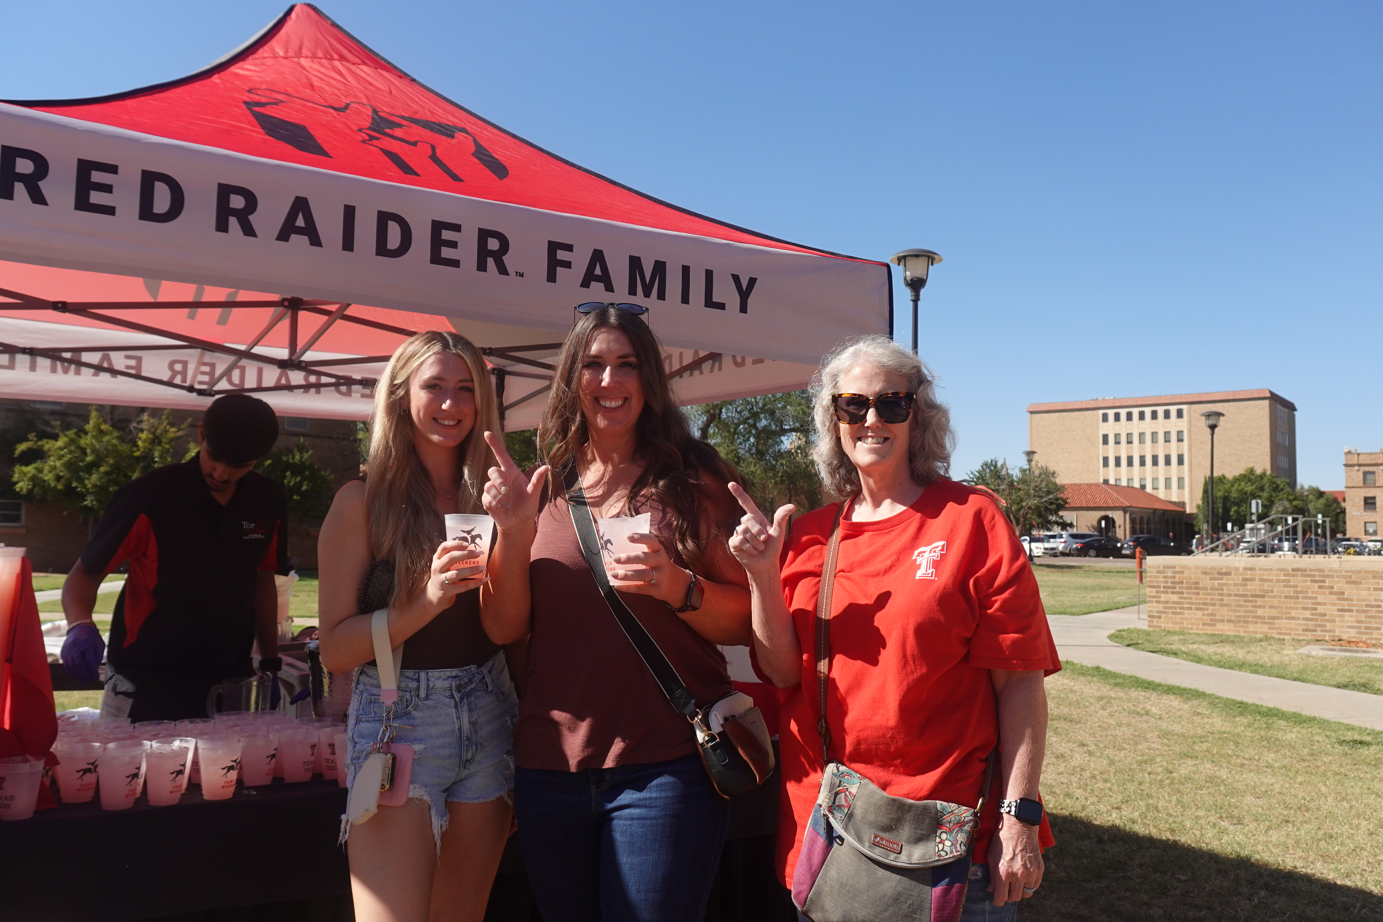
Next steps
Visit www.parent.ttu.edu
Follow us on social media @TTUPFR
Attend additional webinars throughout the summer
Log into your Red Raider Family Network account – ttu.campusesp.com
Family Weekend – September 25-27 go.ttu.edu/familyweekend

Slide 16


Next steps
Fall Tech-In Information:
  Students will receive an email from University Student Housing about signing up for a Timeslot for moving in.
  Visit www.housing.ttu.edu for information related to Fall Tech-In
Raider Welcome
  Activities and events from August 20-30

Slide 17
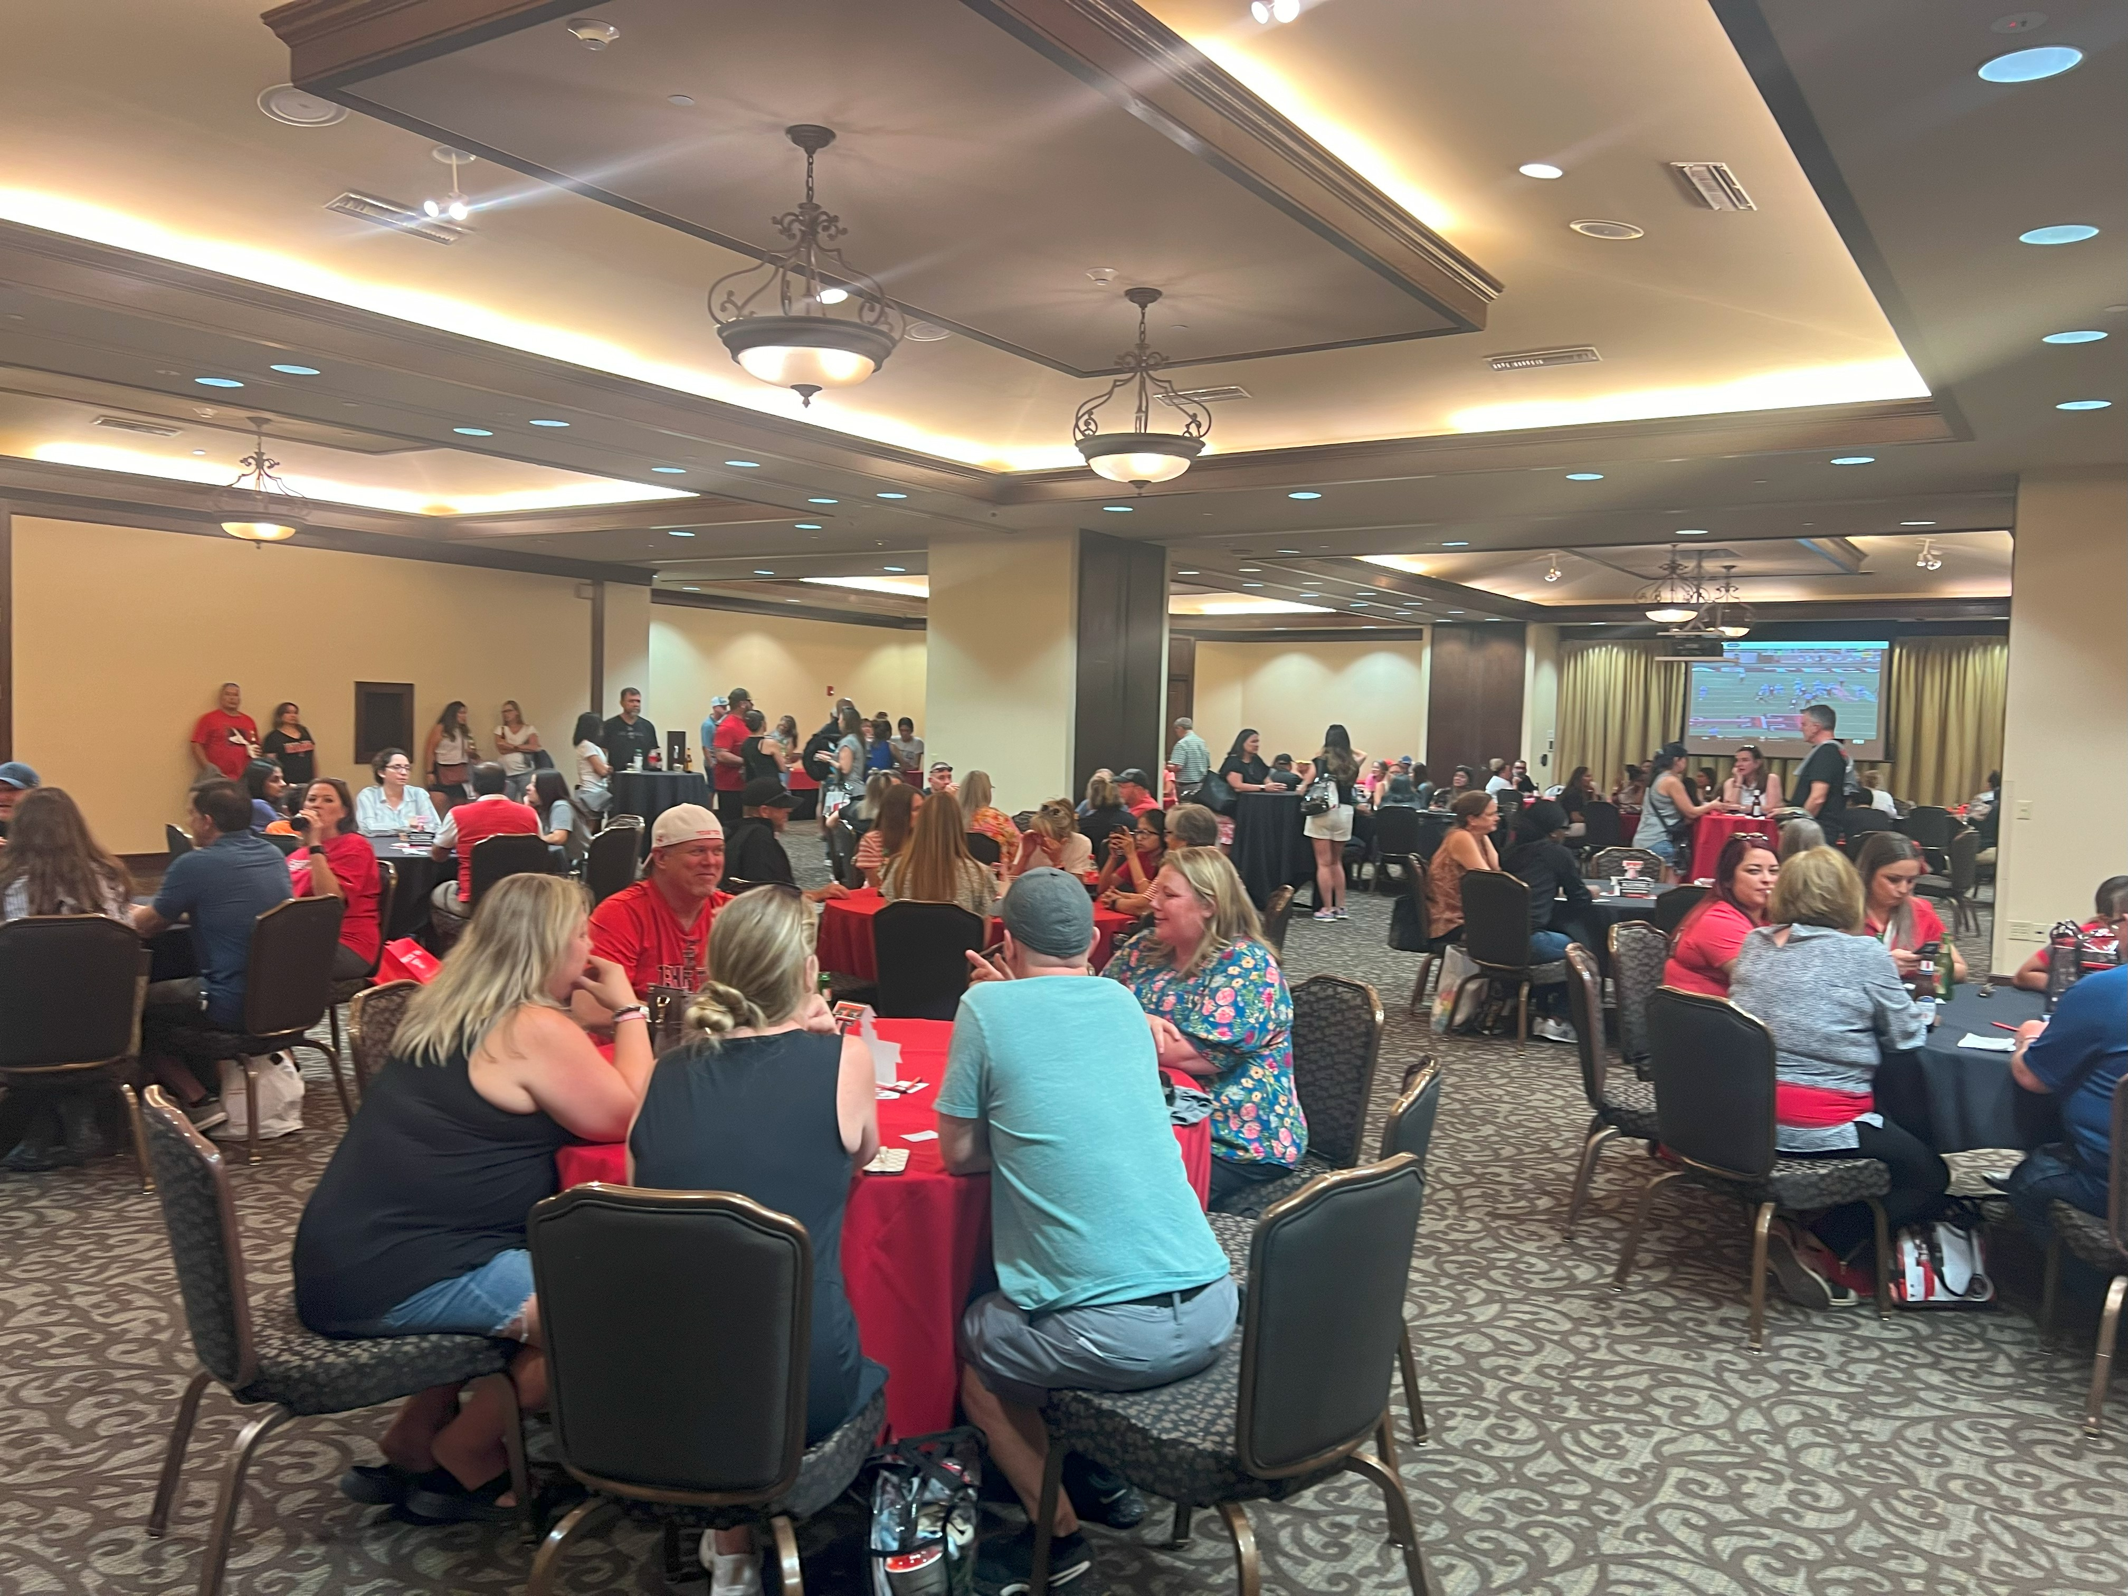
What to Expect at Red Raider Orientation
Need additional information about RRO?
  Visit: www.orientation.ttu.edu
  Email: orientation@ttu.edu
  Call: 806-742-2993
  Instagram: @TTUOrientation

Slide 18
Questions?
Use the Zoom Q&A feature

Slide 19
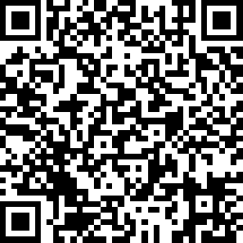

Red Raider Family Webinar Series
Up Next:
CARS 2310: Teaching Student to Thrive at Texas Tech – May 12
Tuition, Financial Aid, and Scholarships – June 3
Health and Wellbeing at Texas Tech – June 10
Parent and Family Relations
parent@ttu.edu
Orientation Services
orientation@ttu.edu

