Slide 1

Academic Success at Texas Tech
Connie Watson | Parent & Family Relations
Patrick Bohn| Learning Center
Dustin Florence| Undergraduate Writing Center

Slide 2

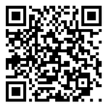
Peer tutoring
Peer Tutoring
  Drop-in (no appointment necessary)
  In-Person (Drane Hall, Library, Residence Halls)
  Student-driven sessions (5 minutes or 2 hours)
  Peer Tutors are academically successful undergraduates (3.5GPA+) who can assist in at least 4 courses
  Average 65 Tutors covering 115+ courses
  24/7 Online Tutoring (Brainfuse Partnership)

Slide 3
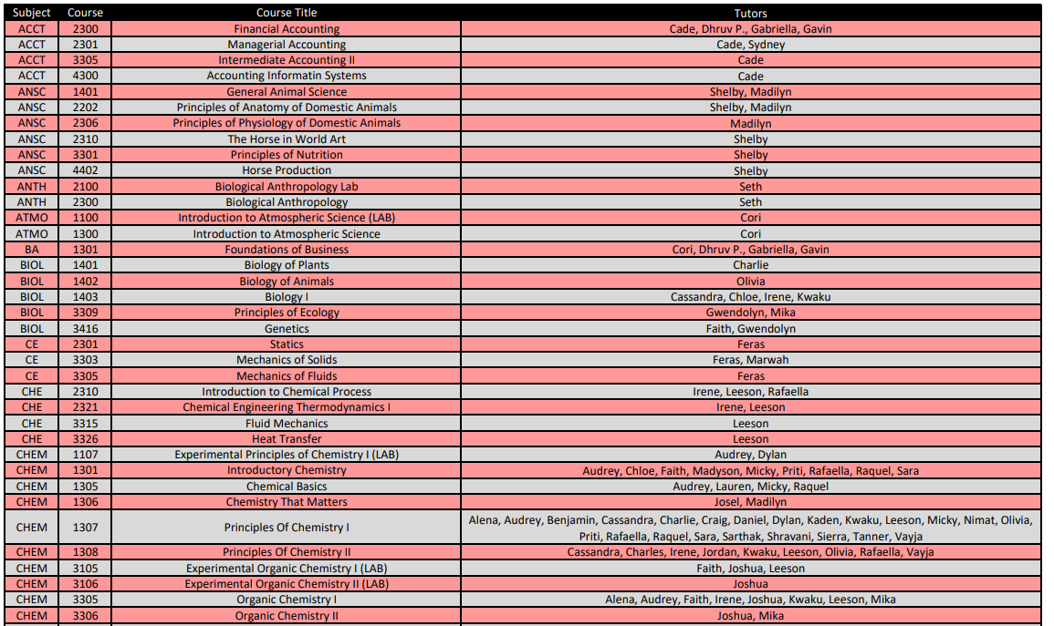
Tutoring subject list

Slide 4
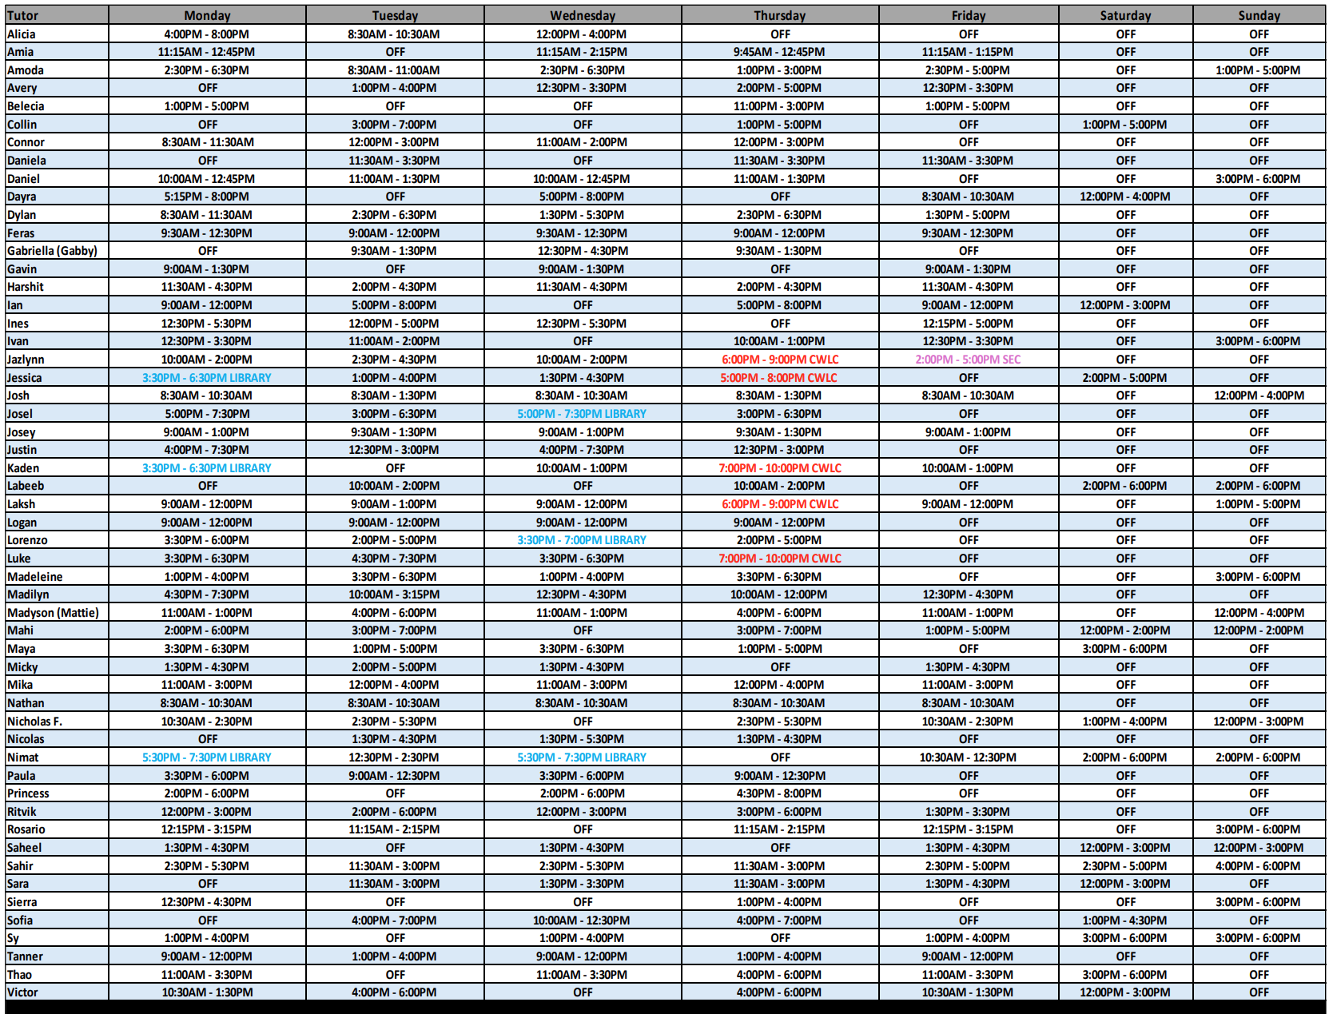
Tutoring schedule

Slide 5
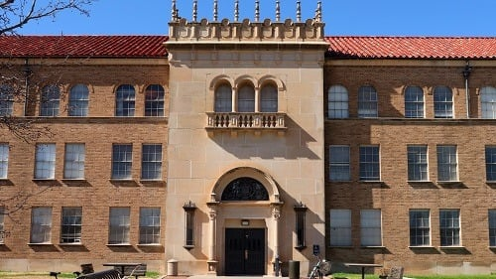
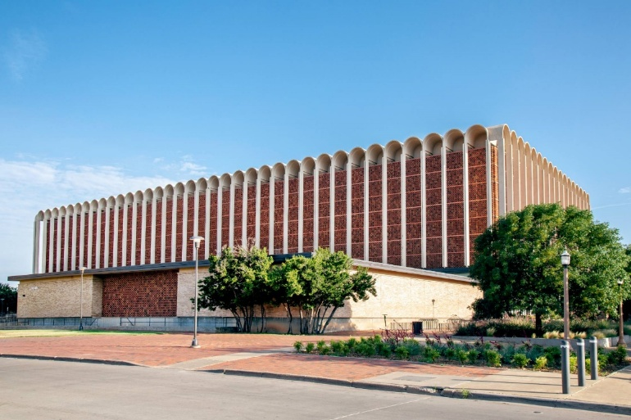
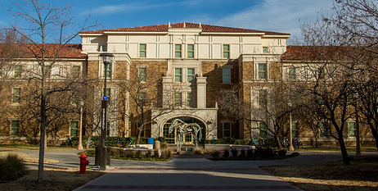
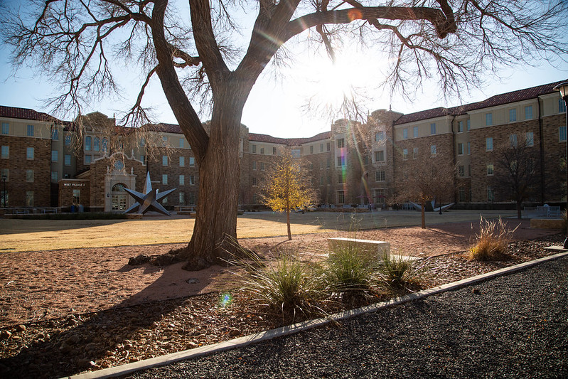
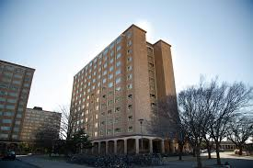
Locations and Hours
Main Location:
Learning Center
Drane Hall, Room 164​
Monday-Thursday 8:00 AM-8:00 PM
Friday 8:00 AM-5:00 PM
Sunday 12:00 PM-6:00PM
Satellite Location:
University Library
The Research Hub, Room 132
Monday 3:30 PM-7:30 PM
Wednesday 3:30 PM-7:30 PM
Satellite Location:
Murray Hall Rm 188
Wednesday and Thursday 5:00 PM – 10:00 PM
Satellite Location:
West Village Complex A, Room 212
Tuesday 5:00-10:00PM
NEW for FALL 2026!
Satellite Location:
Chitwood Weymouth Coleman Learning Center
Wednesday 5:00 PM – 10:00 PM
Thursdays 5:00 PM – 10:00 PM
Notes:
Note subject to change; visit our website for the most current information

Slide 6
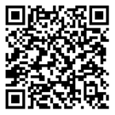
Supplemental Instruction (SI)
Supplemental Instruction (SI)
  Peer-led Review Sessions
  Held across campus (academic building spaces)
  Historically Difficult Courses, High Enrollment/High DFW Rates
  Offer 2, 1.5-hour sessions per week (per course)
  “Raider Reviews” prior to exams
  Provide handouts (additional practice problems, concept reinforcement & review)
  SI Leaders received “A” in course, audit course, work directly with faculty

Slide 7
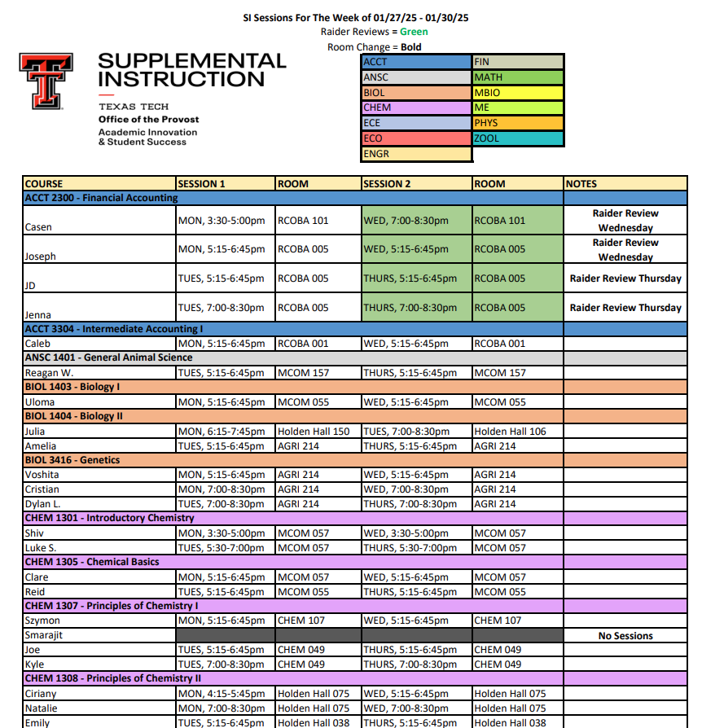
Supplemental Instruction schedule

Slide 8

Peer Learning Specialist
Peer Learning Specialist
  Individual, peer-led learning support
  Intended for non-content assistance
  30-minute, appointment based (virtual or in-person) sessions
  Topics such as:
    Time Management
    Learning Styles
    Setting Goals
    Study Techniques

Slide 9
Tell your student about the Learning Center!
When to recommend our services:
“I have questions, but I don’t want to ask in front of everyone.”
”I went to class, but I am still confused.”
”I am so confused!”
“My professor’s office hours conflict with my other class.”
“I just want to bounce some ideas off someone.”
“I don’t know which formula I should be using for this problem!”
“I wish someone knew what I was going through.”
“I thought I was prepared for that exam, but I didn’t do as well as I had hoped."
”I don’t like studying on my own because I get distracted easily.”

Slide 10
Talk with your student about the Learning Center!
Help your student understand our services:
"I haven’t been to class in a week, the peer tutors can catch me up!”
”I have never been good in Math, so what’s the point?”
“Me + Chemistry = not good.”
“If I get a bad grade, then I will go to tutoring.”
"I never had to study before and I still passed my classes.”
”I don’t feel comfortable asking for help.”
“I don't know who to ask!"
"I was a straight A student in high school, so I will be fine."
"I have a solid B already; I don’t need any help.”

Slide 11
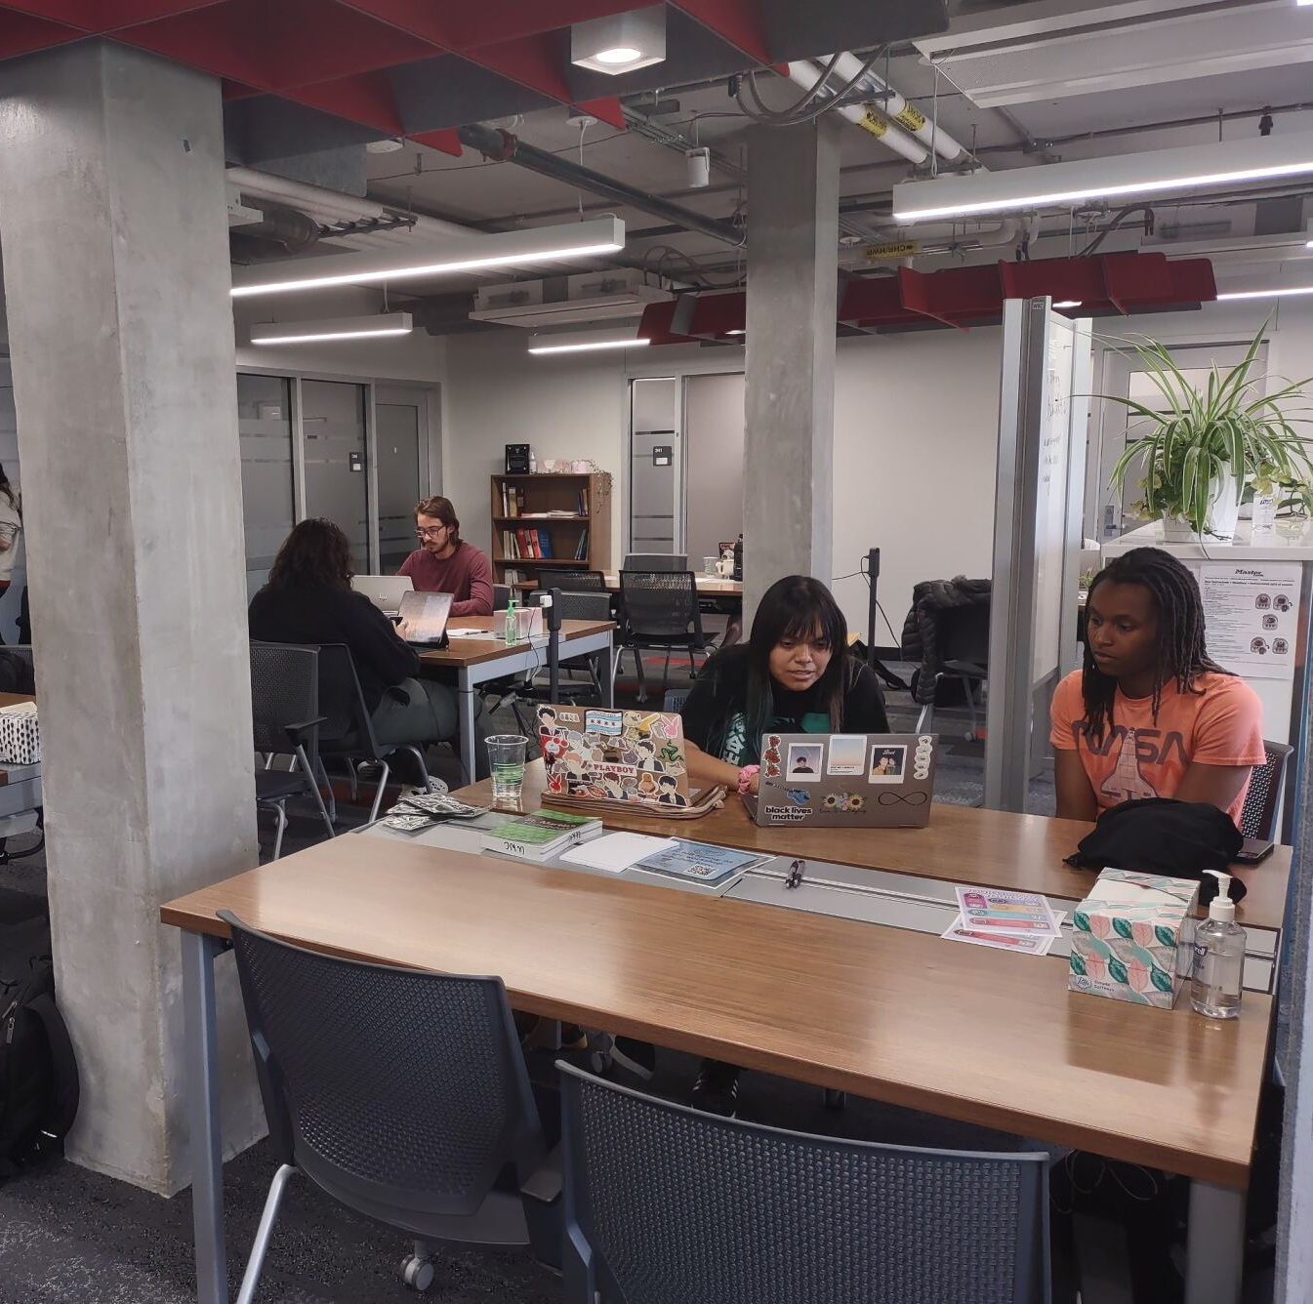
Undergraduate Writing Center Services
Writing consultations
  Any writing project
  Any stage of the writing process
  Can include collaboration with personal librarian
Writing groups
Online resources

Slide 12
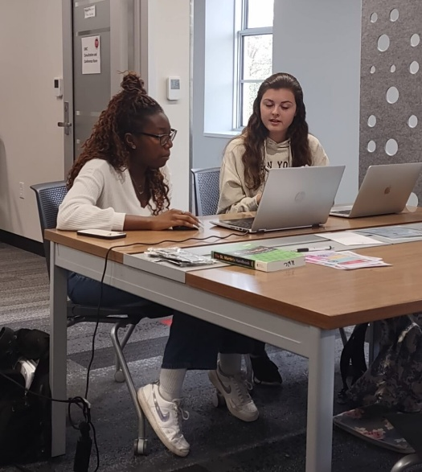
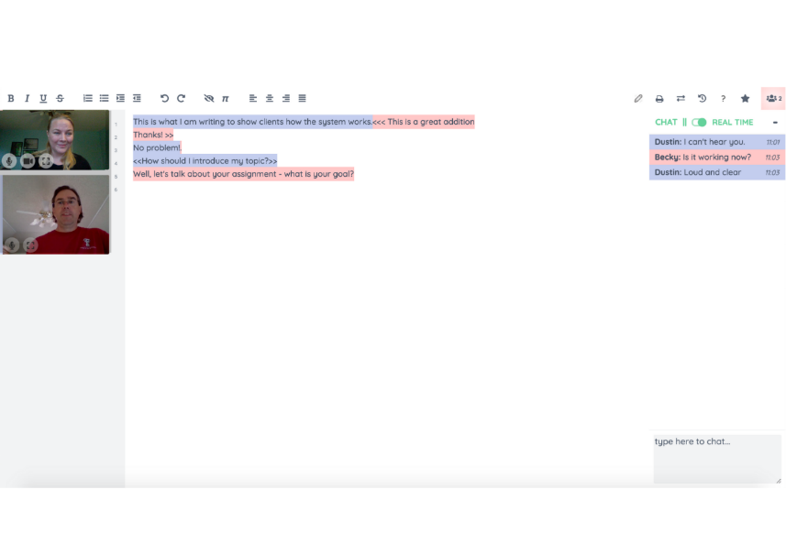
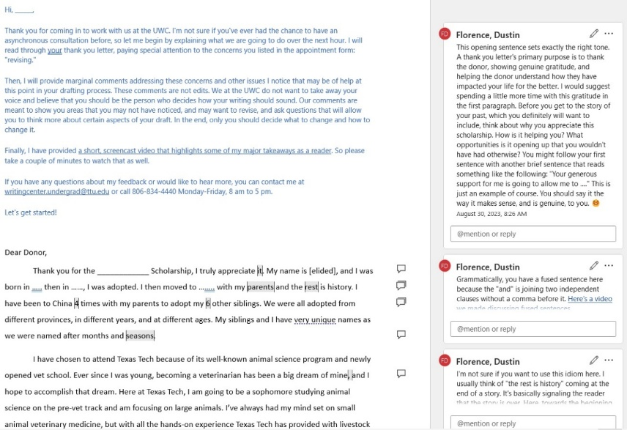
Three types (modalities) of consultations:
In Person
Synchronous Online
(meet online in real time)
Written and/or Audiovisual feedback
(submit a draft and receive written and/or audiovisual feedback)

Slide 13
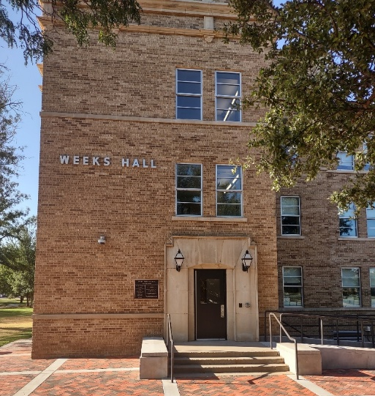
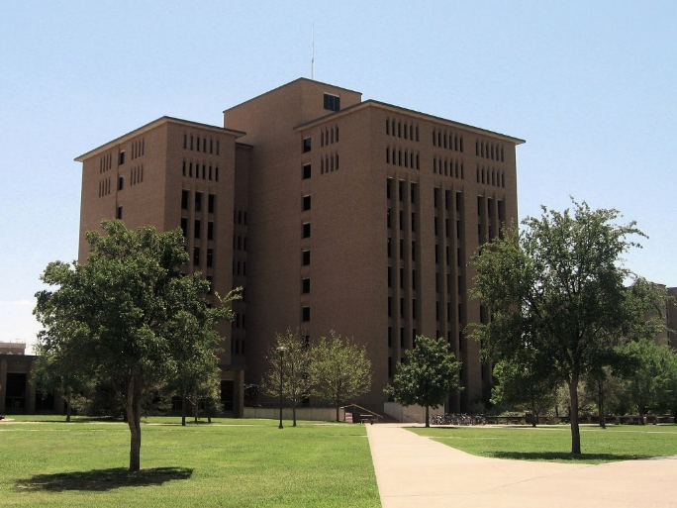
Locations and Hours
Main Location:
Undergraduate Writing Center
Weeks Hall, 3rd Floor
Monday-Thursday 10:00 AM-7:00 PM
Friday 10:00 AM-4:00 PM
Saturday (Written/audio feedback only)
12:00 PM-5:00 PM
Satellite Location:
University Library
Room 132
Sunday 12:00 PM-7:00 PM
Tuesday 2:00 PM-7:00 PM
Satellite Location:
Architecture Library
for architecture majors
Huckabee College, 9th Floor
Spring semester only
Satellite Location:
Murray Hall
Room 188
Wednesday and Thursday
1:00 PM-5:00 PM
Satellite Location:
Chitwood
Chitwood Weymouth Coleman Learning Center
Wednesday and Thursday
1:00 PM-5:00 PM
Satellite Location:
West Village Complex A
Room 212
Tuesday 1:00 PM-5:00 PM

Slide 14
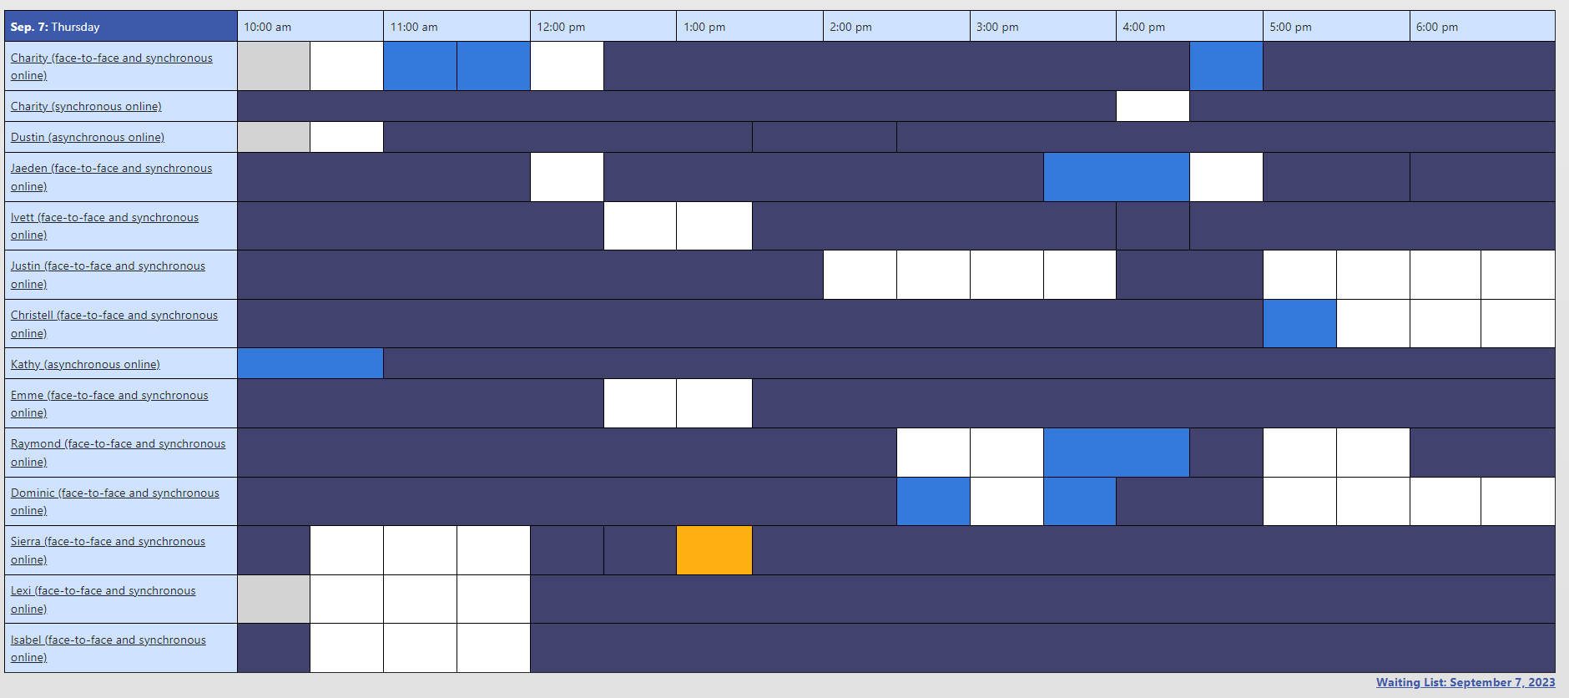
Encourage your student to make an appointment!*
uwc.ttu.edu
806.742.2476, ext. 2
Weeks Hall, 3rd Floor
*Students must schedule and attend their own appointments.
Notes:
F2f and online options

Slide 15
Talk with your student about the UWC!
When to recommend working with the UWC:
“I have an essay coming up!”
“I’ve never written an annotated bibliography/research proposal/lab report!”
“I need to email my professor, but I don’t know what to say!”
“I want to apply for graduate school/law school/medical school/a job!”
“I have a new assignment, and I don’t understand what I’m supposed to do!”
“I didn’t do well on this assignment!”/”I did well on the assignment, and I want to do even better!”
“Will you help me with my writing assignment?”
“I've never used APA Style before!”
“I received comments from my instructor, but I don’t know what to do next!”

Slide 16
Talk with your student about the UWC!
Help your student understand the UWC:
“I'm going to the UWC so they can fix my paper.”
“I’m a good writer, so I don't need the UWC.”
“I've never been a good writer, so what’s the point?”
“I worked with the UWC once already, so I don’t need to go back.”
“I don’t need help; I already know this.”
“I'm too busy to go to the UWC.”
“I need help, but I don't want the writing consultants to judge me!”
“I'm going into STEM, so I don't need the UWC.”
"I don't need to use the UWC because ChatGPT can write my papers for me!”

Slide 17
Questions?
Use the Zoom Q&A feature

Slide 18
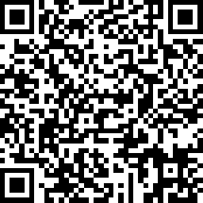

Take our survey
Up Next:
Preparing Your Red Raider for Living Off-Campus – July 15
Preparing Your Red Raider for On-Campus Living – July 22
Student Disability Services: Accommodations – July 28
Parent and Family Relations
parent@ttu.edu
The Learning Center
learningcenter@ttu.edu
Undergraduate Writing Center
writingcenter.undergrad@ttu.edu

