Slide 1

CARS 2310: Thriving at Texas Tech
Morgan Chavez-Brannon| Parent & Family Relations
Dr. Jaclyn Cravens Pickens | Associate Professor
Dr. Iliana Anaya | Professor of Practice

Slide 2



What is TechThrive?
Quality Enhancement Plan – a piece of TTU's Reaffirmation of accreditation efforts (SACSCOC)
TTU's commitment to student well-being
Notes:
Very brief SACSCOC/QEP/site visit overview
TechThrive illustrates TTU's commitment to support an environment that positively impacts student well-being.

Slide 3


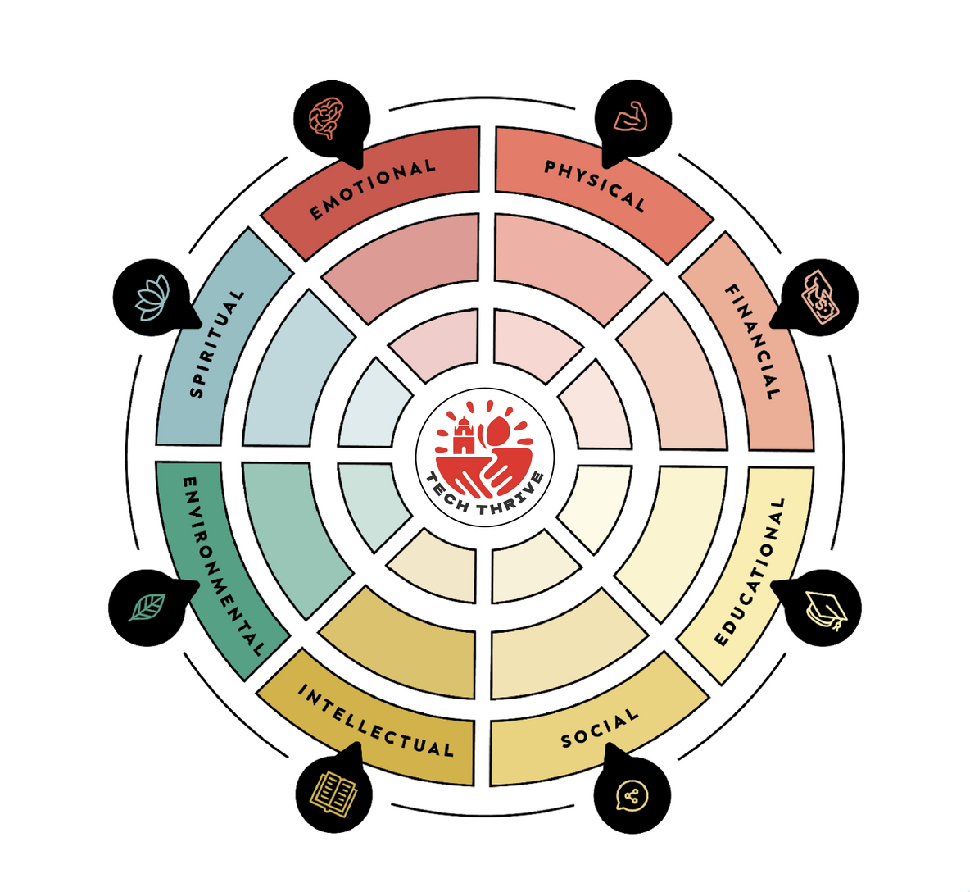
The 8 Dimensions of Wellness
(Swarbrick, 2006)
Notes:
Brief overview of the dimensions emphasizing that holistic well-being is more than mental health.

Slide 4
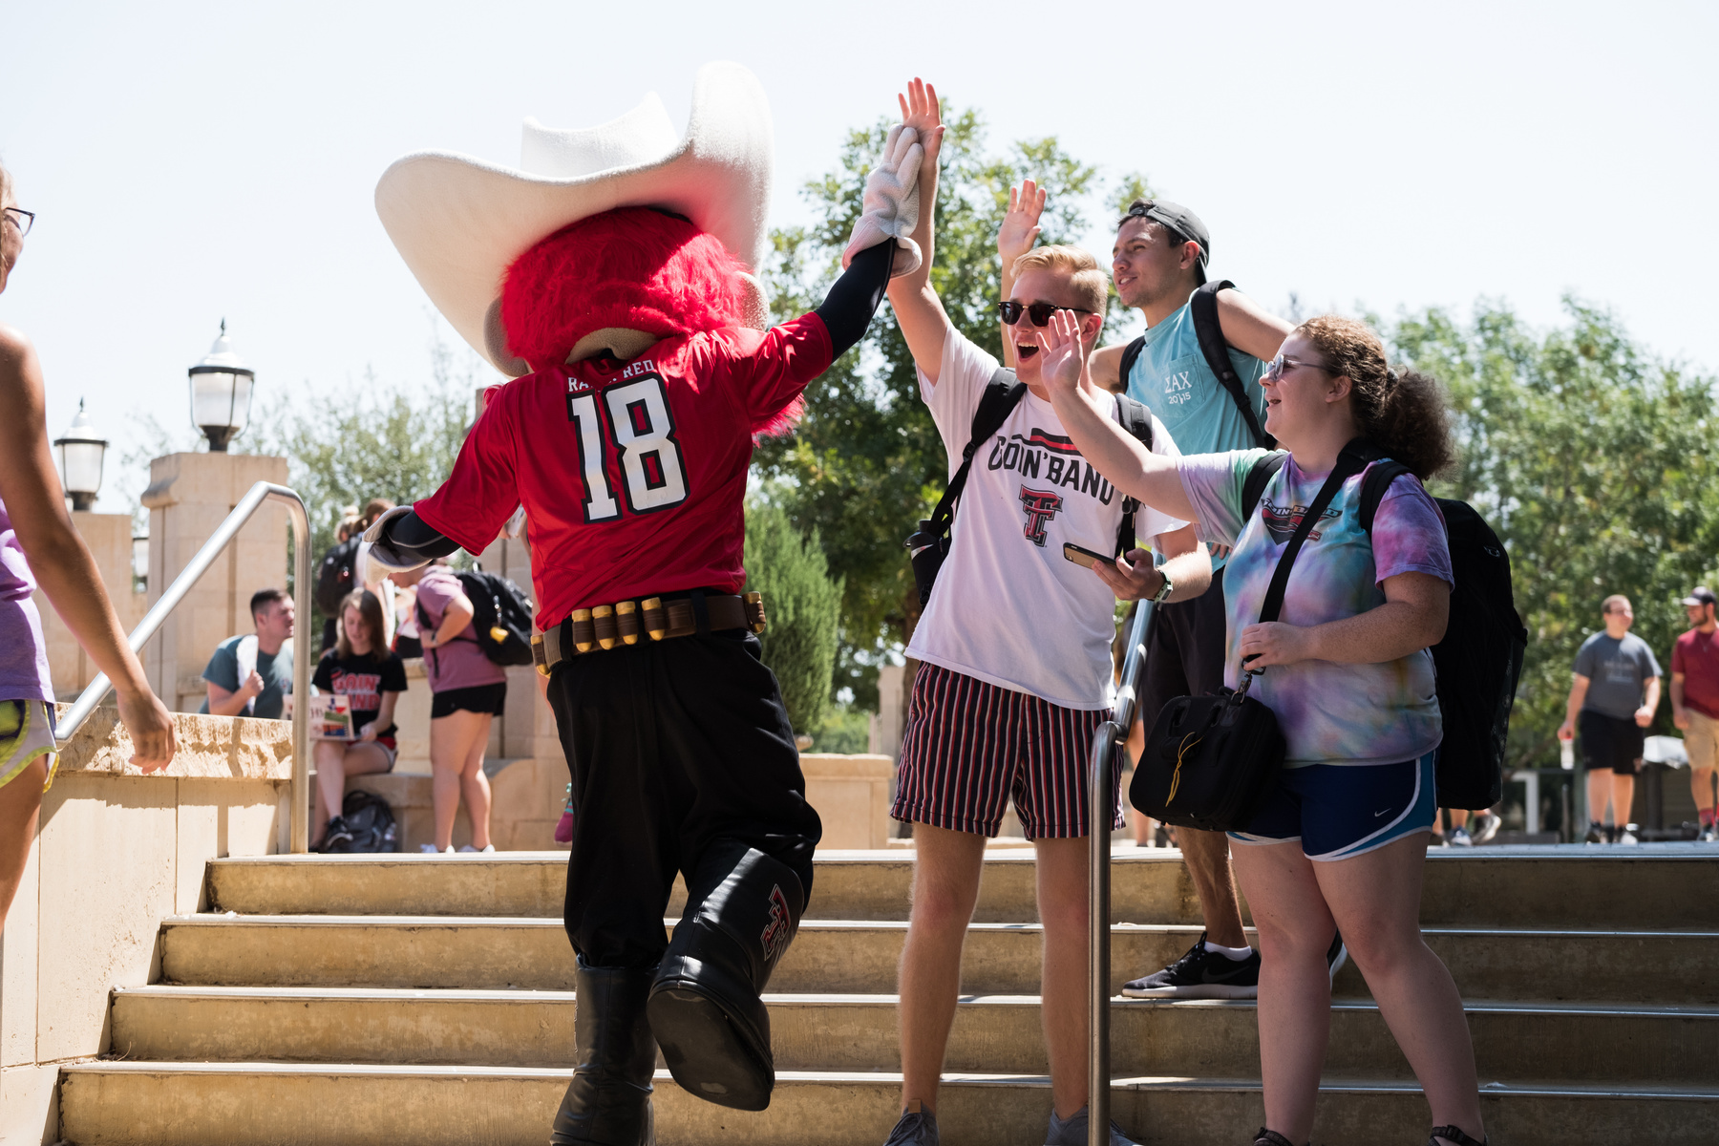
College Students’ Well-being
National trends indicate that college students report…
Increasing moderate and serious psychological distress
Increasing loneliness
Increasing moderate to high levels of overall stress
Notes:
Move quickly through this slide making the point that TTU is not an outlier regarding well-being data.

Slide 5

College Students’ Well-being
A low number of TTU students report knowing how to get help on campus for issues related to:
Food insecurity
Emergency financial situations
Mental health concerns
Notes:
TechThrive was designed in part to address the lack of resource awareness.

Slide 6


College, an “exciting up and down experience for students.”
Notes:
Could see us going from trends in student well-being, to what we see happening with TTU students, particularly during their first year here, then transition into the issue of students reporting they do not know how to find on campus resources.

Slide 7
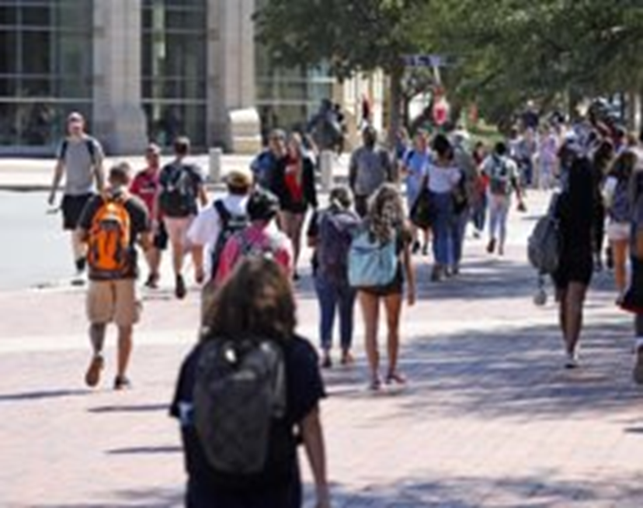

CARS 2310: Thriving at Texas Tech
Personal Growth & Well-being
This course promotes the exploration of knowledge, attitudes, and behaviors associated with the multidimensional aspects of wellness. Students will be exposed to important topics in mental health and well-being that are relevant to the collegiate experience and life after graduation.
Notes:
Emphasize ttu.edu/techthrive as a valuable resource for students and families.
Direct students to the RISE table at the Resource Fair in the ballroom for the access code to Shmoody.

Slide 8
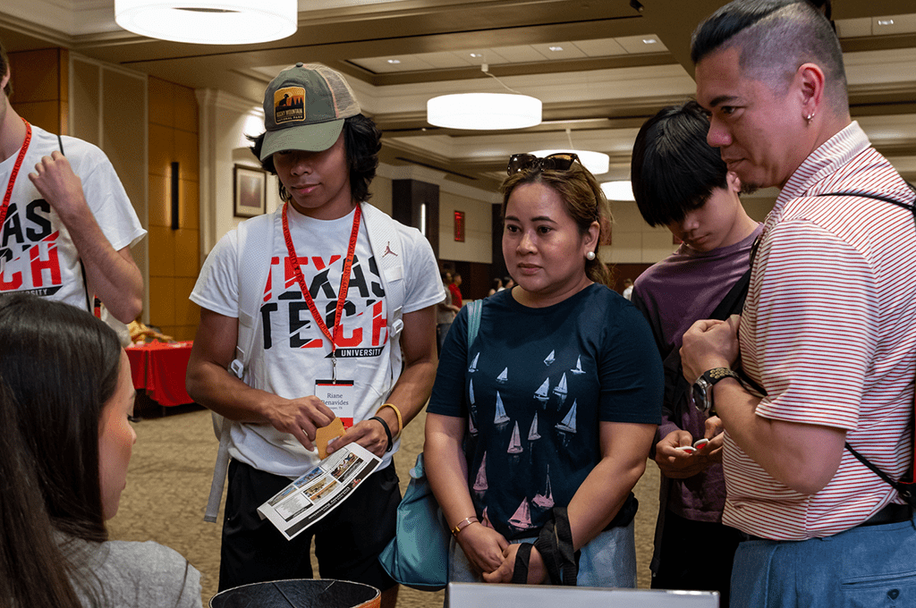
CARS 2310: Thriving at Texas Tech
Personal Growth & Well-being
Student Learning Outcomes:
Assess current level of well-being across each dimension of wellness and develop a plan to enhance well-being.
Increase mental health literacy and utilize this knowledge to develop effective strategies for coping with stressors.
Identify on campus resources available to support student mental health and well-being.
Develop a well-being perspective that enhances their personal and professional experiences at Texas Tech University.
Notes:
Emphasize ttu.edu/techthrive as a valuable resource for students and families.
Direct students to the RISE table at the Resource Fair in the ballroom for the access code to Shmoody.

Slide 9

Course Offerings
Offered Fall, Spring, & Summer
Students can enroll for in-person, online, and TTU online 8-week format
Summer 2026:
  CARS 2310, D01, CRN 77779, CARS 2310, D01, CRN 90234, (TTU Online)
Fall 2026:
  CARS 2310, 001, CRN 51457
  CARS 2310, D01, CRN 51458
  Early Fall: CARS 2310, D01, CRN 30032
  Late Fall: CARS 2310, D01, CRN 50023

Slide 10
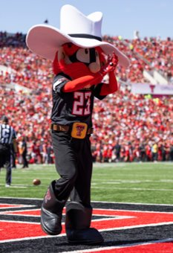
Mindful Matador
Graduation Regalia
CFAS 2310 fulfills requirements
Complete various tasks/attend campus events supporting well-being
Notes:
Cord
10-16 activities during the students' career at TTU.
Activities will be noted "Mindful Matador Eligible"

Slide 11
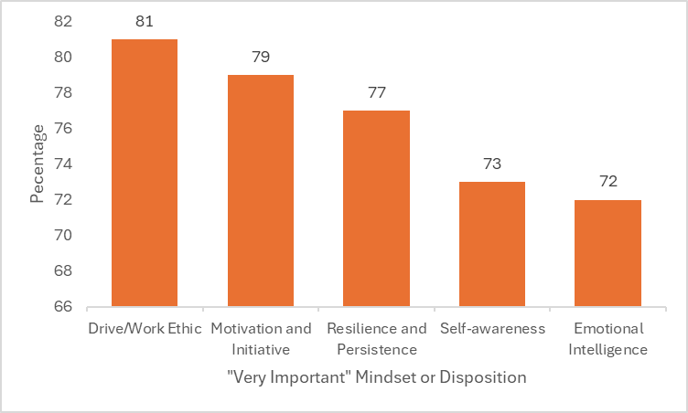
The Career-Ready Graduate: What Employers say about the difference College makes
Notes:
AAC&U 2023 Report (American Association of Colleges and Universities)
The table represents: Percentages of employers who indicated a mindset or disposition is “very important” for success in the workplace.
Focus on bottom 3 – TechThrive speaks to improving all three mindsets.

Slide 12
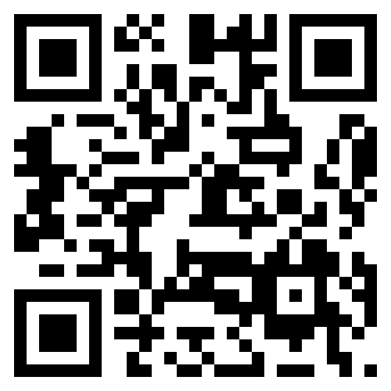
TechThrive Contact Information
For questions related to the Quality Enhancement Plan contact the QEP Co-Directors:
Dr. Jaclyn Cravens Pickens
Associate Professor, CMFT Master’s Program Director Couple, Marriage, and Family Therapy
jaclyn.cravens@ttu.edu
Jill Stangl, J.D.
Assistant Vice Provost for Student Wellbeing Student Life
jill.stangl@ttu.edu

Slide 13
Questions?
Use the Zoom Q&A feature
Notes:
PFR

Slide 14
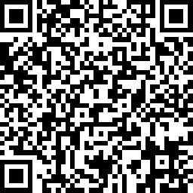

Red Raider Family Webinar Series
Up Next:
Tuition, Financial Aid, and Scholarships – June 3
Health and Wellbeing at Texas Tech – June 10
Campus Safety at Texas Tech – June 17
Parent and Family Relations
parent@ttu.edu
TechThrive
techthrive@ttu.edu
Notes:
PFR

