Slide 1

Tuition, Financial Aid, and Scholarships
Morgan Chavez-Brannon| Parent & Family Relations
Brooks Gustafson| Student Financial Aid & Scholarships
Cheyenne Jackson| Student Business Services

Slide 2
Financial Aid and Scholarships
Information for the 26/27 Academic School Year

Slide 3
Check your offer!
Your student has already submitted FAFSA. They can view what they are eligible for on Raiderlink! (submit 26/27 FAFSA today if you haven’t already)
They will see “Cost of Attendance” as part of the aid offer. This is NOT the bill! COA is just an estimate of combined direct and indirect costs
All scholarships and grants awarded to your student can be viewed in Raiderlink
-Direct loan eligibility can be viewed here too
If necessary complete missing requirements, submit missing documents, view loans, accept scholarships, complete thank you letters

Slide 4
Special circumstances
The 26/27 FAFSA used 2024 tax information, if something has changed in your household that has affected your ability to pay for college, submit a “Special Circumstance” form.
•Loss of employment
•Separation or divorce
•Medical Expenses
•Death of a spouse or parent
•Deduction of a one-time payment
Additional information can be found at www.financialaid.ttu.edu, “Receive Aid”, Special Circumstance
Forms and information will be available at our individual meetings during RRO!

Slide 5
Scholarships
No separate application was needed for 26/27 scholarships. The admissions application was the application to every scholarship on campus for 26/27
All University, College, and Departmental scholarships have been awarded for 26/27
Know the scholarship renewal requirements! Important dates to accept, hours and GPA, thank you letters, etc.
Students will reapply for these scholarships each year
-27/28 Scholarship application will open October 1st

Slide 6
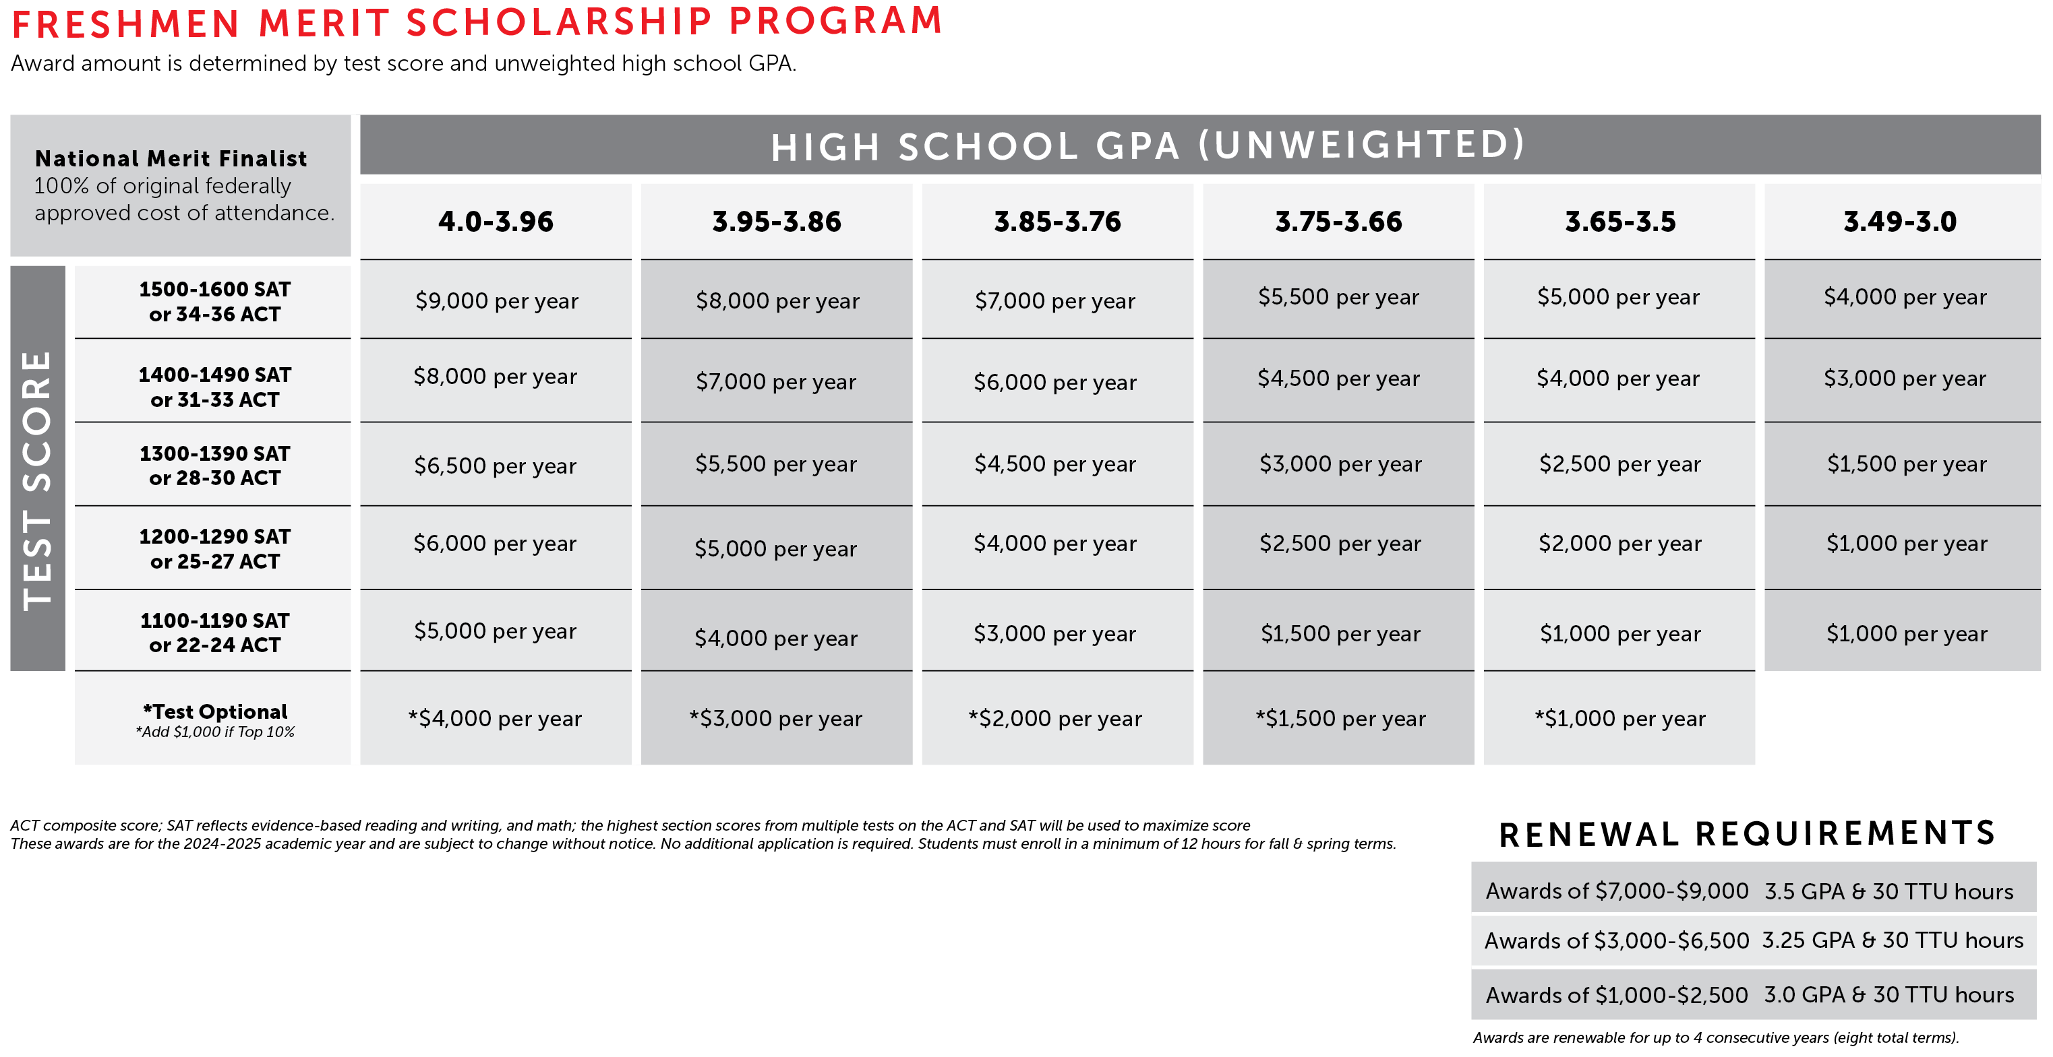
Freshmen Merit Scholarship Program

Slide 7
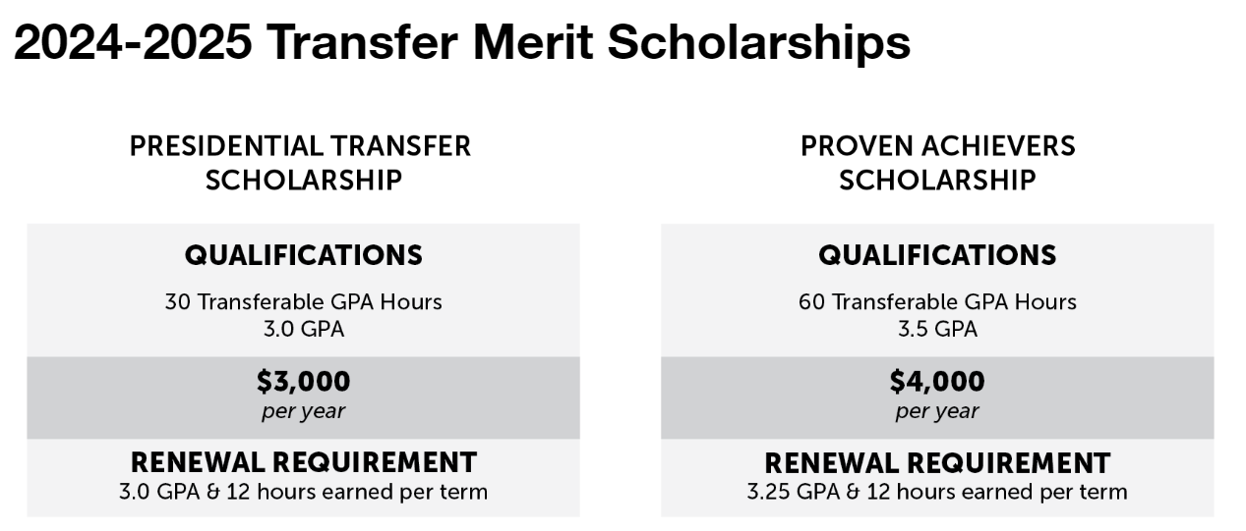
Transfer Merit Scholarships

Slide 8
External Scholarships
If your student has received an external scholarships, they will need to get them to our scholarship office so we can apply them to the bill. Please include your name and TTU R#!
- TTU.ScholarshipUniverse.com
-Bring it to us at the resource fair or individual meetings during RRO
-Bring it to us when they move in August
-Mail it to us:
Texas Tech University - Scholarship Office
West Hall, Room 301
Box 45011
Lubbock, TX 79409-5011

Slide 9
Student Loan Options
Come see us at the individual meeting times during RRO!
We can help project estimated costs for Fall and Spring, then explore your options for covering costs after grants and scholarships
-Options for loans for students or parents
-Federal vs Private and Alternative Loans
We will begin certifying PLUS and Private Alternative loans in early June
Mater Promissory Note (MPN) and Entrance Counselling requirements for Federal Direct (SUB and UNSUB) Loans will update in mid-July

Slide 10
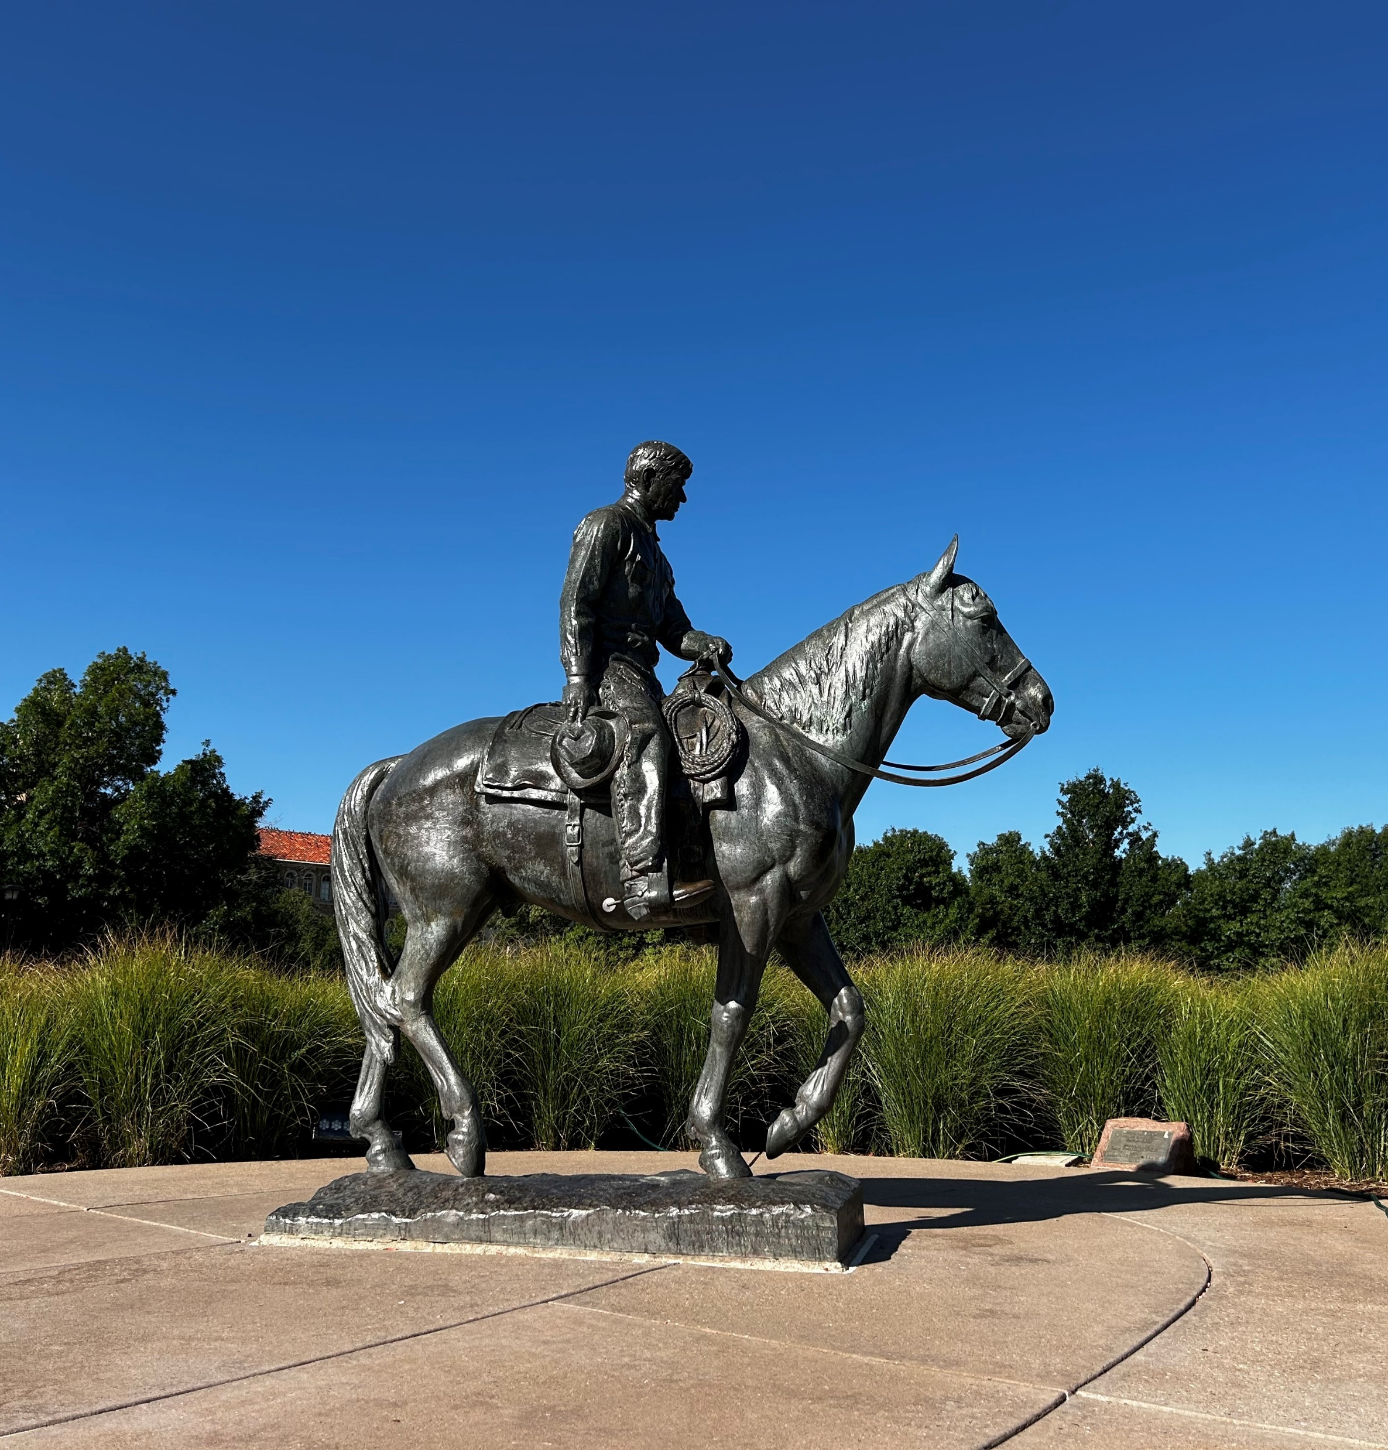
Important Dates
SBS to send your bill late July
All Fin Aid and Scholarships will pay
  10 days before the first day of class
Payment Due Date
  3 days before the first day of class
By the Payment Due Date
  Be paid in full,
  Enrolled into a payment plan, or
  Have enough financial aid accepted to cover 95% of tuition and fees.

Slide 11
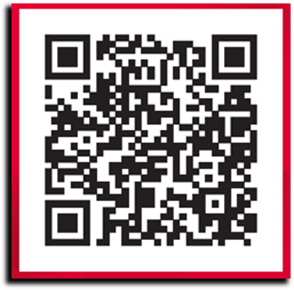
Student Employment
Red Raider Student Employment Center
rrsec.ttu.edu
Jobs for fall incoming students available on August 1st!
Compare jobs:
Wages
On-campus
Hours – 20 hours or less each week

Slide 12
Every year
Check TTU email OFTEN! Any communications about your student's aid will be sent to your students TTU Email. Any missing requirements, needed documents, or approaching deadlines will be communicated via email!
Complete the FAFSA each year
-FAFSA for 27/28 will open October 1st, 2026
Complete the Scholarship Application each year
-Open from October 1st to Feb 1st each year

Slide 13
Orientation
Resource Fair on day one of RRO. Fin Aid and Scholarship staff ready to answer any general questions you have!
Individual Meetings day two in Red Raider Lounge (next to ball room) from 10a to 1:30p
-You don’t need to pre-register for a meeting. Line will open at 10a. Come to the table and get in line. We will text you when we are ready
SBS will also be available for individual meetings

Slide 14

Red to Black

Slide 15


Financial Aid Questions?
  Email:
  finaid.advisor@ttu.edu
  student.employment@ttu.edu
  Websites:
  financialaid.ttu.edu
  scholarships.ttu.edu
  rrsec.ttu.edu
  Walk-Up Counter:
  301 West Hall
  9:00-4:00 M-F
  No appointment needed!
  Phone:
  Financial Aid & Scholarships
  (806) 742-3681

Slide 16
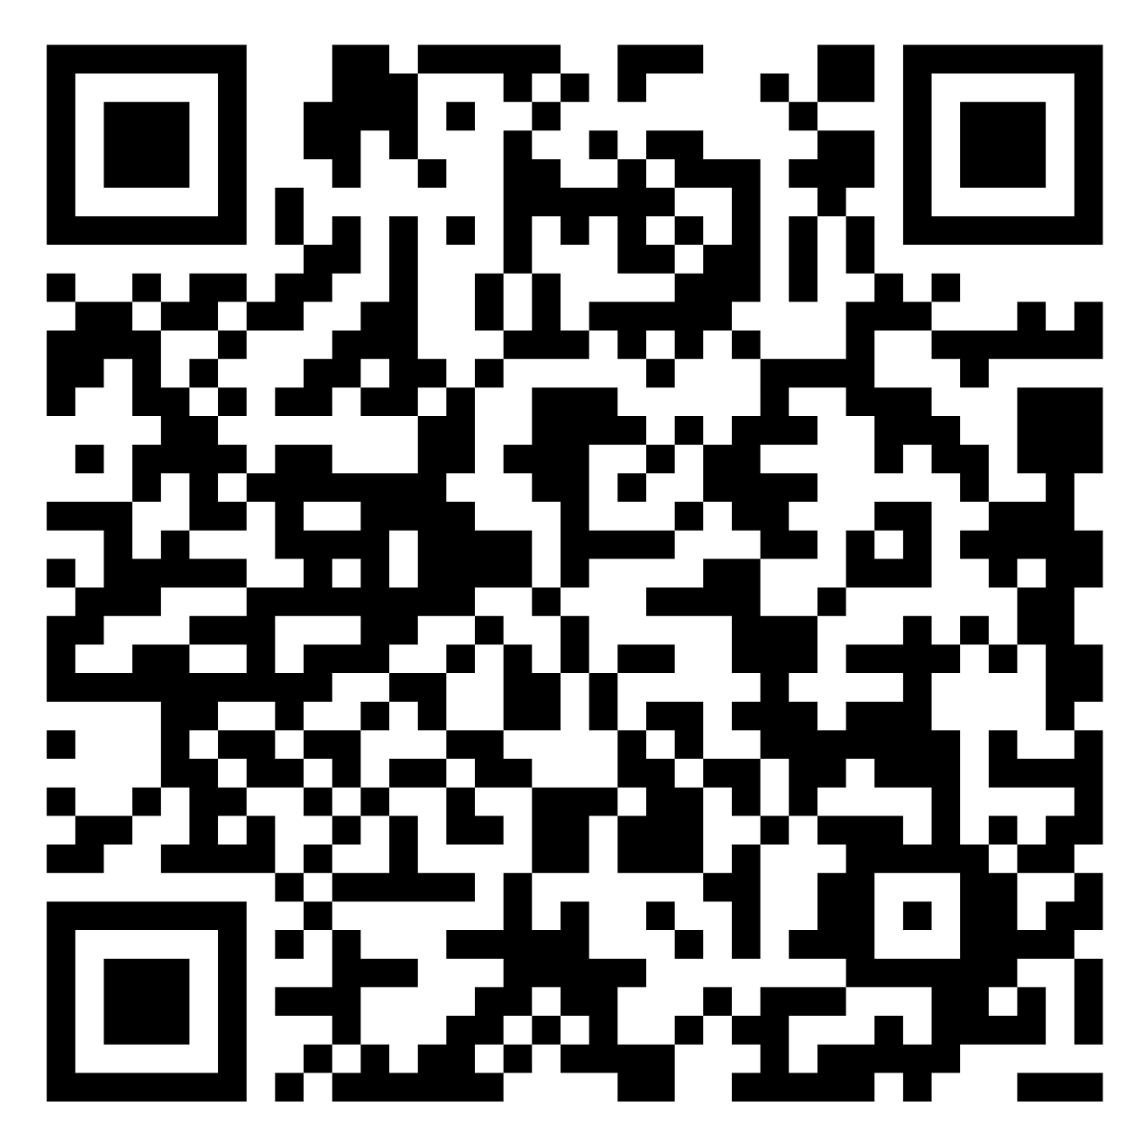
STUDENT
BUSINESS
SERVICES
Information for the 26-27 Academic School Year
LINK TO PRESENTATION

Slide 17
Important Dates
Payment Due Date
  August 19
By the Payment Due Date
  Be paid in full,
  Enrolled into a payment plan, or
  Have enough financial aid accepted to cover 95% of tuition and fees.

Slide 18
Taking Care of Business
Complete the Financial Responsibility Agreement (FRA) - Automatically populates in Raiderlink – students must accept terms and conditions
Agree to the Global Electronic Consent - Automatically populates in Raiderlink – students must accept terms and conditions
Check TTU Email Daily - Done in Raiderlink or by downloading the app to receive your billing notices
Sign-Up for My Direct Deposit - Done in Raiderlink, results in faster refunds
Set Up Authorized User(s) - In eBill, includes parents, guardians, others
Complete FERPA - Through the Red Raider Family Network
Check your eBill regularly – any registration changes can effect your bill

Slide 19
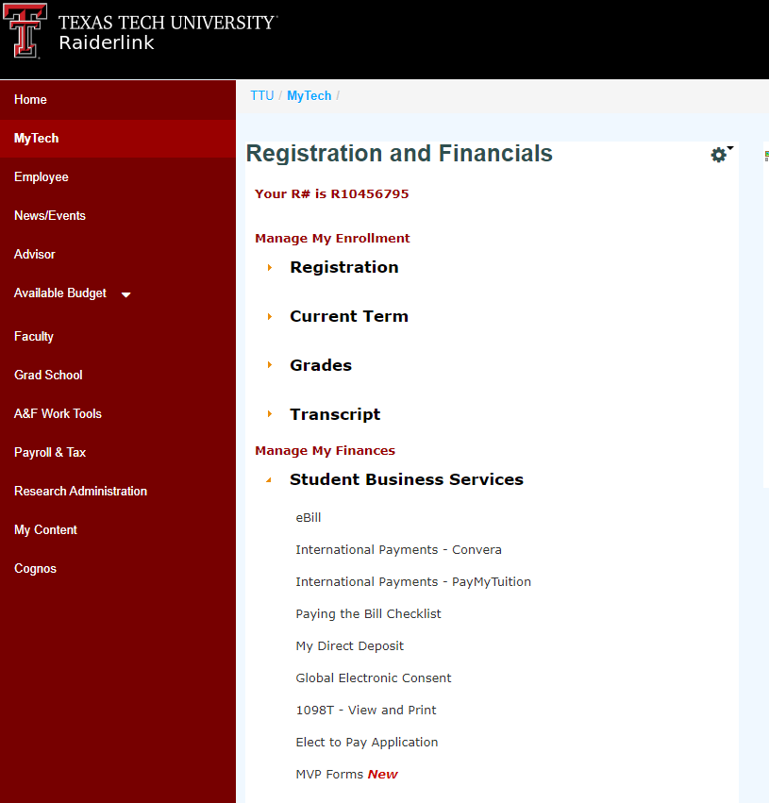
eBill
In the SBS menu in Raiderlink, used to:
  View Statements & Current Activity
  Make Payments
  Enroll in a Payment Plan
  Add Authorized Users
  Purchase GradGuard Tuition Insurance
How-to guides available (go.ttu.edu/sbshelp)
  Payment & Fee Information
  eBill How-to Guides

Slide 20
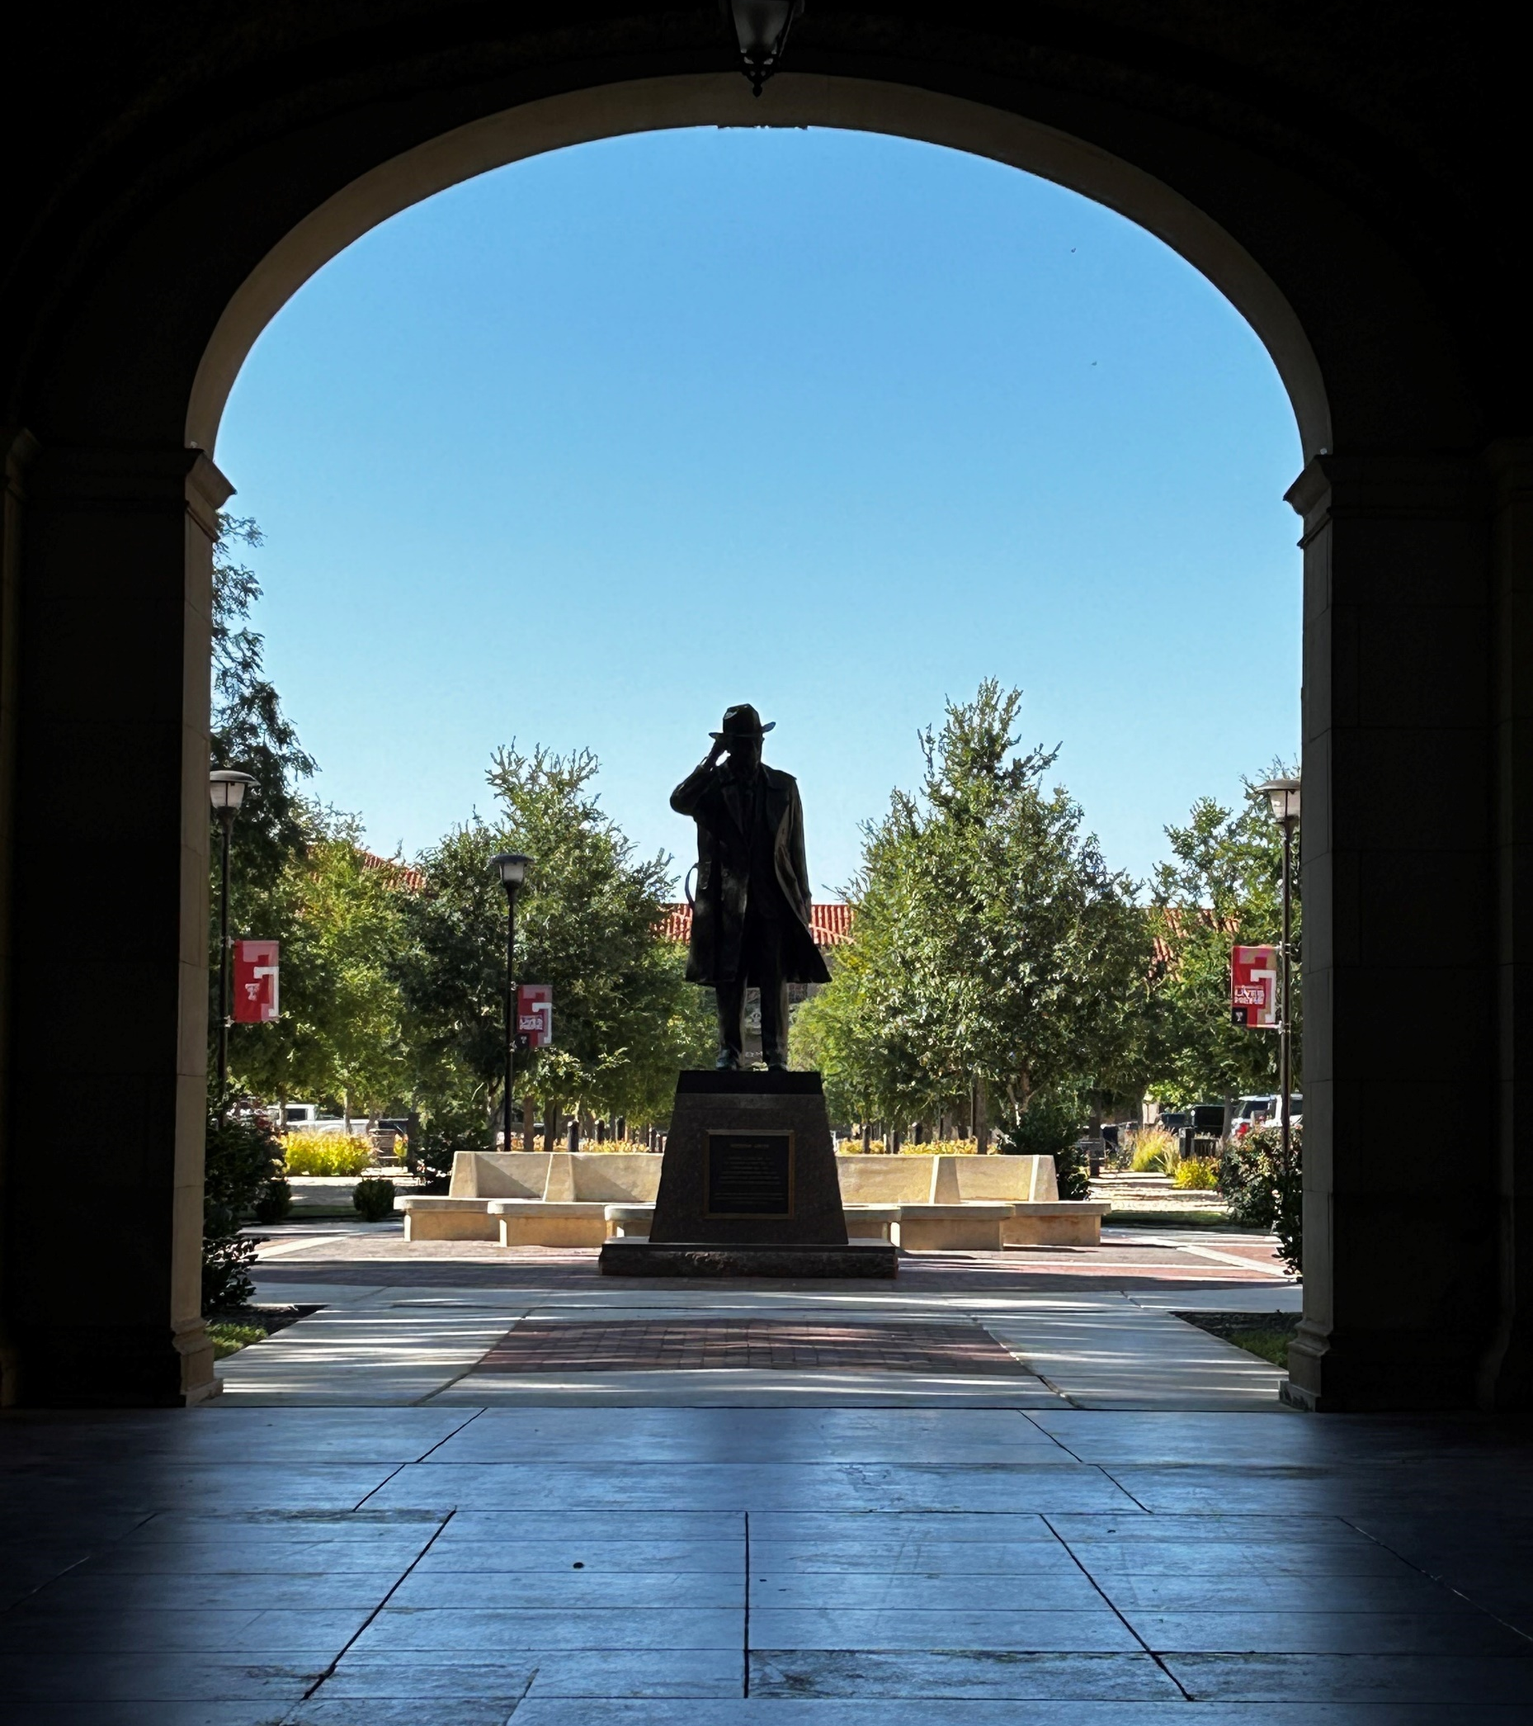
PAYMENT METHODS
Online through eBill
  Debit Cards – No Fees
  Webchecks – No Fees
  Credit Cards (ONLINE ONLY with credit card processing fee 3.0%)
In the office (check SBS website for available hours):
  Debit Cards – No Fees
  Checks - Personal, cashier’s, money orders, traveler’s checks (include student’s R number) – No Fees
  Cash – No Fees
International Payment Options
  Convera GlobalPay for Students
  PayMyTuition
Mail (See Contact Us for Overnight mail address)
Student Business Services
Box 41099
Lubbock, TX 79409-1099

Slide 21
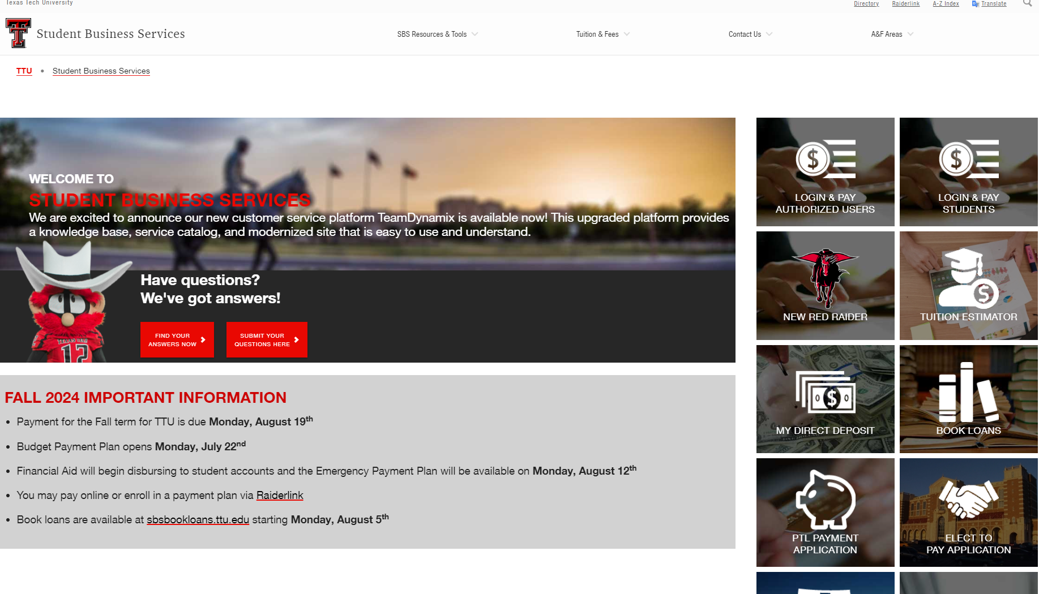
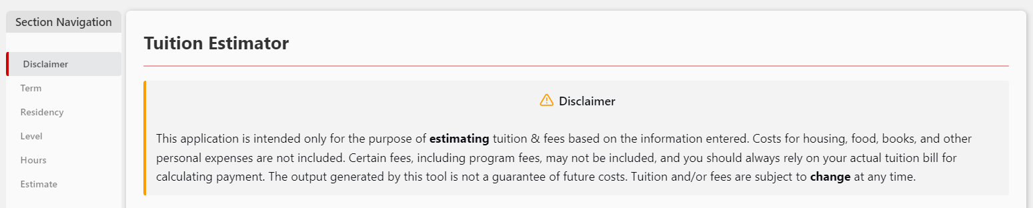
Tuition Estimator
This application is intended only for the purpose of estimating tuition & fees based on the information entered.
Costs for housing, food, books, and other personal expenses are not included. Certain fees, including program fees, may not be included, and you should always rely on your actual tuition bill for calculating payment.
The output generated by this tool is not a guarantee of future costs. Tuition and/or fees are subject to change at any time.
Located on the SBS homepage.

Slide 22
Payment Plans
All payment Plans
Budget Payment Plan
Available approximately 30 days prior to payment due date (after charges have been assessed)
4 equal installments – 25% each and also includes housing, meals parking, etc. if you have those charges
Emergency Payment Plan
Not available until 10 days prior to first class day (corresponds to Financial Aid disbursement)
3 installments – 25%, 37.5%, 37.5% -- does not include housing, meals, parking, etc., even if you have those charges — must owe at least $2,000 in tuition and fees
  If a student has less than $2,000 they can contact SBS to be administratively enrolled in this plan
  If a student has non Tuition and Fee charges, this plan allows them until the final installment to pay those charges in full
Plan intended for students whose financial aid or other funding requires additional processing time and will prevent the student from being cancelled for non-payment
Payment Plans must be set up by the student or Authorized User in eBill.
$25 maximum set up fee per semester
NO INTEREST!
Removes the student from potential cancellation for the term!!

Slide 23

Sponsored Billing
Third Party
Third Parties are sponsors who take responsibility for paying a student's tuition and fee balance.
Third Parties do not include parents or other family members.
Third Party sponsors include Federal and State Military, Prepaid Plans, Texas Workforce Commission, and International and Domestic Sponsors.
Students utilizing military benefits need to initiate their sponsorship through SBS.
Documents and information can be submitted via our customer service portal.

Slide 24
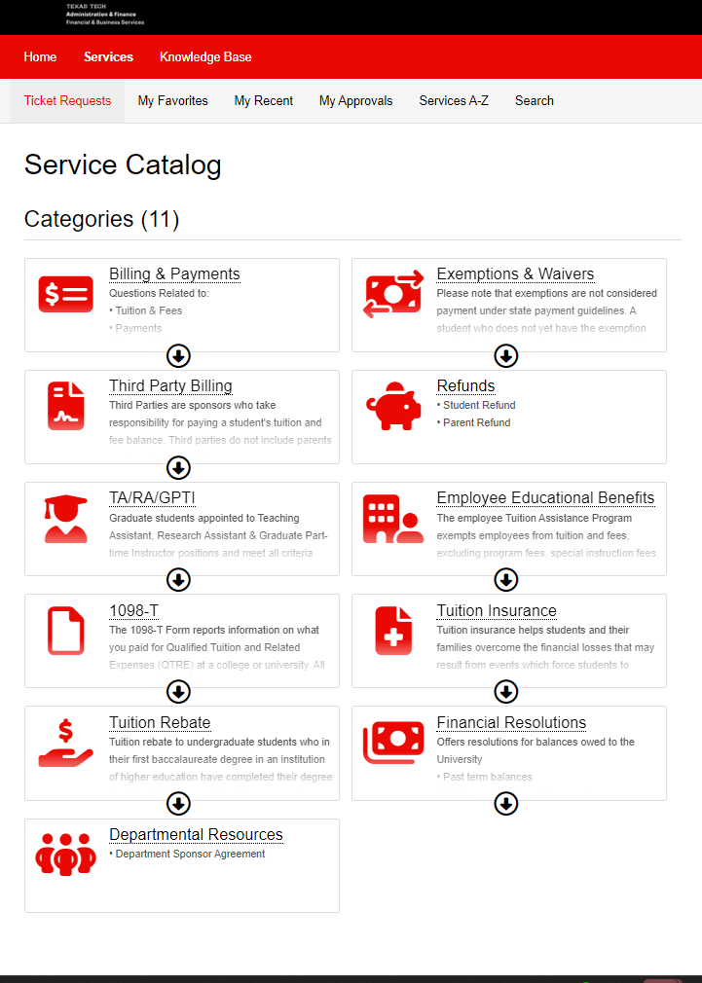
Exemptions & Waivers
Please submit 3rd Party paperwork and/or waiver or exemption documentation via email to sbs@ttu.edu using your TTU email account.
Oklahoma/New Mexico students certify eligibility for Bordering County or Bordering State waivers at www.sbs.ttu.edu
It can take 30 days or more for 3rd party paperwork to be confirmed and applied to student accounts. Students with these benefits should communicate with SBS early.
More info: go.ttu.edu/sbshelp

Slide 25
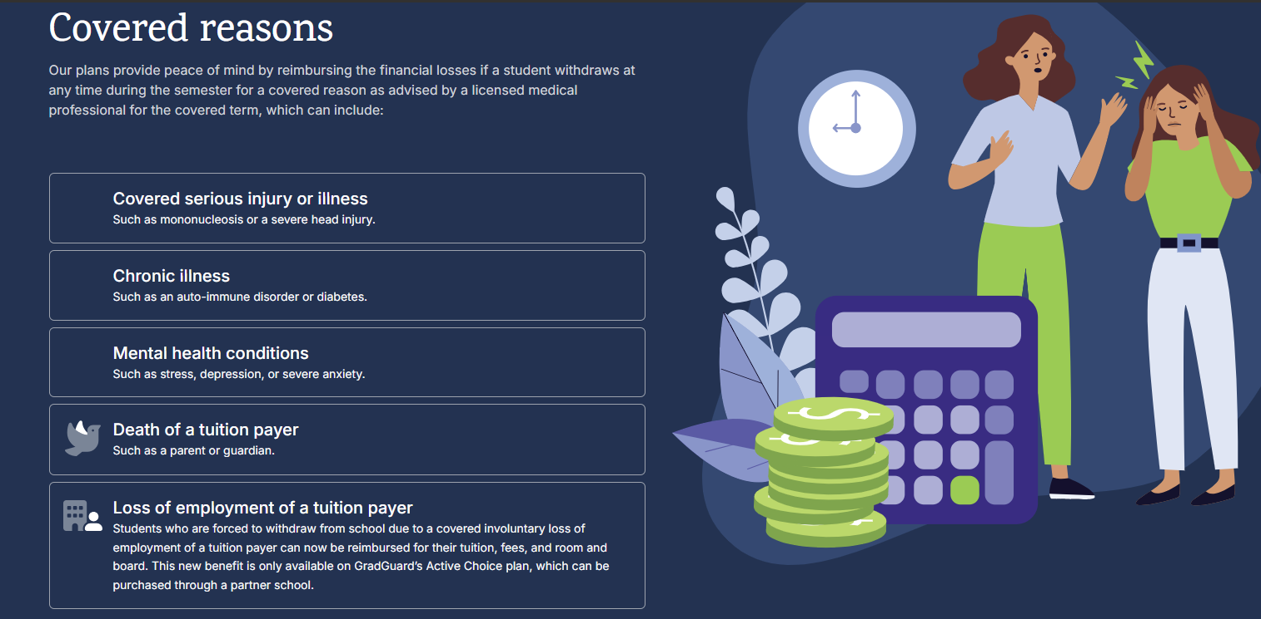
Tuition Insurance

Slide 26

Every Semester
The tuition and fee due date is three business days prior to the first day of class. Students who are not meeting this requirement will receive a “pending cancellation” notification via TTU email.
Students not paid in full or enrolled into a payment plan after receiving a cancellation notice(s) will have their class schedules CANCELLED FOR NON-PAYMENT and must re-register for courses.
Cancelled students are not guaranteed to have the same courses and sections available when they re-register.

Slide 27
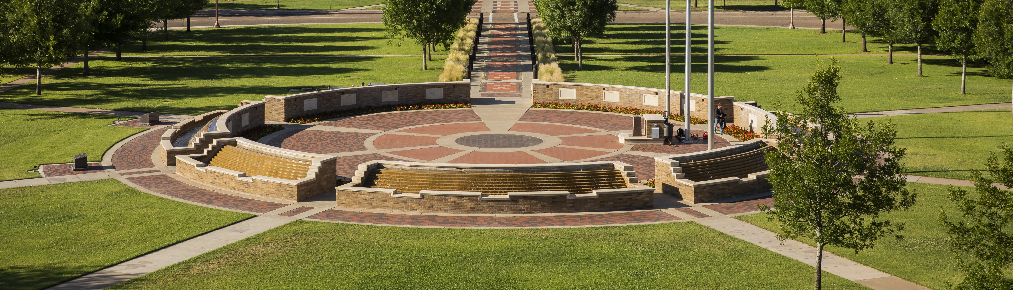

Contact Us
Office
Student Financial Center, West Hall Room 301
Phone
(806) 742-3272
toll free (866) 774-9477
Website
Go.ttu.edu/sbshelp
Hours
9:00 am - 4:00 pm, Monday-Friday
Email
sbs@ttu.edu
LINK TO PRESENTATION
Chatbot
Go.ttu.edu/sbshelp

Slide 28
Questions?
Use the Zoom Q&A feature

Slide 29
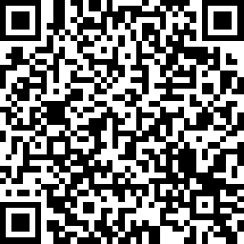

How did we do?
Take our quick survey!
Parent & Family Relations
parent@ttu.edu
Student Business Services
sbs@ttu.edu
Student Financial Aid & Scholarships
finaid.advisor@ttu.edu

