Slide 1

Finishing Touches
Christine Self, Connie Watson, and Morgan Chavez-Brannon
Parent & Family Relations
Notes:
Chris

Slide 2




In today’s webinar
Staying Connected
Housing Reminders
Financial Aid and Tuition Payment Reminders
Meal Plan Reminders
Raider Welcome
Power of Attorney (POA) Workshops
Student Health and Wellness
Navigating Academics
Move-in Reminders and Mailing Packages
OneStop and Refuel & Refresh events
Family Weekend
Q&A
Notes:
Chris
As you can see, we’re covering a lot in this short time together. Keep in mind, we’re sharing reminders about topics like Tuition payment, Financial Aid, and housing, but if you have specific questions about those topics, you may need to reach out directly to those départements. We’ll be sharing links and contact information along the way!

Slide 3


Connect With Us
Parent & Family Relations is your support team on campus!
Supporting your Student From a Distance
Active Listening
Ask, “How would you handle that? Or “Who can you talk to about…?”
Remember, it takes time for students to adjust and make connections
Notes:
Chris

Slide 4
Visit www.financialaid.ttu.edu
FINANCIAL AID/SCHOLARSHIP DISBURSEMENT
If your student is receiving financial aid, such as loans or grants, or scholarships, these will apply to student accounts to pay tuition and fees beginning 10 days before classes start (August 14th)
  All paperwork must have been completed
  All holds must be removed
  Student must be enrolled for the number of credit hours the aid is set up for
In the meantime, your student can see their financial aid and scholarship awards in Raiderlink
Questions?
  Call Student Financial Aid at 806-742-3681
  Email them at finaidadvisor@ttu.edu
  See them at the OneStop when your student moves in
Notes:
Chris

Slide 5
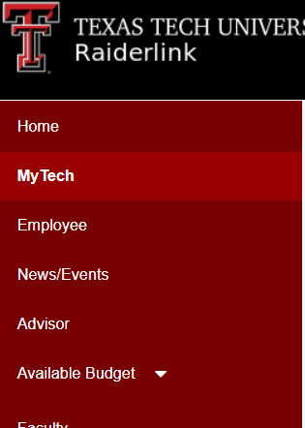
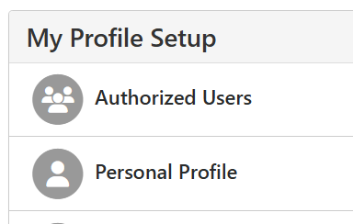
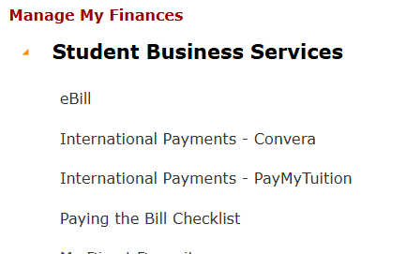
TUITION BILLING REMINDERS
Tuition payment or enrollment in a tuition payment plan is due August 19th, 2026
Have your student set you up as an Authorized User to view/pay the bill or enroll in a payment plan yourself
  Students log into RaiderLink, and navigate to MyTech, then Student Business Services under “Manage my Finances.”
  Then they’ll click “Ebill” and “Authorized Users”.
  They will need your email address to get you set up.
Visit www.sbs.ttu.edu
Questions?
  Call Student Business Services at 806-742-3272
  Email them at sbs@ttu.edu
  See them at the OneStop when your student moves in
Notes:
Chris

Slide 6

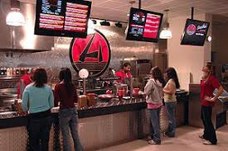
MEAL PLAN CHANGES
Save the date – The last day to make a change to your student's meal plan is the 20th class day of the semester – September 21st
Dining bucks can be added at any time.
Encourage your student to make the most of their meal plan by taking advantage of the Fresh Plate All-You-Care-To-Eat facility.
Visit www.hospitality.ttu.edu for more information. Here, students can:
  Review dining options all over campus
  View hours for all dining facilities
  View “Smart Choices” nutritional information
  Manage their dining bucks and keep track of what they’re spending
Notes:
Chris

Slide 7


RAIDER WELCOME
Raider Welcome is a series of fun and free events held each Fall and Spring to welcome new and returning students to the Texas Tech campus.
Students will get information on campus resources, connect with new friends, and start building their community at Texas Tech
Events are from August 20th – August 30th – encourage your student to attend!
Back to School Pictures:
  August 24th | 10 am – 2 pm
To browse Raider Welcome Activities:
Visit www.depts.ttu.edu/studentengagement/raiderwelcome/
Click “See All Raider Welcome Events”
Click the box next to “Raider Welcome” to filter
Notes:
Morgan

Slide 8

Medical POWER OF ATTORNEY (MPOA) WORKSHOP
Student Legal Services is hosting their annual Medical Power of Attorney Workshop.
September 8 – 10
10:00 am - 3:00 pm
Student Union Building Atrium
Notes:
Morgan

Slide 9


WELLBEING TALKING POINTS
Importance of getting “rest”
Healthy food choices
Use the Rec Center!
Feeling not so great? Make an appointment with Student Health Services
STUDENT HEALTH AND WELLNESS RESOURCES
Student Health - www.depts.ttu.edu/studenthealth
Student Counseling Center – counseling.ttu.edu
RISE – www.rise.ttu.edu
TechThrive - https://www.ttu.edu/techthrive/
TTU Crisis HelpLine (806) 742-5555
Notes:
Morgan

Slide 10



NAVIGATING ACADEMICS
Review and know their course syllabi - deadlines, assignments, exam and finals information are found here!
Using a planner/phone/calendar to keep up with due dates, exams, etc.
Staying engaged with online courses
Utilize your Student Success Specialist and Advisors
ACADEMIC SUCCESS RESOURCES
The Learning Center - www.depts.ttu.edu/soar/lc
Undergraduate Writing Center - www.depts.ttu.edu/provost/uwc/undergraduate/
Student Disability Services - www.depts.ttu.edu/sds
University Coaching - https://www.depts.ttu.edu/ucsa/UC.php
Notes:
Connie

Slide 11

NAVIGATING ACADEMICS
Encourage your student to walk their schedule once they move in
This will help them know how long it’ll take to get between their residence hall or parking lot to class and how to find classrooms, etc.
The “Navigating Raiderland” event on the first two days of classes can help!
Start your student’s semester on the right foot. Encourage them to participate in Navigating Raiderland, an opportunity for your student to build meaningful connections with students and staff, discover campus resources, while learning to navigate campus.
Who: All students
When: August 24 and 25 | 8:00am–3:00pm
Where: Multiple locations on campus
Notes:
Connie

Slide 12

MOVE-IN AND HOUSING REMINDERS
For last minute move-in information review the “What to Bring” and “What Not to Bring” lists on the Tech-In page: https://www.depts.ttu.edu/housing/techin-techout.php
For on-campus students: FixIT request form located on the housing webpage – Go to www.housing.ttu.edu and click “Current Residents” and then “Fixit Maintenance Request”
Students living off campus should work with their apartment complexes when repair needs arise
On-Campus: Use the Mailing Address Generator to send your student mail and packages! Goto www.housing.ttu.edu and click “Current Residents” and then “Hall Addresses and Mailing Information”
Off-Campus: Be sure to get your student’s mailing address, including apartment number, to mail packages and letters
Notes:
Chris

Slide 13
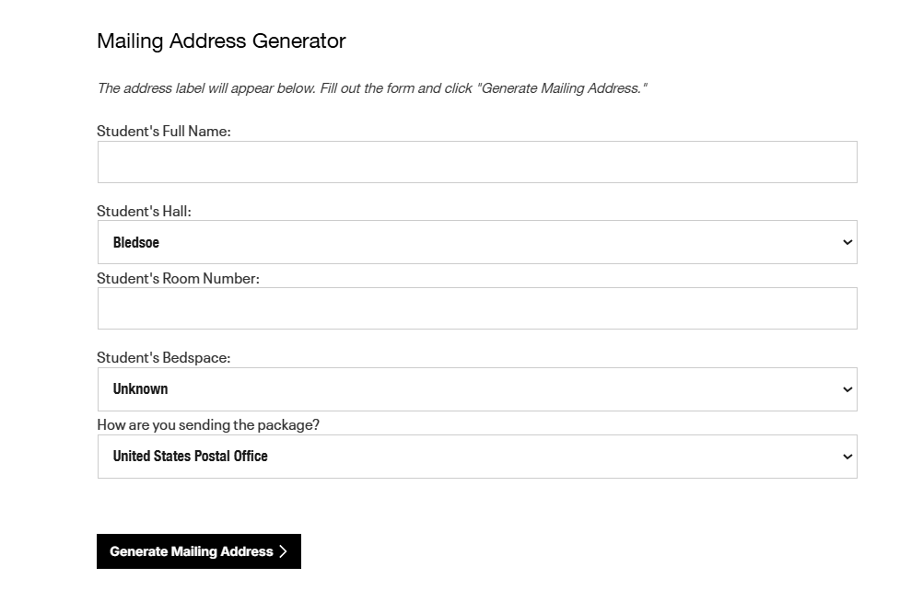
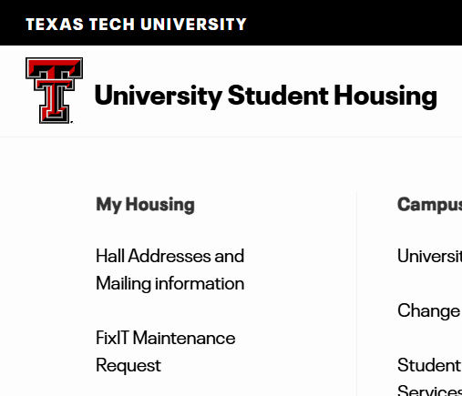
MAILING PACKAGES TO YOUR STUDENT
  Use the Mailing Address Generator to send your student mail and packages! Go to www.housing.ttu.edu and click “Current Residents” and then “Hall Addresses and Mailing Information” under “My Housing”
Notes:
Chris
When filling out the Mailing Address Generator, you’ll need your student’s hall name and room number. Then you can choose either”United States Postal Office” or “UPS, FedEX, Other” and click “Generate Mailing Address.” When a package arrives, it will be signed for at the hall office and students will receive an email to pick up their package. Letters will be placed in the students’ mail box.

Slide 14

ONESTOP
Visit the OneStop at the Student Union Building while you’re here during move-in to get any last-minute questions answered.
Departments you can speak with:
  Student Business Services
  Student Financial Aid & Scholarships
  Transportation & Parking*
  Student ID Office*
Hours vary, depending on the day of your visit
*As staffing allows – their offices are in the Student Union Building
Notes:
Morgan

Slide 15

Stop by and join Parent & Family Relations for our move-in event: Refuel & Refresh!
August 21 and 22
International Cultural Center (free parking)
11:00 am – 2:00 pm
Can wait to see you!
Register on the Red Raider Family Network
Refuel & Refresh Events
Notes:
Connie

Slide 16
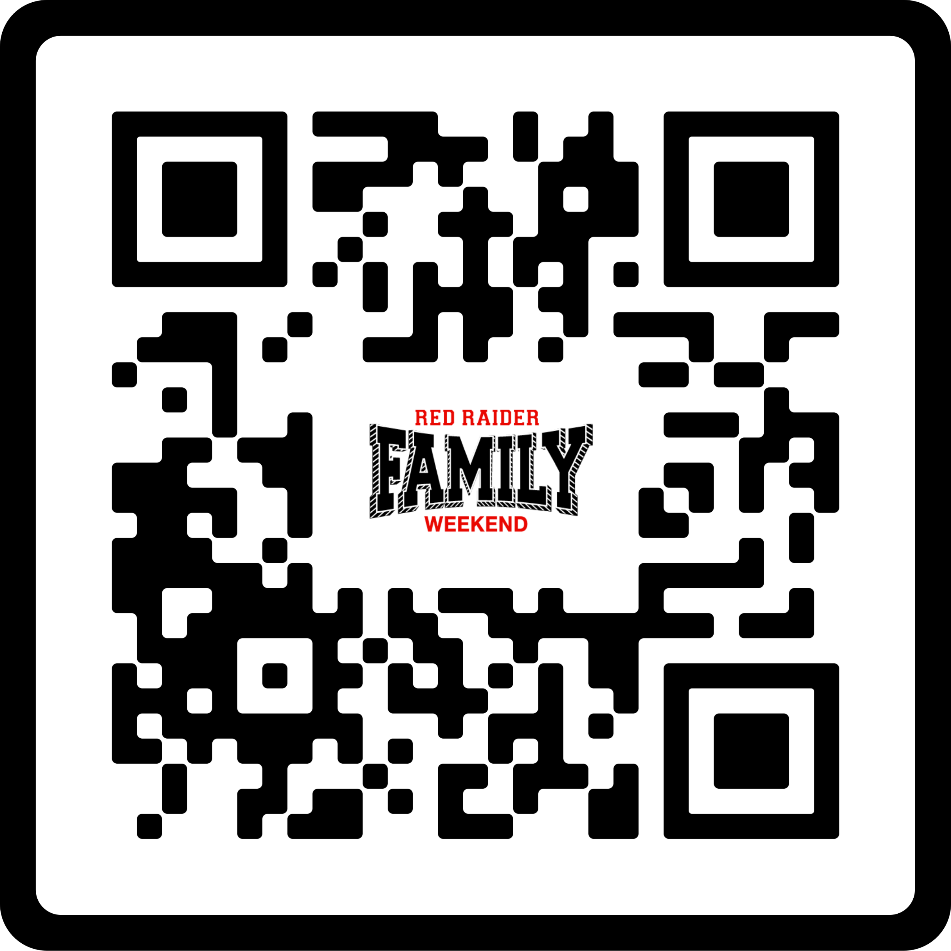
FAMILY WEEKEND AND FAMILY DAYS
Family Weekend at Texas Tech has been a tradition since 1936. Family Weekend 2026 will be September 25-27, 2026 (Texas Tech vs. Sam Houston State; kickoff TBD
Football tickets are sold out!
  Options:
    Get tickets on SeatGeek
    Attend another football weekend!
    There’s lots to do besides the game. See the full schedule on our website. Visit go.ttu.edu/familyweekend
Notes:
Christine

Slide 17
Questions?
Use the Zoom Q&A feature

Slide 18
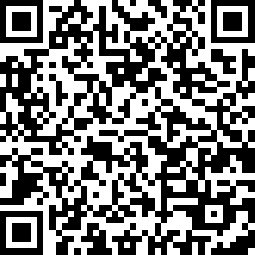

How did we do?
Take our quick survey!
Parent & Family Relations
parent@ttu.edu

