Slide 1

Health and Wellbeing at Texas Tech
Connie Watson | Parent & Family Relations
Amanda Garcia | Student Health Services
Gregory Johnston, PhD| Student Counseling Center

Slide 2


Student Health Services

Slide 3
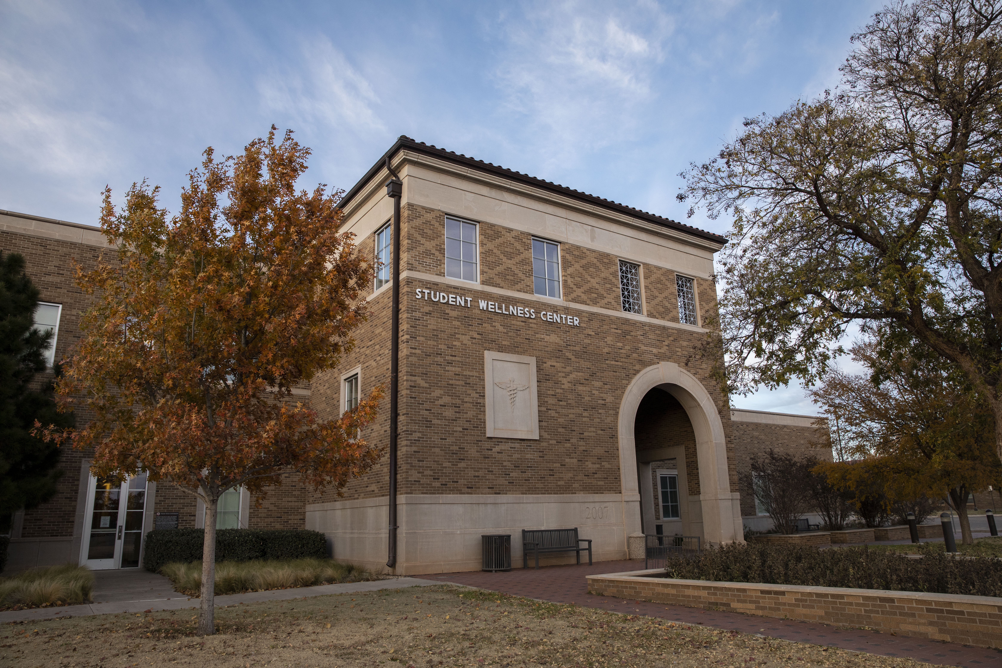
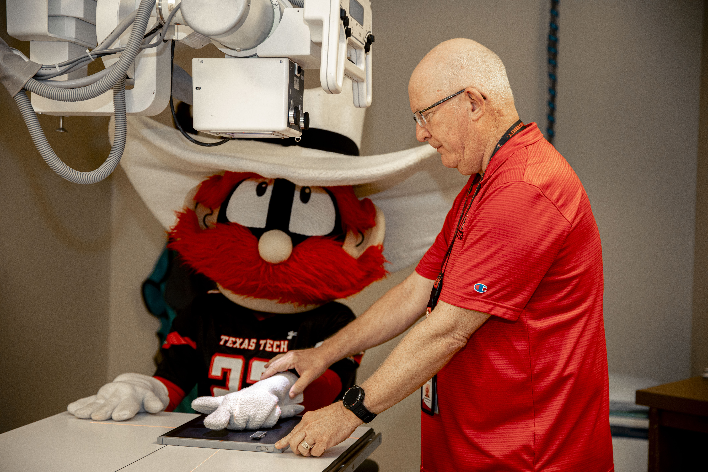
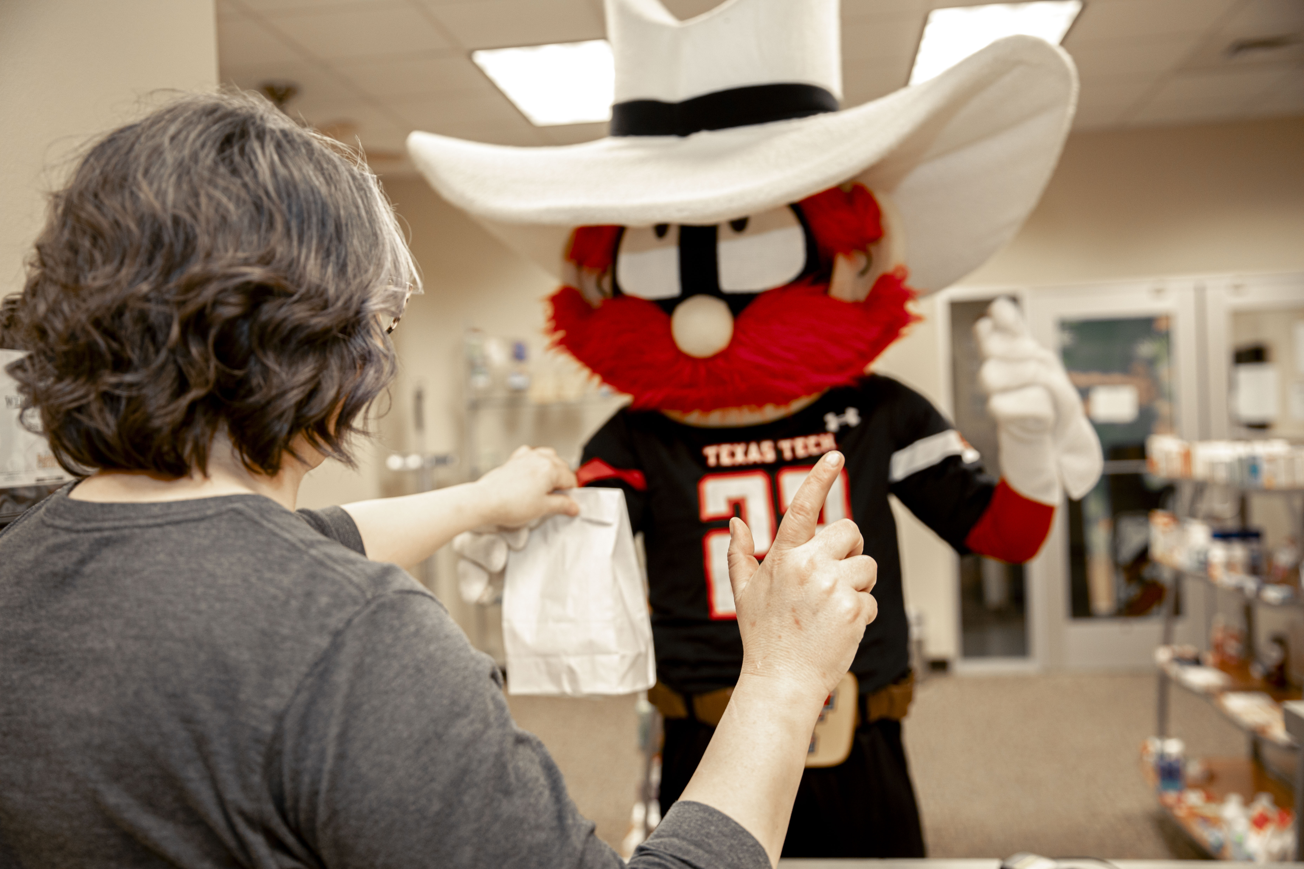
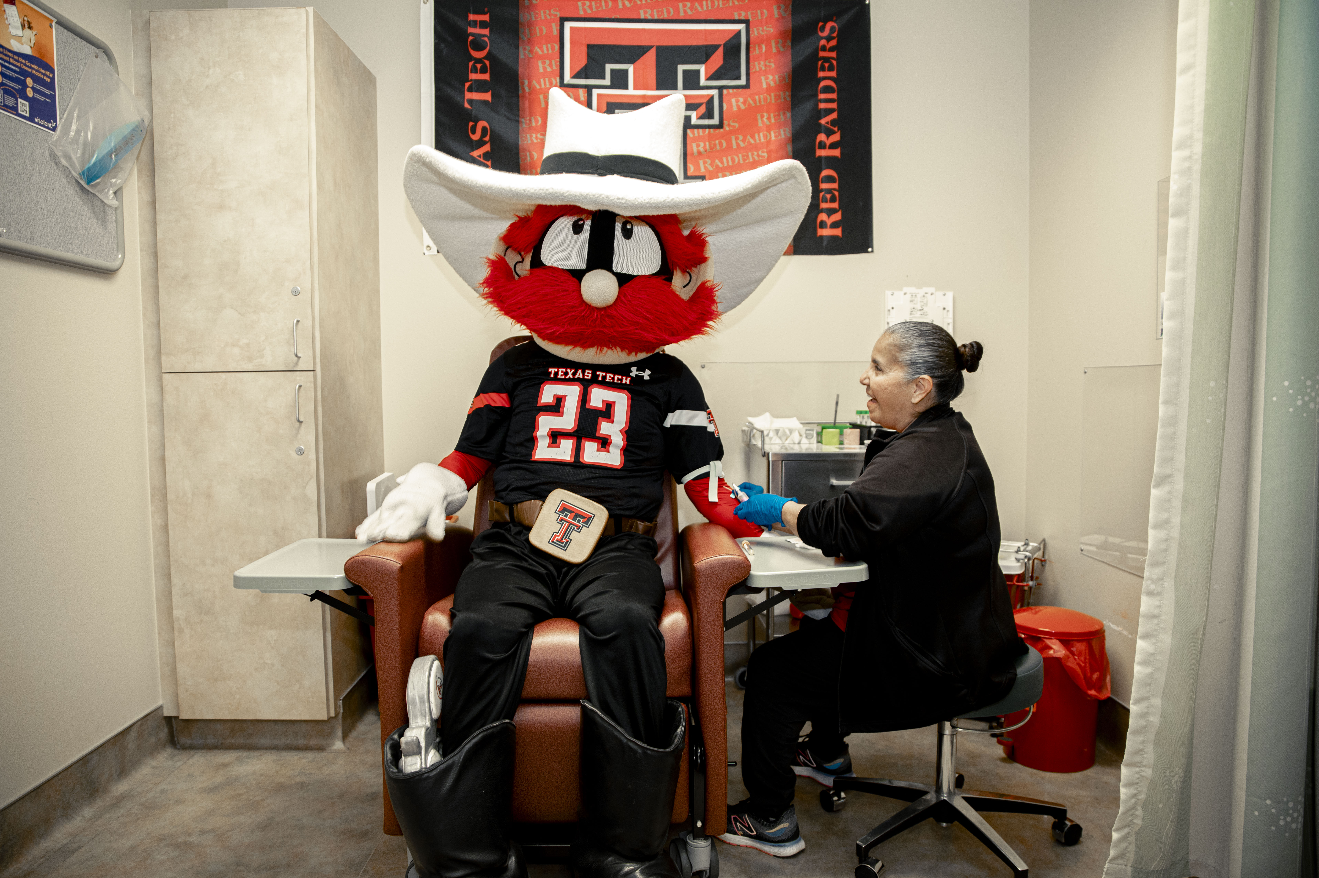
Student Health & Wellness Fee
Includes exclusive access to our building facilities such as:
Pharmacy
Laboratory & Xray
Urgent Care
Primary Care
& More

Slide 4
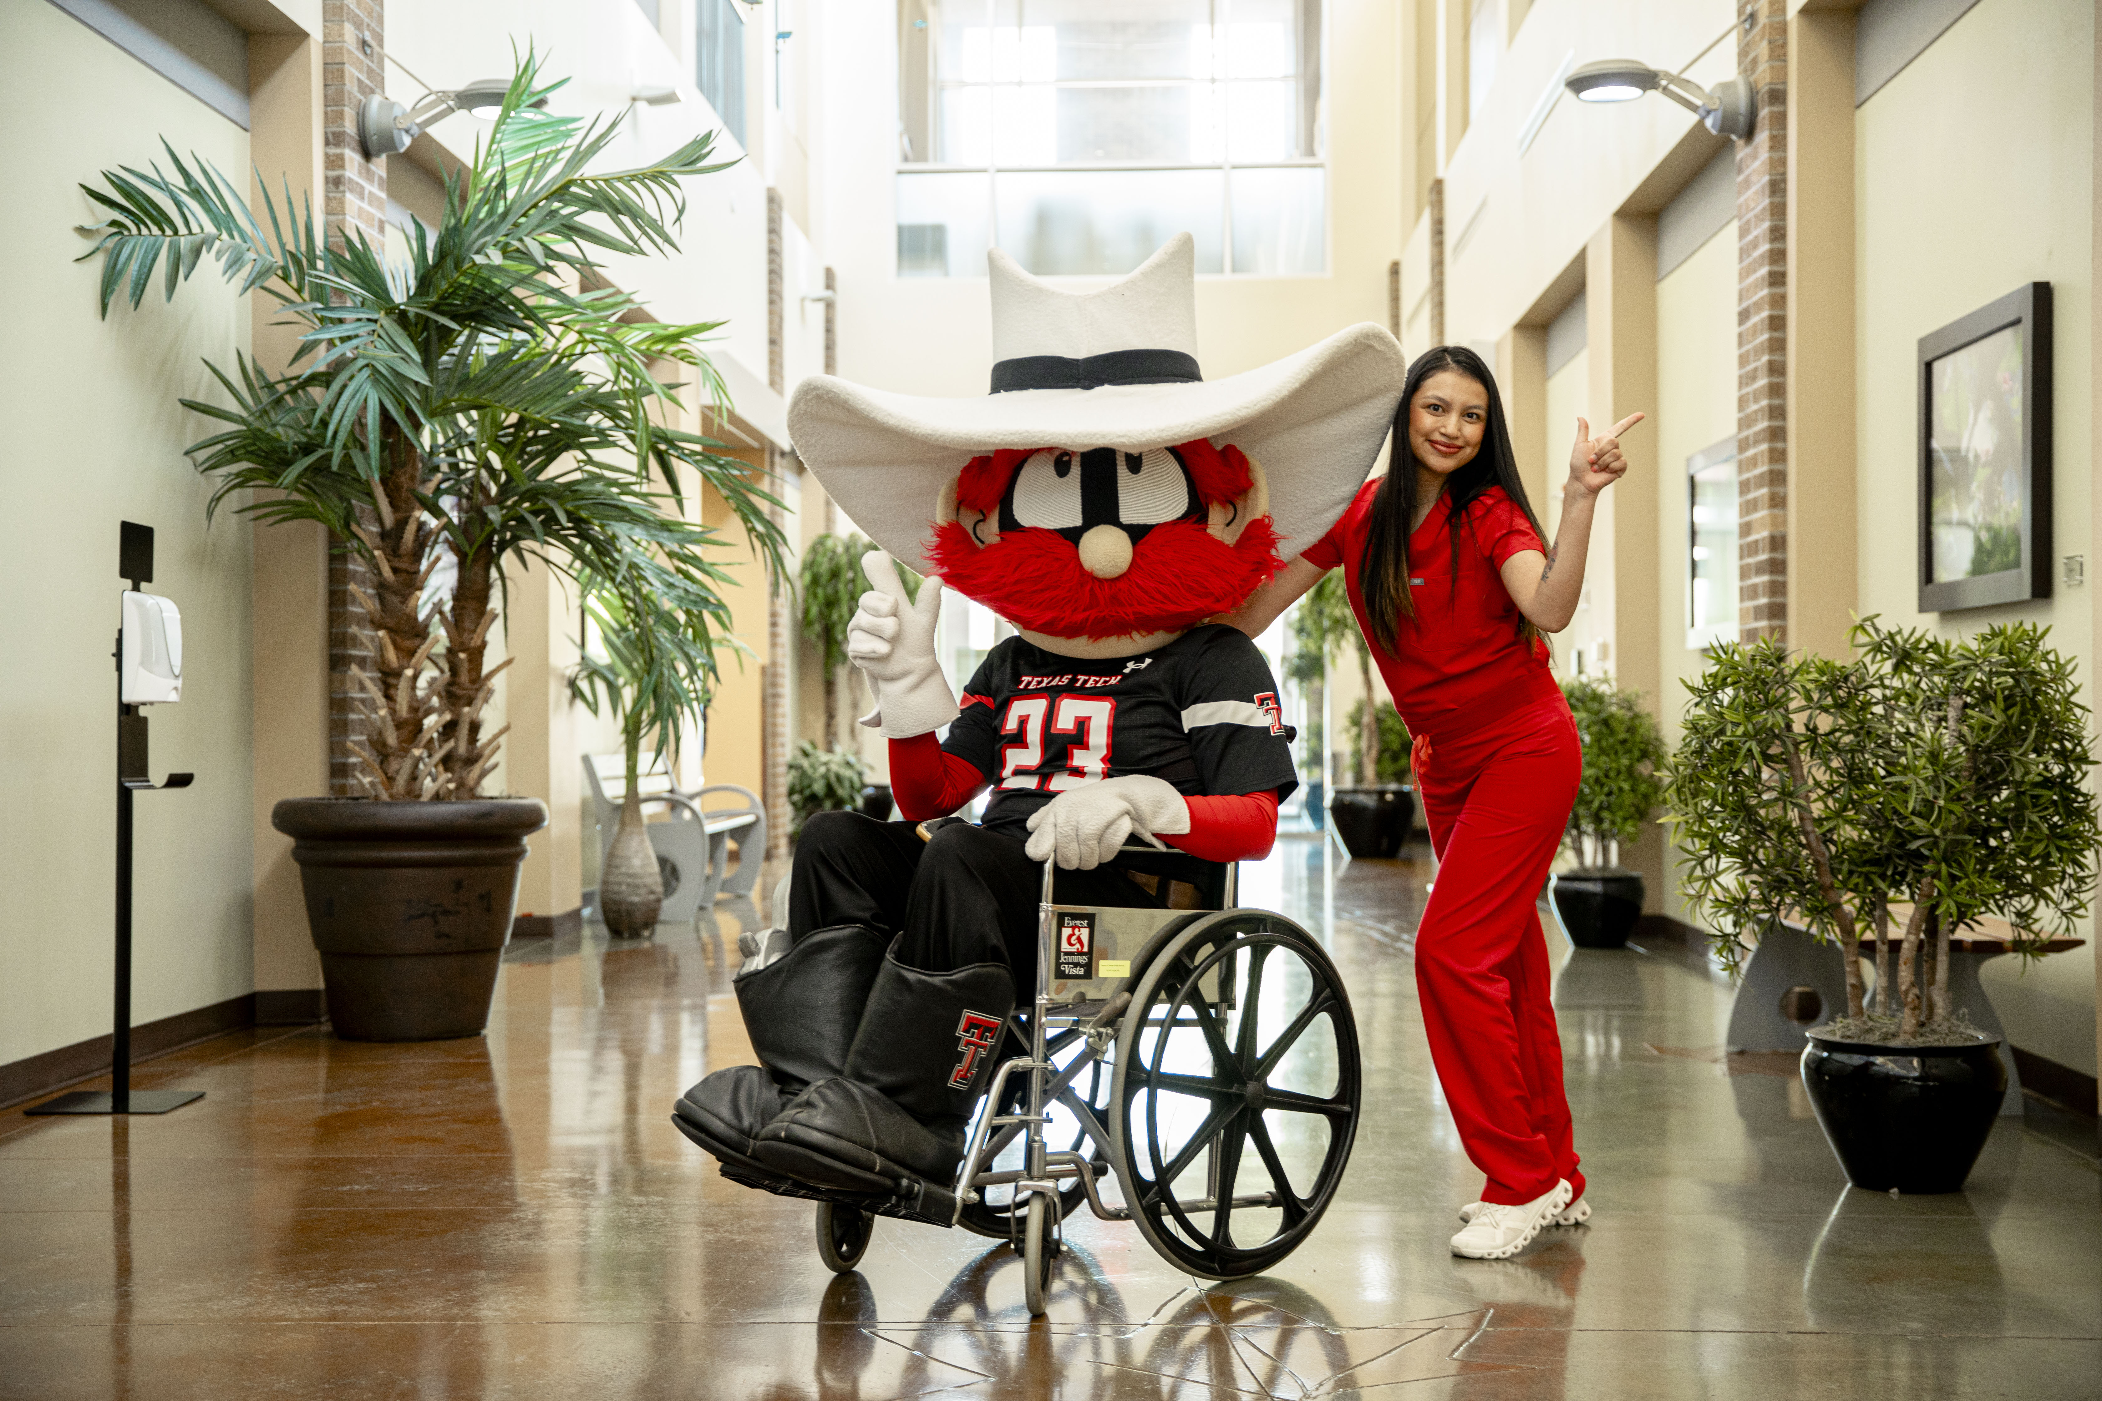
Convenient Specialty Care
Women's health
Behavioral Health
Sports Medicine
Psychiatry
Gyn- Specialized MD
Dermatology
ADHD Testing
Eating Disorder
Licensed Professional Counselors

Slide 5
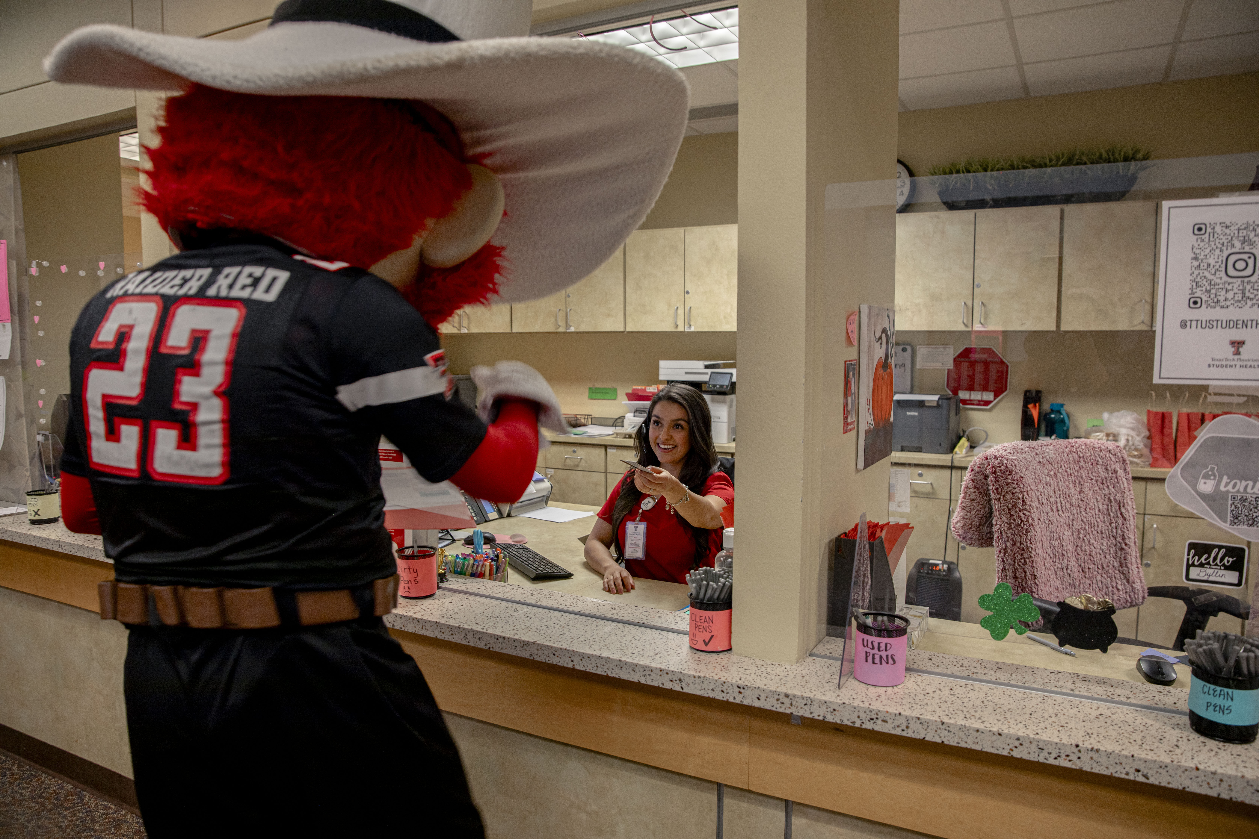
Billing
Self Pay- $40% discount & can bill to Student Business services account.
Insured- Collect copay and coinsurance
Academic Health Care plan- Purchase BCBS plan through the Academic Health Care and all service all 100% Covered.

Slide 6

Scheduling is now just a click away…….
Manage Appointments - Schedule, reschedule or cancel appointments. View past and upcoming appointments.
Pay your bill-Review account balances and securely pay online.
Request Prescription Refills - Review, refill and request your prescriptions.
Find a Doctor - Many of our providers and specialists are available to schedule through MyChart or Find a Doctor.
Access Medical History - Review test results, immunizations, visit summaries and next steps.
Message Your Doctor - Get answers to your medical questions in a secure chat with your medical team.

Slide 7
Exercise Medicine- Fitwell
Texas Tech UREC Fitness and Wellness Program collaborates with the Exercise Medicine on- campus program to promote physical actively as a vital sign of health.
  Program Promotes:
    Making movement a part of the daily campus culture.
    Assessing physical activity at every Student Health clinic visit.
    Providing students with the tools necessary to strengthen healthy physical activity habits that can last a lifetime.
    Connecting university healthcare providers with university health fitness specialist to provide a referral system for exercise prescriptions.
    This program is currently offering a 1-on-1 meeting plus 1 personal training sessions for free group fitness is free. You can also choose F45 and CrossFit. Referral is required.

Slide 8
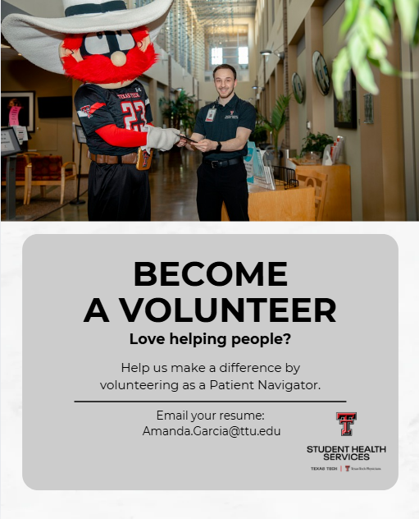
Volunteer opportunities
Volunteer Experience:
Customer Service Experience
Clinic Experience
Professional setting
Panelist
Letter of recommendations

Slide 9
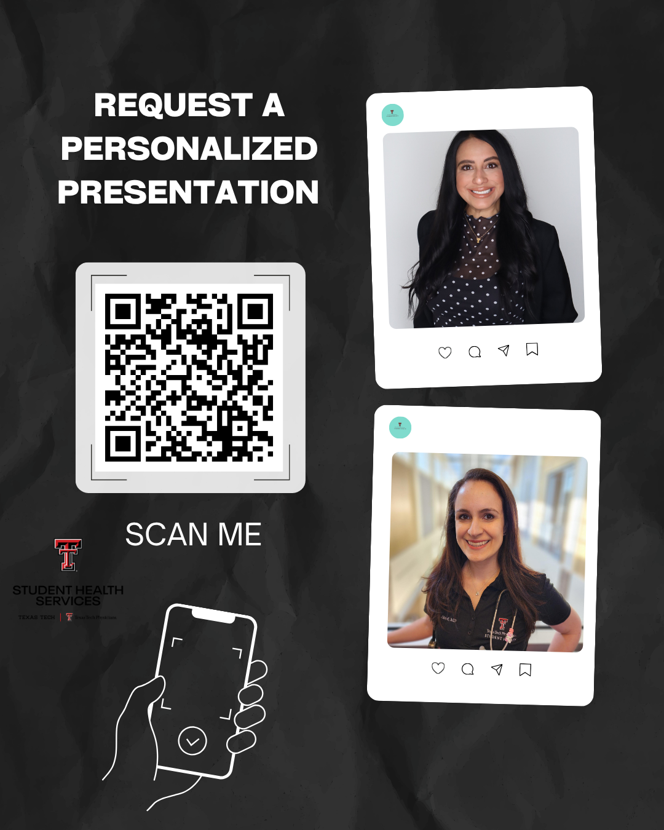
Are you involved in SFL or an organization here on campus?
Topics:
Mental Health
Men’s Health
Sleep hygiene
Women's health
Additional topics will be reviewed and subject to approval.

Slide 10
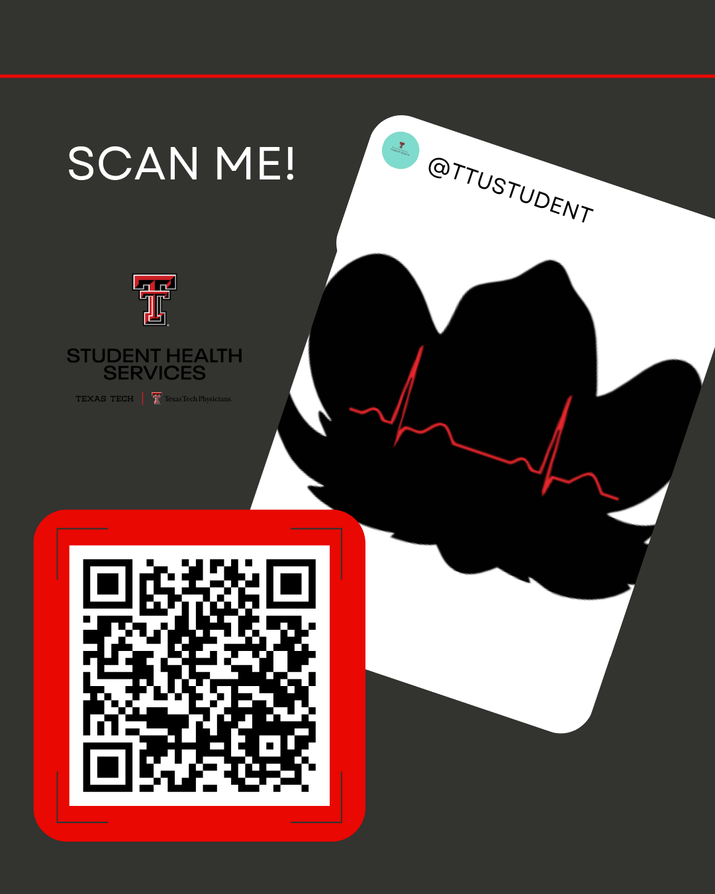
Follow us on Instagram
Handle: TTUSTUDENTHEALTH

Slide 11

Now offering flu vaccines!

Slide 12
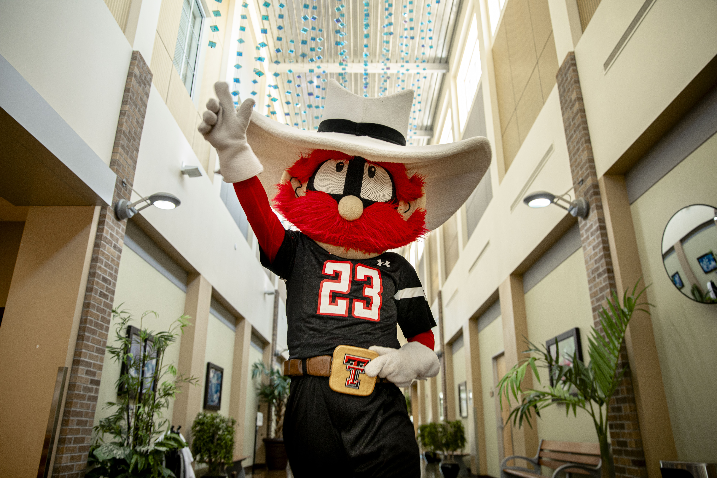
We care for the Red Raider Student Body!
#1 Student Health Provider!

Slide 13
Student Counseling Center
Gregory D Johnston, PhD,
Counselor
Student Counseling Center

Slide 14
Basic Info
We are open M-F 8:00am-5:00 pm
All services are available to enrolled TTU students
All services are voluntary
Services are covered by Student Service/Health & Wellness Fees
  We do not accept insurance
  There is no co-pay involved
  $25 no-show fee
Therapist will determine what treatment will be most effective

Slide 15
Walk-In Clinic
All students wanting our services must come to a triage appointment.
  M-F 12:30pm-3:30pm
  Student fills out paperwork
  Briefly meets with a therapist to discuss treatment options or referrals
  Students can expect an hour and a half to complete the entire process.
If a student is in crisis, they do not need to wait until 12:30 to meet with a therapist.

Slide 16
Services
Manage Your Mood
MindSpa (Biofeedback Training)
Therapy Assistance Online
Bibliotherapy
Group therapy
Individual therapy
  Personal concerns
Relationship therapy
Consultation with faculty, staff, parents, and students about mental health issues.
Outreach to campus community

Slide 17
Confidentiality of Services
All SCC contacts with students are confidential in accordance with Texas state law
SCC employees cannot disclose if a student is receiving SCC services unless the student signs a specific release of information authorizing us to do so
If you are wondering about a student’s follow-through with referral, contact the student directly
You are welcome to share information regarding a student with SCC staff – however, SCC staff must abide by the above guidelines and will not be able to respond without the student’s consent

Slide 18
Manage Your Mood
A 4-week course/group to help manage stress
  Develop mindfulness
  Learn Interpersonal Skills
  Emotion Regulation
  Distress Tolerance
Wednesdays at 2pm
  Email greg.johnston@ttu.edu for more information or to attend.

Slide 19
Manage Your Mood Online
Video segment of Manage Your Mood
  Developed to reduce barriers related to group counseling
  Able to assess from any computer at any time with your eRaider and Password
Visit the Student Counseling Center Website Manage Your Mood website to access online videos. Click on the following link and Manage Your Mood icon to access content. https://www.depts.ttu.edu/scc/treatment-services/manage-your-mood/

Slide 20
MindSpa
A peaceful refuge to nurture your mind, body, and spirit.
Available to all students, faculty, and staff
  Do NOT need a triage/walk-in appointment
Biofeedback
Massage Chair
VR headset with relaxation-based games
Yoga mats/instructional videos/relaxing music
https://www.depts.ttu.edu/scc/self-help-resources/mindspa/

Slide 21
Therapy Online
TELUS
  An online, student support app that allows a student 24/7 access to professional counseling by phone or chat in multiple languages.
Together All
  Safe, anonymous, online peer support community to support your mental health.
  https://www.depts.ttu.edu/scc/

Slide 22
Bibliotherapy
Workbooks that we suggest
  Anxiety
  Depression
  Body Image/Eating Disorders
  Coping Skills
  Self-Compassion/Self-Love

Slide 23
Individual Therapy
One-on-one therapy to address individual concerns
Virtual and in-person services this semester
  Must be in state of TX
  Must have secure internet access
  Must have privacy
Common areas of focus:
  Mental health concerns (i.e. anxiety, depression)
  Relationship concerns
  Academic stress
  Problematic substance use

Slide 24
Group Therapy
Variety of group therapy options
  Mindfulness & Meditation
  Understanding Self and Others process group
  Social Anxiety Group
  Depression and Bipolar disorder Group
https://www.depts.ttu.edu/scc/treatment-services/available-groups/index.php

Slide 25
Relationship Therapy
Available as long as all members of relationship are TTU enrolled students
Definition of relationships are all encompassing
  Romantic partnerships (dyads, triads, etc)
  Roommates
  Friends
  Organization members
Typically focuses on improving communication.

Slide 26
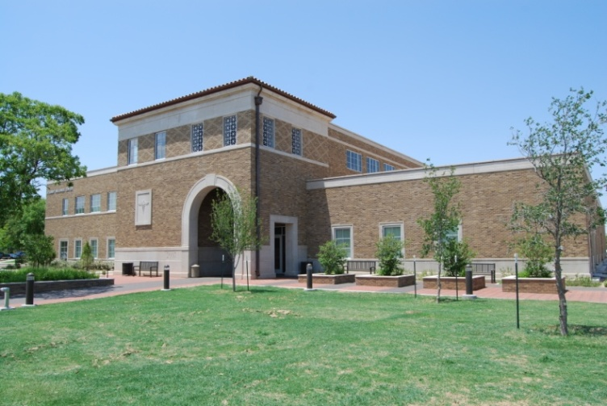
Student Counseling Center Contact Information:
Where: 201 Student Wellness Center
  (on corner of Flint and Main)
Phone : (806) 742-3674
Website: http://counseling.ttu.edu

Slide 27
Questions?
Use the Zoom Q&A feature

Slide 28
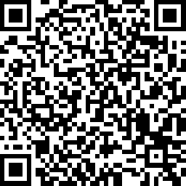

Red Raider Family Webinar Series
Up Next:
Campus Safety at Texas Tech – June 17
Academic Success at Texas Tech – July 8
Preparing Your Red Raider for On-Campus Living – July 22
Parent and Family Relations
parent@ttu.edu
Student Health Services
studenthealthservices@ttuhsc.edu Student Counseling Center
StudentCounselingCenter@ttu.edu
Notes:
PFR

