Slide 1

Intramurals and Club Sports
Morgan Chavez-Brannon | Parent & Family Relations
Matt Gianiodis | University Recreation Sport Programs
Jordon German| University Recreation Sport Programs
Important Reminders
Please type all questions in the Q&A Chat.
The presentation will be recorded if you are unable to stay for the entire meeting.
This is a public forum; please do not share any personal information in accordance with HIPAA & FERPA guidelines.

Slide 2
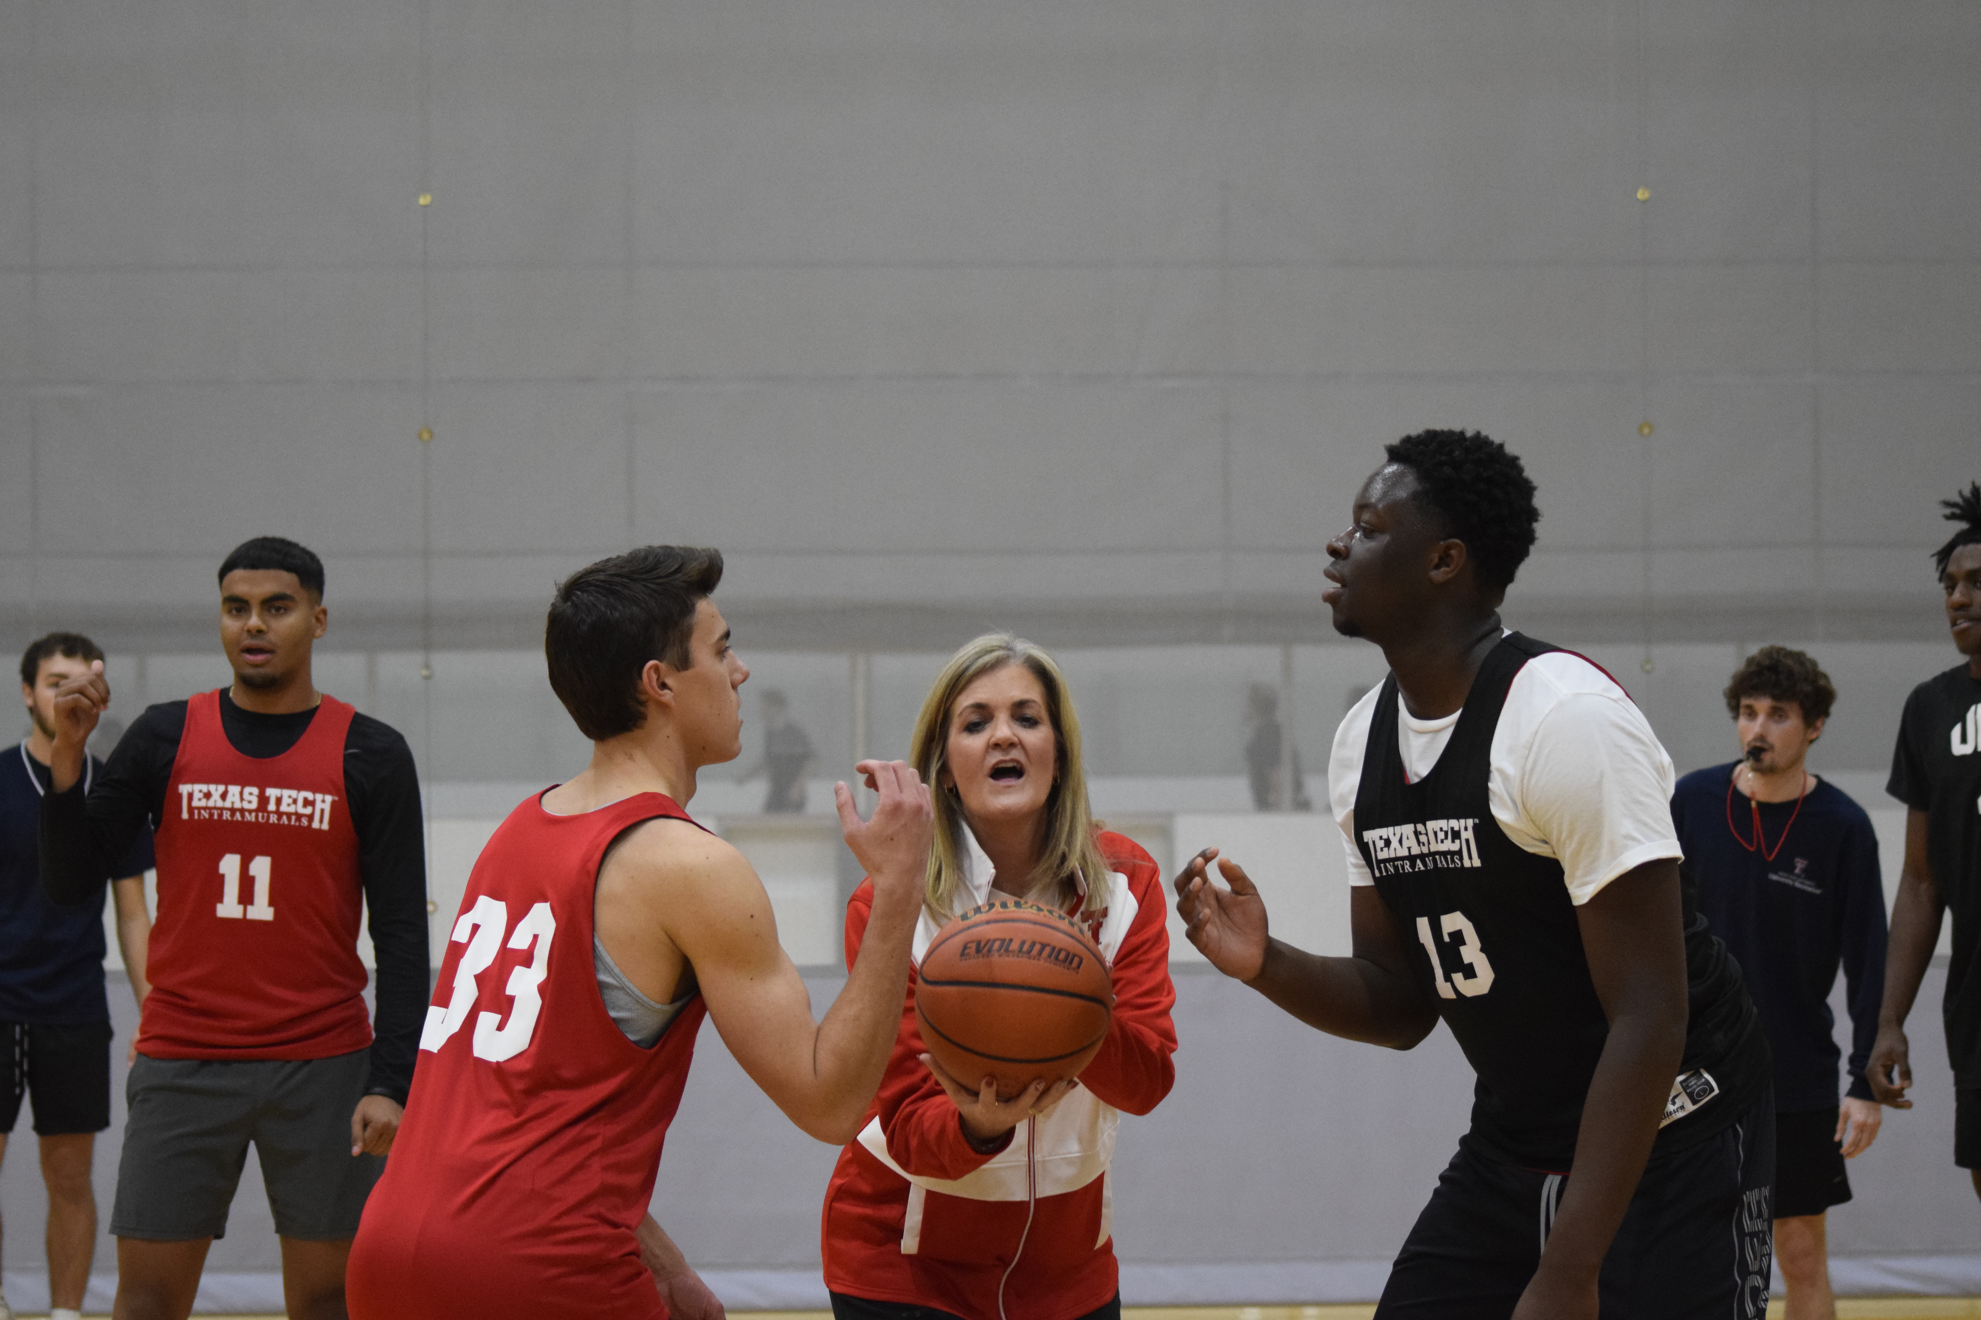
Intramurals
Player Pass
What is it?
  Skill level and sport knowledge does not matter
  Try something new! (not a continuation of your high school career)
  #everyoneplays
Why should someone play?
Time commitment
  Very Minimal depending on how many teams you sign up for!
There is a fee associated to play intramurals
  $30 for a year
  $20 for a semester
  They can purchase this player pass on imleagues.com
  We do have a few sports that are considered free-to play
Job Opportunities!
  We hire and train officials each semester!
  Experienced not required!
  Just knowledge of the sport they are trying to officiate!
What does this get you?
The Player pass gets you access to all of these great sports listed below:
Flag Football
Indoor Volleyball
Basketball
Sand Volleyball
Slow pitch Softball
Outdoor and Indoor Soccer
Floor Hockey
Futsal
Handball
& Many more!!!

Slide 3
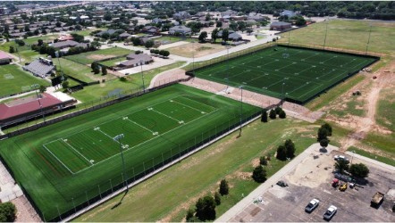
Sport Clubs
Archery
Badminton
Ballroom Dancing
Baseball
Billiards
Bowling
Climbing
Cricket
Cycling/Tri
Disc Golf
Esports
Fencing
Golf
Gymnastics
Historical Fencing
Ice Hockey
Martial Arts
Men’s Lacrosse
Men’s Rugby
Men’s Soccer
Men’s Volleyball
MMA
Olympics
Paintball
Pickleball
Polo
Powerlifting
Rowing
Running
Special
Swimming
Table Tennis
Tech Officials Assn
Tennis
Trap & Skeet
Ultimate Frisbee
Wakeboard
Water Polo
Women’s Lacrosse
Women’s Rugby
Women’s Soccer
Women’s Volleyball
Wrestling

Slide 4
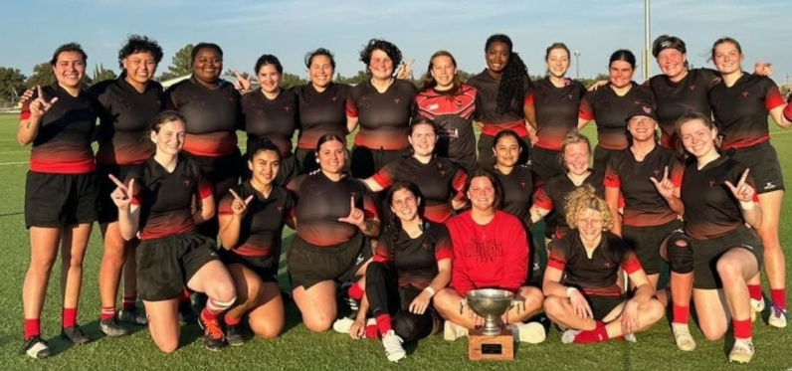

#ONETEAM

Slide 5
Questions?
Use the Zoom Q&A feature

Slide 6
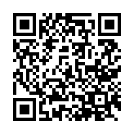

Closing
Up Next:
Start Early, Stand Out: First-Year Steps Toward Career Success – October 7
Student Health 101: Your guide to care on campus – October 16
TSI and Spring Registration – October 19
What is University Coaching? – October 28
Parent and Family Relations
parent@ttu.edu
University Recreation
recreation@ttu.edu

