Slide 1

Student Disability Services: Accommodations
Connie R. Watson | Parent & Family Relations
Kimberly Rindlisbacher | Student Disability Services

Slide 2
Welcome Participants!
Please make sure your microphone is muted. Please type all questions in the Q&A Chat.
The presentation will be recorded if you are unable to stay for the entire meeting.
This is a public forum; please do not share any personal information in accordance with HIPAA & FERPA guidelines.

Slide 3

Preparing for Higher Education
Student Disability Services
Kimberly Rindlisbacher, M. Ed.
Administrator/Case Manager
Abbi May, M. Ed.
Program Director/Case Manager
Stephanie Nelson, MA, LPC
Assistant Director/Case Manager
01/29/2026

Slide 4
Learning Outcomes
What is the ADA & Section 504?
Overview of the SDS office
What are Accommodations?
Q/A

Slide 5
Fast Facts
    According to the National Center for Educational Statistics, "in 2019-2020, around 21 percent of undergraduates and 11 percent of postbaccalaureate students reported having disabilities" (NCES).
    Only about 1/3 of students who have a disability register for accommodations in higher education.
  https://nces.ed.gov/whatsnew/press_releases/4_26_2022.asp
  https://nces.ed.gov/fastfacts/display.asp?id=60
  https://meridian.allenpress.com/nacada-journal/article/27/1/57/36156/Academic-Advisors-and-Students-with-Disabilities-A

Slide 6
Americans with Disabilities Act (ADA)
The ADA is a federal civil rights law designed
  to provide equal opportunity for qualified individuals with disabilities, including students.
  to prohibit discrimination on the basis of a qualified disability.
  to ensure that qualified disabled students can have equal access and opportunity for participation in the programs, services and activities offered by a recipient of federal financial assistance.
https://www.ada.gov/resources/disability-rights-guide/

Slide 7
Section 504 of the Rehabilitation Act
Section 504 of the Rehabilitation Act of 1973 is a law that protects individuals from discrimination.
Subpart D applies to K-12 schools.
A 504 Plan is developed for K-12 students needing certain accommodations and modifications to either the physical space in the school or the learning environment.
Subpart E applies to post-secondary institutions and ensures that students have the same opportunities as their non-disabled peers.

Slide 8
Section 504 of the Rehabilitation Act Part E
Mandates that institutions receiving federal funding cannot discriminate against students with disabilities and must ensure they have equal access to programs and services. This includes accommodations for academic adjustments, housing, financial assistance, and non-academic activities.
Unlike K-12 education, Section 504 in postsecondary settings focuses on providing access to opportunities, while the student's success is largely their own responsibility.
https://gov.texas.gov/organization/disabilities/higher_education#rehab

Slide 9
Individuals with Disabilities Education Act (IDEA)
IDEA ensures a Free Appropriate Public Education (FAPE) for eligible students with disabilities through individualized services in K–12 public schools.
Focuses on special education and related services, not just access or non-discrimination.
Requires an Individualized Education Program (IEP) and education in the Least Restrictive Environment (LRE).
Emphasizes meaningful educational progress and success, with accountability influenced by No Child Left Behind (standards, assessments, and high expectations).
Does not transfer to higher education; after graduation or age-out, protections shift to ADA and Section 504(part E), which focus on equal access.

Slide 10
Law | IDEA | Section 504 | ADA
Full Name | Individuals with Disabilities Education Act | Section 504 of the Rehabilitation Act of 1973 | Americans with Disabilities Act
Primary Purpose | Provides special education services and individualized instruction | Prevents discrimination and ensures equal opportunity | Broad civil rights law prohibiting disability discrimination
Who It Applies To | K–12 public schools | K–12 and higher education | K–12, higher education, employment, public services, and public accommodations
Who Is Covered | Students who meet specific disability categories and eligibility criteria | Any individual with a disability that substantially limits a major life activity | Any individual with a disability, record of disability, or perceived disability
Type of Support | IEP (Individualized Education Program) | 504 Plan (K–12 only) | No formal plan required- Student initiates requests
Focus of Support | Educational success and progress | Equal access to programs and activities | Equal access and non-discrimination
Services Provided | Specialized instruction, related services, accommodations | Accommodations and modifications | Reasonable accommodations and effective communication
Assessment & Accountability | Progress monitoring and educational goals required | No progress goals required | No educational progress requirements
Documentation | Required evaluations and ongoing review | Documentation of disability required | Documentation may be requested, but varies by setting
After High School | Ends at graduation or age-out | 504 Plans do not transfer/end at graduation | Becomes the primary protection in higher education and beyond

Slide 11
Application for Students
Any student who needs accommodations due to a disability must apply for services. The application can be found on the home page of the website. The application includes a questionnaire and prompts students to submit supporting documentation before submitting.
Once a student applies, they are assigned a Case Manager, and have an intake meeting where accommodations are discussed, and our process is reviewed.
Students are responsible for requesting their accommodations each semester.

Slide 12
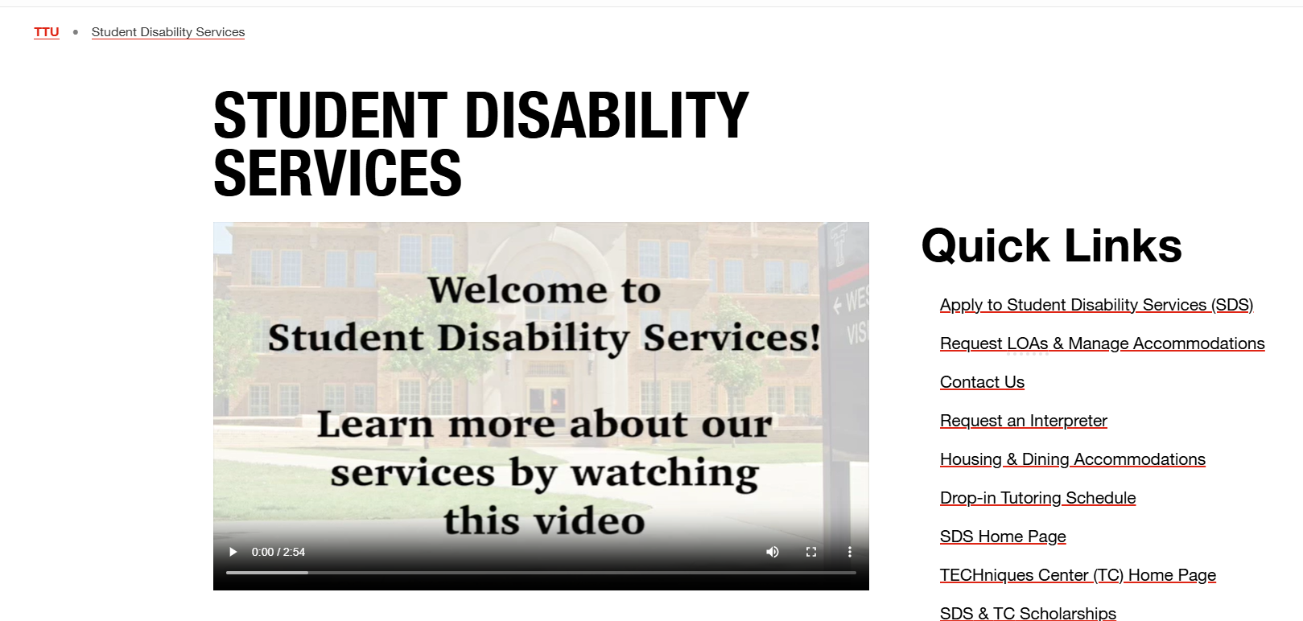

Slide 13
Documentation
High School 504 plan
IEP plan
  FIE is helpful as well
Medical Documentation
Housing/dining specific documentation
https://www.depts.ttu.edu/sds/futurestudents/DocumentationGuidelines.php

Slide 14
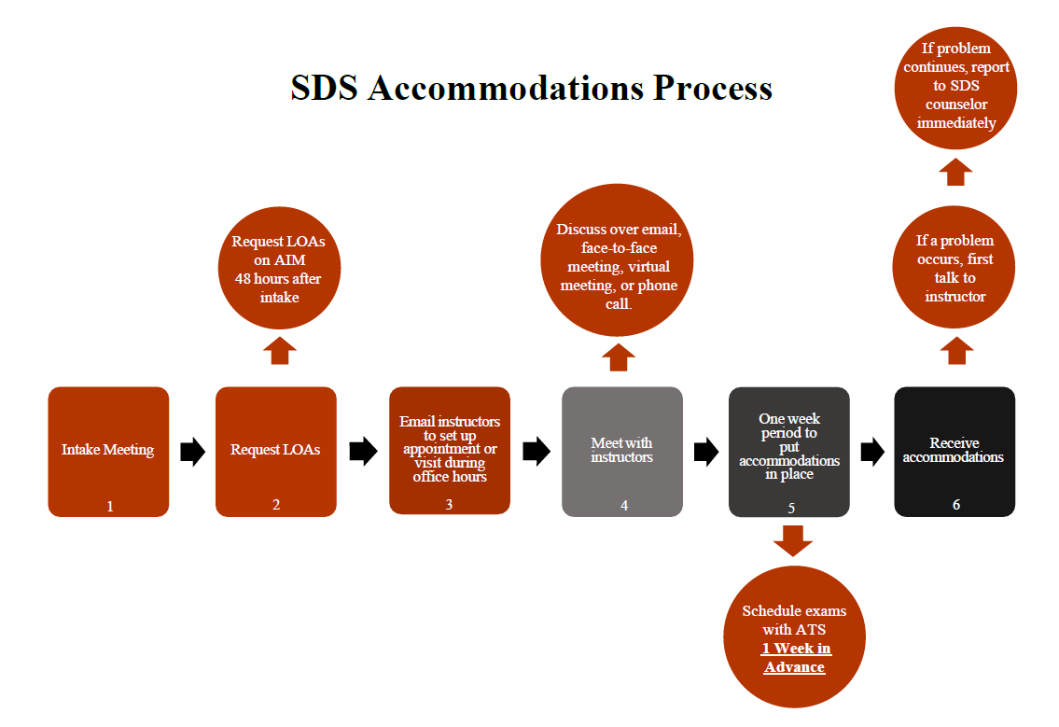

Slide 15
Other SDS Services
Drop In Tutoring
SDS Scholarships
Student Workshops
C.L.A.S.S.
TECHniques Center
Student Events
Create and Paint, Independent Study Day, Open Houses
Case Management-
Regular meetings with SDS Counselors
Resolving issues with accommodations/ faculty questions
Sign Language Interpreters
Professional Development
Partnerships on Campus
Housing, The Burkhart Center (CASE), Dean of Students, Conduct, admissions, Former Foster Youth, MVP..etc.

Slide 16
Types of Disabilities
ADHD/ADD
Learning Disabilities
Dyslexia, Dysgraphia, Dyscalculia..etc.
Chronic Illnesses
Cancer, Chron’s, Diabetes..etc.
Temporary (concussion)
Hearing Impairments
Deaf, and hard of hearing
Mobility Impairments
Wheelchairs, temporary mobility needs
Psychological Disorders
Bipolar, Anxiety, Depression, Panic Disorder
Visual impairments
Partial or Totally Blind
Traumatic Brain Injuries (TBIs)
Autism Spectrum Disorder
Other
Speech Impairments, Genetic Disorders
*This is not an exhaustive list, disabilities can be co-occurring (multiple disabilities)

Slide 17
What is an Accommodation?
An accommodation ensures students can fully access all aspects of a course and education.
Accommodations must be reasonable and appropriate, cannot fundamentally alter course/program standards

Slide 18
Accommodations Cannot:
Reduce assignments
Alter course material
Alter testing/assessment methods (unless accessibility is an issue)
Affect the academic integrity of the course in any way
Fundamentally alter a course or the coursework (lower academic standards)
Change the modality of assignments unless accessibility is an issue
Cannot alter program requirements (accreditation/certifications)

Slide 19
Comparison of High School VS College
Structured Time | Personal Freedom
Mandatory and Free | Voluntary and Expensive
Time is structured by others | Time management falls on the student
Need money for special purchases or events | Neet money to meet basic needs
Teachers/Parents monitor progress/attendance | Student is responsible for progress

Slide 20
Comparison of High School VS College
Tests in HS | Exams in College
Frequent- typically smaller amounts of materials | Infrequent- typically include large amounts of material/ might be cumulative
Make-up and retests are often available | Retests are often not available, make-ups are arranged with the professor if allowed
Reviews might be given with important concepts | Students are responsible for organizing materials and studying on their own
Mastery is often reproducing what you were taught | Mastery is often applying what you’ve learned

Slide 21
Comparison of High School VS College
Grades in HS | Grades in College
Consistent homework grades can help raise averages | Tests/major assignments typically are the largest grades
First/low test scores might not adversely effect final grades | Might be hard to recover from a low test grade
Student can often graduate with D’s or higher | Grades must meet your major/College’s expectations. Standards are typically at least a 2.0 (C average), or higher
Effort Counts | Results Count

Slide 22
Contact SDS
sds@ttu.edu
806-742-2405
Contact Me:
Kimberly Rindlisbacher
Kirindli@ttu.edu

Slide 23
Questions?
Use the Zoom Q&A feature

Slide 24
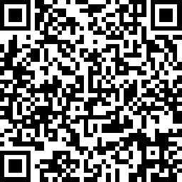

Take Our Survey
Up Next:
Finishing Touches with PFR – August 5
Parent and Family Relations
parent@ttu.edu
Student Disability Services
sds@ttu.edu

