Slide 1

Student Health 101:
Your guide to care on campus
Morgan Chavez-Brannon | Parent & Family Relations
Amanda Garcia | Student Health Services
Important Reminders
Please type all questions in the Q&A Chat.
The presentation will be recorded if you are unable to stay for the entire meeting.
This is a public forum; please do not share any personal information in accordance with HIPAA & FERPA guidelines.

Slide 2

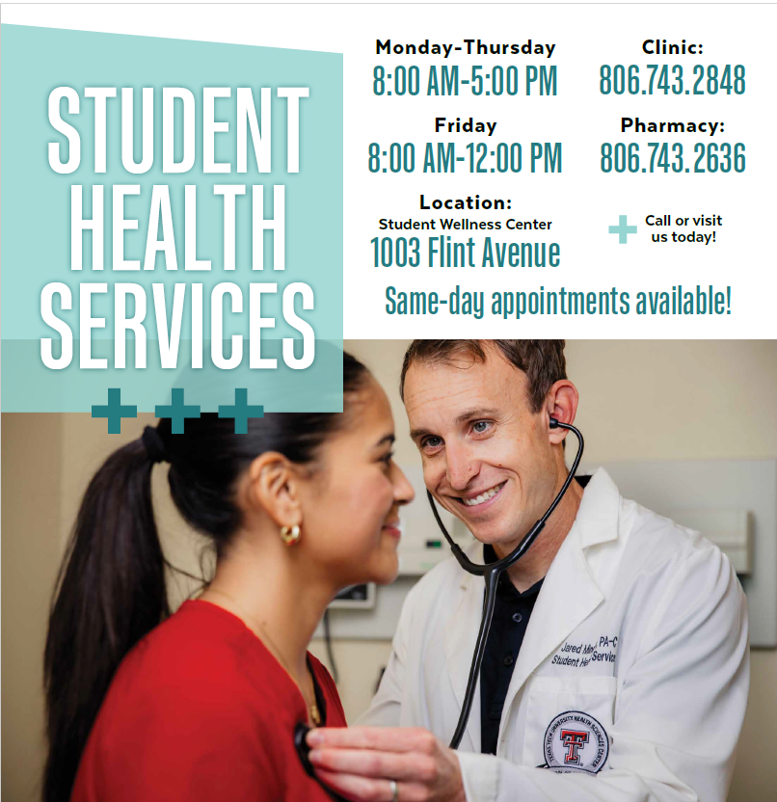
Student Health Services: Hours and Location

Slide 3
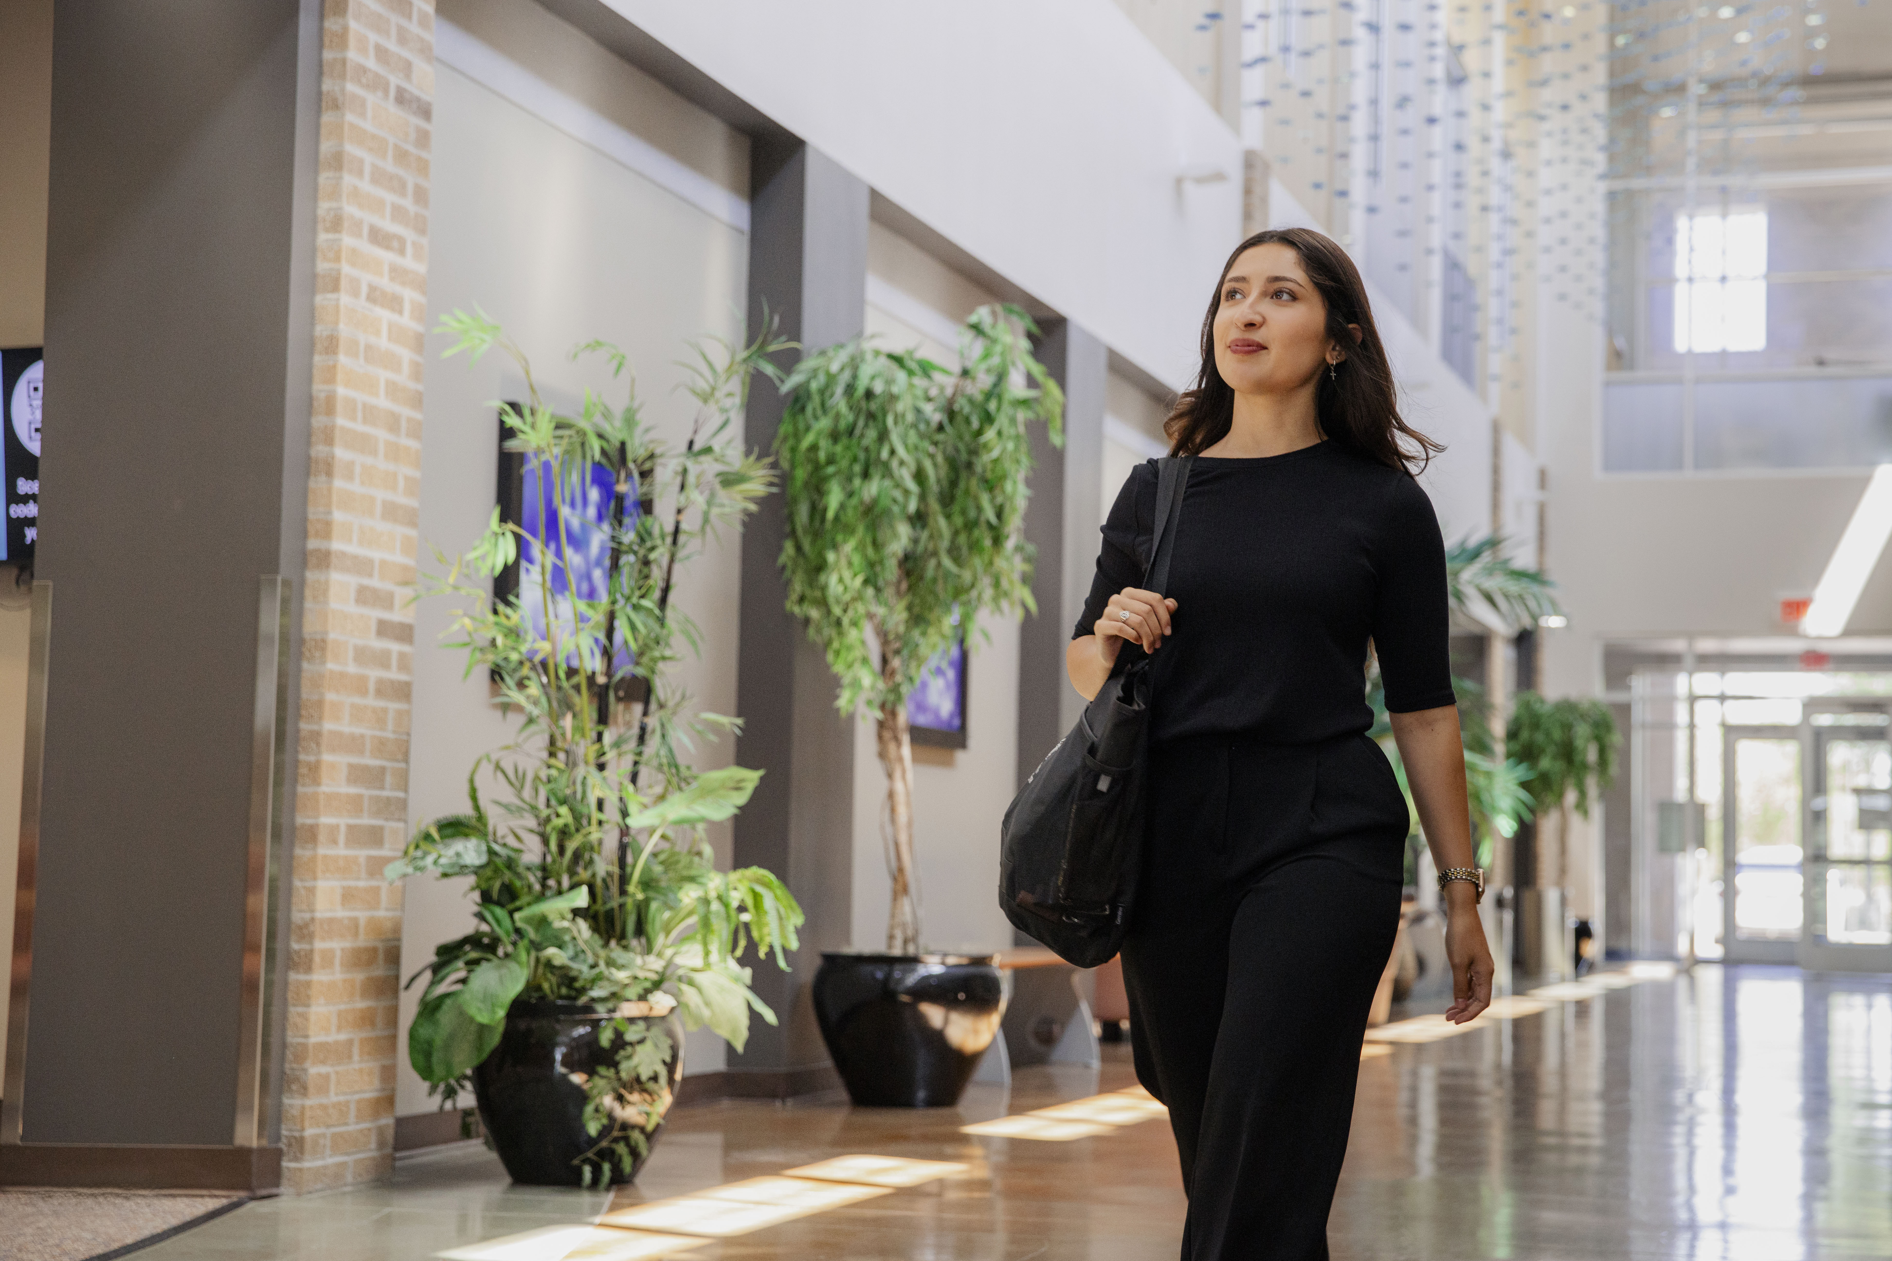
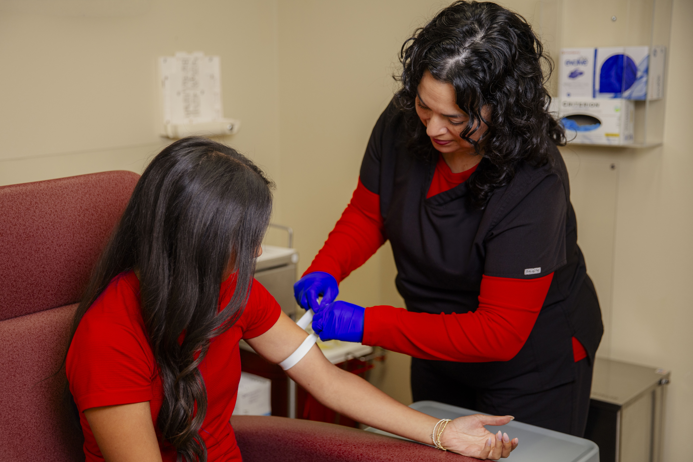
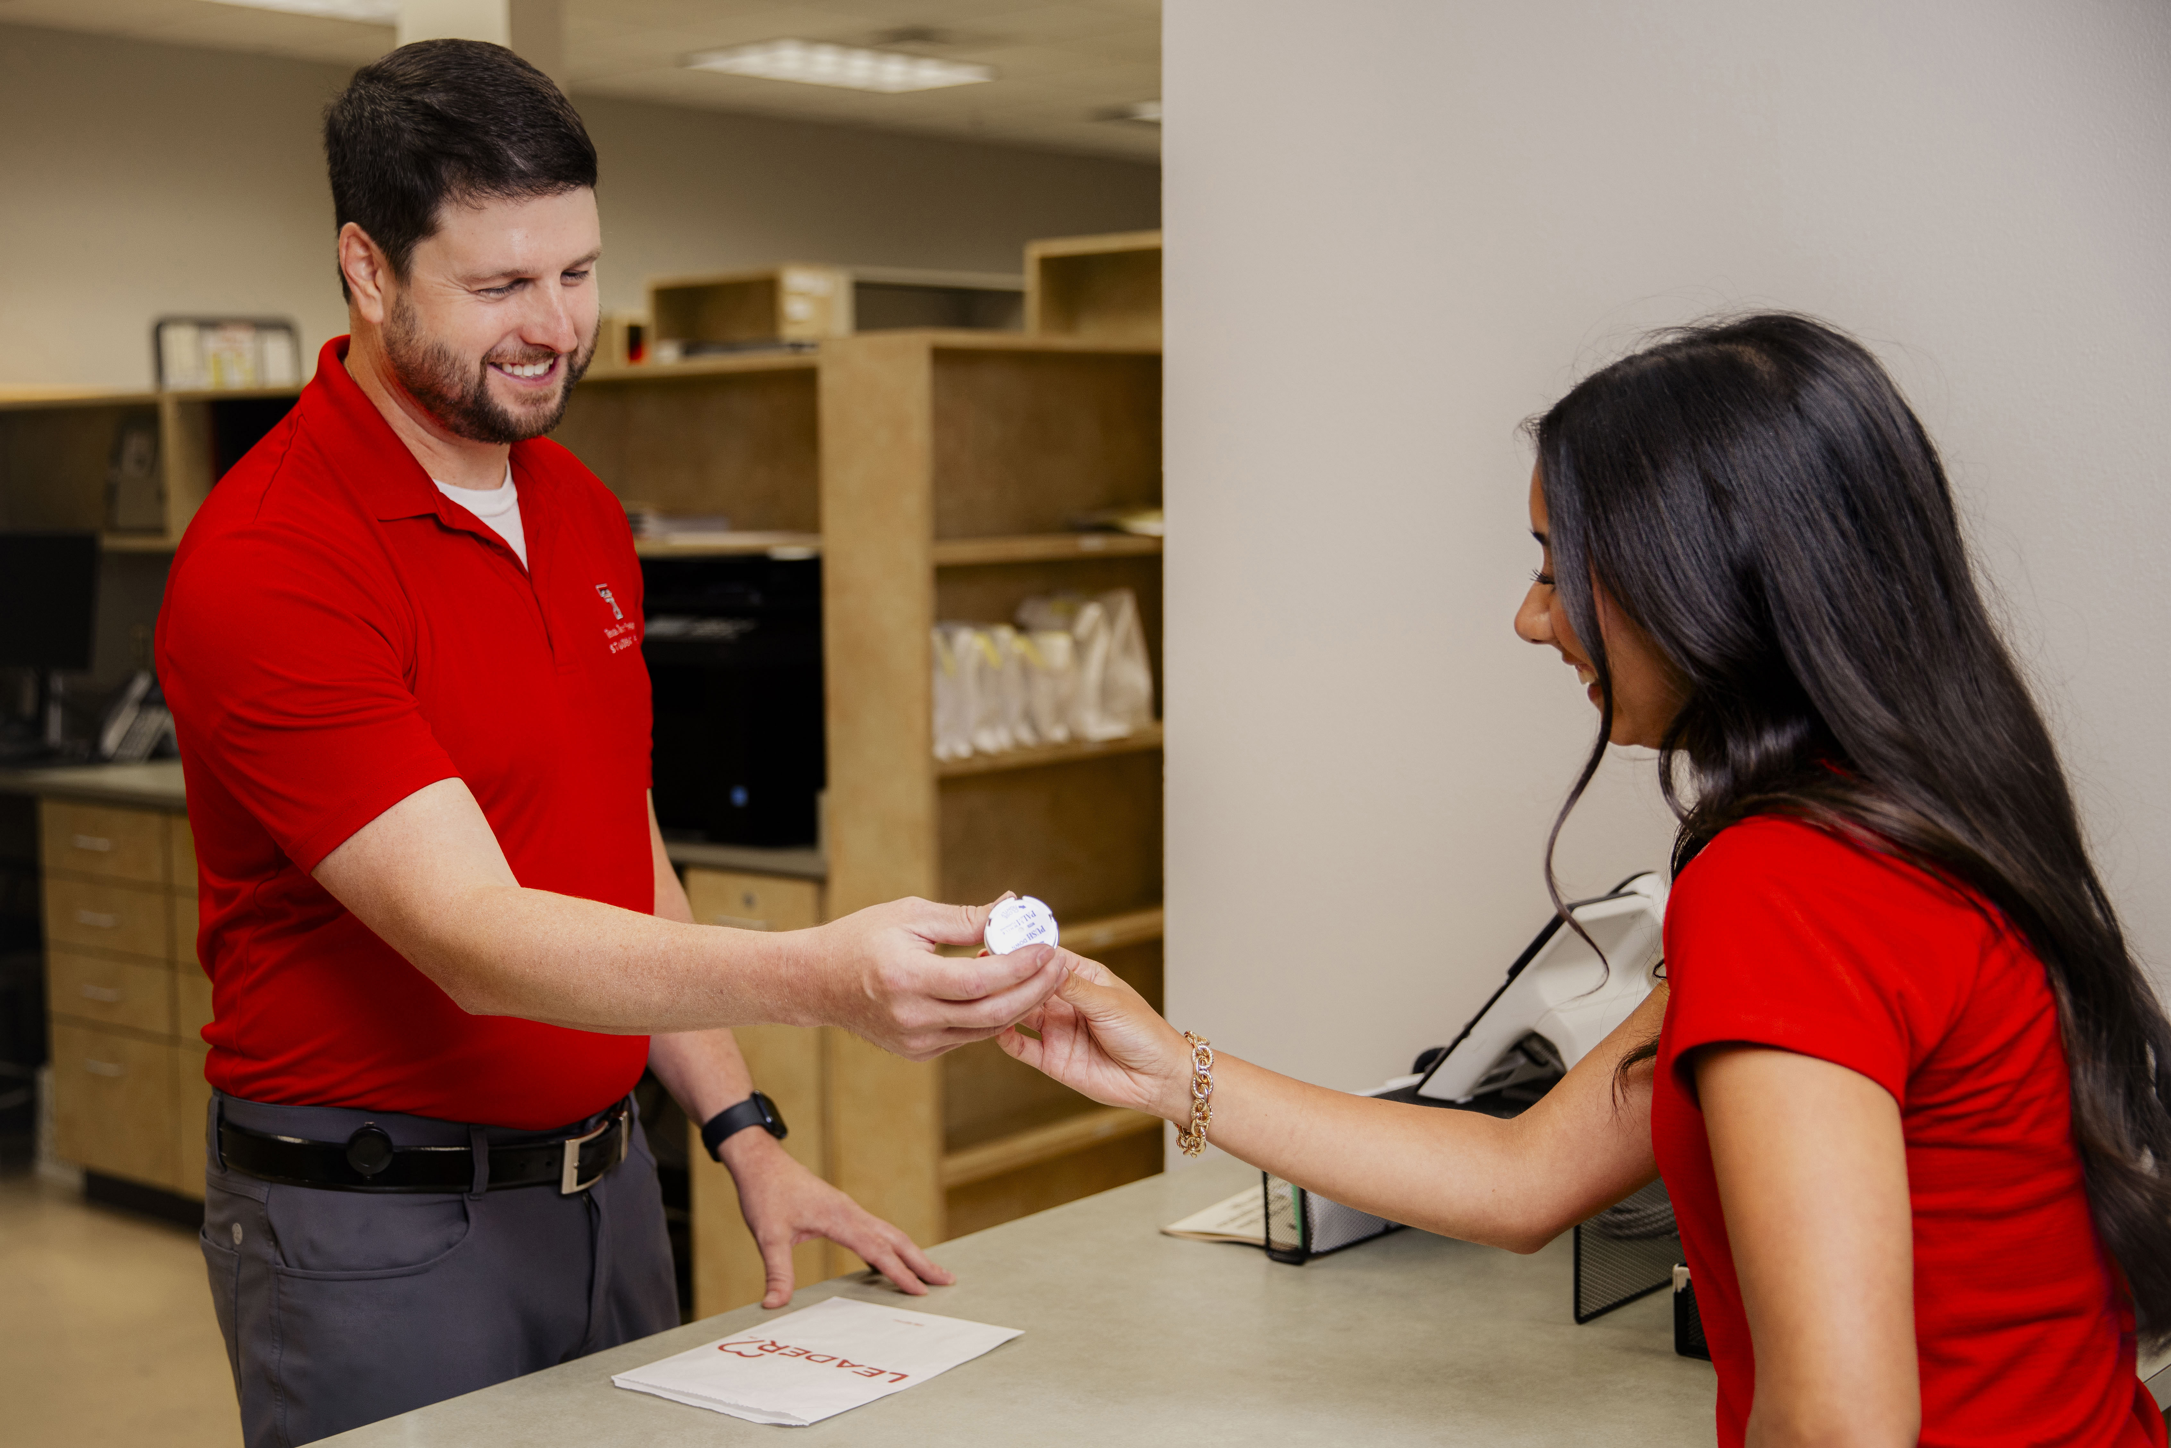
Student Health & Wellness Fee
Includes exclusive access to our building facilities such as:
Pharmacy
Laboratory & Xray
Urgent Care
Primary Care
& More

Slide 4
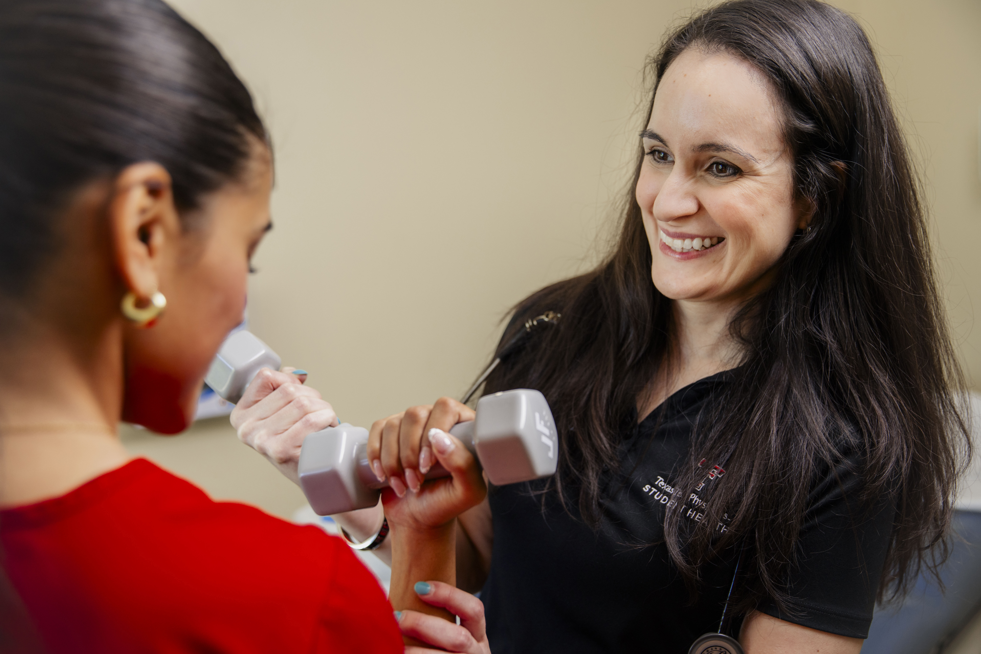
Convenient Specialty Care
Women’s Health
  Gynecology Specialized Care
Behavioral Health
  Licensed Professional Counselors
Sports Medicine
Psychiatry
Dermatology
ADHD Testing
Weight Management

Slide 5
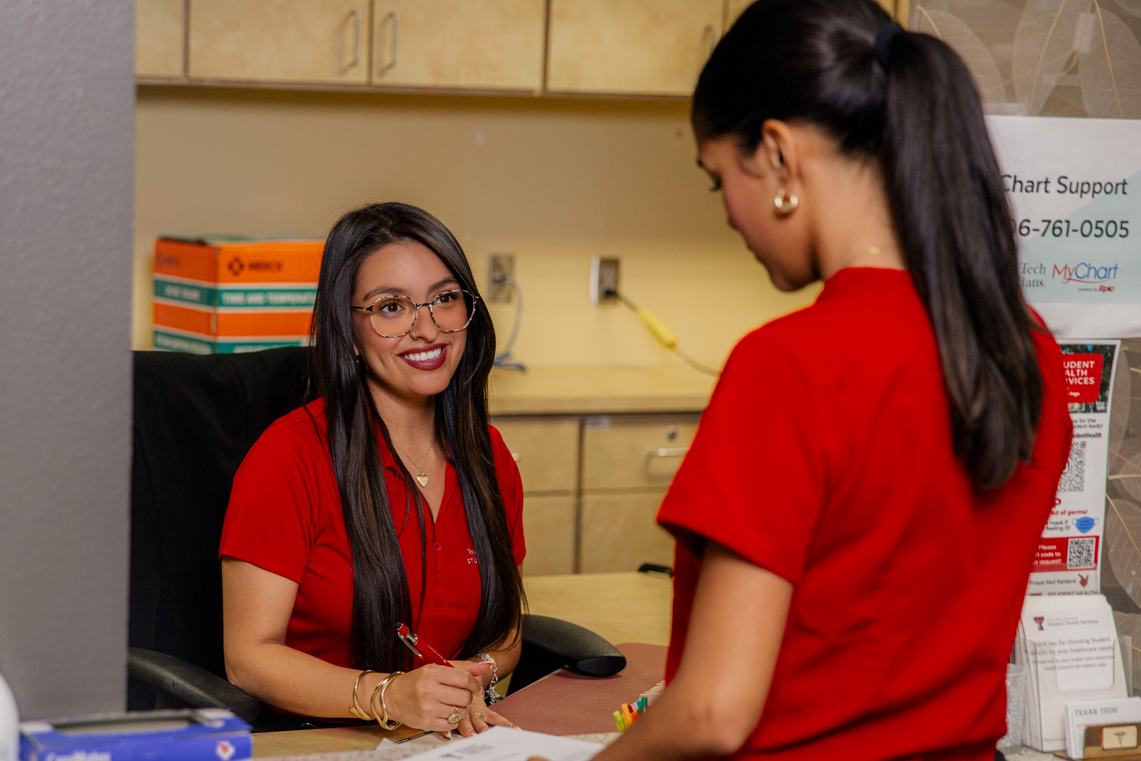
Billing
Self Pay: 40% prompt-pay discount & can bill to Student Business Services account
Insured: Collect co-pay or co-insurance
Academic Health Care Plan: Purchase Blue Cross Blue Shield (BCBS) plan through Academic Health Care
  All in-house services are covered at 100%

Slide 6

Scheduling is now just a click away…….
Manage Appointments - Schedule, reschedule or cancel appointments; View past and upcoming appointments
Pay your bill-Review account balances and securely pay online
Request Prescription Refills - Review, refill and request your prescriptions
Find a Doctor - Many of our providers and specialists are available to schedule through MyChart or Find a Doctor
Access Medical History - Review test results, immunizations, visit summaries, and next steps

Slide 7
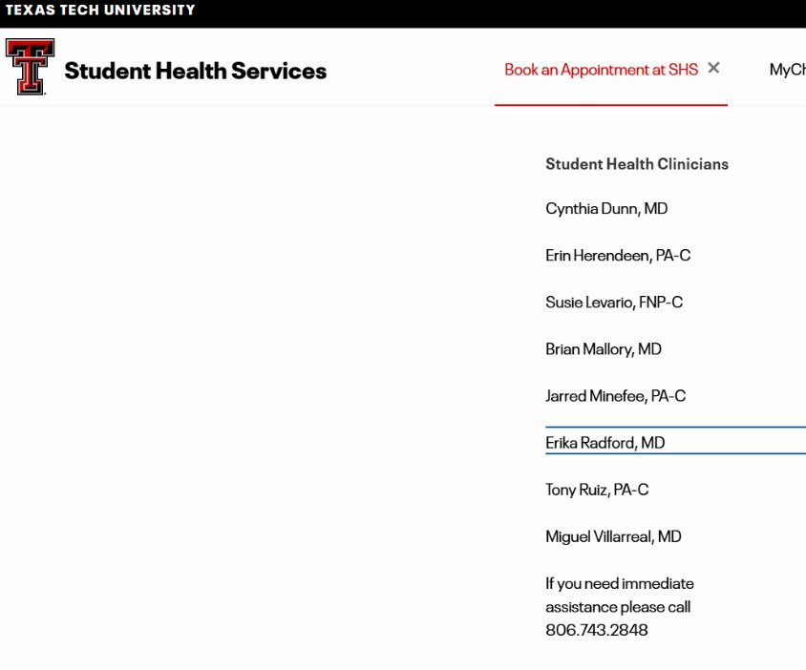
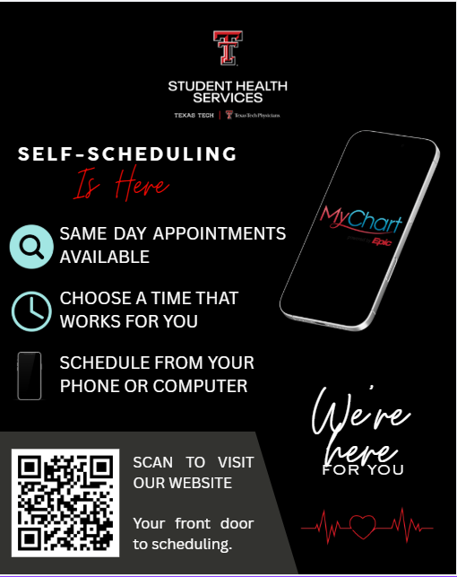
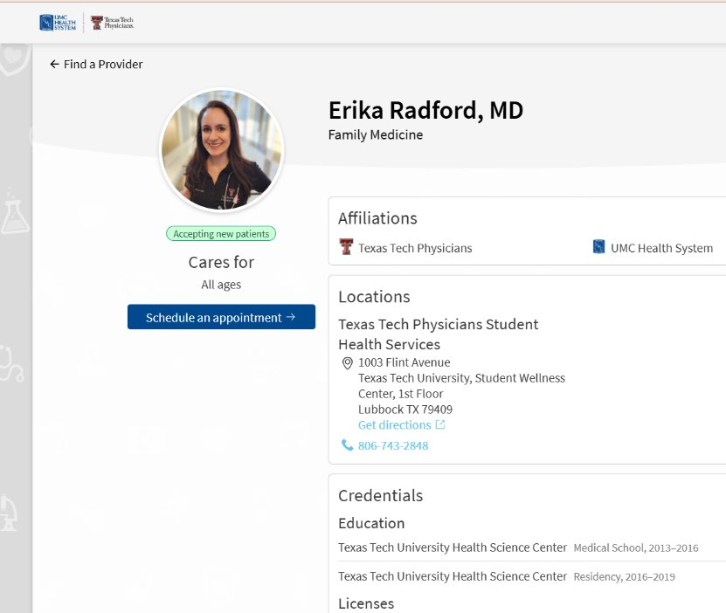
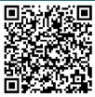
Self-Scheduling

Slide 8
Exercise Is Medicine (EIM): Fitwell
Texas Tech UREC Fitness and Wellness Program collaborates with the Exercise Is Medicine on- campus program to promote physical actively as a vital sign of health.
Program Promotes:
    Making movement a part of the daily campus culture.
    Assessing physical activity at every Student Health clinic visit.
    Providing students with the tools necessary to strengthen healthy physical activity habits that can last a lifetime.
    Connecting university healthcare providers with university health fitness specialists to provide a referral system for exercise prescriptions.
    The EIM program includes One FREE Initial Fitness Consultation & TWO FREE Personal Training Sessions. Referral is required.

Slide 9

Volunteer Opportunities
Volunteer Experience:
Strengthen Communication & Customer Service Skills
Gain Exposure to a Clinical Environment
Build Professional Experience
Participate in Outreach Opportunities
Build Connections for Letters of Recommendation

Slide 10
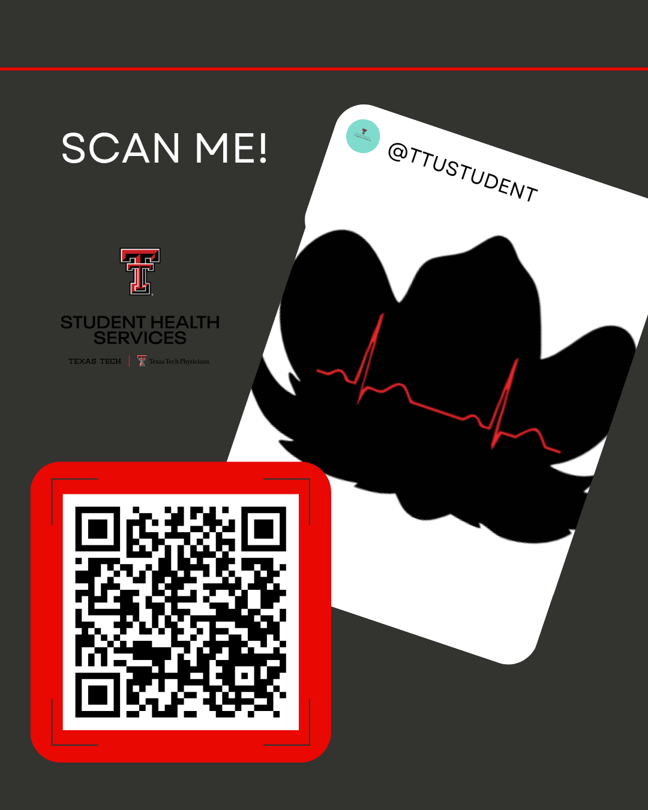
Follow us on Instagram
Handle: @TTUSTUDENTHEALTH

Slide 11
We care for the Red Raiders!
#1 Student Health Provider!

Slide 12
Questions?
Use the Zoom Q&A feature

Slide 13
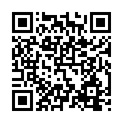

Closing
Up Next:
TSI and Spring Registration – October 19
What is University Coaching? – October 28
Raider Ready Courses: Supporting Student Success from Day One until Graduation – November 13
Parent and Family Relations
parent@ttu.edu
Student Health Services
studenthealthservices@ttuhsc.edu

