Slide 1


What to Expect at
Christine Self | Parent & Family Relations
Anne Zachary | Texas Tech Parents Association
Important Reminders
Please type all questions in the Q&A Chat.
The presentation will be recorded if you are unable to stay for the entire meeting.
This is a public forum; please do not share any personal information in accordance with HIPAA & FERPA guidelines.

Slide 2
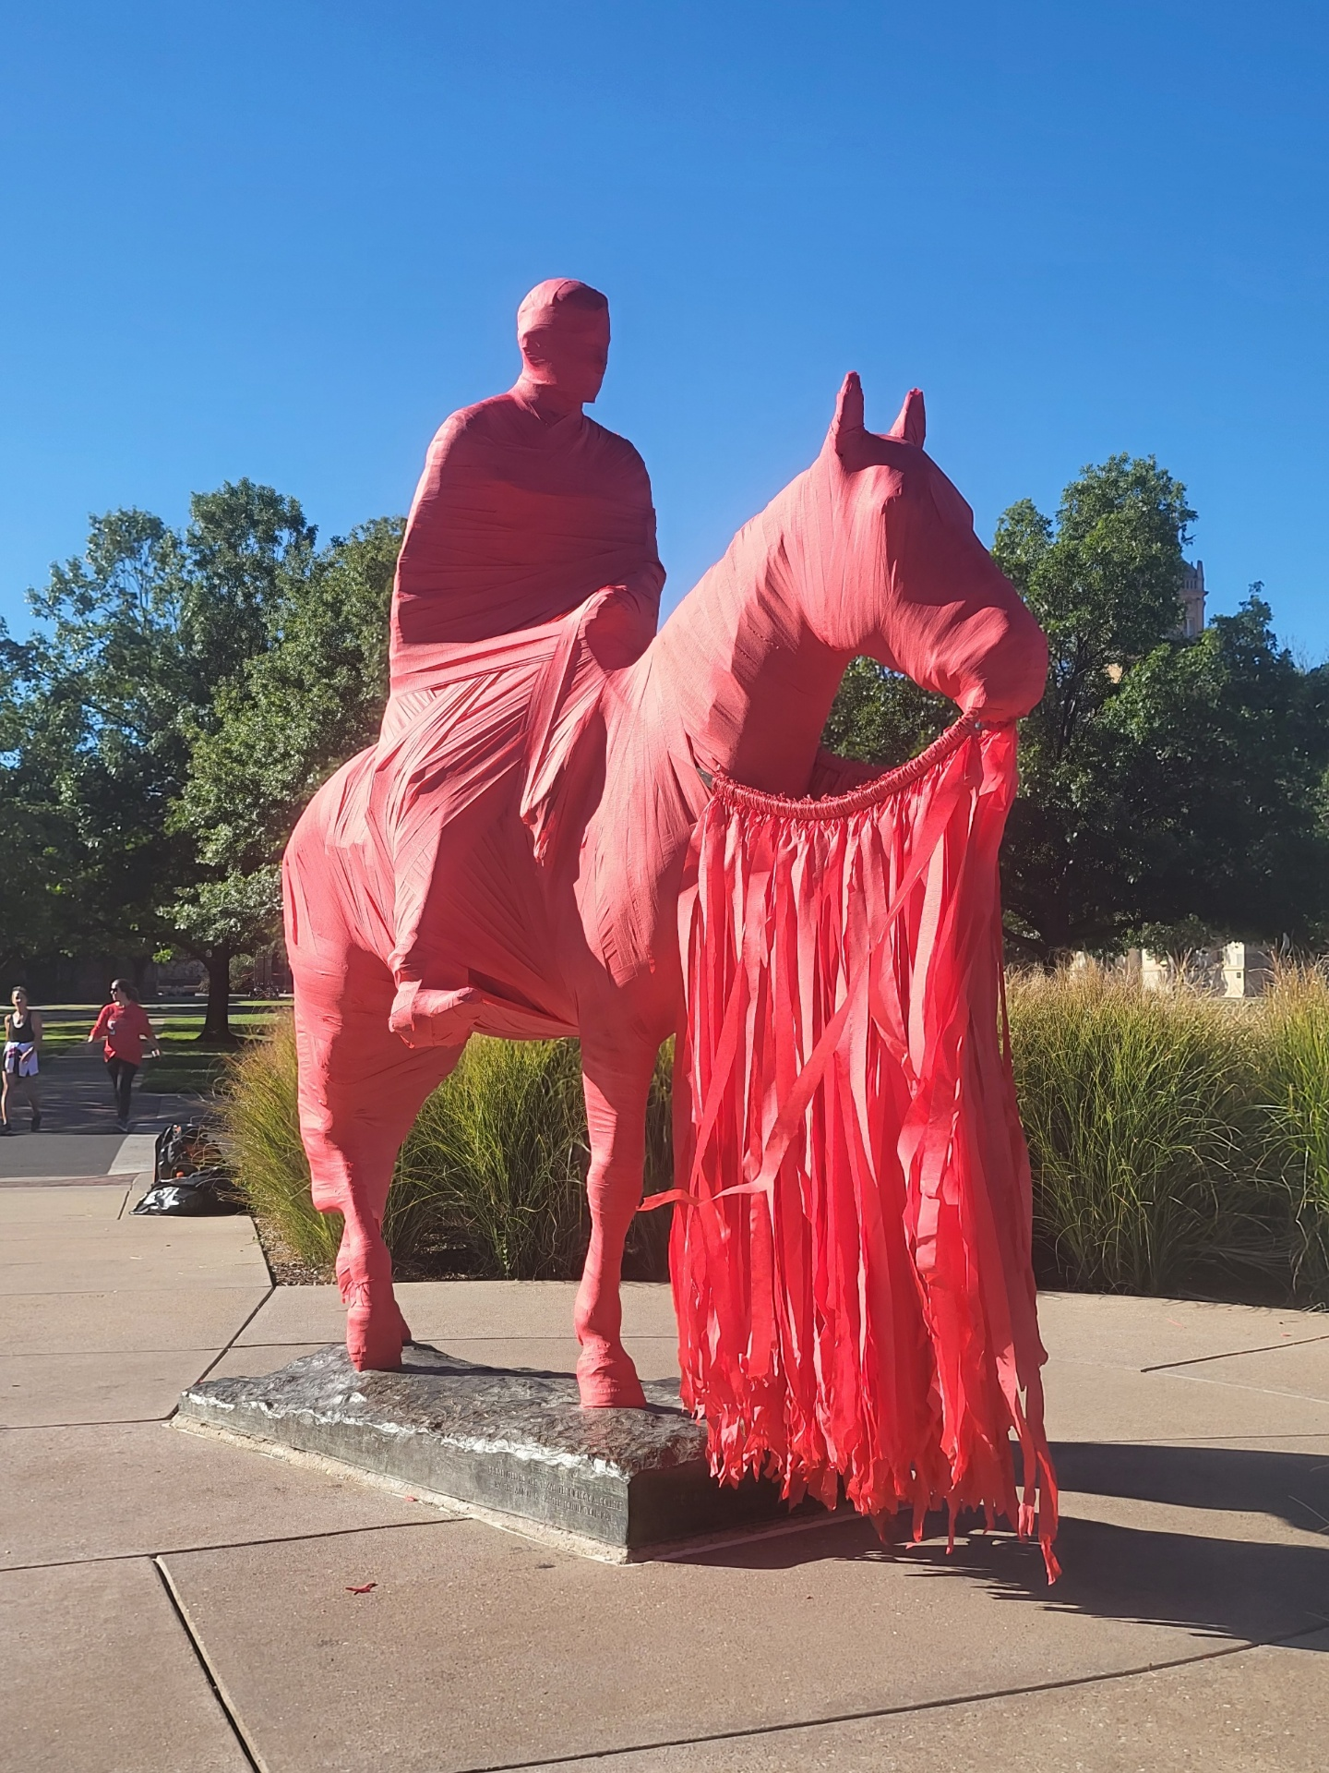

What we’ll talk about
What we’ll talk about:
Schedule of Events
Texas Tech Parents Association Dinner, Housing Fair, and Tailgate
Information and Check-in
Block Party and Brunch
Parking and getting to the Stadium
Football Tickets & Gameday Information
Q&A

Slide 3
Family Weekend Schedule:
Some Tips
“Choose your own adventure!”
Many free activities to choose from
Most activities are come and go
If your student’s college is hosting an event, be sure to stop by!
See the complete schedule at go.ttu.edu/familyweekend

Slide 4
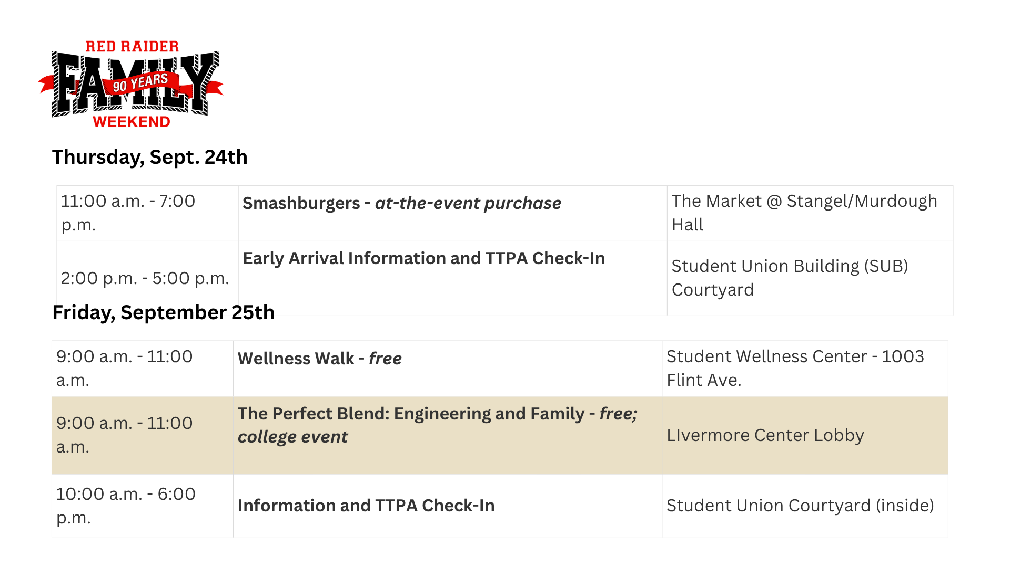
Thursday and Friday morning schedule

Slide 5
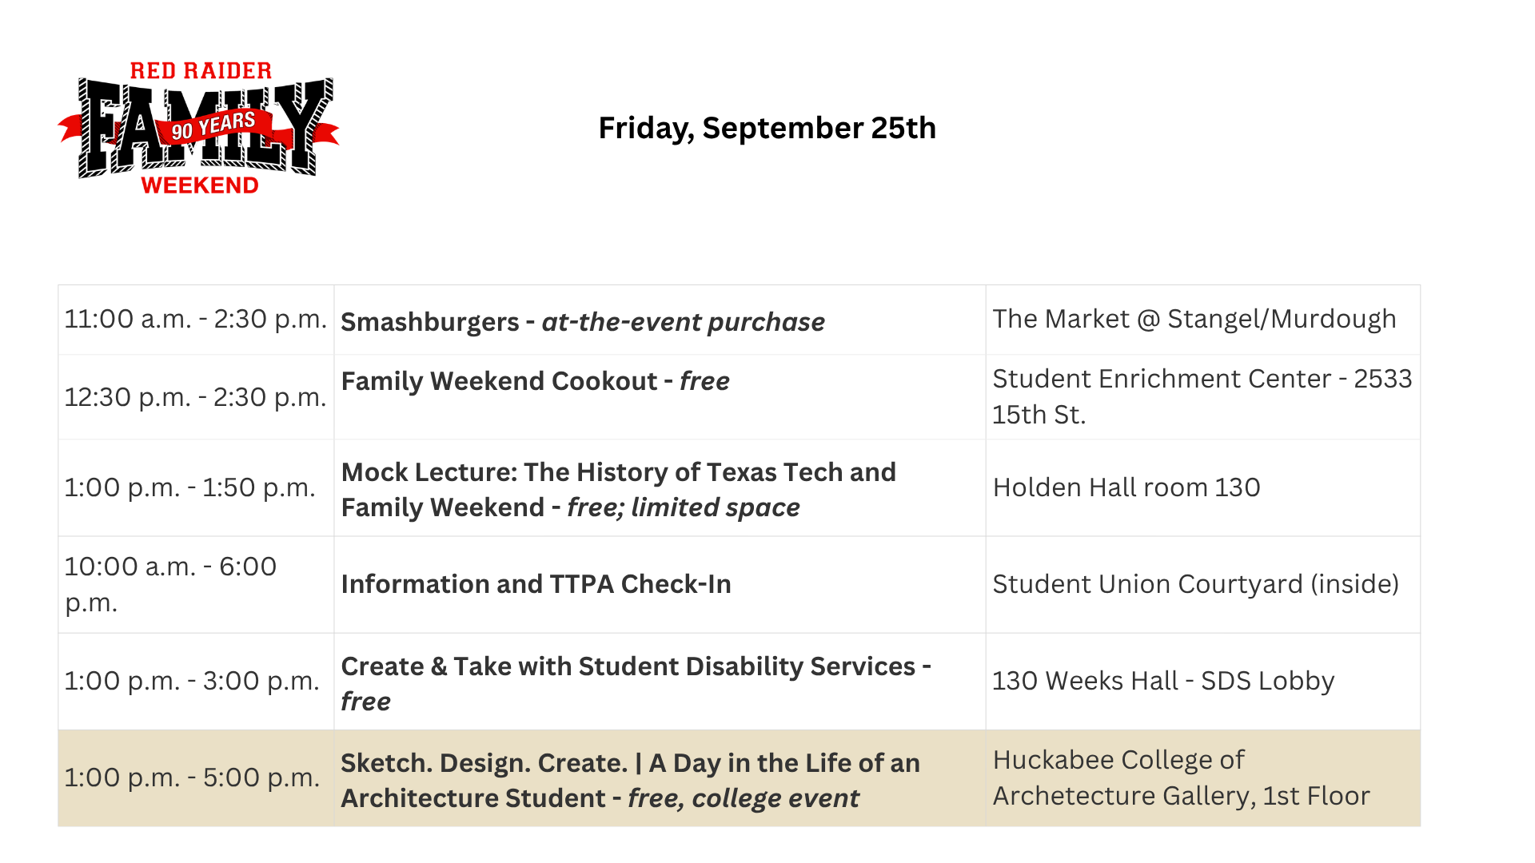
Friday afternoon schedule

Slide 6
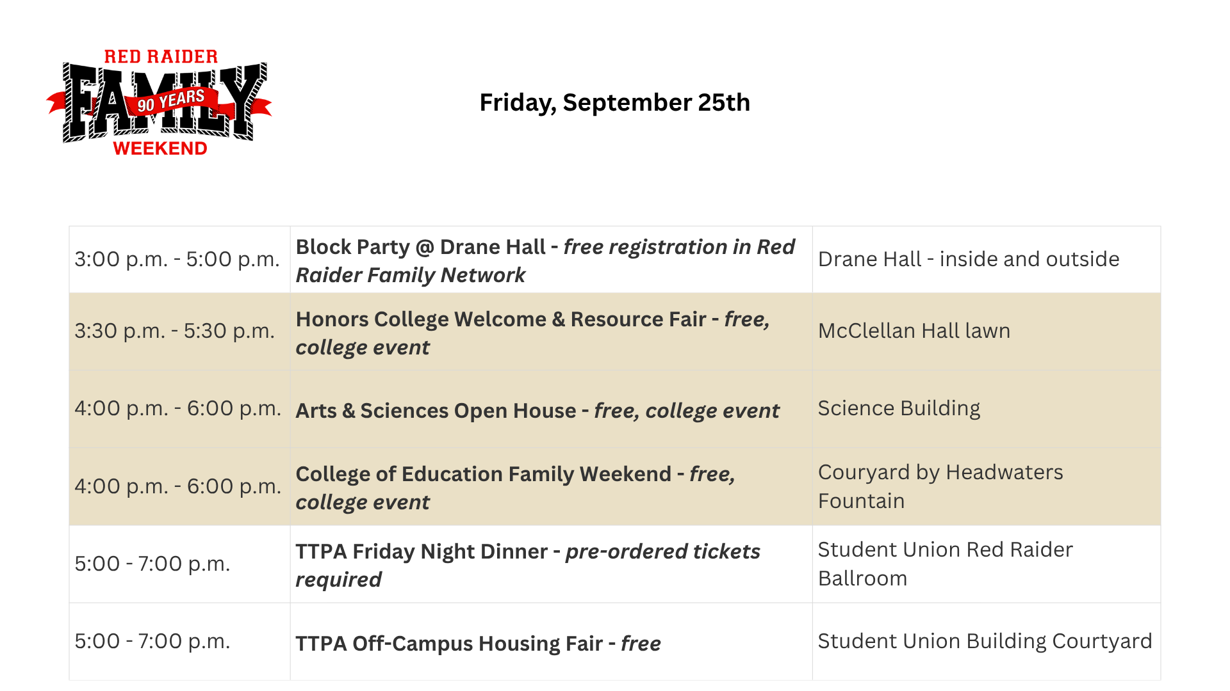
Friday afternoon and evening schedule

Slide 7
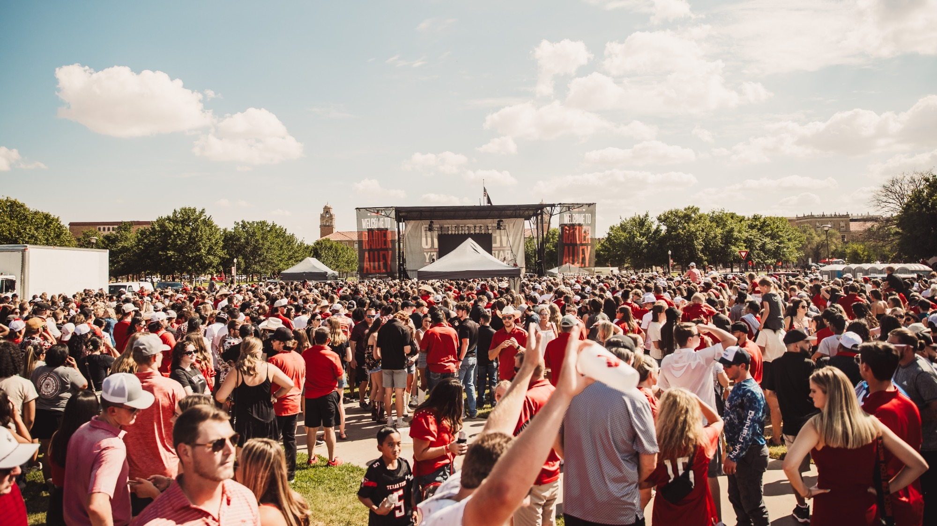
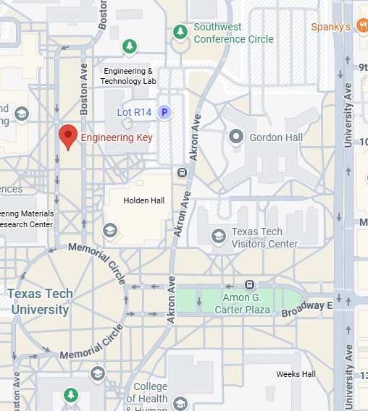
TAILGAITING
RAIDER ALLEY – Engineering Key
Opens 4 hours before kickoff
Concert 2 hours before kickoff
Free admission – food and beverages for sale

Slide 8
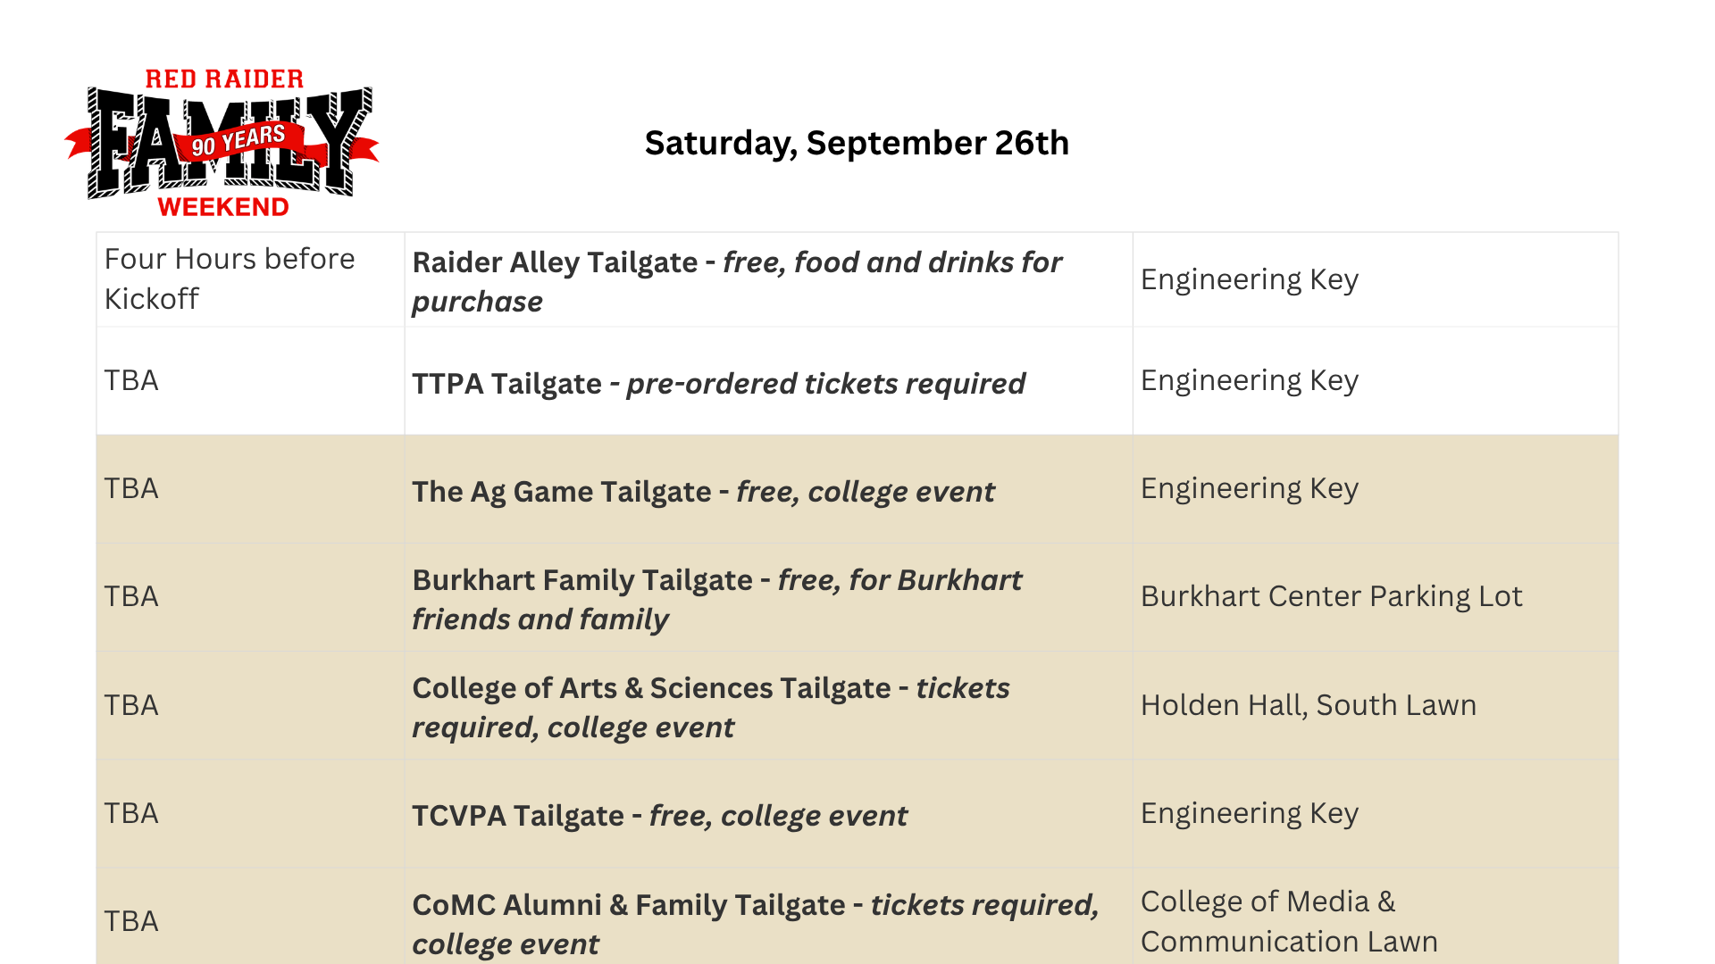
Saturday tailgate schedule

Slide 9
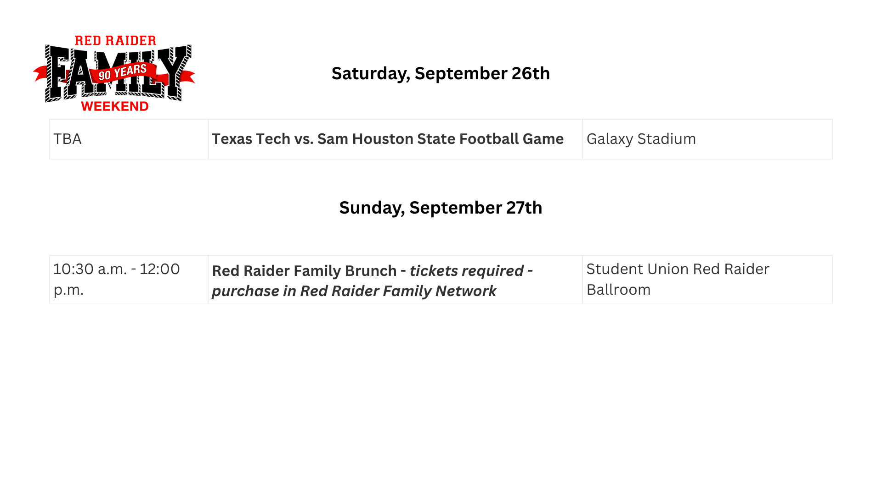
Saturday football game and Sunday morning schedule

Slide 10


TEXAS TECH PARENTS ASSOCIATION
Check-in:
  Student Union Building
    Thursday, September 24th 2pm-5pm
    Friday, September 25th 10am-6pm
Pick up Schedules, Maps, and Tickets purchased through TTPA - Dinner, Tailgate, Parking Pass, T-Shirts and More.
We recommend students pick up the tickets if family will not be in town before pickup time closes.
Friday, September 25th:
  Family Dinner
    5:00pm - 7:00pm
    Ticket Required for all attendees
    Fajita Buffet and Pick-A-Prize
  Student Activities Board Event
    5:30pm - 9pm
    Hosted by Student Activities Board - Fun and Free
  Housing Fair for Fall 2027
    5:30pm - 7:00pm
    Informative & Free
    In partnership with The Daily Toreador

Slide 11
TEXAS TECH PARENTS ASSOCIATION
Saturday, September 26th:
  TTPA Tailgate
    4 Hours Prior to Kickoff
    Meal Provided by Rudy’s BBQ
    Games and Prizes
    One Ticket Per Person over age 3
For more information about events happening during Family Weekend, view our website or scan this QR code.
SCAN HERE!

Slide 12

TTPA BENEFITS AND DISCOUNTS
Resources:
  Road Raider Safe Travel Network Webinars
  Parent Ambassador Program
  Parent Network in your Community/State
Discounts:
  Local Businesses - Barefoot, Red Raider Outfitter, Raiderly and Varsity Books
  Hotel Discounts Year-Round (Rates Vary Based on Events)
  Dell Computers
Ways to Connect:
  parents@ttpa.org
  806-412-4722
  Facebook: @TechParents
SCAN HERE TO JOIN TODAY!

Slide 13
What to Know for Information and TTPA Check-in
What to Know for Information and TTPA Check-in
When: Thursday, September 24th 2-5pm & Friday, September 25th 10am-6:00pm
Where: SUB, ATM Lobby (near the help desk outside the Allen Theater)
Who: Family member or your student may pick up purchased items
There will be maps for parking & tailgating locations and schedules of all the fun events happening on campus. Friendly faces from TTPA & PFR will be available to answer your questions.
Bring a digital or printed copy of the receipt of your purchased items. Lines will be organized in alphabetical order. Grab a spot in your appropriate line and pick up your dinner & tailgate tickets, tshirts, pick-a-prize tickets etc.

Slide 14
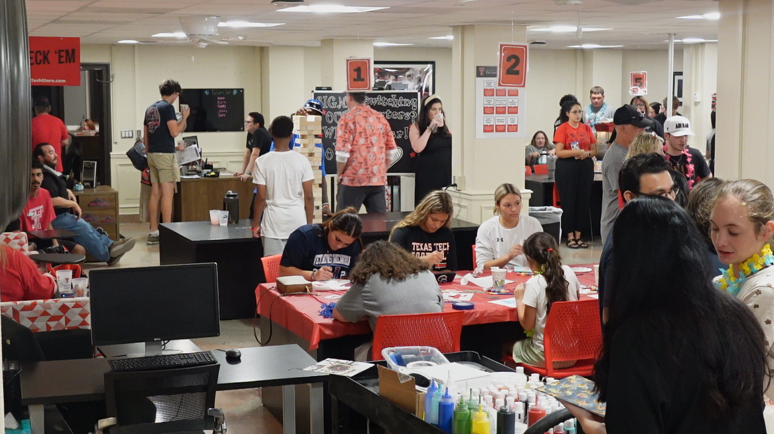
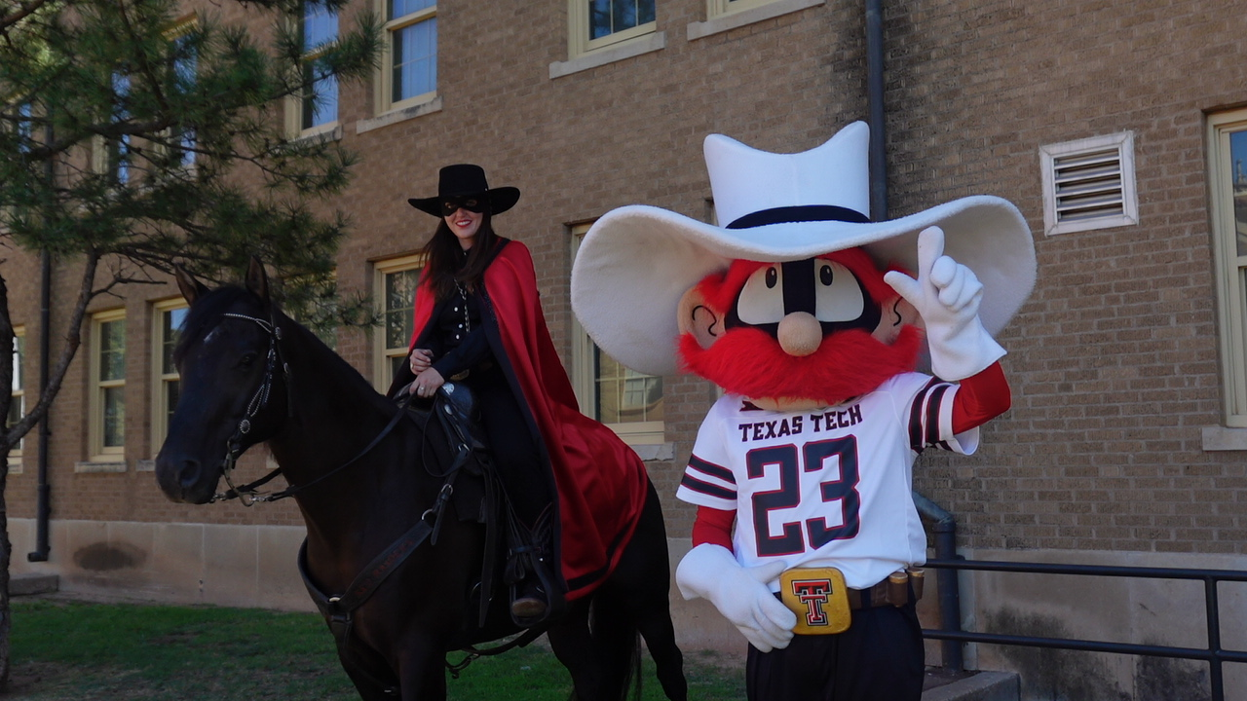
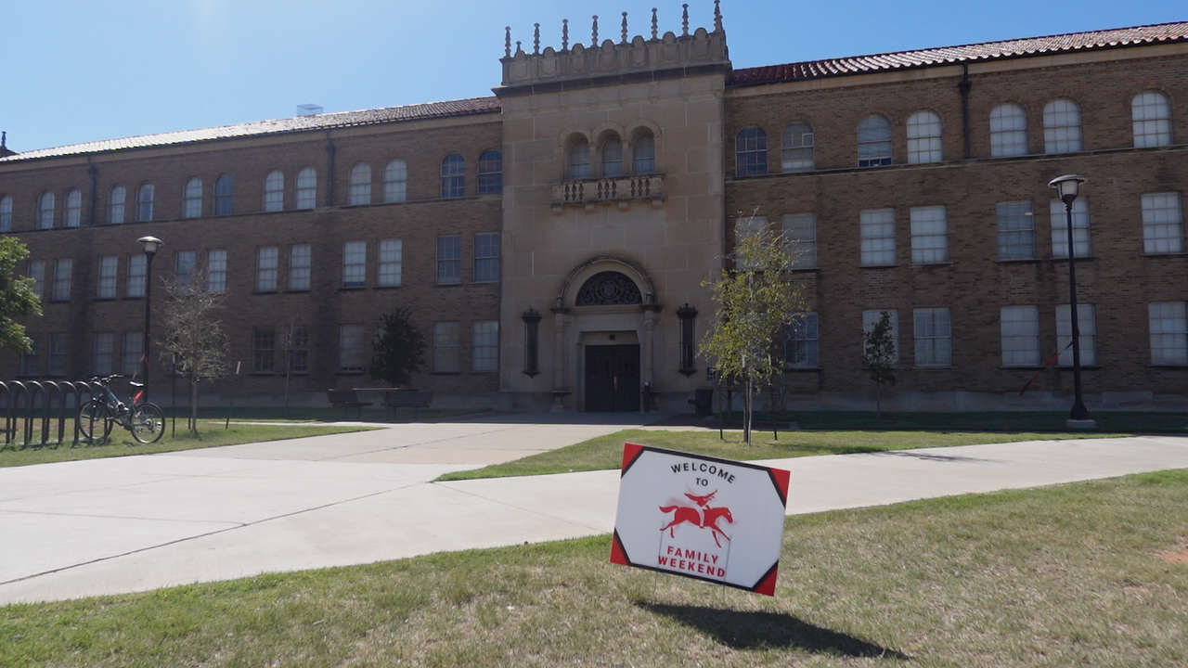
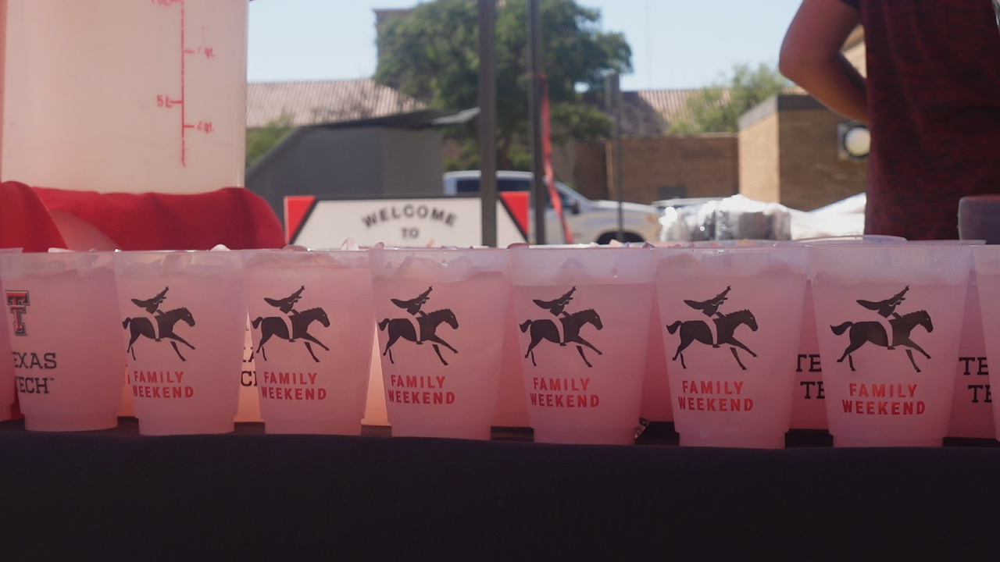
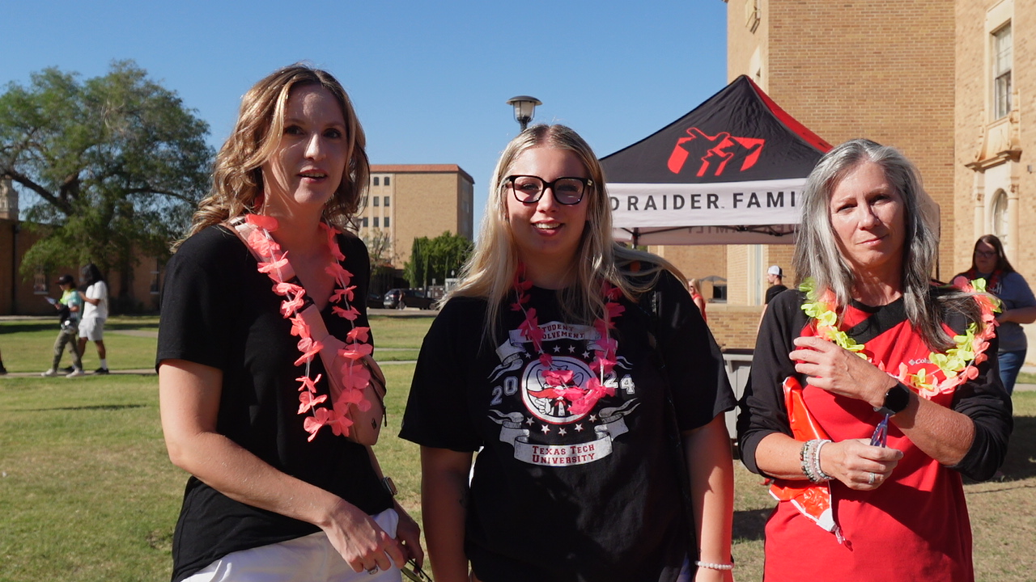
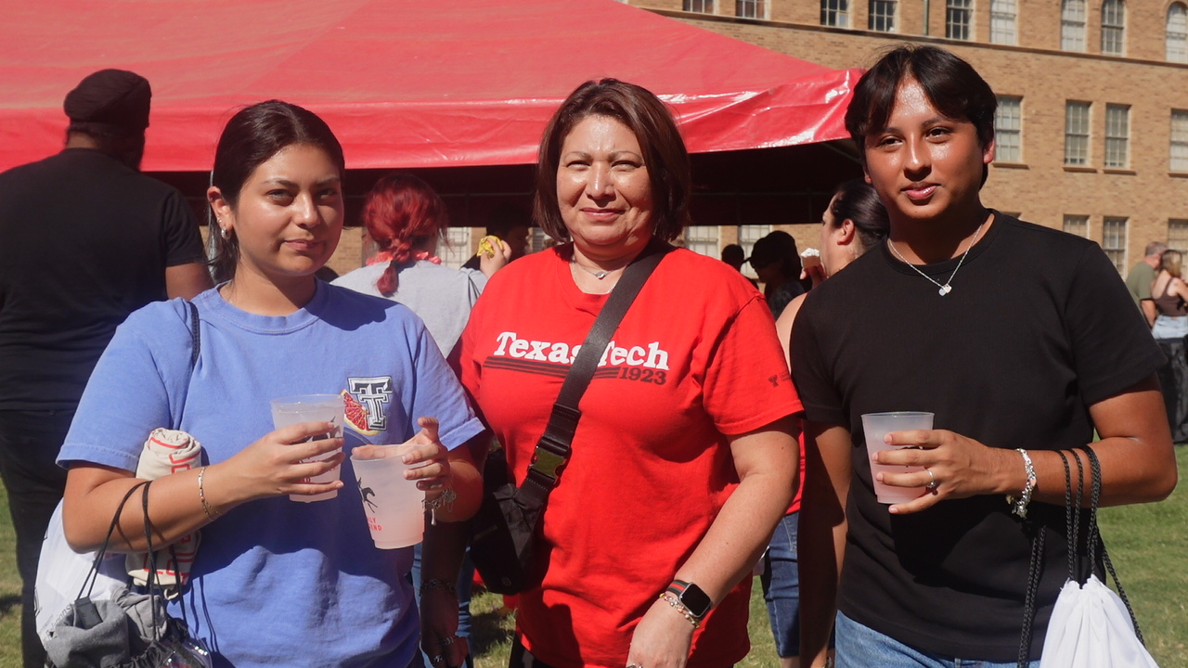
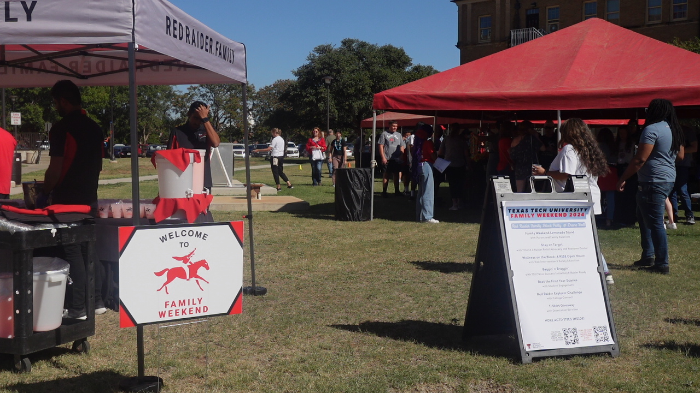
RED RAIDER FAMILY BLOCK PARTY @DRANE HALL
RED RAIDER FAMILY BLOCK PARTY @DRANE HALL

Slide 15


RED RAIDER FAMILY BLOCK PARTY @DRANE HALL continued
Red Raider Family Block Party @ Drane Hall
Event is from 3:00 p.m. - 5:00 p.m.
Activities include: Cornhole, Giant Jenga, Texas Tech Trivia, Mingling & Mocktails, Ring Toss, Family Games, Guess the Evidence, Prize Drop
Souvenir 90th Anniversary Family Weekend T-shirt for the first 100 attendees, Souvenir 90th Anniversary Lemonade cup for all attendees!
Register on the Red Raider Family Network

Slide 16
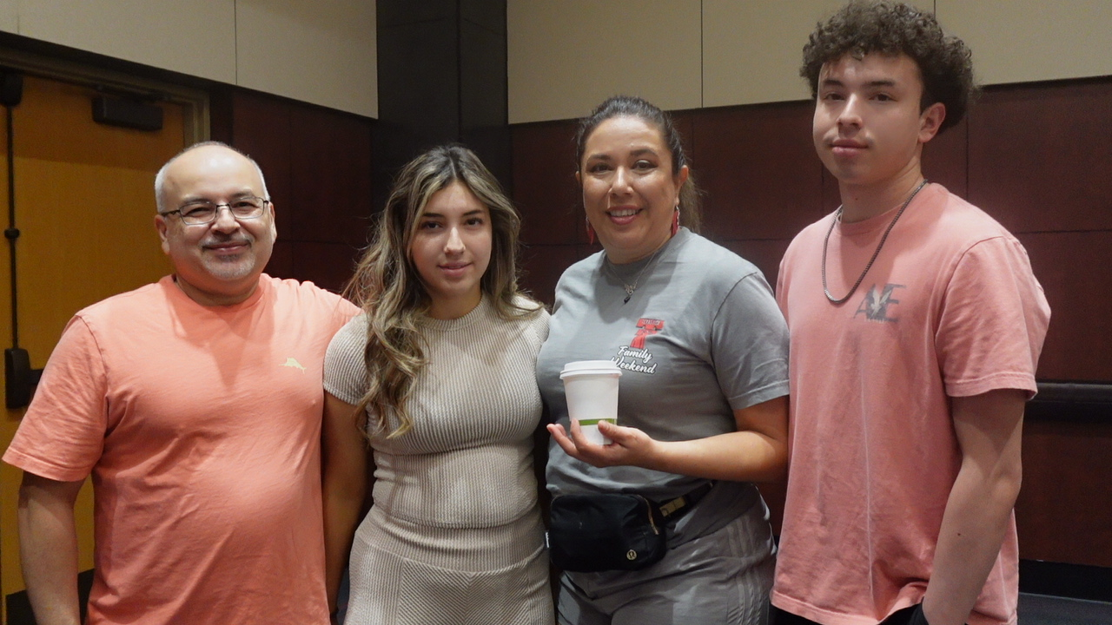
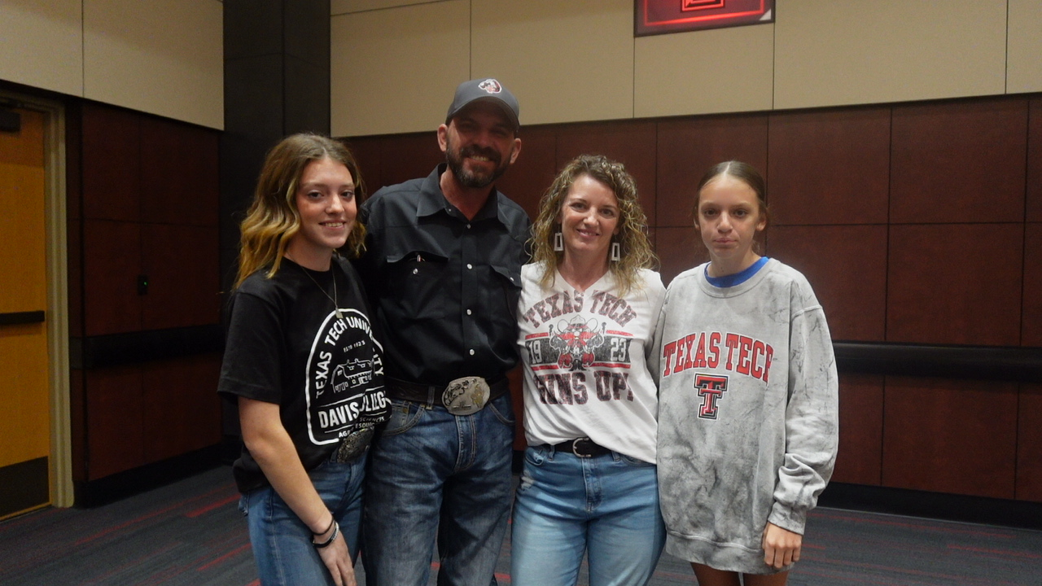
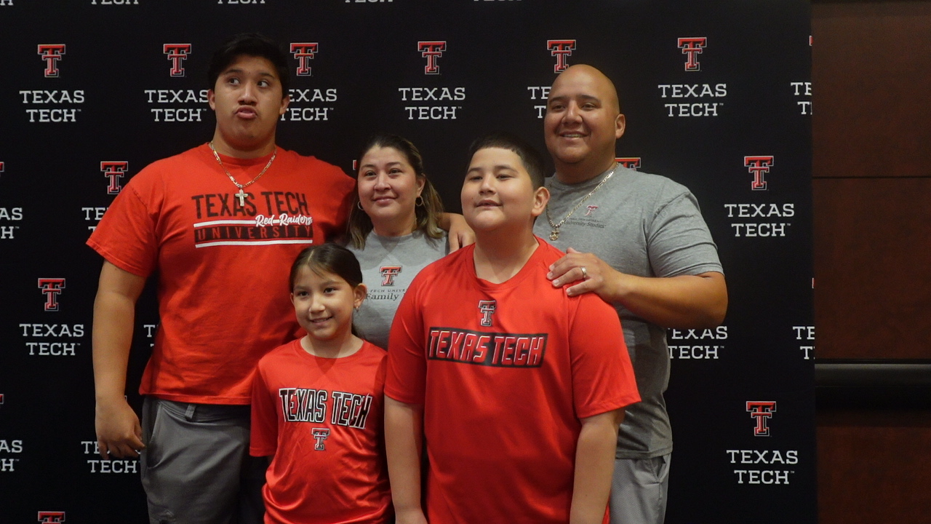
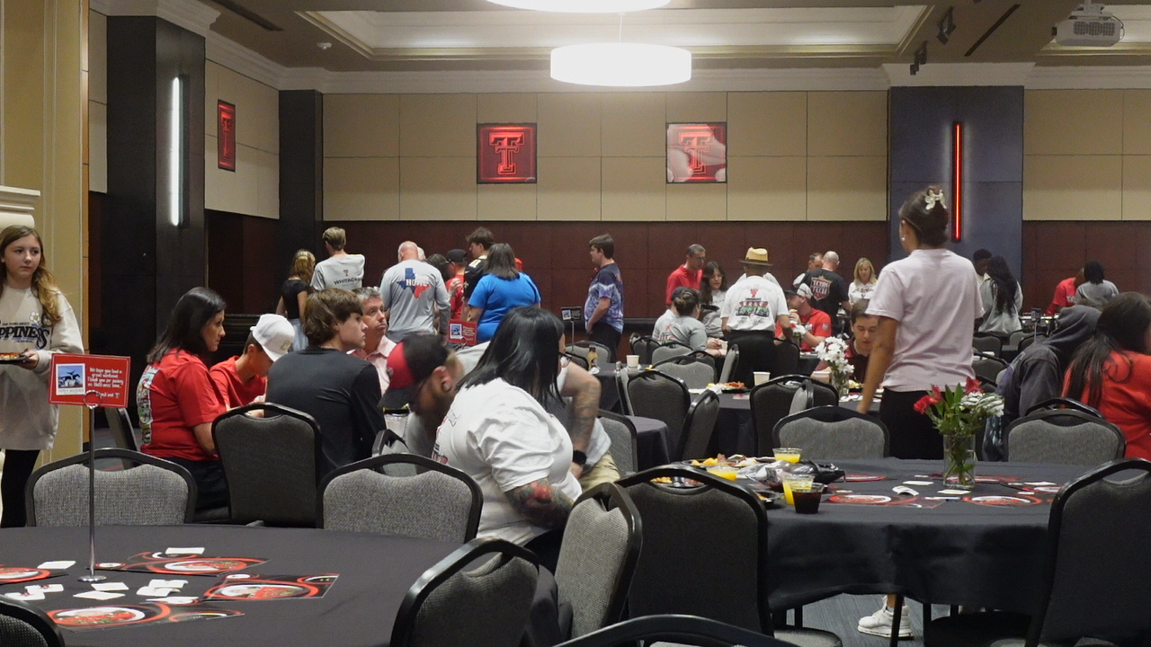
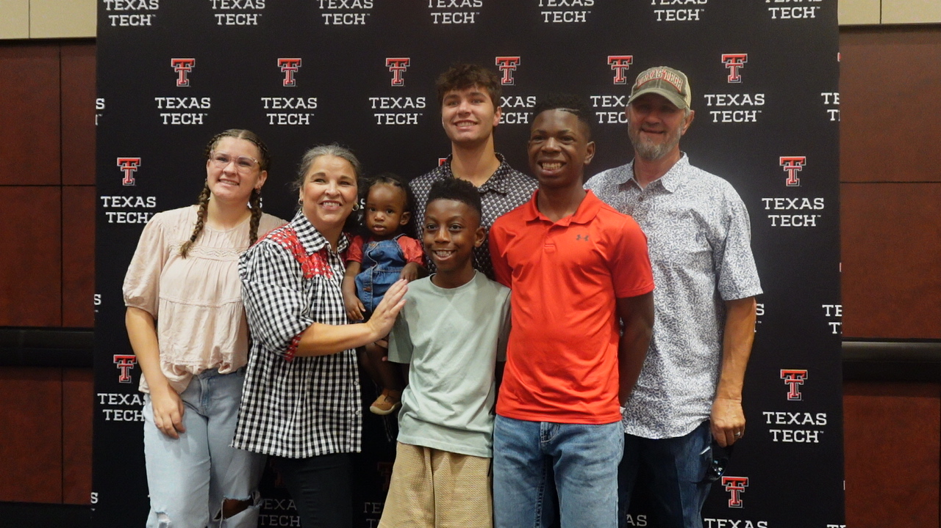
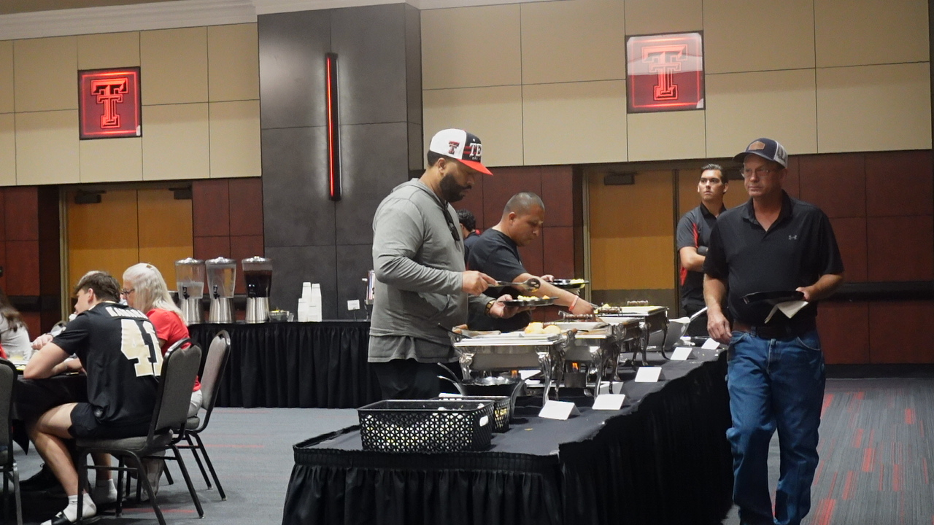
RED RAIDER FAMILY BRUNCH
SUNDAY
September 27th

Slide 17

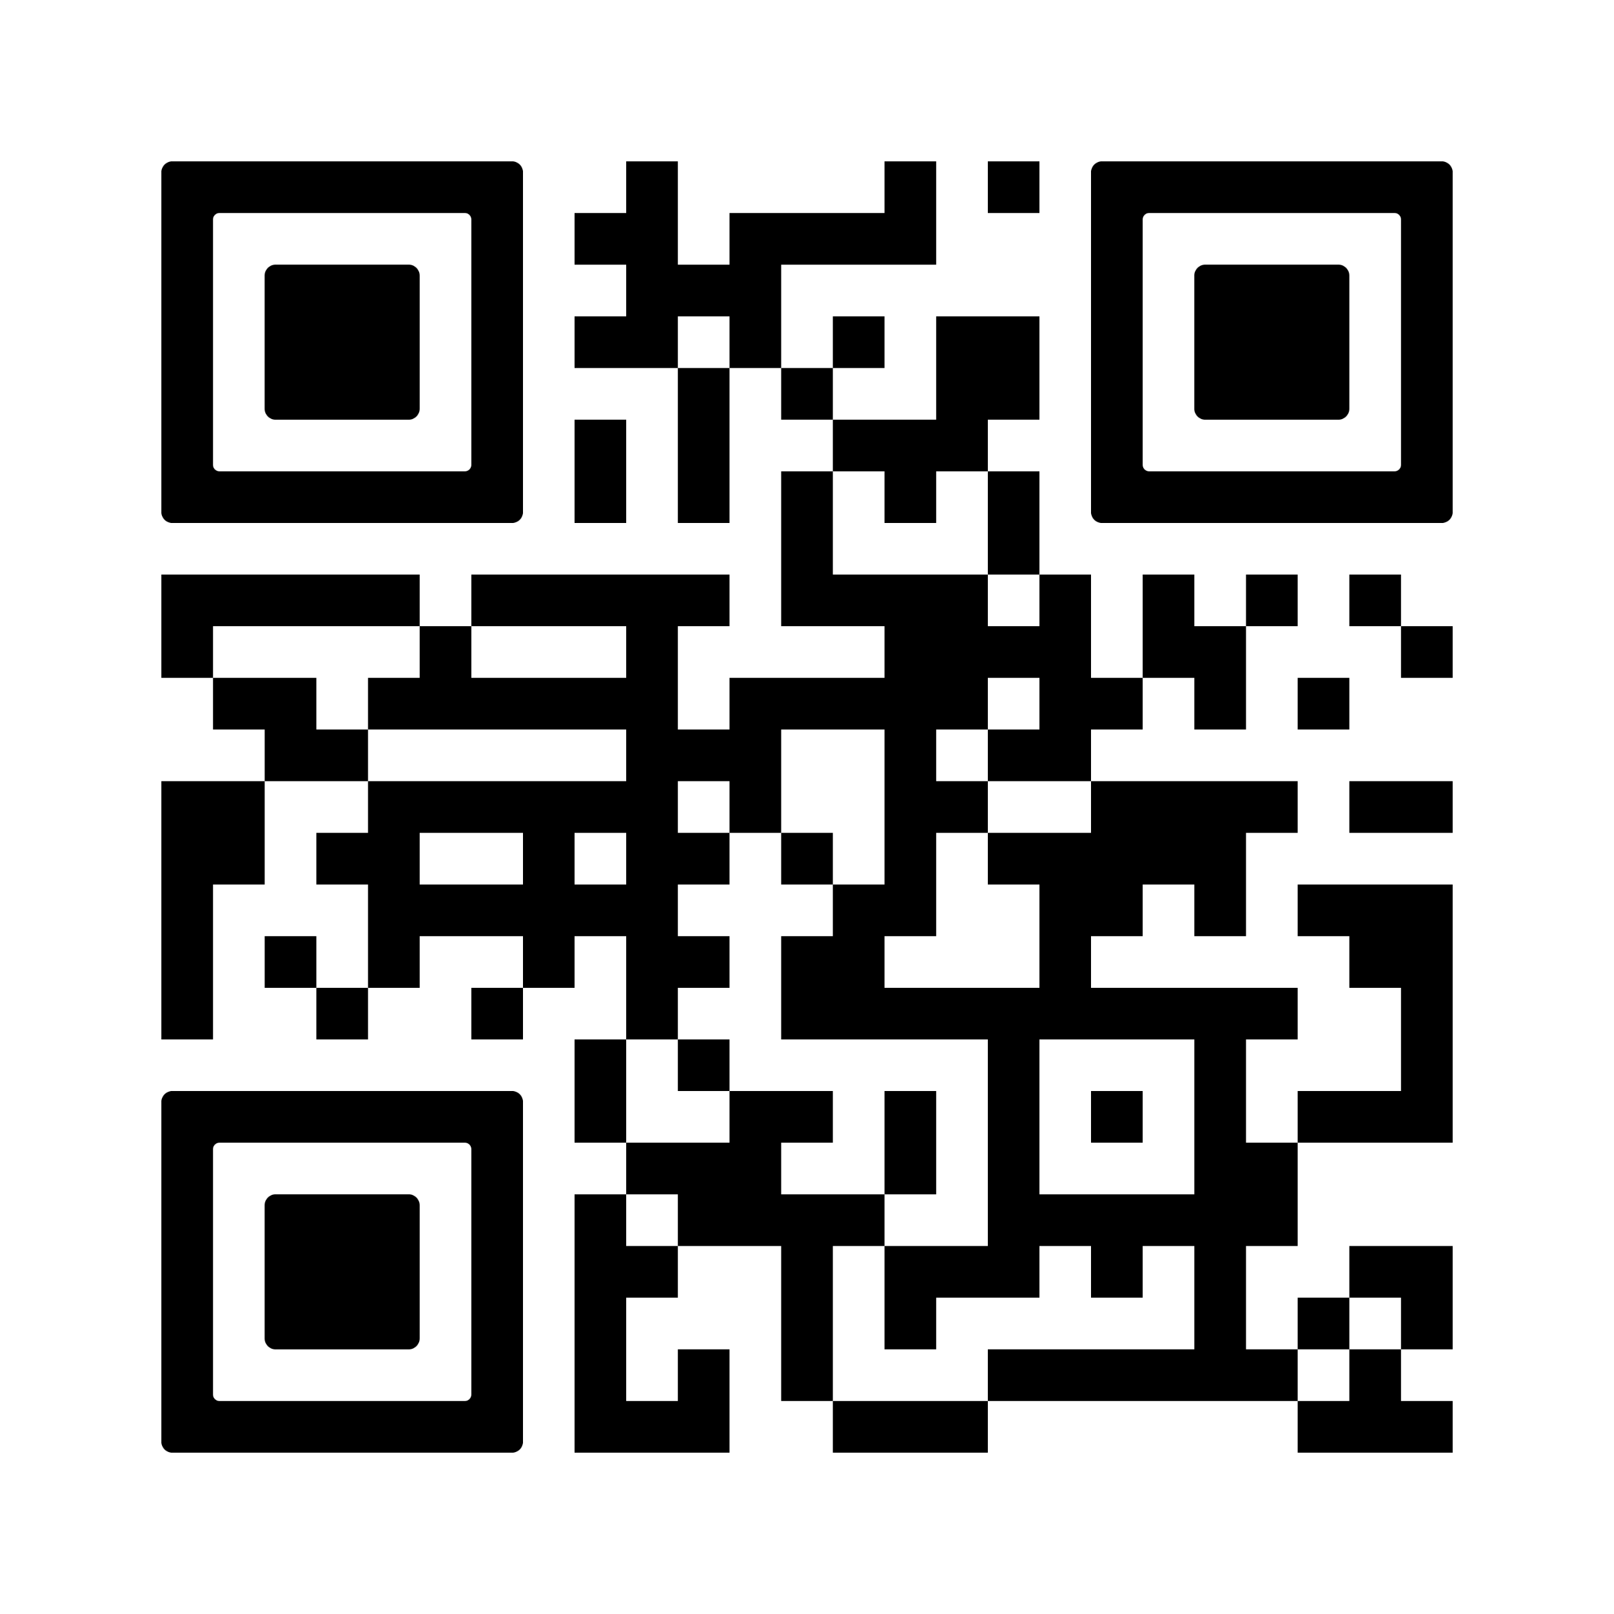

Red Raider Family Brunch continued
Red Raider Family Brunch
Event is from 10:30 a.m. - 12:00 p.m.
Limited Tickets Available
Purchase tickets on the Red Raider Family Network

Slide 18
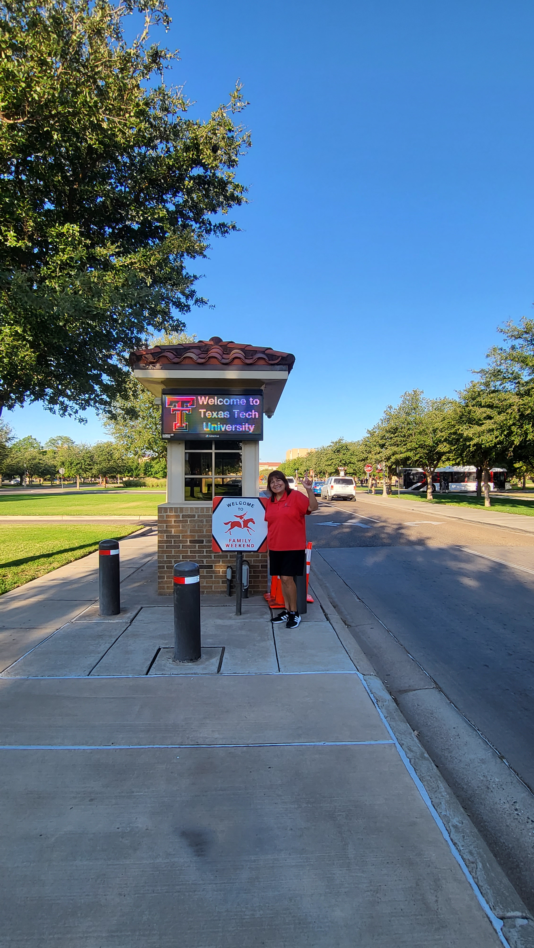
General Parking Tips for Family Weekend (other than football game):
General Parking Tips for Family Weekend (other than football game):
If your student has a car and lives on campus, have them pick you up and park in their residence hall lot
If taking Uber or Lyft, ask to be dropped off at the Texas Tech Library for Family Weekend Check-in, Block Party, other Friday evening events
Park and Pay:
  1. Push any button to activate the pay machine. Screen will light up.
  2. Enter your license plate number and push “OK”
  3. Add the amount of time that you will be parked for.
  4. Either hit “OK” to pay with a card or insert coins.
  5. If paying with card, insert card or use tap to pay.
  6. Don't forget to take your receipt.

Slide 19
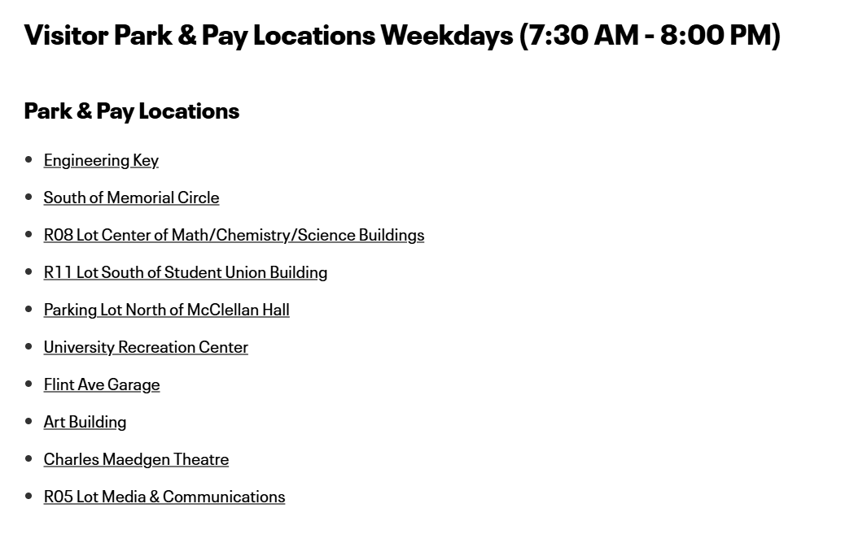

Visitor Park & Pay Locations

Slide 20
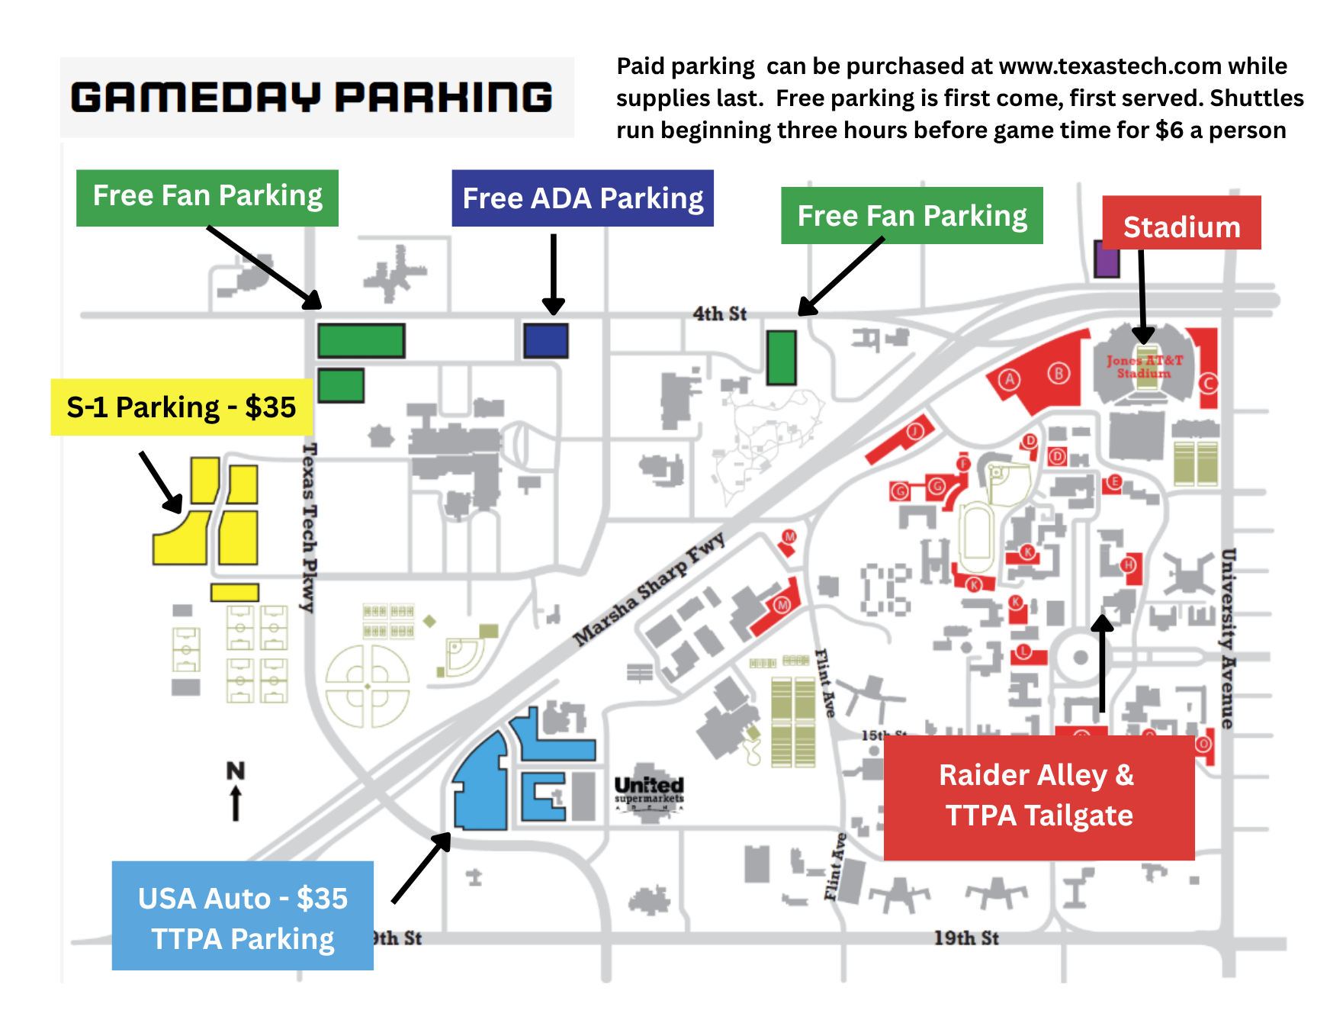

Parking information
Parking information

Slide 21
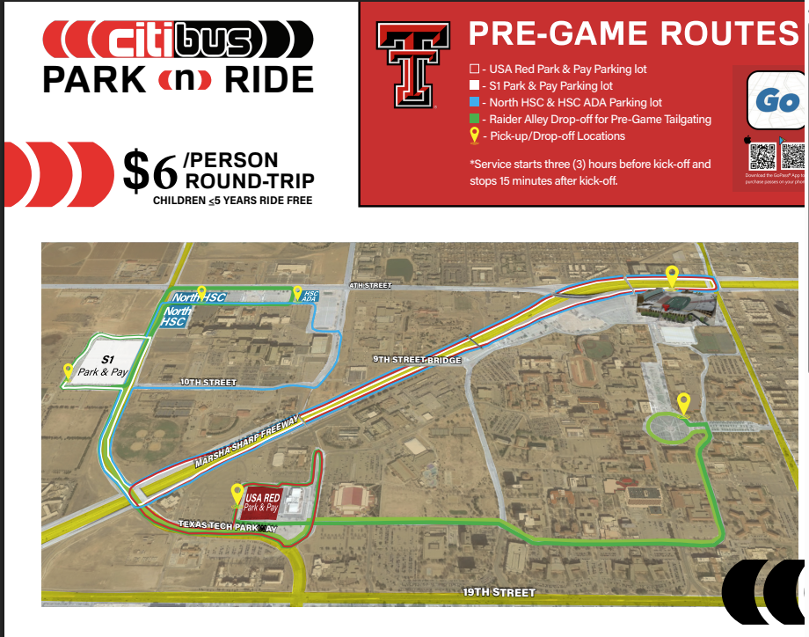

Game day shuttle information
Pre-game shuttles start three hours before kickoff

Slide 22
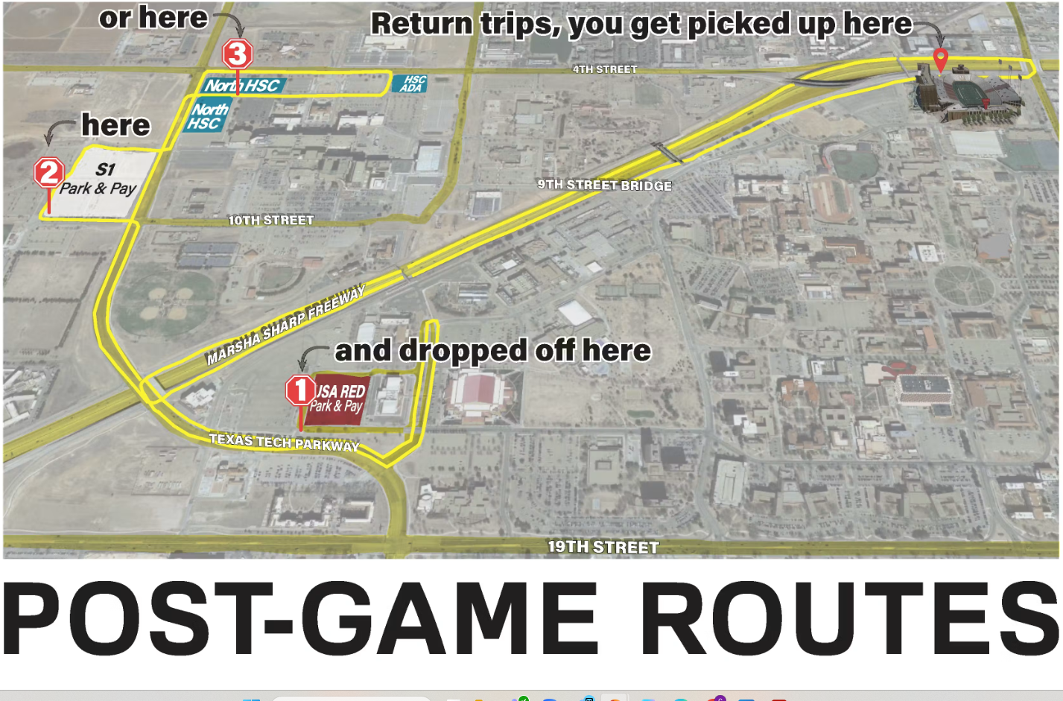
Game Day Shuttles:
Post-Game Routes
Operate until one hour after the game ends

Slide 23
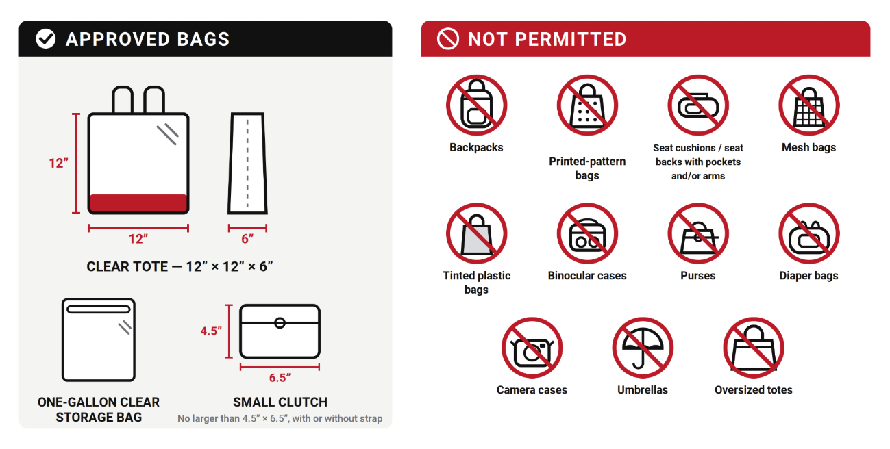
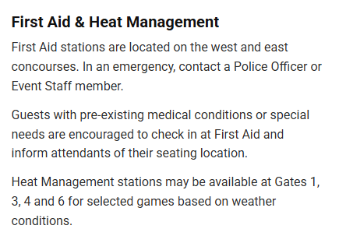

Additional Game Information
Clear Bag Policy
May bring one unopened bottle of water – 20 oz or less
Cashless venue
Mobile ticket scanning using the Texas Tech Red Raiders mobile app – no screenshots accepted
Download your tickets before going to the stadium
No re-entry
Ticket required for guests ages 2 and older
Resale tickets available through SeatGeek

Slide 24
Questions?
Use the Zoom Q&A feature

Slide 25
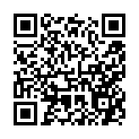

Closing
Up Next:
Intramurals and Club Sports – September 21
Start Early, Stand Out: First-Year Steps Toward Career Success – October 7
What is University Coaching? – October 28
Parent and Family Relations
parent@ttu.edu
Texas Tech Parents Association
parents@ttpa.org

