Slide 1

Campus Safety at Texas Tech
Morgan Chavez-Brannon| Parent & Family Relations
Officer Caitlynn Jeffries | Texas Tech Police Department
Tyler Patrick| Title IX
Claire Nevarez| Clery Compliance

Slide 2

TEXAS TECH POLICE DEPARTMENT
Our mission is to provide a safe and secure environment to live, learn, and educate.
Often referred to as "TTPD"
We operate 24/7, 365 days of the year.
Our primary jurisdiction is defined as all property owned, leased, rented, or otherwise under the control of the Board of Regents.
Enforce all federal, local, and state laws.
We are a concealed carry campus-with exclusionary zones in some areas.
Our current Interim Chief of Police is Amy Ivey. ​

Slide 3
TTPD divisions AND RESOURCES
Texas Tech Police Department has several divisions including:
Patrol, administration, guards, investigations, dispatch, public relations,crime prevention, honor guard, and bicycle patrol.
We also offer and operate many resources on campus including:
Blue phones around campus to assist with emergencies.
Crime prevention presentations and programs including burglary/theft, alcohol and drug awareness, active threat, general safety topics, and more.
Security surveys of TTU system property.
Assist in the operation of TechAlert, our emergency notifications database.
We post on Instagram, Facebook, and X.
  Instagram: texastechpolice
  Facebook: Texas Tech Police Department
  X: TexasTechPD

Slide 4
Crime prevention tips
Lock your bicycle and scooters– Use a U-lock and lock it to a bike rack.
Register your bicycle and scooters with transportation and parking- free of charge.
Place the registration sticker on your property.
Write down the makes, models, descriptions, serial numbers, and model numbers of your valued properties.
Keep photographs and receipts of valued items.
Always verify online accounts and caller authenticity.
Take ALL valuables out of your vehicles or hide them. Lock your car.
Do NOT leave doors to your dorm room or residence hall cracked.
Do NOT share room keys with anyone.
Do NOT let someone into a limited access building who trailed behind you.
Remember, if you see something suspicious, say something and report it to police!

Slide 5
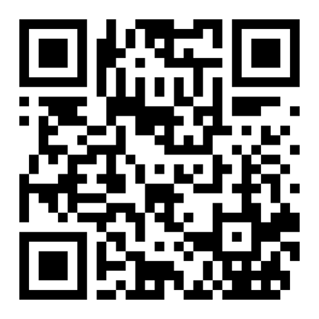
Safety Tips
Always be aware of your surroundings.
Sign up for the emergency notifications in your area.
Create an emergency contact in your phone.
Become familiar with campus locations and off campus locations.
Use the buddy system after dark if possible.
Always have a plan.
Follow our social media pages to stay up to date on important campus safety information.
Ensure you are linked to TechAlert!
If you see something suspicious, say something!!!!
Scan for TechAlert Website

Slide 6
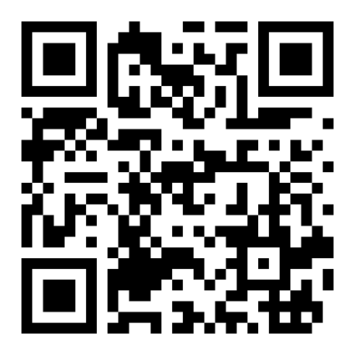
CONTACT INFORMATION
NON-EMERGENCY 806-742-3931
EMERGENCY DIAL 9-1-1
TTPD OPERATES: 24 HOURS, 7 DAYS A WEEK, 365 DAYS A YEAR
Blue phones are available throughout campus in emergency situations.
POLICE@TTU.EDU
My contact information:
  Email: caitlynn.jeffries@ttu.edu
  Office: 806-742-6822
Scan for TTPD Website

Slide 7

Title IX, Sexual Misconduct & Clery Act

Slide 8

What is Title IX?
“No person in the United States shall, on the basis of sex, be excluded from participation in, be denied the benefits of, or be subjected to discrimination under any education program or activity receiving Federal financial assistance.”
Title IX of the Higher Education Amendments of 1972
20 U.S.C. § 1681 & 34 C.F.R. Part 106
Notes:
What you need to know is that any person should be able to be on this campus without discrimination of any kind

Slide 9
What Does Our Office Do?
01
02
03
Provide Supportive Measures
Investigate Reports of Misconduct
Facilitate Resolutions
Notes:
Stop the harassment then remedy the situation through this process and supportive measures (assistance in the classroom, counselling, communication with faculty members); if the student chooses to have the incident investigated, then our office can assist with the investigation; through the result of the investigation and the student’s request, we will help with a formal or informal resolution

Slide 10
Reportable Sexual Misconduct Includes:
Sexual Harassment
Sexual Assault
Nonconsensual Sexual Contact
Nonconsensual Sexual Intercourse
Dating Violence
Domestic Violence
Stalking
Public Indecency
Sexual Exploitation
Notes:
Dating Violence - Violence committed by a person who is or has been in a social relationship of a romantic or intimate nature with the victim
Domestic Violence - Crimes of violence committed d by a current/former spouse of the victim; person with whom the victim shares a child in common; person who is cohabitating with or has cohabitated with the victim as a spouse; or person similarly situated to a spouse of the victim.
Stalking - Engaging in a course of conduct directed at a specific person that would cause a reasonable person to fear f or his/ her safety or the safety of others; or suffer substantial emotional distress.

Slide 11
U.S. Department of Education Protections for
Pregnant, Nursing & Parenting Students
Universities Must
Excuse absences due to pregnancy or childbirth for as long as a doctor says it is necessary
Allow students to return to the same academic and extracurricular status as before medical leave began, which should include giving the opportunity to make up any work missed while the student was out
Provide pregnant students with the same special services it provides to students with temporary medical conditions. This includes homebound instruction/at-home tutoring/independent study
You are not mandated to report pregnancy, however, you can file on behalf of the student or provide information on how to report so that the student may access supportive measures.
Notes:
Reporting pregnancy isn’t required but it’s still protected under the policy so we are able to provide additional resources

Slide 12
What Happens When a Report is Filed?
Title IX Case Management Team reviews report
Sends student email to provide Supportive Measures and discuss resolution options
Student decides if they would like to file a Formal Complaint to participate in the Formal Grievance Process
Informal Resolution
OR
Pursue Investigation for Potential Disciplinary Action
Notes:
Investigation may be limited with informal resolution- investigation process stops when resolution is reached.

Slide 13
How Can Someone Report Incidents?
To the University:
  Deputy Title IX Coordinator | Meredith Holden | 806.834.5556
  Office for Student Civil Rights and Sexual Misconduct Staff | 806.742.7233
  Office of Equal Opportunity | 806.742.3627
  Online Title IX/Sexual Misconduct Reporting Form
Confidential Assistance:
  Student Counseling Center
  Family Therapy Clinic
  Psychology Clinic
  TTUHSC Employee Assistance Program
  Student Health Services
To Law Enforcement:
  TTU Police Department
  Lubbock Police Department
  Note: an employee should not make a report to police on another party’s behalf absent an active emergency

Slide 14
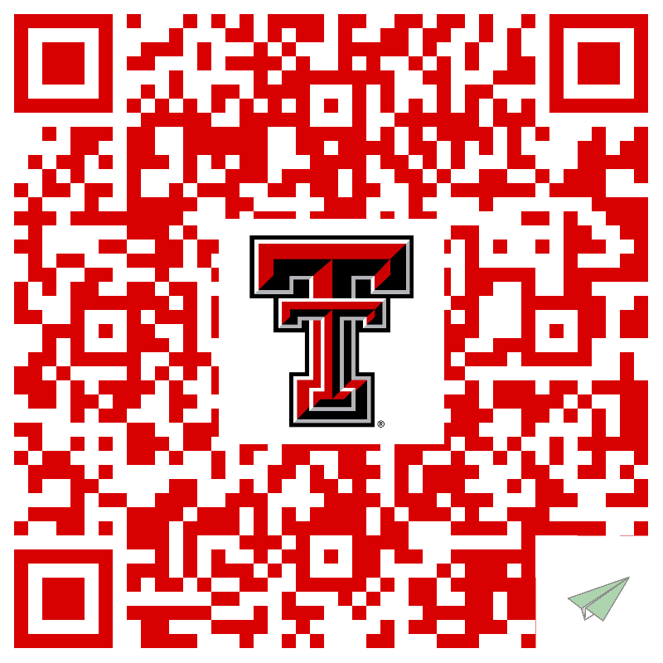
Support Resources Contact Card

Slide 15

Texas Tech University:
The Clery Act

Slide 16

What is The CLERY act?
In 1986, Jeanne Clery was brutally beaten, raped, and murdered in her residence hall
Her parents believed the University failed to share vital campus safety information and campaigned for legislative reform
Sustained efforts led to the passage of the Jeanne Clery Campus Safety Act
Includes compliance within Title IX, VAWA, Stop Campus Hazing Act, and Drug Free Schools and Community Act

Slide 17
Clery Act Compliance
The purpose of the Clery Act is to provide the campus community with timely, accurate, and complete information about crime and the safety of campus so that they can make informed decisions to keep themselves safe.

Slide 18
Clery Specific Geography
It does not matter WHO the victim is or WHEN it occurred, it’s the WHERE:
  On-campus
  Residence Halls
  Public Property within or immediately adjacent to campus
  Non-campus buildings or property

Slide 19
Clery Reportable Crimes
Murder/Non-negligent Manslaughter
Negligent Manslaughter
Sex Offenses:
  Rape
  Forcible Fondling
  Incest
  Statutory Rape
Robbery
Aggravated Assault
Burglary
Motor Vehicle Theft
Arson
Dating Violence
Domestic Violence
Stalking
Arrests & Disciplinary Referrals for Violations of Liquor, Drug, & Weapons Laws
Hate Crimes
Hazing

Slide 20
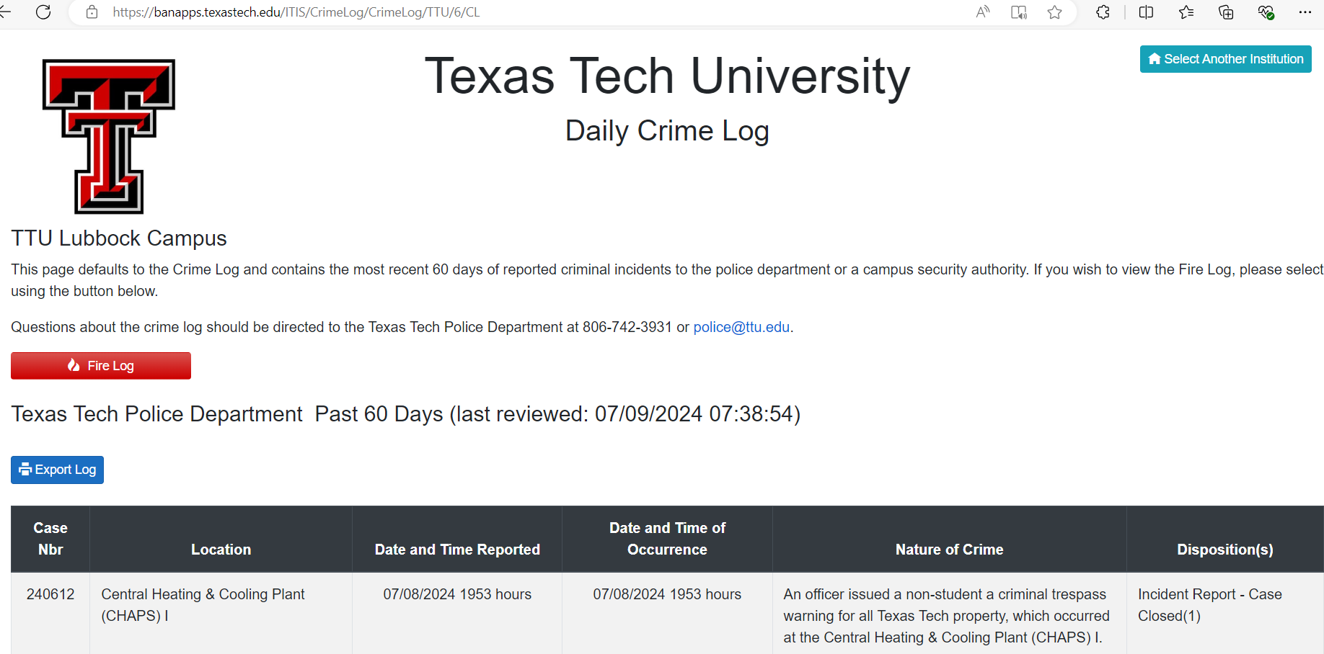
Crime Log
Clery Crime Reports will be listed within two business days of being reported to the Clery Compliance Officer
Crime Log shows the past 60 days of Clery crimes and TTPD crimes

Slide 21
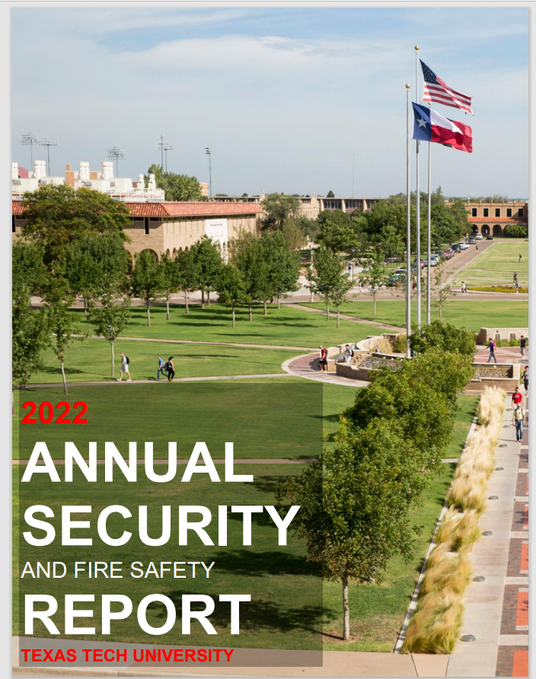
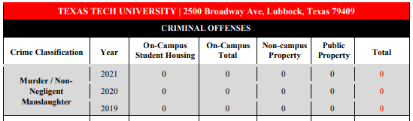
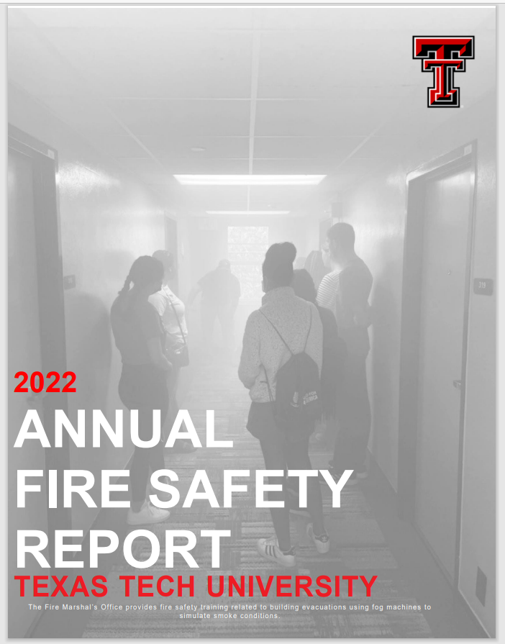
Annual Security Report
Published at the beginning of the Fall semester
Always available on the Texas Tech Clery Compliance website

Slide 22
Clery Campus Notifications-
Timely Warnings
A Timely Warning Notification will be sent out to the entire campus community if the crime is considered by the institution to represent a serious or continuing threat to students and employees
  The goal is to prevent similar crimes from taking place

Slide 23
Stop Campus Hazing Act (SCHA)
On December 23, 2024, the Stop Campus Hazing Act was signed, which amended the Jeanne Clery Campus Safety Act.
SCHA requires institutions of higher education participating in federal student aid programs to track and report hazing incidents to the public.

Slide 24
Stop Campus Hazing Act (SCHA)
Hazing is not just physical abuse
    Violent hazing is the most easily recognized form of hazing, but happens less frequently that intimidation hazing (examples: social isolation, deception, demerits, etc.) and harassment hazing (examples: verbal abuse, threats, sleep deprivation, etc.)
All forms of hazing can result in Hidden Harm: the mental and emotional scars that result from being hazed and even from hazing others. Hazing can be the trigger that pushes someone past their breaking point regardless of whether they have an underlying mental disorder. You don’t know what might break someone.
Hazing can happen to anyone, and can happen in any organization in which there is a hierarchy, including academic clubs, fraternities and sororities, marching bands, and athletic teams.
You can’t consent to hazing. Hazers know what will happen and hide information from new members. Those being hazed are blind to the actual risks and can’t give informed consent.
Listen to your gut feeling. If you think an activity is problematic, find a way to speak up. If it’s an emergency, call 911.
Copyright © 2024 Rector and Visitors of the University of Virginia and its Gordie Center

Slide 25
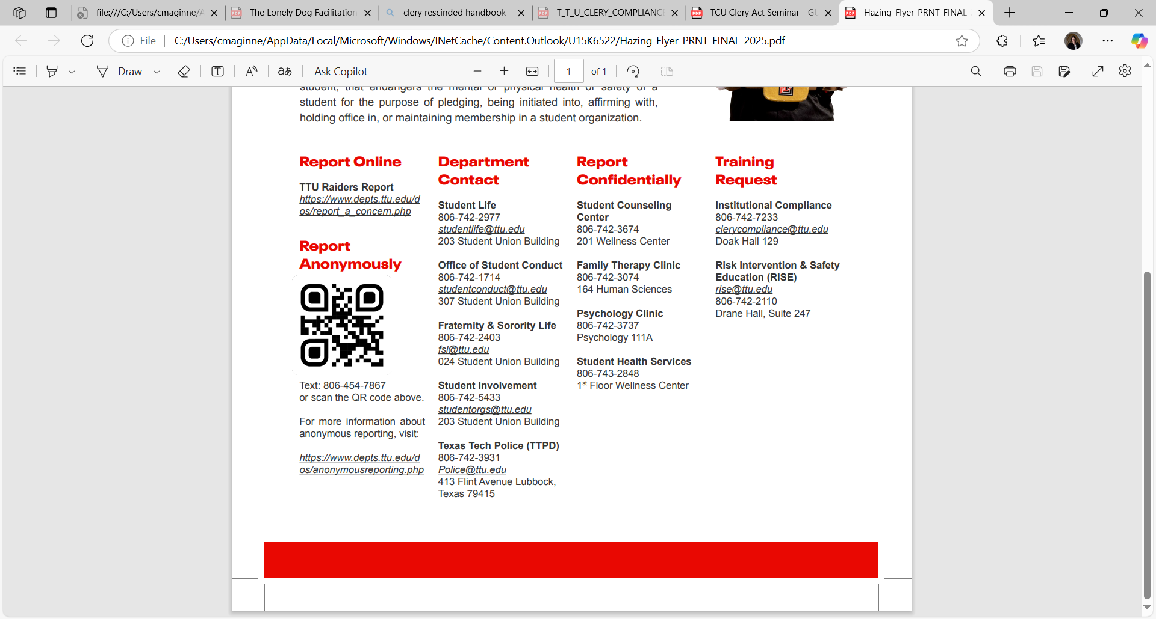
Reporting Hazing at TTU
If you witness an incident of hazing or are made aware of an incident
https://www.depts.ttu.edu/dos/report_a_concern.php
https://www.depts.ttu.edu/dos/anonymousreporting.php

Slide 26
Hazing Resources at TTU
Departmental Resources
Student Life
806-742-2977
studentlife@ttu.edu
203 Student Union Building
Office of Student Conduct
806-742-1714
studentconduct@ttu.edu
Student Union Building
Fraternity & Sorority Life
806-742-2403
fsl@ttu.edu
024 Student Union Building
Student Involvement
806-742-5433
studentorgs@ttu.edu
203 Student Union Building
Texas Tech Police (TTPD)
806-742-3931
police@ttu.edu
413 Flint Ave
Lubbock, TX 79415
Student Counseling Center
806-742-3674
201 Student Wellness Center
Family Therapy Clinic
806-742-3074
164 Human Sciences
Psychology Clinic
806-742-3737
Psychology 111A
Student Health Services
806-743-2848
1st Floor Wellness Center
Request Training
Institutional Compliance
806-742-7233
clerycompliance@ttu.edu
Doak Hall 129
Risk Intervention & Safety Education (RISE)
806-742-2110
rise@ttu.edu
Drane Hall, Suite 247

Slide 27
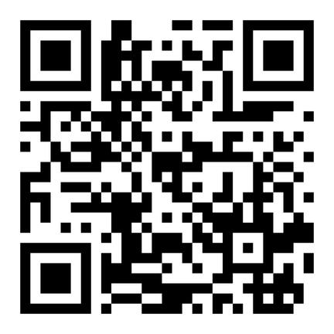
Drug-Free Schools and Communities Act (DFSCA) &
Drug and Alcohol Abuse Prevention Program (DAAPP)
The DFSCA requires that TTU annually notify the community about our policies related to the unlawful possession, use, or distribution of illicit drugs and alcohol.
The Risk Intervention and Safety Education (RISE) office offers resources pertaining to substance use and abuse and overall wellness.
https://www.depts.ttu.edu/rise/

Slide 28
Texas Tech University
Office of Institutional Compliance
Clery Compliance Officer
  Claire Nevarez | Claire.nevarez@ttu.edu
    806.834.1884
Deputy Compliance Officer
  Tyler Patrick, JD, CCEP | tyler.patrick@ttu.edu
    806.834.8871
Chief Compliance Officer
  Dr. Kimberly Simón | kimberly.simon@ttu.edu
    806.834.1949

Slide 29
Questions?
Use the Zoom Q&A feature

Slide 30
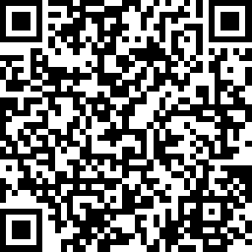

Red Raider Family Webinar Series
Up Next:
Academic Success at Texas Tech – July 8
Preparing Your Red Raider for On-Campus Living – July 22
Parent and Family Relations
parent@ttu.edu
Texas Tech Police Department
ttpd@ttu.edu
Title IX
titleIX@ttu.edu
Clery Compliance
clerycompliance@ttu.edu
Notes:
PFR

