Slide 1

Preparing Your Red Raider for Living Off-Campus
Christine Self | Parent & Family Relations
Kelly Turner| University Student Housing
Sarah Albertson | Off-Campus Housing Office

Slide 2


Slide 3
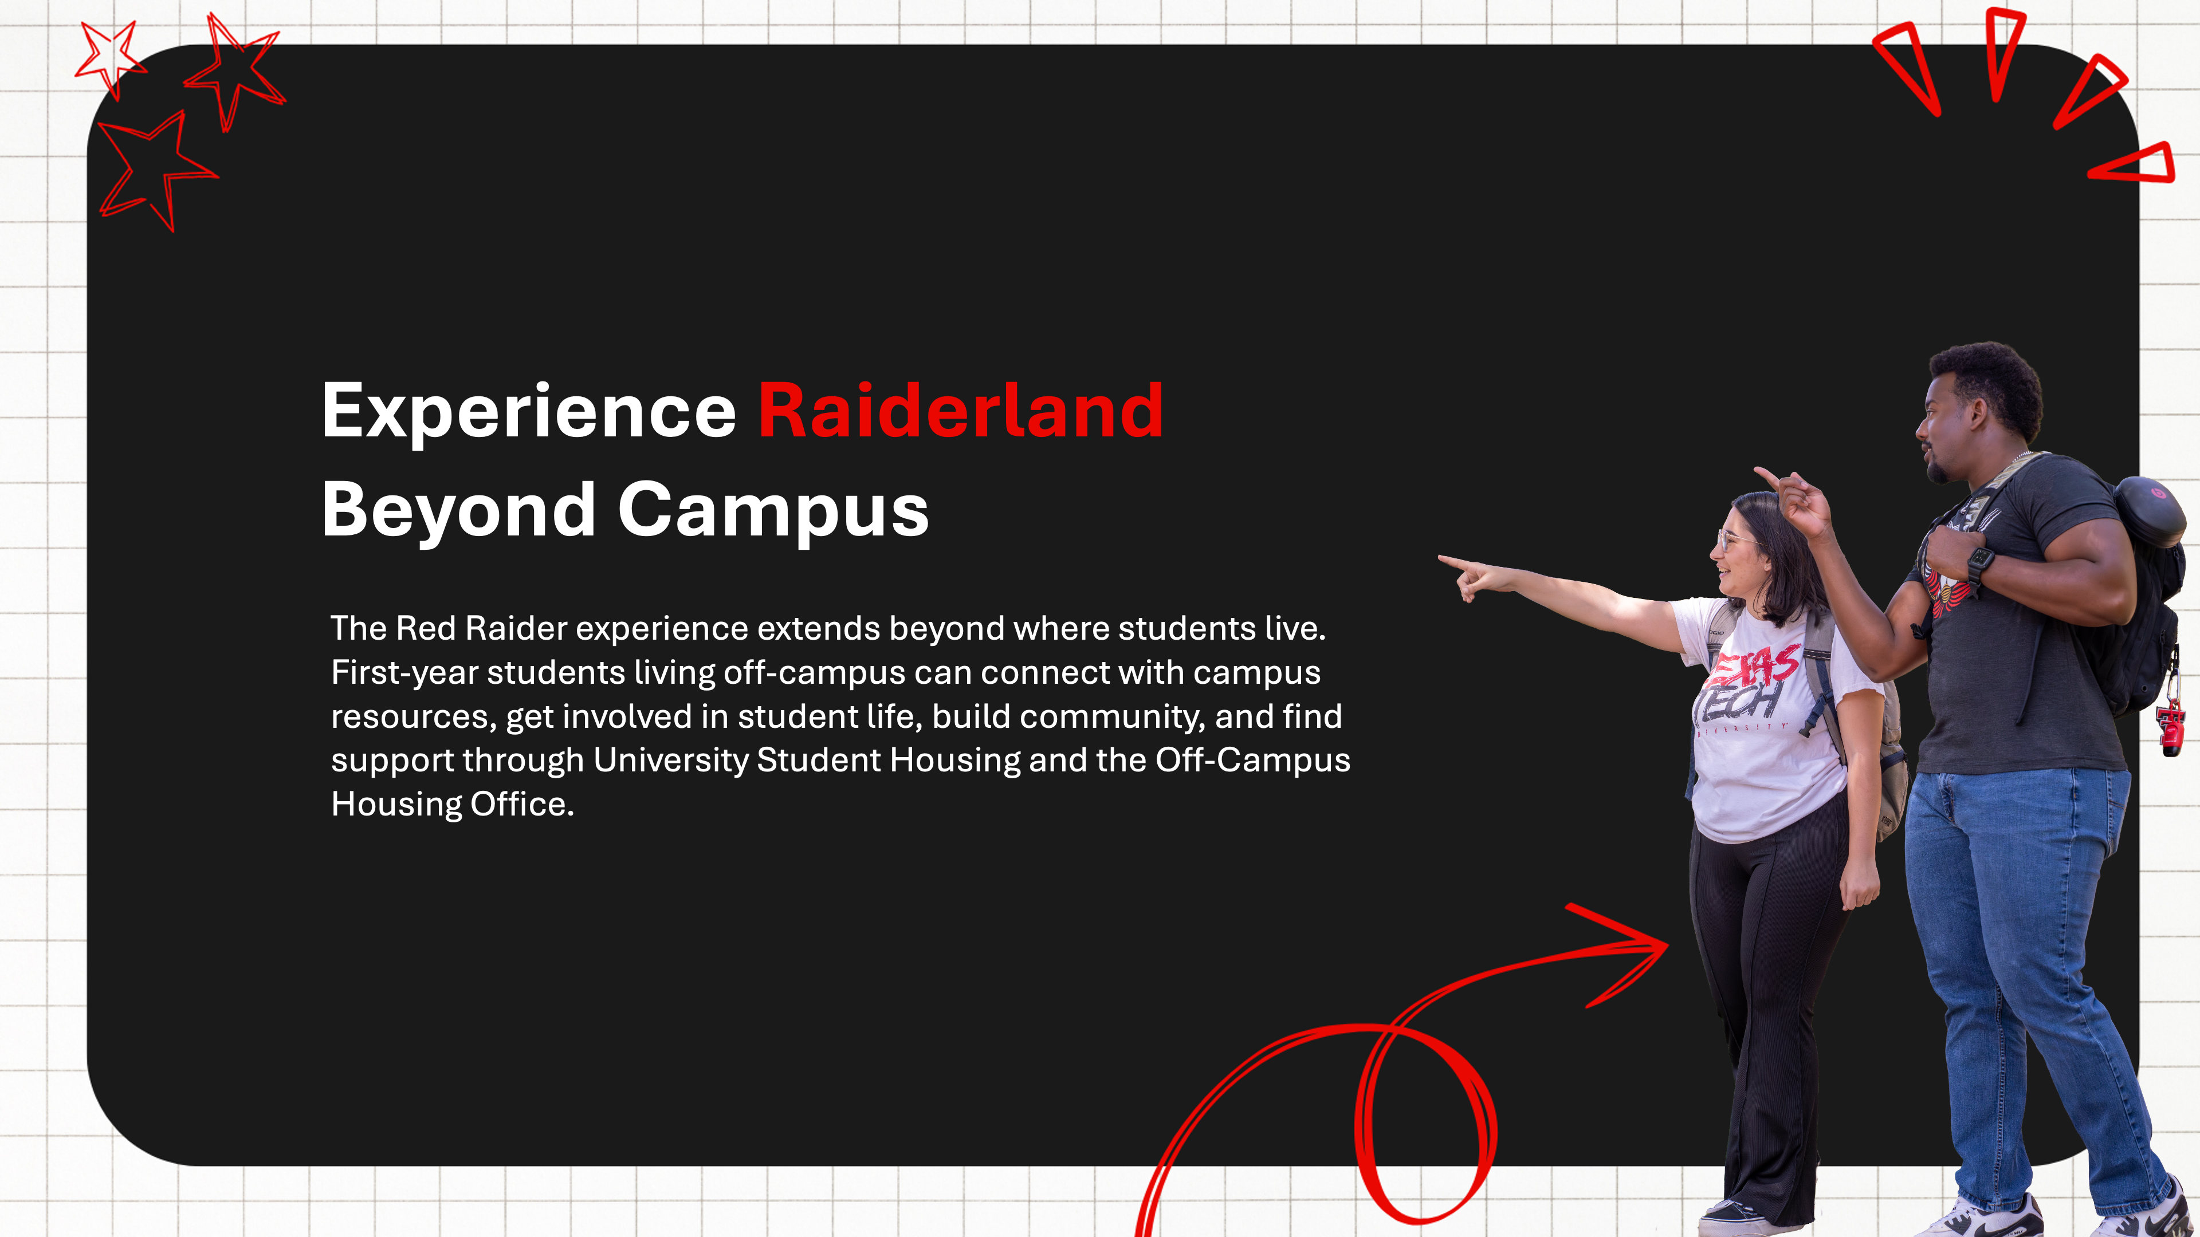

Slide 4
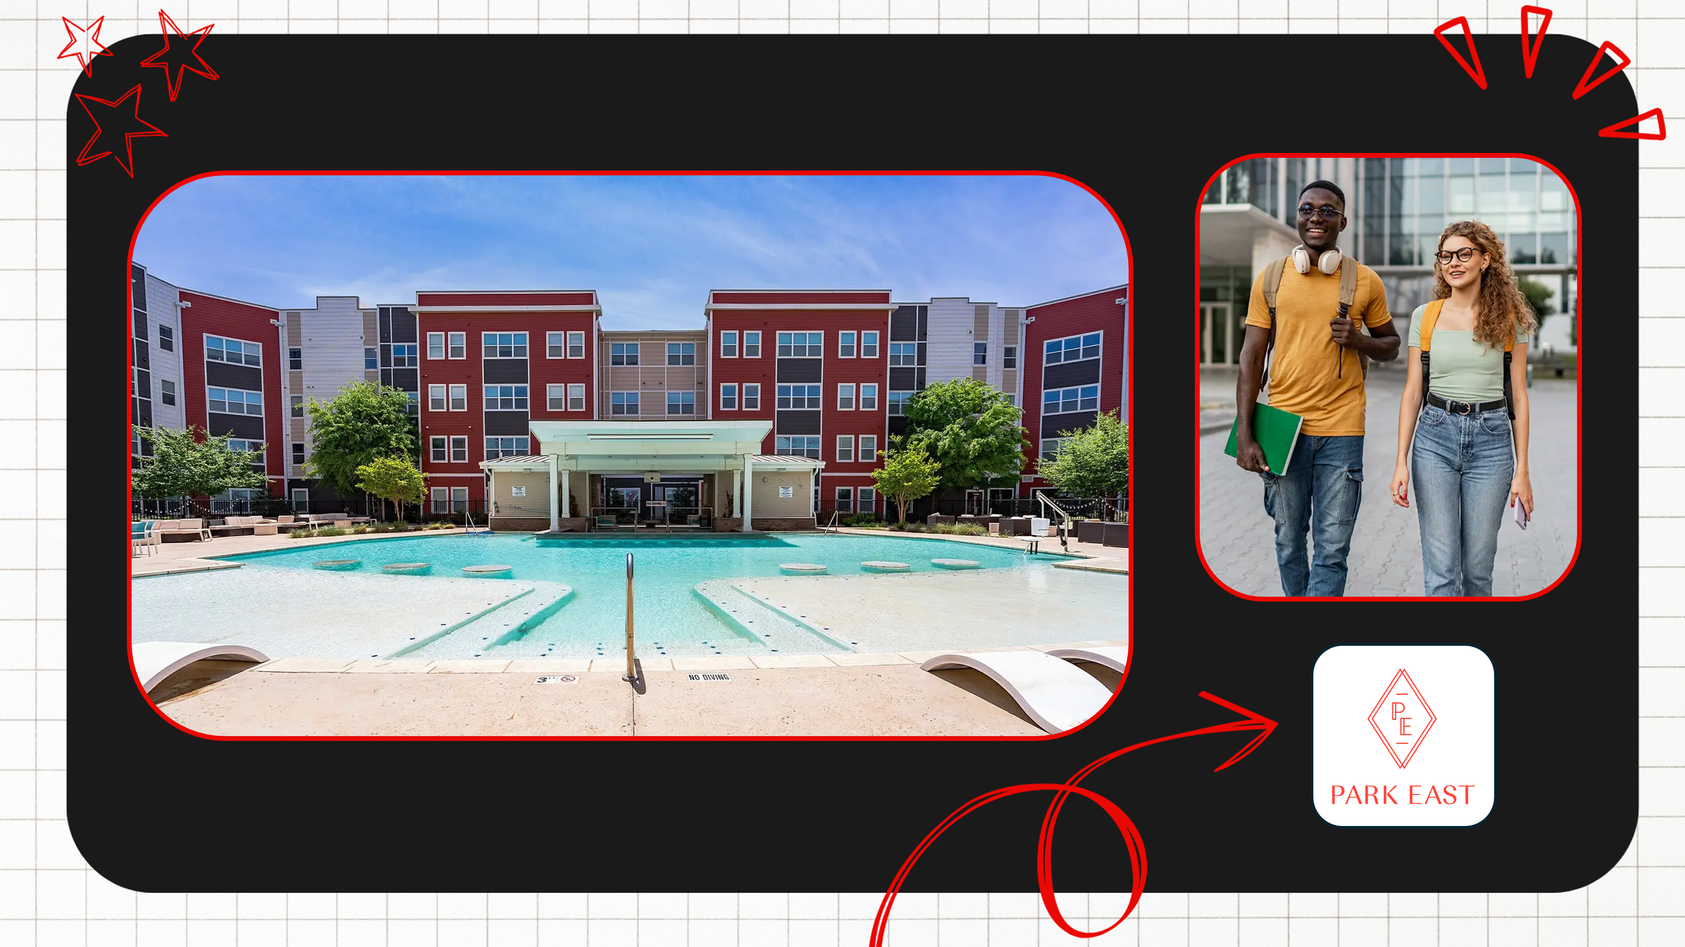

Slide 5


Slide 6


Slide 7
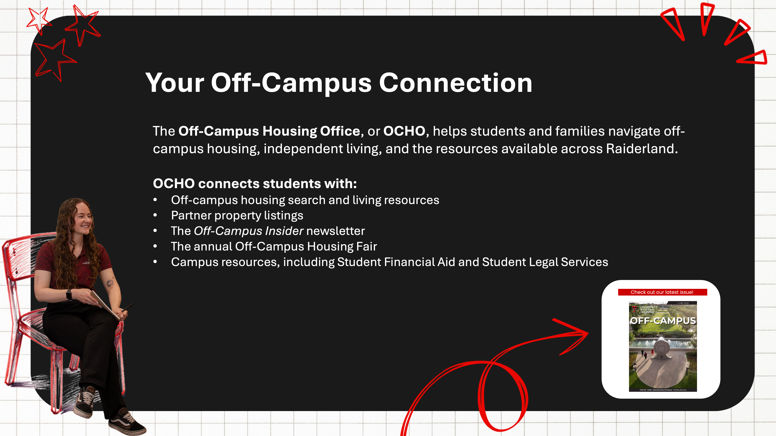

Slide 8
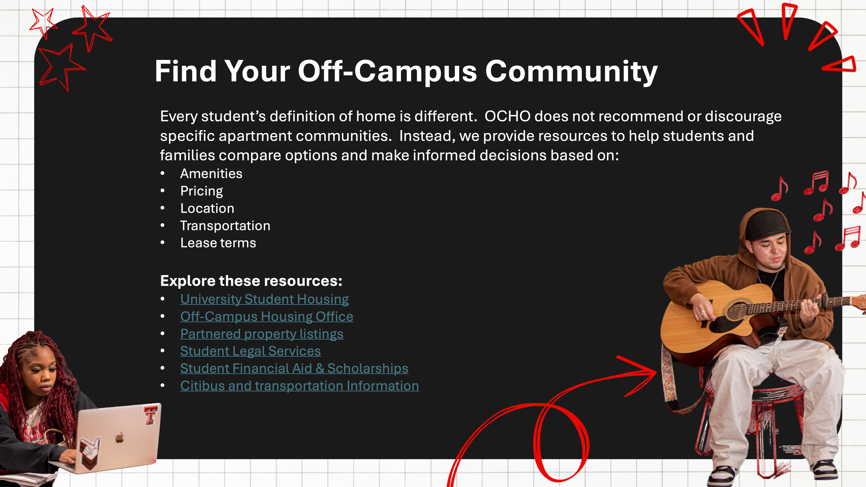

Slide 9
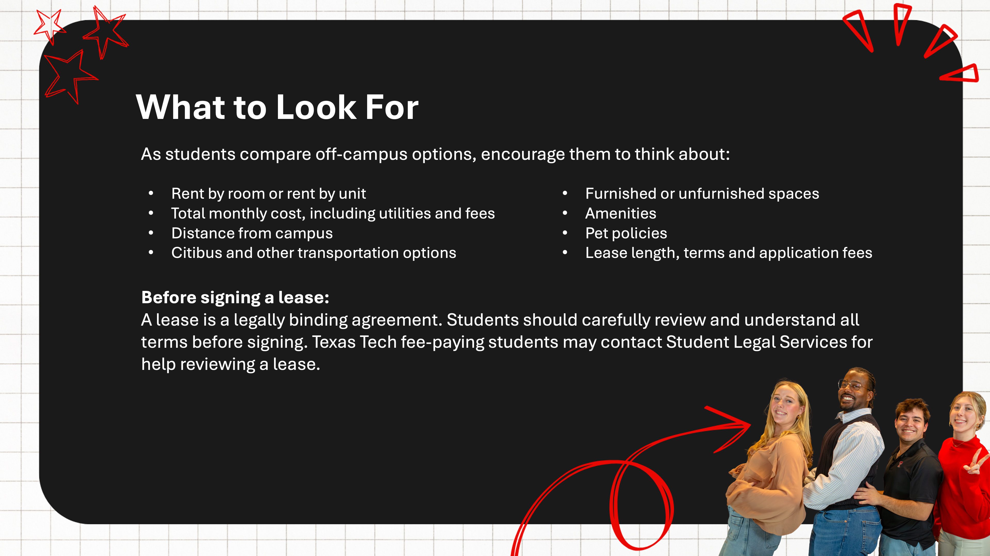

Slide 10
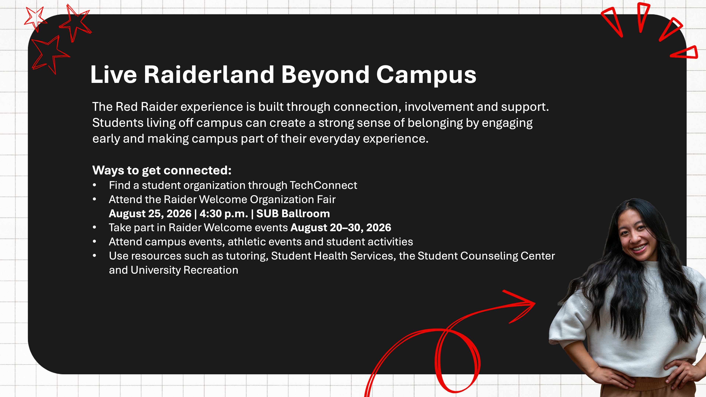

Slide 11
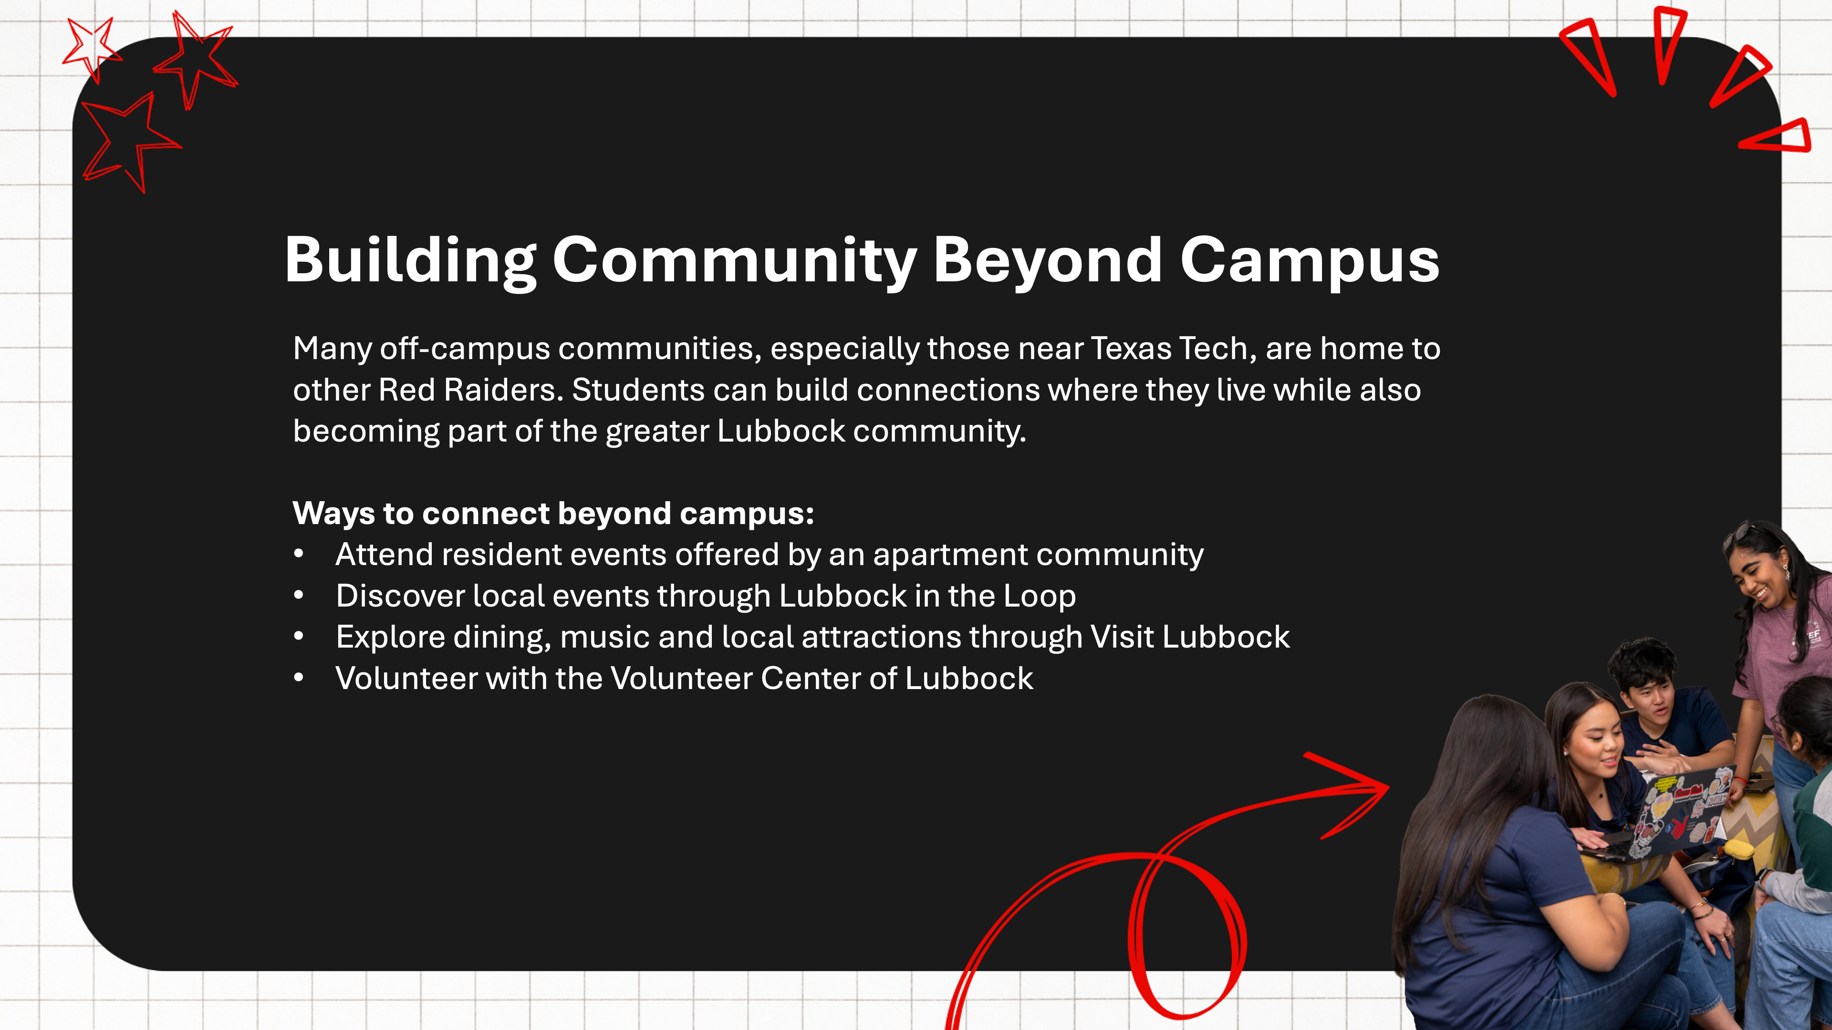

Slide 12
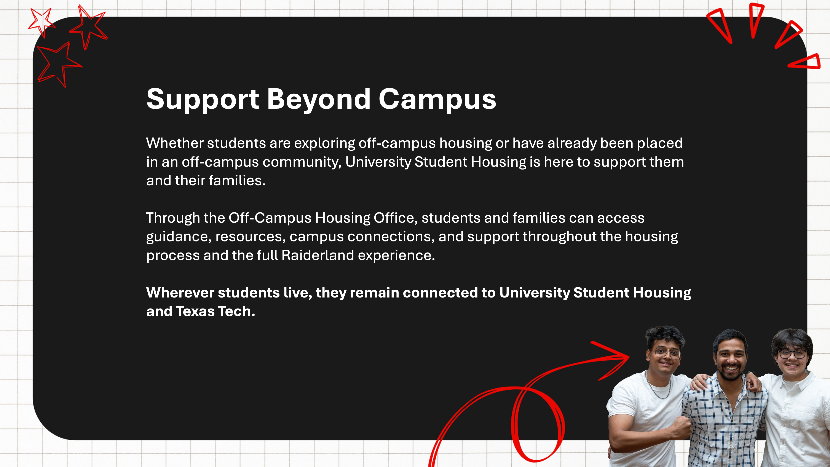

Slide 13


Slide 14

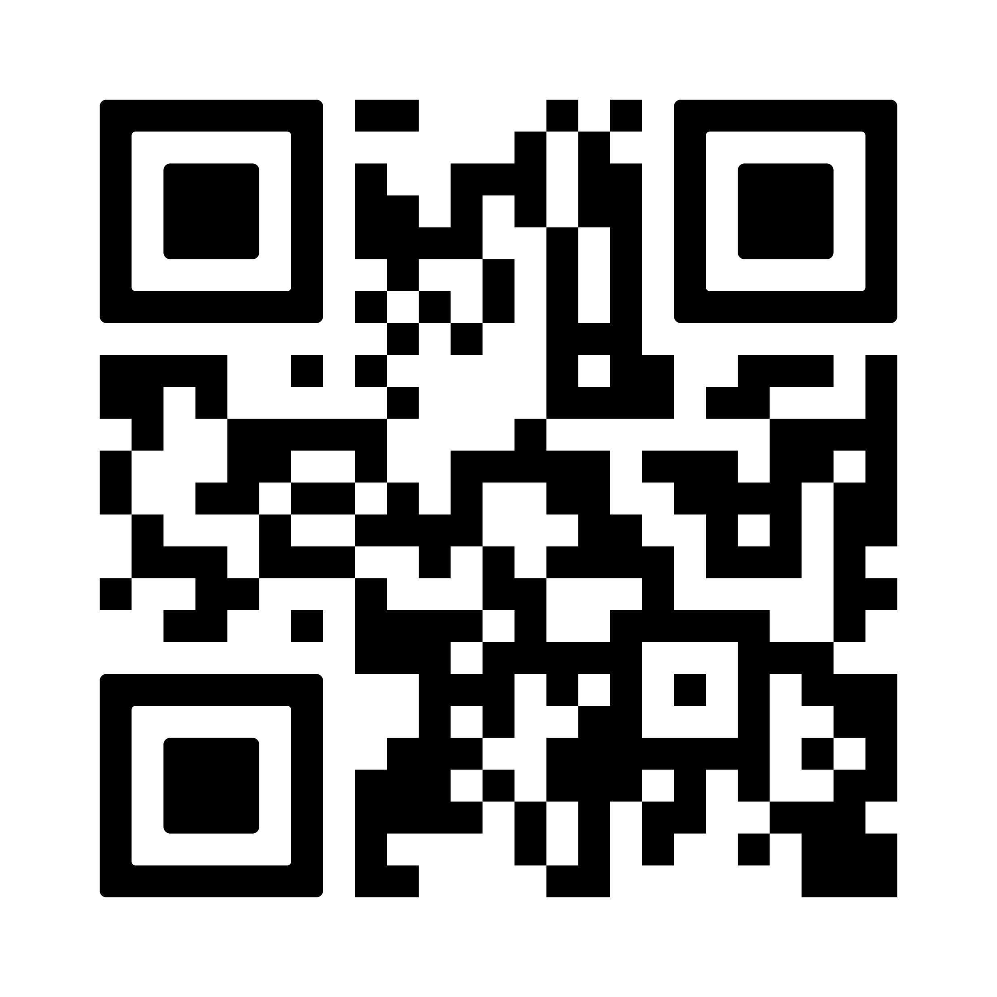
Texas Tech Trek
Saturday, August 22 | 1:30 – 6:30 | Student Union Building
This free, one-day student success conference is designed just for first-time at Texas Tech undergraduate Red Raiders. Through interactive breakout sessions, panels, and real stories from current students, students can explore campus life, connect with support resources, and discover what it means to find their place at Texas Tech.
Encourage your student to participate! Free registration is required.

Slide 15

Join us for Refuel & Refresh
Stop by and join Parent & Family Relations for our move-in event: Refuel & Refresh!
August 21 and 22
International Cultural Center (free parking)
11:00 am – 2:00 pm
Can wait to see you!
Register on the Red Raider Family Network

Slide 16
Questions?
Use the Zoom Q&A feature

Slide 17
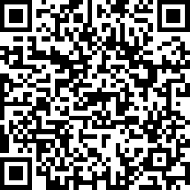

Take Our Survey
Up Next:
Preparing Your Red Raider for On-Campus Living – July 22
Student Disability Services: Accommodations – July 28
Finishing Touches with PFR – August 5
Parent and Family Relations
parent@ttu.edu
Off-Campus Housing Office
housing.offcampus@ttu.edu

