Slide 1

Preparing Your Red Raider for On-Campus Living
Morgan Chavez-Brannon| Parent & Family Relations
Dee Nguyen | Hospitality Services
Kelly Turner| University Student Housing

Slide 2

Hospitality Services Logo

Slide 3

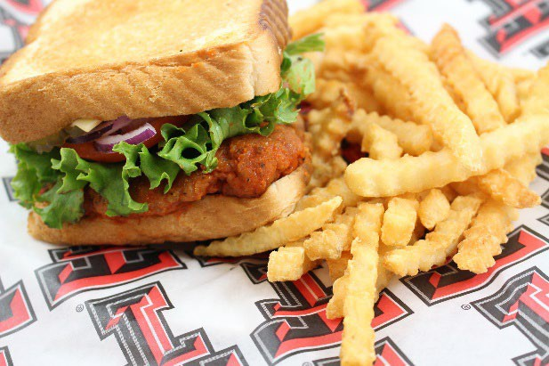

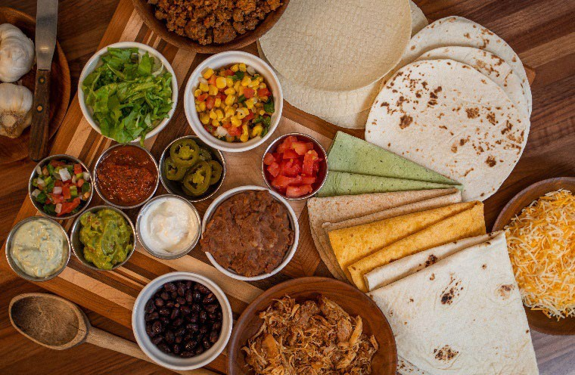
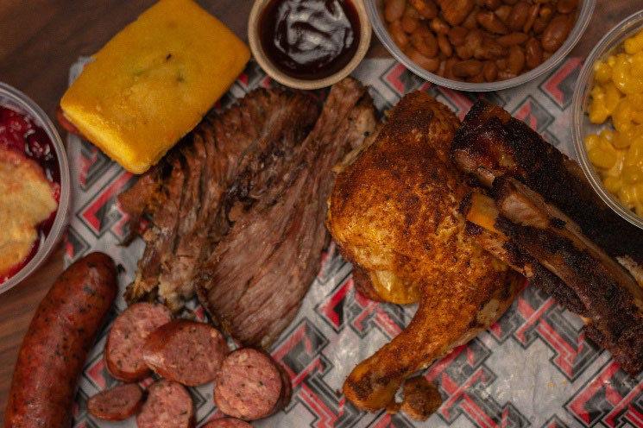
Dining Plans and Important Things to Know
Dining Plans
Red & Black – highest plan for the biggest eaters Matador – lowest and most popular plan
Important Things to Know!
-Dining Plans available to use as soon as you move in
-Add more Dining Bucks at any time.
-Raise or lower your Dining Plan by the 20th class day
-Dining Bucks roll over for the contract period only.
-25% discount at all Hospitality Services locations.
-Fresh Plate @ Wall/Gates is our best value location.

Slide 4
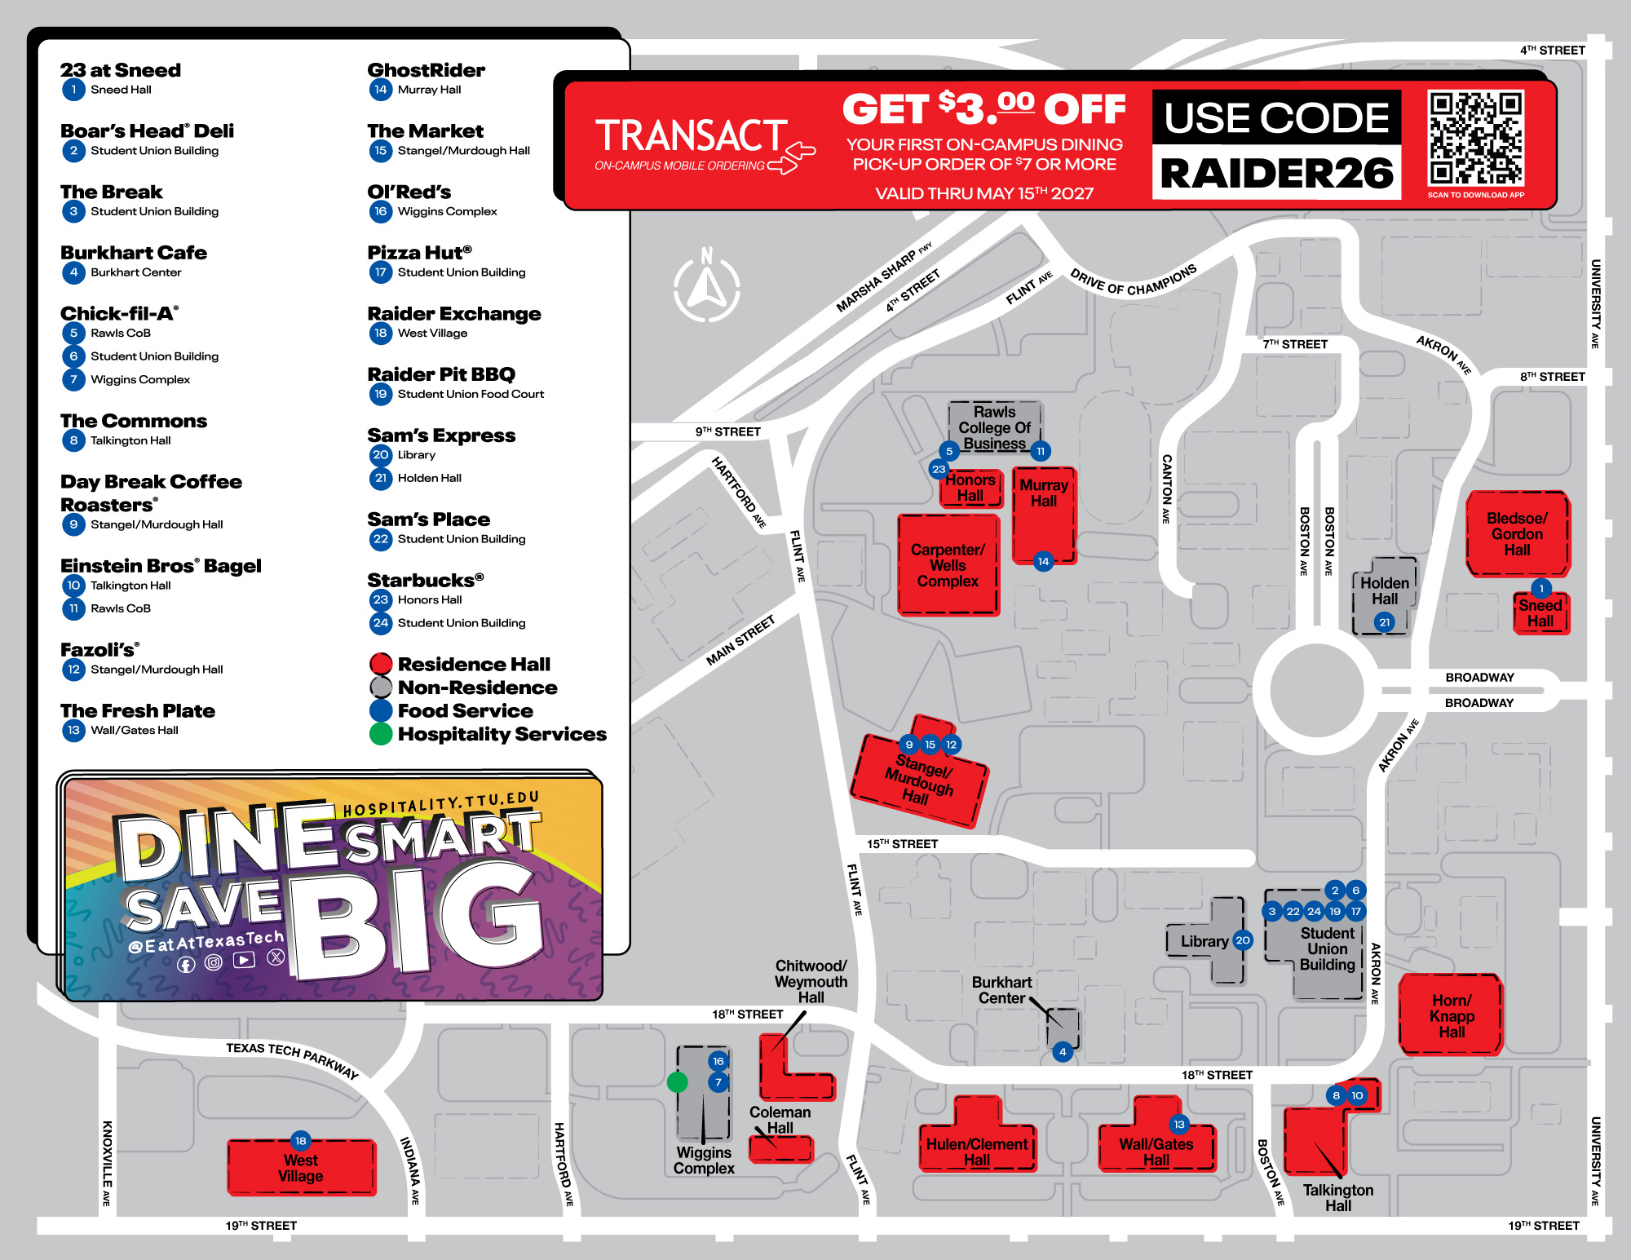
Dining Locations Map

Slide 5


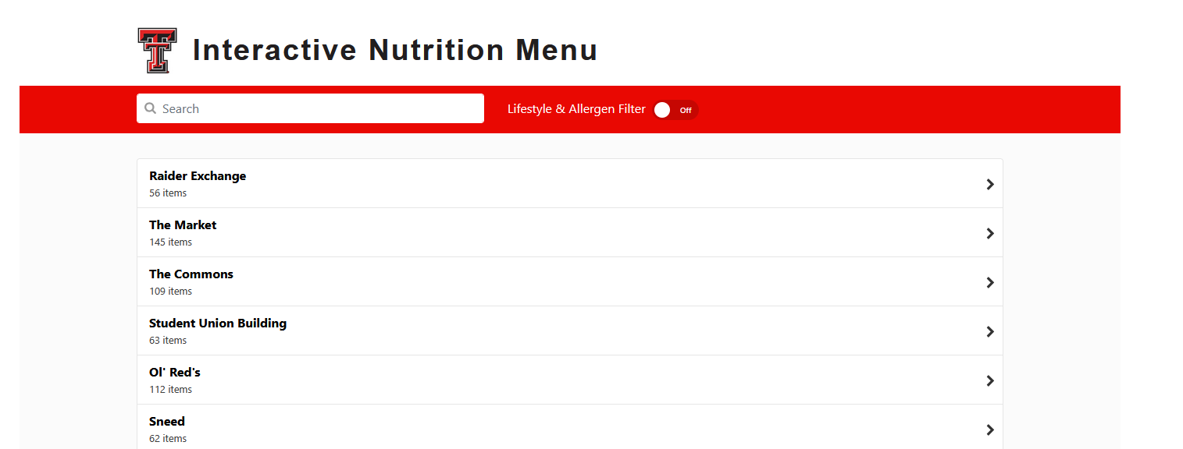
Resources
mindy.diller@ttu.edu

Slide 6


Other Resources
806-742-1360
hospitality@ttu.edu
hospitality.ttu.edu

Slide 7
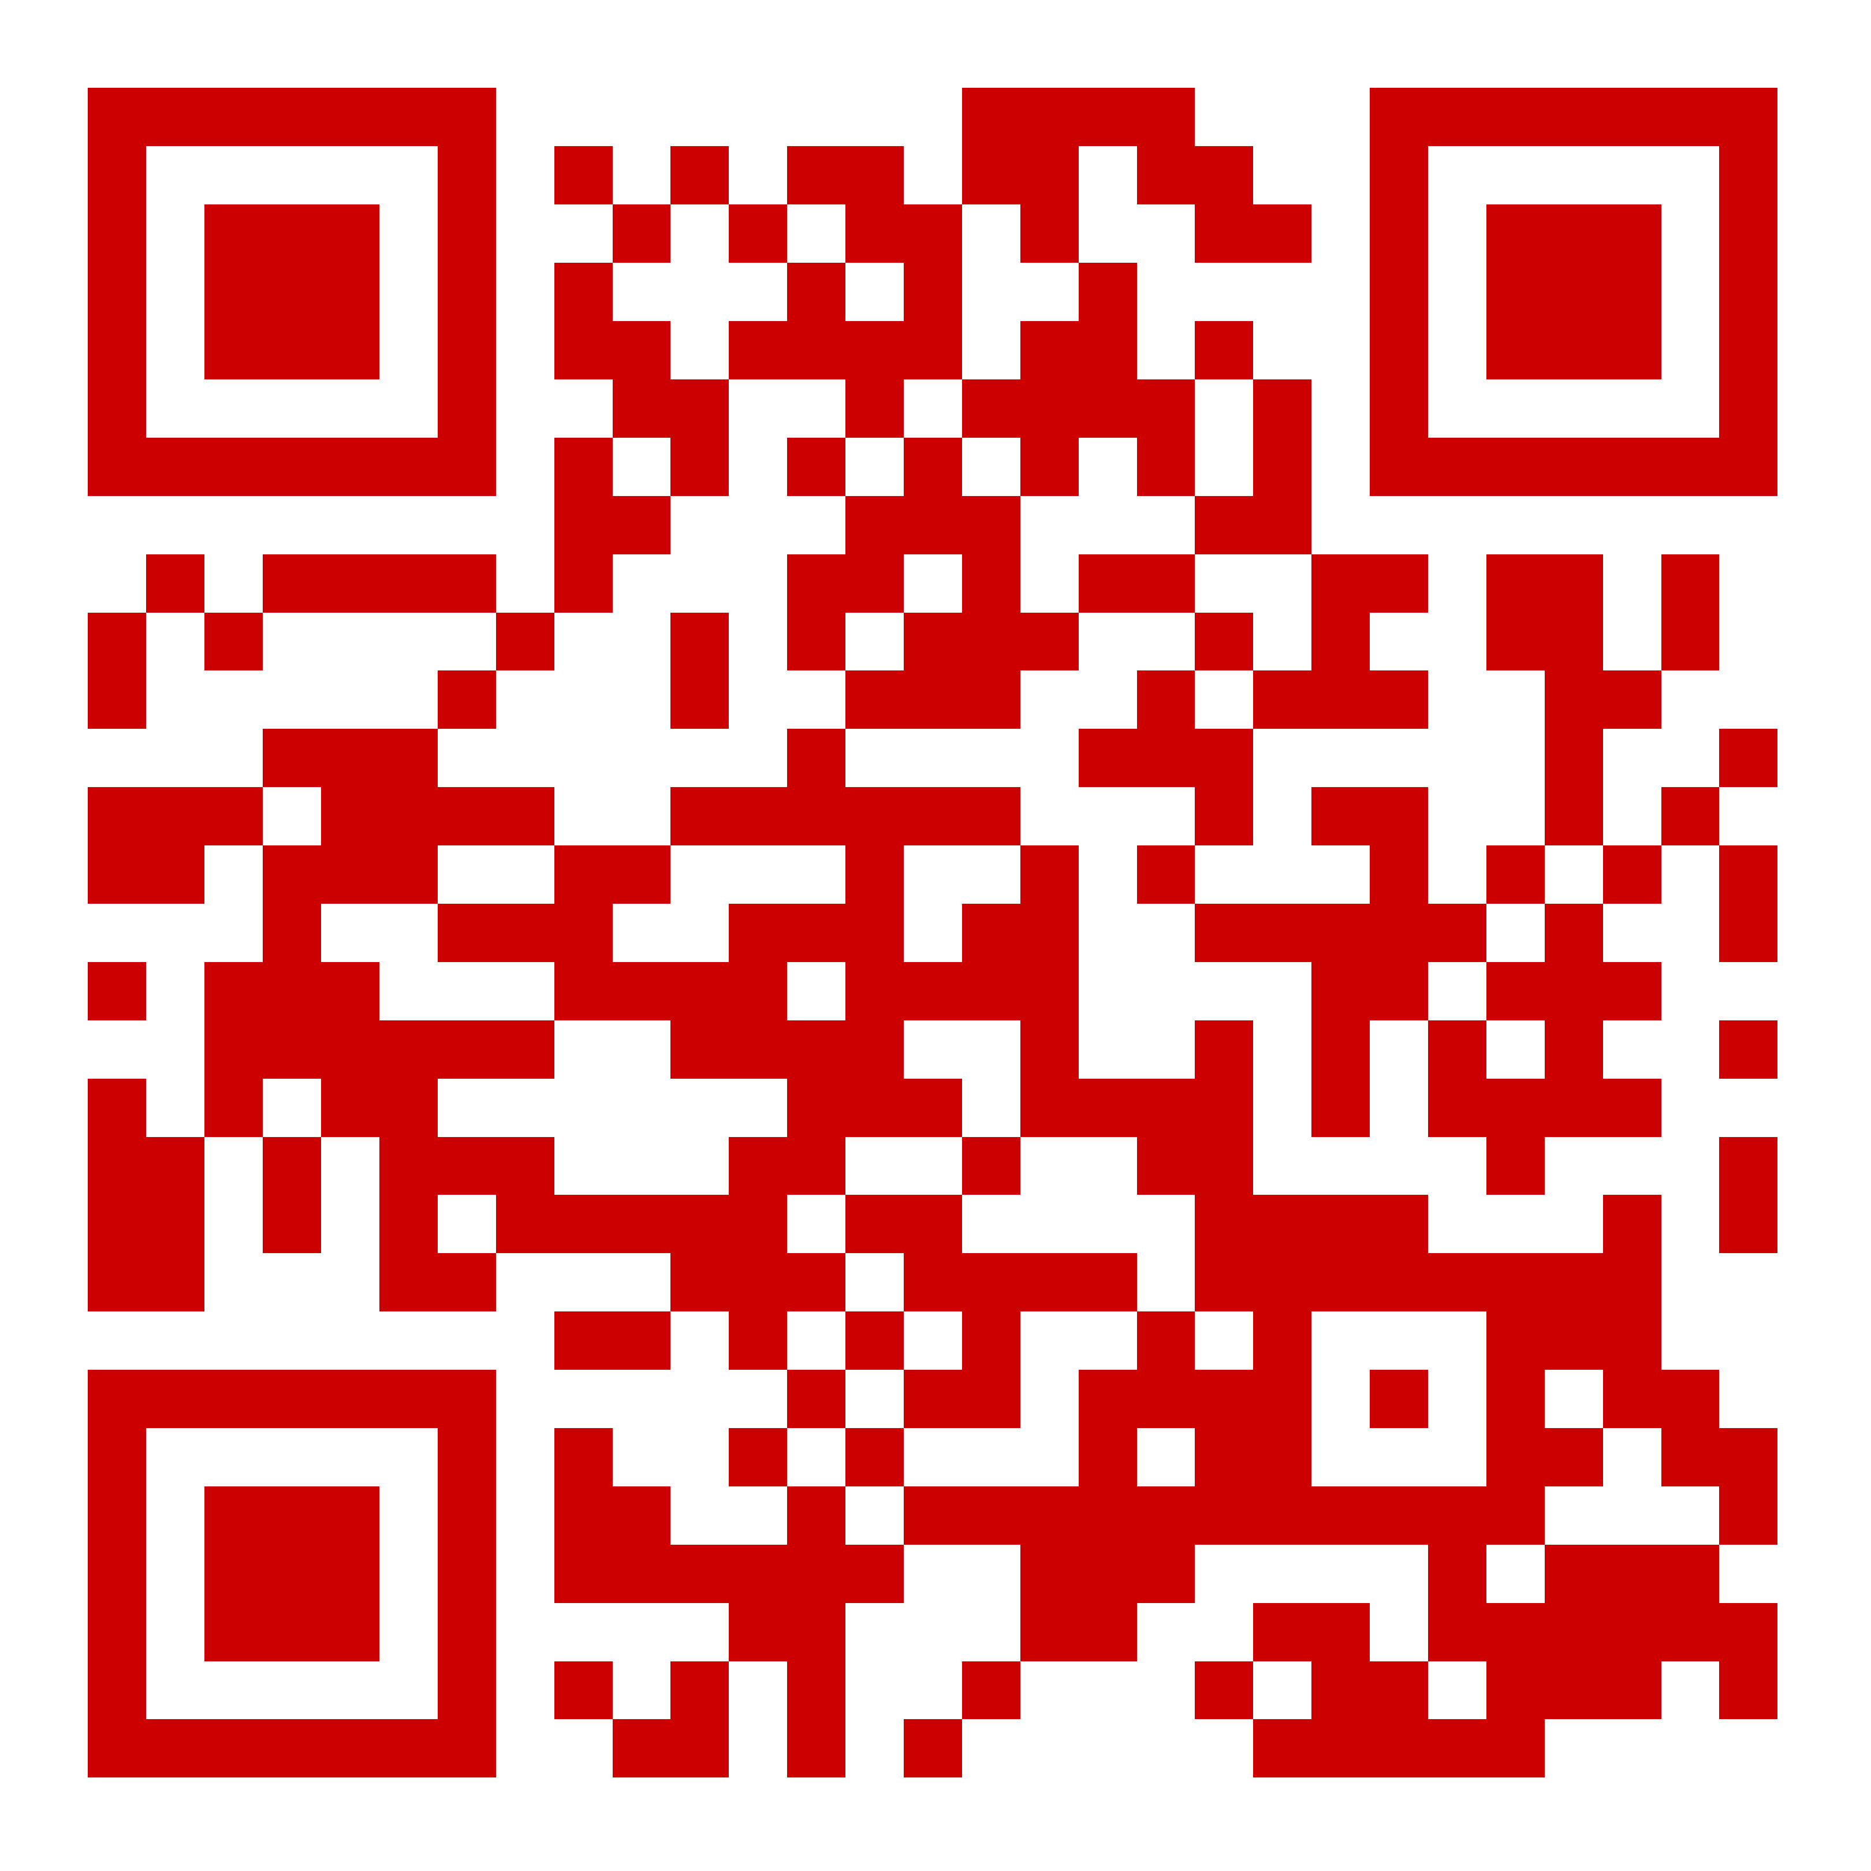
University Student Housing
  Scan to follow along!

Slide 8
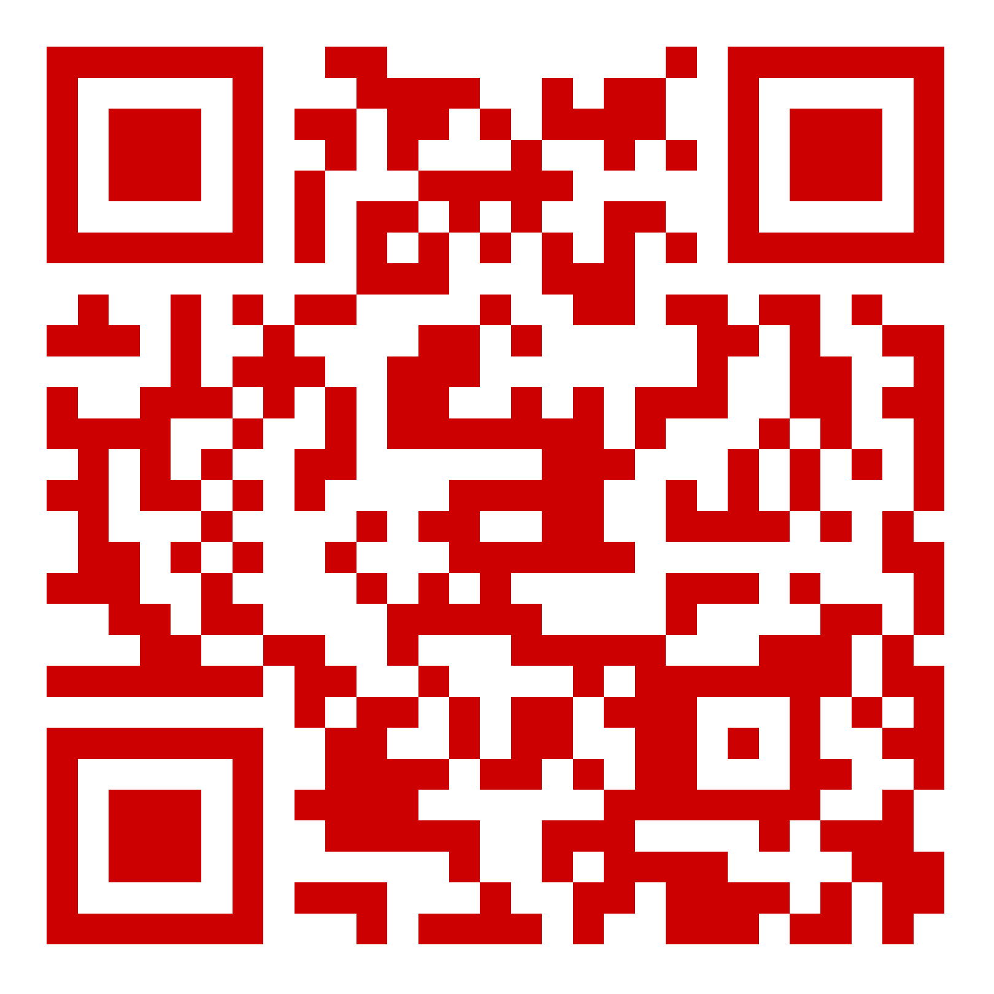
What does it mean to be
Red Cart Ready?
You’ve booked your Tech-In timeslot
You’ve checked in at your residence hall and received room access
You’re ready to use a Red Cart to move belongings into your room
You’ve reviewed what to bring and what not to bring before arriving
You’re prepared to move efficiently and safely with help from Housing staff and volunteers

Slide 9
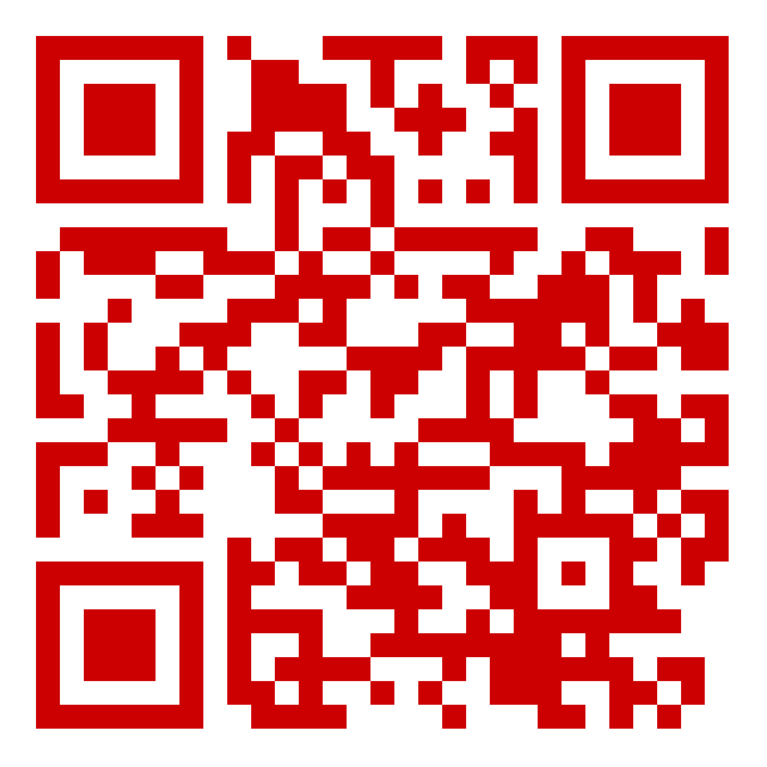
WHAT TO BRING
  Student ID (Tech ID) – check-in, hall access & meals
  Bedding – twin sheets, pillows, blankets, mattress pad
  Bathroom Supplies – toiletries, shower caddy & shower shoes
  Laundry Supplies – basket & high-efficiency detergent
  Personal Items – medications, bike & lock, chargers, ethernet cable
  Scan for the complete “What to Bring” Tech-In checklist

Slide 10
WHAT TO SKIP
  Skip alcohol, illegal drugs & weapons of any kind
  Skip extension cords (without surge protectors)
  Skip candles & open flames
  Skip non-approved pets
  Skip oversized and non-approved electrical appliances
  Scan for the complete “What to Skip” Tech-In checklist

Slide 11
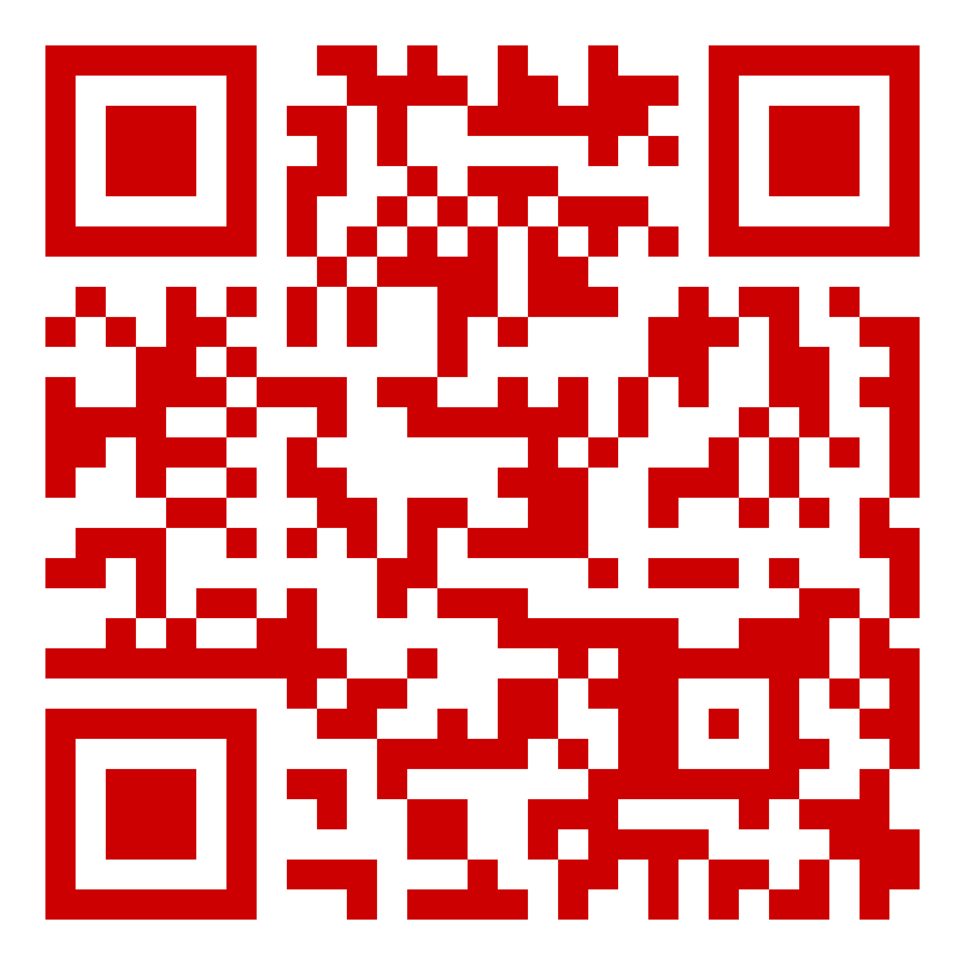
SET YOURSELF UP FOR SUCCESS
1. Schedule Your Tech-In
  Choose your arrival timeslot
  Pack smart and label belongings
2. Complete Your Roommate Agreement
  Communicate early
  Set expectations and boundaries
3. Know Your Resources
  Your CA is here to help
  Get connected to campus organizations and events
4. Stay Connected
  Check your TTU email regularly
  Follow @TTUHousing for updates and reminders

Slide 12
STAY CONNECTED
BEFORE YOU GO . . .
@TTUHousing
housing@ttu.edu
806-742-2661
  We’re here to help before, during and after Tech-In!

Slide 13

Join us for Refuel & Refresh
Stop by and join Parent & Family Relations for our move-in event: Refuel & Refresh!
August 21 and 22
International Cultural Center (free parking)
11:00 am – 2:00 pm
Can wait to see you!
Register on the Red Raider Family Network

Slide 14
Questions?
Use the Zoom Q&A feature

Slide 15
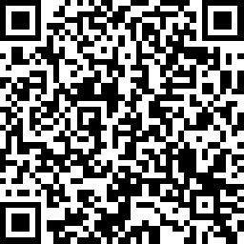

Take Our Survey
Up Next:
Student Disability Services: Accommodations – July 28
Finishing Touches with PFR – August 5
Parent and Family Relations
parent@ttu.edu
Hospitality Services
hospitality@ttu.edu
University Student Housing
housing@ttu.edu

