Slide 1
Day 1: Autodesk Inventor Tutorial
By Noah Plues

Slide 2
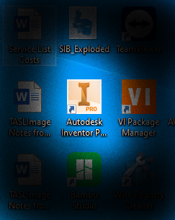
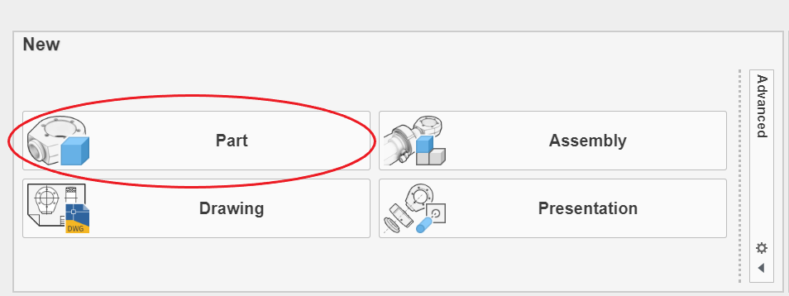
Getting Started
Upon clicking on the Desktop Icon, you will see the option to create a new part, drawing, assembly, or presentation.
In addition, you can access all the parts you’ve worked on previously.

Slide 3
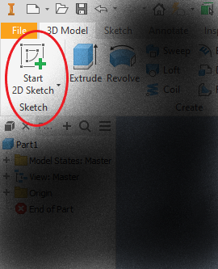
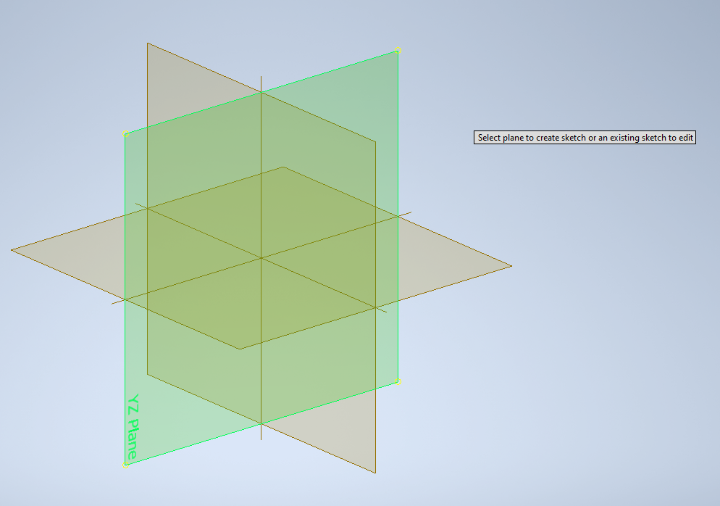
New Part
Upon creating a new part, you will encounter a blank screen with a ribbon on top that allows you to create and make edits to your new object.
To make things simple, select “Start 2D Sketch” on the top left corner of your screen.
Most new 3D parts begin with the creation of a 2D sketch that is later projected into the 3D space.
From there, you can select either the XY, YZ, or XZ plane as the surface that you can create your first sketch.

Slide 4
Your First Sketch
When you create any new sketch, the ribbon will automatically send you to the “Sketch” Menu.
You have the option of drawing a line, a circle, an arc, or a rectangle as your first shape.
Keep in mind that you will need to have a closed surface in order to extrude anything into the 3D space.
After creating your first sketch, you have the option of creating certain dimensions or modifying your sketch in other ways. The complete menu is shown below:

Slide 5
3D-Modeling
Once we have a 2D sketch created, we can extrude it by a certain distance to create a 3D model.
Other ways to create a new 3D model is to revolve the sketch around an axis, create a loft feature between two or more sketches, or sweep a sketch along a curve.
Once we’ve created our 3D model, we can perform various modifications to it, just like we did with our 2D sketch from earlier.
Such modifications include boring a hole, filleting the corners, or hollowing out our model using the Shell command.

Slide 6
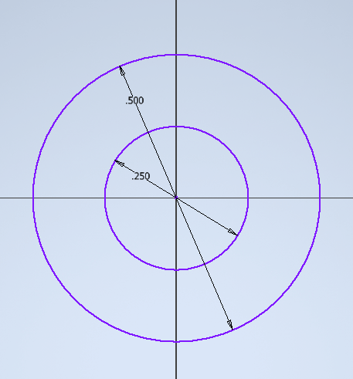
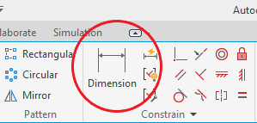
Example 1: 8-Toothed Gear
This is a relatively simple part to sketch up. Our first step is to create two concentric circles.
All dimensions are in inches and can be modified using the ‘Dimension’ feature.

Slide 7
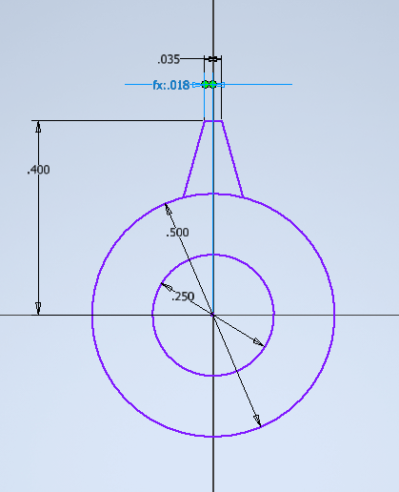
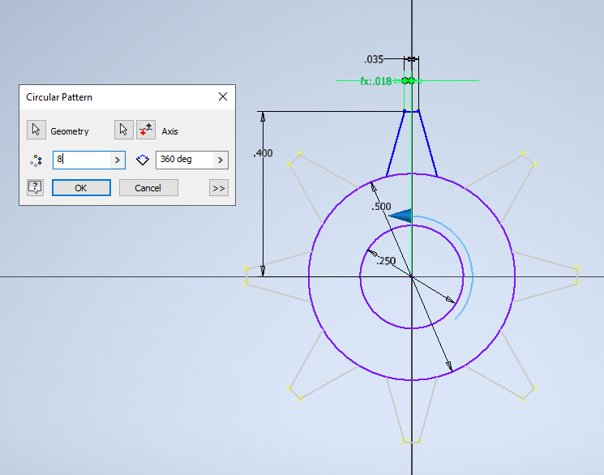
Example 1 – Cont.
After establishing the inner and outer diameter of the gear, we can draw the teeth.
We can make this easy by drawing out one tooth, and then revolving it around the centerpoint. We can create as many teeth as we want this way.
Note: the dimension fx: .018 was created by dividing the dimension fx: .035 by 2.

Slide 8
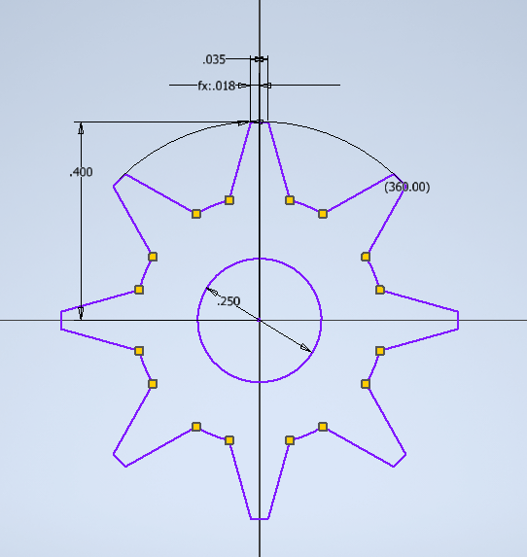
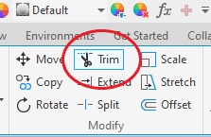
Example 1 – Cont.
Once we’ve drawn the teeth, we should trim the segments inside so that the space is interconnected. This can be done with the “Trim” feature.

Slide 9
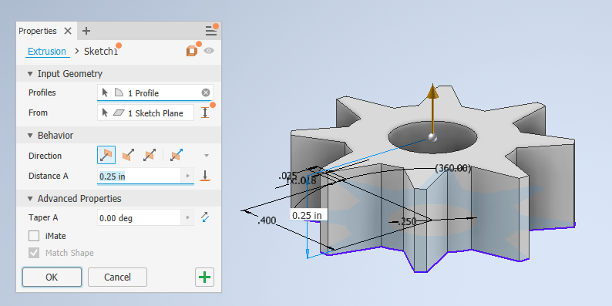
Example 1 – Cont.
Finally, this shape is ready to be extruded into 3D. The length of the extrusion can be modified.
Extrusions can also be used to cut out a negative space in an already-existing object or performed in both directions. In addition, you can specify the distance of the extrusion toward an already-existing surface if one exists.

Slide 10
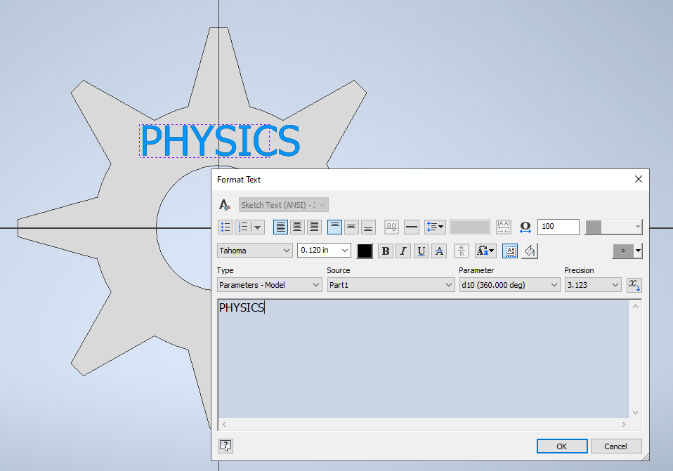
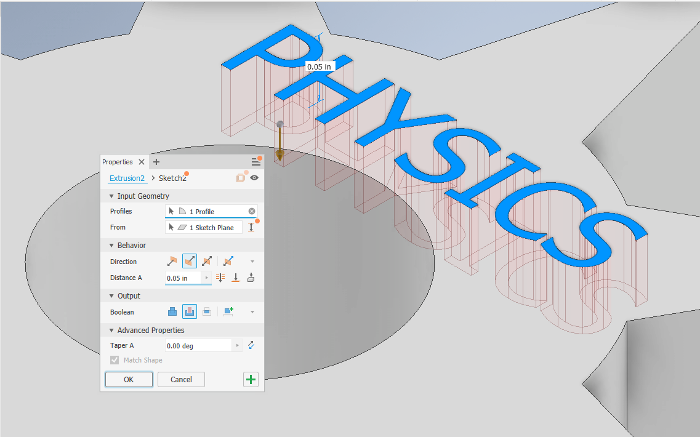
Example 1 – Cont.
To add some flair to this design, how about we emboss some text onto it? All we have to do is select the “Text” feature under “Sketch” and type something. We then extrude it downwards.

Slide 11
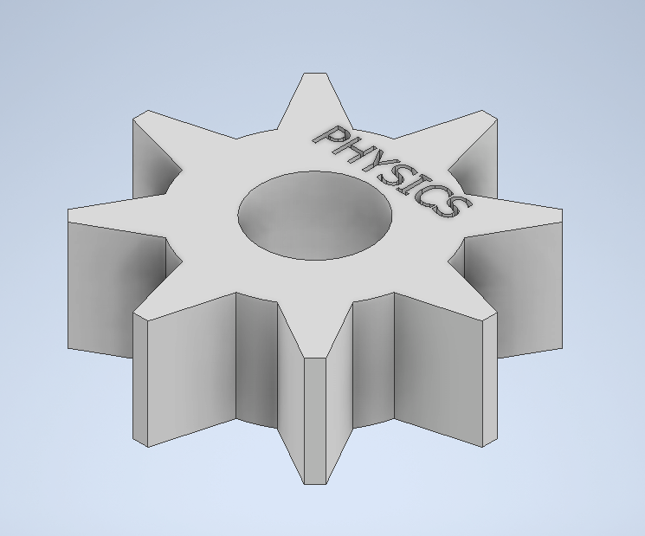
TA DAAA
KA-BOOM

Slide 12
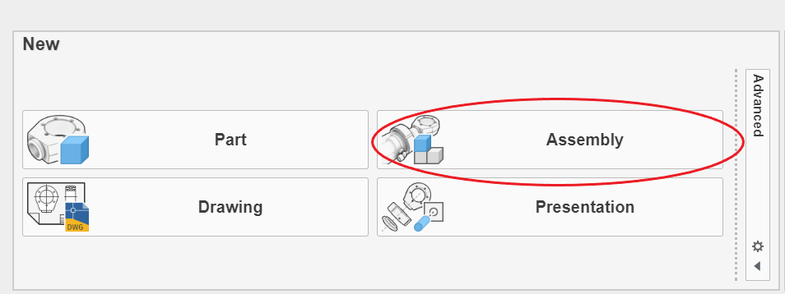
Creating an Assembly
Next, we’ll demonstrate how to create an assembly of two or more parts. This is particularly important when we need to create multi-component systems.

Slide 13
Example 2: Nut and Bolt
Here, We will create a threaded nut-bolt combo. This will be a simple assembly with two components.

Slide 14
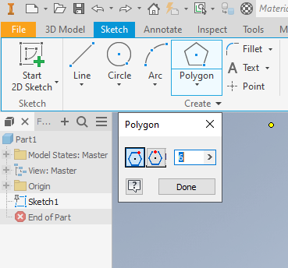
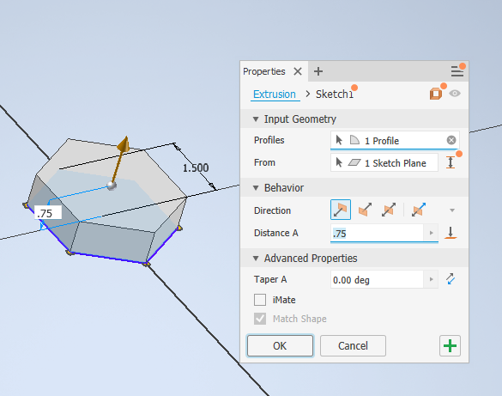
Creating Part 1
Step 1: Create a hexagon and extrude it to create the base. Note that we’ll need to select the down arrow from the “Rectangle” feature to select “Polygon”

Slide 15
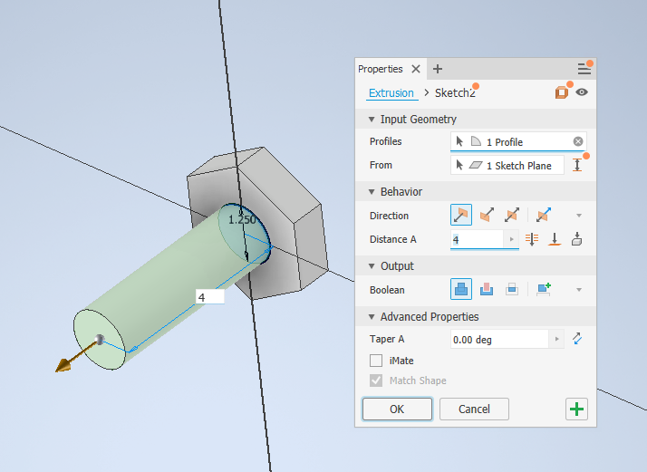
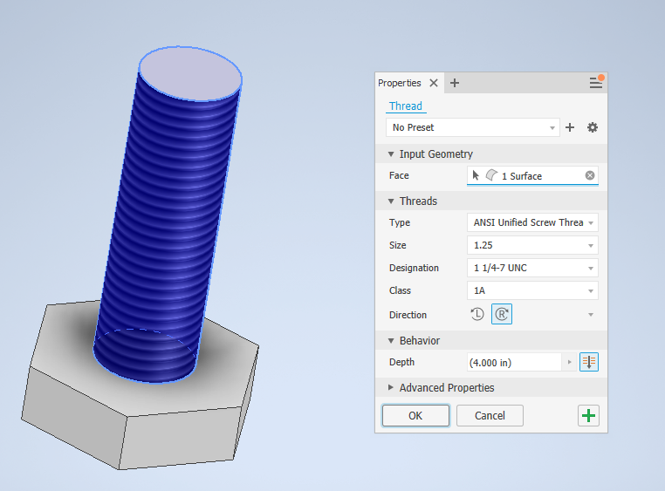
Creating Part 1
Step 2: Sketch a circle on the base and extrude that as well
Step 3: Select the “Thread” feature and click on the surface of the cylinder. Modifications can be made as necessary.

Slide 16
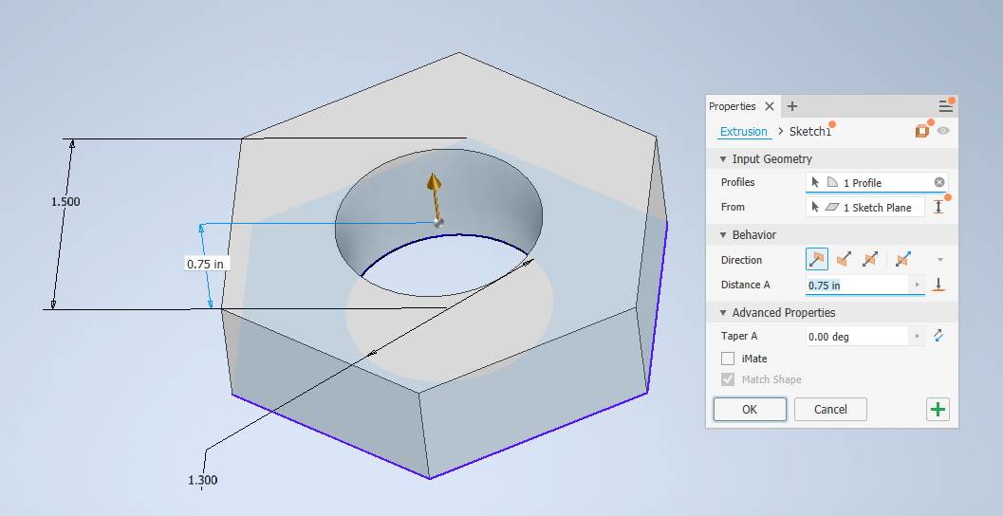
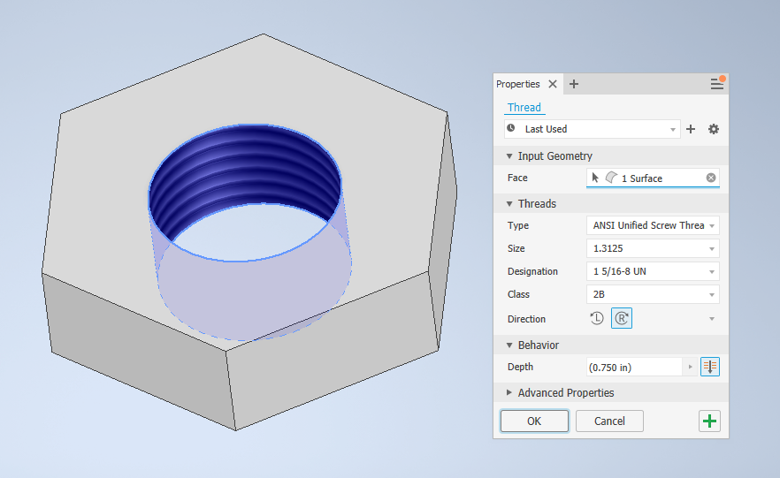
Creating Part 2
To create the bolt, all we need to do is sketch another hexagon with a circle in the middle for the hole. Note that there needs to be a small tolerance between the nut and the bolt for the two to properly mate together.

Slide 17
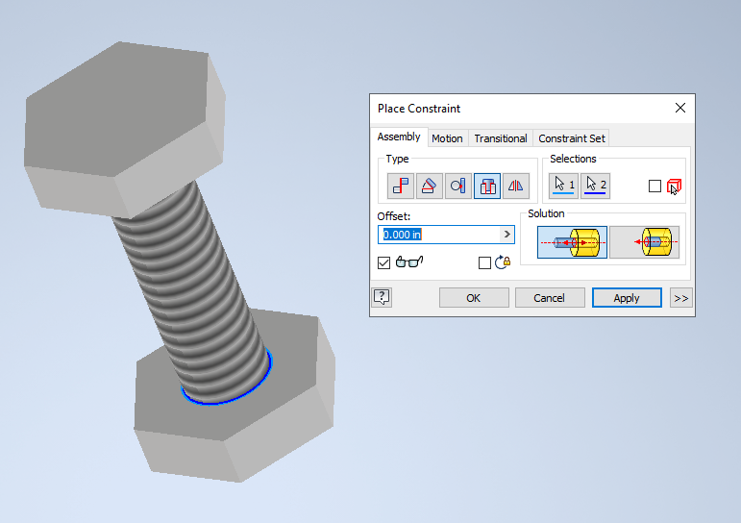
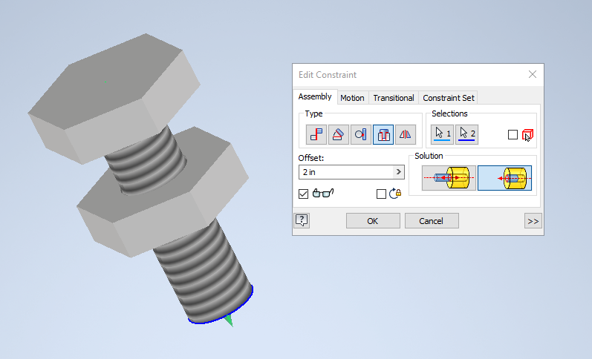
Creating the Assembly
To finish our assembly, all we need to do is to load both parts and create a constrain relationship between the two. Since we’re trying to insert a shaft into a hole, we will use the “Insert” relationship.
We can adjust the position of the bolt on the screw by modifying our “Offset” parameter.

Slide 18
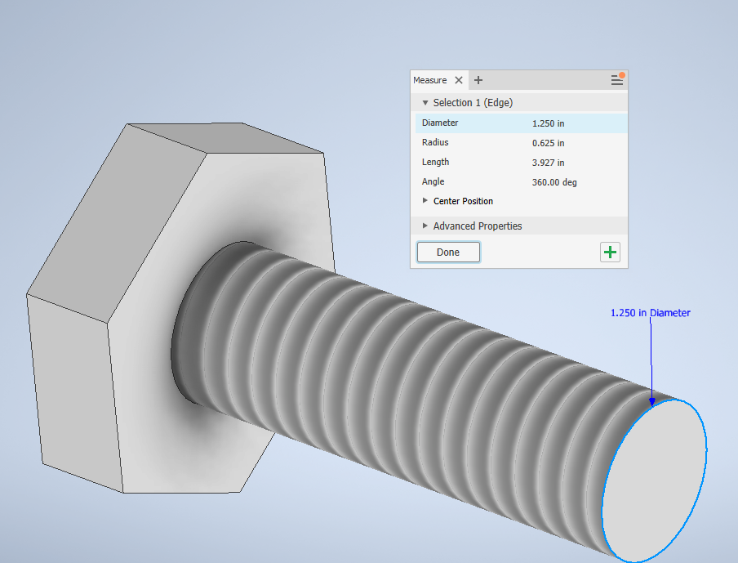
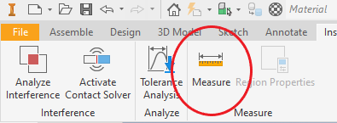
Additional Features
We can check the dimensions of a particular part by going to “Inspect” > “Measure” and selecting either a radial or a linear dimension.
If we’d like to make our models more realistic, we can alter the material that they are made of, as well as perform static and dynamic simulations on them.

Slide 19
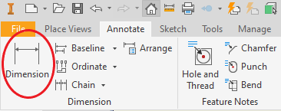
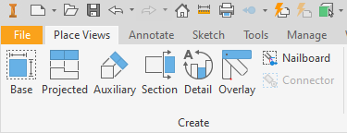
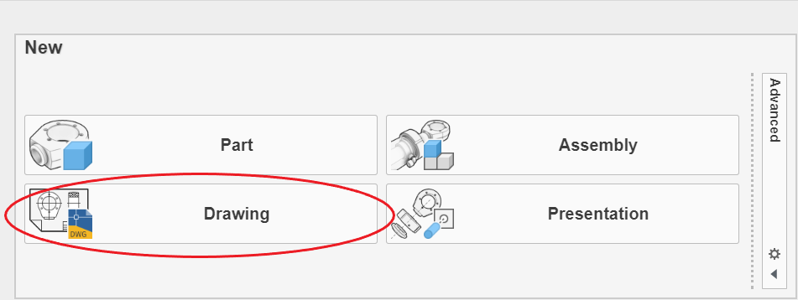
Drawings
Finally, to make our models presentable, we can create drawings that showcase each dimension and feature.
Each drawing should have a number of views: The base view, one or two projected views, and one auxiliary view depending on how much space is available. With more complicated structures, it would be helpful to include a section view.

Slide 20
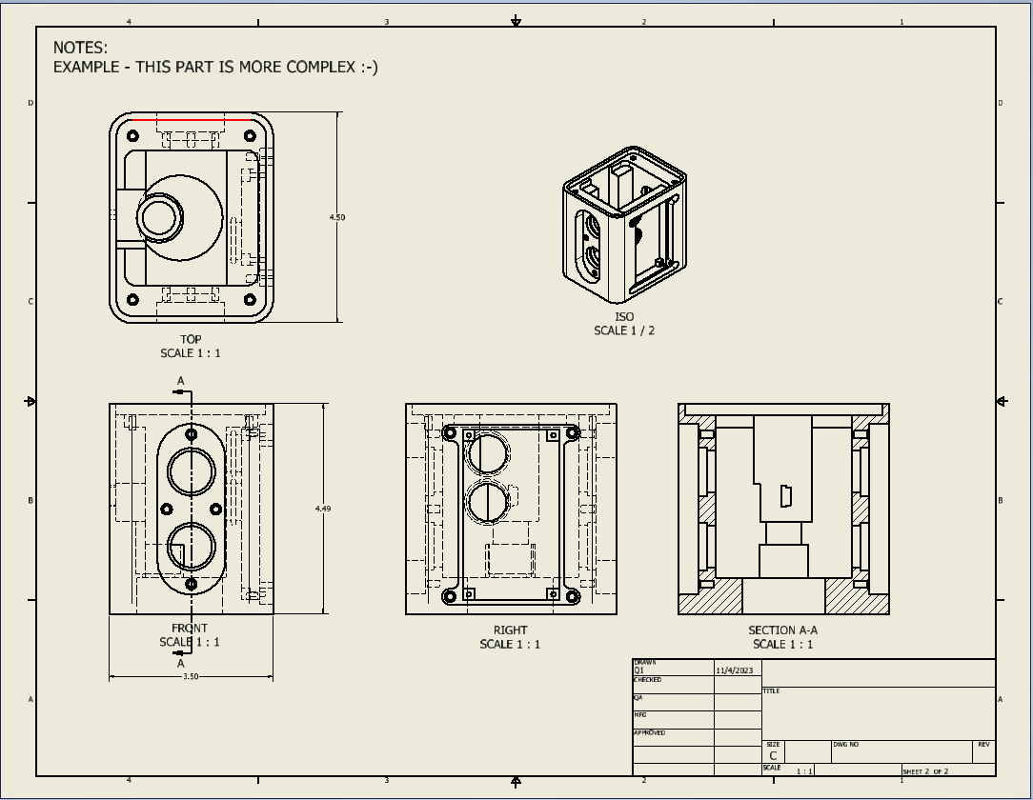
Drawing - Example

Slide 21
Questions?

