Slide 1
PHYS 5300-019 Measured properties of solids
R. V. Duncan, Ph.D.
October 13, 2022

Slide 2
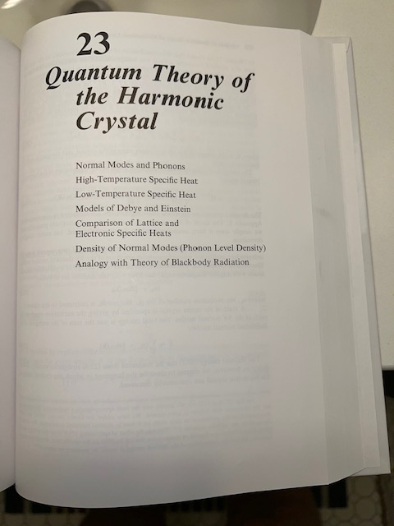
A great CMP text

Slide 3
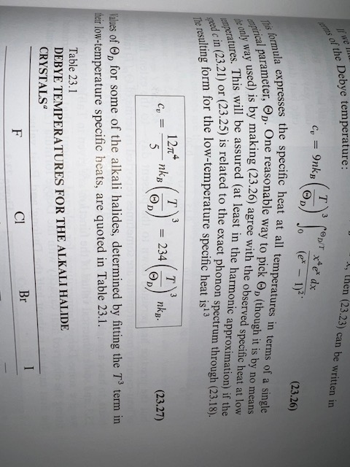
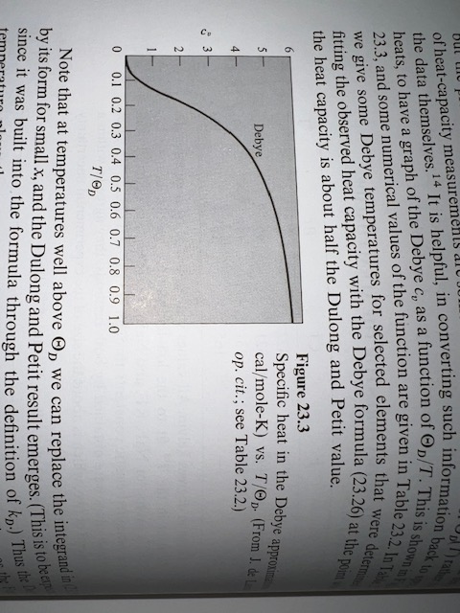
Lattice specific heat
High T: Dulong and Petit
https://en.wikipedia.org/wiki/Dulong–Petit_law

Slide 4
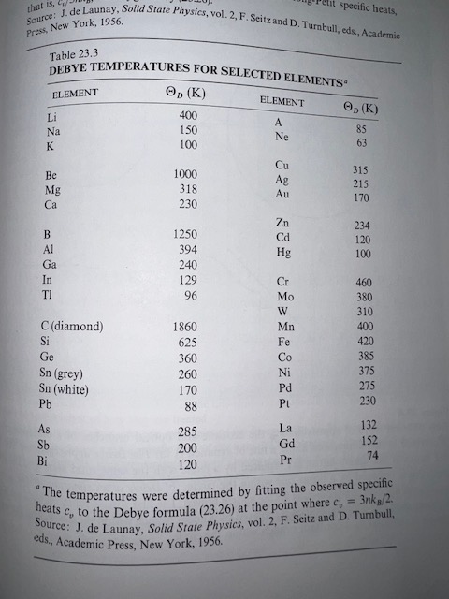
Debye temperatures

Slide 5
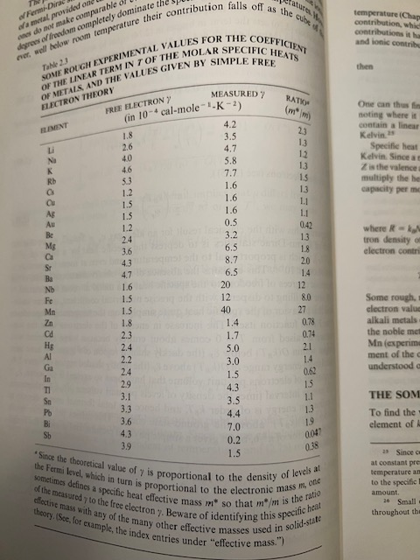
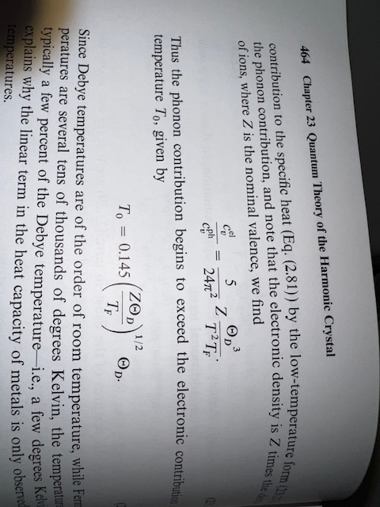
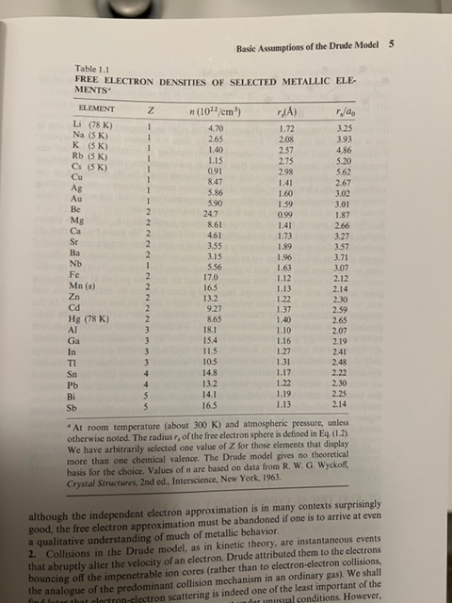
Conduction electrons: specific heat
When does the lattice specific heat
become greater than the electronic
contribution? Well…

Slide 6
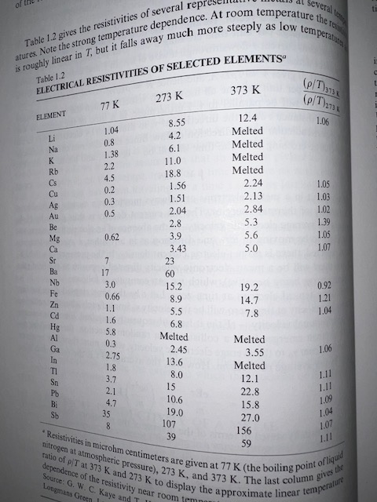
Electrical and thermal conductivity σ = 1/ρ RRR = ρ(300K) / ρ(~0K) good pure Cu: RRR > 1,000 most dirty metals: RRR ~ 5
At low-T: https://en.wikipedia.org/wiki/Wiedemann–Franz_law
Useful: https://cds.cern.ch/record/1973682/files/arXiv:1501.07100.pdf

Slide 7
Back to Mossbauer and quantum nucleonics
P_{recoilless} = exp(-E_{r}/k_{B}Θ_{D})
E_{r} ~ 2 meV, k_{B}Θ_{D} ~ 41 meV
P_{recoilless} = 0.95
P² = 0.91
https://en.wikipedia.org/wiki/Mössbauer_effect
⁵⁷Fe
⁵⁷Fe
γ
Detector
v(t) ~ (1 cm/s) sin ωt
β ~ 3.3x10⁻¹¹ sin ωt

Slide 8
Solid-state control of nuclear quantum dynamics
Lattice excitations, circularly polarized magnons, in a permalloy film, change the magnetic field at the ⁵⁷Fe nucleus from 28 T to 25T, resulting in shifted energy transitions shown in blue. Hence, this lattice excitation modifies quantum coherence in ⁴⁷Fe nuclei.
See also K.P. Heeg, et al., “Coherent X-ray – optical control of nuclear excitons” in Nature 590, pp.401 – 418 (2021). They state that these results may “… unlock coherent optical control for nuclei, and pave the way for nuclear Ramsey spectroscopy and spin-echo-like techniques, which should not only advance nuclear quantum optics, but also help to realize X-ray clocks and frequency standards.” We have seen this in force at PQE’22!
A new suggestion: Can this also influence novel nuclear reactions, and thereby impact future nuclear science? Not certain yet, but possibly yes
“Coherent control of collective nuclear quantum states
via transient magnons”, Fig. 1
(Bocklage et al., Sci. Adv. 7 : eabc3991 29 Jan 2021)

