Slide 1
NANOPARTICLES SYNTHESIS
PHY5900-019
SAMUEL ADEOSUN

Slide 2
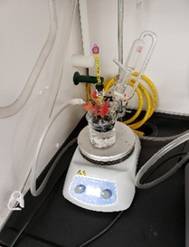
Nanoparticles synthesis approach/strategy
• Nucleation is the process whereby nuclei (seed) acts as template for crystal growth.
• Growth is the union of individual molecules that aggregates to form nanoparticles.
• Seed-mediated growth method is one of the most reliable and versatile methods to control the shapes of noble metal nanocrystals.

Slide 3
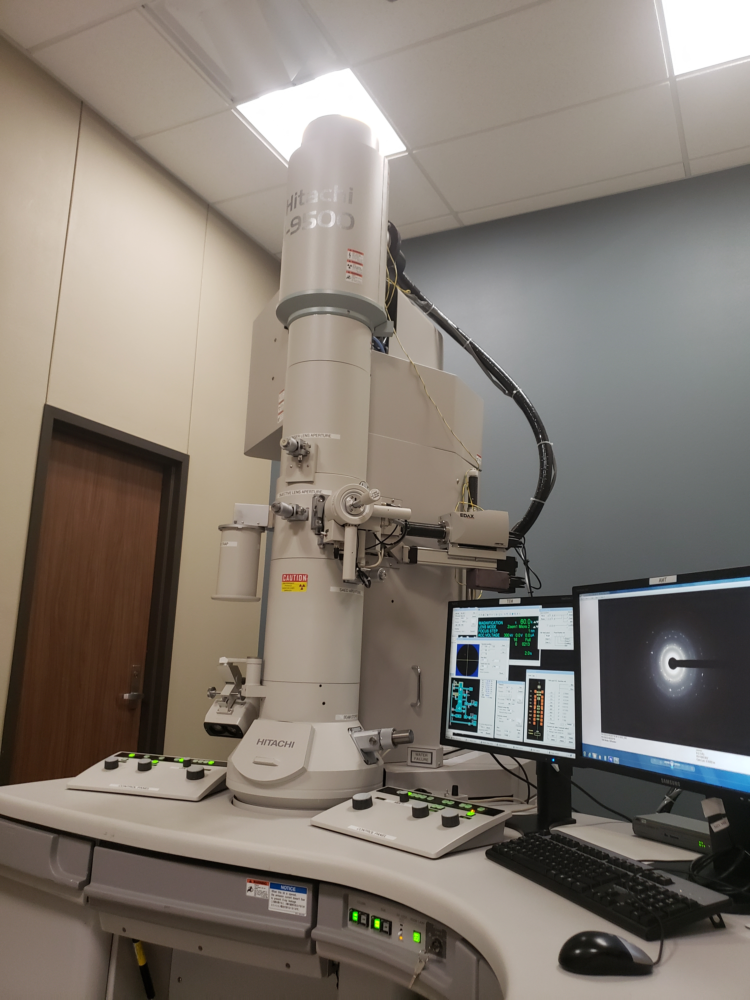
Nanoparticles characterization techniques
• Transmission Electron Microscopy (TEM) is a characterization technique in which electrons beam is transmitted through a specimen to form image. A drop or two of the sample within 100 nm thickness is suspended on TEM grid.
Other characterization techniques for nanoparticles
Nanoparticle Characterization Techniques – nanoComposix

Slide 4
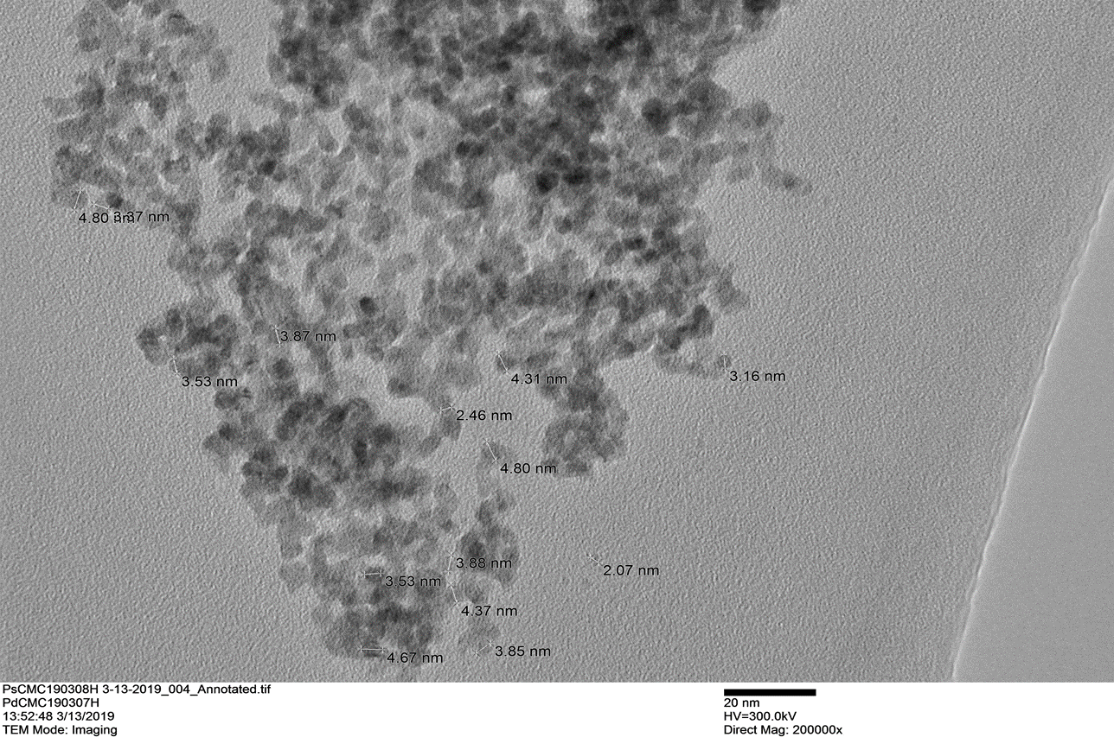

PdCMC synthesis

Slide 5
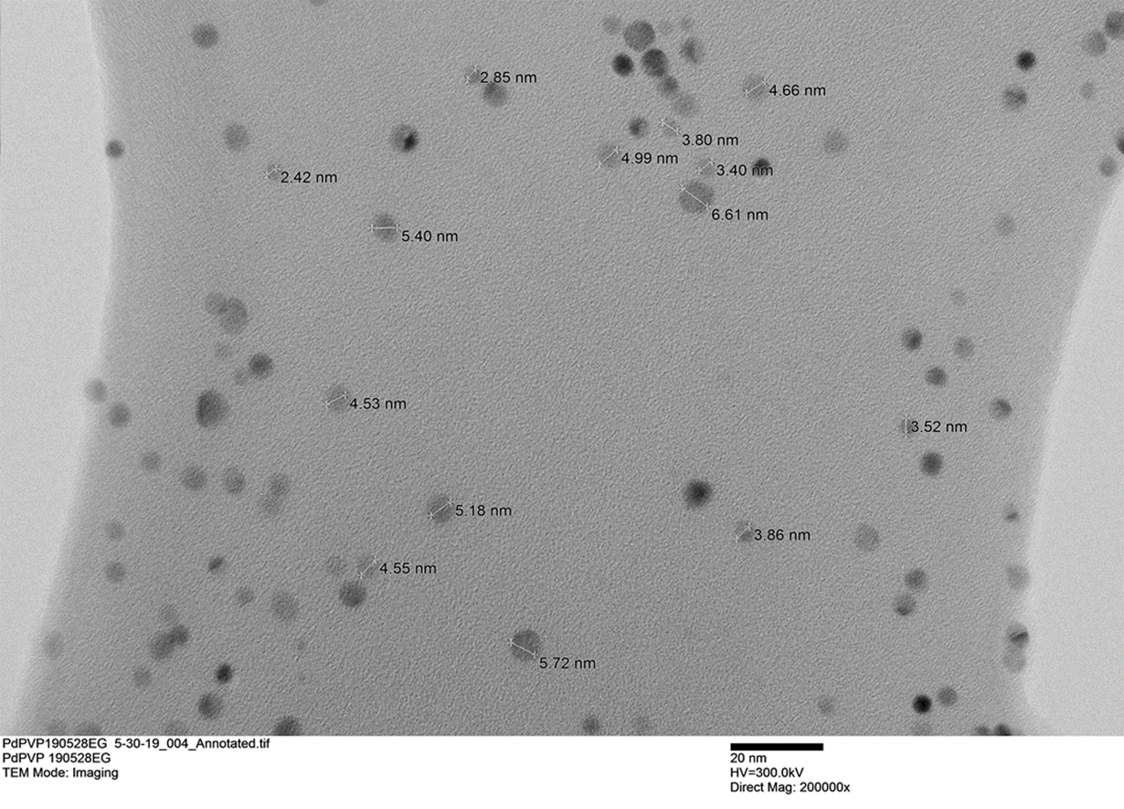
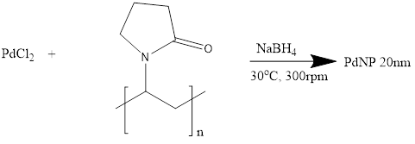
PdPVP synthesis

Slide 6
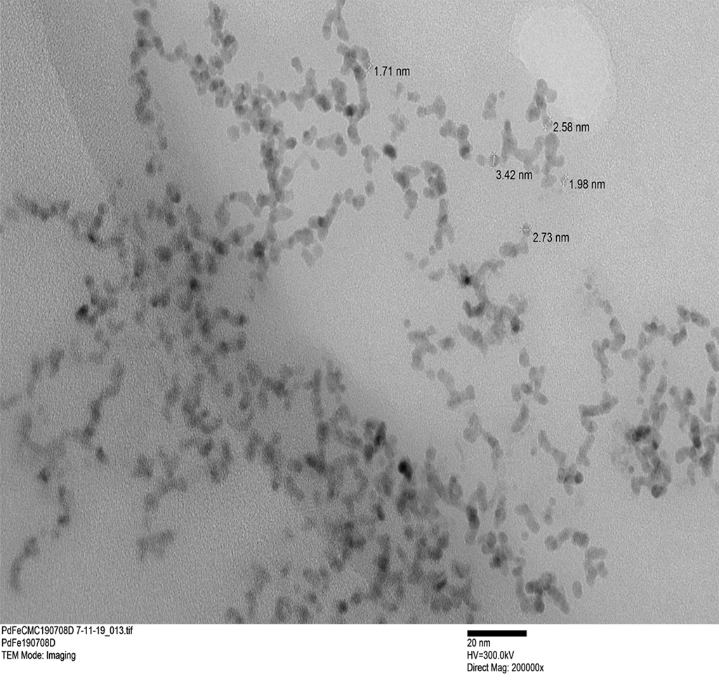
PdFeCMC synthesis
Journal of Nanoscience and Nanotechnology vol. 17, 2833 – 2835, 2017

Slide 7
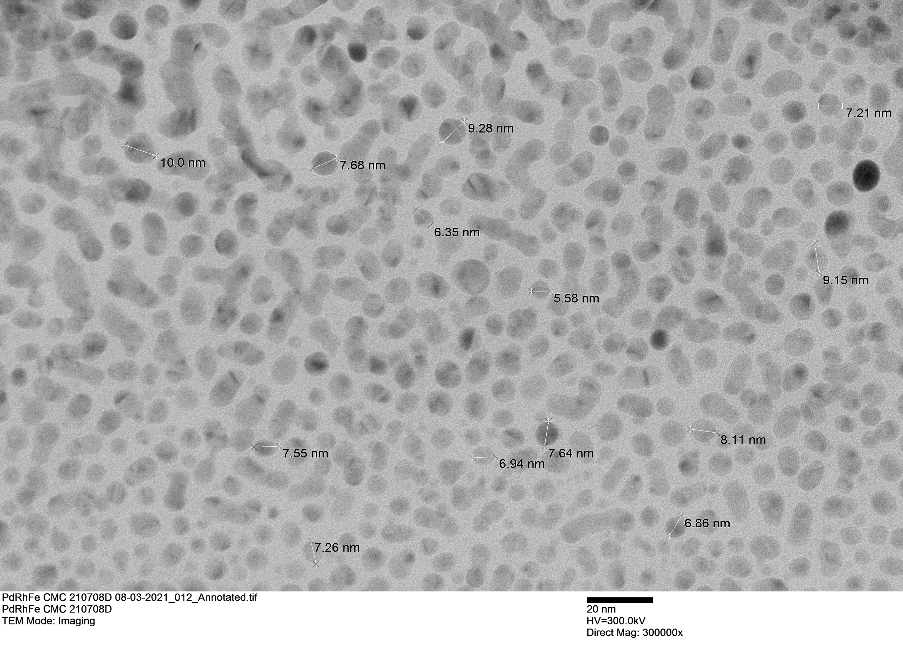
PdRhFeCMC synthesis

Slide 8
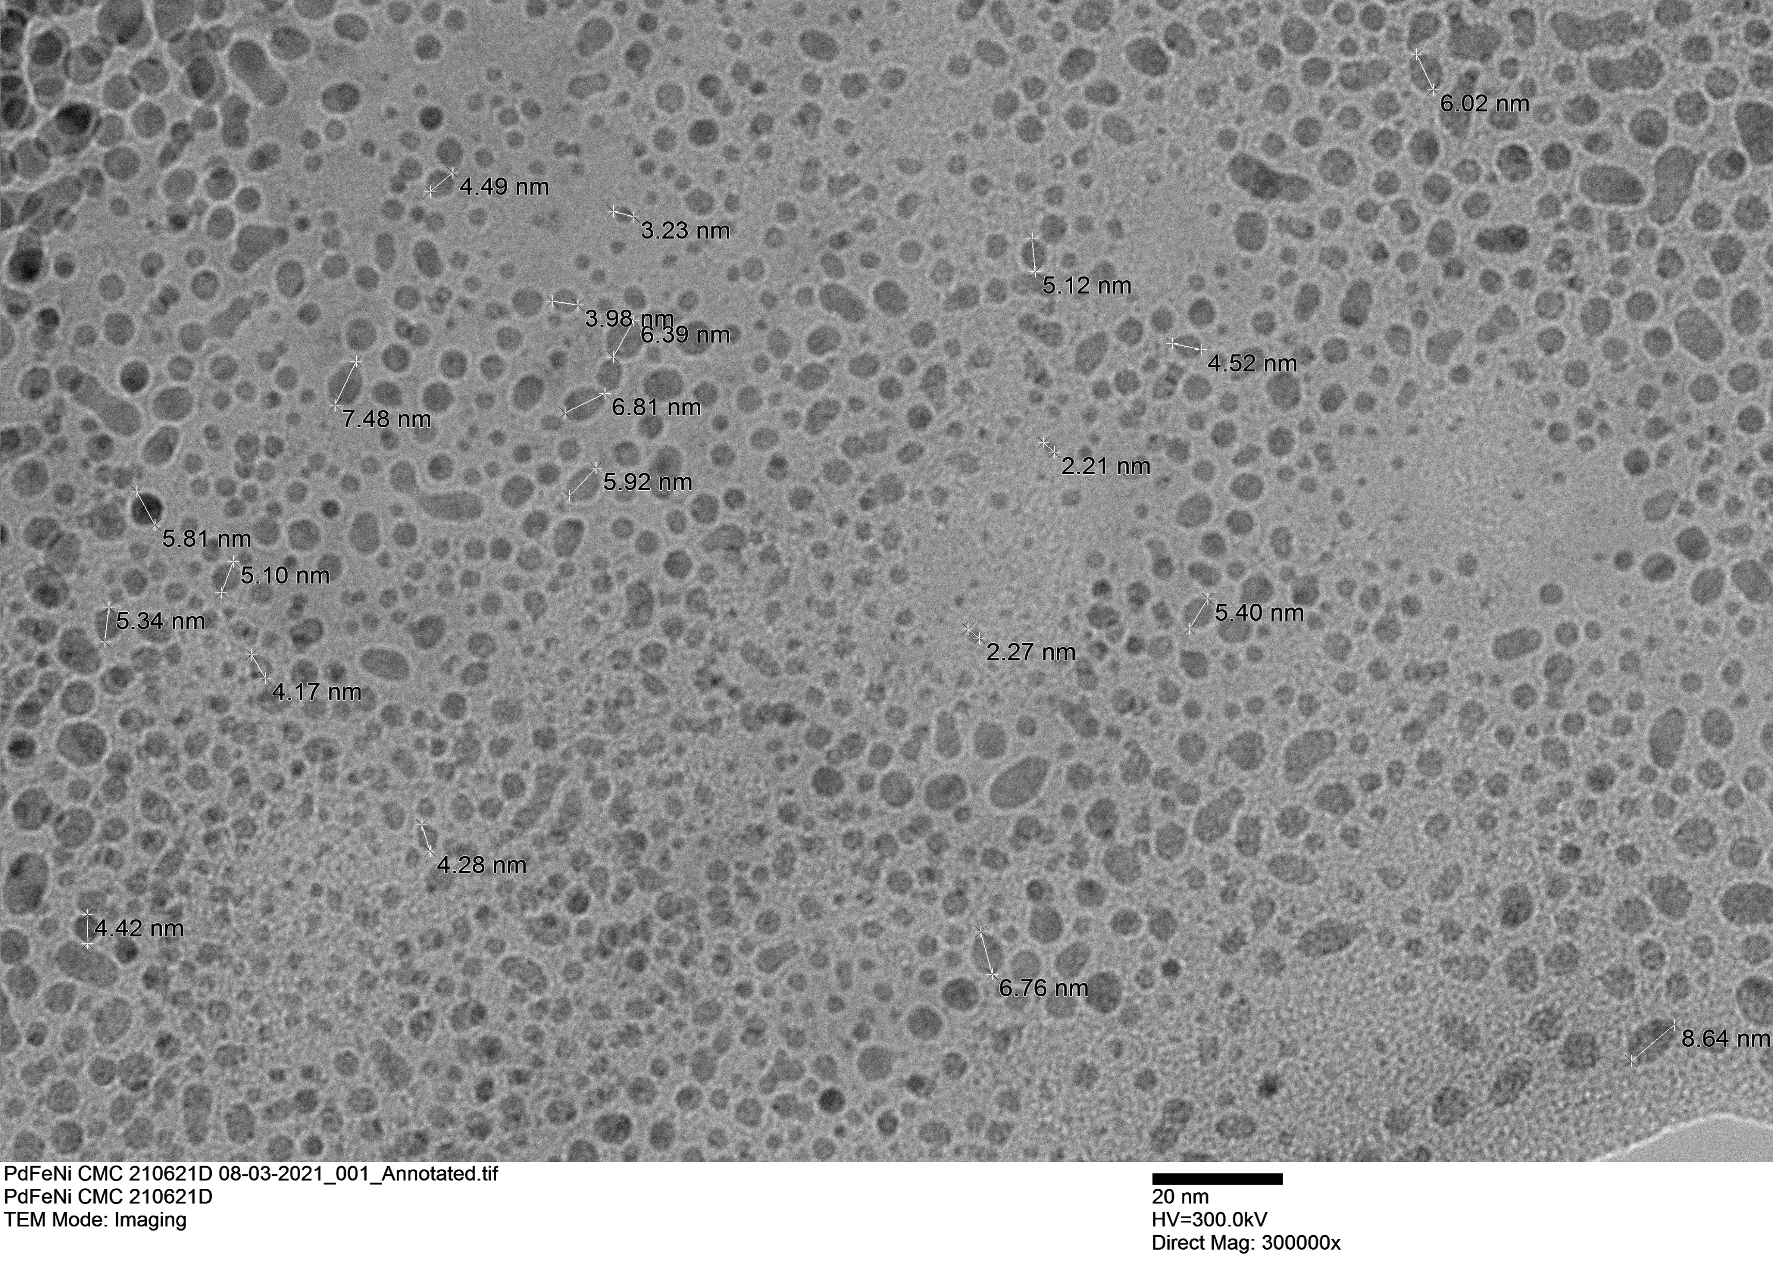
PdFeNiCMC synthesis
Ind. Eng. Chem. Res., 2007, 46(1) pp 29-34

Slide 9
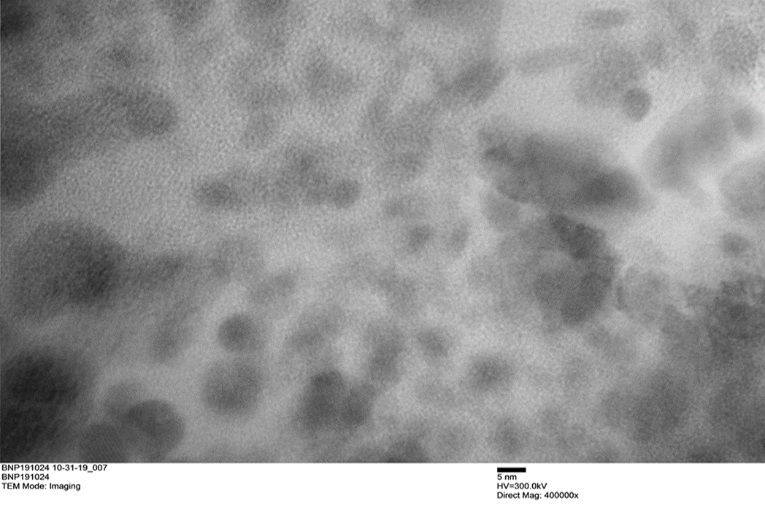
Boron nanoparticles synthesis
Chem. Commun., 2007, 580-582

Slide 10
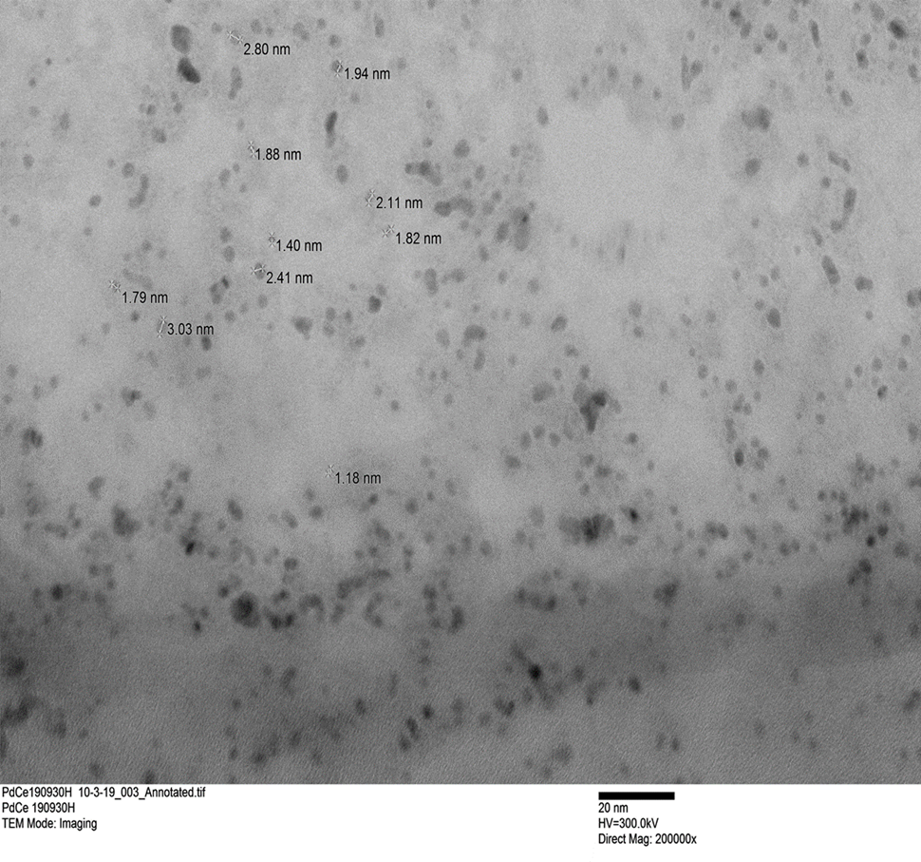
PdCeCMC synthesis
Material Chemistry and Physics Vol. 187, 1 Feb. 2017, Pages 133-140

Slide 11
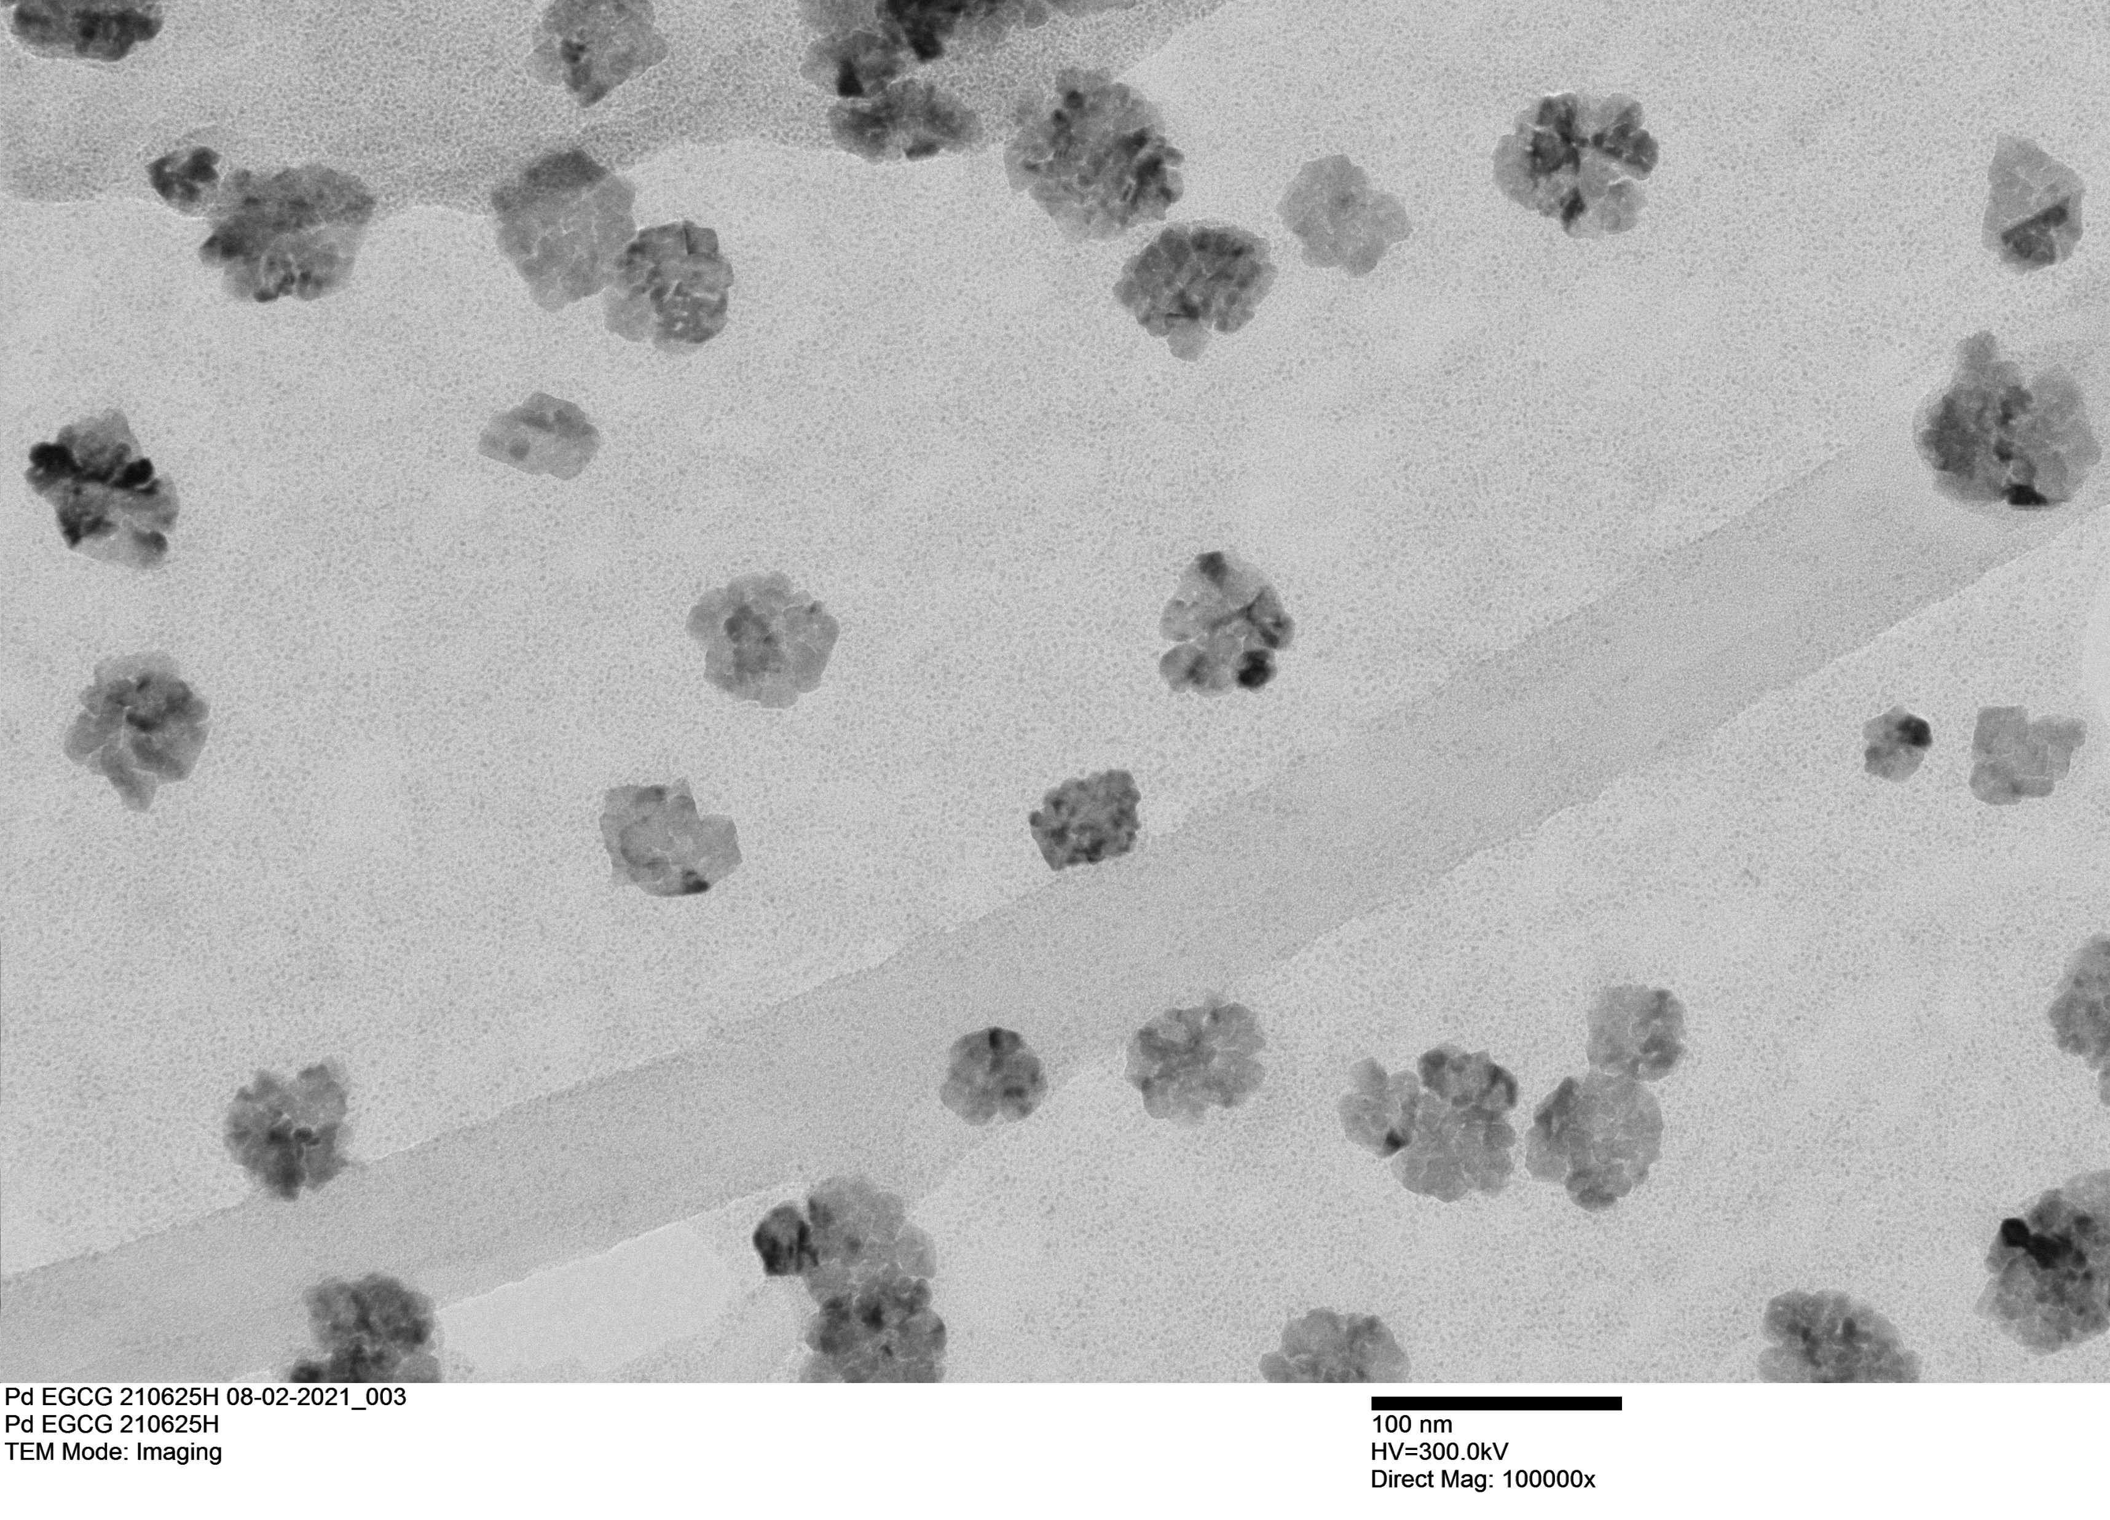
PdEGCG synthesis
Katti, Kattesh V., Azizi, Orchideh, Gupta, Sagar, Katti, Kavita K., El-boher Arie, Duncan, Robert and Hubler Graham EGCG stabilized Palladium nanoparticles, methods for making, and electrochemical cell United States Patent Application 20170009366

Slide 12
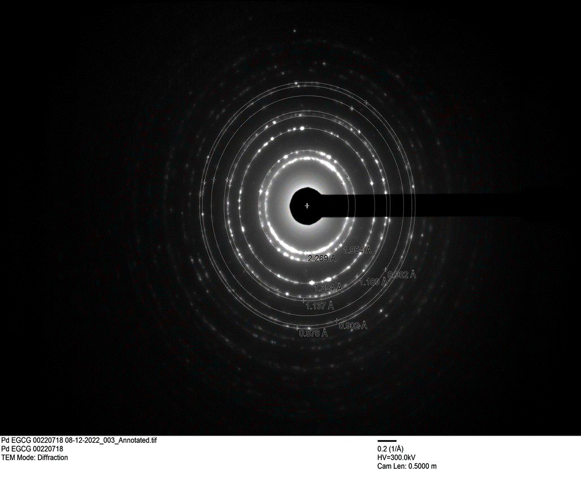
SAED Pattern of Palladium nanoparticles

Slide 13
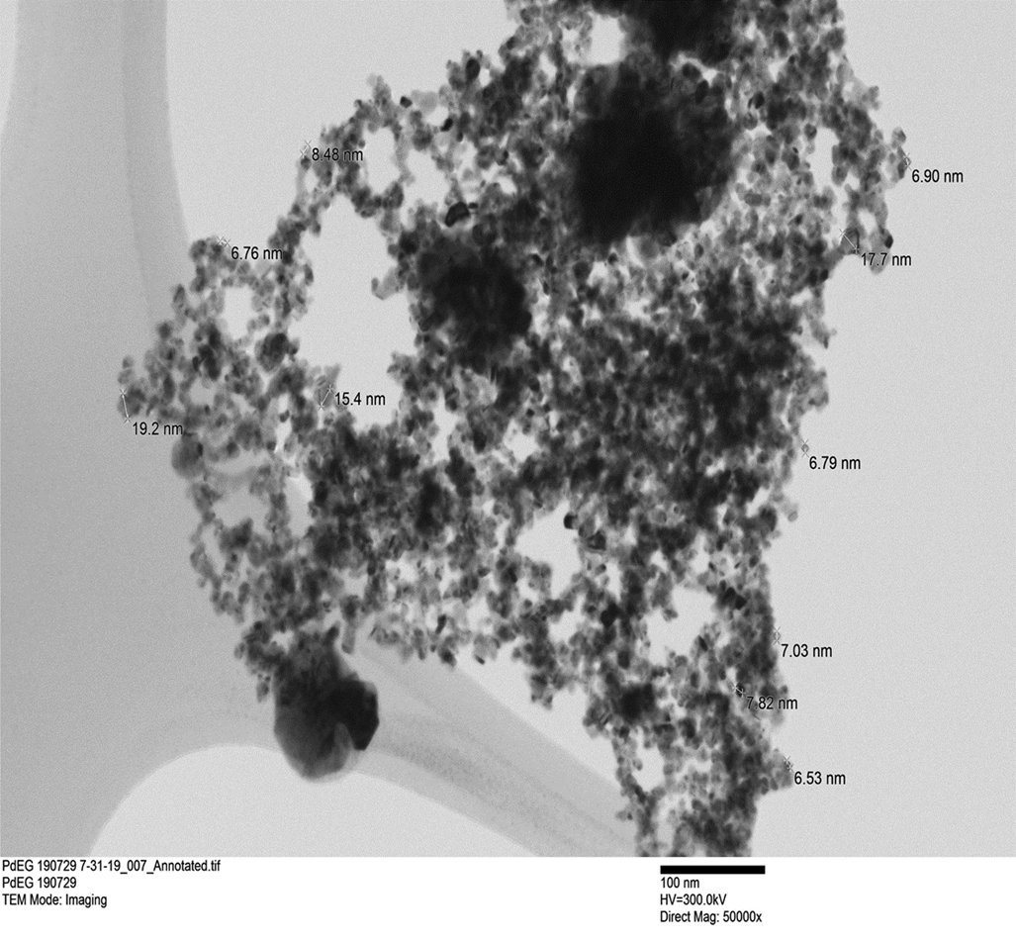
Palladium nanoparticles using Ethylene glycol (Polyol method)
Material Chemistry and Physics Vol. 187, 1 Feb. 2017, Pages 133-140

