Slide 1
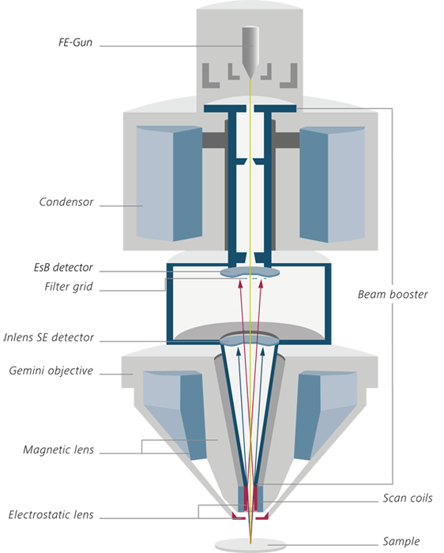
FIB system
EDS system
Sample Loading
Oxford EBSD system
BS detector
STEM detector
Stage Rotation 360 º
Tilt: 70 º

Slide 2
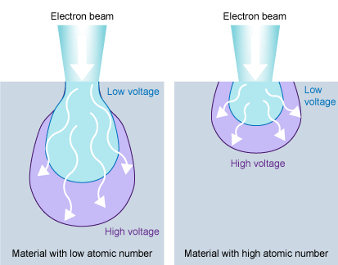
Zeiss Acceleration Voltage: max 30 kV
Penetration depth of Pd as function of Acceleration Voltage
V, kV | depth, um | A | Density g/cm3 | Z
1 | 0.00818 | 106.42 | 11.9 | 46
2 | 0.0260
5 | 0.120
10 | 0.382
12 | 0.518
15 | 0.753
20 | 1.22
22 | 1.43
25 | 1.77
30 | 2.40
http://www.ammrf.org.au/myscope/sem/practice/principles/voltagevstype.php

Slide 3
Penetration Depth, H = 0.0276 A V ^{1.67} , μm
z^{0.89} ρ
A= atomic weight, g mol⁻¹
V= accelerating voltage, kV
z= atomic number
ρ= density, g cm⁻³
Penetration Depth α Interaction Volume

Slide 4
High
Unclear surface structures
More edge effect
High Resolution
More charge-up
More beam damage
Accelerating Voltage
Clear surface structures
Less edge effect
Low Resolution
Less charge-up
Less beam damage
Low

Slide 5
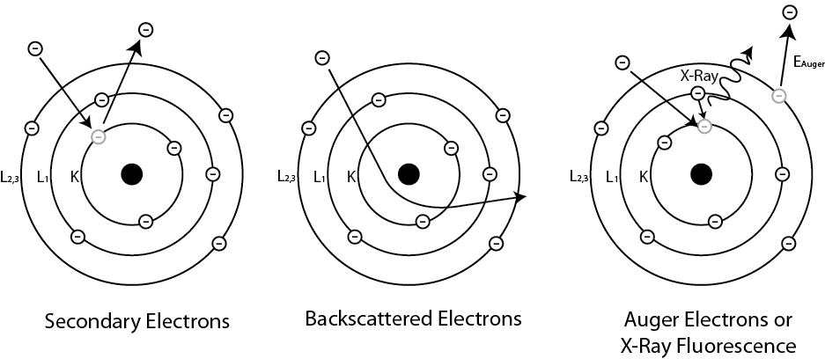
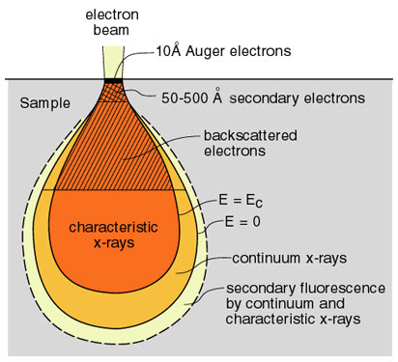
Various modes of electron emission from incident x-rays or electrons. Secondary electrons are inelastically scattered from the emission of valence electrons, backscattered electrons are elastically scattered where larger atoms deflect more electrons increasing collection rates. Auger and x-ray effects are caused by the ejection of inner shell electron compensated for by an electron in a higher orbital dropping down and filling the vacant energy level where then excess energy will either be given off in the form of a characteristic x-ray or the ejection of an outer orbital electron
Signals emitted from different parts of the interaction volume
https://sites.ualberta.ca/~ccwj/teaching/microscopy/

Slide 6
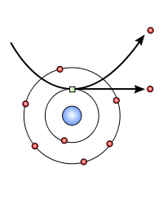
secondary electron Image
secondary electrons originate from the surface or the near-surface regions of the sample. They are a result of inelastic interactions between the primary electron beam and the sample and have lower energy than the backscattered electrons (<50 eV). Secondary electrons are very useful for the inspection of the topography of the sample’s surface,

Slide 7
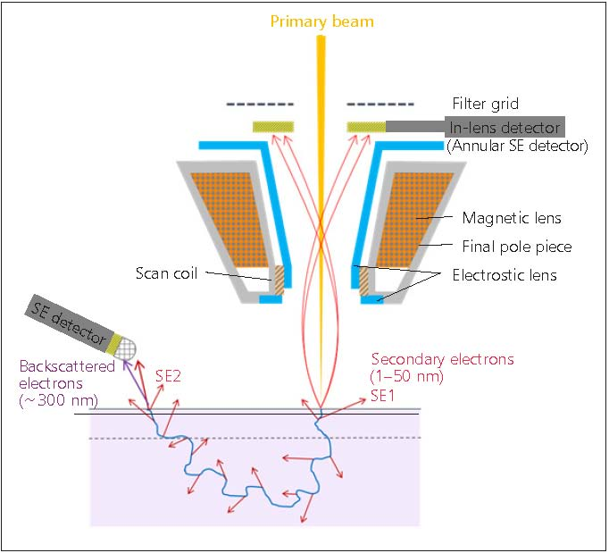
Zeiss Secondary Electron Detector: SESI and Inlens
SE1
the principle of in-lens secondary electron (SE) detection The beam is decelerated by an electrostatic lens and the field applied to decelerate also causes the acceleration of the scattered electrons in the other direction back into the lens on a helical path. The in-lens SE detector is placed on top of the final pole piece in the SEM chamber. The traditional SE detector (Everhart-Thornley (ET)) is also shown in the image, positioned outside the lens system and positively biased to draw SEs. The positioning of this detector favors both SE1 and SE2 electrons but the in-lens detector system favors mostly SE1s.

Slide 8
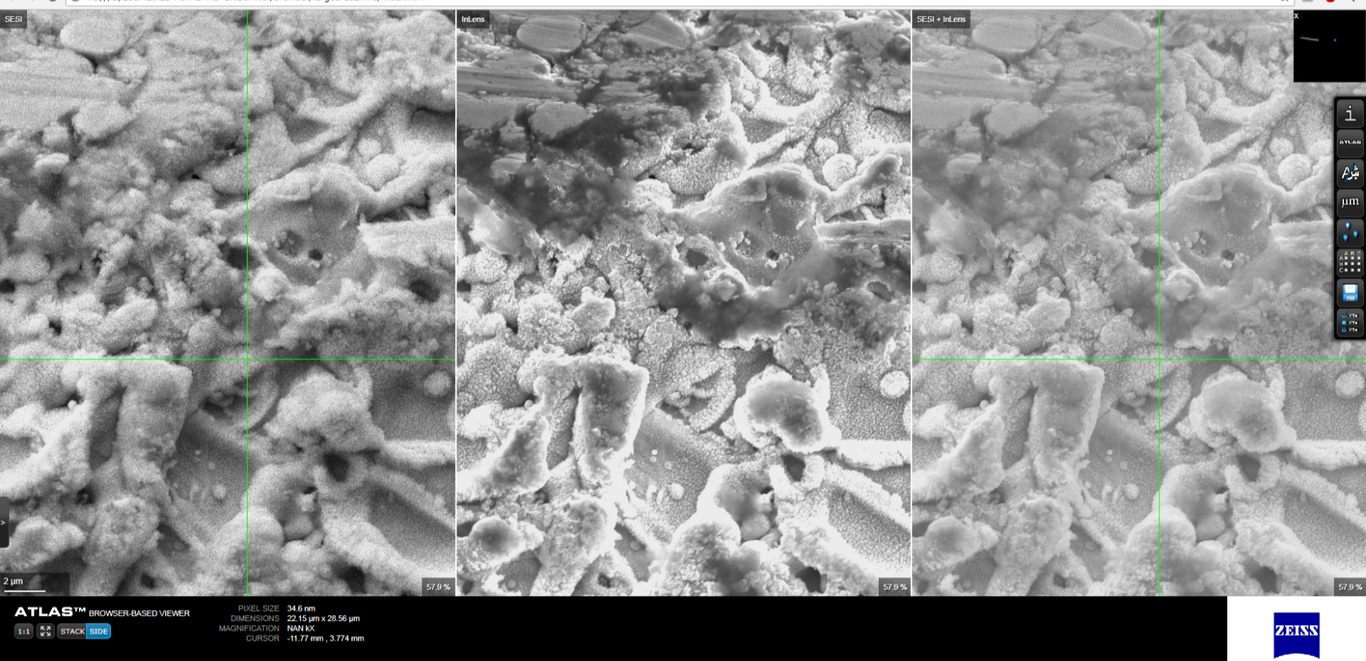
In our application, multiple detectors image acquisition are used during large area imaging
SESI
Inlens
SESI+Inlens

Slide 9
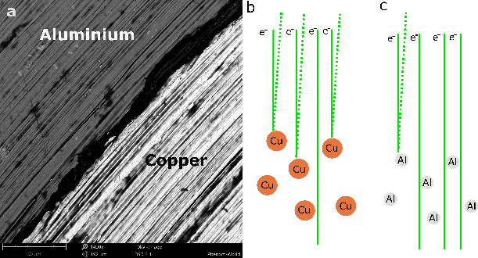
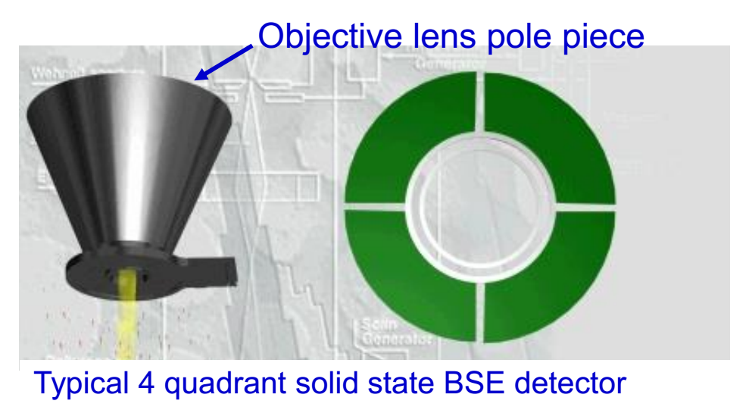
Back Scattered Electron Image from BSD (Back Scattering Detector)
This type of electrons originate from a broad region within the interaction volume. They are a result of elastic collisions of electrons with atoms, which results in a change in the electrons’ trajectory. Think of the electron-atom collision as the so-called “billiard-ball” model, where small particles (electrons) collide with larger particles (atoms). Larger atoms are much stronger scatterers of electrons than light atoms, and therefore produce a higher signal .The number of the backscattered electrons reaching the detector is proportional to their Z number. This dependence of the number of BSE on the atomic number helps us differentiate between different phases, providing imaging that carries information on the sample’s composition. Moreover, BSE images can also provide valuable information on crystallography, topography and the magnetic field of the sample.

Slide 10
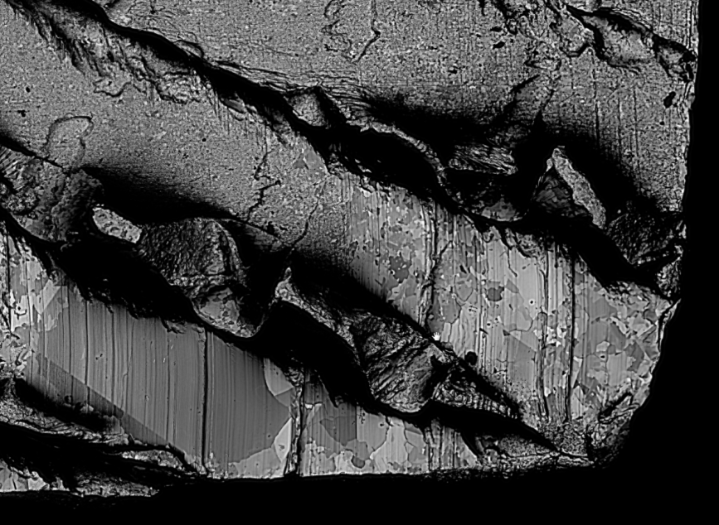
In our experiments, back scatter detector is often used for collecting phase contrast image, mainly for statistical analysis of the grain size.
BSD images of 1cm * 1cm foil sample after annealing at 900 C

Slide 11
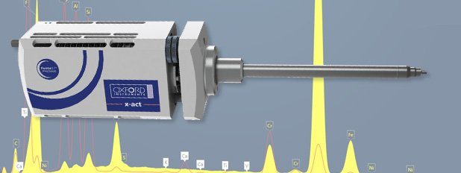
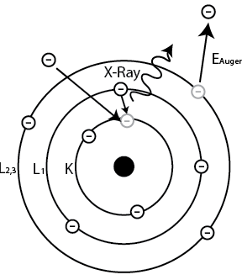
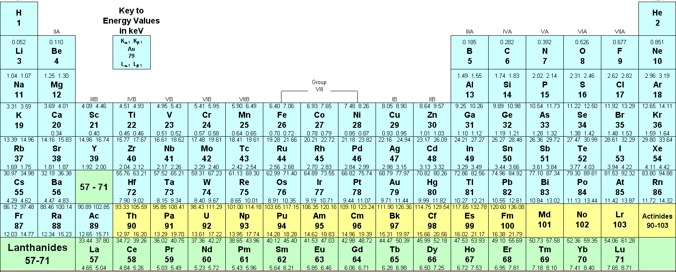
EDS analysis
Energy Dispersive Spectroscopy (EDS) Analysis provides elemental and chemical analysis of a sample inside the SEM, TEM or FIB. Oxford Instruments provides AZtec, a new and revolutionary materials characterisation system that gathers accurate data at the micro- and nanoscales.

Slide 12
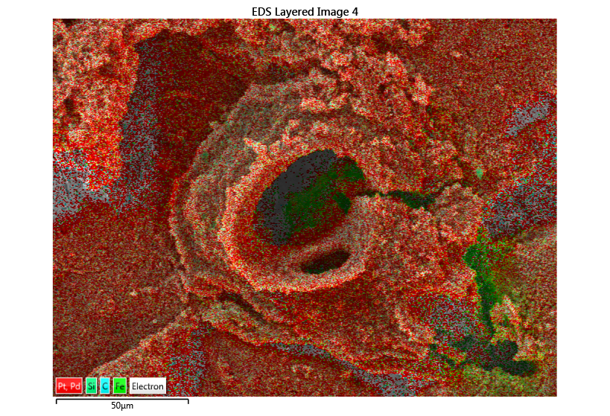
In our experiments, EDS system is often used to map the elements, showing the spatial distribution of elements in a sample
EDS mapping of the volcano feature of C100A sample.

Slide 13
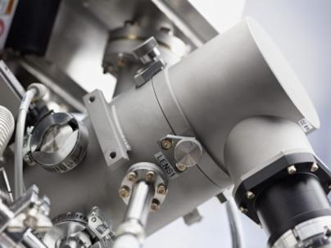
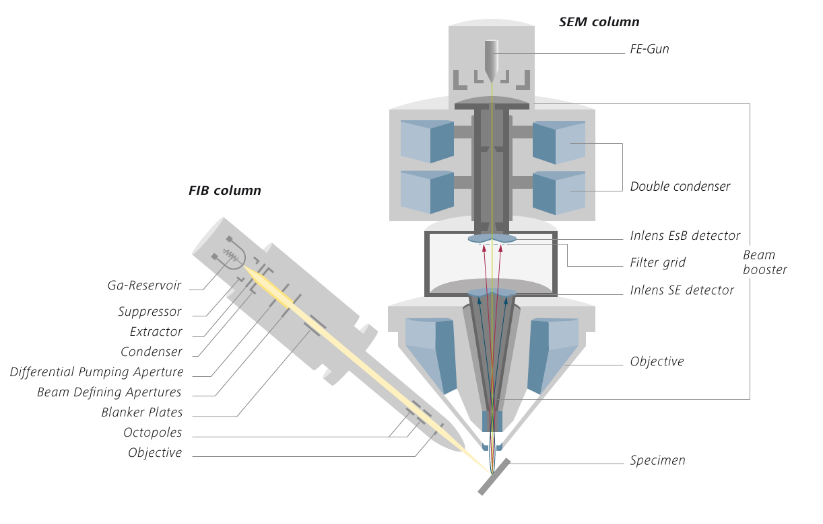
FIB system
Access five orders of magnitude in beam current, from 1 pA up to 100 nA
Get precise and reproducible results with maximum stability during acquisition
Benefit from fast and precise material removal or milling thanks to the larger beam currents of up to 100 nA
Achieve exceptionally small probe sizes with a diameter of less than 3 nm at currents as low as 1 pA
The Crossbeam family now additionally comes with automatic FIB emission recovery for long-term experiments

Slide 14
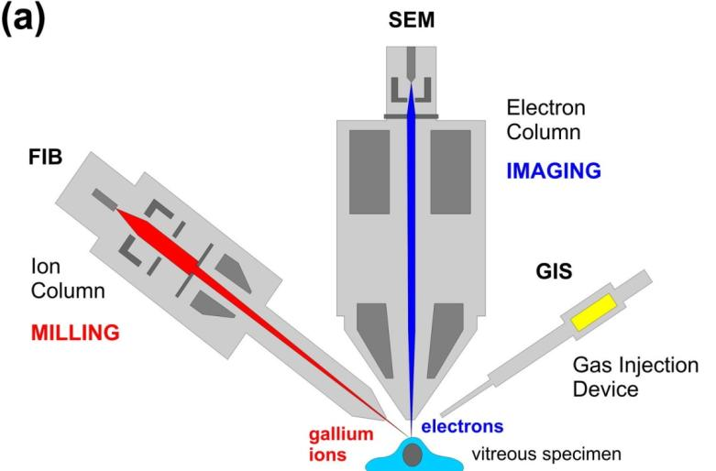
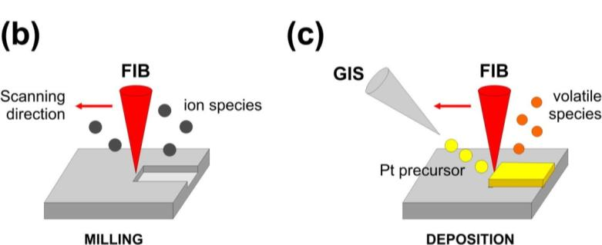
FIB application: Milling and Deposition
e
Operating principle of a FIB/SEM microscope. (a) A focused gallium ion beam removes material from the sample in a process called milling. Non-destructive imaging is performed with the electron beam. (b) Ion beam milling: kinetic energy transfer during multiple ion-atom collisions causes surface atoms to overcome their surface binding energy and to become ejected as a sputtered species. Scanning the ion beam multiple times over the target surface leads to progressive removal of material. (c) Electron beam-assisted deposition: the electron beam is used to deposit materials (Pt, C etc) released from a gas-injection needle onto the specimen surface.

Slide 15
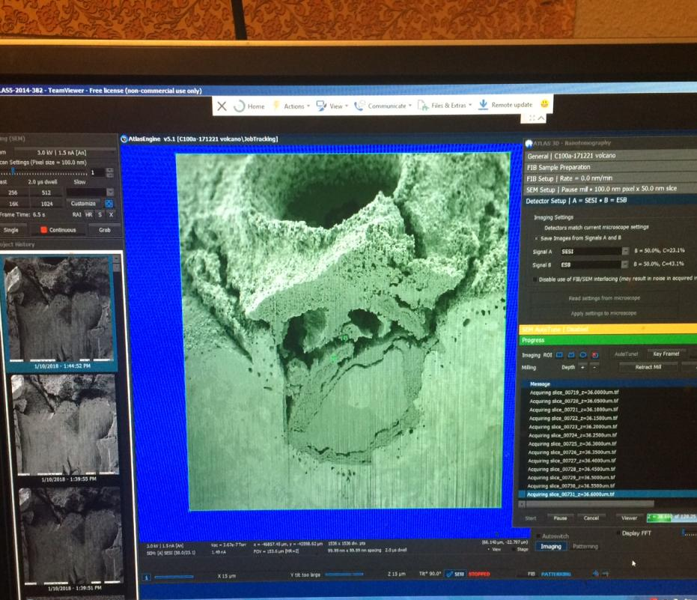
In our experiments, FIB system is used to further study “special feature’ of the sample, such as failure analysis and 3D construction.

Slide 16
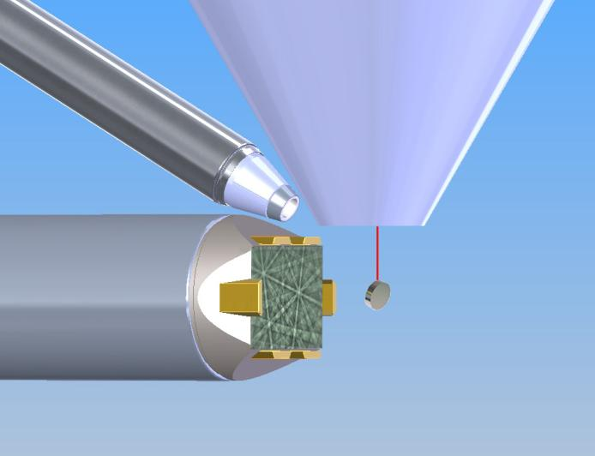
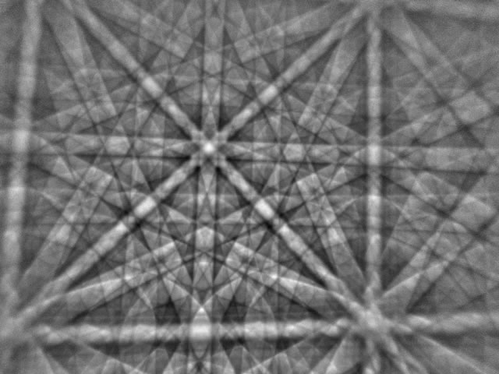
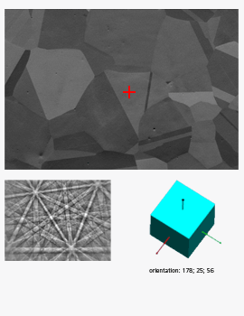
EBSD system
Animation, F5
This animation shows the basic principle. In this case, an electron beam moves to 5 points on the sample - each point is made from the same material but the grains/crystals are oriented in different ways. Each of the 5 points results in a different backscatter pattern, this is analyzed by the software to derive the crystal orientation at that point.
http://www.ebsd.com/ebsd-for-beginners

Slide 17
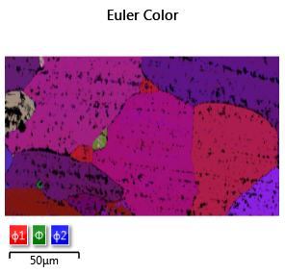
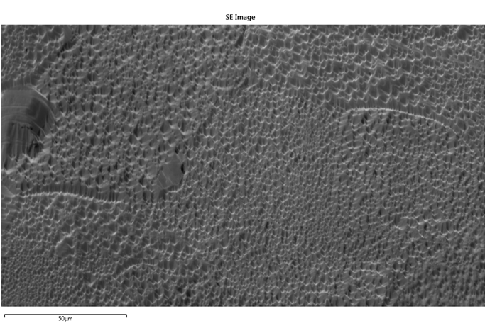
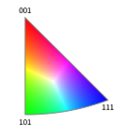
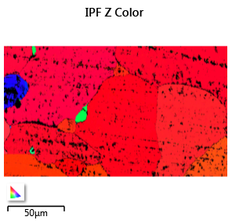
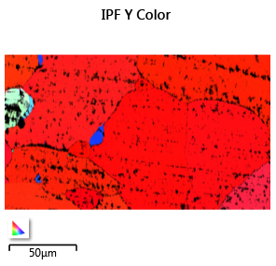
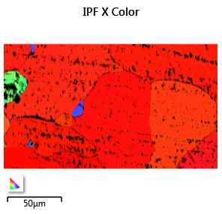
In our applications, EBSD is used to collect maps of crystal as well as to study the grain boundaries and measure the distribution of various boundary types in a sample
Inverse Pole Figure maps and All Euler Map to study the grain boudry and crystal orientation of the 75 um foil sample

Slide 18
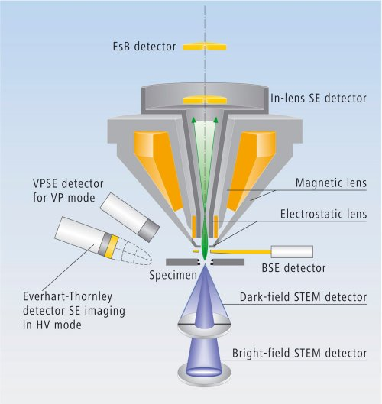
ASB detector
Energy selective Backscattered (EsB) Detector is suitable for clear compositional contrast. It is an annular shaped in-column detector that is located above the In-lens detector. The ability to detect BSE makes sub-surface information and nano-scale composition visible. To prevent detection of SE, a filtering grid is installed in front of the EsB Detector. By switching on the filtering grid voltage, the SE will be rejected and only BSE will be detected. Below a landing energy of 1.5 kV, the filtering grid has the additional function of selecting the desired energy of the BSE. This means the threshold energy of inelastically scattered BSE can be selected to enhance contrast and resolution
http://syzx.scnu.edu.cn/semdoc/detector.htm

