Slide 1
MIGRATION IN EUROPE:
CURRENT TRENDS AND POLICIES
Cristina Bradatan, PhD,
cristina.bradatan@ttu.edu
Texas Tech Population Center, Department of SASW
Global Migration: Second Annual Peace and Security Forum, Texas Tech University
March , 2010

Slide 2
Overview
Introduction
European Union migration
Russia and migration
Migration in ‘other Europe’
European migrants in the US
Conclusions

Slide 3
European immigration: introduction
While there is a long history of people moving back and forth within Europe, it was only after 1960s that Europe started to receive significant numbers of non European immigrants.
Units of analysis:
  European Union (27 states)
  ‘other Europe’
  Russia

Slide 4
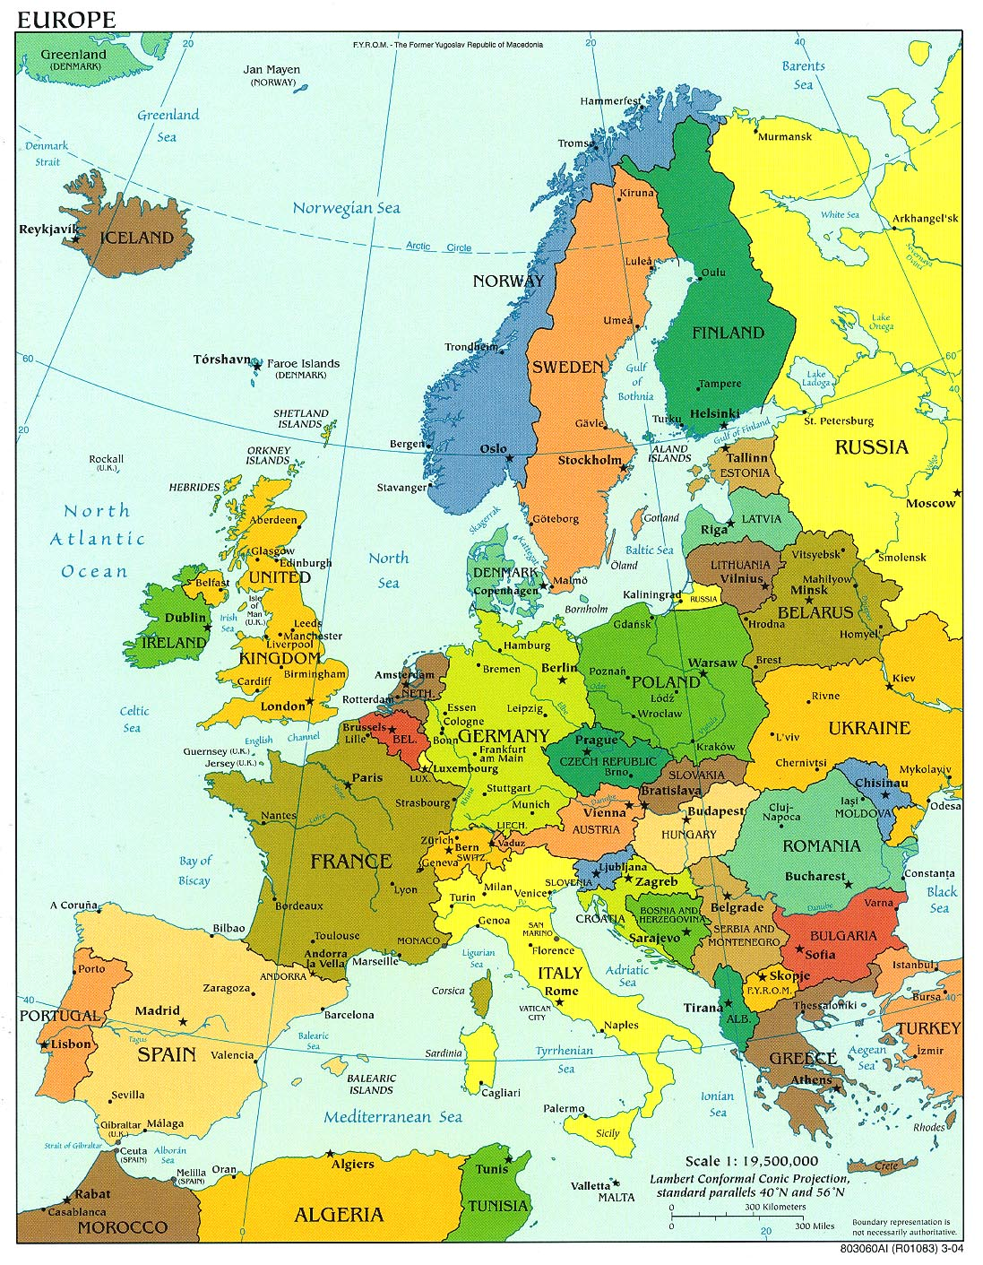

Slide 5
Short history of EU migration
European Union has been built as an economic community promoting free trade and labor force circulation between member states (European Coal and Steel Community – 1951, European Economic Community, 1957)
Guest-worker programs in 1960s
Family reunification in 1970s
Refugees: European policies
Economic boom of Southern European countries (Spain and Italy) in late 1980s
The fall of the Berlin’s wall and emigration of Eastern Europeans (1990s)

Slide 6
EU migration: numbers
On January 1st 2008, 30.8 million foreign citizens lived in EU states
11.3 million of them were EU citizens of another state (Eurostat, 2009). The top three ethnic migrant groups in the EU are:
  Turkish (2.4 million),
  Moroccans (1.7 million)
  Romanians (1.6 million).
Although negotiations are currently underway to unify immigration policies within EU, one cannot speak of a homogeneous EU-wide immigration policy. Each country has the freedom to define its own rules.

Slide 7
EU immigration: numbers
Among the European Union countries, the Southern ones (mostly Italy and Spain, but also Portugal to a lesser extent) became important destination for immigrants only in the past 10 years.
While Germany still have the highest stock on immigrants (7.2 million – Germany), Spain has the second largest immigrant population (5.2 million) and Italy has 3.4 million (fifth largest) (Eurostat, 2009).

Slide 8
‘Old’ countries of immigration: France and Germany
Immigration to France - MAGREB
Data problems; estimations
Numbers:
Germany:
  Turkish immigration
  German natives: policies and real life

Slide 9
New countries of immigration: why Southern Europe?
Low fertility and old age structure
  TFR around 1.3
  Percent 65+ : 16.8% in Spain and 19.7% in Italy
Labor market
  Segmented: migrants are concentrated in services, construction, agriculture
  Temporary versus fixed contracts
Strong informal economy
  Estimated to be worth 27% and 20% of the GDP in Italy and Spain respectively
Notes:
9

Slide 10
Why Southern Europe?
Relatively soft immigration policies
  Perception of openness due to early imprecision of policy
  Enforcement focus at Southern border ( Africa )
  Low internal controls, easier to overstay visas
  Periodic regularizations present opportunity for stability
  Lack of long term government strategy (esp. in Italy)
Migration of Roma (Gypsy)
Notes:
10

Slide 11
‘New Europe’: migration and aging
2004 and 2007 waves of integration
Low fertility
Emigration and immigration trends:
  Poland
  Bulgaria
  Romania
  Hungary
  Czech Republic

Slide 12
Russia: emigration and immigration
Post 1990s reality
Russian citizens in former USSR countries
Aging population – men life expectancy
Immigration to Russia
Policies toward Russians living abroad: Baltic countries

Slide 13
‘Other’ Europe
Former Yugoslav countries (Bosnia, Serbia, Croatia, Macedonia)
Albania: emigration trends
Emigration from Ukraine and Moldova

Slide 14
European born living in the US
There are 5 million European born currently living in the US
The largest number of European immigrants come from the UK, Germany, Poland and Russia
Italy, Greece and Romania send a disproportionately large number of educated immigrants.
Most Europeans in the US come to study, work or through diversity visas

Slide 15
Conclusions
Changes in trends: Spain and Italy receive now large number of immigrants
East to West migration
Most migrants in Europe come from Africa or from another European country
Emigrants from Europe tend to be mostly skilled workers

