Slide 1
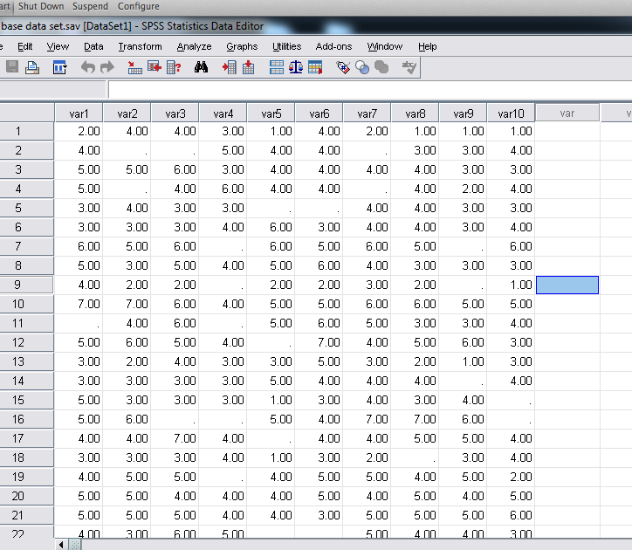
1. Open the SPSS data set on which you want to run the alpha analysis

Slide 2
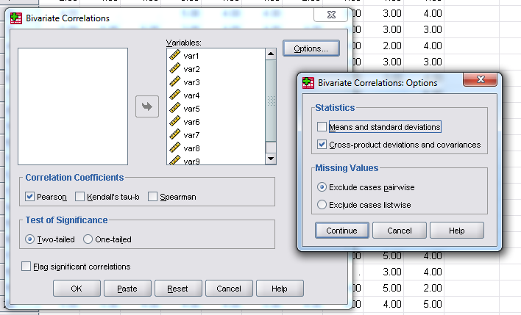
2. Request a correlation matrix of the items for which you want an alpha. Ask for cross-products and exclude data pairwise.

Slide 3
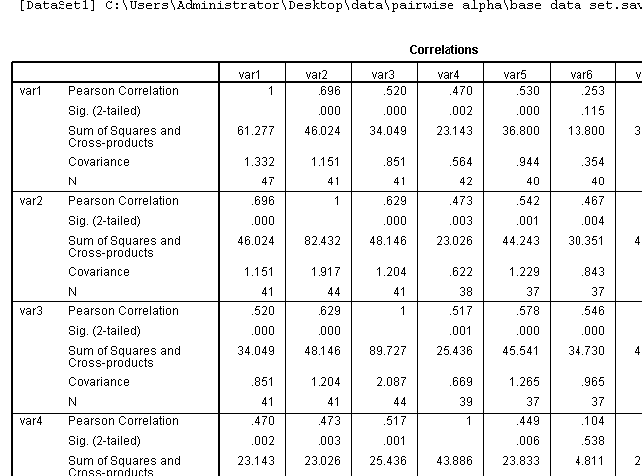
3. You’ll get a large table as output.

Slide 4
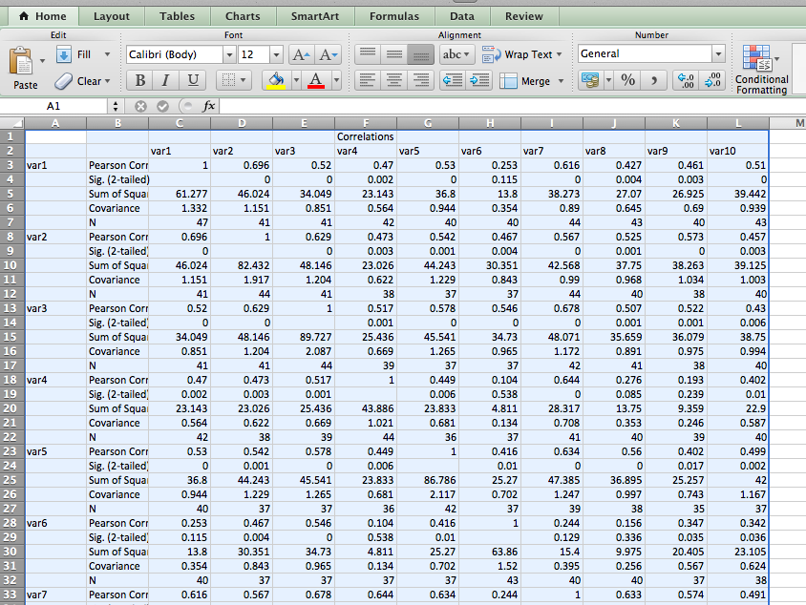
4. Copy and paste the table to excel

Slide 5
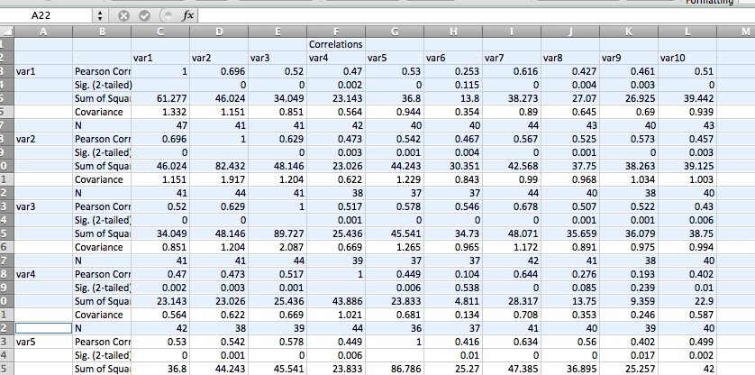
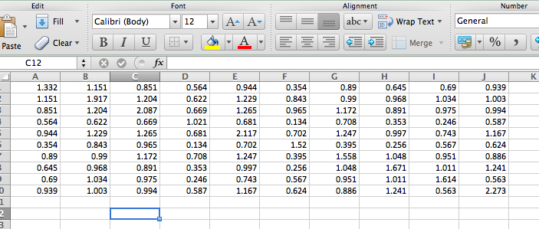
5. Delete the extra info—everything except the “covariance” line.

Slide 6
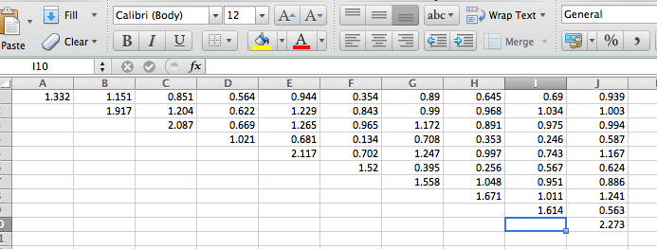
6. Delete the bottom left triangle of the matrix (but keep the diagonal).

Slide 7
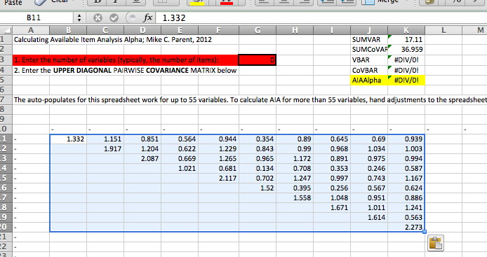
7. Copy and paste the upper right triangle into the excel calculator

Slide 8
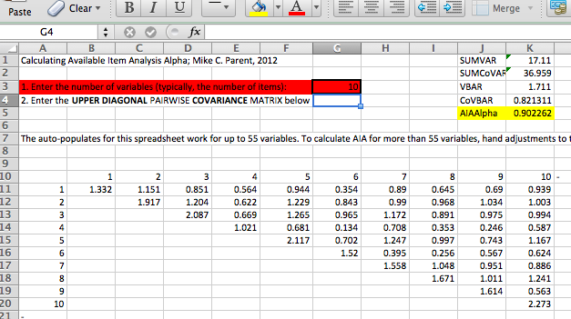
8. Enter the number of variables into the calculator. Done!

