Slide 1


Slide 2




Slide 3




Welcome
Naïma Moustaïd-Moussa, Ph.D., FTOS, FAHA
Executive Director for Institute for One Health Innovation;
Paul W. Horn Distinguished Professor for TTU Department of Nutritional Sciences;
Professor for TTUHSC Department of Cell Biology & Biochemistry;
Founding Director of the Obesity Research Institute
naima.moustaid-moussa@ttu.edu
Jannette Dufour, Ph.D.
University Distinguished Professor & Chair
Cell Biology & Biochemistry, SOM, TTUHSC
Associate Director of the Obesity Research Institute
jannette.dufour@ttuhsc.edu
Kembra Albracht-Schulte, Ph.D.
Assistant Professor, Kinesiology & Sport Management
Director, Nutrition, Exercise, & Translational (NExT) Medicine Laboratory
Texas Tech University, Lubbock, Texas
kembra.albracht@ttu.edu

Slide 4
Mission: Develop interdisciplinary research to prevent and treat obesity & its related complications using innovative collaborations
ORI is dedicated to transdisciplinary collaborations and mentoring: The ultimate goal is advancing science and securing major external funding
Sharing ORI work, current research and funding opportunities
Communications with new members
Activities that connect ORI members and promote collaborations and mentoring opportunities
https://www.depts.ttu.edu/research/obesityresearch/

Slide 5

FALL 2024 SEMINAR SERIES
BALANCING THE SCALE:
NAVIGATING THE COMPLEX INTERPLAY OF WEIGHT LOSS MEDICATIONS, TIMED EATING, AND PHYSICAL ACTIVITY
Deborah J. Clegg, Ph.D.
Vice President for Research, Professor, Internal Medicine
Texas Tech University Health Sciences Center El Paso, Texas
Weight Loss Medications: The Largest Human Uncontrolled Trial! What We Know and What We Need to Learn!

Slide 6
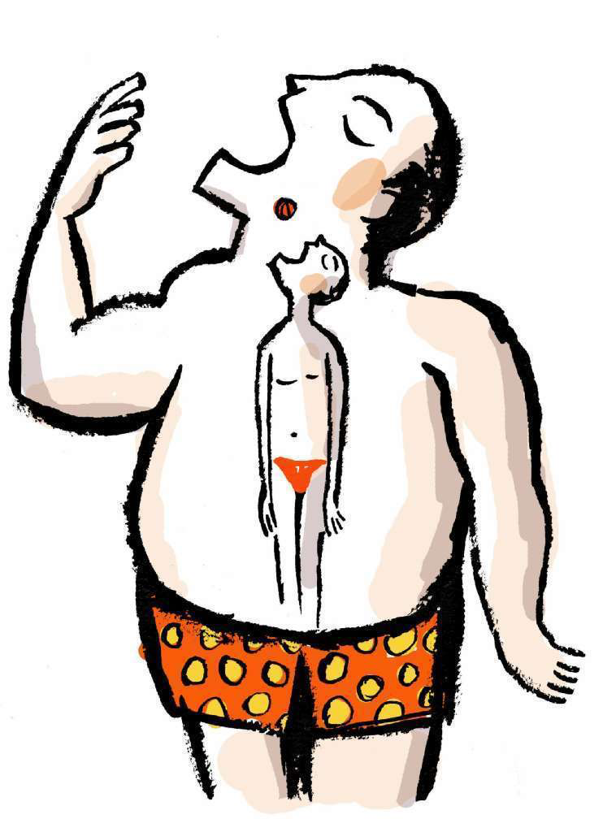
Weight Loss Medications:
The Largest Human Uncontrolled Trial!
What We Know and What We Need to Learn!
Deborah J. Clegg
Professor, Internal Medicine
Vice President for Research
Texas Tech University Health Sciences Center
El Paso, TX
Notes:
Slides 2-13 – Intro – 3-5 min max
Slides 14-X – Energy Balance – 5-7 min max
Slides X-X – Energy Gap – 5-7 min max
Slides X-X – Self-Monitoring – 8-10 min max
Slides X-X – Pitfalls in Energy Balance – 5-7 min max
Slides X-X – The Plateau – 3-5 min max
Slides X-X – Turbulent Waters (transition to Alan) – 1-2 min max

Slide 7

Learning Objectives
Describe the health impact and costs associated with obesity
Discuss approaches to weight management
Discuss use of anti-obesity pharmacotherapies

Slide 8
US Obesity Epidemic Grows
African Americans and Hispanic Groups are most affected
BMI ≧30
BMI ≧40
From 1999–2000 through 2017–2018:
Prevalence of obesity increased from 30.5% to 42.4%
Prevalence of severe obesity increased from 4.7% to 9.2%
NCHS Data Brief No. 360, February 2020

Slide 9
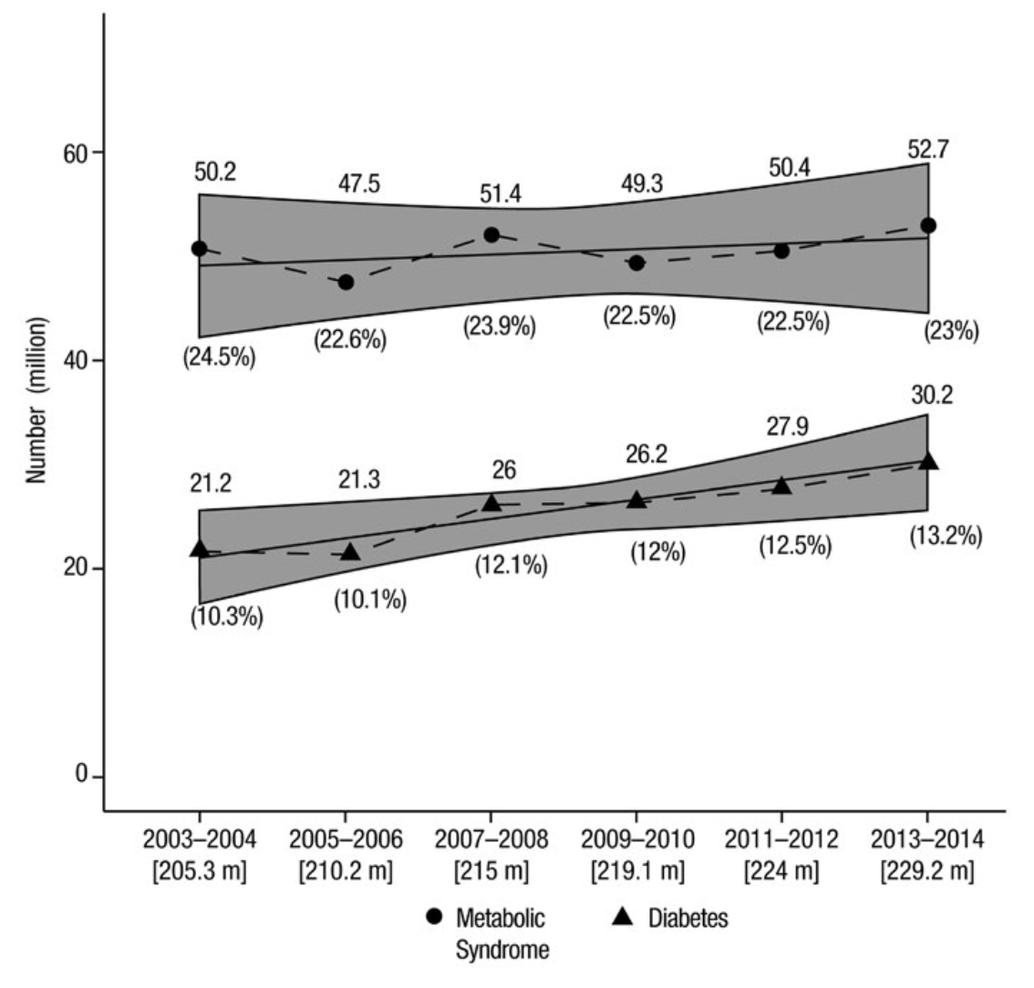
Obesity: Comorbidities and Costs
MetS
Back pain
T2DM
Type 2 Diabetes
Hypertension
Osteoarthritis
The total cost of chronic diseases due to obesity and overweight was $1.72 trillion - equivalent to 9.3% of the US GDP
Obesity 2019; 27:309-314
Milken Institute 2018

Slide 10
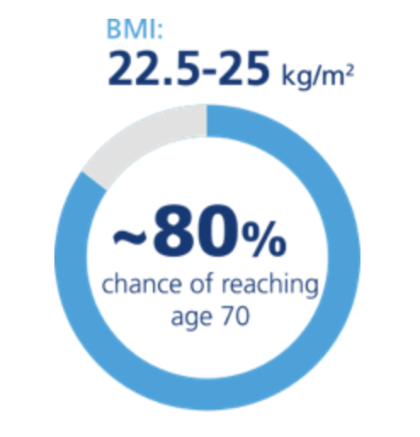
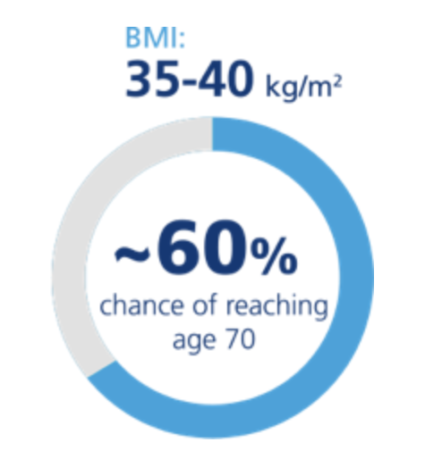
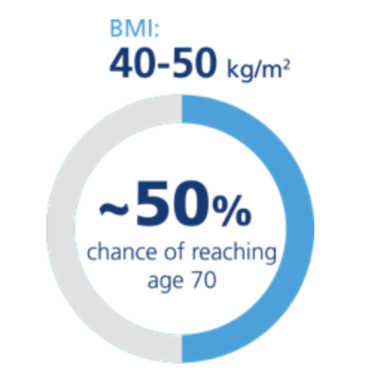
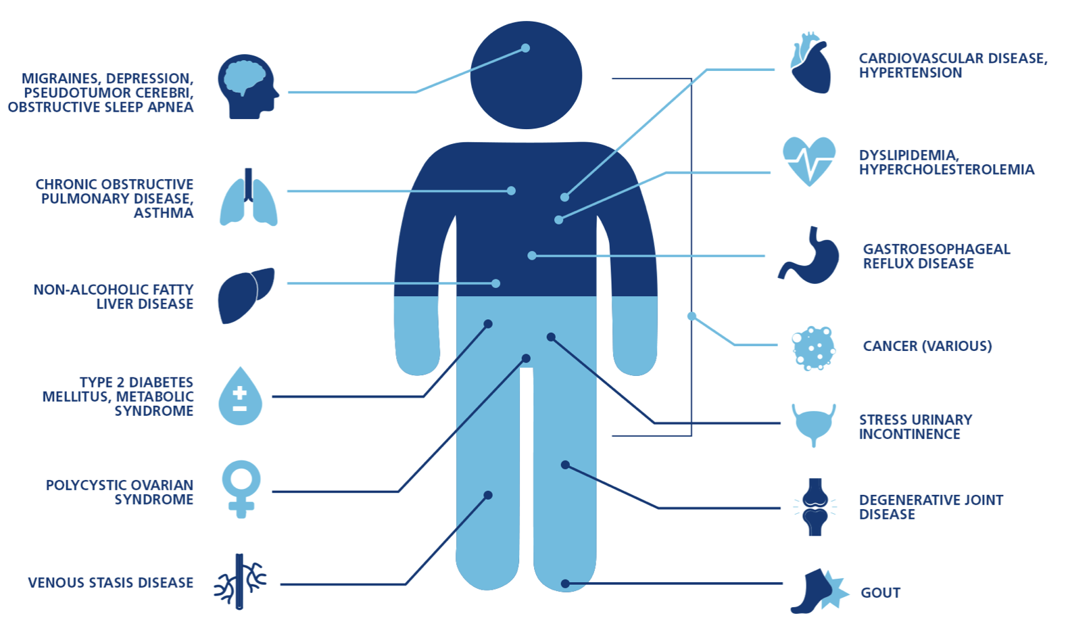
For every 5 BMI units above
22.5-25 kg/m², there is a
30% increase in overall mortality
Lancet. 2009;373:1083-1096
Obes Rev. 2017;18:715-723

Slide 11
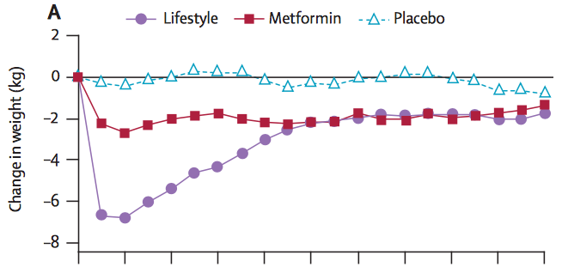

Benefits of Weight Loss
Diabetes Prevention Program
Finnish Diabetes Prevention Study
In at-risk groups 5-7% weight loss,
though not sustained:
Improved Cardiovascular Risk Factors
Improvements in glucose, BP, lipoproteins
Reduced incidence of MetS
Reduced incidence of diabetes
No decrease in mortality
Diabetologia 2013; 56: 284-293
Diabetes Care 2014;37:2622–2631
Diabet Med 2013; 30: 46-55
Lancet 2009; 374: 1677–86

Slide 12
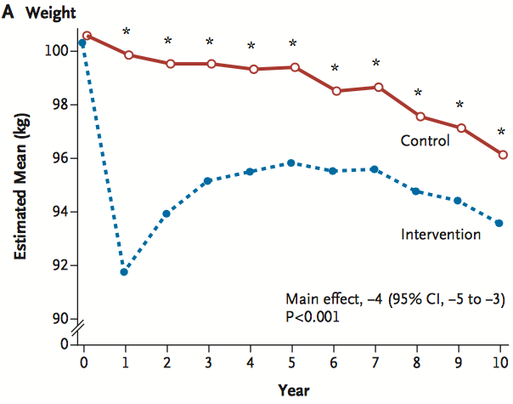
CV Outcomes and Weight Loss
Da Qing Diabetes
Prevention Study – 30 yr data
6-yr lifestyle intervention
1.9 kg weight loss
Delayed T2DM by 4 years
Reduction in CV events, mortality
Increased life expectancy 1.44 yr
Look AHEAD
Weight loss
8.6% at 1 year
6% at 10 years
Did not reduce CV death
Post-hoc analysis:
Those with ≥10% weight loss
- 20% lower CV mortality
- 21% lower MACE
Lancet 2008; 371: 1783–89
Lancet Diabetes Endocrinol 2019; 7:452-61
NEJM 2013;369:145-54
Lancet Diabetes Endocrinol 2016; 4: 913–21

Slide 13
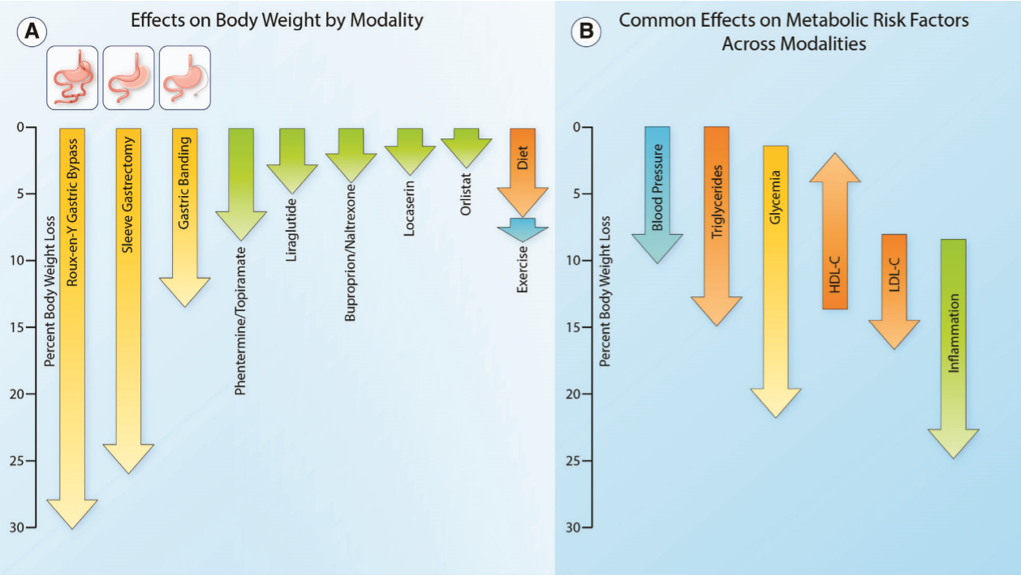
Expected Weight Loss & Benefits
Circulation Research. 2020;126:1646–1665

Slide 14

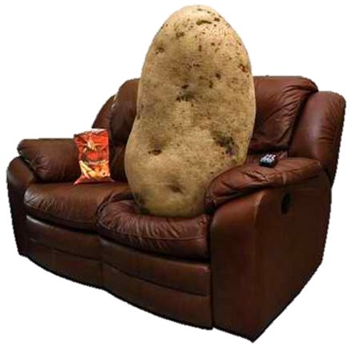



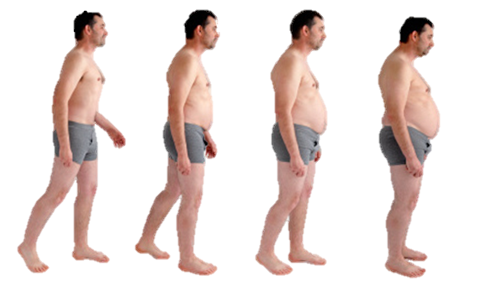
Environmental and Societal Influences
INDIVIDUAL INFLUENCES
Genetic Stress
Time Hedonic eating
Motivation Medications
Intake
Expenditure
Weight Change
Fat
Activity
NEAT
Gain
Lose
Thermic
Effect Food
Protein
Resting
Metabolic
Rate
Carb
Energy Balance is More Complicated than Thermodynamics

Slide 15
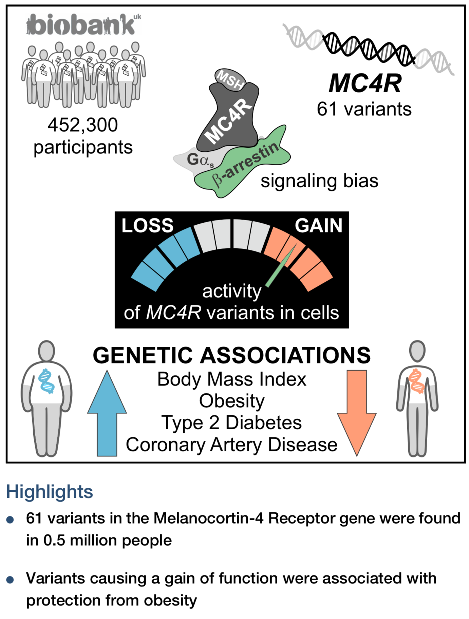

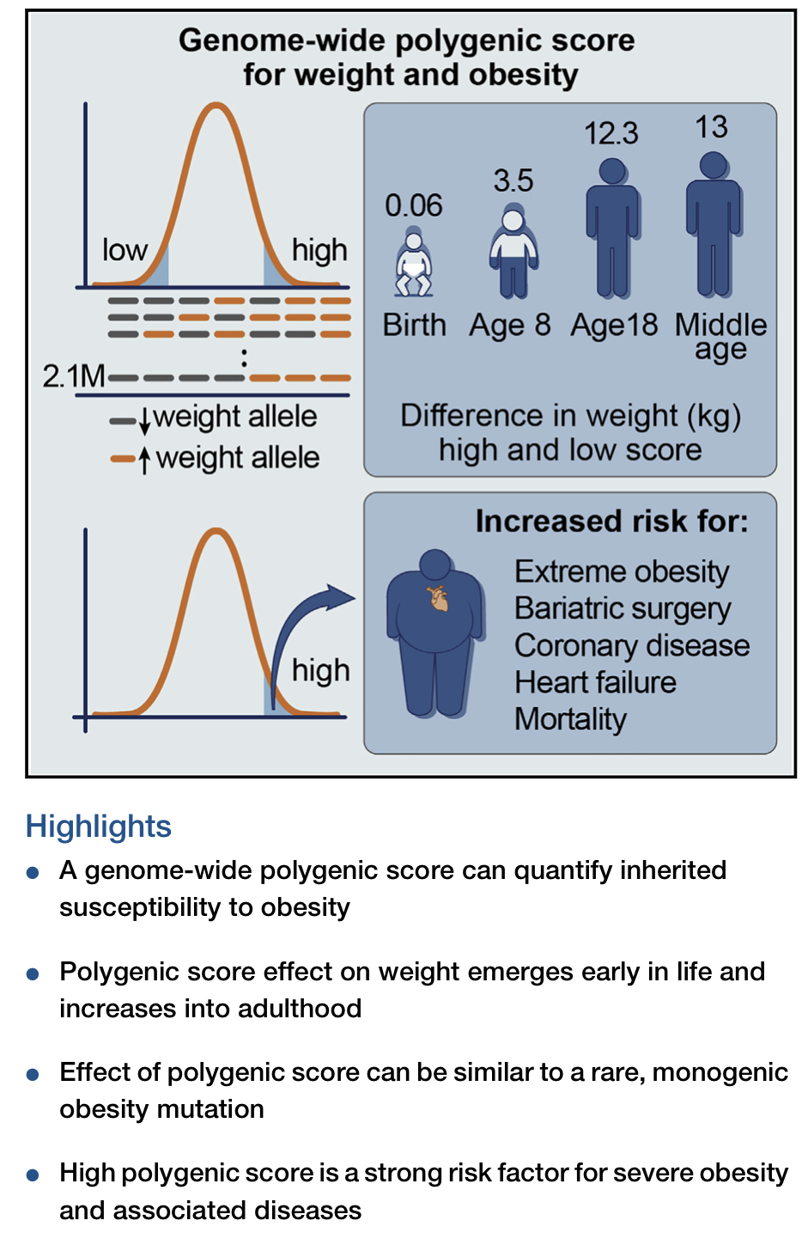
Evolving Genetics of Obesity
Cell 2019; 177:597–607
Cell 2019; 177:587–596

Slide 16
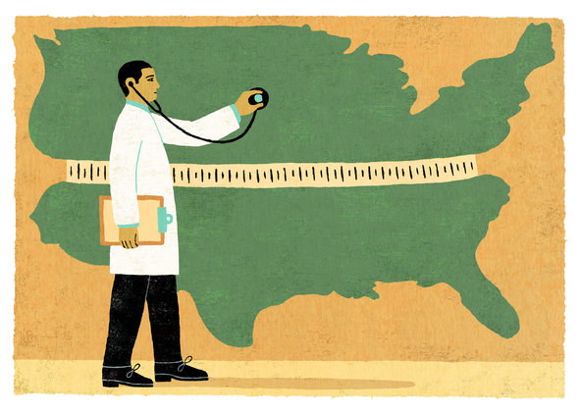
Nutritional Trends in Modern Society

Slide 17
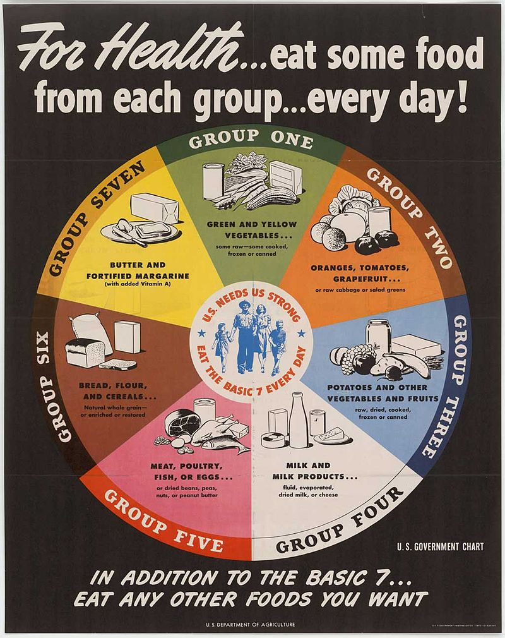
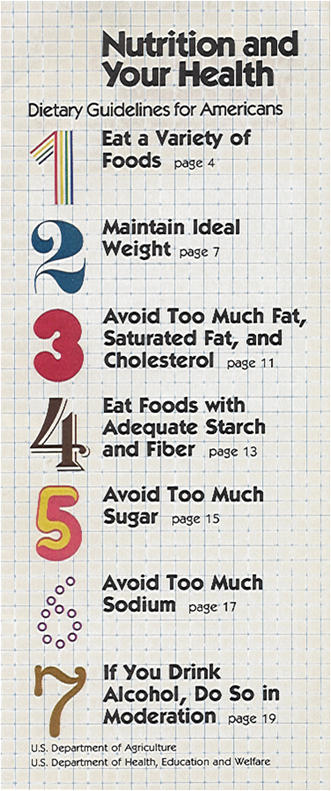
Changes in USDA Dietary Guidelines
in Response to US Nutrition Status
1945
1980

Slide 18

Unprecedented access to food

Slide 19

Changes in Dietary Habits
Items traditionally thought of as “healthy” have more calories and sugar
Starbucks Pumpkin Spice Latte Grande + whip – 420 kcal
50 g sugar (12 tsp.)

Slide 20

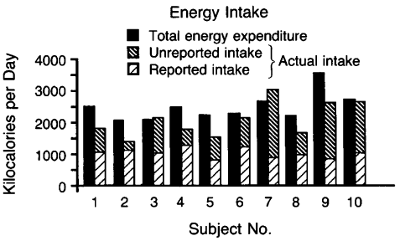
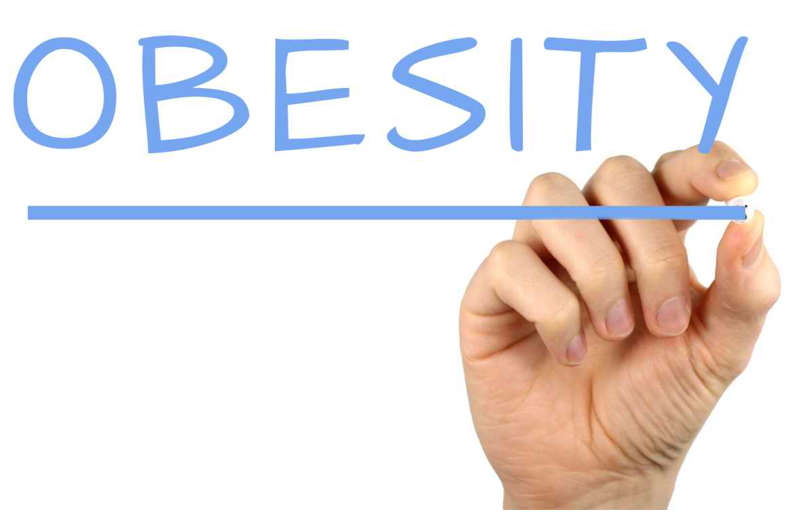
Energy Balance Misperceptions
Subjects with obesity may:
Underestimate intake 47%
  Portion sizes
  Calorie content
Over report physical activity 51%
NEJM 1992; 327:1893

Slide 21

Metabolic Adaptation to Weight Loss
HBO Weight of the Nation

Slide 22
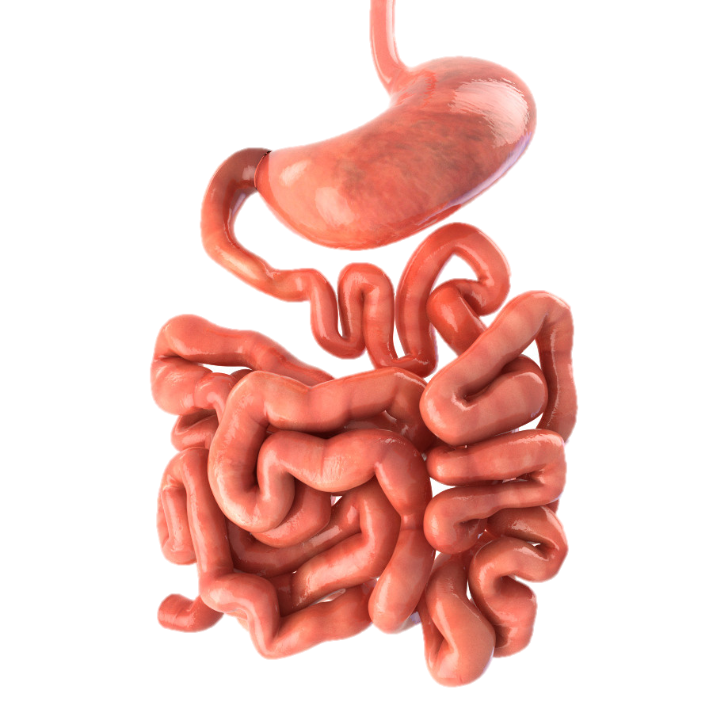
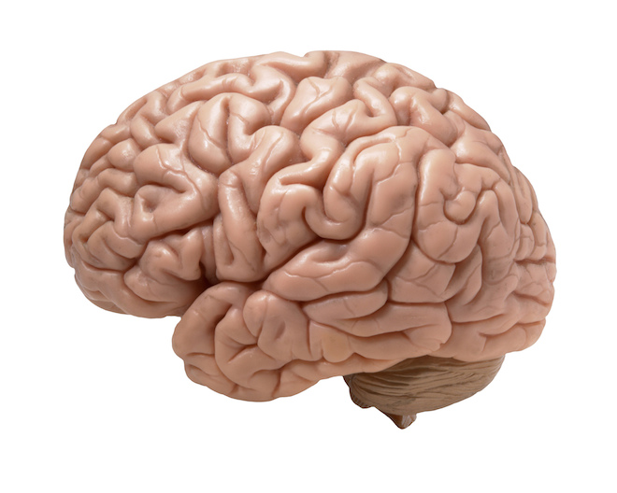
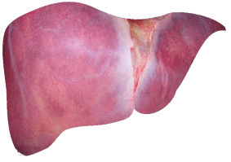
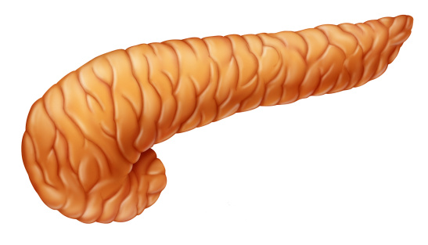
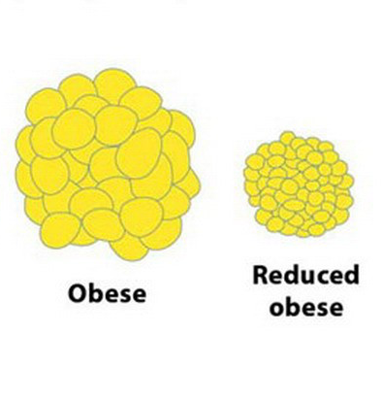
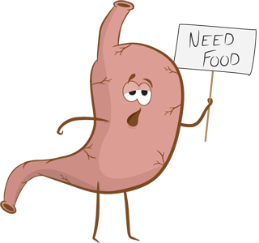
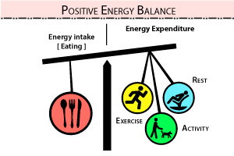
Leptin, Ghrelin and Weight Regain
Bile Acids
GLP-1
GIP
Microbiome
PYY
Insulin
Decreased
Leptin
Increased
Ghrelin

Slide 23
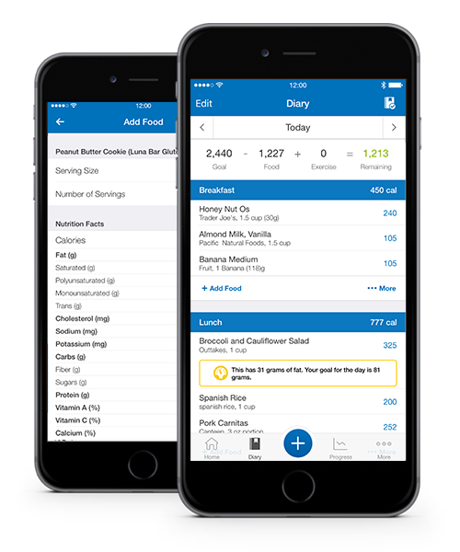
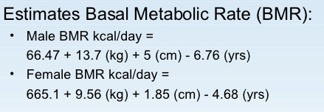
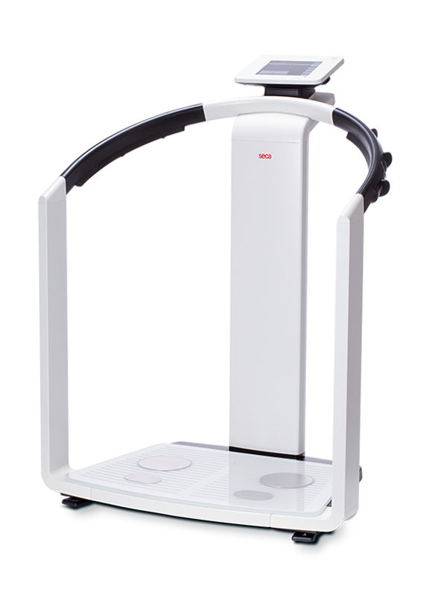
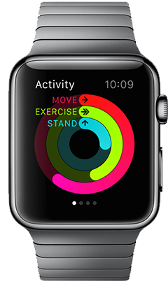
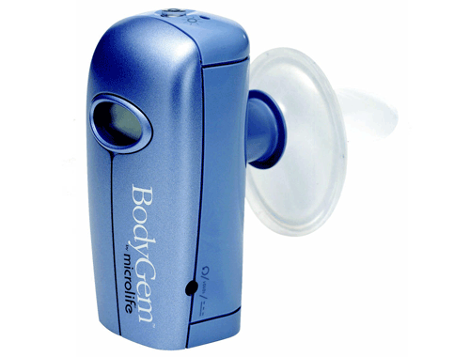
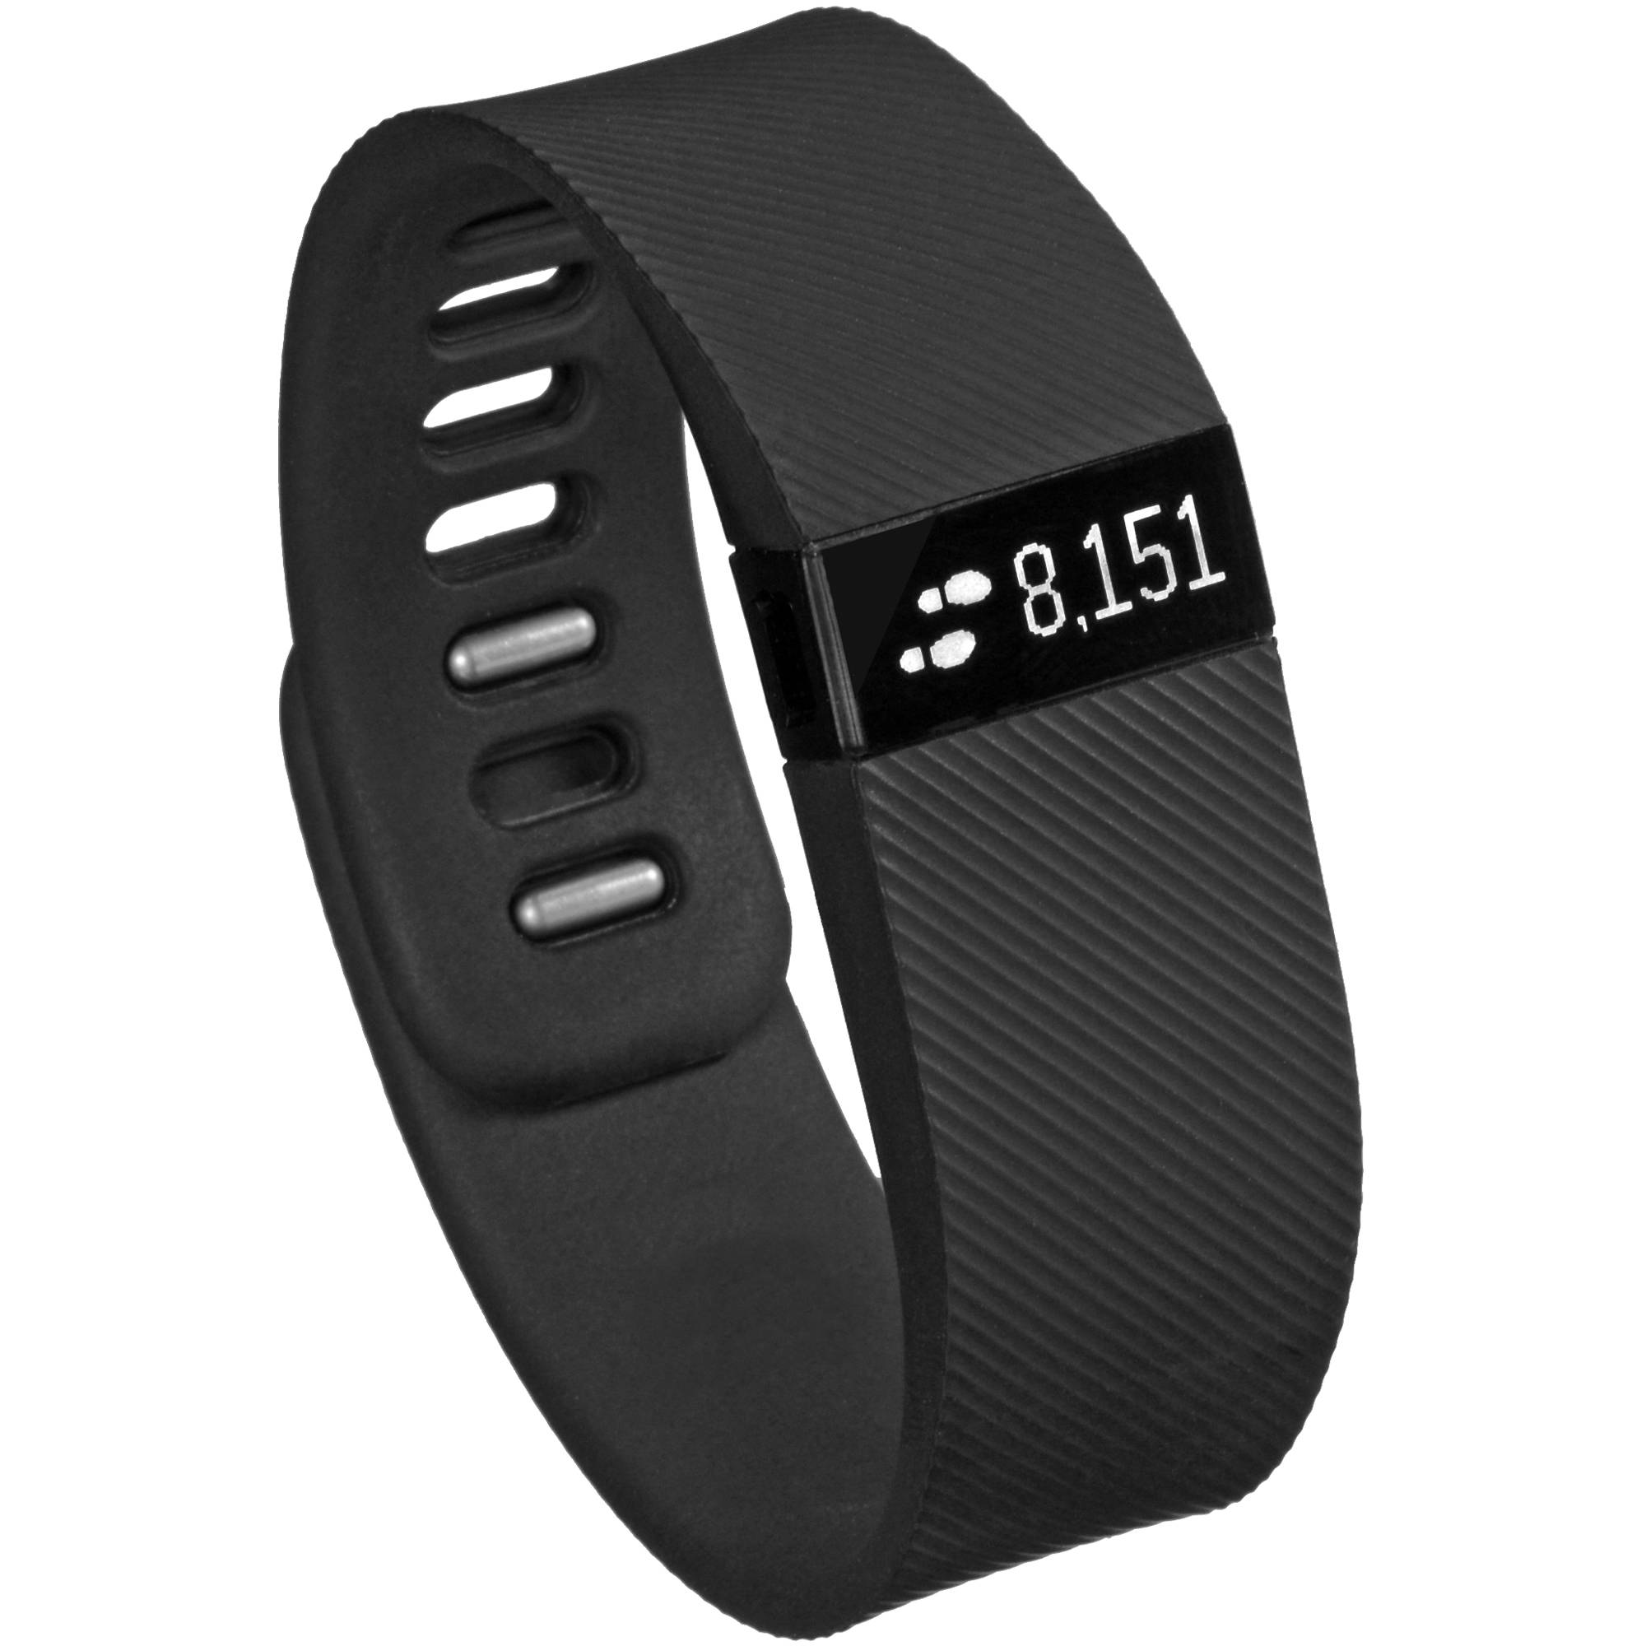
Rebalance the Energy Equation
Equations: e.g. Harris-Benedict
Tracking Apps
Indirect
Calorimetry
Bioelectrical
Impedance
Estimate REE
Intake
Expenditure
Daily Intake Goals
Women: 1200 kcal
Men: 1500 kcal
If BMI >40: +300 kcal

Slide 24
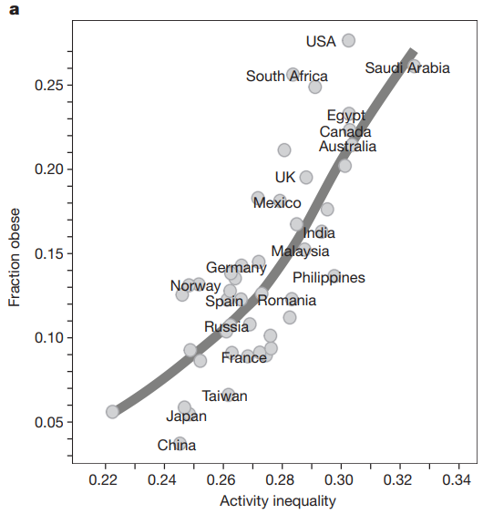
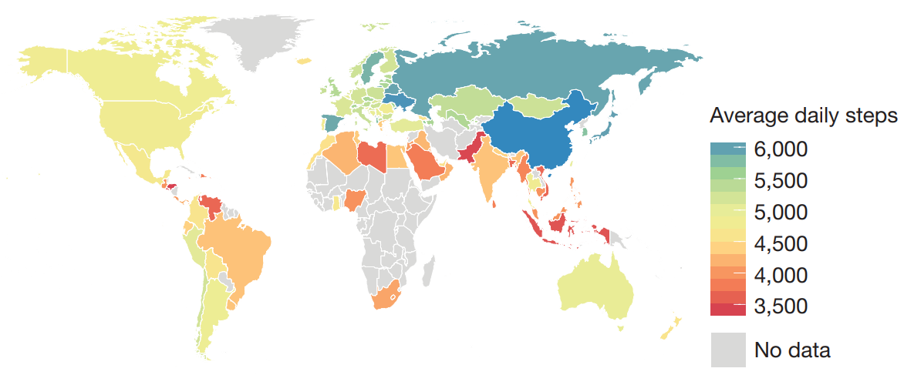
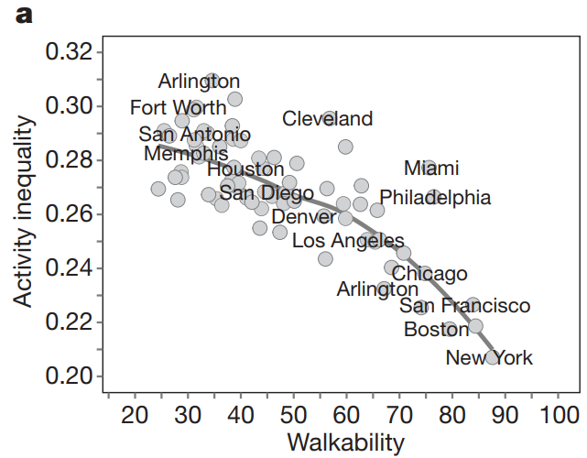
Activity Inequality Predicts Obesity
Inequality in how activity is distributed within countries is a better predictor of obesity prevalence than average activity volume. Reduced activity in females contributes to a large portion of the observed activity inequality
Nature 2017; 547: 336–339
Notes:
111 countries across the globe
68 million days of physical activity for 717,527 people

Slide 25
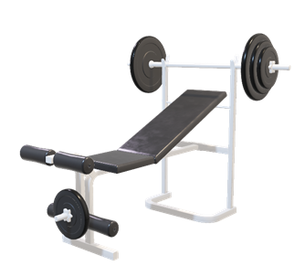
Overcome Exercise Challenges
Unable to exercise
My joints hurt and I can’t exercise so I will never lose weight
Exercise doesn’t work
I was going to classes 4 days a week, then I quit because I wasn’t losing
Exercise fuels calorie intake
I get so hungry when I workout that I am eat more than I should
Exercising to eat
I work out so I can eat what I want
I will burn this off later
Eating to exercise
I need to gain muscle because that will burn more calories
I have a 5k this weekend, so I have been carb loading
Refocus on exercise benefits beyond weight loss
CV risk reduction, glucose control, blood pressure, stress management, sleep…

Slide 26

Weight Loss Diets

Slide 27

We want to believe it will work..

Slide 28
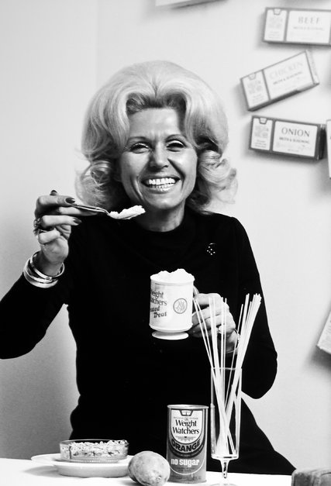
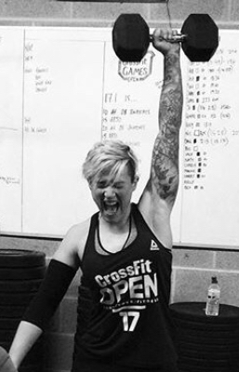

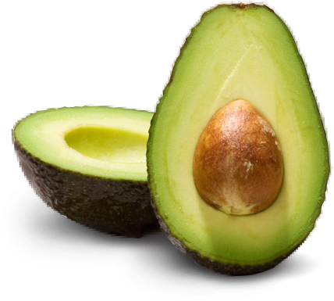
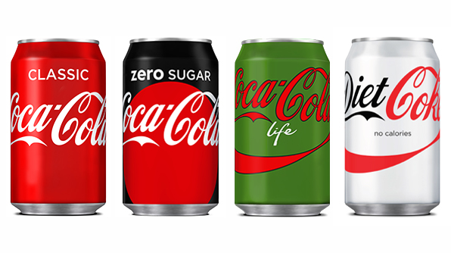
Diet Fatigue is Real
Out
Weight Loss
Dieting
In
Healthy
Fit
Strong
Eating Clean
Jean Nidetch
Founder of Weight Watchers, in 1972.
Credit
Martha Holmes/LIFE Images Collection/Getty Images

Slide 29
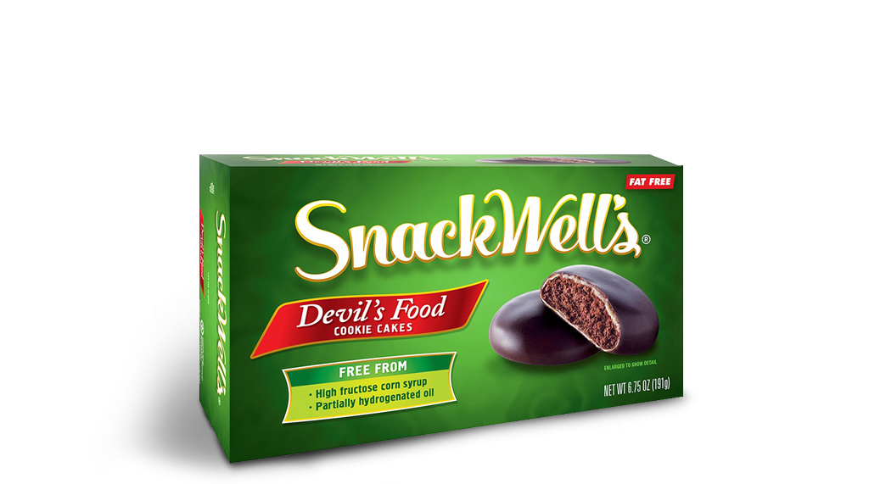
Diet Fads and Trends
We vilify food components or processing as the cause for obesity
We overcompensate with other potentially unhealthy or calorie dense components (e.g. fat for sugar or vice versa)
SnackWell Effect
Fat-free but high-sugar
It’s fat free so it’s good for me..

Slide 30
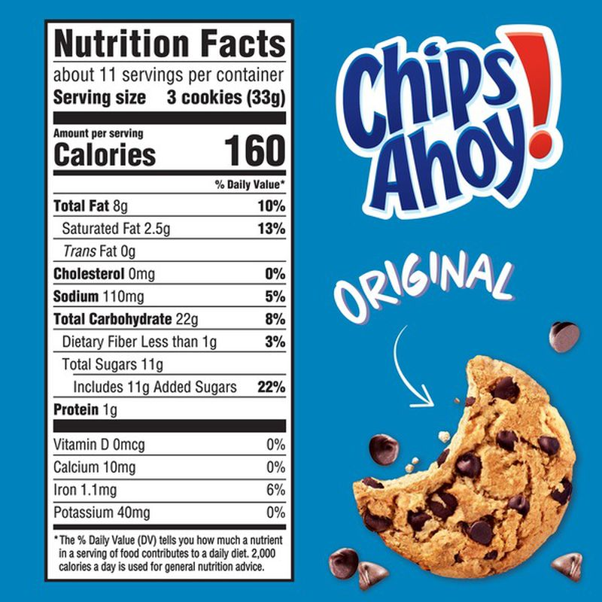
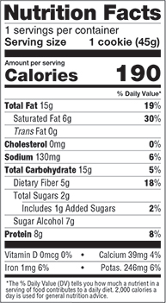
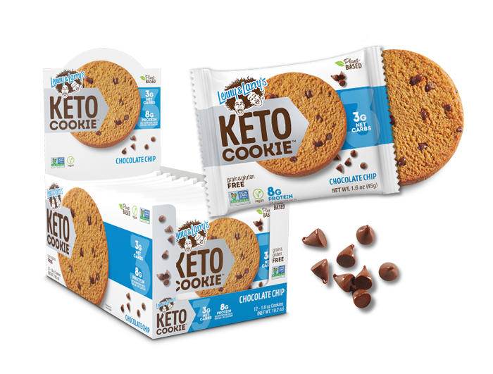
Calorie Deficits v.s. “healthy” choices
I eat healthy but I don’t lose weight

Slide 31


WHICH IS THE BEST?
NO DIET IS CLEARLY BETTER
Branded diets attempt to simplify calorie restriction and improve adherence
BIOLOGICAL PLAUSIBILTY
Higher protein diets may induce more satiety and facilitate less calorie intake
ADHERENCE IS THE KEY
MODERATE MACRONUTRIENTS
Weight Watchers
Jenny Craig
Nutrisystem
Slim-Fast
LOW CARBOHYDRATE
Atkins
South Beach
Zone
LOW FAT
Ornish
Rosemary Conley

Slide 32
Adherence is More Important than Macros for Weight Loss
Weight Change by
Meal Plan Type
Weight Change by
Meal Plan Adherence
r=0.07, P=0.40
r = -0.60, P<0.001
Δ Weight at 12 Months (kg)
Atkins
Zone
Weight Watchers
Ornish
Atkins
Zone
Weight
Watchers
Ornish
Mean Adherence Score
Over 1 Year
JAMA. 2005;293:43-53

Slide 33
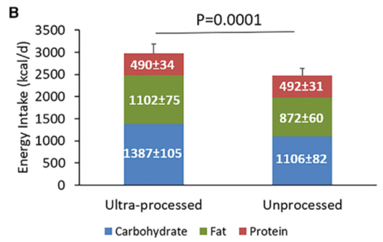
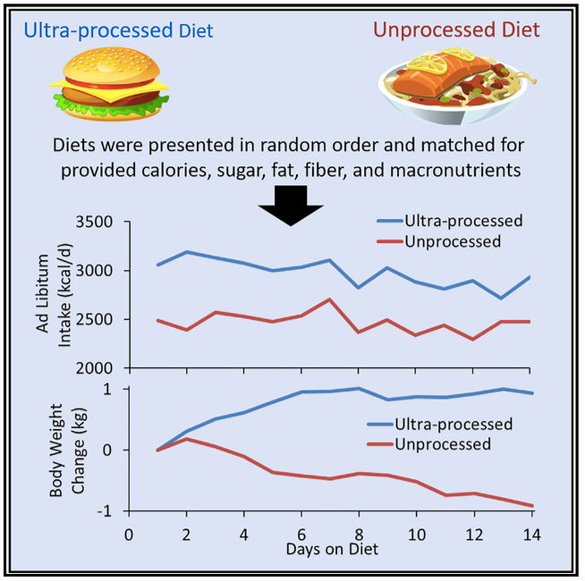
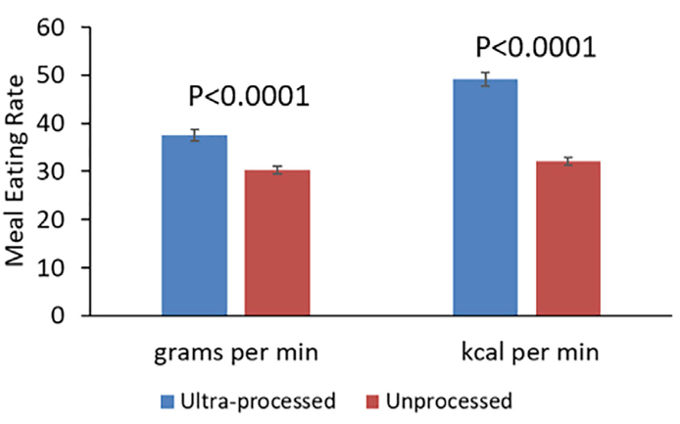
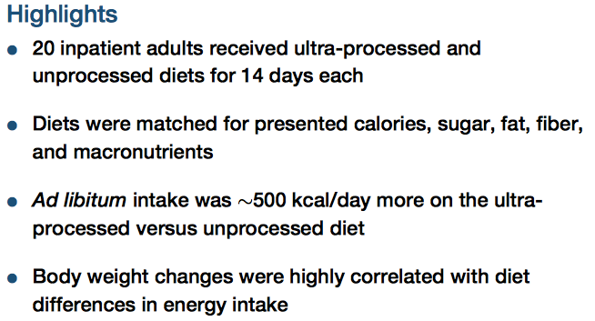
Ultra-Processed Diets Cause Excess Calorie Intake and Weight Gain
Cell Metabolism 2019; 30: 66-77

Slide 34

Managing Expectations and Guiding Behaviors
Challenges to Changes in Diet and Activity
Unrealistic expectations
All or nothing
Time
Fads and myths
Confusion
Events and holidays
Behavioral Therapies to Address Challenges
Goal setting
Cognitive reframing
Problem solving
Self-monitoring
Stress management
Behavioral substitution
Patients Seeking
Weight Loss
Depression 19%
Binge eating 17%
Anxiety 12%
Suicidal ideation 9%
JAMA. 2016;315(2):150-163

Slide 35

Managing Expectations?? The Biggest Loser

Slide 36
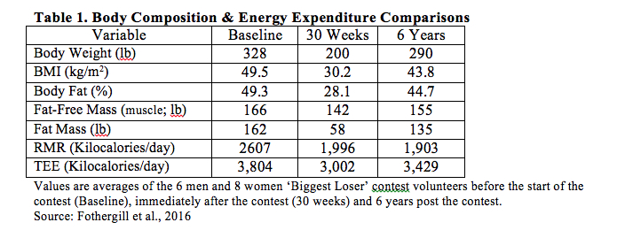
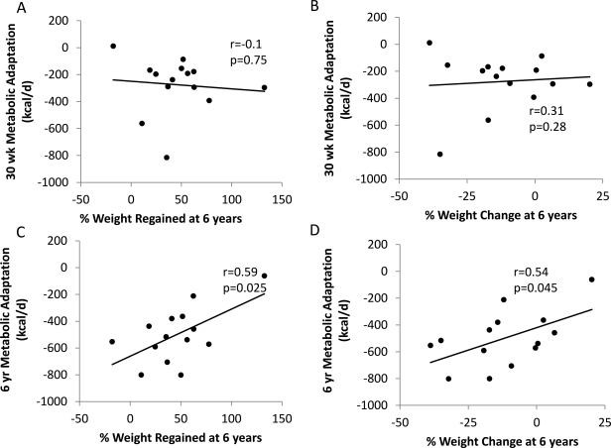
Managing Expectations?? The Biggest Loser
Weight Regain 6 yrs Following

Slide 37
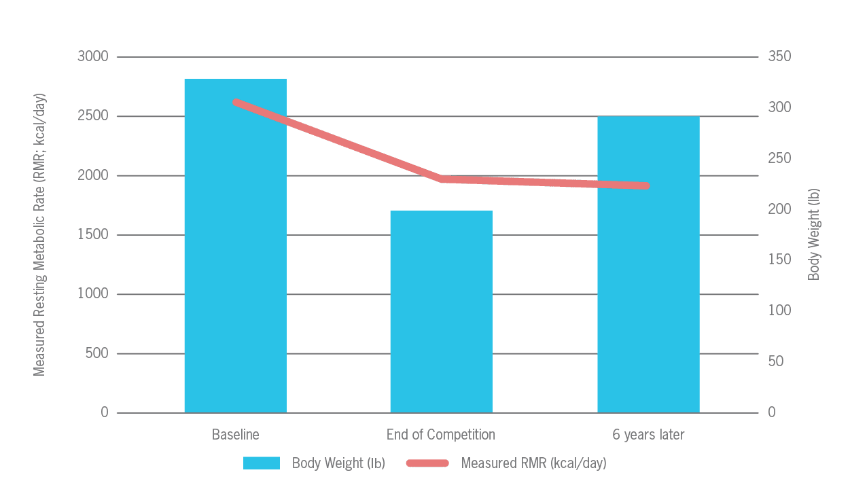


Managing Expectations?? The Biggest Loser
Metabolic Rate and Fat Free Mass

Slide 38
Obesity Treatment Guidelines
AHA - ACC -TOS
Anti-Obesity Medications
BMI ≥30 or ≥27 kg/m² + ≥1 comorbidity
Medications work to reinforce lifestyle change and should be prescribed as an adjunct to lifestyle interventions…
Anti-Obesity meds are prescribed to <2% of eligible people
Obesity 2014;22(S2):S1-S410

Slide 39
Think of Obesity and Anti-Obesity Medications Like Hypertension
Weight Loss
Weight Maintenance
If you stop treatment
the condition returns!
Weight
3-6 months
For the foreseeable future

Slide 40

Orlistat
Dosing
60 mg or 120 mg
Three times daily before meals
Side Effects & Considerations
Diarrhea
Malabsorption
Nephrolithiasis
Severe liver injury (rare)
Cost per month
$42 (60 mg), $556 (120 mg)
 | Orlistat | Placebo
Weight loss 1 year | 8.8% | 5.8%
>10% weight loss | 38.9% | 24.8%
30% of dietary fat excreted
JAMA. 1999;281:235-242

Slide 41

GLP-1

Slide 42

GLP-1

Slide 43


Weight Loss Pharmacology

Slide 44

Weight Loss Following Pharmacology

Slide 45

GLP-1 GIP RA Combination
A1c Change
Dulaglutide -1.1
LY3298176
1 mg -0.7
5 mg -1.6
10 mg -2.0
15 mg -2.4
 | LY3298176 | Placebo
Weight Loss | 12.7% | 0.4%
>10% weight loss | 39% | 0%
Lancet ‭2018; 392: 637–49‬

Slide 46

Cost and Weight Loss Pharmacology

Slide 47

Lost Weight – Now What?

Slide 48

Lost Weight – Now What: Plastic Surgery?

Slide 49


Concerns Over Weight Loss:
Lean Muscle Mass Loss

Slide 50

Lost Weight – Now What: Suicide Ideation

Slide 51

Lost Weight – Now What: Suicide Ideation

Slide 52

Lost Weight – Now What: Suicide Ideation
Hair Loss/Aspiration

Slide 53

Lost Weight – Now What: Suicide Ideation

Slide 54

Lost Weight – Now What: Side Effects

Slide 55
Microplastics/Xenoestrogens/EDCs
Microplastic/Nanoplastic
Xenoestrogens/EDCs
EDCs
Attached to/are EDCs
Degradation persists in the environment*
$990 Billion (2018) Health Care Costs^{3,5,7}
Mimic Activity of Estrogen⁶
Easily released during plastics degradation
$250 Billion 2018 Health Care Costs (1.2% GDP)^{2,3}
Disrupt Endocrine Function
Bioaccumulation accelerating extinction
What if we could reduce the health risks of EDCs?

Slide 56




Example TA2: Capitalize When They Are ‘on the Move’
EDC Serum Concentrations
NEW: Rapid Weight Loss- Induced Movement
May 2024, 15.5 million US adults, or 6% of the population have used injectable weight loss medications³⁰
Capitalize on rapid weight loss as an opportunity to reduce body burden of EDCs
NEW: Rapid Weight Loss- Induced Extraction
Increase glucuronidation = breakdown liver
Increase sulphonridation = liver/bile
Increase gut microbiota breakdown
Capitalizing on weight loss-induced movement as an opportunity to extract

Slide 57



Medications Potentiate Intensive Behavioral Therapy
Obesity 2019;27:75-86

Slide 58

Anti-Obesity Medications
Bupropion Naltrexone
⬆DA/NE
MOP-R
Phentermine
Topiramate
⬆DA/NE
Phentermine
⬆DA/NE
GABA-R
Liraglutide
GLP-1 R
⬇GASTRIC EMPTYING
Not FDA Approved
For Weight Loss
Metformin
SGLT-2 inhibitors
Topiramate
Bupropion
Lisdexamfetamine
LIPASE INHIBITION
Orlistat

Slide 59
APPROACH TO WEIGHT LOSS
EXCLUDE 2° CAUSES
Medications, Hormonal, Ψ
INTEGRATED WEIGHT MANAGEMENT PROGRAM
Nutrition
Counseling
Optimized Physical
Activity
Behavioral
Therapy
PHARMACOTHERAPY
BARIATRIC SURGERY

Slide 60

Take Home Messages
Weight gain and environmental influences promote biological and behavioral cues that facilitate positive energy balance, obesity and regain
Vilification of one dietary component or type of food can lead to overconsumption of other equally unhealthy components
No single diet is better than the other: adherence is the key to weight loss
Consider anti-obesity medications to facilitate more consistent calorie restriction if appropriate
Notes:
Slides 2-13 – Intro – 3-5 min max
Slides 14-X – Energy Balance – 5-7 min max
Slides X-X – Energy Gap – 5-7 min max
Slides X-X – Self-Monitoring – 8-10 min max
Slides X-X – Pitfalls in Energy Balance – 5-7 min max
Slides X-X – The Plateau – 3-5 min max
Slides X-X – Turbulent Waters (transition to Alan) – 1-2 min max

Slide 61


POST MEETING SURVEY
Your feedback is valuable to us and
will assist us in enhancing future events.

Slide 62



Acknowledgements
Thank You to the Organizing Committee
Naïma Moustaïd-Moussa
Jannette Dufour
Kembra Albracht-Schulte
Alex Scoggin,
Elyvine Ingabire-Gasana,
Alexis Rodriguez,
Hushyar Azari
OR&I, ORDC and COHS
We want to hear from you!
Keep Up to Date with News and Events
https://www.depts.ttu.edu/research/obesityresearch/
FALL 2024 SEMINAR SERIES
BALANCING THE SCALE:
NAVIGATING THE COMPLEX INTERPLAY OF WEIGHT LOSS MEDICATIONS, TIMED EATING, AND PHYSICAL ACTIVITY
Join us for part 2 & 3 of our Seminar!
Oct. 30th @ 11:30 a.m., TTU, Rm 063 Human Sci. Bldg.
Nov. 13th @ 11:30 a.m., TTU, Rm 063 Human Sci. Bldg.
@Obesity Research Institute-Texas Tech University
@ Obesity_Research_Institute_TTU
For more information
or to register
scan QR code or
visit bit.ly/ORITTU!

Slide 63
Featuring:
10/30/2024
Grant Tinsley, Ph.D.
Associate Professor, Kinesiology & Sport Management
Texas Tech University, Lubbock, Texas
Fasting Interventions for Body Composition Modification
11/13/ 2024
Kembra Albracht-Schulte, Ph.D.
Assistant Professor, Kinesiology & Sport Management
Texas Tech University, Lubbock, Texas
The Key Role of Physical Activity in the Era of Anti-Obesity Medications: Essential Benefits Beyond the Scale
Scan to Register!
Fall 2024 Seminar Series
Balancing the Scale:
Navigating the Complex Interplay of Weight Loss Medications, Timed Eating, and Physical Activity

Slide 65


Consistent calorie restriction still more important than macronutrients
BMJ 2020;369:m696

Slide 66


Slide 67


