Slide 1

SECC Coordinator Training
August 2018
www.secc.ttu.edu | 743-3538 | secc@ttu.edu

Slide 2

What is the SECC?
State Employee Charitable Campaign
Established in 1993 by Texas State Statute
Offers Texas State Employees the ONLY opportunity to donate to charity THROUGH PAYROLL DEDUCTION
Texas State Employees are made up of State Agency and Higher Education/University staff

Slide 3
2017 Campaign Results
  TTU $452,973
  TTUS $38,951
  TTUHSC $257,017
  Total TTU Gifts $748,941
Notes:
Number 1 in the state for 2 consecutive years for highest per capita giving (entire system)!!

Slide 4
Greater West Texas SECC Results
  $993,316 in 2017
Notes:
LBK: 818,849
ABI: 89,029
PB: 33,954
SA: 50,740
#2 in the entire state for giving for 3 consecutive years

Slide 5
Coordinator Duties
Distribute campaign materials
Educate
Promote payroll deduction
Coordinate, plan, and host employee meetings
Utilize agency speakers
Collect pledge forms and complete summary reports
Deliver reports and pledge forms to your university campaign coordinator

Slide 6
Campaign Best Practices
Educate yourself as much as possible
Know your resources
Make your pledge first
Make it fun!
Contact each individual personally
Encourage payroll deduction
Make the ask
Say “THANK YOU”!

Slide 7
Resources
Speakers Bureau
    Over 45 speakers available from over 25 different local agencies.
Online
    www.secctexas.org
    www.secc.ttu.edu
SECC Print Materials
    Campaign Directory
    Coordinator Guide
Incentives
TTU, TTUHSC and TTUS Campaign Coordinators
    Jessica Carrillo, 834-1312, jessica.carrillo@ttu.edu
    Darcy Pollock, 743-3538 , darcy.pollock@ttuhsc.edu
    Joni Harrison, 834-8656, joni.harrison@ttu.edu

Slide 8
SECC Charity Qualifications
All charities in the campaign must meet strict eligibility criteria
They range from small local organizations to large and well-known national and international groups
They are nonprofit health and human services organizations
They spend no more than 25 percent of funds on administration and fund raising
Keep the directory as a reference for help later

Slide 9
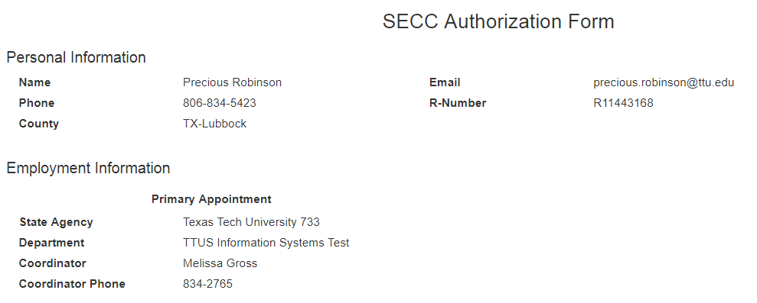
Individual Pledge Form
Log-in with e-raider, 1st page you will see is populated from HR Banner System
Notes:
*if donor has 2nd apt, it will be listed here as well so donor can choose which appt. will get credit for gift or can make a percentage go to each

Slide 10
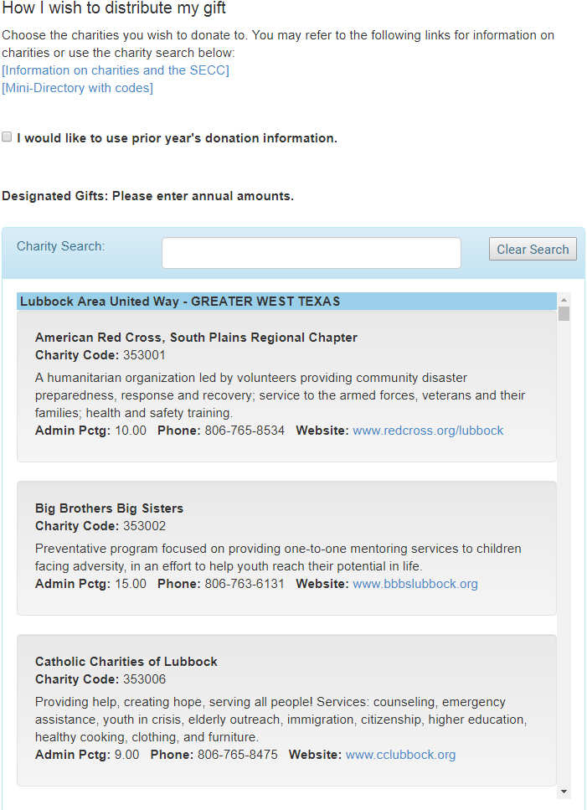
Individual Pledge Form
This area of the pledge form allows donors to select the option to continue the prior years gift
Donor can search all approved charities for 2018 (use name, charity code, key words)
Notes:
-If a donor selects to use lasts years donation, if one of their choices is not in the 2018 campaign then a box will pop up notifying the donor they must select another charity

Slide 11
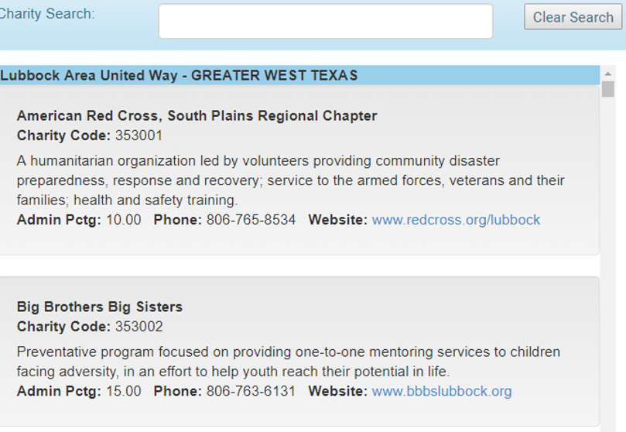
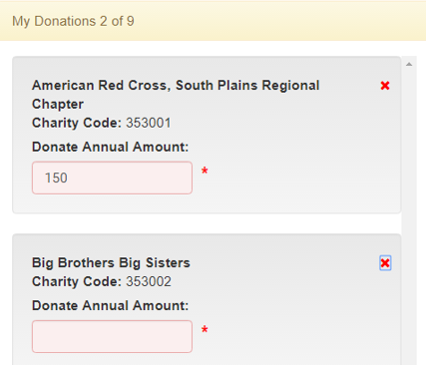
Individual Pledge Form
Once donor has chosen their charity or charities (max 9) of choice, all they need to do is click the charity and it will move into the my donations
box
There you will enter the annual amount you want to donate
Notes:
***Make sure and emphasize that donors are limited to giving to 9 charities***

Slide 12
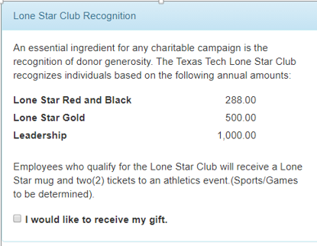
Individual Pledge Form
Leadership - $1,000 and above
Lone Star Club
Red & Black – 1 hour per month
Gold – 1% of annual income
The donor must click the box stating they want the Lone Star gift!

Slide 13
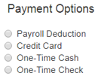
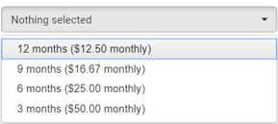
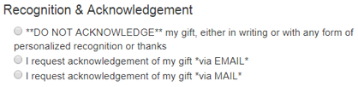
SECC Pledges, Payment & Recognition
Payroll Options
Notes:
Payroll- 12, 9, 6 or 3 month- if someone can elect payroll in either of these selections then it will show, it will also show the amount per pay check that will be taken out
Credit card- paid through touchnet
One-time Gifts- Cash or checks, as a coordinator you will have to go in and mark the donor’s gift as received once its been given to you
Go over Recognition options (DOES NOT INCLUDE MUG)

Slide 14
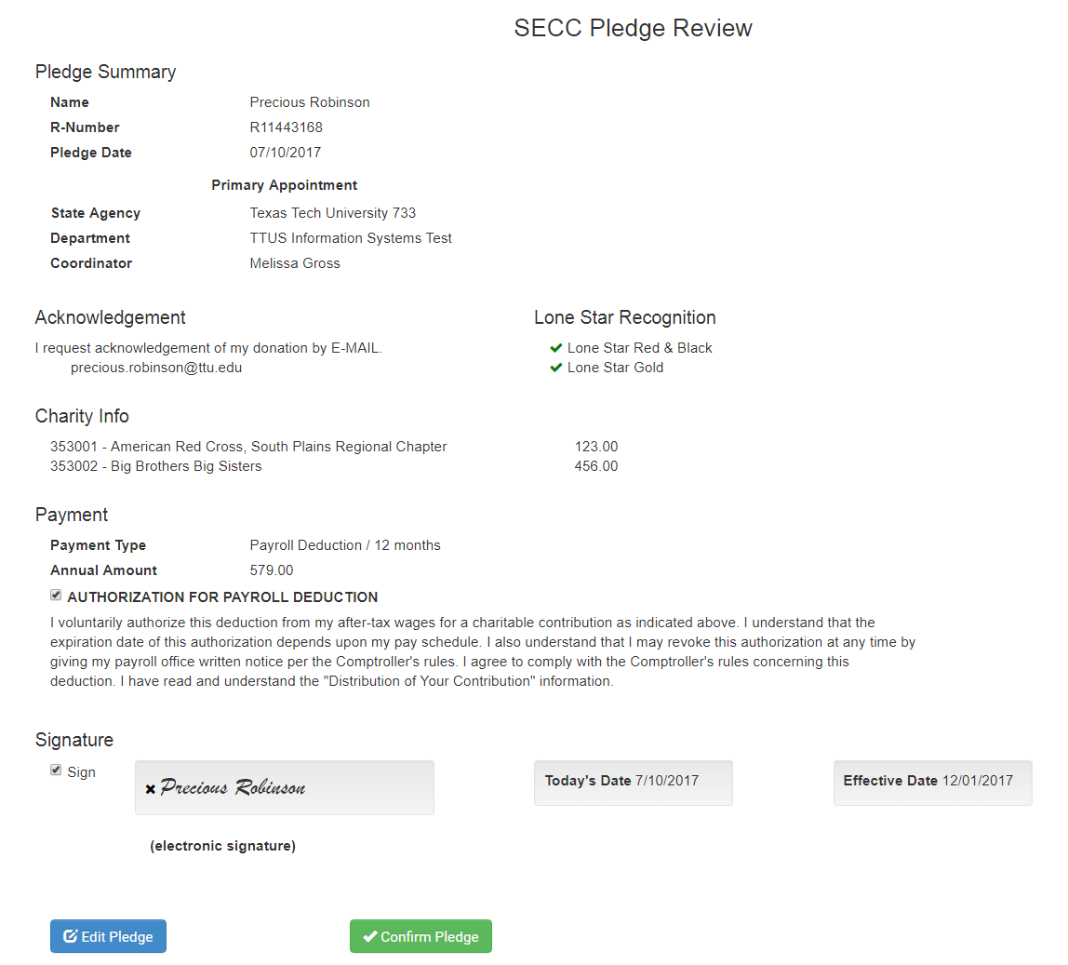
Pledge Review
The Pledge Review screen will allow the donor to review all selections made.
If donor selected payroll deduction, they will have to click the authorization of payroll deduction box
The donor will select the sign box and an electronic signature will sign the review form

Slide 15
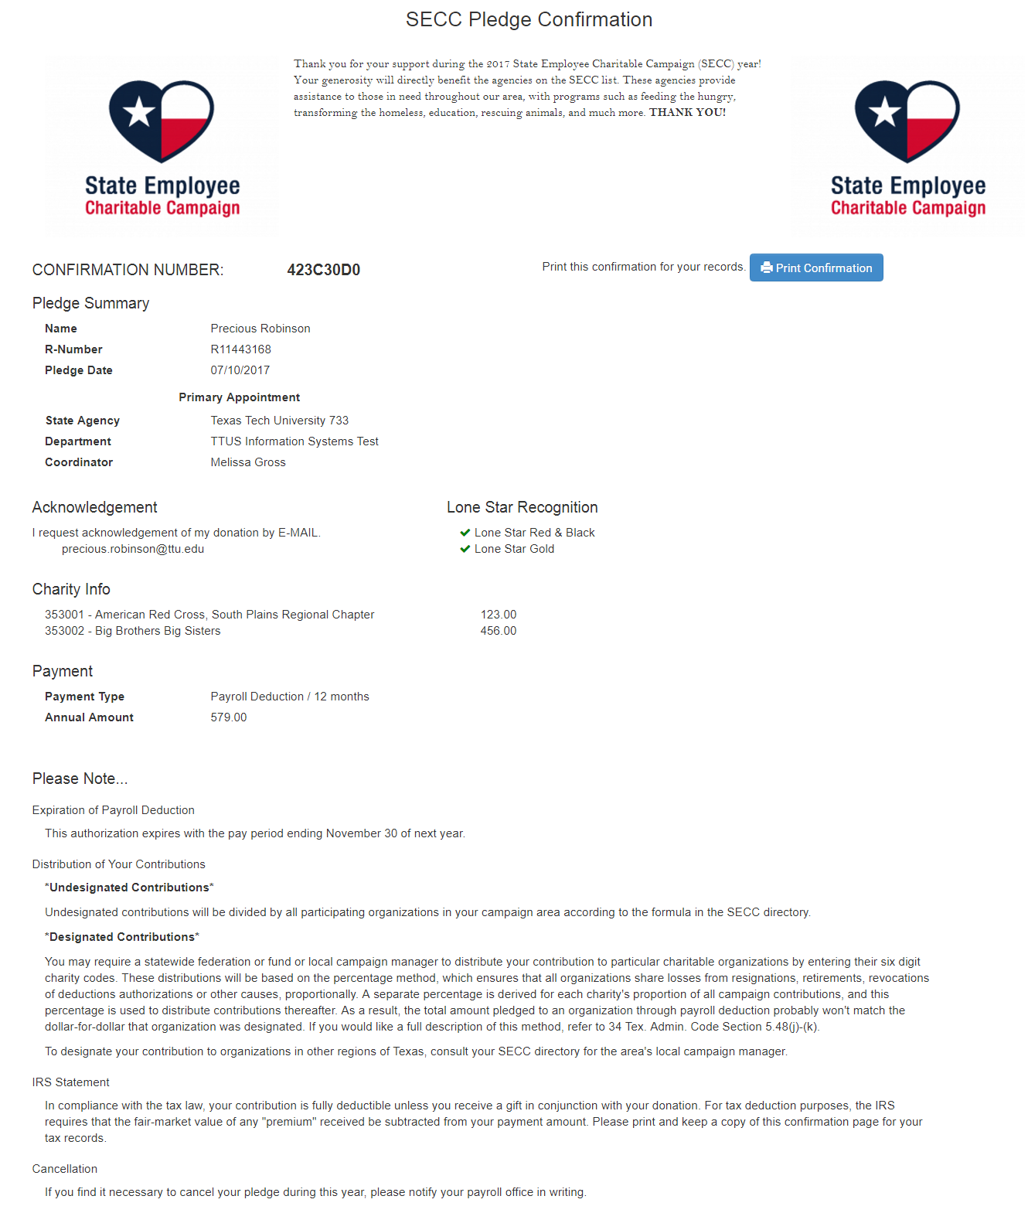
Confirmation
Donor will receive a confirmation page. On this page the donor will be able to print or email this document.
If a donor gives a one-time gift, this page needs to accompany the gift.
Notes:
To cancel contact HR

Slide 16
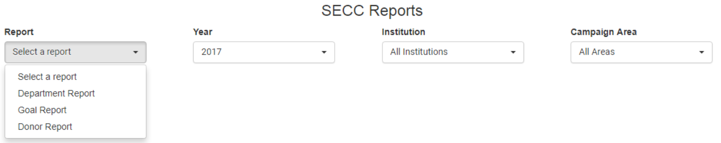
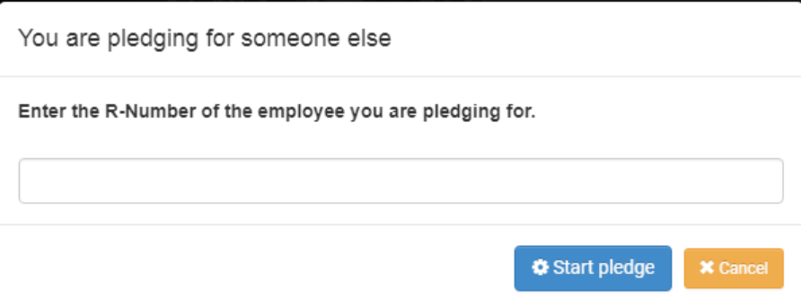
Coordinator Reports
As a coordinator, you will able to view reports for your department only
  Departmental report
  Goal Report
  Donor Report
Coordinators will be able to make a pledge for someone else
  For example, if you receive a paper pledge form from a donor, you will enter it into the online system (cash and check only)
Notes:
Departmental- departments progress
Goal report- where your department is goal wise
Donor report- who has given in your department
Fundraiser report – dept name, coordinator, fundraiser name, pledge date, charities
Drill down report – most comprehensive to least (year, institution, department, individual, pledge, charity details)
Leadership report – opting in for the mug
Report readers – view reports only, can’t pledge for someone else
Pledging for someone else: must have R# and only one-time cash/checks gifts, it works exactly like it would if you were doing for yourself, only difference is the confirmation page will say the pledge was made by (coordinators name) on behalf of donors name

Slide 17
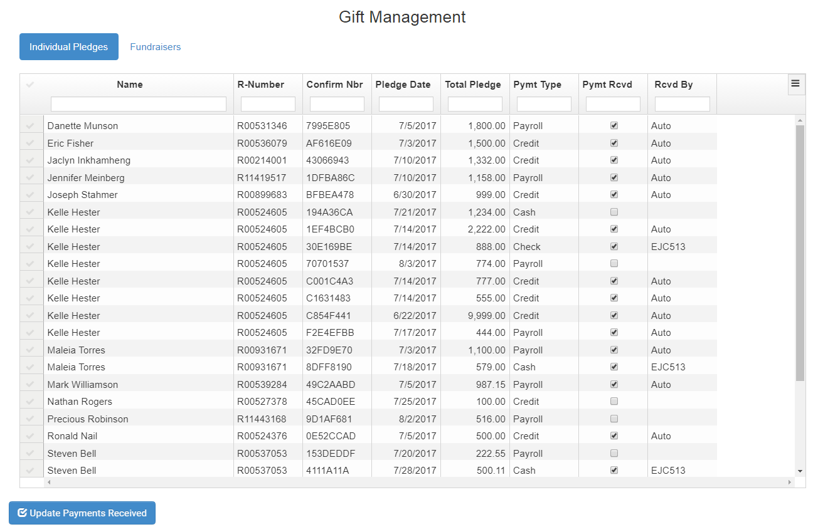
Coordinator Duties
For all fundraisers and one-time gifts (cash/check), the coordinator will have to confirm they have received the money before they send it their main coordinator
The main coordinator will then mark it as received a second time before it taken to the Lubbock Area United Way office
Notes:
This is a 2-step verification process for safety and auditing purposes

Slide 18



Kick-off Dates and Agency Fairs
Texas Tech System
09/04/2018
3:30-5:00pm
Board of Regents Boardroom
Texas Tech University
09/05/2018
3:30-5:00pm
4:00pm- President Schovanec
SUB- Matador Room (2nd Floor)
Texas Tech University Health Science Center
09/06/2018
3:00-4:30pm
2AB South Elevator Landing (next to cafeteria)
Notes:
Say a HUGE THANK YOU!!!!

