Slide 1
Faculty Senate Agenda October 8, 2014 #335
I. Call to order – Dr. Michael Farmer, Faculty Senate President
II. Recognition of guests:
III. Approval of minutes, Meeting #334, September 10, 2014.
IV. Thank you letter from Chancellor Robert Duncan
V. Speakers:
3:20pm to 3:35pm
Brenda Bullard-Director, Operations Div. Engineering Services
Bailey Bryan-Director, Marketing Manager for Operations
3:35pm to 3:50pm
Dr. Ralph Ferguson, Director for TTU Ethics Center
3:50pm to 3:55pm
Mike Henry, Assistant Director, Student Resolution Center

Slide 2
Agenda Continued
V. Old Business: Review of Committees & Liaison Reports
Administrator Evaluation Survey Cmty -Todd Brashears
TTU Ethics Advisory Board -Tim Dallas
Survey of Tenured Women Leaving Tech Cmty
Ombudsperson Search Committee
Student Evaluation Form
OP Revisions by the Faculty Status and Welfare -Lewis Held
OP 32.06 Faculty Responsibility-attachment
OP 74.02 Conduct of Research and Scholarly Activity-attachment
FS Funded Research Committee Working Group

Slide 3
Agenda Cont.
New Business:
Revisions from Huffaker on Regent’s Rule 10
Fall, 2015 Schedule Adjustment (Dec 5 Game)
Announcements:
Faculty Conversations, Michael San Francisco (Flyer at Door)
Spring Break 2016-Richard Meek Update
Open Teaching Concept
VIII. Adjournment.

Slide 4
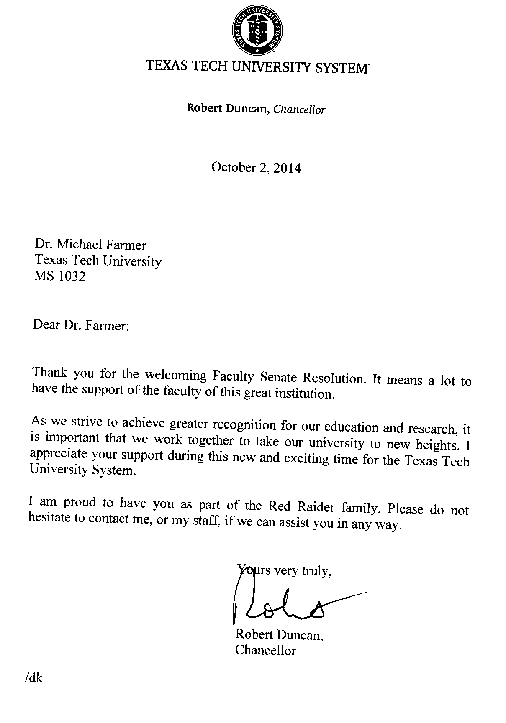

Slide 5
V. SPEAKERS
Brenda Bullard
Operations Division Engineering Services Director
For More Information Visit:
www.depts.ttu.edu/operations
www.facebook.com/operationsdivision
www.twitter.com/TTUOperations
742-4OPS

Slide 6
Dr. Ralph Ferguson TTU Ethics Center 834-4264 ralph.ferguson@ttu.edu

Slide 7
Michael Henry, J.D. Title IX Investigator Assistant Director, Student Resolution Center Texas Tech University michael.henry@ttu.edu 806-742-SAFE (7233)

Slide 8
Administrator Evaluation Survey Committee Todd Brashears-Chair todd.brashears@ttu.edu Committee members- Todd Brashears Rob Weiner Jorge Morales
VI. OLD BUSINESS

Slide 9
Three Types Of Reports
Bar Charts

Slide 10
Distribution Charts

Slide 11
Breakdown Tables

Slide 12
Report on the TTU Ethics Advisory Board meeting on 9/11/2014 Senator Tim Dallas reporting. The Ethics Advisory Board is comprised of faculty and staff across TTU and TTUHSC. The Board had been dormant for approximately 2 years. The primary discussion items for the meeting included: (1) Showing examples of TTU Ethics Center web content (Interview with Ambassador Tibor Nagy) (2) Attempt to locate an ethics journal at TTU (3) Attempts to bring in prominent outside speakers for various ethics events (4) Develop and fund a student ethics team that would compete in the nation Ethics Bowl. The Ethics Bowl team discussion received the most attention. (5)The next convening of the board is scheduled for 17 December, 2014

Slide 13
FS Poll of Tenured Women Faculty Leaving Tech: Michael Farmer-convener Jaclyn Canas-ENTX Ryan Cassidy-Lib Ali Duffy – DAN Charlotte Bingham – Women’s Studies
Will Have List of Names by 10/15 from Provost
Expect about 40 tractable names: NEED VOLUNTEERS
Need 15 Callers Across Campus – each to call about 3 persons

Slide 14
Ombudsperson Search: Shane Blum-Chair Shane.Blum@ttu.edu Mark Wallace-AG Carolyn Tate-FS Sec Gretchen Adams-A&S Michael Farmer-FS Pres Rob Stewart-Provost Office

Slide 15
New Student Evaluation Form:
THIS FALLL, THIS NOVEMBER
Open File

Slide 16
OPs Needing Revision
OP 32.22. Selection and Removal of Endowed Chairs and Professorships
NOT STAFFED
OP 74.14 concerns the Senate role in institutes and centers and its involvement in making faculty appointments.
NOT STAFFED
OP 32.05–Faculty Grievance Procedures concerns grievances and has needed revision
Only Farmer and Held; need two more

Slide 17
OP Revisions at Faculty Status and Welfare
Lewis Held
Open Files

Slide 18
FS Funded Research Committee Working Group: Michael Farmer-convener Michael.Farmer@ttu.edu Jaclyn Canas-ENTX (?) Phil Smith-ENTX Dave Richman-EDUC Tim Dallas - IEE

Slide 19
VI. New Business Research Committee Item
Regent’s Rule 10 on Intellectual Property.
Arrived on Senates Across system Last Week.
What are Regent’s Rules? Why?
What might be Problematic.
Texas Councils of Faculty Senates.

Slide 20
2015 Fall Schedule Change (Exams) Dec 5 Football Game
· Move start of classes from Monday, August 24 to Friday, August 21.
· Last day of classes for the semester will be Tuesday Dec 1
· Day of no classes moves from Thursday Dec 3 to Wed Dec 2.
· Finals begin on Thursday Dec 3 and continue on Friday Dec 4
· Game Day Saturday Dec 5
· Off day Sunday Dec 6
· Finals resume Monday Dec 7 through Wed Dec 9
· Day of grading on Thursday Dec 10
· Commencements on Friday Dec 11 and Sat Dec 12

Slide 21
VII. Announcements

Slide 22
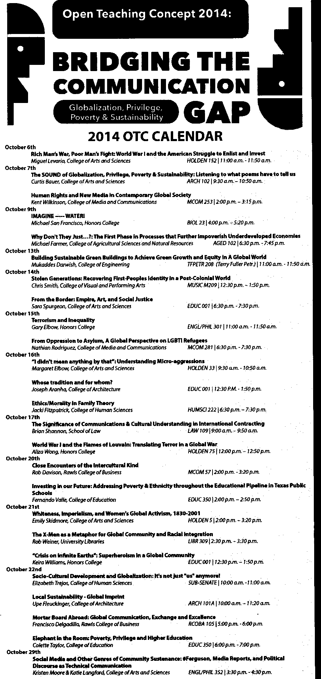

Slide 23
OTHER ANNOUNCEMENTS??
From Floor

Slide 24
VIII. Adjournment?

