Slide 1
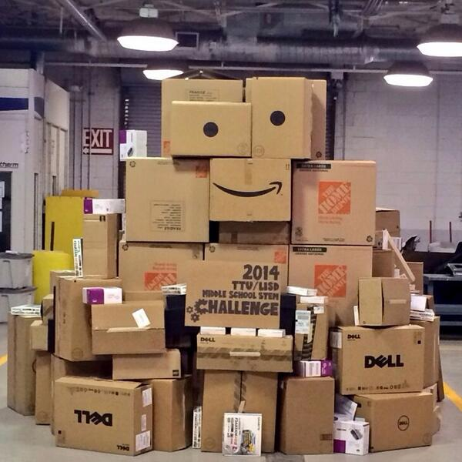
Cardboard Boat Races
2014 TTU - LISD Middle School STEM Challenge
A One Week Challenge Guide
Kristin Yearkey, MS
Please note: All photos used by permission from Texas Tech University and Lubbock ISD unless otherwise referenced. http://www.stem.ttu.edu/challenge/

Slide 2
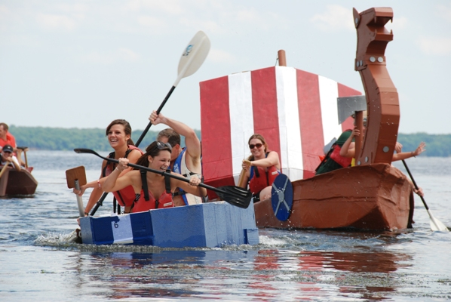
Cardboard boat races- What are they?
Quite simple:
Design and build boats out of cardboard and duct tape.
Race them for the fastest times.
http://potomaclocal.com/2010/07/16/ready-set-cardboard-boat/

Slide 3
Rules of the Race
Construction rules:
The ENTIRE BOAT must be built of cardboard and duct tape
Only exceptions are the paddles & decorations
NO outside materials – you can only use what is provided for you.
Only adults can handle the knives.
Follow all shop safety rules.
If you have any questions, ask us!

Slide 4
Rules of the Race
Participant rules:
During competition, the crew must be IN the boat.
This means no towing, holding, swimming, or allowing the life jacket to provide floatation of the vessel.
Throwing water on another boat is reason for disqualification, unless it is from the normal incidental splash of paddles.

Slide 5
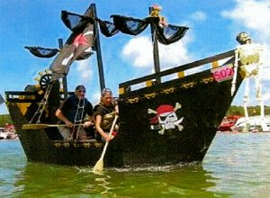
Rules of the Race
Participant rules:
Participants are expected to maintain the dignity of a yachtsman.
(But without the language of a sailor.)
http://www.earth911.com/living/art-entertainment/cardboard-boat-racing-gains-popularity/

Slide 6
Rules of the Race
Safety rules:
EVERY participant in a boat must be wearing a Personal Floatation Device (PVD).
The crew compartment of a boat CANNOT be enclosed so as to interfere with escape.
Follow all posted and stated safety rules.

Slide 7
Boat Design
Things to consider:
Size
Stability
Mobility
Strength
Weight of materials when wet
Note:
Everything must be removed from the pool.

Slide 8
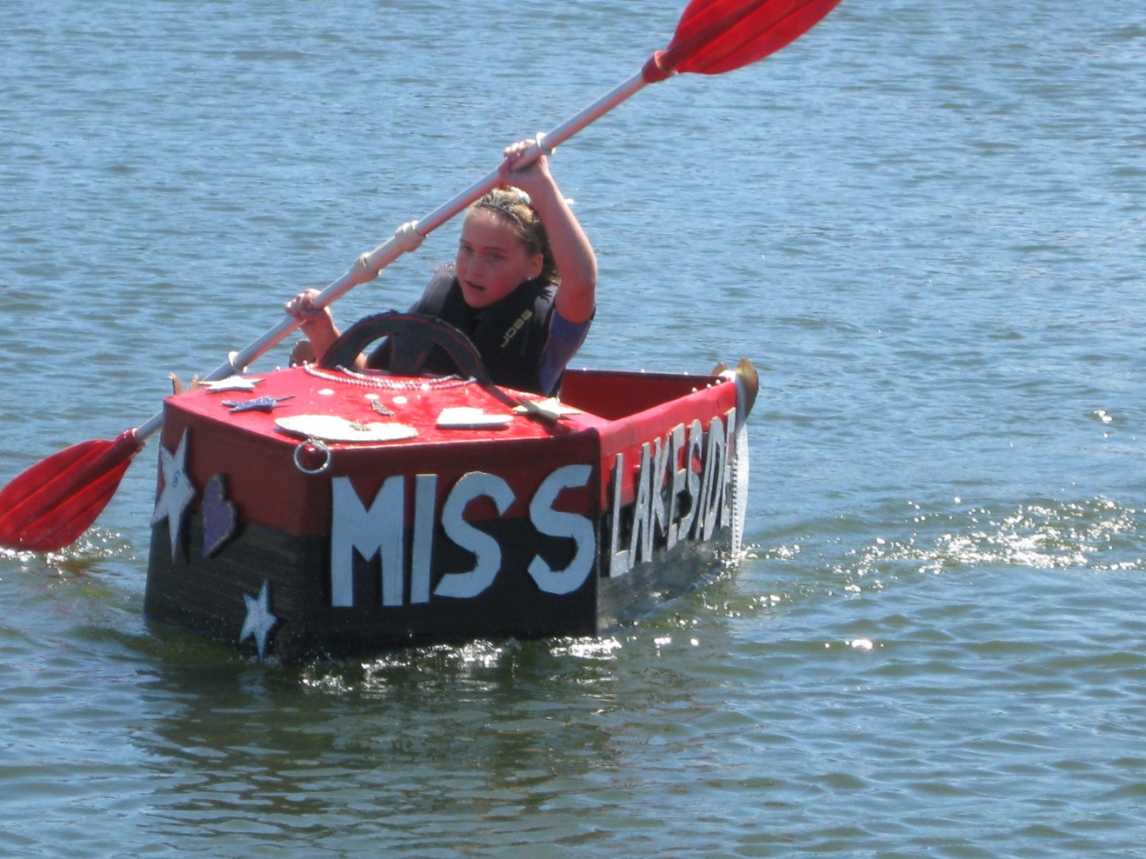
Boat Design Suggestions
Set the design goal: Fun, Speed, Looks
Sketch the design
http://www.lakesideinfo.com/2011/07/cardboard-boat-racing-anyone/

Slide 9
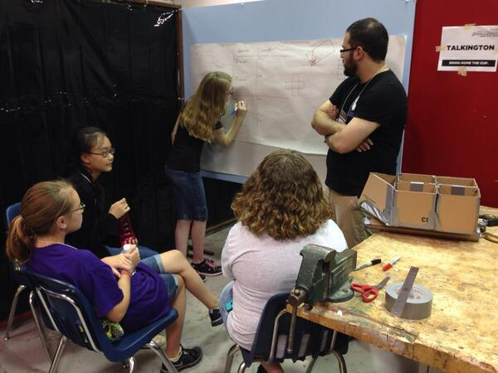
Boat Design Suggestions
Set the design goal: Fun, Speed, Looks
Estimate time and materials

Slide 10
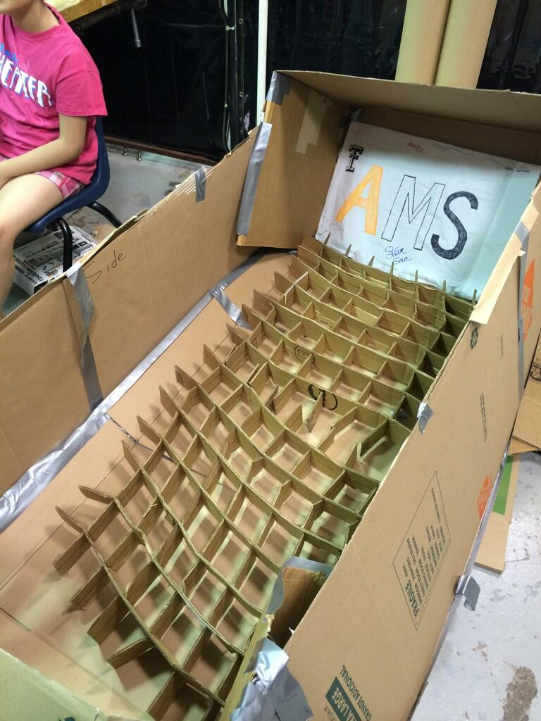
Boat Design Suggestions
Set the design goal: Fun, Speed, Looks
Decide construction techniques

Slide 11
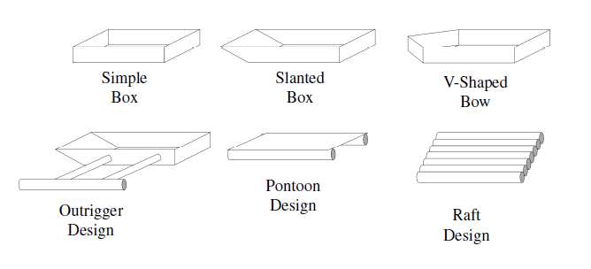
Boat Design
Sample construction designs:

Slide 12
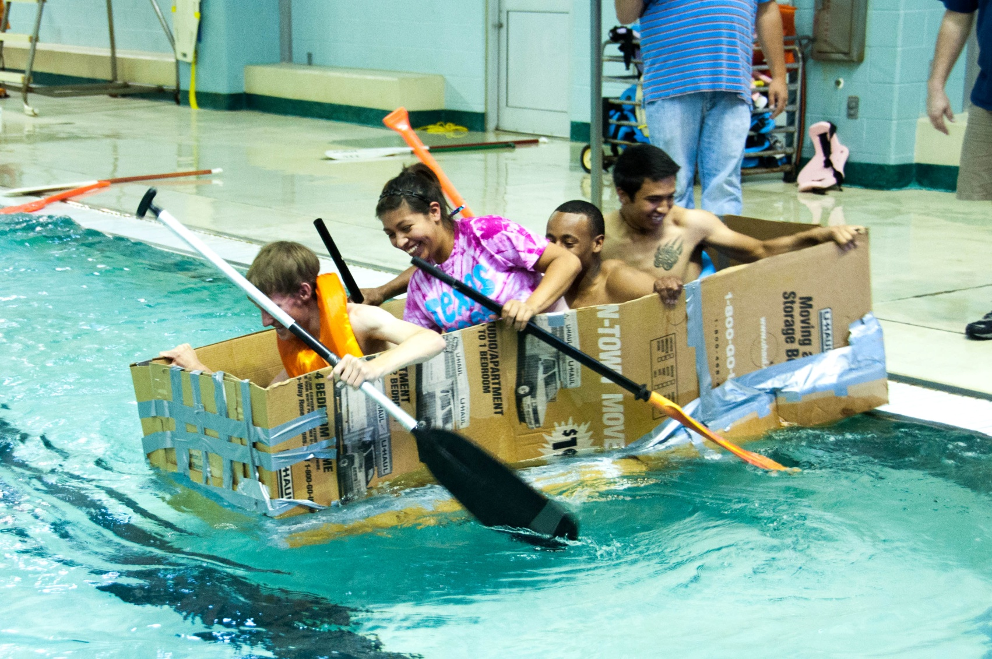
Boat Design Examples
Simple Box:

Slide 13
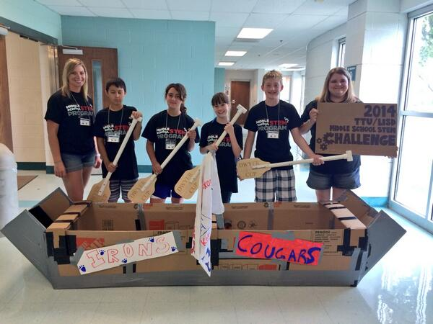
Boat Design Examples
Slanted Box:

Slide 14
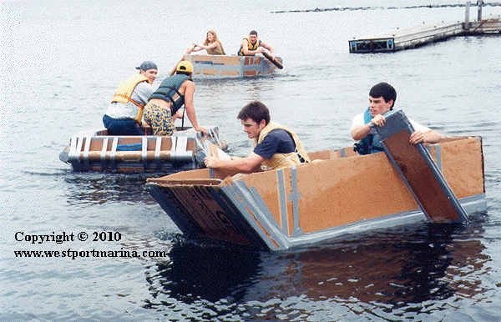
Boat Design Examples

Slide 15
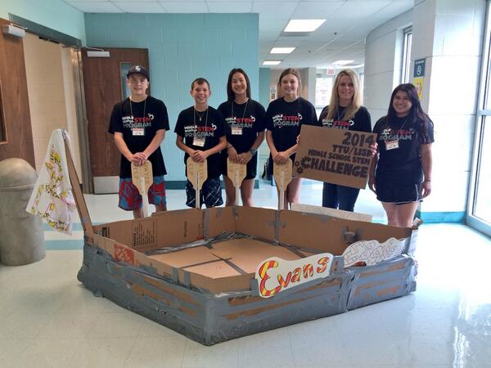
Boat Design Examples
V-Shaped Bow:

Slide 16
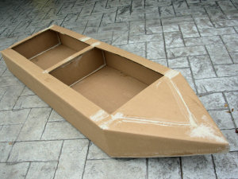
Boat Design Examples
http://www.capecoralregatta.com/Index/BoatBuilding

Slide 17
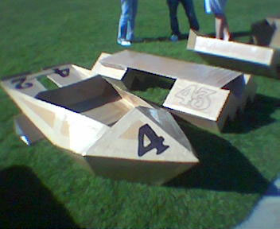
Boat Design Examples
http://www.blue-room.com/onetruth/archive/000591.html

Slide 18
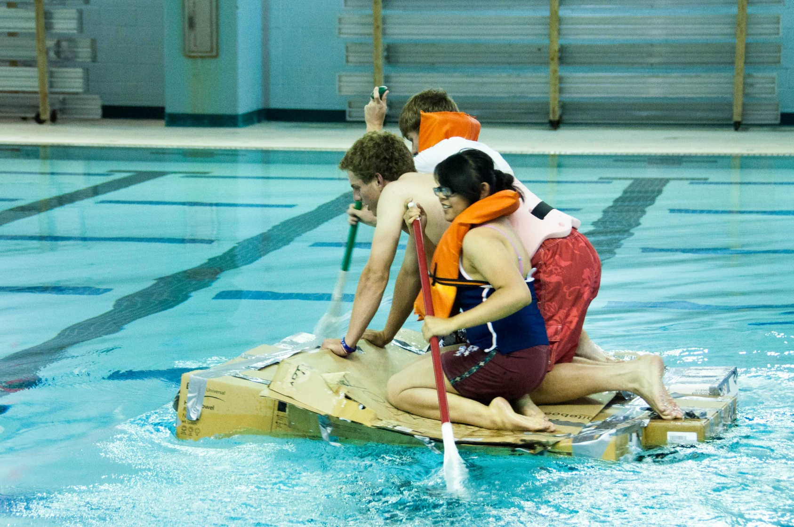
Boat Design Examples
Pontoon/ Raft:

Slide 19
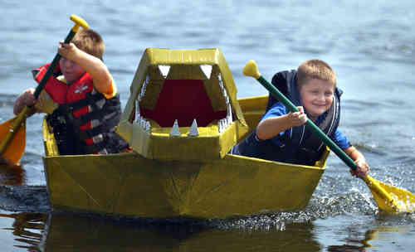
Boat Design Suggestions
Flat bottoms/ sit to paddles are the best/ easiest
http://fredericksburg.com/News/FLS/2005/082005/08212005/123782

Slide 20
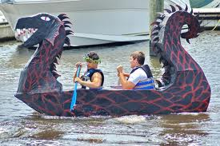
Boat Design Suggestions
Long boats go fast but are harder to turn
http://fredericksburg.com/News/FLS/2005/082005/08212005/123782

Slide 21
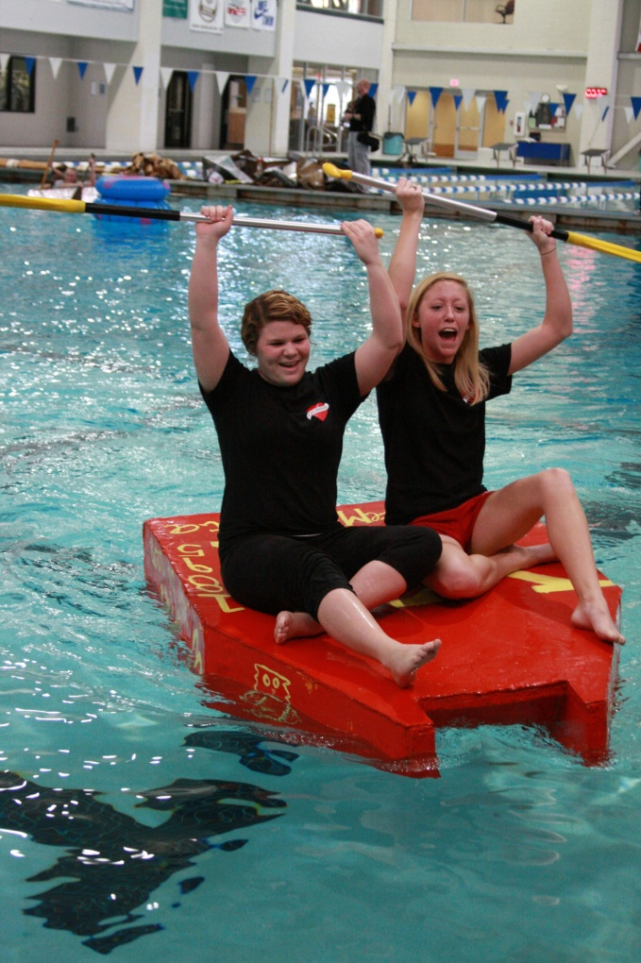
Boat Design Suggestions
Short boats (<10 feet) are harder to keep straight
http://ualr.edu/forum/index.php/2011/02/24/sink-or-swim-cardboard-boat-regatta-yields-mostly-sinkers/

Slide 22
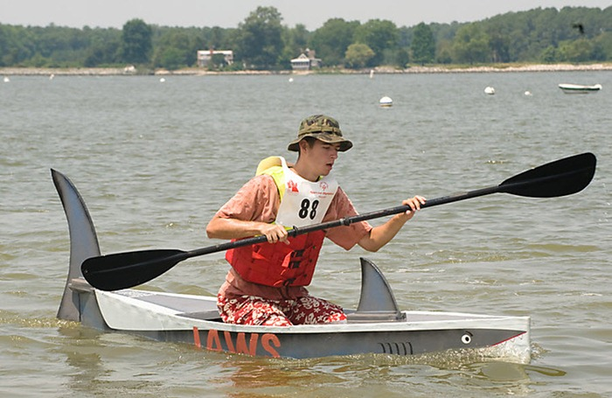
Boat Design Suggestions
Kneeling is a “power” position, but sitting is more comfortable
http://www.amusingplanet.com/2010/06/oxford-cardboard-boat-race-2010.html

Slide 23
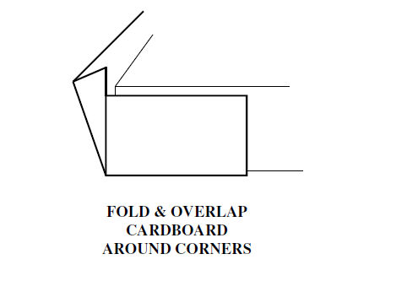
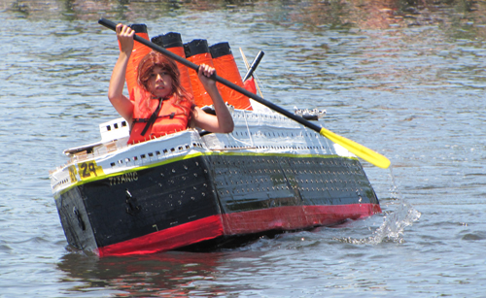
Boat Construction
Tips and Techniques
Have strong corner and supporting edges
http://riverheadnewsreview.timesreview.com/tag/riverhead-cardboard-boat-race/

Slide 24
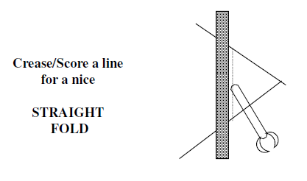
Boat Construction
Tips and Techniques
Have clean crease for a straight fold

Slide 25
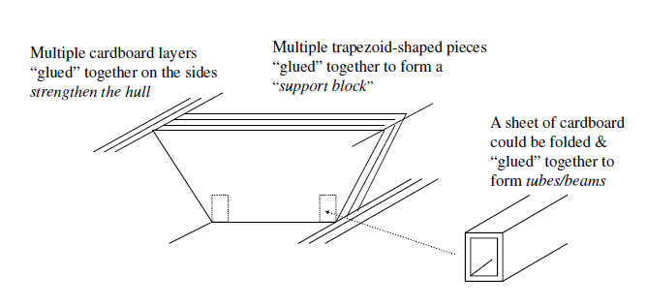
Boat Construction
Tips and Techniques
Strengthen the boat with what you can!

Slide 26
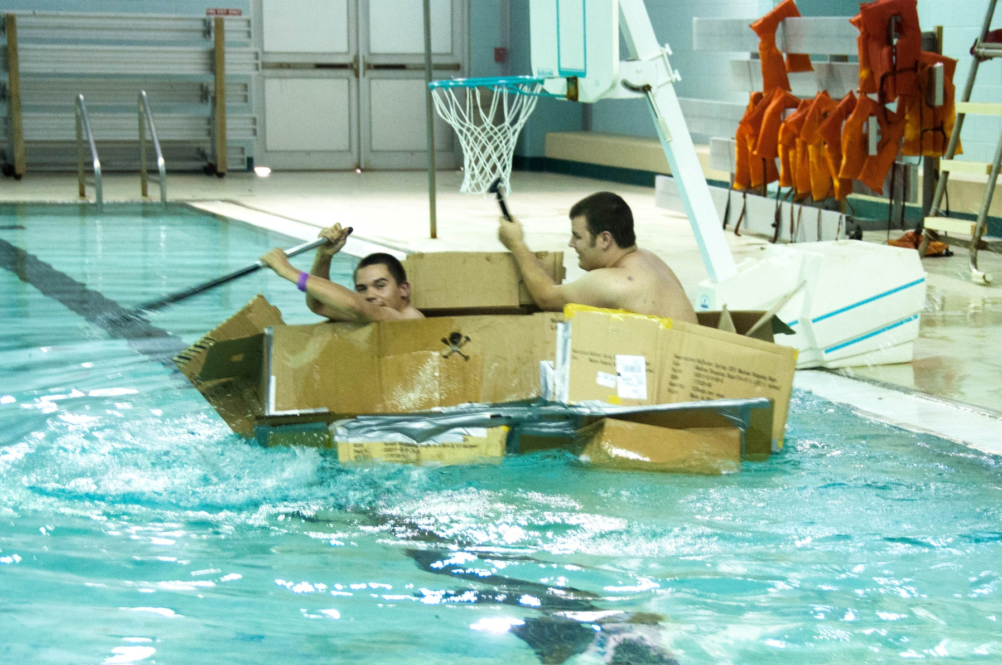
Boat Construction

Slide 27
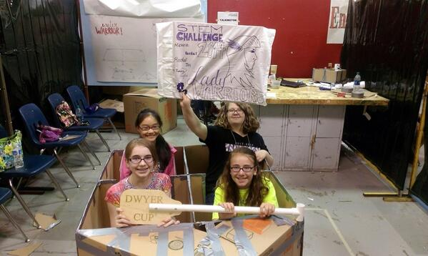
And remember, have fun with it…

Slide 28
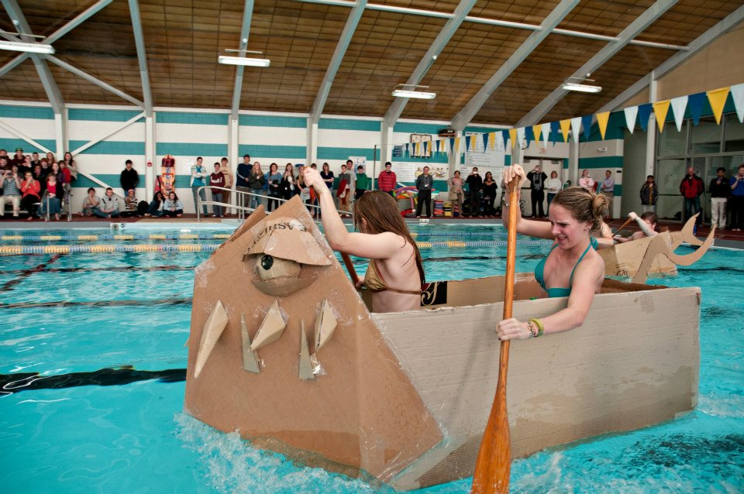
Really…
http://imgur.com/YfXUl

Slide 29
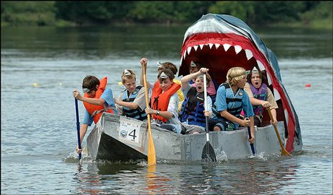
Or else…
http://www2.ljworld.com/photos/galleries/2005/aug/21/cardboard_boat_race/

Slide 30
www.stem.ttu.edu/challenge

